Slide 1


DevOps Intro
Gopala Krishnan C
Gopala Krishnan C

Slide 2
Contents
What is DevOps?
Why DevOps?
Workflow of Waterfall Method
Advantages & Disadvantages
Agile Software Development
Advantages & Disadvantages
DevOps
Difference between Agile and DevOps
Agile DevOps
DevOps Lifecycle
DevOps Lifecycle Stages
DevOps Tools
DevOps Principles
Roles and Responsibilities of a DevOps Engineer

Slide 3
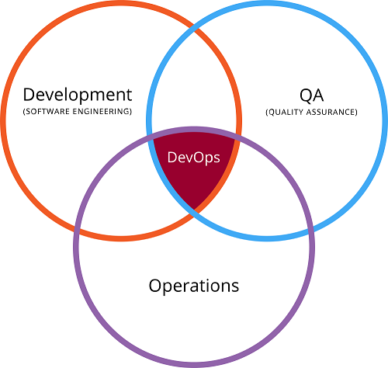
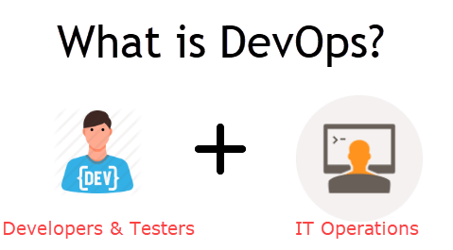
What is DevOps?
DevOps is a practice or methodology or culture which promotes collaboration between Development and Operations Team to deploy code to production faster in an automated & repeatable way. The word 'DevOps' is a combination of two words 'development' and 'operations.’
DevOps helps to increases an organization's speed to deliver applications and services. It allows organizations to serve their customers better and compete more strongly in the market.
In simple words, DevOps can be defined as an alignment of development and IT operations with better communication and collaboration.

Slide 4
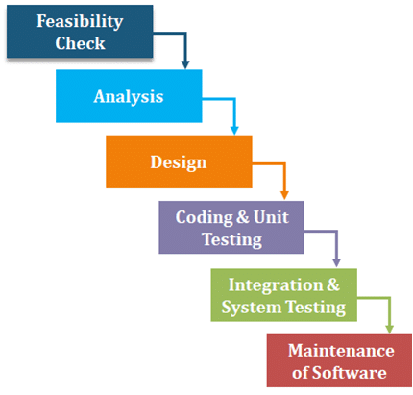
Waterfall Method
Before DevOps, Waterfall Model was the earliest SDLC approach that was used for Software Development in a sequential flow.
Workflow of Waterfall Method:
Let’s consider you’re developing your software using the Waterfall Method. So, these are the aspects that will occur during your SDLC if you’re using this method:
Feasibility Check: Feasibility phase is used for determining whether this approach/technique will be feasible enough for developing the software.
Analysis of the System Requirements: Analyse from the customers point of view and gather the information about the system and the software requirements, these requirements list will be captured in a document in a need to remove any incompleteness in that particular product.
Design: The goal of this phase is to transform software requirement specification (SRS) document into an ordered structure which is appropriate for the implementation in a programming language
Coding and Unit Testing: The design that we created previously is supposed to get converted into a source code then every design module is coded and checked individually if they are working in a proper manner.
Integration and System Testing: After the design of each module has been coded, then the integration of these modules is carried out appropriately, then these integrated modules are tested individually as a resultant. After this, an acceptance testing is carried out in which product is delivered and tested by the customer whether to accept it or reject it.
Maintenance: Maintenance is that phase of the software lifecycle where 60% of the efforts are spent during the whole software development process.

Slide 5
Waterfall Method Pros & Cons
Pros:
This method was easy and simple to use.
Easy to manage due to the rigid model.
Each phase had review process making it less vulnerable to errors.
One at a time process phases, due to which these phases do not overlap each other.
Reliable for the small projects.
Cons:
While your application is in testing stage, it gets really difficult to go back and make changes to any issues those were developed in previous steps due to miscommunication or the lack of knowledge.
It was a risky process as it was difficult to diagnose and provide the feedback.
Its main focus was to help the internal teams to work efficiently, it used to exclude the end user/clients due to which majority people did not trust this methodology.
Delays in testing process, because this method insists the teams to wait until this process is on 4th or 6th stage.

Slide 6
Agile Software Development
Agile refers to an incremental approach like Waterfall model, but with the iterative approach along with focusing on customers feedback and small rapid changes as well as releases. It basically breaks the product into smaller divisions and finally integrates them for the testing process.
Advantages:
It prefers to take customer’s feedback throughout the project, which gives enough time to team for making decisions quickly.
It prefers making changes, welcomes them, but at an expensive cost.
Having an ability to scale.
There is a continuous attention to the technical excellence and good designs.
Prioritizing and scheduling the most valuable features for the implementation, which reduces the risk of having an unusable resource.
Small and dedicated teams are involved with high degree of involvement and coordination.
Disadvantages:
There is less predictability.
Requires more time and commitment, testers, developers and customers must interact with each other constantly and should agree to each other’s decisions in order to get the task done, which in a nutshell is time consuming.
Limited documentation often comes as a problem, in case of fall backs there are very less detailed documents in order to cross check.
Requires minimal planning at the beginning which does makes it easier to develop the project quickly but there is never a finite end due to unexpected functionality there is never a clear vision and they’re not sure of what their final product looks like.

Slide 7


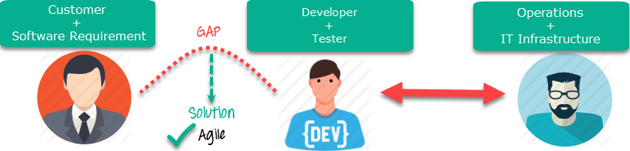
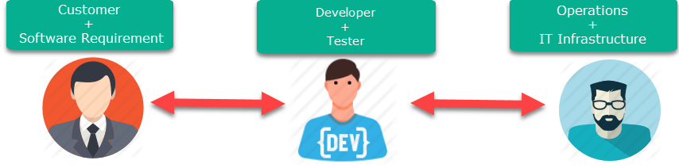


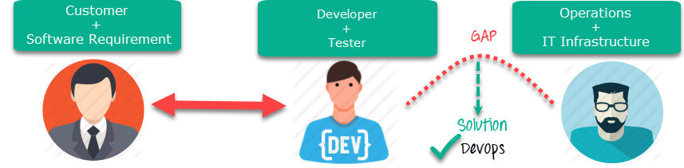
Why DevOps?
The main problem faced were the gaps created in these both the methods as:
In case of Waterfall Model, there was a gap between Customer Software Requirements and the Developers, which was overcome by Agile
Similarly, in case of Agile Method there was a gap between Developers and Operations folks
Gaps created between customers and developers
Gaps created operations and development folks
How do you think it was overcome?
Then DevOps was introduced in order to overcome this gap between Developers and Operations folks.

Slide 8
Difference between Agile and DevOps
Now let’s check the major differences between Agile and DevOps.
Agile Methodology | Simply DevOps
Majorly focuses on collaboration, customer feedback, and small, rapid changes | It brings Developers and Operations team together
It does not focus on Automation | Its primary goal is the Automation in order to increase the efficiency while deployment
Development process is inherent for Agile, making it majorly focused towards Development process instead testing and implementation process | Whereas, DevOps focuses on all Development, testing and implementation with equal importance
It overcomes the gap between customers and developers | It overcomes the gap between Developers and Operations folks

Slide 9
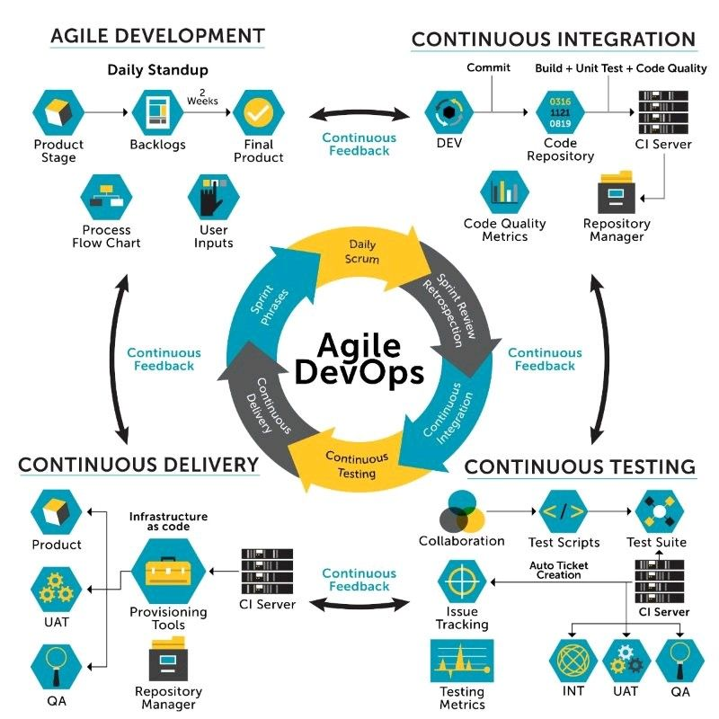
Agile DevOps

Slide 10
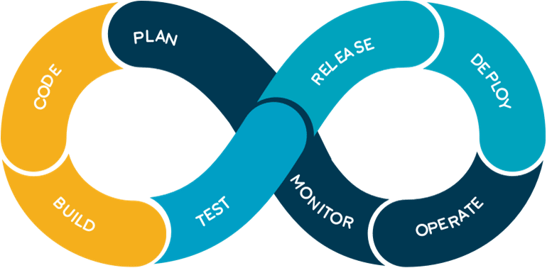
DevOps Lifecycle
DevOps basically emphasis on bringing all the Development and Operations + IT infrastructures guys together, which includes developers, system admins, QA’s.
You can actually figure it all out from the DevOps diagram below, whatever the process flow we discussed here can be understood with a gist through this DevOps diagram.
Code: First step to this life-cycle is Code, where developer build the code on any platform.
Build: You build the version of your program in any extension depending upon the language you’re using.
Test: For DevOps to be successful, you must Automate all the testing process using any automation tools like Selenium etc.
Release: Process for managing, planning, scheduling and controlling the build in different environments after testing and before deploying.
Deploy: Then Deploy is to get all your application’s artifacts/all your code files and deploy or execute them on the server.
Operate: Then we run that application after the deployment, where users are using it as a real use case.
Monitor: Monitor helps in providing a crucial information which basically help you to ensure the service uptime and the optimal performance.
Plan: Gather all the information through monitoring and whatever the feedback you received through the monitoring, you implement those changes for the better performance.

Slide 11
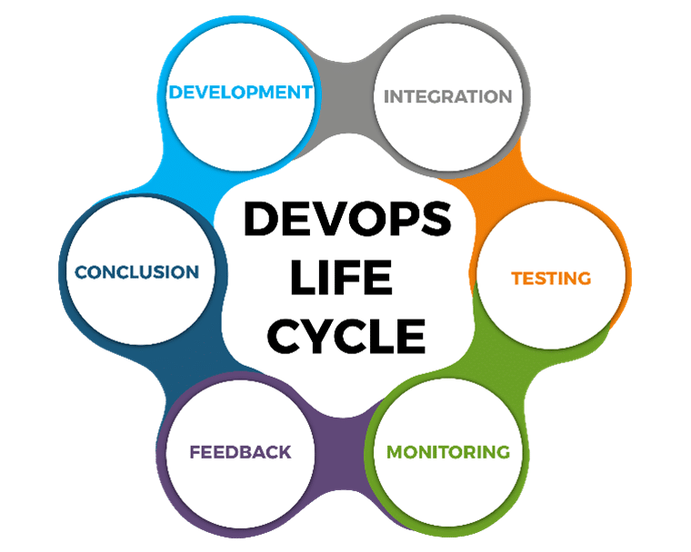
Different DevOps Lifecycle Stages
Now let’s discuss about different stages in DevOps Lifecycle which contributes to the consistent software development lifecycle:
Continuous Development
Continuous Integration
Continuous Testing
Continuous Monitoring
Virtualization and Containerization
These stages are basically the aspects for achieving the DevOps goal.

Slide 12
DevOps Lifecycle Stages
Now let’s Discuss each of them in detail.
Continuous Development:
In Waterfall Model, your software product parts get broken into multiple pieces or sub-parts for the short development cycles but in this stage, your software is getting developed continuously.
Tools used:
As we Code & Build in this stage, so one can use GIT to maintain the different versions of the code and to build/package the code into an executable file, we use a reliable tool called as Maven.
Continuous Integration:
In this stage, if your code is supporting a new functionality, it is then integrated with an existing code continuously. As the continuous development keeps on taking place the existing code needs to be integrated with the latest one “continuously”, also the changed code should ensure that there are no errors in the current environment for them to work smoothly.
Tools used:
Jenkins is the tool that is used for the Continuous Integration here, one can pull the latest code from the GIT Repository, of which you can produce the build and deploy on test or the production server.

Slide 13
DevOps Lifecycle Stages
Continuous Testing:
In this stage, your developed software is being tested continuously to detect the bugs using the several automation tools.
Tools used:
So, for the QA/Testing purposes, one can use the automated tools for it and the tool used widely for automation testing is Selenium, as it lets the QAs to test the codes in parallel fashion to ensure that there is no error, in-competencies or flaws in the software.
Continuous Monitoring:
Continuous monitoring is a very crucial part of the DevOps life-cycle where it helps in providing the important information which basically helps you to ensure the service up-time and the optimal performance. The operations team get the results from the reliable monitoring tools to detect and fix the bugs/flaws in the application.
Tools used:
Several tools like Nagios, Splunk, ELK Stack and Sensu are used for monitoring the application. They help you to monitor your application and servers closely to check their health and if they are operating actively or not, any major issue detected by these tools are forwarded to the developer’s team for them to fix them in the continuous development phase.
As we have discussed about DevOps and its main tools along with their functionalities.

Slide 14
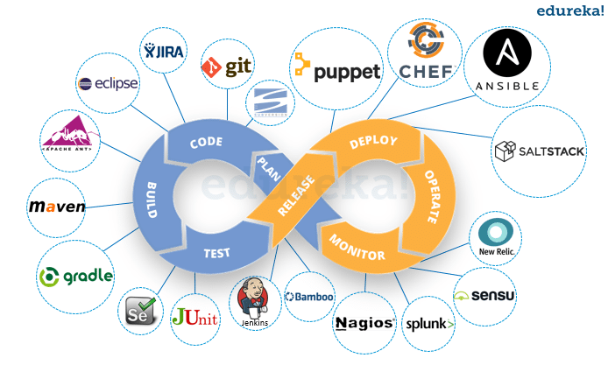
DevOps Tools

Slide 15
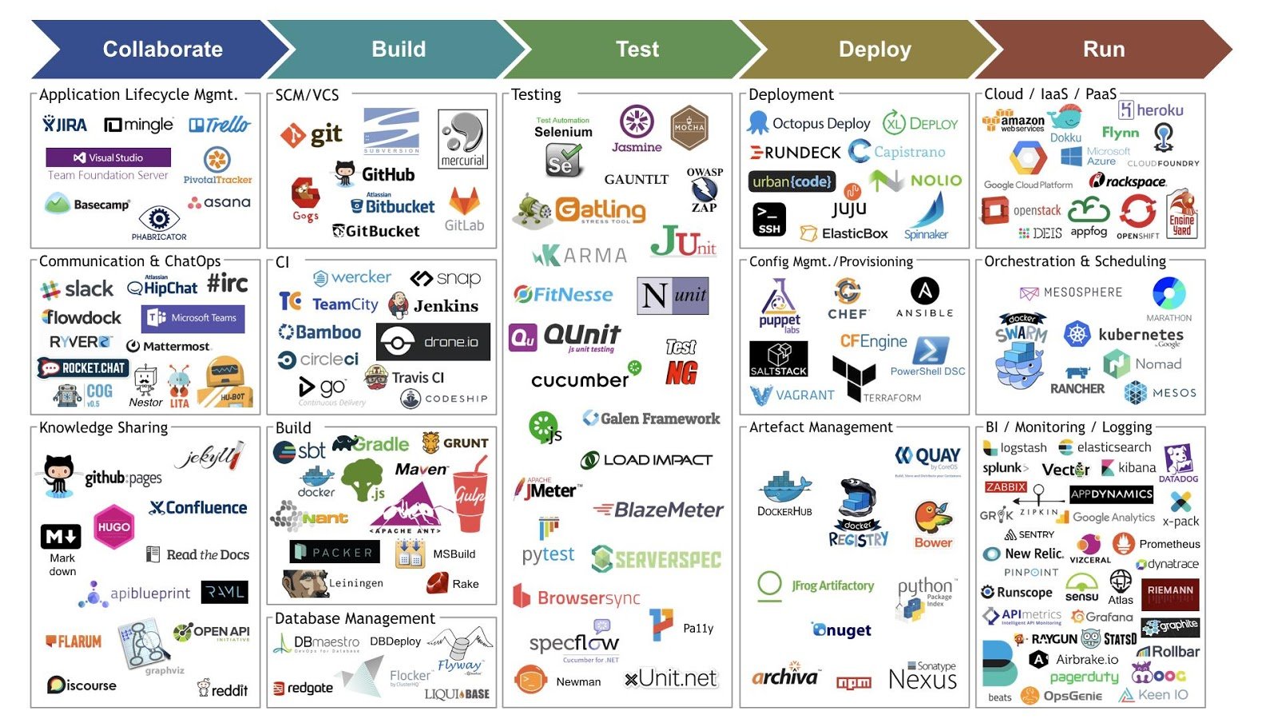
DevOps Tools

Slide 16
DevOps Principles
Here, are six principles which are essential when adopting DevOps:
Customer-Centric Action: DevOps team must take customer-centric action for that they should constantly invest in products and services.
End-To-End Responsibility: The DevOps team need to provide performance support until they become end-of-life. This enhances the level of responsibility and the quality of the products engineered.
Continuous Improvement: DevOps culture focuses on continuous improvement to minimize waste. It continuously speeds up the improvement of product or services offered.
Automate everything: Automation is a vital principle of DevOps process. This is not only for the software development but also for the entire infrastructure landscape.
Work as one team: In the DevOps culture role of the designer, developer, and tester are already defined. All they needed to do is work as one team with complete collaboration.
Monitor and test everything: It is very important for DevOps team to have a robust monitoring and testing procedures.

Slide 17
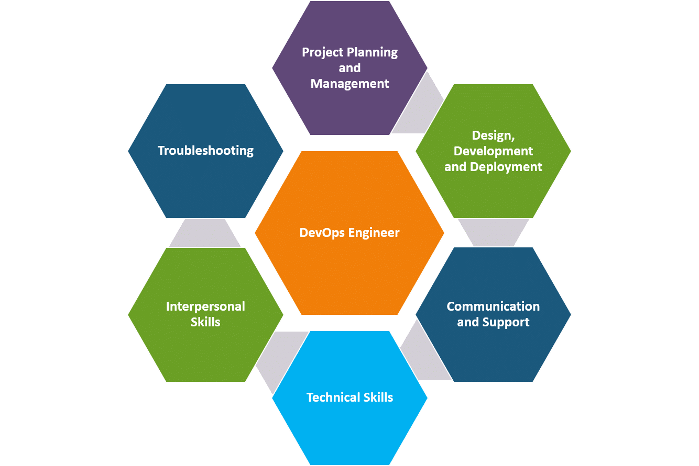
Roles and Responsibilities of a DevOps Engineer
DevOps is merely a culture which is being incorporated by the giants in IT world.
DevOps, when practiced the right way, keeping certain roles and responsibilities in mind, helps overcome the gap between development and operation.
Project planning and management: In addition to monitoring software, regulating and updating tools, they also provide their expertise on costs, benefits, risks and what not about various projects.
Design, development and deployment: DevOps Eng. are required to design and develop automated modules for better and smooth functioning within the production environment by designing risk management techniques and tests etc.
Communication and support: DevOps Eng. should have exceptional communication skills which comes in handy when they need to work and coordinate with different departments and provide support.
Technical skills: Some basic technical experience and familiarity with configuration tools is a must.
Interpersonal skills: Since they are in a constant interaction with other departments in the business, they should be approachable, organised, foresight, team player and ability to multitask would be a bonus.
Troubleshooting: Last but not the least, one of the ongoing responsibilities of DevOps Eng. is to troubleshoot and come up with solutions for various errors to benefit the firm with speed and efficiency.
The main objective of these roles and responsibilities is to be able to perform coding, scripting and process re-engineering.

Slide 18


Slide 19
Ques & Ans
What is DevOps?
Our team has some ideas and wants to turn those ideas into a software application. Now, as a manager, I am confused about whether I should follow the Agile work culture or DevOps. Can you tell me why I should follow DevOps over Agile?
In terms of development and infrastructure, mention the core operations of DevOps.
What are some technical and business benefits of DevOps work culture?
Name some of the most important DevOps tools?
What is CI? What is its purpose?
Name three important DevOps KPIs.
What is the difference between continuous deployment and continuous delivery?
What is DevOps? Is it a tool?
What are the core operations of DevOps in terms of development and infrastructure?
Can one consider DevOps as an Agile methodology?

Slide 20
Ques & Ans
1. What is DevOps?
Characteristics | DevOps
Basic premise | A collaboration of development and operations teams. It is more of a cultural shift.
Related to | Agile methodology
Priorities | Resource management, communication, and teamwork
Benefits | Speed, functionality, stability, and innovation
2. Our team has some ideas and wants to turn those ideas into a software application. Now, as a manager, I am confused about whether I should follow the Agile work culture or DevOps. Can you tell me why I should follow DevOps over Agile?
According to the current market trend, instead of releasing big sets of features in an application, companies are launching small features for software with better product quality and quick feedback from customers, for high customer satisfaction. Now, to keep up with this, we have to:
Increase the deployment frequency in the safest and reliable way
Lower the failure rate of new releases
Shorten the bug resolution time
DevOps fulfils all these requirements for fast and reliable development and deployment of a software. Companies like Amazon and Google have adopted DevOps and are launching thousands of code deployments per day. But Agile, on the other hand, only focuses on the development of a software.

Slide 21
Ques & Ans
3. In terms of development and infrastructure, mention the core operations of DevOps.
Core operations of DevOps include:
Development
Version Control
Testing
Integration
Deployment
Delivery
Configuration
Monitoring
Feedback
4. What are some technical and business benefits of DevOps work culture?
Technical benefits:
Continuous software delivery
Less complex problems to fix
Faster bug resolution
Business benefits:
Faster delivery of features for customer satisfaction
More stable operating environments
More time available to add product value

Slide 22
Ques & Ans
5. Name some of the most important DevOps tools?
Git
Maven
Selenium
Jenkins
Docker
Puppet
Chef
Ansible
Nagios
6. What is CI? What is its purpose?
CI or Continuous Integration is the process of compiling the entire code base, every time a member of the software development team checks the code, into the shared source code repository.
If a team member checks into the code file with a bug, then the build gets broken. In this sort of scenario, other developers can’t synchronize the shared source code repository without introducing compilation errors into their own local workspaces. Thus, collaborative and shared software development cannot go forward.
When a CI build breaks, it is crucial that the problem is corrected immediately. A CI process often includes a suite of unit, and integration and regression tests that run every time the compilation succeeds. If any of these tests fail, the build will be considered unstable, not broken.

Slide 23
Ques & Ans
7. Name three important DevOps KPIs.
Three of the most common DevOps KPIs are:
Mean time to failure recovery
Deployment frequency
Percentage of failed deployments
8. What is the difference between continuous deployment and continuous delivery?
Continuous deployment is fully automated, and the deployment to production needs no manual intervention in continuous deployment; whereas, in continuous delivery, the deployment to production requires some manual intervention for change management in the organization, and it needs to be approved by the manager or higher authorities to be deployed in production. According to your organization’s application risk factor, continuous deployment/delivery approach will be chosen.
9. What is DevOps? Is it a tool?
DevOps can’t be referred to as a tool; it is a collaborative work culture that combines development and operations teams for continuous development, continuous testing, continuous integration, continuous deployment, and continuous monitoring.
10. What are the core operations of DevOps in terms of development and infrastructure?
The core operations of DevOps are application development, version control, unit testing, deployment with infrastructure, monitoring, configuration, and orchestration.
11. Can one consider DevOps as an Agile methodology?
DevOps can be considered as complementary to the Agile methodology but not completely similar.

