Slide 1
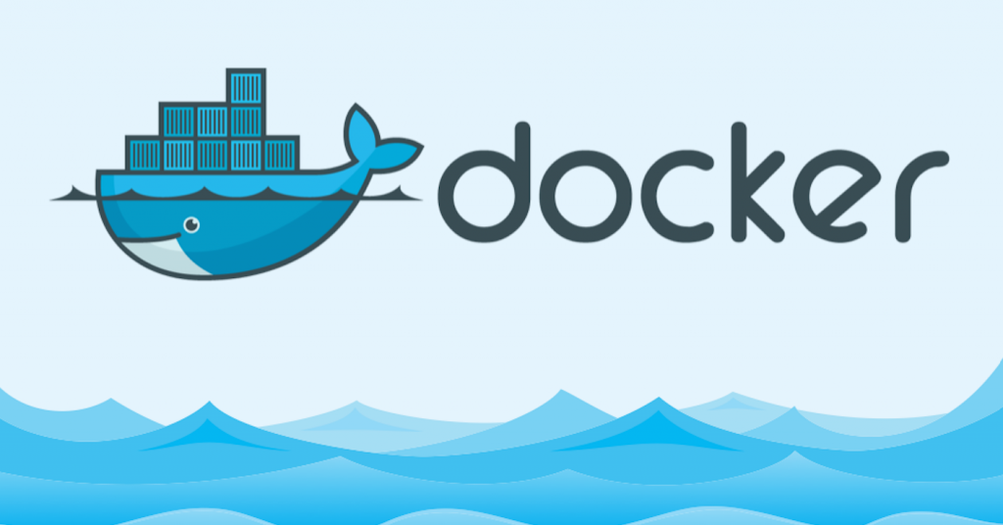
Gopala Krishnan C

Slide 2
Contents
What is Virtualization?
What is Hypervisor?
What is Containerization?
Advantages of Containerization over Virtualization
Introduction to Docker
Docker Architecture
Docker Engine
Docker Images
Docker Registries
Docker Containers
Docker Installation
Docker Commands
Dockerfile
Docker Volume
Docker Network
Docker Compose
Docker Swarm

Slide 3
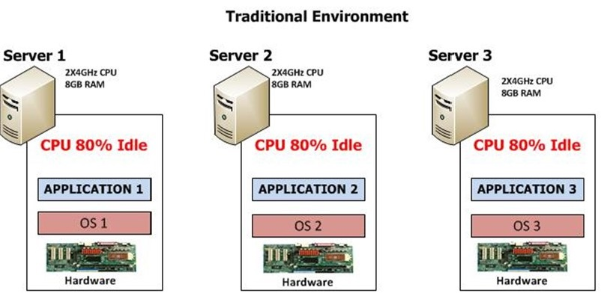
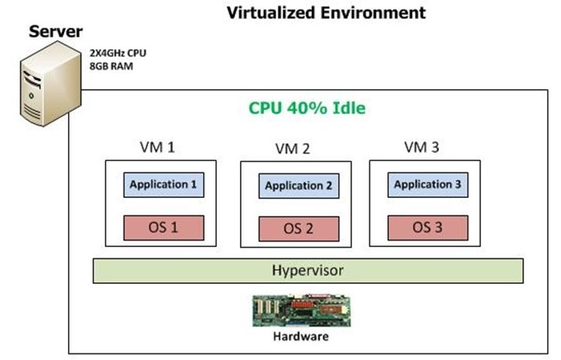
What is Virtualization?
Virtualization is the technique of importing a Guest operating system on top of a Host operating system. This technique was a revelation at the beginning because it allowed developers to run multiple operating systems in different virtual machines all running on the same host. This eliminated the need for extra hardware resource. The advantages of Virtual Machines or Virtualization are:
Multiple operating systems can run on the same machine
Maintenance and Recovery were easy in case of failure conditions
Total cost of ownership was also less due to the reduced need for infrastructure

Slide 4
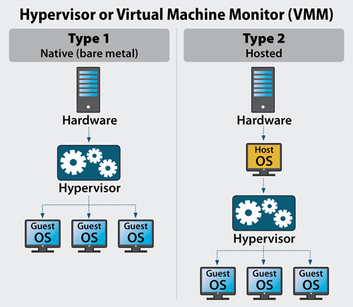
What is Hypervisor?
A hypervisor is a thin software layer that intercepts operating system calls to hardware. Hypervisors typically provide a virtualized CPU and memory for the guests running on top of them.
Hypervisors are classified as one of two types:
Type 1 – This type of hypervisor is also known as native or bare-metal. They run directly on the hardware with guest operating systems running on top of them. Examples include VMware ESX, Citrix XenServer, and Microsoft’s Hyper-V.
Type 2 – This type of hypervisor runs on top of an existing operating system with guests running at a third level above hardware. Examples include VMware Workstation and SWSoft’s Parallels Desktop.
As you know nothing is perfect, Virtualization also has some shortcomings.
Following are the disadvantages of Virtualization:
Running multiple Virtual Machines leads to unstable performance
Hypervisors are not as efficient as the host operating system
Boot up process is long and takes time

Slide 5
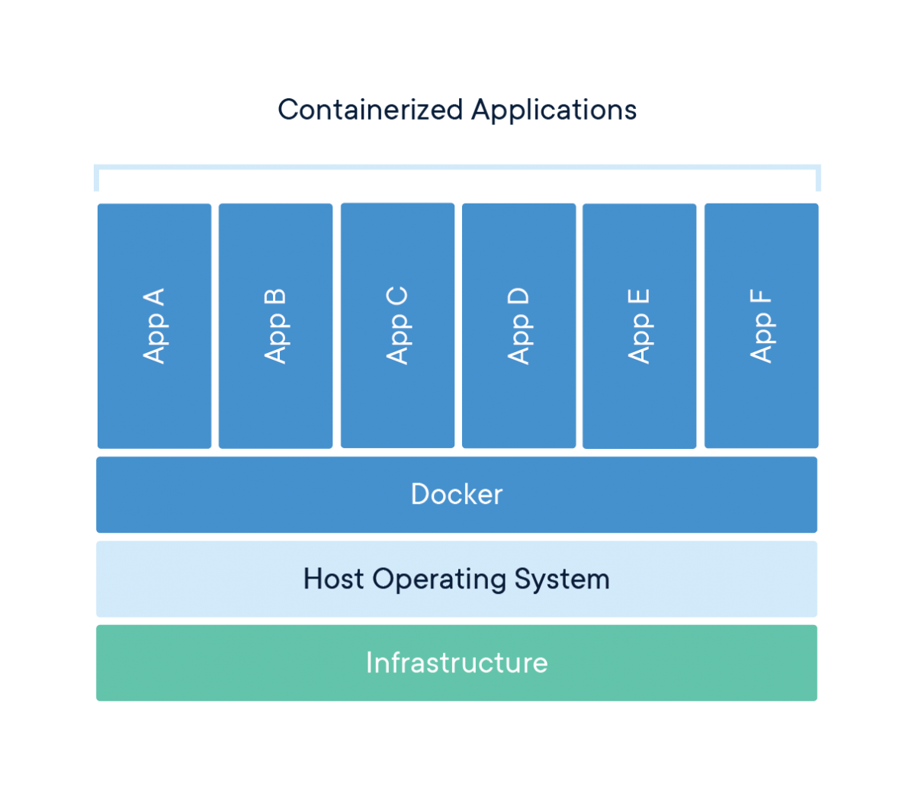
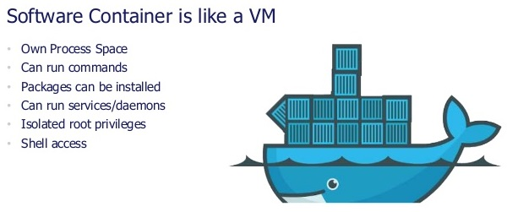
What is Containerization?
Containerization is the technique of bringing virtualization to the operating system level.
While Virtualization brings abstraction to the hardware, Containerization brings abstraction to the operating system.
Do note that Containerization is also a type of Virtualization.
Containerization is however more efficient because there is no guest OS here and utilizes a host’s operating system, share relevant libraries & resources as and when needed unlike virtual machines.
Application specific binaries and libraries of containers run on the host kernel, which makes processing and execution very fast.
Even booting-up a container takes only a fraction of a second. Because all the containers share, host operating system and holds only the application related binaries & libraries.
They are lightweight and faster than Virtual Machines.

Slide 6
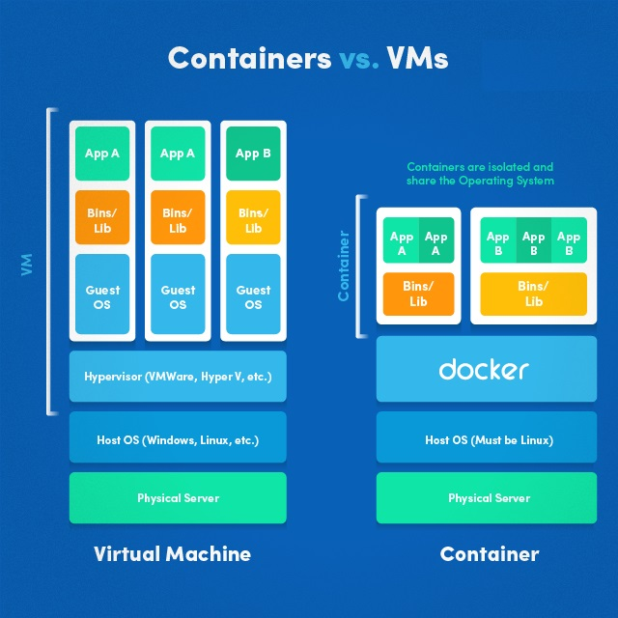
Advantages of Containerization over Virtualization
Containers on the same OS kernel are lighter and smaller
Better resource utilization compared to VMs
Boot-up process is short and takes few seconds
Containerization:
Containerization is a lightweight alternative to full machine virtualization that involves encapsulating an application in a container with its own operating environment.
Containers use the same host operating system (OS) repeatedly, instead of installing an OS for each guest VM.
Containers also provide a way to isolate applications and provide a virtual platform for applications to run on .
Virtualization:
A virtual machine is a copy of a complete server basically it has its own OS which means the replication of binaries, drivers, or libraries between different VMs running on same server and a wastage significant server resources.
All these containers are handled by the containerization layer which is not native to the host operating system. Hence a software is needed, which can enable you to create & run containers on your host operating system.

Slide 7
Introduction to Docker
Docker is a containerization platform that packages your application and all its dependencies together in the form of Containers to ensure that your application works seamlessly in any environment. This tool designed to make it easier to create, deploy, and run applications by using containers.
Containerization is increasingly popular because containers are:
Flexible: Even the most complex applications can be containerized.
Lightweight: Containers leverage and share the host kernel, making them much more efficient in terms of system resources than virtual machines.
Portable: You can build locally, deploy to the cloud, and run anywhere.
Loosely coupled: Containers are highly self sufficient and encapsulated, allowing you to replace or upgrade one without disrupting others.
Scalable: You can increase and automatically distribute container replicas across a datacenter.
Secure: Containers apply aggressive constraints and isolations to processes without any configuration required on the part of the user.

Slide 8
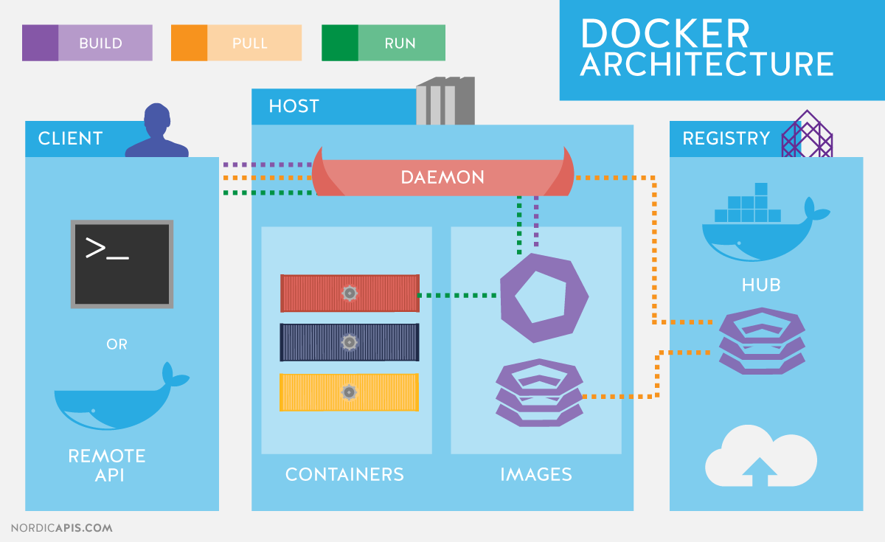
Docker Architecture
Let's talk about Docker main components in the Docker Architecture
Docker Engine
Docker Images
Docker Registries
Docker Containers
Dockerfile
Docker Engine
Docker is the client-server type of application which means we have clients who relay to the server. So the Docker daemon called: dockerd is the Docker engine which represents the server.
The docker daemon and the clients can be run on the same or remote host, and they communicate through command line client binary, as well as a full RESTful API to interact with the daemon: dockerd.

Slide 9
Docker Architecture
Docker Images:
Docker images are the "source code" for our containers; we use them to build containers. They can have software pre-installed which speeds up deployment. They are portable, and we can use existing images or build our own.
Docker Registries:
Docker stores the images we build in registries. There are public and private registries. Docker company has public registry called Docker hub, where you can also store images privately. Docker hub has millions of images, which you can start using now.
Docker Hub URL: https://hub.docker.com/
Docker Containers:
Containers are the organizational units of Docker. When we build an image and start running it; we are running in a container. The container analogy is used because of the portability of the software we have running in our container. We can move it, in other words, "ship" the software, modify, manage, create or get rid of it, destroy it, just as cargo ships can do with real containers.
In simple terms, an image is a template, and a container is a copy of that template. You can have multiple containers (copies) of the same image.
Dockerfile:
A Docker Image is created by the sequence of commands written in a file called as Dockerfile.

Slide 10
Docker Installation
Note: This installation for Centos7. If you want to install in windows or Mac please refer the documentation.
https://docs.docker.com/install/
Uninstall old versions:
# yum remove docker docker-client docker-client-latest docker-common docker-latest docker-latest-logrotate docker-logrotate docker-engine
Install using the repository:
Before you install Docker Engine - Community for the first time on a new host machine, you need to set up the Docker repository. Afterward, you can install and update Docker from the repository.
Setup the Repository:
Install required packages. yum-utils provides the yum-config-manager utility, and device-mapper-persistent-data and lvm2 are required by the devicemapper storage driver.
# yum install -y yum-utils device-mapper-persistent-data lvm2
Use the following command to set up the stable repository.
# yum-config-manager --add-repo https://download.docker.com/linux/centos/docker-ce.repo

Slide 11
Docker Installation
Install Docker Engine - Community:
Install the latest version of Docker Engine - Community and containerd.
# yum install –y docker-ce docker-ce-cli containerd.io
If prompted to accept the GPG key, verify that the fingerprint matches 060A 61C5 1B55 8A7F 742B 77AA C52F EB6B 621E 9F35, and if so, accept it.
Docker is installed but not started. The docker group is created, but no users are added to the group.
Start Docker:
# systemctl start docker
Enable Docker Service: (When system boot up docker daemon will start automatically)
# systemctl enable docker
If you would like to use Docker as a non-root user, you should now consider adding your user to the “docker” group with something like:
# usermod -aG docker your-user

Slide 12
Docker Commands
docker -v
docker info
docker images
docker pull
docker run
docker ps
docker ps -a
docker exec
docker stop
Docker kill
docker start
docker commit
docker login
docker push
docker rm
docker rmi
docker build

Slide 13

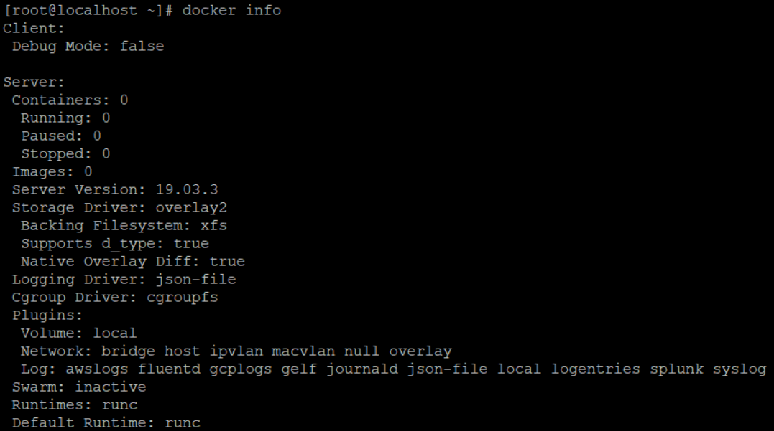
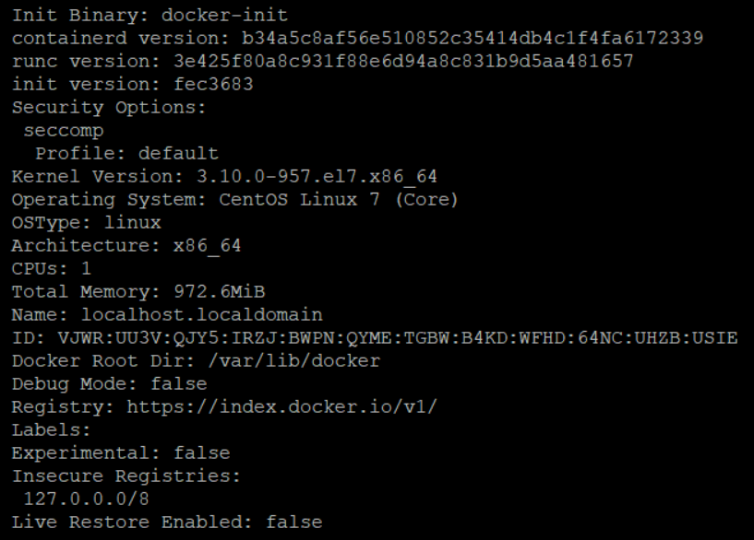
Docker Commands
docker -v
This command is used to get the currently installed version of docker
docker info
we can see we have information about docker containers how many are running, paused or stopped and how many images we have downloaded.

Slide 14
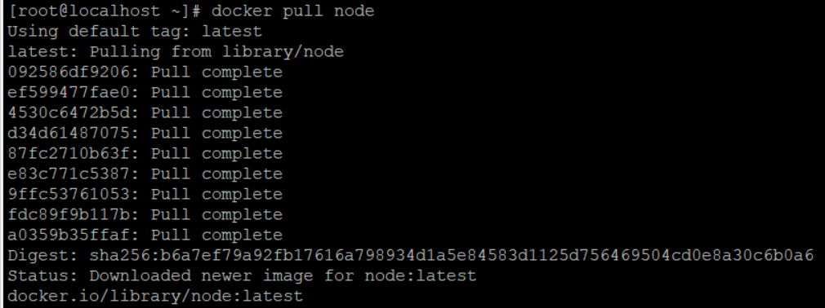
Docker Commands
docker images
This command lists all the locally stored docker images
docker pull
Usage: docker pull <image name>
This command is used to pull images from the docker repository(hub.docker.com)

Slide 15
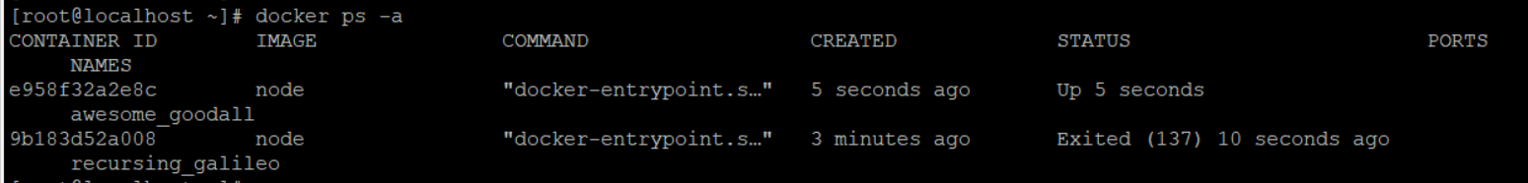
Docker Commands
docker run
Usage: docker run -it -d <image name>
This command is used to create a container from an image
docker ps
This command is used to list the running containers
docker ps -a
This command is used to show all the running and exited containers

Slide 16
Docker Commands
docker exec
Usage: docker exec -it <container id> bash
This command is used to access the running container
docker stop
Usage: docker stop <container id>
This command stops a running container
docker kill
Usage: docker kill <container id>
This command kills the container by stopping its execution immediately. The difference between ‘docker kill’ and ‘docker stop’ is that ‘docker stop’ gives the container time to shutdown gracefully, in situations when it is taking too much time for getting the container to stop, one can opt to kill it

Slide 17
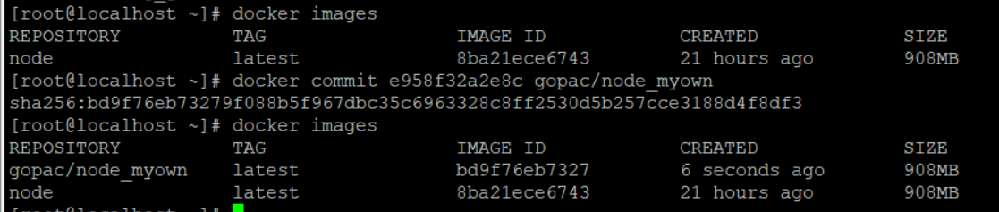
Docker Commands
docker start
Usage: docker start <container id>
This command starts a stopped or killed container
docker commit
Usage: docker commit <container id> <username/imagename>
This command creates a new image of an edited container on the local system

Slide 18
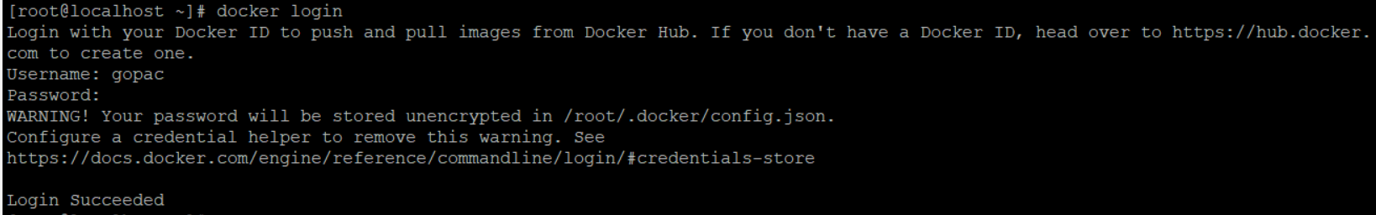
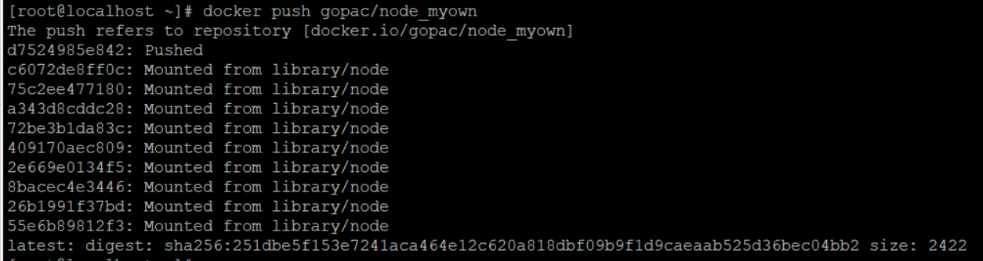
Docker Commands
docker login
This command is used to login to the docker hub repository
docker push
Usage: docker push <username/image name>
This command is used to push an image to the docker hub repository

Slide 19
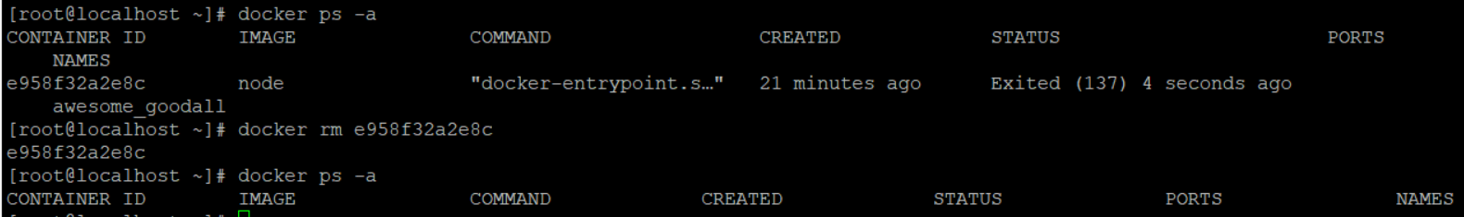
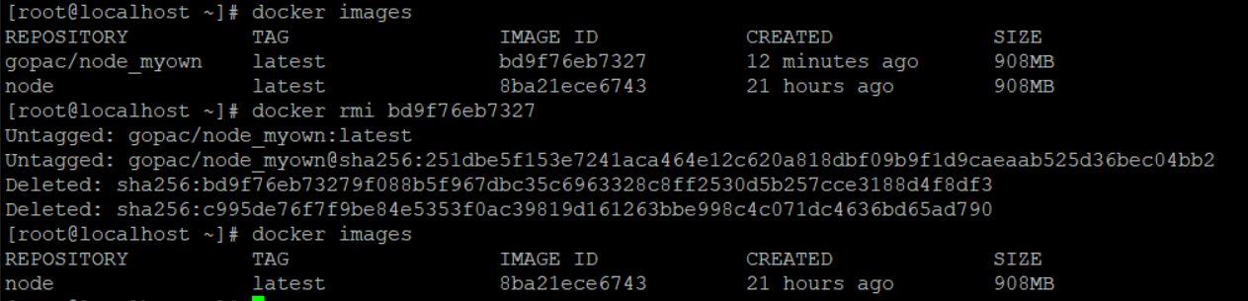
Docker Commands
docker rm
Usage: docker rm <container id>
This command is used to delete a stopped container
docker rmi
Usage: docker rmi <image-id>
This command is used to delete an image from local storage

Slide 20
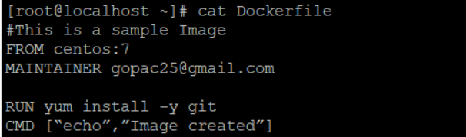
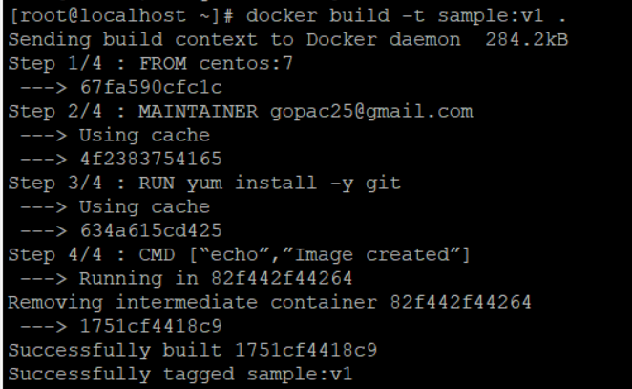
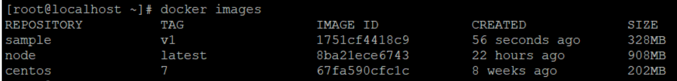
Docker Commands
docker build
Usage: docker build <path to docker file>
This command is used to build an image from a specified docker file

Slide 21
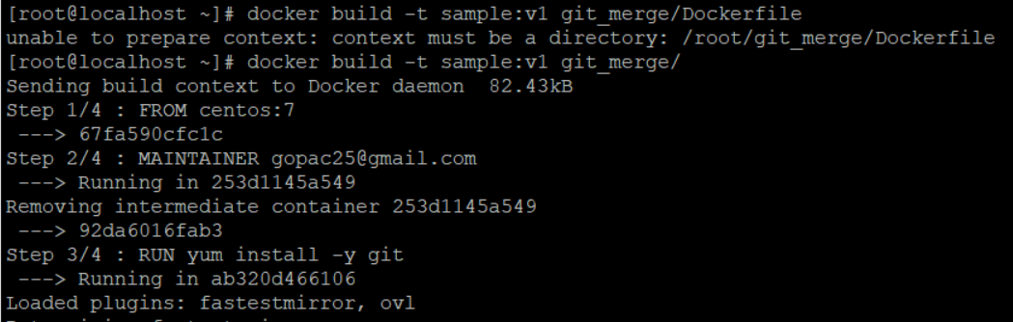
Docker Commands
docker build issues:
Note: For building docker image the Dockerfile should be correct name and we should mention the directory where we have Dockerfile.

Slide 22
Dockerfile
EXPOSE
Usage:
EXPOSE <port> [<port> ...]
ENV
Usage:
ENV <key> <value>
ENV <key>=<value> [<key>=<value> ...]
ADD
Usage:
ADD <src> [<src> ...] <dest>
ADD ["<src>", ... "<dest>"] (this form is required for paths containing whitespace)
COPY
Usage:
COPY <src> [<src> ...] <dest>
COPY ["<src>", ... "<dest>"]
ENTRYPOINT
Usage:
ENTRYPOINT ["<executable>", "<param1>", "<param2>"] (exec form, preferred)
ENTRYPOINT <command> <param1> <param2> (shell form)
Instructions
FROM
Usage:
FROM <image>
FROM <image>:<tag>
MAINTAINER
Usage:
MAINTAINER <name>
RUN
Usage:
RUN <command>
RUN ["<executable>", "<param1>", "<param2>"] (exec form)
CMD
Usage:
CMD ["<executable>","<param1>","<param2>"] (exec form, this is the preferred form)
CMD ["<param1>","<param2>"] (as default parameters to ENTRYPOINT)
CMD <command> <param1> <param2> (shell form)

Slide 23
Dockerfile
VOLUME
Usage:
VOLUME ["<path>", ...]
VOLUME <path> [<path> ...]
USER
Usage:
USER <username | UID>
WORKDIR
Usage:
WORKDIR </path/to/workdir>
ARG
Usage:
ARG <name>[=<default value>]
SHELL
Usage:
SHELL ["<executable>", "<param1>", "<param2>"]
From node:latest
MAINTAINER gopac25@gmail.com
WORKDIR /project/first/web
RUN git clone https://github.com/gopac25/webapp-demo.git /project/first/web/
RUN npm install -g lite-server
EXPOSE 3000
CMD lite-server

Slide 24
Docker Volume
The docker volume create command allows you to create a volume without relating it to any particular container. We’ll use this command to add a volume named DataVolume1:
Step 1 — Creating an Independent Volume
# docker volume create --name DataVolume1
To make use of the volume, we’ll create a new container from the Ubuntu image, using the --rm flag to automatically delete it when we exit. We’ll also use -v to mount the new volume.
# docker run -ti --rm -v DataVolume1:/datavolume1 ubuntu
While in the container, let’s write some data to the volume:
# echo "Example1" > /datavolume1/Example1.txt
Because we used the --rm flag, our container will be automatically deleted when we exit. Our volume, however, will still be accessible.
# exit
We can verify that the volume is present on our system with docker volume inspect:
# docker volume inspect DataVolume1

Slide 25
Docker Volume
Next, let’s start a new container and attach DataVolume1:
# docker run --rm -ti -v DataVolume1:/datavolume1 ubuntu
Verify the contents:
# cat /datavolume1/Example1.txt
Output
Example1
Exit the container:
#exit

Slide 26
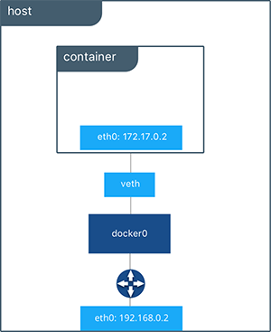
Docker Network
When you install Docker, it creates three networks automatically. You can list these networks using the docker network ls command:
$ docker network ls
NETWORK ID NAME DRIVER
7fca4eb8c647 bridge bridge
9f904ee27bf5 none null
cf03ee007fb4 host host
$ docker network create --driver bridge isolated_nw
1196a4c5af43a21ae38ef34515b6af19236a3fc48122cf585e3f3054d509679b
$ docker network inspect isolated_nw

Slide 27


