Slide 1

Jenkins
Gopala Krishnan C

Slide 2
Contents
What is Jenkins?
What is Continuous Integration?
Why use Continuous Integration with Jenkins?
Real-world case study of Continuous Integration
CICD Workflow
Continuous Deployment / Delivery
Jenkins Installation
Jenkins Plugin Installation
Create Users & Manage Permissions
Creating a Freestyle Build Job

Slide 3
What is Jenkins?
Jenkins is an open source automation tool written in Java with plugins built for Continuous Integration purpose.
Jenkins is used to build and test your software projects continuously making it easier for developers to integrate changes to the project and making it easier for users to obtain a fresh build.
It also allows you to continuously deliver your software by integrating with a large number of testing and deployment technologies.
Jenkins is a widely used application around the world that has around 300k installations and growing day by day.
It is a server-based application and requires a web server like Apache Tomcat. The reason Jenkins became so popular is that of its monitoring of repeated tasks which arise during the development of a project.
For example, if your team is developing a project, Jenkins will continuously test your project builds and show you the errors in early stages of your development.
Jenkins supports the complete development lifecycle of software from building, testing, documenting the software, deploying and other stages of a software development lifecycle.
Jenkins can be installed through native system packages, Docker, or even run standalone by any machine with a Java Runtime Environment (JRE) installed.

Slide 4
What is Continuous Integration?
In Continuous Integration after a code commit, the software is built and tested immediately.
In a large project with many developers, commits are made many times during a day. With each commit code is built and tested.
If the test is passed, build is tested for deployment. If deployment is a success, the code is pushed to production.
This commit, build, test, and deploy is a continuous process and hence the name continuous integration/deployment.
A Continuous Integration Pipeline is a powerful instrument that consists of a set of tools designed to host, monitor, compile and test code, or code changes, like:
Continuous Integration Server (Jenkins, Bamboo, TeamCity, Gitlab CI, Circle CI, GoCD and others)
Source Control Tool (e.g., CVS, SVN, GIT, Mercurial, Perforce, ClearCase and others)
Build tool (Make, ANT, Maven, Ivy, Gradle, and others)
Automation testing framework (Selenium, Junit, Appium, TestComplete, UFT, and others)
Static Code Analysis (SonarQube, Veracode, Parasoft, Raxis, and others)
Code Courage Tools/QA (CodeCover, EMMA, JaCoCo, NoUnit, and others)

Slide 5
Why use Continuous Integration with Jenkins?
Before Jenkins | After Jenkins
Once all Developers had completed their assigned coding tasks, they used to commit their code all at same time. Later, Build is tested and deployed. Code commit built, and test cycle was very infrequent, and a single build was done after many days. | The code is built and test as soon as Developer commits code. Jenkin will build and test code many times during the day If the build is successful, then Jenkins will deploy the source into the test server and notifies the deployment team. If the build fails, then Jenkins will notify the errors to the developer team.
Since the code was built all at once, some developers would need to wait until other developers finish coding to check their build | The code is built immediately after any of the Developer commits.
It is not an easy task to isolate, detect, and fix errors for multiple commits. | Since the code is built after each commit of a single developer, it's easy to detect whose code caused the built to fail
Code build and test process are entirely manual, so there are a lot of chances for failure. | Automated build and test process saving timing and reducing defects.
The code is deployed once all the errors are fixed and tested. | The code is deployed after every successful build and test.
Development Cycle is slow | The development cycle is fast. New features are more readily available to users. Increases profits.

Slide 6
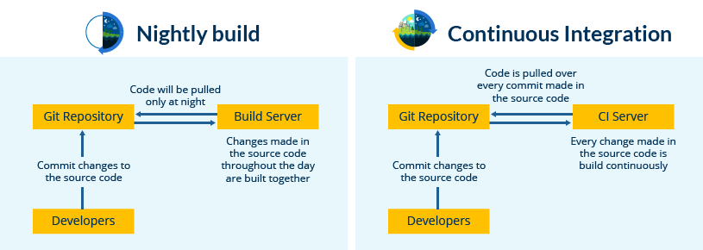
Real-world case study of Continuous Integration
I am sure all of you aware of old phone Nokia. Nokia used to implement a procedure called nightly build. After multiple commits from diverse developers during the day, the software built every night.
Since the software was built only once in a day, it's a huge pain to isolate, identify, and fix the errors in a large code base.
Later, they adopted Continuous Integration approach. The software was built and tested as soon as a developer committed code. If any error is detected, the respective developer can quickly fix the defect.

Slide 7
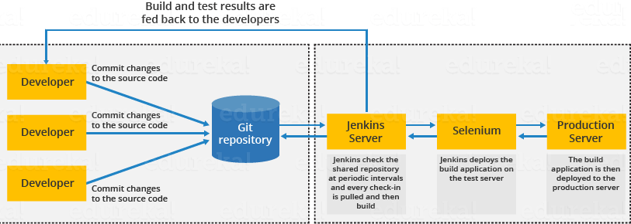
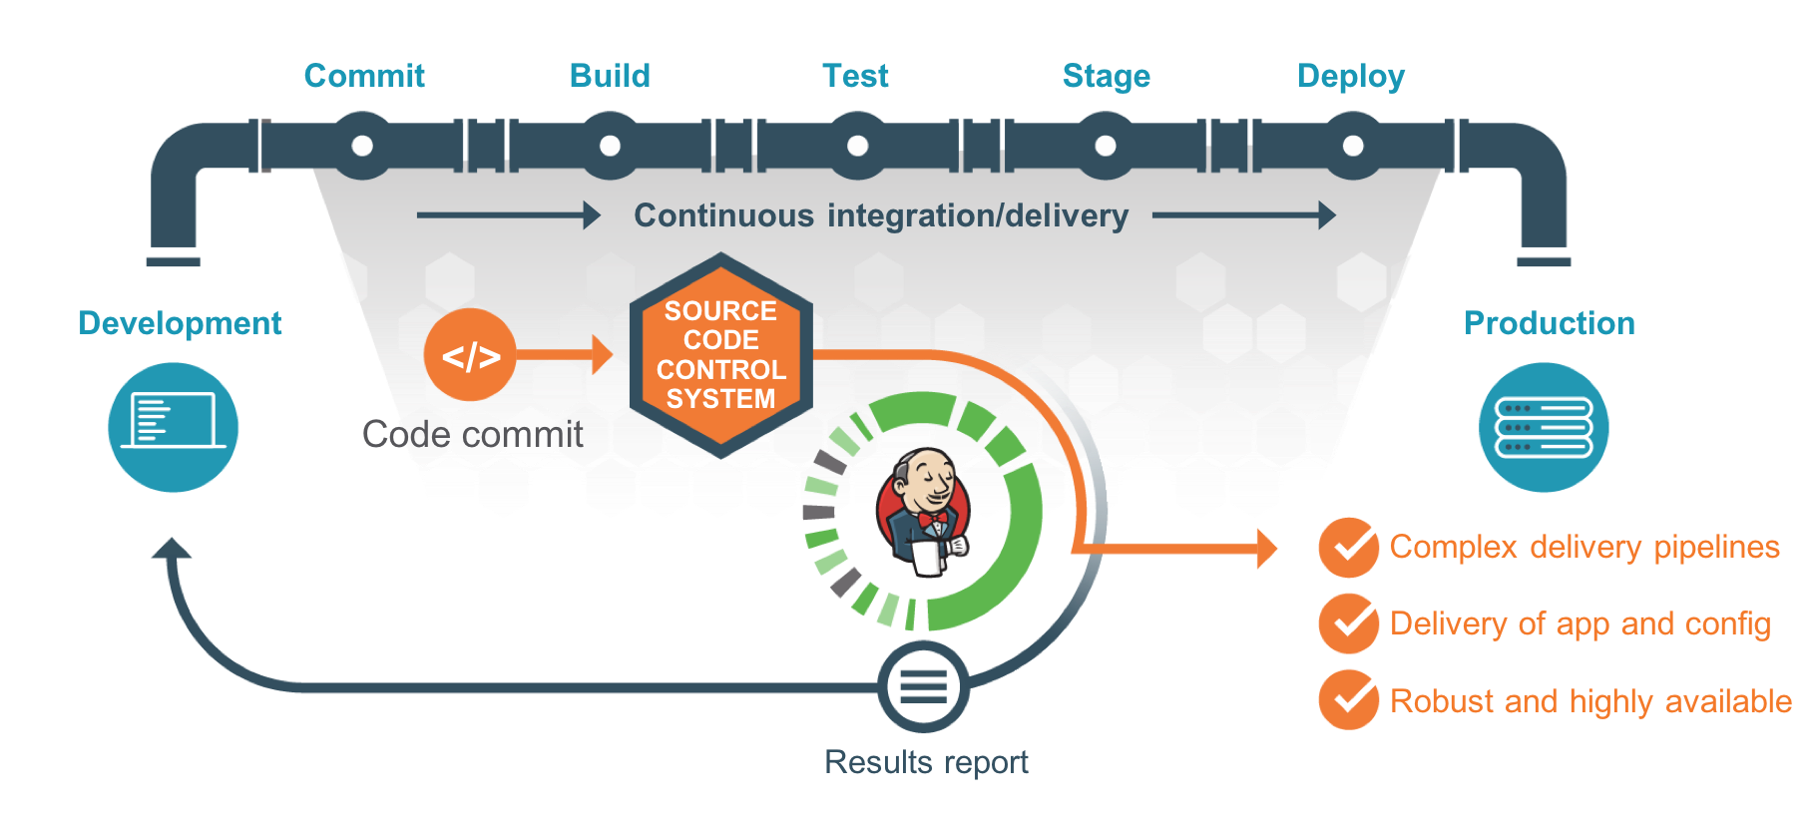
CICD Workflow

Slide 8
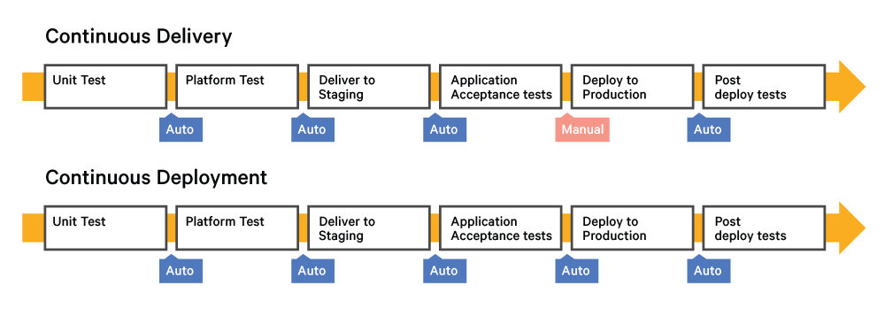
Continuous Deployment / Delivery
Continuous Deployment:
Continuous deployment is fully automated, and the deployment to production needs no manual intervention in continuous deployment
Continuous Delivery:
The deployment to production requires some manual intervention for change management in the organization, and it needs to be approved by the manager or higher authorities to be deployed in production.
According to your organization’s application risk factor, continuous deployment/delivery approach will be chosen.

Slide 9
Jenkins Installation
We have multiple ways to install Jenkins
Install a Jenkins package in standalone machine
Install Jenkins.war file in standalone machine
Run the Jenkins as a docker container
Run Jenkins as a docker container
https://docs.docker.com/install/linux/docker-ce/centos/
# yum remove docker docker-client docker-client-latest docker-common docker-latest docker-latest-logrotate docker-logrotate docker-engine
# yum install -y yum-utils device-mapper-persistent-data lvm2
# yum-config-manager --add-repo https://download.docker.com/linux/centos/docker-ce.repo
# yum install docker-ce docker-ce-cli containerd.io
# systemctl start docker
# systemctl enable docker
# systemctl status docker
# docker run --name myjenkins -itd --privileged -p 8085:8080 gopac/jenkins_master:v1

Slide 10
Jenkins Installation
Install a Jenkins package in standalone machine:
https://wiki.jenkins.io/display/JENKINS/Installing+Jenkins+on+Red+Hat+distributions
# yum install java-1.8.0-openjdk
# yum -y install wget
# wget -O /etc/yum.repos.d/jenkins.repo http://pkg.jenkins-ci.org/redhat-stable/jenkins.repo
# rpm --import https://jenkins-ci.org/redhat/jenkins-ci.org.key
# yum -y install jenkins
# systemctl start jenkins
# systemctl status jenkins
# systemctl enable jenkins
Configure Firewall:
# firewall-cmd --permanent --new-service=jenkins
# firewall-cmd --permanent --service=jenkins --set-short="Jenkins Service Ports"
# firewall-cmd --permanent --service=jenkins --set-description="Jenkins service firewalld port exceptions"
# firewall-cmd --permanent --service=jenkins --add-port=8080/tcp
# firewall-cmd --permanent --add-service=jenkins
# firewall-cmd --zone=public --add-service=http --permanent
# firewall-cmd --reload
Go to Jenkins URL:
http://192.168.44.145:8080

Slide 11
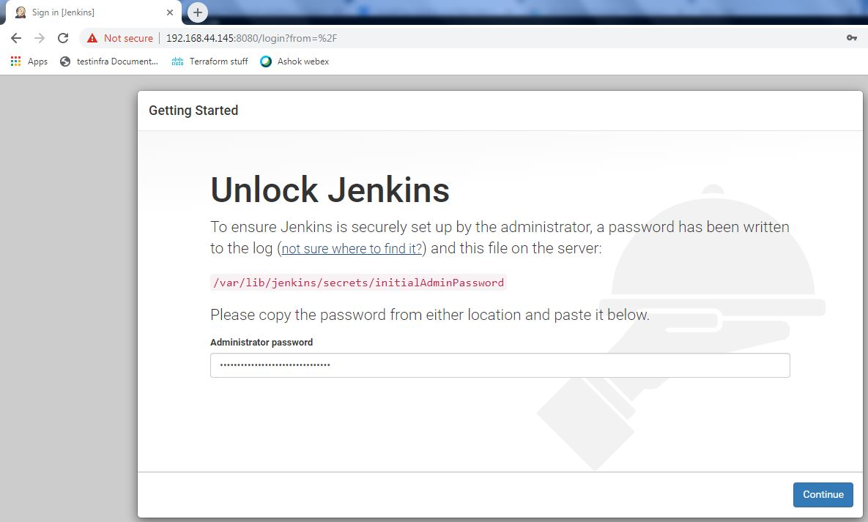
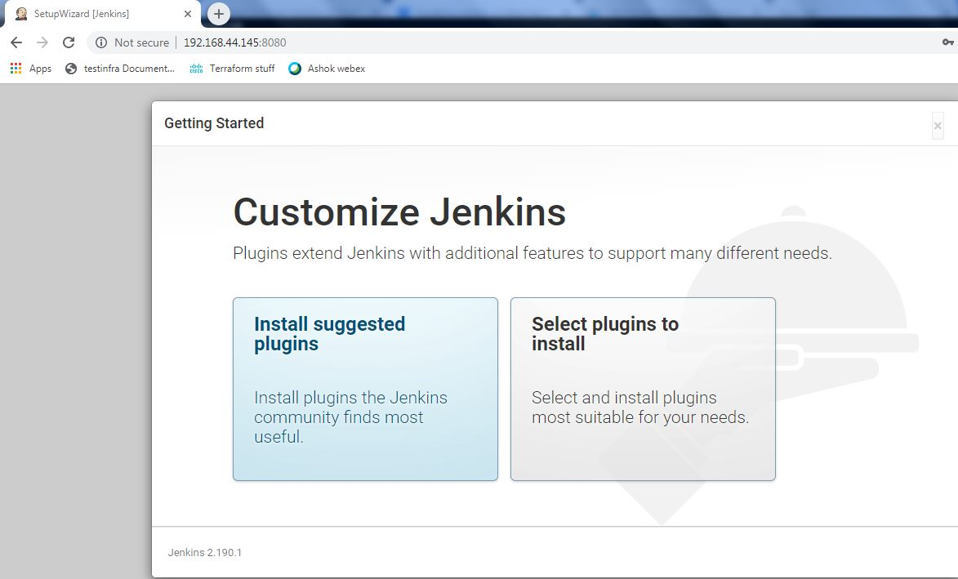
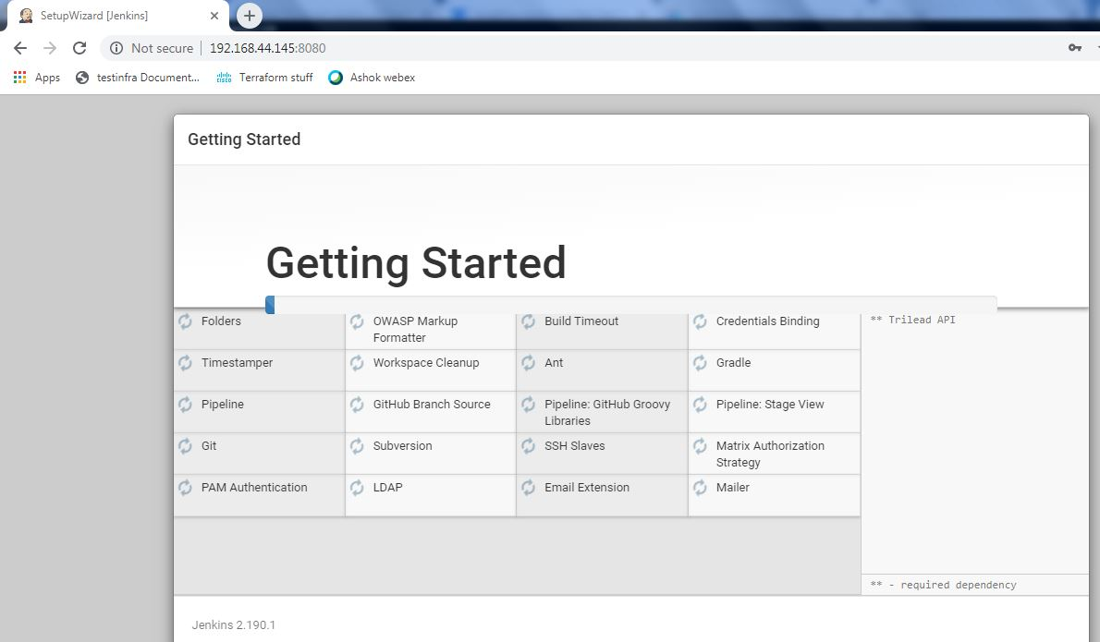
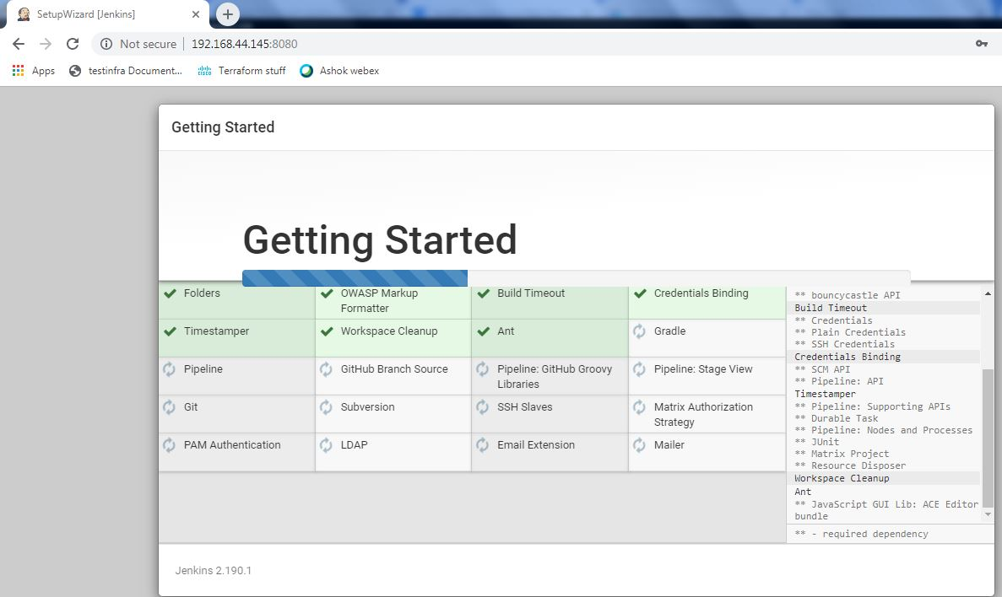
Jenkins Installation

Slide 12
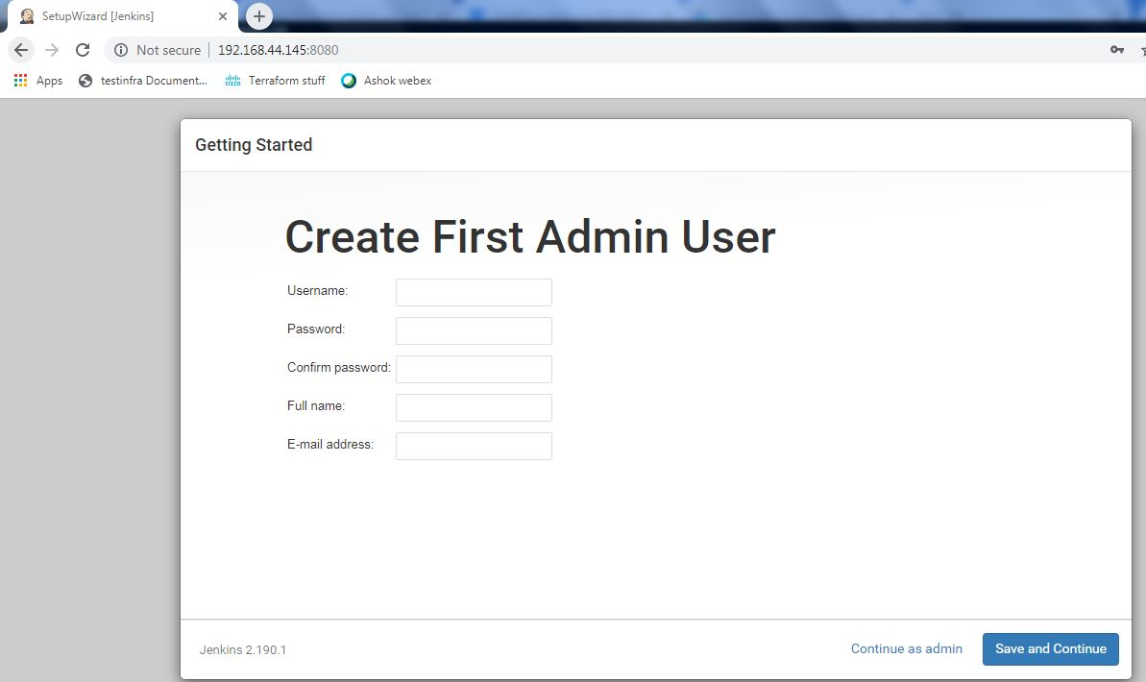
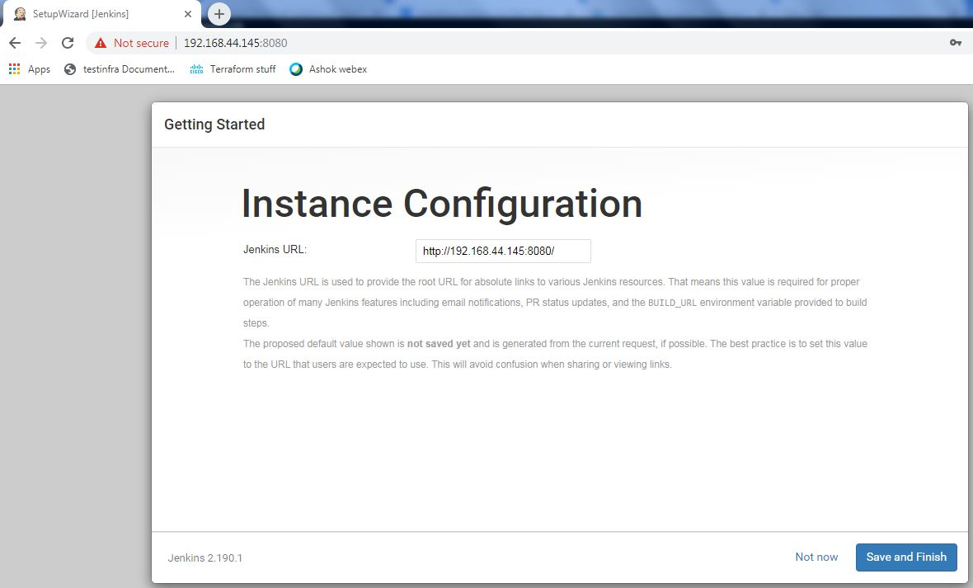
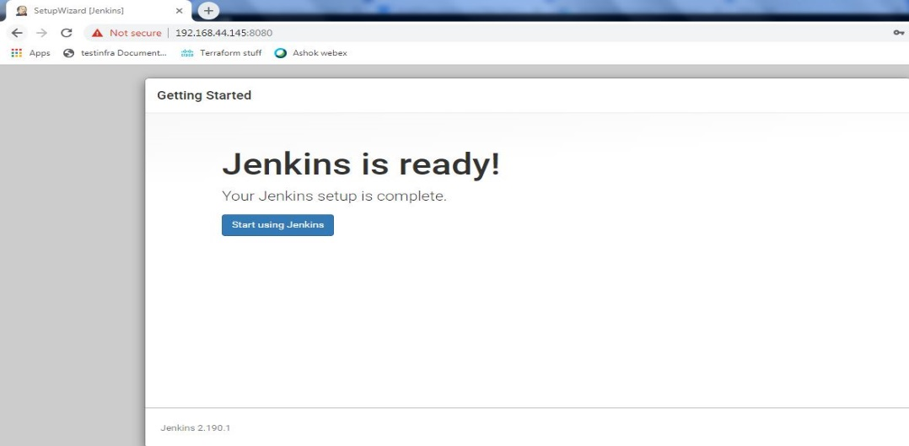
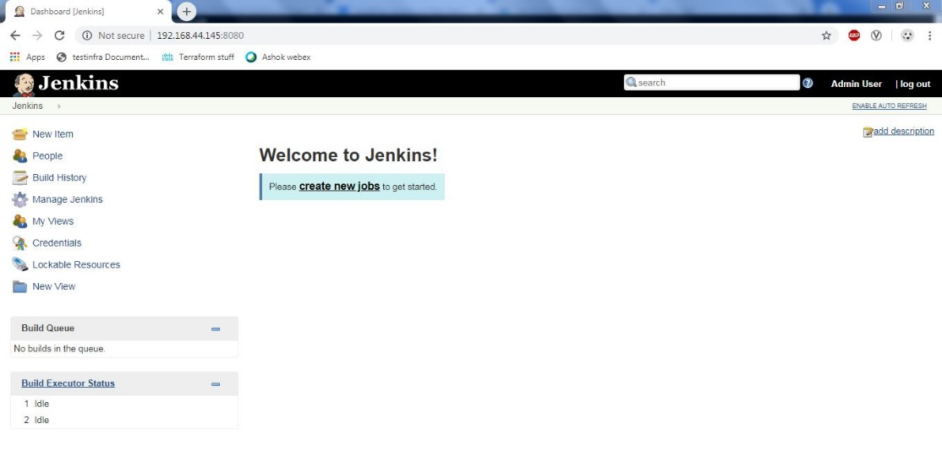
Jenkins Installation

Slide 13
Jenkins plugin Installation
There are two methods for installing plugins in Jenkins:
Installing it through your Jenkins dashboard
Downloading the plugin from Jenkins website and installing it manually.
Step 1)
Go to Manage Jenkins
Click on the Manage Plugins option
Step 2)
In available section, screen Search for “plugin name".
Select required plugin
Click on "Install without restart" (make sure you have an active internet connection)

Slide 14
Create Users & Manage Permissions
Generally, in a large organization, there are multiple, separate teams to manage and run jobs in Jenkins. But managing this crowd of users and assigning roles to them can prove troublesome.
By default, Jenkins comes with very basic user creation options. You can create multiple users but can only assign the same global roles and privileges to them. This not ideal, especially for a large organization.
The Role Strategy Plugin enable you to assign different roles and privileges to different users. You will first need to install the plugin in your Jenkins mange environment.
How to Create/Add a User
Install Role-based Authorization Strategy plugin
Create Roles
Assign a Role
Project Roles
How to Create/Add a User
Step 1)
Login to your Jenkins dashboard
Step 2)
Under Manage Jenkins, Click Create User
Enter User details like password, name, email etc.
Click Create User
Step 3)
User is created

Slide 15
Create Users & Manage Permissions
Install Role Strategy Plugin
There are two methods for installing plugins in Jenkins:
Installing it through your Jenkins dashboard
Downloading the plugin from Jenkins website and installing it manually.
Step 1)
Go to Manage Jenkins
Click on the Manage Plugins option
Step 2)
In available section, screen Search for "role".
Select Role-based Authorization Strategy plugin
Click on "Install without restart" (make sure you have an active internet connection)
Step 3)
Go to Manage Jenkins -> Configure Global Security -> Under Authorization, select Role Based Strategy. Click on Save.

Slide 16
Create Users & Manage Permissions
Create Roles
In this step, we shall learn to certain roles to a single user or a group of users.
Step 1)
Go to Manage Jenkins
Select Manage and Assign Roles
Note: that the Manage and Assign Roles option will only be visible if you've installed the role strategy plugin.
Step 2) Click on Manage Roles to add new roles based on your organization.
Step 3)
To create a new role called “engineer",
Type “engineer" under "role".
Click on "Add" to create a new role.
Now, select the permissions you want to assign to the “engineer" role.
Click Save
Assign a Role
Step 1) Now that you have created roles, let us assign them to specific users.
Go to Manage Jenkins
Select Manage and Assign Roles
Step 2) We shall add the new role “engineer" to user
Selector engineer role checkbox
Click Save

Slide 17
Create Users & Manage Permissions
Project Roles
You can create project specific roles under Project Roles.
Step 1) In Jenkin's Manage and Assign Roles
Enter a role as "tester"
Add a pattern to this by adding tester.*, so that any username starting with "tester" will be assigned the project role you specify.
Click Add
Select privileges
Click Save

Slide 18
Creating a Freestyle Build Job
The freestyle build job is a highly flexible and easy-to-use option. You can use it for any type of project; it is easy to set up, and many of its options appear in other build jobs.
Step 1) To create a Jenkins freestyle job, log on to your Jenkins dashboard by visiting your Jenkins installation path. Usually, it will be hosted on localhost at http://localhost:8080 If you have installed Jenkins in another path, use the appropriate URL to access your dashboard.
Step 2) Click on "New Item" at the top left-hand side of your dashboard.
Step 3) In the next screen,
Enter the name of the item you want to create. We shall use the "Hello world" for this demo.
Select Freestyle project
Click Okay
Step 4) Enter the details of the project you want to test.
Step 5) Under Source Code Management, Enter your repository URL. We have a test repository located at https://github.com/gopac25/freestyle.git
It is also possible for you to use a local repository.
If your GitHub repository is private, Jenkins will first validate your login credentials with GitHub and only then pull the source code from your GitHub repository.

Slide 19
Creating a Freestyle Build Job
Step 6) Now that you have provided all the details, it's time to build the code. Tweak the settings under the build section to build the code at the time you want. You can even schedule the build to happen periodically, at set times.
Under build,
Click on "Add build step“
Click on "Execute Shell" and add the commands you want to execute during the build process.
Step 7) When you have entered all the data,
Click Apply
Save the project.
Step 8) Now, in the main screen, Click the Build Now button on the left-hand side to build the source code.
Step 9) After clicking on Build now, you can see the status of the build you run under Build History.
Step 10) Click on the build number and then Click on console output to see the status of the build you run. It should show you a success message, provided you have followed the setup properly.
we have executed a shell script hosted on GitHub. Jenkin pulls the code from the remote repository and builds continuously at a frequency you define.

Slide 20


