Slide 1
Prodapt - SDIL – Fixathon
One Click - Deployment
Gopalakrishnan
Jagadeesh
Kanapathi Raja

Slide 2





Problem Statement
Currently, the deployment is done manually and require SDIL deployment team to present during the deployment window.
Engineer follow the deployment guide then proceed with deployment at each country and component level.
Current Scenario - Overview
Too many manual steps and swivel process
More time in validating VMs and N/w Connectivity.
Too many dependencies/pre-requisites
High Opex cost
Automate pre-checks and post validations
Configuration script to enable ONE click deployment.
Use Docker / kubenetes to orchestrate deployment.
Makes it seamless and simple to operate a complex multi-geographic pipline.
Greater accuracy and reducing the human error factor
Build pipeline as a code with intermediate CI/CD stages using Jenkins.
Create Monitoring dashboard through artefacts
Current Challenges
Validation Enablers
Advantages
Results
60%
70%
60%
Increase Reusability
Reduction in Deployment time for end-to-end CI/CD window
Reduction in waiting time with parallel execution of multiple applications/ countries
Lower IT spend in the process and resource usage
Same toolchain can be used for multiple environment Prod & Pre-Prod.

Slide 3

Current Vs Proposed Solution
Current Pain Points
Manual steps in updating the JIRA story & task.
Validate the connectivity between the CICD tools.
Manual Status update and Monitoring
Post-Deployment checks like checking VMs status and application readiness is done through Putty.
Proposed Solution
Auto update the JIRA stories and task.
Automation script that will enable deployment across multiple application/VMs
Visualized view of VMs and its current status.
Automated post deployment validation steps.

Slide 4









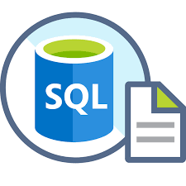


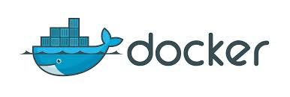
Proposed - Solution Design
Developer
Jenkins
Pull/ Push Request
Prechecks
Deployment
Post verification
Precheck, Deployment
& Post validation
Deployment
Engineer
Success
Without
Failure
Creating Issues
Failures
Email - Notification
Deployment Engineer
End-Users
Deploy in Prod/Pre-Prod

Slide 5


Tools Used
Jenkins is deployed through Linux OS which manages entire CICD work flow.
JIRA Server instance used as Lifecyle management tool to align user stories & log issues.
GIT chosen for source code management repository
Docker container is used instead of VMs to containerize applications.
Portainer is used to orchestrate the Docker container.
Note: All the above picked tools are open-source except JIRA with 30 days free server trail pack.

Slide 6


Demo
Developer
Jenkins
Local Server
Prechecks
Deployment
Post verification
Precheck, Deployment
& Post validation
Deployment
Engineer
Success
Without
Failure
Creating Issues
Failures
Email - Notification
Deployment Engineer
End-Users
Deploy in Prod/Pre-Prod

