Slide 1
ACS Deployment
Gopalakrishnan C & Aishwaryalakshmi S

Slide 2
ACS - Introduction
ACS:
ACS stands for Auto Configuration Server
Vendor : Axiros
Component owner : Roman Reiss / Heimo Pleschiutschnig
Usage:
Interact with clients or CPE’s for management , reporting, troubleshooting and firmware upgrades.
ACS have a connectivity between all the set top boxes where the customers being used. We can manage all our operations of all set top boxes using ACS application.
For example we can do reboot, upgrade your set top boxes, downgrade your set top boxes remotely and FTI (First Time Installation.
Supporting Countries:
BE - Telenet
NL - Ziggo
CH - UPC
UK - Virgin Media
CL - VTR

Slide 3
ACS - Introduction Cont..
Infrastructure for each country:
Two MySQL Database servers with 4 CPUs & 10 GB Memory
Store CPE logs and Netflix & Widewine keys
Two Northbound Application Servers with 6 CPUs & 4 GB Memory
Reporting and database cluster to store data
Two Southbound Application Servers with 4 CPUs & 6 GB Memory
Handle incoming TR-069 requests and notification server
Features:
ACS have a feature called campaigns. The campaigns used to do bulk activities.
When we are upgrading all of our set top boxes we will create a campaigns and will schedule at night. Once its done all of our set top boxes provisioned to the higher version.

Slide 4
ACS - Introduction Cont..
MQTT Service:
Mqtt service using by the customer care. When customer reports any issue in the set top box they will contact customer care.
Customer care use this service and login the set top boxes to fix the issue. For mqtt service we have different user in all the servers for all countries.
CRS:
CRS stands for CPE Redirect Service
When we are doing First Time Installation CRS will detect the GEO Graphical location automatically and download required packages based on the location from VSPP and configure the set top boxes.
As per CRS upgrade we are updating the OMW config file.

Slide 5
ACS - Deployment
Deployment Versions:
M2D3 – Greenfield.
R4.5.3 – Manual Table Creation & Key import.
R4.6 – Some manual activities.
R4.7 – Automatic Table Creation & User Creation. Prechecks are automated
R4.8 – Changed chroot path. Replaced mysql proxy LB to advanced HA proxy LB. Upgraded
Mysql & ACS Application version.
R4.9 - Small patch from development side.
R4.10 – Fstab fix
R4.12 – STB Provisioning
R4.13 – Changes in CPE ID & Cleanup activities
R4.15 - Cleanup activities & OMW file update
Deployment Timings:
PreProd - All five countries (BE,NL,CH,UK,CL) in same day 6 AM to 11:30 AM CET
Prod - Four Countries (BE,NL,CH,UK) in same day 1 AM to 6AM CET
- CL (VTR) in Next day 7 AM to 12 PM CET

Slide 6
ACS - Application Workflow
ACS Development Team
Develop the code based on the requirement.
Lab OBOSI Team
Lab team doing code evaluation, syntax issues, compilation issues and also they test only one application.
E2ESI Team (5A Lab)
E2ESI team is doing the integration testing for all of our components.
Also they verify all the user stories are functionally working.
PreProd Deployment
SDIL Deployment team doing preprod and prod deployment.
Prod Deployment
Note:
Lab OBOSI & E2ESI Team handled by Accenture.
PreProd & Prod Deployment handled by us (Prodapt).

Slide 7
ACS - Deployment Process Flow
Below process we are following for all the deployments.
Access to the servers (PreProd/Prod)
VPN Access
Jump Servers Access
ACS Servers
Temp Sudo Access
Prepare Application LLD
We need to verify all the variables and attributes in the ansible deployment playbook with acs-obo.ini file based on the deployment guide.
Verify the servers list and IP addresses with help of Infra LLD for all countries.
Update the new variables & attributes in acs-obo.ini file.
Once acs-obo.ini file updated we need to get an approval from E2ESI team in LG. The acs-obo.ini file should be approved before deployment. We have Jira ticket for this. We need to attach the file and send the ticket to particular person.
Create CRQs for all release.

Slide 8
ACS - Deployment Process Flow Cont..
Prerequisites for all countries
Connection Status based on Network LLDs.
All the binaries are in place.
All the deployment related Playbooks, Jenkins Pipeline jobs, Variables, Vault file.
Take Jira tickets on your name and create subtasks based on the Runbook.
Snapshot ticket should be created and send to Ashok.
Verify all the services are up and running for all servers. And verify DB replication happening correctly.
Verify ACS GUI is working properly before upgrade.
Deployment/Upgrade
Run the Jenkins pipeline job with parameters.
Sanity Check
After upgrade verify all the services are up and running.
Verify DB replication happening correctly.
Verify all ACS GUI is working properly after upgrade.

Slide 9
ACS - Deployment Process Flow Cont..
TAF Job Execution
We need to run TAF jobs in Jenkins
Update the test results in Jira tickets.
Handover the Application to E2ESI team.
E2ESI team validate the functional changes of latest release.

Slide 10
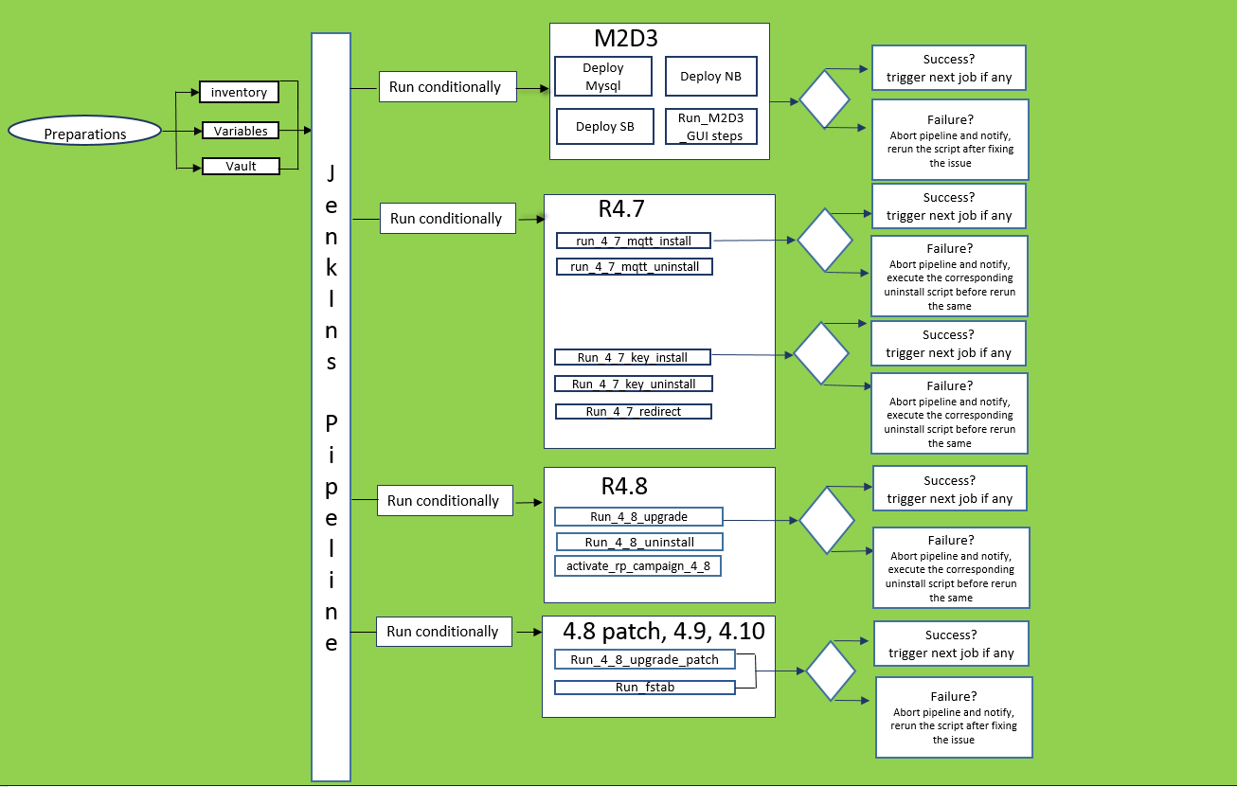
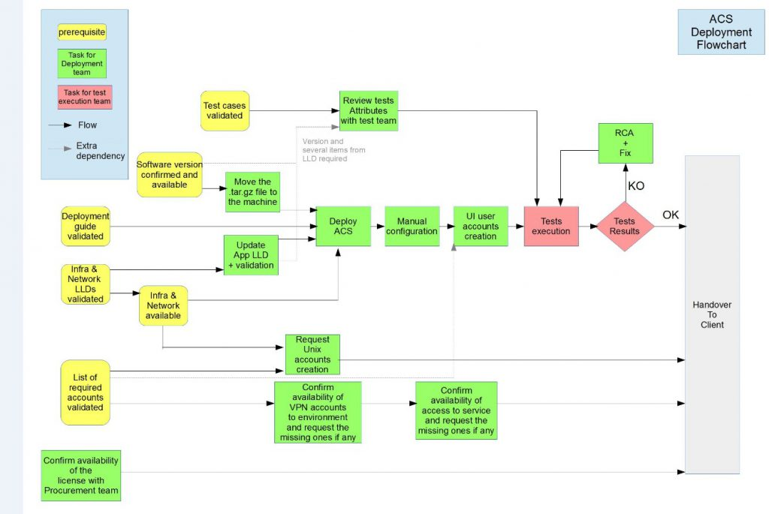
Deployment Stages

Slide 11
Access Details
Below accesses we need to raise for new joiners
UIM account access
VPN access[lab/prod]
Service Access in UIM
CNT-CIO-DC-MGT-GREEN : To access production instances from jump hosts
CNT-ECX-JUMPHOSTS : access Jump Hosts
CNTLABS-LGI-Users
Jump servers access
Crowd access
Wiki access
Jira access
Bitbucket access
Host Access - We need to raise host access for all PreProd & Production ACS servers. We can raise the access via bundles or we can raise individual server access.
Jenkins URL access

Slide 12
Point of Contacts
Component owner : Roman Reiss / Heimo Pleschiutschnig
Technical doubts : Martin Adelmann

Slide 13
Pre-Deployment steps
Creating sub-tasks in Jira
Connectivity checks in ACS servers
Deployment guide/upgrade steps to be documented and approved before any manual deployments
Confirm binaries availability in Nexus repository
Get approval

Slide 14
Greenfield deployment steps
For Greenfield deployment, the below steps to be performed after installation and for upgrades that has DB changes, the below step to be performed before and after deployment to make sure the mysql replication cluster is working
Ssh to DB01 and execute : SELECT TABLE_NAME, TABLE_ROWS FROM information_schema.tables WHERE table_schema= “dawn”
Ssh to DB02 and execute the command in 1’st step
Compare the output between DB01 and DB02, they have to be identical (indicates they are at the same state)
In DB01 execute: insert into AXServiceLogTable(id,ts,logLevel,state,log) values(100,999,9,0,’firstToSecond’);
In DB02 execute: insert into AXServiceLogTable(id,ts,logLevel,state,log) values(100,999,9,0,’secondToFirst’);
Validate again the DB01 and DB02 query output with the command on step 1. This is to check replication works both ways
In DB01 execute: use dawn; delete from AXServiceLogTable where log = ‘firstToSecond’;
In DB02 execute: use dawn; delete from AXServiceLogTable where log = ‘secondToFirst’
Validate again the DB01 and DB02 query output with the command on step 1. The output should be the same, indicates the entries deleted on both directions

Slide 15
Start/Stop Procedure
Start MySQL service in both the DB Nodes :
sudo /usr/sbin/chroot /app/opt/production_mysql_38 /etc/init.d/mysql start
Start axess_all_daemons service in all the NB/SB Nodes:
sudo /usr/sbin/chroot /app/opt/production_mysql_38 /etc/init.d/axess_all_daemons start
Stop axess_all_daemons service in all the NB/SB Nodes:
sudo /usr/sbin/chroot /app/opt/production_mysql_38 /etc/init.d/axess_all_daemons stop
Stop mysql service in both the DB Nodes :
sudo /usr/sbin/chroot /app/opt/production_mysql_38 /etc/init.d/mysql stop

Slide 16
Deployment Steps
Preparation for Pipeline execution
Executing Jenkins job/pipeline
Troubleshooting if fails

Slide 17
Post deployment steps
ACS web UI configuration
Create double tunnelling
Validating deployment
Email to automation team to provide link for modifying values to the Application Testing parameters for automation
Handing over the deployed app to E2ESI team
Grant access to component owners for application installation and confirm remote access
Default username & password : admin/ax
Request automation team to trigger the Jenkins automation test build
Scrum master will hand over the application to the corresponding E2ESI team
Syntax : ssh –L<port_number>: localhost:< portnumber> <username>@<IP address of jumpserver>
Promt for NB/SB node password
Syntax : ssh –L<port_number>: localhost:443 <username>@<IP address of NB/SB>
Navigate to /dawn/admin_accounts in ACS UI and Mange Users section to create user accounts
Note: ACS UI configuration to be performed for both the primary and secondary nodes of NB and SB (x4 times)
Check and rectify all the failed test cases
Inform automation team to trigger the build again to have all the test cases successful

