Slide 1

Infrastructure as Code (IaC)
Gopala Krishnan &
Jenifer
Notes:
Insight Title should be verbose, catchy and should bring out solution statement
Insight can have maximum of 15 words in the title section
Insight title can have a combination of both title and sub-title or simply title itself

Slide 2
Contents
Executive Summary
IaC Categories
Infrastructure as a Service (IaaS)
Platform as a Service (PaaS)
Software as a Service (SaaS)
Viewpoint and approach
Benefits of IaC
Risks Involved with IaC
Current State of IaC
Infrastructure Provisioning using Terraform
what is terraform?
Key Features
Reasons to Consider Terraform
Advantages & Disadvantages
Configuration Management using Ansible
what is ansible?
Ansible Components/Concepts
Features & Capabilities
Advantages
CICD Workflow and Demo with IaC
Notes:
This is the opening slide to talk about one or more of the following
Talk about the specific business challenge(s)
Pain point of customers/domain which are generic across the telco industry
Constraints and bottlenecks commonly faced by every service provider
What Problem statement is not
For e.g. customer is not aware of agile, we have introduced the technology/process

Slide 3
Executive Summary
Businesses must deliver software with higher quality and velocity to their target client. One way to enable this is to automate the infrastructure setup and application configuration and deployment. Each stage of the software development lifecycle (SDLC) from local dev to acceptance and eventually to production is performed in an automated, repeatable, and deterministic manner. This process supports the enabling capability of Infrastructure as Code (IaC).
Infrastructure as Code (IaC) is a method to provision and manage IT infrastructure through the use of source code, rather than through standard operating procedures and manual processes.
The concept of IaC is that the description of the infrastructure resources and their topology is modeled through code and then managed like software. These descriptor files are managed through version control. Executions are orchestrated via configuration management and Continuous Integration/Continuous Deployment (CI/CD) platforms.
IaC helps you automate the infrastructure deployment process in a repeatable, consistent manner, which has many benefits.
Notes:
This is the opening slide to talk about one or more of the following
Talk about the specific business challenge(s)
Pain point of customers/domain which are generic across the telco industry
Constraints and bottlenecks commonly faced by every service provider
What Problem statement is not
For e.g. customer is not aware of agile, we have introduced the technology/process

Slide 4
IaC Categories
IaC processes fall into three categories:
Infrastructure as a Service (IaaS)
Platform as a Service (PaaS)
Software as a Service (SaaS)
Infrastructure as a Service (IaaS) is a cloud-computing offering in which a vendor provides users access to computing resources such as servers, storage and networking. Organizations use their own platforms and applications within a service provider’s infrastructure.
Key features:
Instead of purchasing hardware outright, users pay for IaaS on demand.
Infrastructure is scalable depending on processing and storage needs.
Saves enterprises the costs of buying and maintaining their own hardware.
Because data is on the cloud, there can be no single point of failure.
Enables the virtualization of administrative tasks, freeing up time for other work.
IaaS Examples: Amazon Web Services (AWS), Cisco Metapod, Microsoft Azure, Google Compute Engine (GCE)
Notes:
This is the opening slide to talk about one or more of the following
Talk about the specific business challenge(s)
Pain point of customers/domain which are generic across the telco industry
Constraints and bottlenecks commonly faced by every service provider
What Problem statement is not
For e.g. customer is not aware of agile, we have introduced the technology/process

Slide 5
IaC Categories Cont…
Platform as a service (PaaS) is a cloud computing offering that provides users with a cloud environment in which they can develop, manage and deliver applications. In addition to storage and other computing resources, users are able to use a suite of prebuilt tools to develop, customize and test their own applications. Hardware and software tools available over the internet.
Key features:
PaaS provides a platform with tools to test, develop and host applications in the same environment.
Enables organizations to focus on development without having to worry about underlying infrastructure.
Providers manage security, operating systems, server software and backups.
Facilitates collaborative work even if teams work remotely.
PaaS Examples: AWS Elastic Beanstalk, Heroku, Windows Azure (mostly used as PaaS), Force.com, OpenShift, Apache Stratos, Magento Commerce Cloud, Apprenda

Slide 6
IaC Categories Cont…
Software as a service (SaaS) is a cloud computing offering that provides users with access to a vendor’s cloud-based software. Users do not install applications on their local devices. Instead, the applications reside on a remote cloud network accessed through the web or an API. Through the application, users can store and analyze data and collaborate on projects.
Key features:
SaaS vendors provide users with software and applications via a subscription model.
Users do not have to manage, install or upgrade software; SaaS providers manage this.
Data is secure in the cloud; equipment failure does not result in loss of data.
Use of resources can be scaled depending on service needs.
Applications are accessible from almost any internet-connected device, from virtually anywhere in the world.
SaaS Examples: Google Apps, Salesforce, Workday, Concur, Citrix GoToMeeting, Cisco WebEx, Adobe

Slide 7
Viewpoint & Approach
We believes the following high-level approach will help clarify the major steps needed to introduce IaC to our teams. Within each step there are details specific to your business where we can work closely with our team to architect and build the right tech stack detailed implementation plan and enabling capabilities.
Below principles will help us to succeed IaC implementation in our environment.
Principle 1: Easy Reproducibility of the Systems
Principle 2: High Level of Flexibility
Principle 3: Dynamic Design
Define the degree of infrastructure configuration that'll be exposed using IaC approaches.
Define the configuration management approach, as well as tool sets to leverage.
Define how the developers and DevOps organization should use these mechanisms.
Create automated processes for monitoring and accounting of IaC and DevOps.

Slide 8
Benefits
Speed and simplicity
Configuration consistency
Minimization of risk
Increased efficiency in software development
Cost savings
Improving Customer Satisfaction
Scalable and Immutable Infrastructure

Slide 9
Risks Involved in IaC
There is some risk that needs to be accounted for:
Missing proper planning
IaC requires new skills
Error replication
Configuration Drift
Accidental Destruction

Slide 10
Current State of IaC
The general IaC concept, as well as available tools, has reached a very mature state with a lot of organizations having defined their roadmaps for adopting it.
The first thing that should be clarified is the difference between “configuration orchestration” and “configuration management” tools, both of which are considered IaC tools and are included on this list.
Configuration orchestration tools, which include Terraform and AWS CloudFormation, are designed to automate the deployment of servers and other infrastructure.
Configuration management tools like Ansible, Chef, Puppet, and the others on this list help configure the software and systems on this infrastructure that has already been provisioned.
Configuration orchestration tools do some level of configuration management, and configuration management tools do some level of orchestration. Companies can and many times use both types of tools together.
There are now a number of tools available to adopt Infrastructure as Code with and the right tool will differ for every Infrastructure or DevOps team. The available tools differ widely in usage and functionality so below is a high-level overview of some of the most popular tools available for building and managing your IaC.

Slide 11
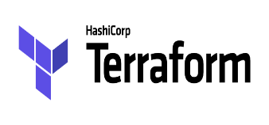
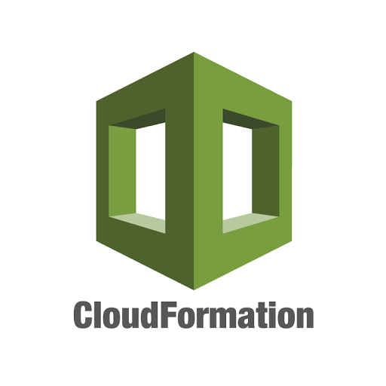
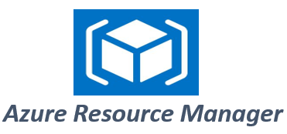

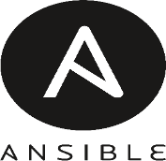
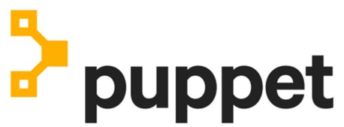

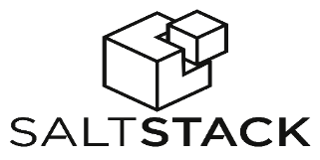



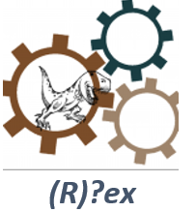

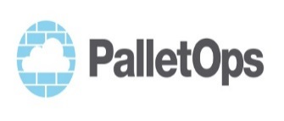
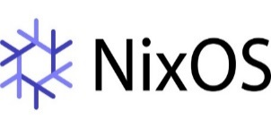
Tools

Slide 12
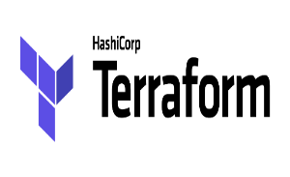
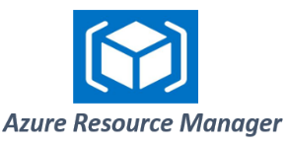
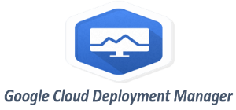
Tools Overview
Terraform is an infrastructure provisioning tool created by Hashicorp. It allows you to describe your infrastructure as code, creates “execution plans” that outline exactly what will happen when you run your code, builds a graph of your resources, and automates changes with minimal human interaction. Terraform uses its own domain-specific language (DSL) called Hashicorp Configuration Language (HCL).
AWS CloudFormation is a configuration orchestration tool that allows you to code your infrastructure to automate your deployments. CloudFormation is deeply integrated into and can only be used with AWS, and CloudFormation templates can be created with YAML in addition to JSON. You can even deploy infrastructure stacks across multiple AWS accounts and regions with a single CloudFormation template.
Azure Resource Manager allows you to define the infrastructure and dependencies for your app in templates, organize dependent resources into groups that can be deployed or deleted in a single action, control access to resources through user permissions, and more.
Google Cloud Deployment Manager offers many similar features to automate your GCP infrastructure stack. You can create templates using YAML or Python, preview what changes will be made before deploying, view your deployments in a console user interface, and much more.

Slide 13


Tools Overview Cont…
Chef is one of the most popular configuration management tools that organizations use in their continuous integration and delivery processes. Chef allows you to create “recipes” and “cookbooks” using its Ruby-based DSL. These recipes and cookbooks specify the exact steps needed to achieve the desired configuration of your applications and utilities on existing servers. This is called a “procedural” approach .
Puppet is another popular configuration management tool that helps engineers continuously deliver software.
Using Puppet’s Ruby-based DSL, you can define the desired end state of your infrastructure and exactly what you want it to do. Then Puppet automatically enforces the desired state and fixes any incorrect changes. This is “declarative” approach. Also, Puppet is mainly directed toward system administrators, while Chef primarily targets developers.
Ansible is an infrastructure automation tool created by Red Hat, the huge enterprise open source technology provider. Ansible models your infrastructure by describing how your components and system relate to one another, as opposed to managing systems independently. Ansible doesn’t use agents, and its code is written in YAML in the form of Ansible Playbooks, so configurations are very easy to understand and deploy.
Docker helps you easily create containers that package your code and dependencies together so your applications can run in any environment, from your local workstation to any cloud service provider’s servers. YAML is used to create configuration files called Dockerfiles. These Dockerfiles are the blueprints to build the container images that include everything – code, runtime, system tools and libraries, and settings – needed to run a piece of software. Because it increases the portability of applications, Docker has been especially valuable in organizations who use hybrid or multi-cloud environments. The use of Docker containers has grown exponentially over the past few years and many consider it to be the future of virtualization.

Slide 14
Infrastructure Provisioning using terraform
What is terraform?
Terraform is a tool for building, changing and versioning infrastructure safely and efficiently. Terraform can manage existing and popular service providers as well as custom in-house solutions.
The configuration file described in Terraform can create a single application or the entire data centre. Terraform even generates an execution plan before creating the actual infrastructure.
As the configuration changes, Terraform is capable of updating the infrastructure with the new changes made to it. Terraform can even manage low-level components such as compute, networking, storage as well as high-level components like DNS entries, SaaS features, etc.
Key Features:
Infrastructure as Code: The infrastructure is described using an advanced configuration language. It can be changed, shared and re-used.
Execution Plans: Terraform has a planning strategy where it executes a dry run to the configuration. It shows the changes to be made to infrastructure even before making the actual changes.
Resource Graph: The tool creates a graph of all the resources and shows the dependency on one another.
Change Automation: The changes can be made to your infrastructure with very less human intervention avoiding possible human error.

Slide 15
Infrastructure Provisioning using terraform Cont…
Reasons to Consider Terraform:
Terraform lets you define infrastructure in config/code and will enable you to rebuild/change and track changes to infrastructure with ease. Terraform provides a high-level description of infrastructure.
Terraform is the only sophisticated tool that is completely platform agnostic as well as supports other services while there are a few alternatives, but they are focused on a single cloud provider.
Terraform enables you to implement all kinds of coding principles like having your code in source control, the ability to write automated tests, etc
Terraform is the right tool for infrastructure management as many other tools have a severe impedance mismatch from trying to wrangle an API designed for configuring management to control an infrastructure environment. Instead, Terraform matches correctly with what you want to do- the API aligns with the way you think about infrastructure.
Terraform has a lively community and is open source, there is a massive community developing around this tool. Many people are already using it, and it’s easier to find people who know how to use it, plugins, extensions, professional support, etc. This also means Terraform is evolving at a much faster rate. They do releases very often.
Terraform’ s speed and operations are exceptional. One cool thing about Terraform is, its plan command lets you see what changes you’re about to apply before you apply them. Code reuse feature and Terraform tends to make most changes faster than similar tools like CloudFormation.

Slide 16
Infrastructure Provisioning using terraform Cont…
Advantages:
The Terraform files would be considered as documentation since our entire environment is described there.
Terraform will manage the state of your environment, that means, if something is not in conformity, it will try to fix keeping as close as possible of the desired state.
With Terraform, you can manage different cloud environments at the same configuration files. That is really useful when you need to handle with different cloud providers.
Repeatable deployments between environments.
Changes to environments can be seen before making real changes.
It integrates well with each of our providers.
Disadvantages:
The way Terraform manages variables is a bit annoying. Sometimes we need to declare the same variable in more the one file. So far, this doesn't make sense for me.
Due to the speed, as new AWS products are released, if we want to work with something new, we need to wait for a new version with this new feature be released.
As with most DevOps tools, Terraform has its own DSL language and will require time to learn the product for you feel confident in its usage.
Terraform is vulnerable when it comes to error handling.

Slide 17
Configuration Management using ansible
What is Ansible?
Ansible is an open source automation platform. It is very, very simple to setup and yet powerful. Ansible can help you with configuration management, application deployment, task automation.
It uses no agents and no additional custom security infrastructure, so it's easy to deploy - and most importantly, it uses a very simple language (YAML, in the form of Ansible Playbooks) that allow you to describe your automation jobs in a way that approaches plain English. Ansible works by connecting to your nodes and pushing out small programs, called "Ansible modules" to them.
Types of tasks ansible automates,
Provisioning – This tool can be used to set up servers in the target infrastructure.
Application deployment – By automating the deployment to your production systems of internally developed applications DevOps is made way easier.
Configuration management – Alter configuration of an application, device, install or update applications, implement a security policy, OS, device, start and stop services.

Slide 18
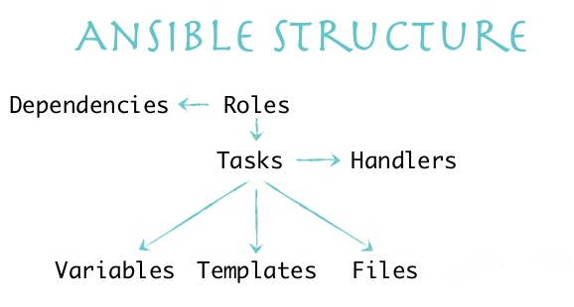
Configuration Management using ansible
Ansible Components/Concepts:
Inventory - File where you declare the list of hosts and groups
Modules - Ansible ships with a number of modules (called the 'module library') that can be executed directly on remote hosts or through Playbooks. Users can also write their own modules
Playbooks - Play, Tasks and Modules - A playbook is a yaml file where you run series of tasks on the hosts
Variables - Ansible provides a mechanism for overriding variables.
Templates - Templates are a powerful resource for generating files on the hosts. A template will have a common structure and it will be populated with specify variable values at runtime.
Roles - Roles are ways of automatically loading certain vars_files, tasks, templates, and handlers based on a known file structure. Grouping content by roles also allows easy sharing of roles with other users.

Slide 19
Configuration Management using ansible Cont…
Features & Capabilities:
Configuration Management - Ansible is designed to be very simple, reliable and consistent for configuration management.
Application Deployment - Ansible lets you quickly and easily deploy multitier apps.
Orchestration - Ansible uses automated workflows, provisioning and more to make orchestrating tasks easy.
Security and Compliance - As with application deployment, sitewide security policies (such as firewall rules or locking down users) can be implemented along with other automated processes.
Cloud Provisioning - The first step in automating your applications’ life cycle is automating the provisioning of your infrastructure. With Ansible you can provision cloud platforms, virtualized hosts, network devices and bare-metal servers.
Advantages:
Free. Ansible is an open-source tool.
Very simple to set up and use. No special coding skills are necessary to use Ansible’s playbooks.
Powerful. Ansible lets you model even highly complex IT workflows.
Flexible. You can orchestrate the entire application environment no matter where it’s deployed. You can also customize it based on your needs.
Agentless. You don’t need to install any other software or firewall ports on the client systems you want to automate. You also don’t have to set up a separate management structure.
Efficient. Because you don’t need to install any extra software, there’s more room for application resources on your server.

Slide 20
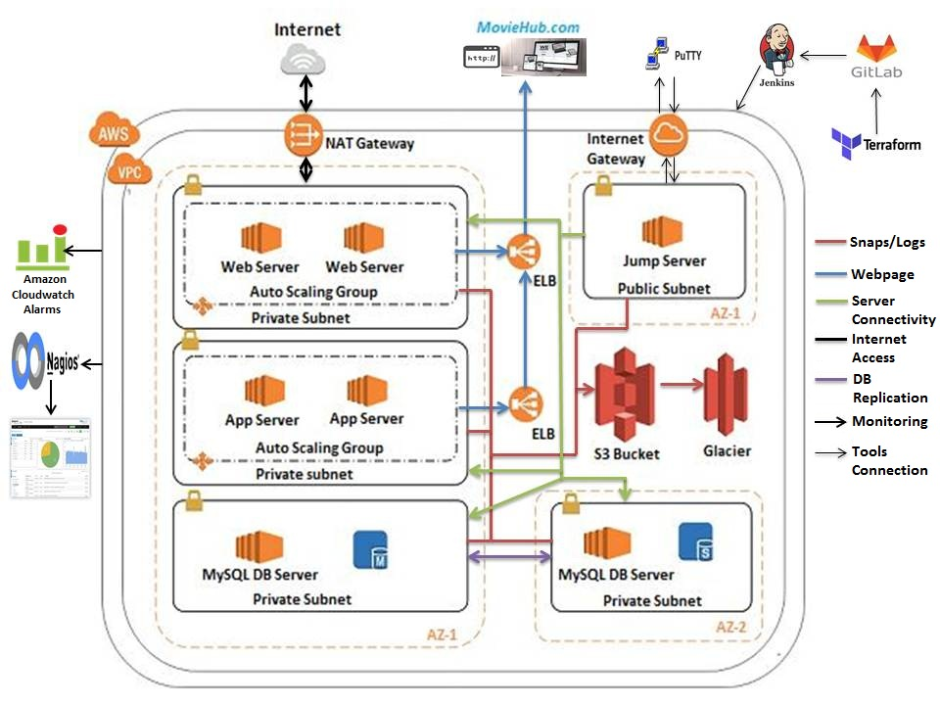
CICD Workflow – Moonshot Demo

Slide 21
Notes:
Should we keep the insights email id ?

