Slide 1





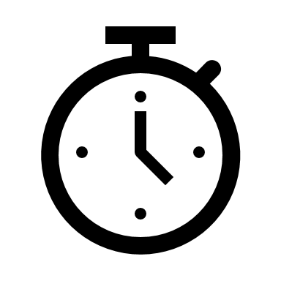
Tech Talk
on
Infrastructure as Code
- The Next Generation of IT Automation
“Showing a strong success and visible benefits is key to getting others to agree to try your way of doing things.” – Frederic Rivain
Kalam Centre,
C1
18th Sep’19
3pm - 5pm IST
Gopala Krishnan
Jenifer

