Slide 1

Gopala Krishnan C

Slide 2
Contents
What is Git?
Version Control System Types
Centralized Version Control
Distributed Version Control
Why Git Version Control
Git Lifecycle
Environment Setup
DevOps Lifecycle Stages
DevOps Tools
DevOps Principles
Roles and Responsibilities of a DevOps Engineer

Slide 3
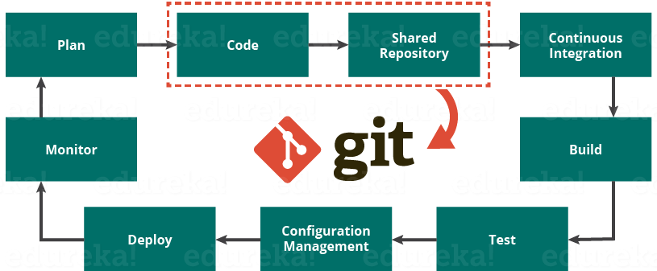
What is Git?
GIT is a tool in DevOps which is used as version-control system for tracking changes in system files and coordinating work on those files among a group of people. In the software development field, GIT is used in source-code management and track the changes in any files.
GIT is a distributed version control and source code management system with an emphasis on speed.
It is repository which is used to manage projects, set of files as they change over the time.
Using GIT every code change or commit you get latest development code for the project

Slide 4
Version Control System Types
There are two types of VCS: centralized and distributed.
Centralized Version Control:
A centralized version control system works on a client-server model.
There is a single, (centralized) master copy of the code base, and pieces of the code that are being worked on are typically locked, (or “checked out”) so that only one developer is allowed to work on that part of the code at any one time.
Access to the code base and the locking is controlled by the server.
When the developer checks their code back in, the lock is released so it’s available for others to check out.
Examples of centralized VCS systems are CVS and Subversion.
Distributed Version Control:
These systems work on a peer-to-peer model: the code base is distributed amongst the individual developers’ computers. In fact, the entire history of the code is mirrored on each system.
There is still a master copy of the code base, but it’s kept on a client machine rather than a server.
There is no locking of parts of the code; developers make changes in their local copy and then, once they’re ready to integrate their changes into the master copy, they issue a request to the owner of the master copy to merge their changes into the master copy.
Examples of distributed VCS’s are Git and Mercurial.

Slide 5
Why Git Version Control?
There are some facts which makes Git so popular:
Work offline: Git provides users the very convenient options of working both online and offline.
Undo your Mistakes: Git allows you to undo commands for almost every situation. You get to correct the last commit for minor change, also you can revert a whole commit for unnecessary changes.
Restore deleted commits: This feature is very helpful while dealing with large projects, while trying out experimental changes.
Secure: Git provides protection against secret alteration of any files and helps maintaining an authentic content history of the source file.
Performance: Being distributed version control system it has an optimized performance due to its feature like committing new changes, branching, merging and comparing past versions of the source file.
Flexibility: Git supports different kinds of nonlinear development workflows, for both small and large projects.

Slide 6
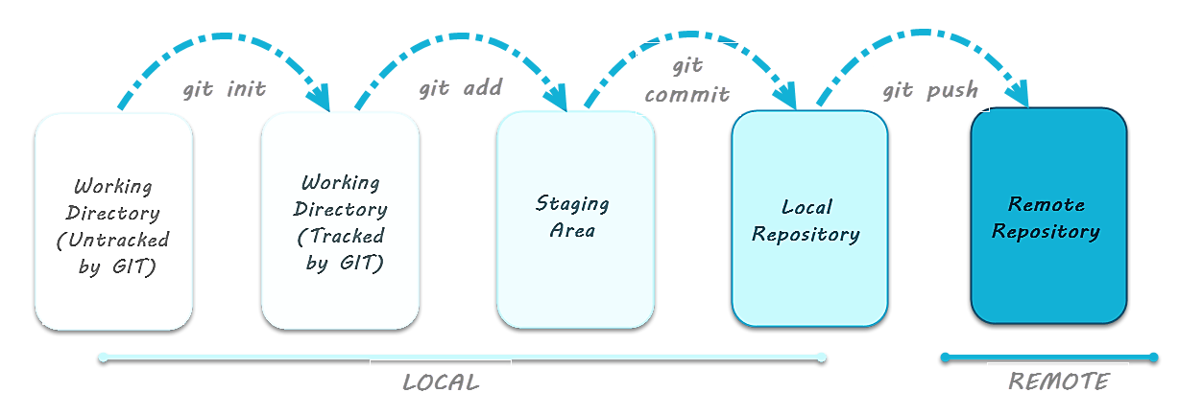
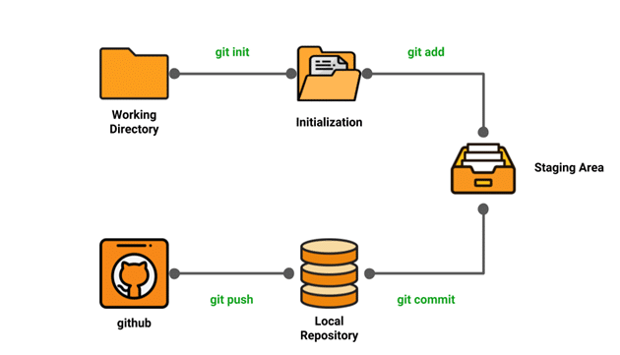
Git Lifecycle
Local working directory: First stage of a Git project lifecycle is the local working directory where your project resides, which may or may not be tracked.
Initialization: To initialize a repository we give the command Git init. With this command, we have made the Git aware of the project file in our repository.
Staging area: Now that our source code files, data files, configuration files are being tracked by Git we will add the files that we want to commit to the staging area by Git add command. This process can be also called as indexing, we can also say that index constitutes of files added to the staging area.
Commit: Now that our files that need to be committed are ready, we will commit them using Git commit -m “your message”.
We have successfully committed files to our local repository. But how does it help in our projects? The answer is, when we will be doing collaborative projects, files may need to be shared with our team members. That is when the next stage of Git lifecycle occurs, which is GitHub, where we publish files from local repository to remote repository. And how do we do that? We do that by using Git push command.

Slide 7
Environment Setup
Before going to learn git we need to do following steps.
Create a GitHub account
Install & Configure Git
Creating a local repository
Create a GitHub Account:
Go to https://Github.com
Create one GitHub account
Login
Install & Configure Git:
Linux: yum –y install git
Windows: Download Git SCM package and install
Configure Git:
Configure your git username and email using the following commands. These details will be associated with any commits that you create:
$ git config --global user.name "example"
$ git config --global user.email "example@example.com"
Creating a Local Repository:
Go to the Git terminal or Linux server and Create the Local Directory.

Slide 8
Git Commands
We will divide the Git commands into two primary categories.
Local- Git init, Git touch, Git status, Git add, Git commit, Git rm
Remote- Git remote, Git pull, Git push
Local Commands:
Git init: Use the Git init command to initialize a Git repository in the root of the folder
touch: To add files to a Project touch can be used. Let us see how we add a file to the Git repository we have just created Step-1: First, we will create a new file with command touch. Step-2: Then, we will see the files present in our master branch.
Git status: After creating the new file, you can use the Git status command and see the status of the files in the master branch.
Git add: Now we will add the humble.txt file to the staging environment by using Git add before going ahead to the staging and see the change using Git status.
Git commit: There you go you have successfully created your first commit.

Slide 9
Git Commands
Git clone:
remote commands like remote, push, pull in Git, but for that, we will have to create a new repository in our GitHub account: Step-1: Go to your GitHub account. Step-2: Create a new repository.
Remote Commands:
To push an existing repository to remote repository from a command line follow the commands given below.
Git remote:
Push:
Git push origin EnterBranchName Don’t get confused by the word origin. Let me tell you what exactly that command is referring to: Instead of writing the whole Git URL, like: Git push Git@Github.com:Git/Git.Git yourbranchname we can give the following command: Git push origin yourbranchname.
Pull:
When it comes to syncing remote repository pull command comes in handy. Let us take a look at the steps that leads to pulling operation in Git.
remote origin
pull master

Slide 10
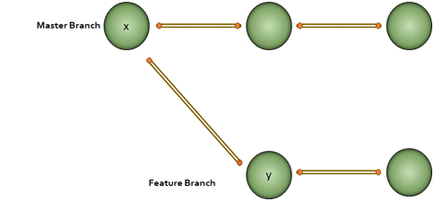
Git Commands
Branching:( Git checkout, Git branch)
Now that we are a bit familiar with let’s take a step further and discuss one of the most important operations of Git branching.
Branching:
For instance, if you are on the master branch and want to create a new branch to add a feature in the main project. Step-1: Run Git checkout -b <new branch name> Step-2: Use Git branch now to confirm that your branch is created
Note: Now, you must be wondering how to change branch in git to master branch right? Use the following command: git checkout master

Slide 11

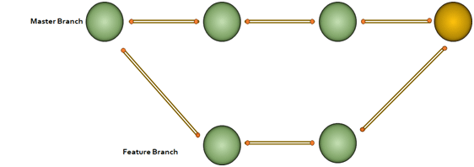
Git Commands
Merging: (Git checkout, Git add, Git log, Git merge, merging conflicts, rebasing):
Now that we have learned how to create a branch and work on a branch, let us take a look at merge feature of Git by merging a branch into the master branch. Further in this git tutorial, let’s understand merging with an example. Say, we have a master and a feature branch.
Merging git The merge commit represents every change that has occurred on feature since it branched from master.
Note: Even after merging we can go on with our work on both the master and feature branch independently. Let us see how to perform merging using Git bash: Step1: Create a new branch called branch2
Step2: create a new file in that branch.
Step3: Add changes from all tracked and untracked files Note: refer the following command Git add attributes

Slide 12
Git Commands
In our case, we have given the command as Git add -A and after that, we will commit one sentence as shown below in this git tutorial.
Step4: Check the last 3 logs by giving the command as Git log -3
We have created another branch on our master branch. Now we will see how to perform merging.
But before that we let us get inside the master branch, by giving the following command
Git checkout master.
After that, we will perform merging by
Git merge branch2
Now we have successfully merged the branch into master. Let us take a look at how it looks inside the master branch using the following command.
Git log –graph:
Here you can see the graph with commits on both master and developers branch. Red parts of the graph indicate merging operation. Merging Advantage:
Merging allows parallel working in a collaborative work.
Saves the time of manual merging
Merging Disadvantage:
Merging conflicts may occur.
Now that we have successfully learned to branch and merge with Git and GitHub. Now in this git tutorial, let us look at another very important Git operation i.e. rebasing.

Slide 13
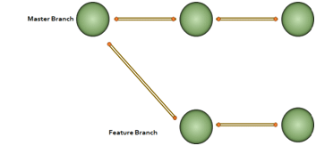
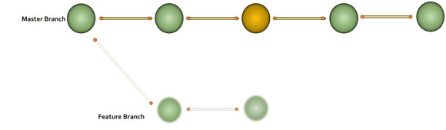
Git Commands
Git Rebase:
When the project becomes relatively large, the commit log and history of the repository becomes messy. So, we use rebasing. Rebasing will take a set of commits, copy them and store them outside your repository. That helps us maintain a linear sequence of commits in our repository. Now in this Git Tutorial, , let us take the same example of master and feature branch. Here, we will rebase master branch. And see what happens.
Note: In rebasing the base of feature branch gets changed and the last commit of the master branch becomes the new base of the feature branch.

Slide 14
Git Commands
Now let us perform rebasing in Git bash.
Advantage of rebasing:
cleaner project history
Disadvantage of rebasing:
For collaboration workflow re-writing project history can be potentially catastrophic.
Now that we understood what merging and rebasing is in this git tutorial, let us see where to use merge and where to use rebasing.
Golden rule of Git merging and rebasing: When to use git merge:
Use merge while working on public branches
When to use git rebase:
Use rebase while working on local branches
As we have mentioned earlier in this git tutorial, one major disadvantage of merging is merge conflicts, which can be a backbreaking work during a team project. Let us understand how merge conflict occur and how to resolve this issue.

Slide 15
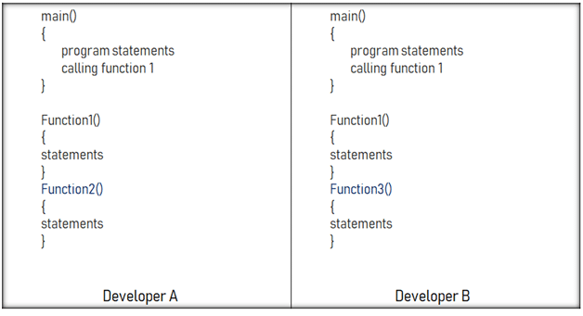
Git Commands
Git Merge Conflict:
This drawback of merging operation in Git can be explained with a simple example shown below.
Say, we have two branches of the master branch, branch1, and branch2. And two developers working on these two branches independently on the same code file. As we have shown in the figure above, they have made below mentioned modifications:
Developer-A added a function called function2 in our main code.
Developer-B added a different function called function3 to the same code file.
How to merge these two modifications now? That is where our merging conflict occur.

Slide 16
Git Commands
Solving merging conflicts:
Manually resolve it in merging tool.
File locking doesn’t allow different developers to work on the same piece of code simultaneously. It helps to avoid merge conflicts, but slows down development.
Similarly rebasing has rebasing conflicts as well, which can also be solved with the help of Git merging tool. Let us look at a few Git workflows briefly, before we end this tutorial, so that you get an idea which Git workflow to choose for your team project.

Slide 17
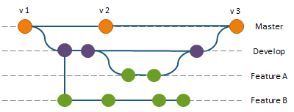
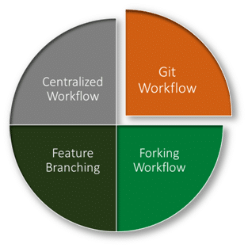
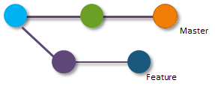
Comparing Git Workflows:
Why is it important to choose the right Git workflow for team project? Depending upon the team size, choosing the right Git workflow is important for a team project to increase the productivity.
Now in this git tutorial, let us look at different Git workflows:
Centralized workflow: In Git centralized workflow, only one development branch is there, which is called master and all changes are committed into that branch itself.
Feature Branching Workflow: In feature workflow, feature development takes place only in a dedicated feature branch.
Git Workflow: In case of Git workflow, instead of a single master branch, this workflow uses two branches. Here, master branch stores the official release history whereas our develop branch acts as an integration branch for features.
Forking Workflow: In case of forking workflow, contributor has two Git repositories: one private local and one on public server-side.

Slide 18
Ques & Ans
What is DevOps?
Our team has some ideas and wants to turn those ideas into a software application. Now, as a manager, I am confused about whether I should follow the Agile work culture or DevOps. Can you tell me why I should follow DevOps over Agile?
In terms of development and infrastructure, mention the core operations of DevOps.
What are some technical and business benefits of DevOps work culture?
Name some of the most important DevOps tools?
What is CI? What is its purpose?
Name three important DevOps KPIs.
What is the difference between continuous deployment and continuous delivery?
What is DevOps? Is it a tool?
What are the core operations of DevOps in terms of development and infrastructure?
Can one consider DevOps as an Agile methodology?

Slide 19
Ques & Ans
1. What is DevOps?
Characteristics | DevOps
Basic premise | A collaboration of development and operations teams. It is more of a cultural shift.
Related to | Agile methodology
Priorities | Resource management, communication, and teamwork
Benefits | Speed, functionality, stability, and innovation
2. Our team has some ideas and wants to turn those ideas into a software application. Now, as a manager, I am confused about whether I should follow the Agile work culture or DevOps. Can you tell me why I should follow DevOps over Agile?
According to the current market trend, instead of releasing big sets of features in an application, companies are launching small features for software with better product quality and quick feedback from customers, for high customer satisfaction. Now, to keep up with this, we have to:
Increase the deployment frequency in the safest and reliable way
Lower the failure rate of new releases
Shorten the bug resolution time
DevOps fulfils all these requirements for fast and reliable development and deployment of a software. Companies like Amazon and Google have adopted DevOps and are launching thousands of code deployments per day. But Agile, on the other hand, only focuses on the development of a software.

Slide 20
Ques & Ans
3. In terms of development and infrastructure, mention the core operations of DevOps.
Core operations of DevOps include:
Development
Version Control
Testing
Integration
Deployment
Delivery
Configuration
Monitoring
Feedback
4. What are some technical and business benefits of DevOps work culture?
Technical benefits:
Continuous software delivery
Less complex problems to fix
Faster bug resolution
Business benefits:
Faster delivery of features for customer satisfaction
More stable operating environments
More time available to add product value

Slide 21
Ques & Ans
5. Name some of the most important DevOps tools?
Git
Maven
Selenium
Jenkins
Docker
Puppet
Chef
Ansible
Nagios
6. What is CI? What is its purpose?
CI or Continuous Integration is the process of compiling the entire code base, every time a member of the software development team checks the code, into the shared source code repository.
If a team member checks into the code file with a bug, then the build gets broken. In this sort of scenario, other developers can’t synchronize the shared source code repository without introducing compilation errors into their own local workspaces. Thus, collaborative and shared software development cannot go forward.
When a CI build breaks, it is crucial that the problem is corrected immediately. A CI process often includes a suite of unit, and integration and regression tests that run every time the compilation succeeds. If any of these tests fail, the build will be considered unstable, not broken.

Slide 22
Ques & Ans
7. Name three important DevOps KPIs.
Three of the most common DevOps KPIs are:
Mean time to failure recovery
Deployment frequency
Percentage of failed deployments
8. What is the difference between continuous deployment and continuous delivery?
Continuous deployment is fully automated, and the deployment to production needs no manual intervention in continuous deployment; whereas, in continuous delivery, the deployment to production requires some manual intervention for change management in the organization, and it needs to be approved by the manager or higher authorities to be deployed in production. According to your organization’s application risk factor, continuous deployment/delivery approach will be chosen.
9. What is DevOps? Is it a tool?
DevOps can’t be referred to as a tool; it is a collaborative work culture that combines development and operations teams for continuous development, continuous testing, continuous integration, continuous deployment, and continuous monitoring.
10. What are the core operations of DevOps in terms of development and infrastructure?
The core operations of DevOps are application development, version control, unit testing, deployment with infrastructure, monitoring, configuration, and orchestration.
11. Can one consider DevOps as an Agile methodology?
DevOps can be considered as complementary to the Agile methodology but not completely similar.

