Slide 1
Blockchain - A Revolution?
Platinum Trading Institute

Slide 2
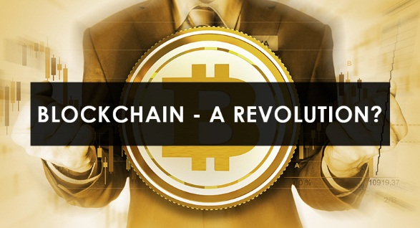
Blockchain - A Revolution?
The entire world was swept off its feet with the evolution of Blockchain Technology.
The profundity of the technological shift would certainly bring a dramatic change in the way the world does business.
The technology stayed instrumental in empowering digital currency-Bitcoin.

Slide 3
What’s new in this technology?
The new technology keeps the user’s information confidential as the Blockchain does the vetting and keeps the permanent public record of all the transactions.
Giving complete security to its users, the world looked for an alternative that could faultlessly performed peer-to-peer transactions sans any intermediary like a bank or governing body.

Slide 4
Interesting, right?
This is just a sneak preview of the full presentation. We hope you like it! To see the rest of it, just click here to view it in full on PowerShow.com. Then, if you’d like, you can also log in to PowerShow.com to download the entire presentation for free.

