Slide 1
BLOCKCHAIN
--Distributed Ledger

Slide 2
Introduction
Staurt Haber & Stornetta release white paper(it includes what is blockchain & how to works)
Blockchain 1.0
In 2009,Satoshi Nakomoto implemented crypt currency( bitcoin) using blockchain technology
Blockchain 2.0
In 2015,Vitalik Buterin developed decentralised application using blockchain technology
Blockchain 3.0
IBM started developing Hyperledger Fabric

Slide 3
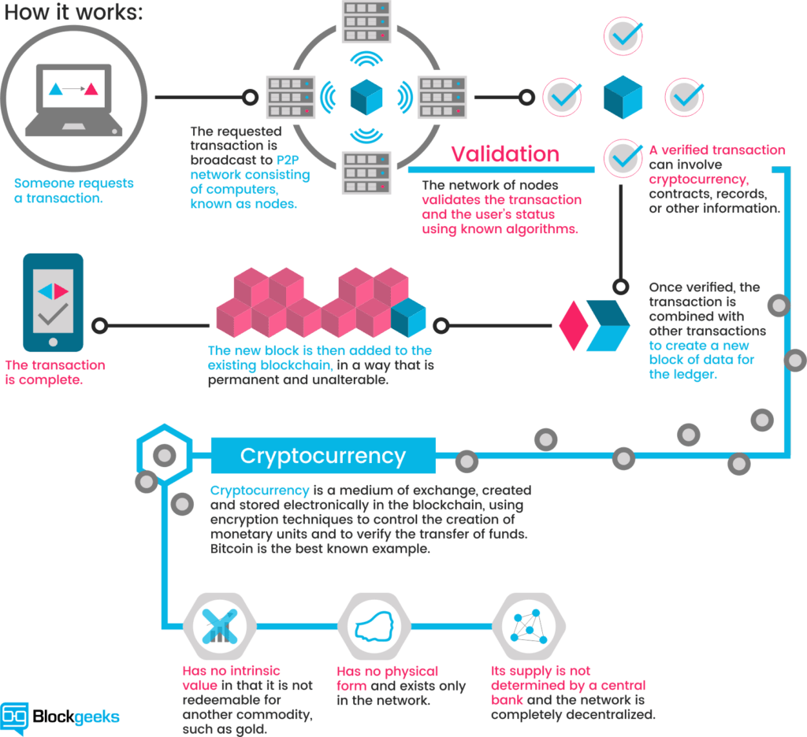
Transaction using Blockchain

Slide 4
How the blocks are stored in blockchain
Blockchain is a collection of blocks
Block also stores reference to previous block
Block also stores timestamp
Block0 hash Block1 hash Block2 hash

Slide 5
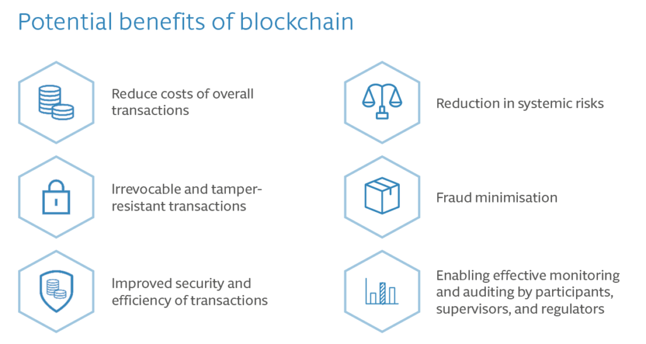
Benefits

