Slide 1
CKS

Slide 2
Find Certificate
We will look to find certificate
CA
Api server cert
Etcd server cert
Api-etcd
Scheduler api
Control manager-api
Kubelet –api
Kubelet server cert

Slide 3
Containers under the Hood
Container and Images
Namespace and cgroup
Scenarions

Slide 4
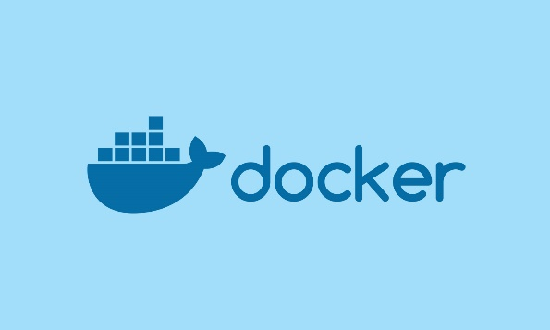
Container and Images
Docker build
Docker run
Dockefile
Image
Container
Script/text file how to build an image
Docker push
Docker pUll
Multi Layer Binary represent of state
Running instance of the Image
Repo

Slide 5
Container
Collection of one or multiple application
Include all its dependency
Just a process which run on the Linux Kernal
But which cannot see everything

Slide 6
Kernel Vs User Space
Application
Library
Syscall interface
Linux Kernal
Hardware

Slide 7
Technical Overview: Contianer and system calls
App1 Process
Kernal
Hardware

Slide 8
Technical Overview: Contianer and system calls
App2 Process
App1 Process
System Call
Kernal
Hardware

Slide 9
Linux Kernal Namespace
Namespace are for Isolation
Restrict access to mount or root filesystem
PID
Mount
Network
User

Slide 10
Demo Docker Isolation in action
Create Two Container and check they cannot see each other
Then run them in the same namespace

Slide 11
Cluster Reset
Every New Section work with a fresh Cluster

Slide 12
NetworkPolicies
Default Deny
Secanarion
Firewall Rule in K8s
Implement by the network plugins CNI(Calico/Weave)
Namespace Level
Restrict the ingress or egress for a group of pods based on certain rules and condtions

Slide 13
Without Network Policy
By default every pod can access every poid
Pod are not isolated

Slide 14
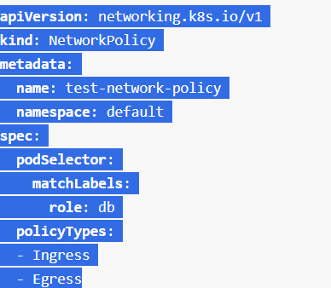
NetworkPolicy
Valid policy
Denies all outgoing and incoming traffic in the default namespace

Slide 15
Immutability of the container at runtime
Immutability
Container and Pod Level Enforcement
Scenario to Ensure Pod Containers are immutable

Slide 16
Immutability
It means container will not be modified during lifetime

Slide 17
Immutability
Mutable
Immutable
Ssh on vm instance
Stop application
Update application
Start application
Create a new vm image
Delete vm instance
Create new vm instance

Slide 18
Immutability
Mutable
Immutable
We always know the state of the contianer
Ssh on Container instance
Stop application
Update application
Start application
Create a new container image
Delete container instance
Create new container instance

Slide 19
Immutability
Immutable
We always know the state of the contianer
Advance Deployment Method
Easy Rollback
More Reliability
Better Security on Container
Create a new container image
Delete container instance
Create new container instance

Slide 20

Enforce On Container Image Level
Remove Bash Shell
Make File System Reade Only
Run as User and non Root
But what is we have no control of the container?
Or if we are too lazy?
We can do the same in K8s

Slide 21
Make Manual Changes to container – Command?
Pod Startup timeline
Pod
Starts
App Container
starts
App Containers
RUns
Command: chmod a-w –R / && nginx

Slide 22
Make Manual Changes to container – StartupProbe
Pod Startup timeline
Pod
Starts
App Container
starts
App Containers
RUns
Once you put startup probe there will be no readiness probe and liveness probe will be executed
Startupprobe
runs
Our startup probe will run a
Command: chmod a-w –R/

Slide 23
Enforce Read-Only Root FileSystem
Enforce Read Only Root filesystem
Using SecurityContexts and Pod Security Policies

Slide 24
Move logic init container
Pod Startup timeline
Pod
Starts
Init Container
Start
App Containers
Start
Read
An application required before initialized it want cache to be done
ReadWrite
Volumes

Slide 25
Startup Probe for immutability
Use startup probe to remove touch and bash from a container

Slide 26
RBAC
With RBAC it should be ensured that only certain people can even edit pod specs

Slide 27
CKS
Auditing

Slide 28
Auditing
Introduction
Setup and configure Audit Logs
Use Audit Logs to investigate access history

Slide 29
Audit Logs Introduction
Api request
Create pods
Kubernetes API
New Image for deployment
Read Secret
Audit Logs
History Api Request

Slide 30
Audit Logs Introduction
Did someone access an important secret while it was not protected
When was the last time that user X did access cluster Y?
Does my CRD work properly?

Slide 31
Audit Logs Intro
Api Requests
Kubernetes API
Audit Logs
Request Received
Response Started
Respnse Complete
Panic
Stages

Slide 32
API Request Stages
Each requests can be recorded with an associate stage the known stage are
RequestReceived- the stage for events generated as soon as the audit handles receive the request and before it is delegated down he handler chain
ResponseStarted: once the response headers are sent but before the response body is sent. The stage is only generated for long running request(watch)
ResponseCompleted: the response body has been completed and no more bytes will be sent
Panic: event generated with a panic occured

Slide 33
Audit Logs Intro
Lots of data being generated
Api Requests
Kubernetes API
Audit Logs
Request Received
Response Started
Respnse Complete
Panic
What event should be recorder and what data should these contians
Stages

Slide 34
Audit Policy – What data to store
What event should be recorder and what data should these contains?
None: don’t log events that match this rule
Metadata: log request metadata (request user
Timestamp resource web etc. But not request of response body
Requests- log event metadata and request body but not response body. This will not apply for non resource requests
RequestResponse: log event metadata requests and response bodies. This will not apply to non-resource requests
Audit policy rule level

Slide 35
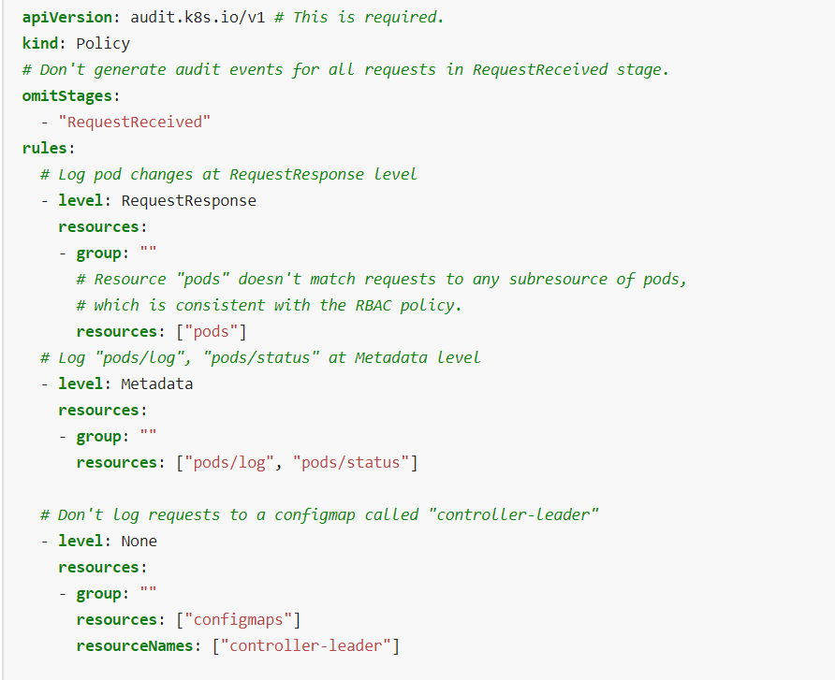
Audit Policy-what data to store
What event should be recorded and what data should it contains

Slide 36
Audit Backends: Where to store all the data
Audit Logs
Where to store all the data
Api Requests
Kubernetes API
Audit Logs
<Log(Json FIles)
ElasticSearch
FileBeat
Fluentd
Webhook(externalAPI)
Dynamic Backend(Audit Sink APi)

Slide 37
Audit Logs OverView
Lots of data being generated
Event Content
Pod Secret get deleted
Api Requests
Kubernetes API
Audit Logs
Request Received
Response Started
Respnse Complete
Panic
{None Metadata Request RequestResponse}
Levels
Stages

Slide 38
Setup Audit Logs
Configure apiserver to store Audit Logs in Json Format

Slide 39
Setup Audit Logs
Create a secret and investigate the Json audit log

Slide 40
Restrict amount of audit logs to collect
We want to restrict loggin data with an audit policy
Nothing from stage requestreceived
Nothing from get watch list
From secret only metadata level
Everything else requestresponse level
Change policy file
Disabled audit loggin in apiserver wait till restart
Enalbe audit logging in apiserverr wait till restart
If api server do not start check the logs in
/var/log/pods/kube-system_kube-apiserver*
Which will contains the details why our audit login is not enabled
Test your changes

Slide 41
Kernal Hardening Tools
Seccomp
Overview
AppArmor Docker and K8s
Seccomp Docker and K8s

Slide 42
Linux Kernal Isolation
Container Isolation
Namespace
Restrict What Process can see
1. other process
User
File System
Cgroups
Restrict the resource usage of process
RAM,DISK,CPU

Slide 43
Kernal Vs UserSpace
Firefox
Application
userspace
Curl
Libraries
glibc
Getpid()
libxyz
Reboot()
Syscall Interface
Kernal Namespace
Linux Kernal
Hardware

Slide 44
Kernal Vs UserSpace
Firefox
Application
userspace
Curl
Libraries
glibc
Getpid()
libxyz
Seccomp App Armour
Reboot()
Syscall Interface
Kernal Namespace
Linux Kernal
Hardware

Slide 45
Overview
AppArmor
Seccomp

Slide 46
App Armor
Filesystems
Other Processes
Networks

Slide 47

App Armor
Filesystems
Allow certain things and disallow everything
Other Processes
We can create a profile in app armour what my application can do and cannot do
We can create a profile for kubelet what it can do
Networks

Slide 48
AppArmor
Profile Modes
ENforce
Complain
UnConfined
Process Cannot Escape
Process can escape but it will be logged
Process Can eSCAPE

Slide 49
AppArmor Main Command
#show all Profiles
Aa-status
#generate a new profile (smart wrapper around aa-logprof)
Aa-genprof
#put profile in complain mode
Aa-complain
#put profile in enforce mode
Aa-enforce
#update a profile if app produced some more usage logs (syslog)
Aa-logprof

Slide 50
AppArmor Main Command
Setup Simple AppArmor Prfile for Curl
We will do the same in worker node

Slide 51
AppArmor with K8s
If you want to use apparmour with k8s
Container runtime need to support AppArmor
AppArmor need to be installed on every node
Apparmor profiles need to be available on every node
Apparmor profiles are specified per containers
Done using annotations

Slide 52
Create a Pod which uses an
POD
Worker node

Slide 53
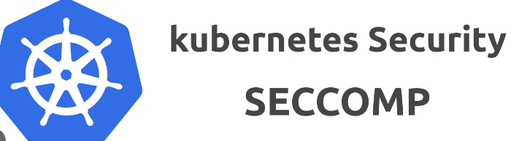
Seccomp
Secure computing mode
Secure facility in the linux kernel
Restrict Execution of syscalls

Slide 54
Seccomp
Exit()
Only calls to there allowed
Sigturn()
write()
read()
write()
exec()
getpid()
What kind of syscall we want to do suppose I want to disable exex and getpid

