Slide 1

Ansible: Next Gen Configuration Management and Provisioning
Gopal Das

Slide 2
Agenda
Why – Motivation for Use
What – Let’s Introduce
How – It Works
Reference

Slide 3
Why – Motivation for Use

Slide 4
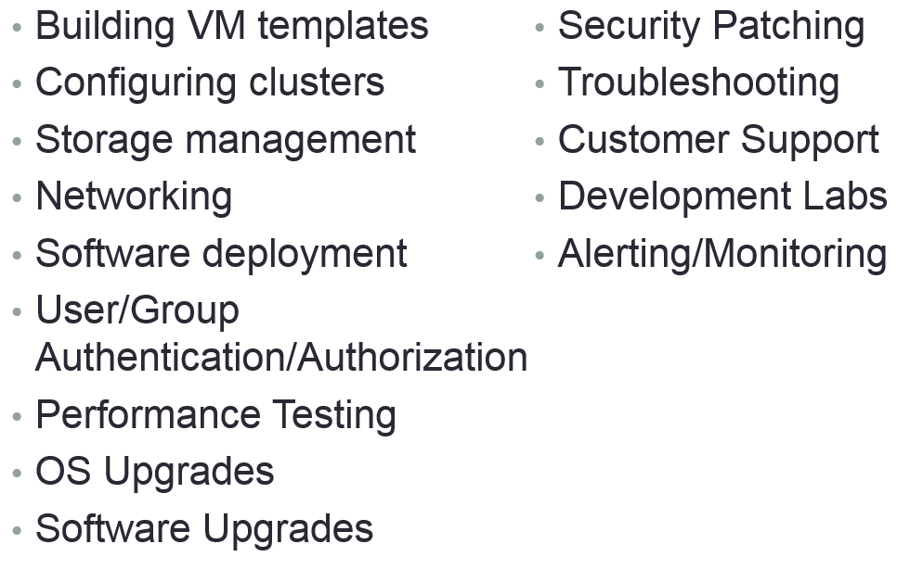
What Are You Doing

Slide 5
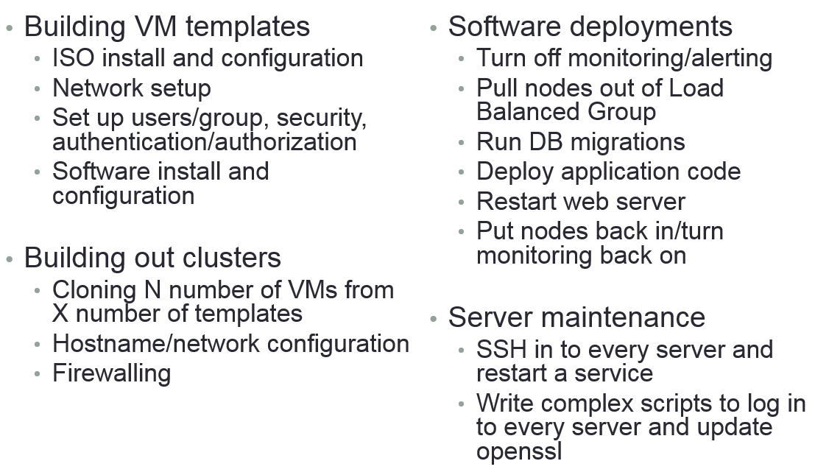
How Are You Doing

Slide 6
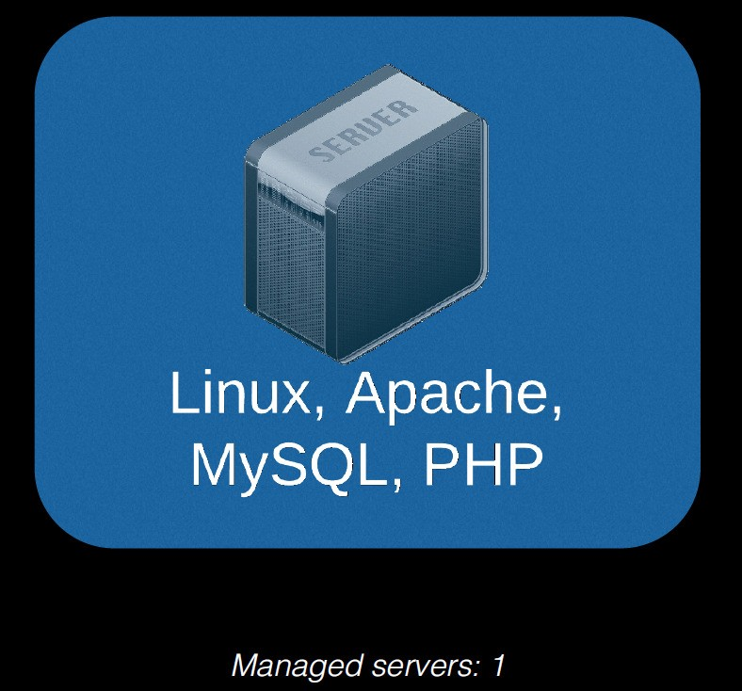
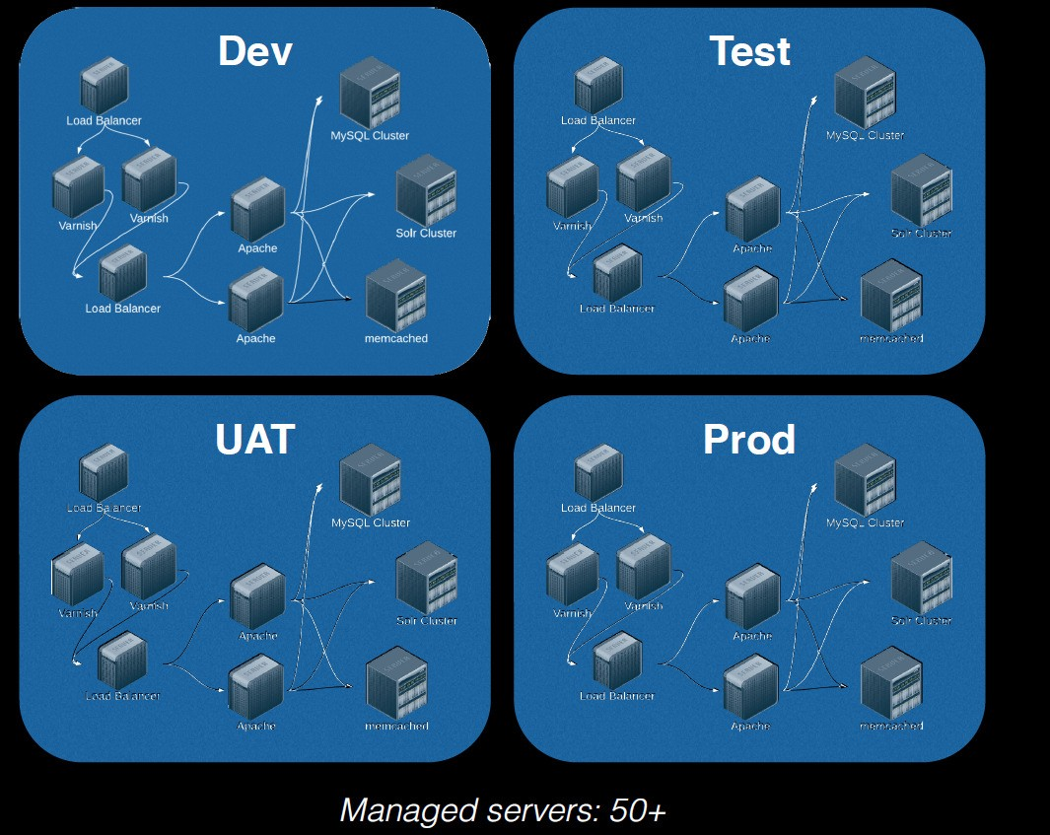

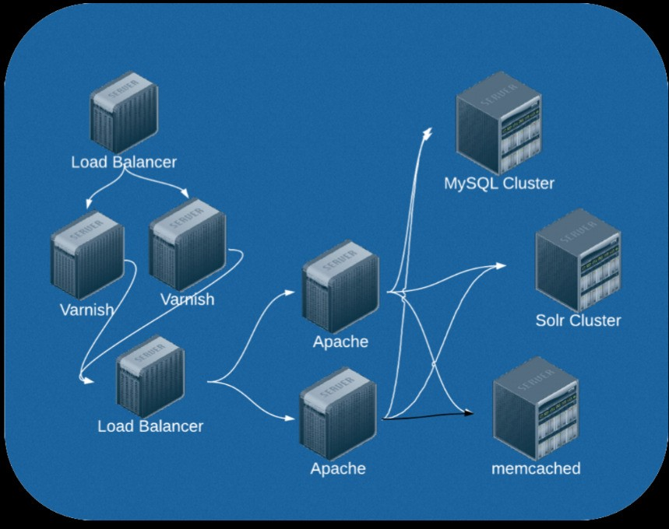

Requirement Scale-out

Slide 7
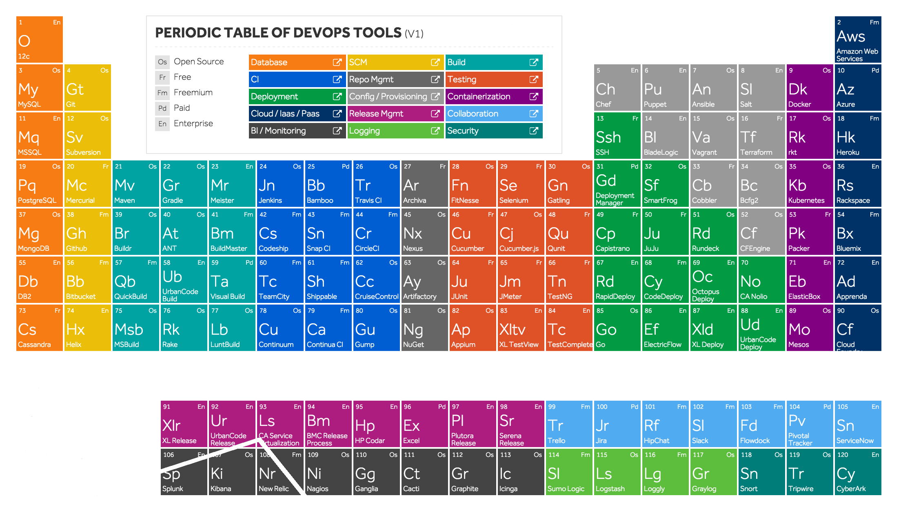

Slide 8


Slide 9
What – Let’s Introduce

Slide 10


Slide 11
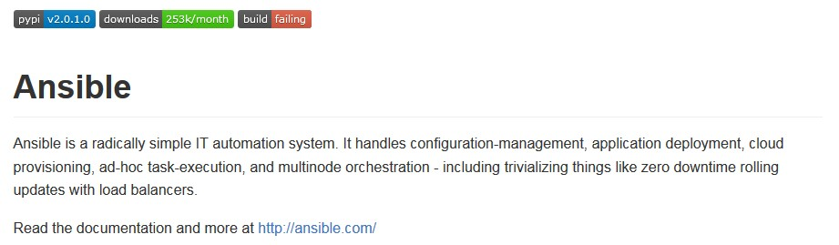
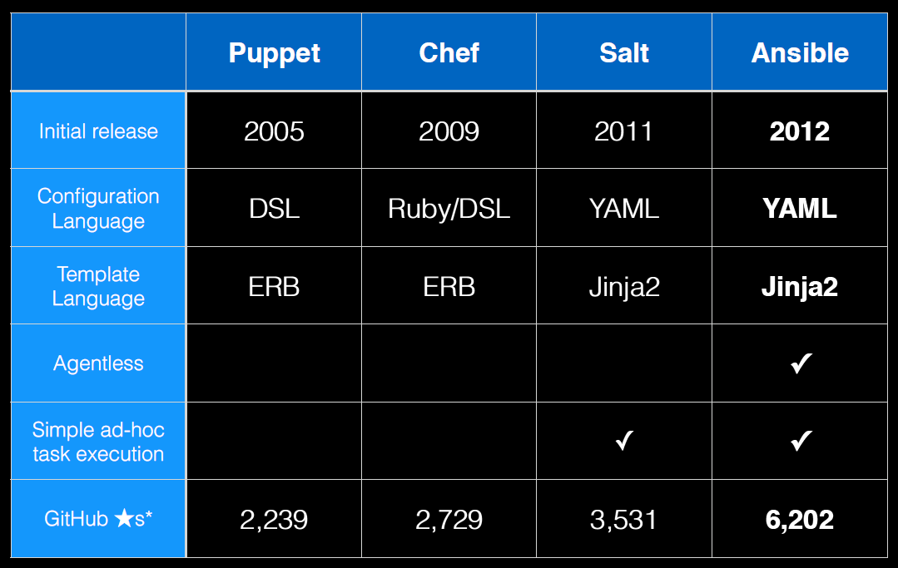

Slide 12
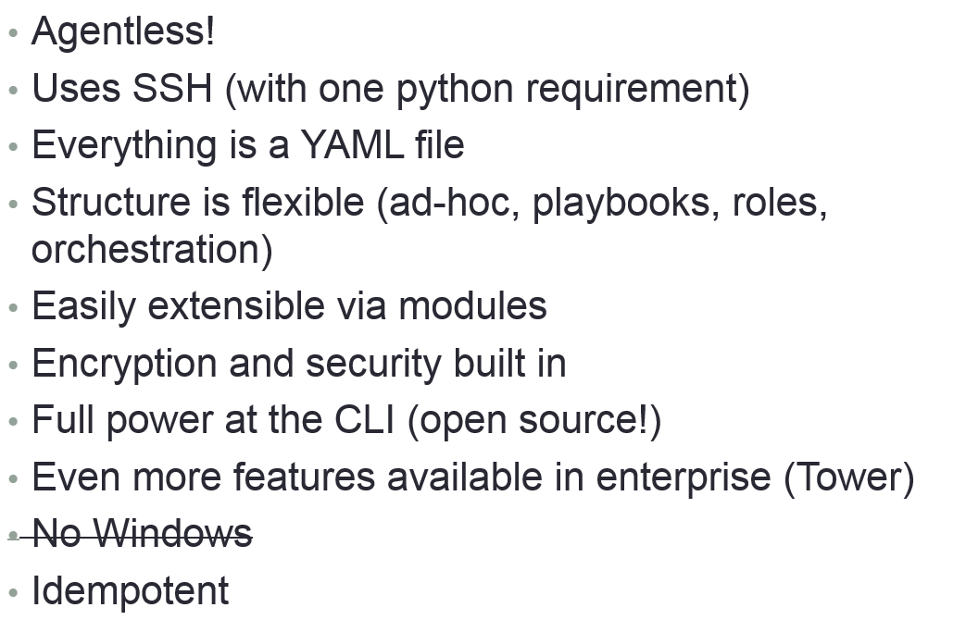
Features

Slide 13
How – It Work’s

Slide 14

Building Blocks
Ad-hoc Commands
Inventory
Playbook
Push Mode
Pull Mode
Tasks
Variables
Templates
Handlers
Roles
Modules

Slide 15
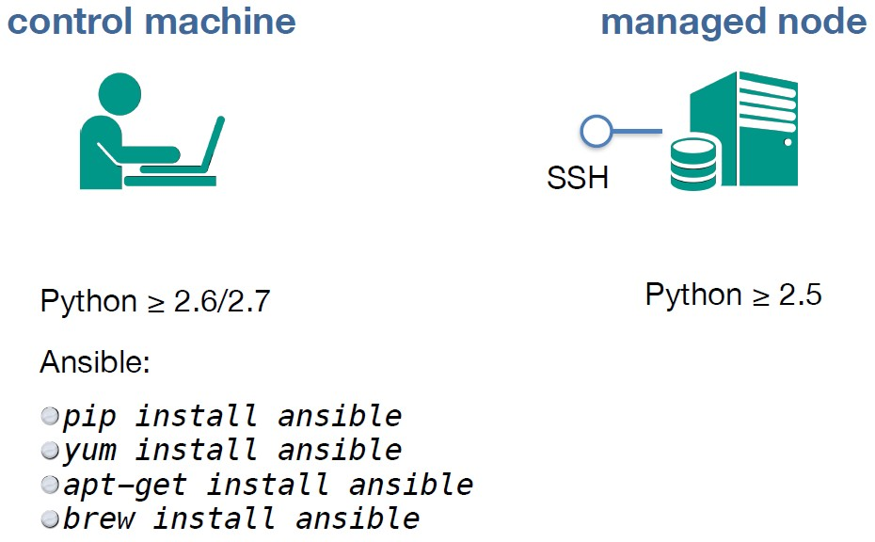
Ad-hoc Commands

Slide 16
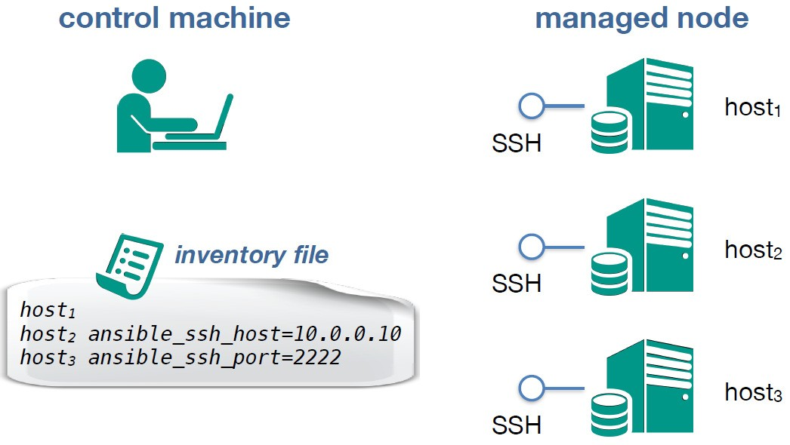
Ad-hoc Commands

Slide 17
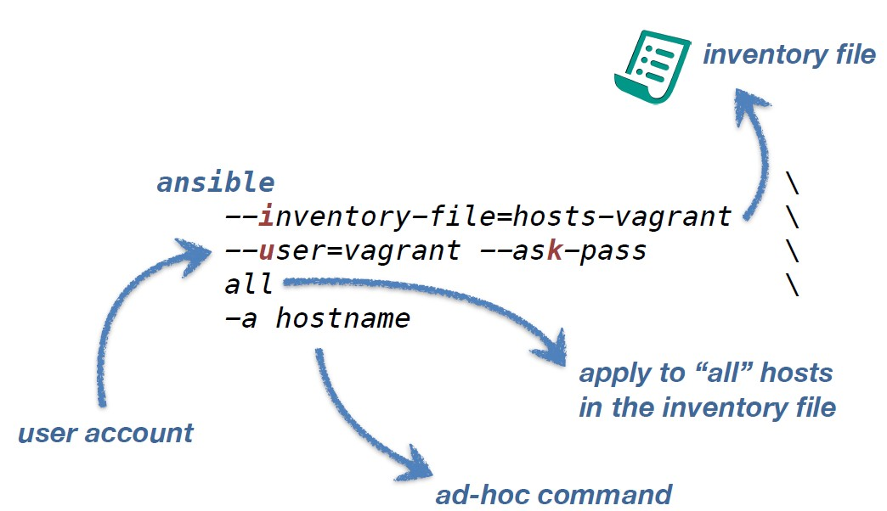
Ad-hoc Commands

Slide 18

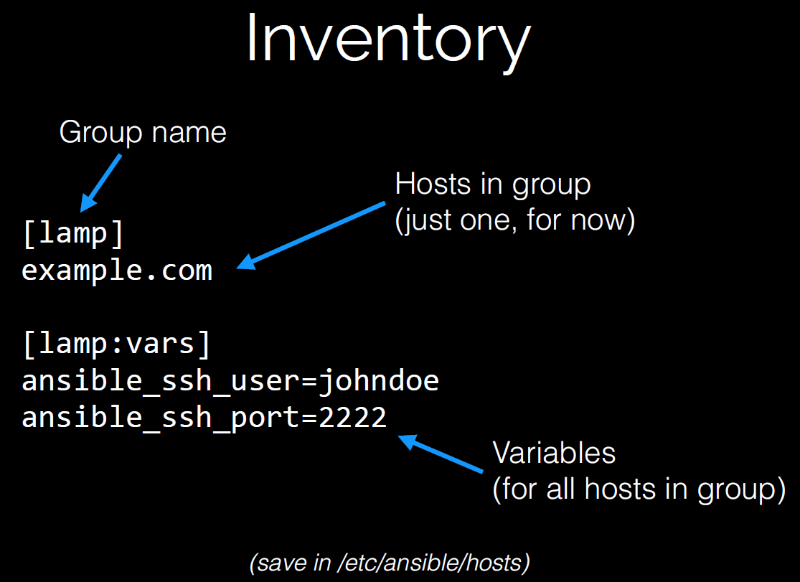
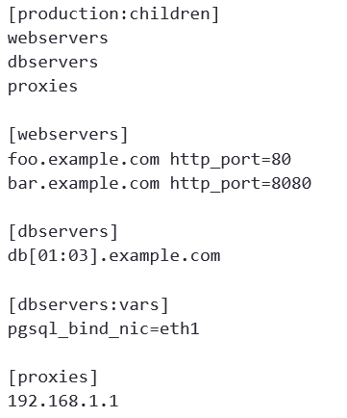
Inventory

Slide 19

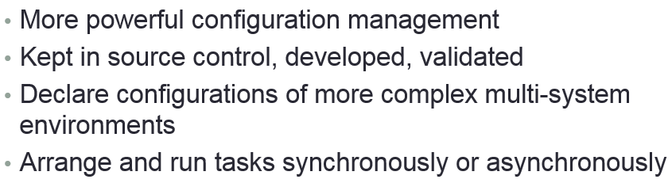
Playbooks

Slide 20
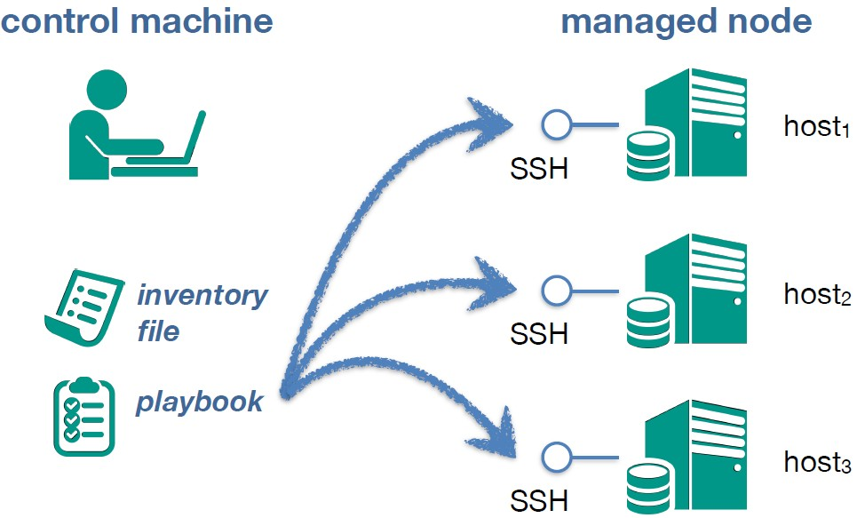
Playbooks – Push Mode

Slide 21
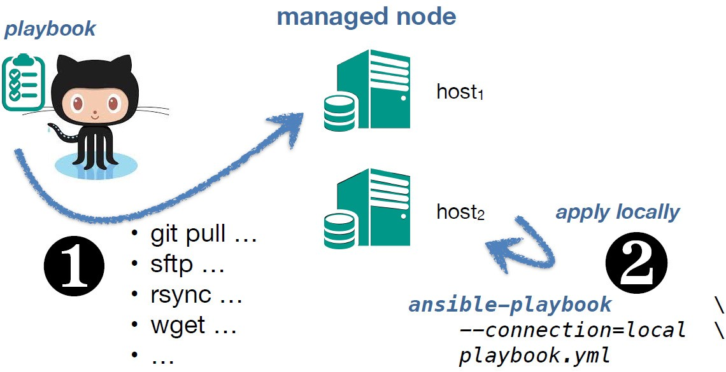
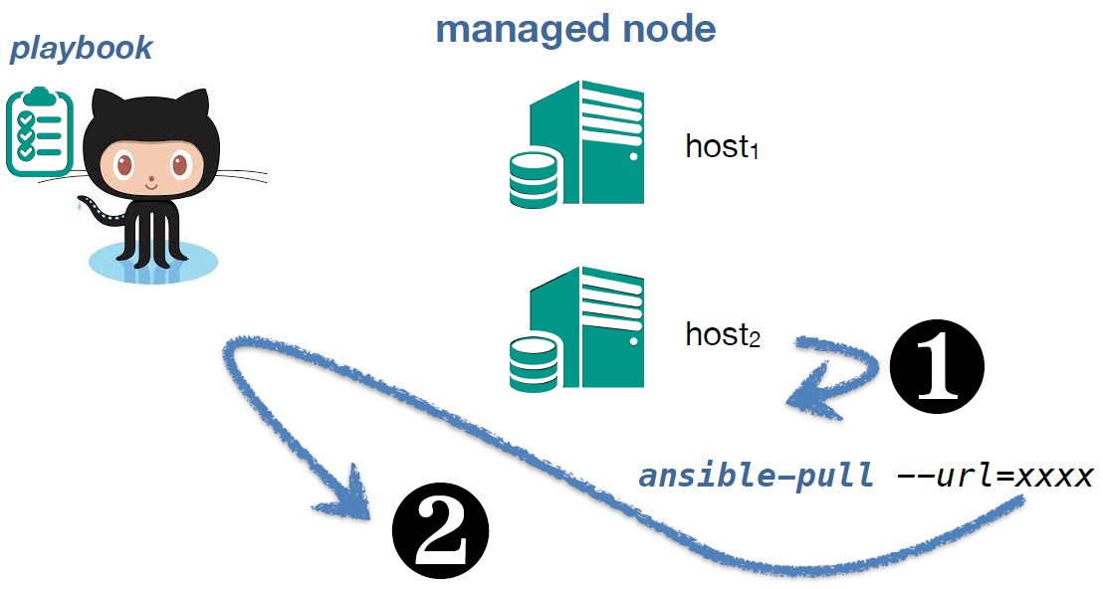
Playbooks – Pull Mode

Slide 22
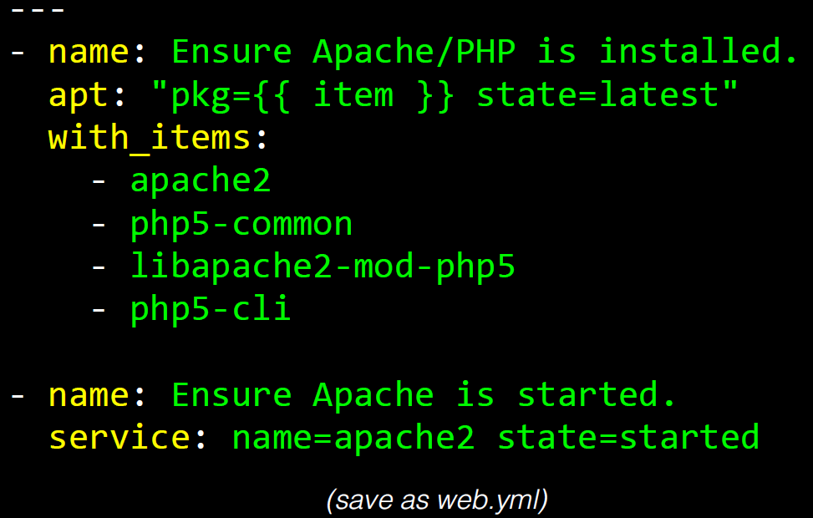
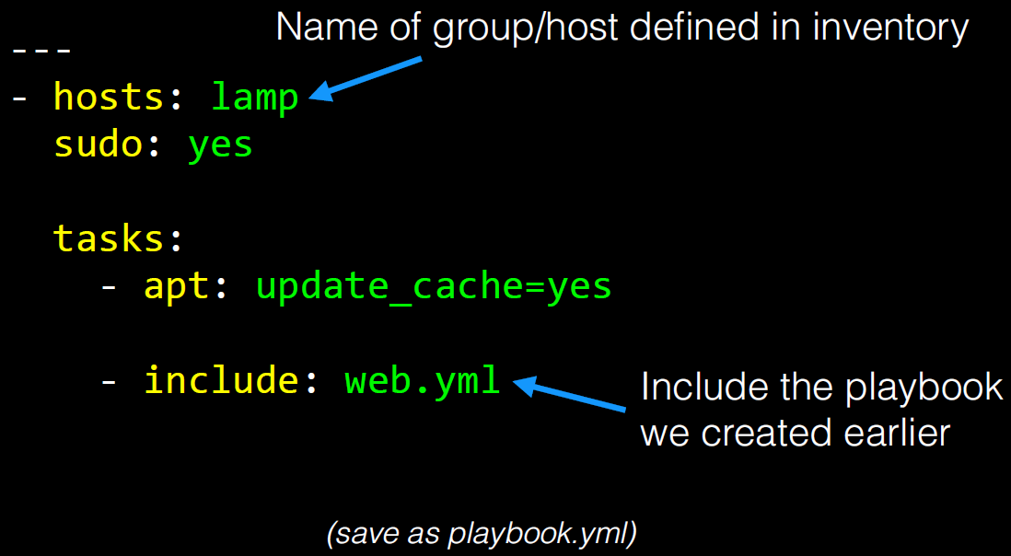
Playbook – Example

Slide 23
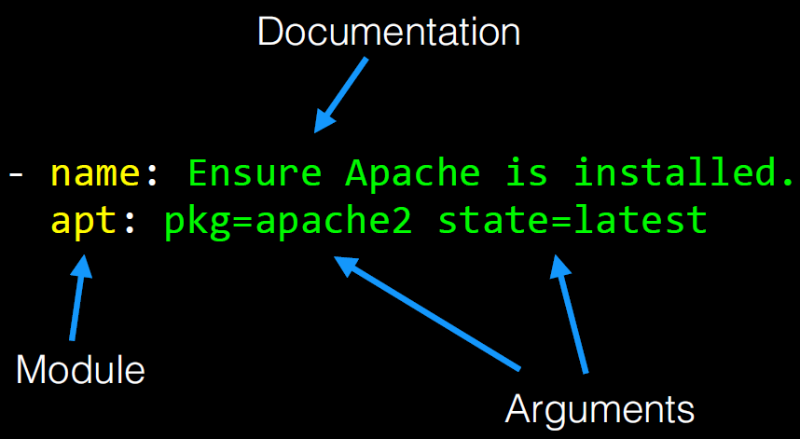
Playbook – Tasks

Slide 24
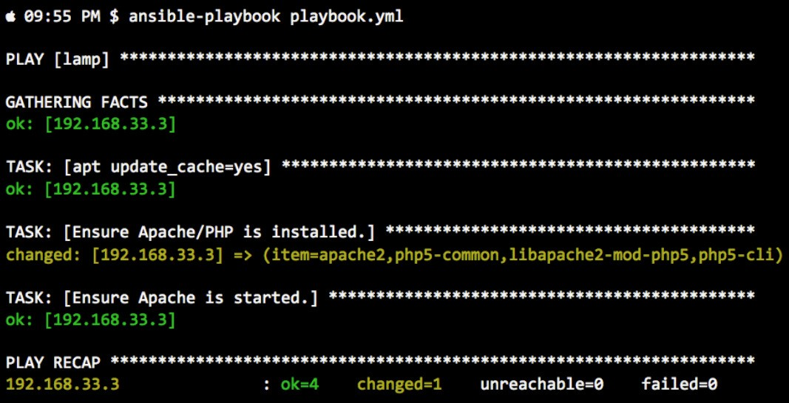
ansible-playbook run

Slide 25
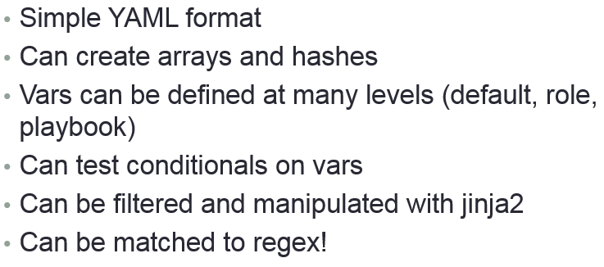
Playbook - Variables

Slide 26
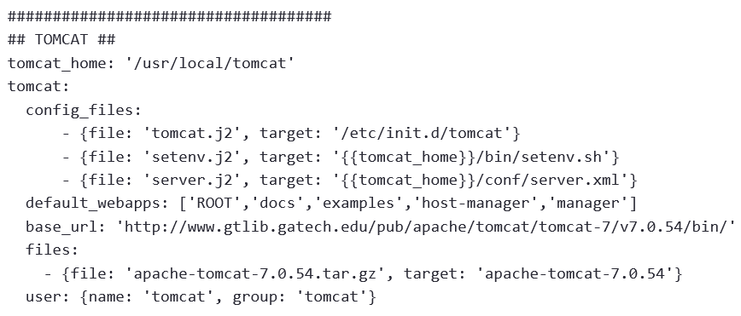
Variables - Example

Slide 27
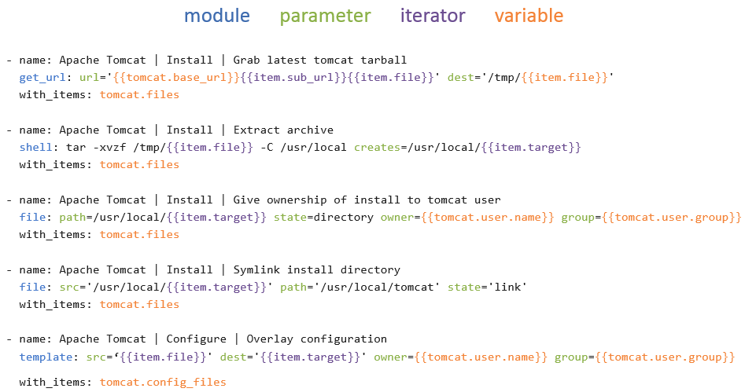
Variables - Example

Slide 28
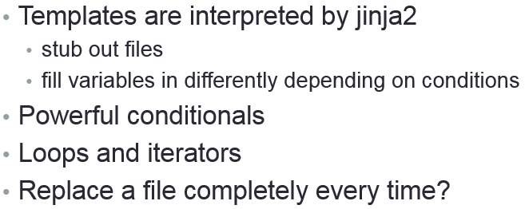
Playbooks - Templates

Slide 29
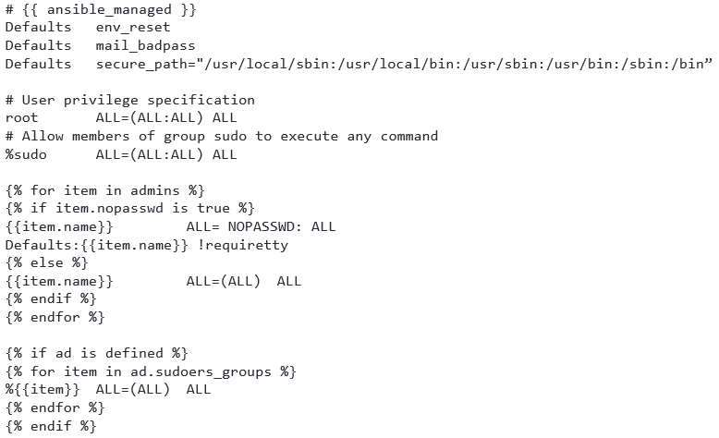
Templates – sudoers Jinja2 template

Slide 30
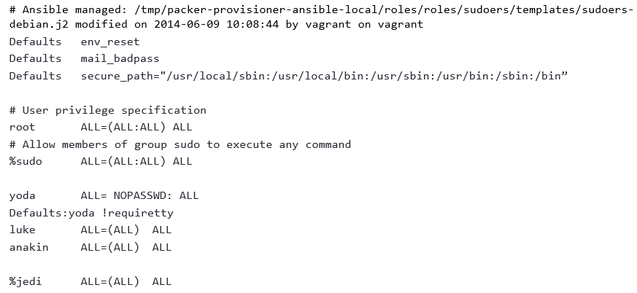
Templates – sudoers file after expansion

Slide 31
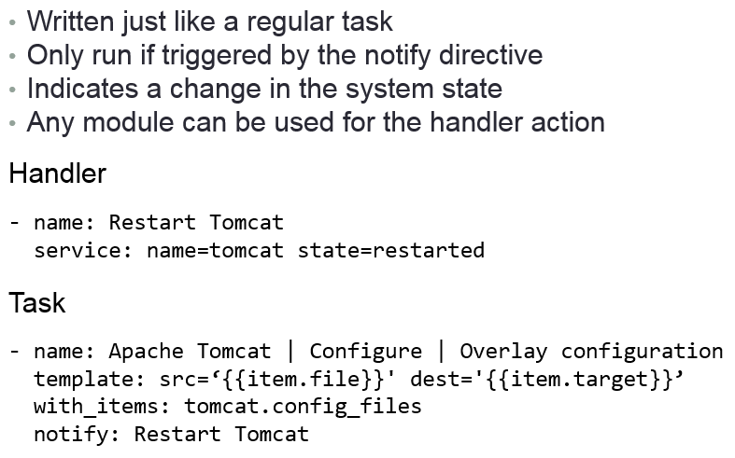
Handlers

Slide 32
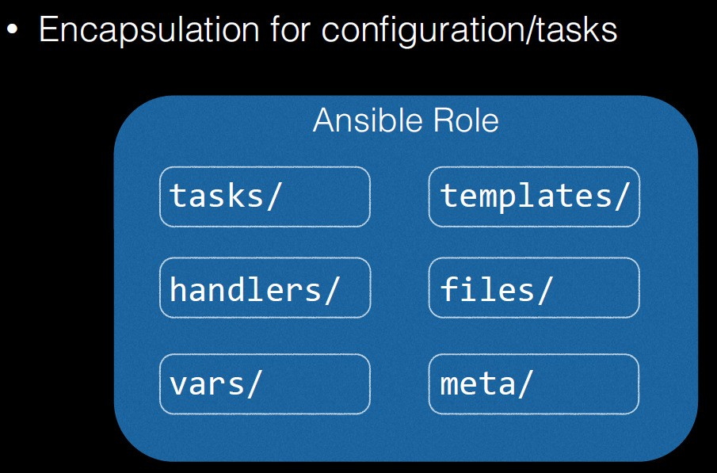
Roles

Slide 33
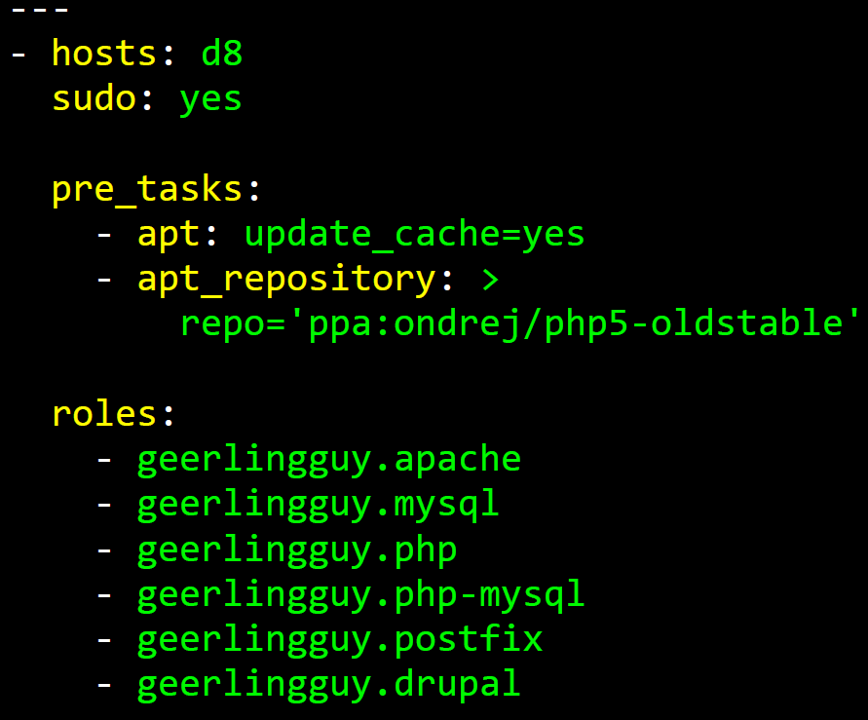
Roles

Slide 34
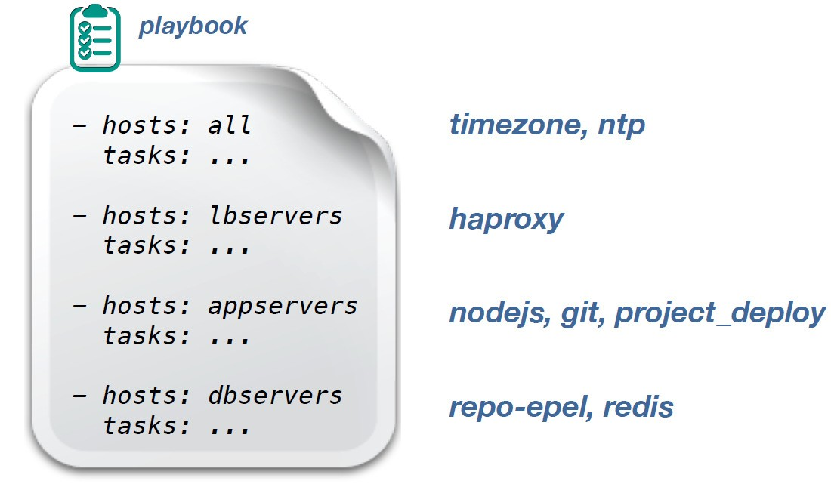
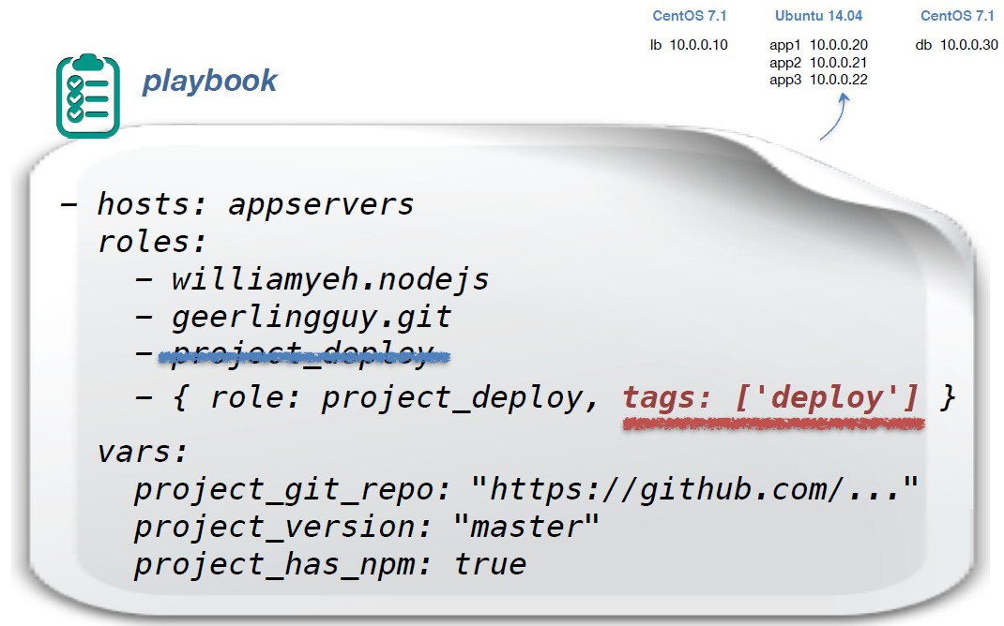
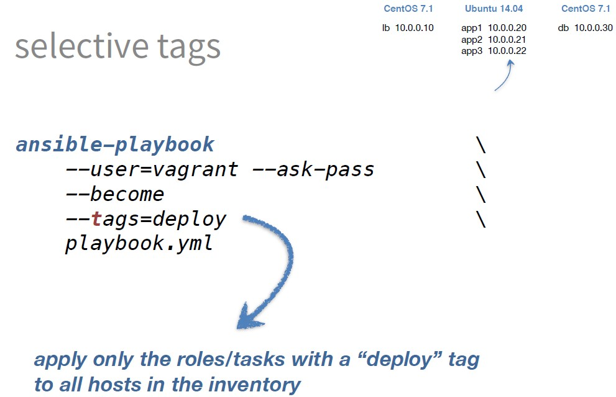
Generalization v/s Specialization (Tasks and Roles)

Slide 35
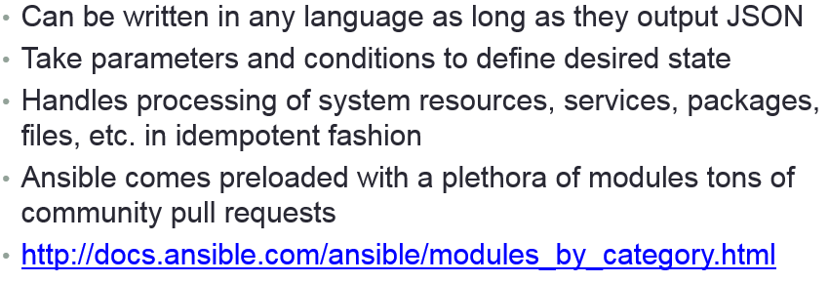
Modules

Slide 36
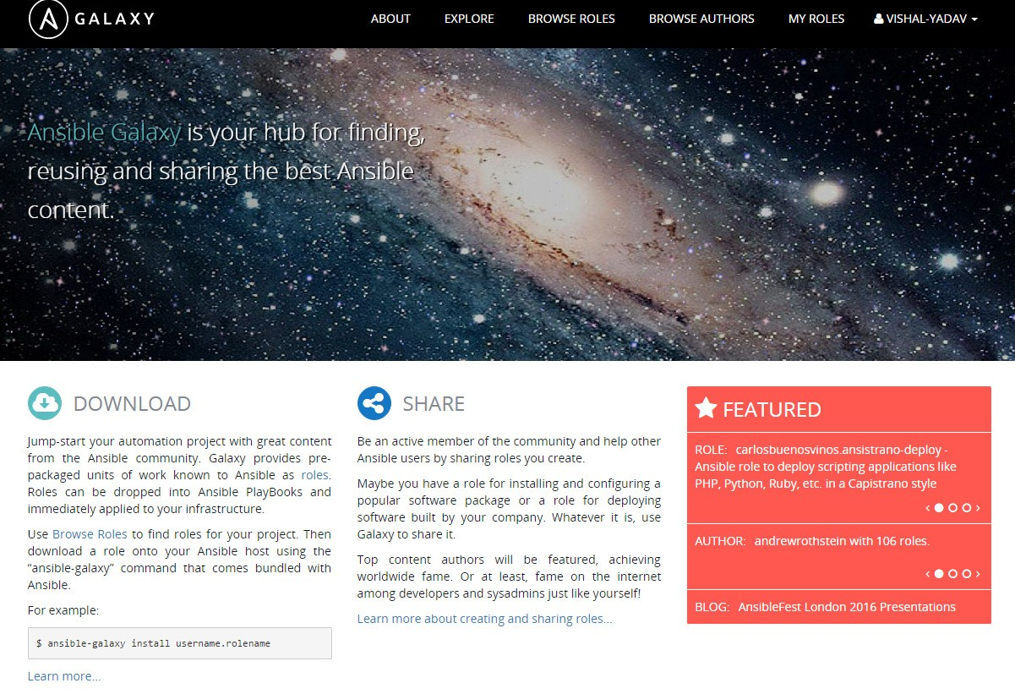
Ansible-Galaxy

Slide 37
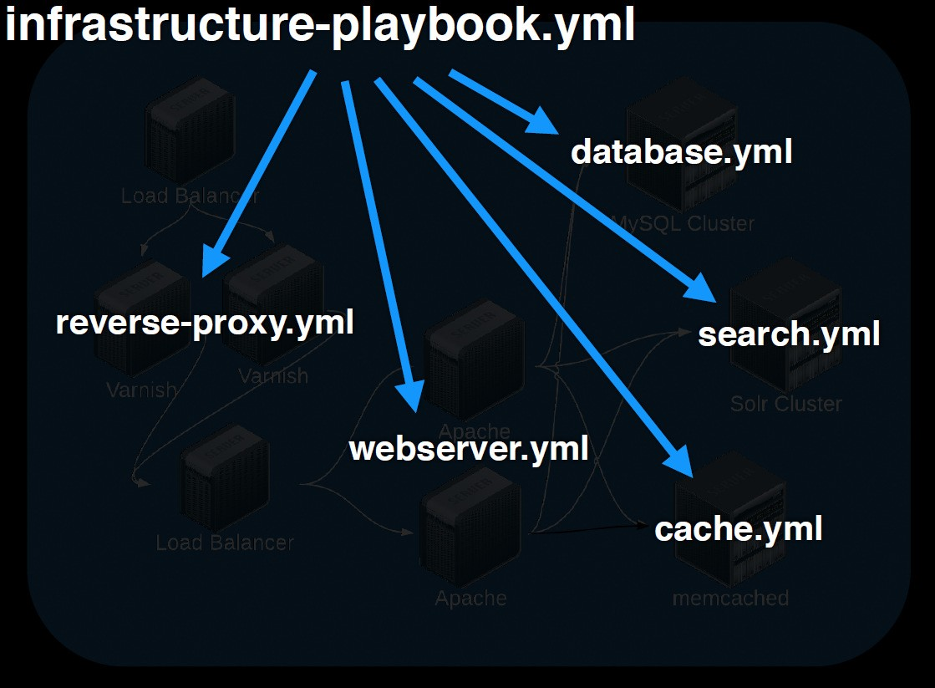

What We Achieved (See Slide #6)

Slide 38

Reference
Ansible Docs (http://docs.ansible.com/ansible/index.html)
Ansible for DevOps by Jeff Geerling (https://leanpub.com/ansible-for-devops)

Slide 39


