Slide 1
Google Certified
Associate Cloud Engineer

Slide 2






Getting Started
GCP has 200+ services. This exam expects knowledge of 40+ Services. Exam expects in-depth knowledge about these services
Exam tests your decision making abilities:
Which service do you choose in which situation?
This course is designed to give you in-depth knowledge & make tough choices
Our Goal : Enable you to understand and use GCP in your real world projects!

Slide 3
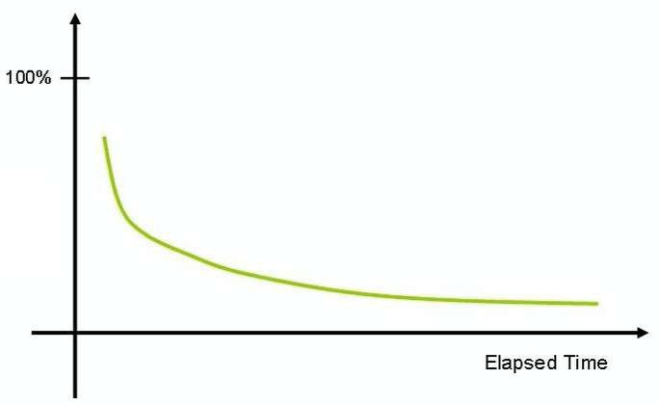
How do you put your best foot forward?
Challenging certification - Expects you to understand and REMEMBER a number of services
As time passes, humans forget things.
How do you improve your chances of remembering things?
Active learning - think and take notes
Review the presentation every once in a while

Slide 4

Our Approach
Three-pronged approach to reinforce concepts:
Presentations (Video)
Demos (Video)
Two kinds of quizzes:
Text quizzes
Video quizzes
(Recommended) Take your time. Do not hesitate to replay videos!
(Recommended) Have Fun!

Slide 5
GCP - Getting started

Slide 6
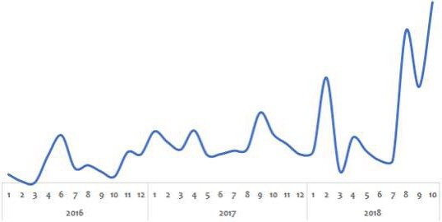
Before the Cloud - Example 1 - Online Shopping App
Challenge:
Peak usage during holidays and weekends
Less load during rest of the time
Solution (before the Cloud):
PEAK LOAD provisioning : Procure (Buy) infrastructure for peak load
What would the infrastructure be doing during periods of low loads?

Slide 7
Before the Cloud - Example 2 - Startup
Challenge:
Startup suddenly becomes popular
How to handle the sudden increase in load?
Solution (before the Cloud):
Procure (Buy) infrastructure assuming they would be successful
What if they are not successful?

Slide 8
Before the Cloud - Challenges
High cost of procuring infrastructure
Needs ahead of time planning (Can you guess the future?) Low infrastructure utilization (PEAK LOAD provisioning)
Dedicated infrastructure maintenance team (Can a startup aﬀord it?)

Slide 9

Silver Lining in the Cloud
How about provisioning (renting) resources when you want them and releasing them back when you do not need them?
On-demand resource provisioning
Also called Elasticity

Slide 10
Cloud - Advantages
Trade "capital expense" expense"
for "variable
Benefit from massive economies of scale
Stop guessing capacity
Stop spending money maintaining data centers
"Go global" in minutes
running and

Slide 11
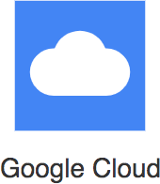
Google Cloud Platform (GCP)
One of the Top 3 cloud service providers Provides a number of services (200+)
Reliable, secure and highly-performant:
Infrastructure that powers 8 services with over 1 Billion Users: Gmail, Google Search, YouTube etc
One thing I love : "cleanest cloud"
Net carbon-neutral cloud (electricity used matched 100% with renewable energy)
The entire course is all about GCP. You will learn it as we go further.

Slide 12
Best path to learn GCP!
Cloud applications make use of multiple GCP services
There is no single path to learn these independently
HOWEVER, we've worked out a simple path!
services

Slide 13
Setting up GCP Account
Create GCP Account

Slide 14
Regions and Zones

Slide 15
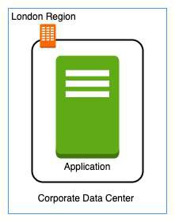
Regions and Zones
Imagine that your application is deployed in a data center in London What would be the challenges?
Challenge 1 : Slow access for users from other parts of the world (high latency)
Challenge 2 : What if the data center crashes?
Your application goes down (low availability)

Slide 16
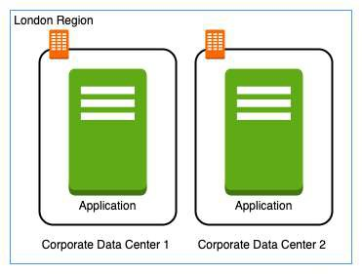
Multiple data centers
Let's add in one more data center in London What would be the challenges?
Challenge 1 : Slow access for users from other parts of the world
Challenge 2 (SOLVED) : What if one data center crashes?
Your application is still available from the other data center
Challenge 3 : What if entire region of London is unavailable?
Your application goes down

Slide 17
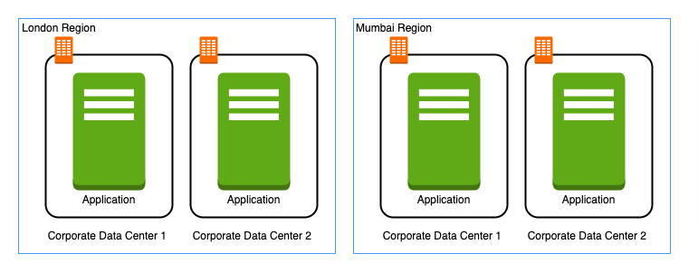
Multiple regions
Let's add a new region : Mumbai What would be the challenges?
Challenge 1 (PARTLY SOLVED) : Slow access for users from other parts of the world
You can solve this by adding deployments for your applications in other regions
Challenge 2 (SOLVED) : What if one data center crashes?
Your application is still live from the other data centers
Challenge 3 (SOLVED) : What if entire region of London is unavailable?
Your application is served from Mumbai

Slide 18
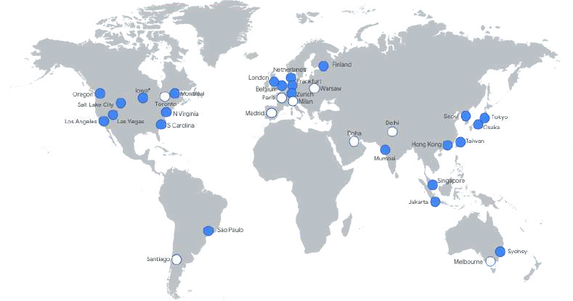
Regions
Imagine setting up data centers in diﬀerent regions around the world
Would that be easy?
(Solution) Google provides 20+ regions around the world
Expanding every year
Region : Specific geographical location to host your resources
Advantages:
High Availability
Low Latency Global Footprint
Adhere to government regulations

Slide 19
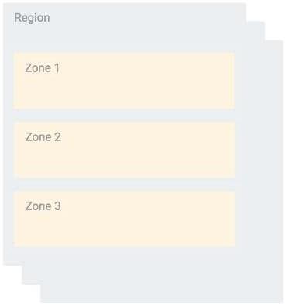
Zones
How to achieve high availability in the same region (or geographic location)?
Enter Zones
Each Region has three or more zones
(Advantage) Increased availability and fault tolerance within same region
(Remember) Each Zone has one or more discrete clusters
Cluster : distinct physical infrastructure that is housed in a data center
(Remember) Zones in a region are connected through low-latency links

Slide 20
Regions and Zones examples
New Regions and Zones are constantly added
Region Code | Region | Zones | Zones List
us-west1 | The Dalles, Oregon, North America | 3 | us-west1-a us-west1-b
 |  |  | us-west1-c
europe- north1 | Hamina, Finland, Europe | 3 | europe-north1-a, europe- north1-b europe-north1-c
asia-south1 | Mumbai, India APAC | 3 | asia-south1-a, asia-south1-b asia-south1-c

Slide 21
Compute

Slide 22
Compute Engine Fundamentals

Slide 23
Google Compute Engine (GCE)
In corporate data centers, applications are deployed to physical servers
Where do you deploy applications in the cloud?
Rent virtual servers
Virtual Machines - Virtual servers in GCP
Google Compute Engine (GCE) - Provision & Manage Virtual Machines

Slide 24


Compute Engine - Features
Create and manage lifecycle of Virtual Machine (VM) instances
Load balancing and auto scaling for multiple VM instances
Attach storage (& network storage) to your VM instances
Manage network connectivity and configuration for your VM instances
Our Goal:
Setup VM instances as HTTP (Web) Server
Distribute load with Load Balancers

Slide 25
Compute Engine Hands-on
Let's create a few VM instances and play with them
Let's check out the lifecycle of VM instances Let's use SSH to connect to VM instances

Slide 26
Compute Engine Machine Family
What type of hardware do you want to run your workloads on? Diﬀerent Machine Families for Diﬀerent Workloads:
General Purpose (E2, N2, N2D, N1) : Best price-performance ratio
Web and application servers, Small-medium databases, Dev environments
Memory Optimized (M2, M1): Ultra high memory workloads
Large in-memory databases and In-memory analytics
Compute Optimized (C2): Compute intensive workloads
Gaming applications

Slide 27
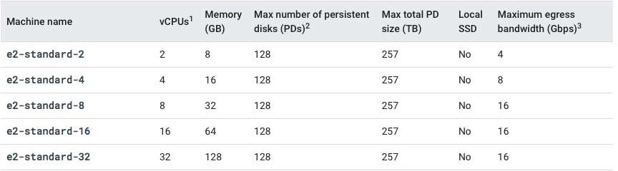
Compute Engine Machine Types
How much CPU, memory or disk do you want?
Variety of machine types are available for each machine family
Let's take an example : e2-standard-2:
e2 - Machine Type Family
standard - Type of workload
2 - Number of CPUs
Memory, disk and networking capabilities increase along with vCPUs

Slide 28


Image
What operating system and what software do you want on the instance?
Type of Images:
Public Images: Provided & maintained by communities or third party vendors
Custom Images: Created by you for your projects
Google or Open source

Slide 29
Compute Engine Hands-on : Setting up a HTTP server
#! /bin/bash sudo su
apt update
apt -y install apache2 sudo service apache2 start
sudo update-rc.d apache2 enable
echo "Hello World" > /var/www/html/index.html
echo "Hello world from $(hostname) $(hostname -I)" > /var/www/html/index.html
Commands:
sudo su - execute commands as a root user
apt update - Update package index - pull the latest changes from the APT repositories
apt -y install apache2 - Install apache 2 web server
sudo service apache2 start - Start apache 2 web server
echo "Hello World" > /var/www/html/index.html - Write to index.html
$(hostname) - Get host name
$(hostname -I) - Get host internal IP address

Slide 30
Internal and External IP Addresses
External (Public) IP addresses are Internet addressable.
Internal (Private) IP addresses are internal to a corporate network You CANNOT have two resources with same public (External) IP address.
HOWEVER, two diﬀerent corporate networks CAN have resources with same Internal (private) IP address
All VM instances are assigned at least one Internal IP address
Creation of External IP addresses can be enabled for VM instances
(Remember) When you stop an VM instance, External IP address is lost
DEMO: VM instances - Internal and External IPs

Slide 31
Static IP Addresses
Scenario : How do you get a constant External IP address for a VM instance?
Quick and dirty way is to assign an Static IP Address to the VM!
DEMO: Using Static IP Address with an VM instance

Slide 32
Static IP Addresses - Remember
Static IP can be switched to another VM instance in same project
Static IP remains attached even if you stop the instance. You have to manually detach it.
Remember : You are billed for an Static IP when you are NOT using it!
Make sure that you explicitly release an Static IP when you are not using it.

Slide 33
Simplify VM HTTP server setup
How do we reduce the number of steps in creating an VM instance and setting up a HTTP Server?
Let's explore a few options:
Startup script
Instance Template Custom Image

Slide 34
Bootstrapping with Startup script
#!/bin/bash apt update
apt -y install apache2
echo "Hello world from $(hostname) $(hostname -I)" > /var/www/ht
Bootstrapping: Install OS patches or software when an VM instance is launched.
In VM, you can configure Startup script to bootstrap
DEMO - Using Startup script

Slide 35


Instance templates
Why do you need to specify all the VM instance details (Image, instance type etc) every time you launch an instance?
How about creating a Instance template?
Define machine type, image, labels, startup script and other properties
Used to create VM instances and managed instance groups
Provides a convenient way to create similar instances
CANNOT be updated
To make a change, copy an existing template and modify it
(Optional) Image family can be specified (example - debian-9):
Latest non-deprecated version of the family is used
DEMO - Launch VM instances using Instance templates

Slide 36
Reducing Launch Time with Custom Image
Installing OS patches and software at launch of VM instances
increases boot up time
How about creating a custom image with OS patches and software pre-installed?
Can be created from an instance, a persistent disk, a snapshot, another image, or a file in Cloud Storage
Can be shared across projects
(Recommendation) Deprecate old images (& specify replacement image)
(Recommendation) Hardening an Image - Customize images to your corporate security standards
Prefer using Custom Image to Startup script
DEMO : Create a Custom Image and using it in an Instance Template

Slide 37
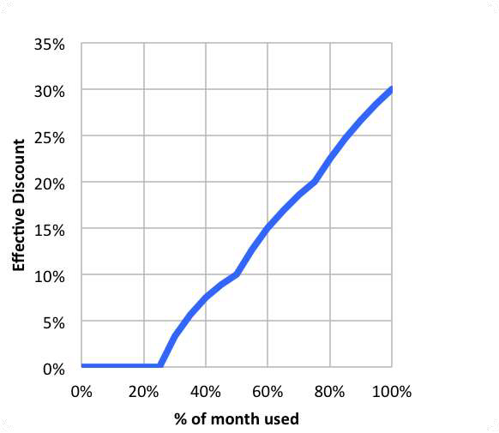
Sustained use discounts
Automatic discounts for running VM instances for significant portion of the billing month
Example: If you use N1, N2 machine types for more than 25% of a month, you get a 20% to 50% discount on every incremental minute.
Discount increases with usage (graph) No action required on your part!
Applicable for instances created by Google Kubernetes Engine and Compute Engine
RESTRICTION: Does NOT apply on certain machine types (example: E2 and A2)
RESTRICTION: Does NOT apply to VMs created by App Engine flexible and Dataflow
Source: https://cloud.google.com

Slide 38
Committed use discounts
For workloads with predictable resource needs
Commit for 1 year or 3 years
Up to 70% discount based on machine type and GPUs
Applicable for instances created by Google Kubernetes Engine and Compute Engine RESTRICTION: Does NOT apply to VMs created by App Engine flexible and Dataflow

Slide 39
Preemptible VM
Short-lived cheaper (upto 80%) compute instances
Can be stopped by GCP any time (preempted) within 24 hours
Instances get 30 second warning (to save anything they want to save)
Use Preempt VM's if:
Your applications are fault tolerant
You are very cost sensitive
Your workload is NOT immediate
Example: Non immediate batch processing jobs
RESTRICTIONS:
NOT always available
NO SLA and CANNOT be migrated to regular VMs NO Automatic Restarts
Free Tier credits not applicable

Slide 40
Spot VMs
Spot VMs: Latest version of preemptible VMs
Key Diﬀerence: Does not have a maximum runtime
Compared to traditional preemptible VMs which have a maximum runtime of 24 hours
Other features similar to traditional preemptible VMs
May be reclaimed at any time with 30-second notice
NOT always available
Dynamic Pricing: 60 - 91% discount compared to on-demand VMs Free Tier credits not applicable

Slide 41
Google Compute Engine - Billing
You are billed by the second (after a minimum of 1 minute)
You are NOT billed for compute when a compute instance is stopped
However, you will be billed for any storage attached with it!
(RECOMMENDATION) Always create Budget alerts and make use of Budget exports to stay on top of billing!
What are the ways you can save money?
Choose the right machine type and image for your workload
Be aware of the discounts available:
Sustained use discounts
Committed use discounts
Discounts for preemptible VM instances

Slide 42
Compute Engine : Live Migration & Availability Policy
How do you keep your VM instances running when a host system needs to be updated (a software or a hardware update needs to be performed)?
Live Migration
Your running instance is migrated to another host in the same zone
Does NOT change any attributes or properties of the VM SUPPORTED for instances with local SSDs
NOT SUPPORTED for GPUs and preemptible instances
Important Configuration - Availability Policy:
On host maintenance: What should happen during periodic infrastructure maintenance?
Migrate (default): Migrate VM instance to other hardware
Terminate: Stop the VM instance
Automatic restart - Restart VM instances if they are terminated due to non-user-initiated reasons (maintenance event, hardware failure etc.)

Slide 43
Compute Engine Features: Custom Machine Types
What do you do when predefined VM options are NOT appropriate for your workload?
Create a machine type customized to your needs (a Custom Machine Type)
Custom Machine Type: Adjust vCPUs, memory and GPUs
Choose between E2, N2, or N1 machine types
Supports a wide variety of Operating Systems: CentOS, CoreOS, Debian, Red Hat, Ubuntu, Windows etc
Billed per vCPUs, memory provisioned to each instance
Example Hourly Price: $0.033174 / vCPU + $0.004446 / GB

Slide 44

Compute Engine Features: GPUs
How do you accelerate math intensive and graphics-intensive workloads for AI/ML etc?
Add a GPU to your virtual machine:
High performance for math intensive and graphics-intensive workloads
Higher Cost
(REMEMBER) Use images with GPU libraries (Deep Learning) installed
OTHERWISE, GPU will not be used
GPU restrictions:
NOT supported on all machine types (For example, not supported on shared-core or memory-optimized machine types)
On host maintenance can only have the value "Terminate VM instance"
Recommended Availability policy for GPUs
Automatic restart - on

Slide 45
Virtual Machine - Remember
Associated with a project
Machine type availability can vary from region to regions
You can only change the machine type (adjust the number of vCPUs and memory) of a stopped instance
You CANNOT change the machine type of a running instance
VM's can be filtered by various properties
Name, Zone, Machine Type, Internal/External IP, Network, Labels etc
Instances are Zonal (Run in a specific zone (in a specific region))
Images are global (You can provide access to other projects - if needed)
Instance templates are global (Unless you use zonal resources in your templates)
Automatic Basic Monitoring is enabled
Default Metrics: CPU utilization, Network Bytes (in/out), Disk Throughput/IOPS
For Memory Utilization & Disk Space Utilization - Cloud Monitoring agent is needed

Slide 46
Virtual Machine - Best Practices
Choose Zone and Region based on:
Cost, Regulations, Availability Needs, Latency and Specific Hardware needs
Distribute instances in multiple zones and regions for high availability
Choose right machine type for you needs:
Play with them to find out the right machine type
Use GPUs for Math and Graphic intensive applications
Reserve for "committed use discounts" for constant workloads
Use preemptible instances for fault-tolerant, NON time critical workloads
Use labels to indicate environment, team, business unit etc

Slide 47
Compute Engine Scenarios
Scenario
What are the pre-requisites to be able to create a VM instance?
Solution
Project
Billing Account
Compute Engines APIs should be enabled
Sole-tenant nodes
Use "VM Manager"
You want dedicated hardware for your compliance, licensing, and management needs
I have 1000s of VM and I want to automate OS patch management, OS inventory management and OS configuration management (manage software installed)
You want to login to your VM instance to install software You do not want to expose a VM to internet
You want to allow HTTP traﬀic to your VM
You can SSH into it
Do NOT assign an external IP Address
Configure Firewall Rules

Slide 48
Quick Review
Image
What operating system and what software do you want on the VM instance? Reduce boot time and improve security by creating custom hardened Images.
You can share an Image with other projects
Machine Types
Optimized combination of compute(CPU, GPU), memory, disk (storage) and networking for specific workloads.
You can create your own Custom Machine Types when existing ones don't fit your needs

Slide 49
Quick Review
Static IP Addresses: Get a constant IP addresses for VM instances
Instance Templates: Pre-configured templates simplifying the creation of VM instances
Sustained use discounts: Automatic discounts for running VM instances for significant portion of the billing month
Committed use discounts: 1 year or 3 year reservations for workloads with
predictable resource needs
Preemptible VM: Short-lived cheaper (upto 80%) compute instances for non- time-critical fault-tolerant workloads

Slide 50
Gcloud

Slide 51

Gcloud
Command line interface to interact with Google Cloud Resources Most GCP services can be managed from CLI using Gcloud:
Compute Engine Virtual Machines
Managed Instance Groups Databases
and ... many more
You can create/delete/update/read existing resources and perform actions like deployments as well!
(REMEMBER) SOME GCP services have specific CLI tools:
Cloud Storage - gsutil
Cloud BigQuery - bq Cloud Bigtable - cbt
Kubernetes - kubectl (in addition to Gcloud which is used to manage clusters)

Slide 52
Gcloud - Getting Started
Installation
Gcloud is part of Google Cloud SDK
Cloud SDK requires Python
Instructions to install Cloud SDK (and Gcloud) => https://cloud.google.com/sdk/docs/install
You can also use Gcloud on Cloud Shell
Connecting to GCP
gcloud init - initialize or reinitialize gcloud
Authorize gcloud to use your user account credentials
Setup configuration
Includes current project, default zone etc
gcloud config list - lists all properties of the active configuration

Slide 53
gcloud config set
Sets the specified property in your active configuration
gcloud | config | set | core/project VALUE
gcloud | config | set | compute/region VALUE
gcloud | config | set | compute/zone VALUE
gcloud | config | set | core/verbosity VALUE(debug)
Syntax - gcloud config set SECTION/PROPERTY VALUE
core, compute - SECTIONS
project, region, zone - PROPERTIES
Specifying core is optional as it is the default SECTION!
gcloud config set project VALUE
gcloud config set verbosity VALUE(debug)
Get more details with gcloud config set --help
Look for AVAILABLE PROPERTIES in the content
Opposite - gcloud config unset

Slide 54
Playing with gcloud config set
gcloud config set compute/region us-east2 gcloud config set compute/zone us-east1-b gcloud config list
testing@cloudshell:~ (useful-device-303710)$ gcloud config list [component_manager]
disable_update_check = True [compute]
gce_metadata_read_timeout_sec = 30 region = us-east1
zone = us-east1-b [core]
account = testing@gmail.com disable_usage_reporting = True
project = useful-device-303710 verbosity = info
[metrics]
environment = devshell

Slide 55
Gcloud - Managing Multiple Configurations
Scenario: You are working on multiple projects from the same machine. You would want to be able to execute commands using diﬀerent configurations.
How do you simplify this?
gcloud config configurations create/delete/describe/activate/list
Create new configuration: gcloud config configurations create NAME(dev)
Activate specific configuration: gcloud config configurations activate NAME(dev)
List Configurations: gcloud config configurations list

Slide 56
gcloud command structure - Playing with Services
gcloud GROUP SUBGROUP ACTION ...
GROUP - config or compute or container or dataflow or functions or iam or ..
Which service group are you playing with?
SUBGROUP - instances or images or instance-templates or machine-types or regions or zones
Which sub group of the service do you want to play with?
ACTION - create or list or start or stop or describe or ...
What do you want to do?
Examples:
gcloud compute instances list
gcloud compute zones list gcloud compute regions list
gcloud compute machine-types list
gcloud compute machine-types list --filter="zone:us-central1-b"
gcloud compute machine-types list --filter="zone:( us-central1-b europe-west1-d )"

Slide 57
gcloud compute instances create
Creating Compute Instances
gcloud compute instances create [NAME]
Options:
--machine-type (default type is n1-standard-1 - gcloud compute machine-types list)
--custom-cpu --custom-memory --custom-vm-type(n1/n2) (Custom Machine)
--custom-cpu 6 --custom-memory 3072MB --custom-vm-type n2
--image or --image-family or --source-snapshot or --source-instance-template or --source-machine-image (beta)
--service-account or --no-service-account
--zone=us-central1-b
--tags (List of tags - Allow network firewall rules and routes to be applied to VM instances)
--preemptible
--restart-on-failure(default) --no-restart-on-failure --maintenance-policy(MIGRATE(default)/TERMINATE)
--boot-disk-size, --boot-disk-type --boot-disk-auto-delete(default) --no-boot-disk-auto-delete
--deletion-protection --no-deletion-protection(default)
--metadata/metadata-from-file startup-script/startup-script-url
--metadata-from-file startup-script=/local/path/to/script/startup OR --metadata startup-script="echo 'hello world'"
shutdown-script
--network --subnet --network-tier (PREMIUM (default), STANDARD)
--accelerator="type=nvidia-tesla-v100,count=8" --metadata="install-nvidia-driver=True" (GPU)

Slide 58
Compute Instances - Default Region and Zone
Three Options:
Option 1 (Centralized Configuration): gcloud compute project-info add-metadata
--metadata=[google-compute-default-region=REGION | google-compute-default-zone=ZONE]
Option 2 (Local gcloud configuration): gcloud config set compute/region REGION Option 3 (Command Specific): --zone or --region in the command
Priority: Option 3 (if exists) overrides Option 2 (if exists) overrides Option 1

Slide 59
List and Describe commands
Typically list commands are used to list a set of resources
gcloud compute RESOURCES list
gcloud compute images/regions/zones/disk-types list
gcloud compute instances/disks/snapshots list
Most list commands support a few common options
--filter="zone:VALUE"
--sort-by (NAME, ~NAME)
--uri (https://www.googleapis.com/compute/v1/projects/windows-sql-cloud/global/images/sql-2019-web- windows-2019-dc-v20210112)
gcloud compute images list --sort-by NAME --filter "PROJECT:(windows-cloud ubuntu-os-cloud)"
Typically describe commands are used to describe a specific resource gcloud compute images describe ubuntu-1604-xenial- v20210203 --project ubuntu- os-cloud
gcloud compute regions describe us-central1

Slide 60
Playing with Compute Instances - gcloud
Playing with compute instances
gcloud compute instances list/start/stop/delete/reset/describe/move
gcloud compute instances start example-instance
gcloud compute instances stop example-instance-1 example-instance-2 gcloud compute instances delete example-instance
--delete-disks=VALUE (all or data or boot)
--keep-disks=VALUE (all or data or boot)
gcloud compute instances move example-instance-1 --zone us-central1-b --destination-zone us- central1-f
Move a VM from one zone to another

Slide 61
Playing with Instance Templates
gcloud compute instance-templates create/delete/describe/list
gcloud compute instance-templates create INSTANCE-TEMPLATE
--source-instance=SOURCE_INSTANCE --source-instance-zone (Which instance to create a template from?)
Supports almost all options supported by gcloud compute instances create [NAME]
--image or --image-family or --source-snapshot or --source-instance-template
--service-account or --no-service-account
--tags
--preemptible
--restart-on-failure(default) --no-restart-on-failure --maintenance-policy(MIGRATE(default)/TERMINATE)
--boot-disk-size, --boot-disk-type --boot-disk-auto-delete(default) --no-boot-disk-auto-delete
--deletion-protection --no-deletion-protection(default)
--metadata/metadata-from-file startup-script/startup-script-url
--network --subnet --network-tier (PREMIUM (default), STANDARD)
--accelerator="type=nvidia-tesla-v100,count=8" --metadata="install-nvidia-driver=True" (GPU)
Using Instance Tempate to create an instance
gcloud compute instances create my-test-vm --sourc e-instance-template=my-instance-template- with-custom-image

Slide 62
Instance Groups

Slide 63
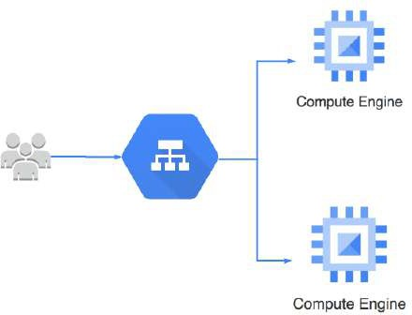
Instance Groups
How do you create a group of VM instances?
Instance Group - Group of VM instances managed as a single entity
Manage group of similar VMs having similar lifecycle as ONE UNIT
Two Types of Instance Groups:
Managed : Identical VMs created using a template:
Features: Auto scaling, auto healing and managed releases
Unmanaged : Diﬀerent configuration for VMs in same group:
Does NOT oﬀer auto scaling, auto healing & other services
NOT Recommended unless you need diﬀerent kinds of VMs
Location can be Zonal or Regional
Regional gives you higher availability (RECOMMENDED)

Slide 64
Managed Instance Groups (MIG)
Managed Instance Group - Identical VMs created using an instance template
Important Features:
Maintain certain number of instances
If an instance crashes, MIG launches another instance
Detect application failures using health checks (Self Healing) Increase and decrease instances based on load (Auto Scaling)
Add Load Balancer to distribute load
Create instances in multiple zones (regional MIGs)
Regional MIGs provide higher availability compared to zonal MIGs
Release new application versions without downtime
Rolling updates: Release new version step by step (gradually). Update a percentage of instances to the new version at a time.
Canary Deployment: Test new version with a group of instances before releasing it across all instances.

Slide 65

Creating Managed Instance Group (MIG)
Instance template is mandatory
Configure auto-scaling to automatically adjust number of instances based on load:
Minimum number of instances
Maximum number of instances
Autoscaling metrics: CPU Utilization target or Load Balancer Utilization target or Any other metric from Stack Driver
Cool-down period: How long to wait before looking at auto scaling metrics again?
Scale In Controls: Prevent a sudden drop in no of VM instances
Example: Don't scale in by more than 10% or 3 instances in 5 minutes
Autohealing: Configure a Health check with Initial delay (How long should you wait for your app to initialize before running a health check?)
Time for a Demo

Slide 66
Updating a Managed Instance Group (MIG)
Rolling update - Gradual update of instances in an instance group to the new instance template
Specify new template:
(OPTIONAL) Specify a template for canary testing
Specify how you want the update to be done:
When should the update happen?
Start the update immediately (Proactive) or when instance group is resized later(Opportunistic)
How should the update happen?
Maximum surge: How many instances are added at any point in time?
Maximum unavailable: How many instances can be oﬀline during the update?
Rolling Restart/replace: Gradual restart or replace of all instances in the group
No change in template BUT replace/restart existing VMs
Configure Maximum surge, Maximum unavailable and What you want to do? (Restart/Replace)

Slide 67
Playing with Managed Instance Groups - Command Line
gcloud compute instance-groups managed
Create instance group: create
gcloud compute instance-groups managed create my-mig --zone us-central1-a --template my- instance-template --size 1
--health-check=HEALTH_CHECK: How do you decide if an instance is healthy?
--initial-delay: How much time should you give to an instance to start?
Other similar commands - gcloud compute instance-groups managed delete/describe/list
Setup Autoscaling: set-autoscaling/stop-autoscaling
gcloud compute instance-groups managed set-autoscaling my-mig --max-num-replicas=10
--cool-down-period (default - 60s): How much time should Auto Scaler wait after initiating an autoscaling action?
--scale-based-on-cpu --target-cpu-utilization --scale-based-on-load-balancing --target-load-balancing-utilization
--min-num-replicas --mode (oﬀ/on(default)/only-scale-out)
gcloud compute instance-groups managed stop-autoscaling my-mig
Update existing MIG policies (ex: auto healing policies):
gcloud compute instance-groups managed update my-mig
--initial-delay: How much time should you give to the instance to start before marking it as unhealthy?
--health-check: How do you decide if an instance is healthy?

Slide 68
Managed Instance Group - Command Line - Making Updates
Resize the group:
gcloud compute instance-groups managed resize my-mig --size=5
Recreate one or more instances (delete and recreate instances):
gcloud compute instance-groups managed recreate-instances my-mig --instances=my- instance-1,my-instance-2
Update specific instances:
gcloud compute instance-groups managed update-instances my-mig --instances=my-instance- 3,my-instance-4 (Update specific instances from the group)
--minimal-action=none(default)/refresh/replace/restart
--most-disruptive-allowed-action=none(default)/refresh/replace/restart
Update instance template:
gcloud compute instance-groups managed set-instance-template my-mig --template=v2- template
After updating instance template, you can trigger roll out of the new template using update-instances, recreate-
instances or rolling-action start-update commands

Slide 69
Managed Instance Groups - Command Line - Rolling Actions
Scenario: You want to manage your new release - v1 to v2 - without downtime
gcloud compute instance-groups managed rolling-action
Restart(stop & start)- gcloud compute instance-groups managed rolling-action restart my- mig
--max-surge=5 or 10% (Max no of instances updated at a time)
Replace(delete & recreate)- gcloud compute instance-groups managed rolling-action replace
my-mig
--max-surge=5 or 10% (Max no of instances updated at a time)
--max-unavailable=5 or 10% (Max no of instances that can be down for the update)
--replacement-method=recreate/substitute (substitute (default) creates instances with new names. recreate reuses names)
Updates instances to a new template:
Basic Version (Update all instances slowly step by step) - gcloud compute instance-groups managed rolling- action start-update my-mig --version=template=v1-template
Canary Version (Update a subset of instances to v2) - gcloud compute instance-groups managed rolling-action start-update my-mig --version=template=v1-template --canary-version=template=v2-template,target-size=10%

Slide 70
Playing with Managed Instance Groups - Scenarios
I want to ensure that I have one healthy instance running all the time: gcloud compute instance-groups managed set-autoscaling my-group --max-num- replicas=1 --min-num-replicas=1
I want to make a new release with no reduction in available number of instances. I want to update one instance at a time:
gcloud compute instance-groups managed rolling-action start-update my-group -- version=template=my-v1-template --max-surge 1 --max-unavailable 0

Slide 71
Instance Group Scenarios
Scenario Solution
You want MIG managed application to Create multiple zone MIG (or regional MIG)
survive Zonal Failures
You want to create VMs of diﬀerent Create Un-managed Instance Group
configurations in the same group
You want to preserve VM state in an MIG
Stateful MIG - Preserve VM state (Instance name, attached Persistent disks and Metadata). Recommended for stateful workloads (database, data processing apps)
You want high availability in an MIG even when there are hardware/software updates
Use an instance template with availability policy
automatic restart: enabled & on-host maintenance: migrate Ensures live migration and automatic restarts
You want unhealthy instances to be automatically replaced
Configure health check on the MIG (self healing)
Avoid frequent scale up & downs
Cool-down period/Initial delay

Slide 72
Cloud Load Balancing

Slide 73
Cloud Load Balancing
Distributes user traﬀic across instances application in single region or multiple regions
Fully distributed, software defined managed service
Important Features:
Health check - Route to healthy instances
Recover from failures
Auto Scaling
Global load balancing with single anycast IP
Also supports internal load balancing
Enables:
High Availability
Auto Scaling Resiliency
of an

Slide 74
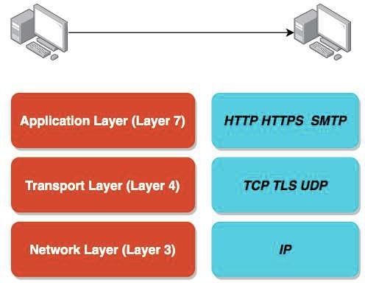
HTTP vs HTTPS vs TCP vs TLS vs UDP
Computers use protocols to communicate Multiple layers and multiple protocols
Network Layer - Transfer bits and bytes
Transport Layer - Are the bits and bytes transferred properly?
Application Layer - Make REST API calls and Send Emails
(Remember) Each layer makes use of the layers beneath it
(Remember) Most applications talk at application layer. BUT some applications talk at transport layer directly(high performance).

Slide 75
HTTP vs HTTPS vs TCP vs TLS vs UDP
Network Layer:
IP (Internet Protocol): Transfer bytes. Unreliable.
Transport Layer:
TCP (Transmission Control): Reliability > Performance
TLS (Transport Layer Security): Secure TCP
UDP (User Datagram Protocol): Performance > Reliability
Application Layer:
HTTP(Hypertext Transfer Response Cycle
HTTPS: Secure HTTP
Protocol): Stateless Request
SMTP: Email Transfer Protocol and a lot of others...

Slide 76
HTTP vs HTTPS vs TCP vs TLS vs UDP
Most applications typically communicate at application layer
Web apps/REST API(HTTP/HTTPS), Email Servers(SMTP), File Transfers(FTP)
All these applications use TCP/TLS at network layer(for reliability)
HOWEVER applications needing high performance
directly communicate at transport layer:
Gaming applications and live video streaming use UDP (sacrifice reliability for performance)
Objective: Understand Big Picture. Its OK if you do not understand all details.

Slide 77


Cloud Load Balancing - Terminology
Backend - Group of endpoints that receive traﬀic from a Google Cloud load balancer (example: instance groups)
Frontend - Specify an IP address, port and protocol. This IP address is the frontend IP for your clients requests.
For SSL, a certificate must also be assigned.
Host and path rules (For HTTP(S) Load Balancing) - Define rules redirecting the traﬀic to diﬀerent backends:
Based on path - in28minutes.com/a vs in28minutes.com/b
Based on Host - a.in28minutes.com vs b.in28minutes.com
Based on HTTP headers (Authorization header) and methods (POST, GET, etc)

Slide 78
Load Balancing - SSL/TLS Termination/Oﬀloading
Client to Load Balancer: Over internet
HTTPS recommended
Load Balancer to VM instance: Through Google internal network
HTTP is ok. HTTPS is preferred.
SSL/TLS Termination/Oﬀloading
Client to Load Balancer: HTTPS/TLS
Load Balancer to VM instance: HTTP/TCP

Slide 79
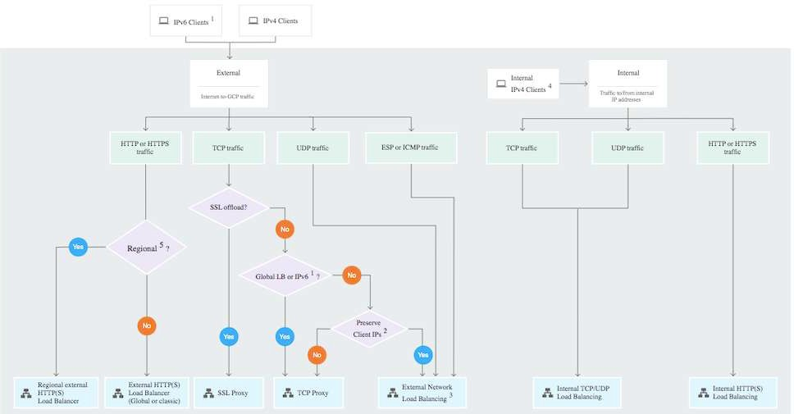
Cloud Load Balancing - Choosing Load Balancer
https://cloud.google.com/load-balancing/images/choose-lb.svg

Slide 80
Cloud Load Balancing - Features
Load Balancer | Type of Traﬀic | Proxy or pass- through | Destination Ports
External HTTP(S) | Global, External, HTTP or HTTPS | Proxy | HTTP on 80 or 8080 HTTPS on 443
Internal HTTP(S) | Regional, Internal, HTTP or HTTPS | Proxy | HTTP on 80 or 8080 HTTPS on 443
SSL Proxy | Global, External, TCP with SSL oﬀload | Proxy | A big list
TCP Proxy | Global, External, TCP without SSL oﬀload | Proxy | A big list
External Network TCP/UDP | Regional, External, TCP or UDP | Pass-through | any

Slide 81
Load Balancer Scenarios
Scenario Solution
You want only healthy instances to Configure health check
receive traﬀic
You want high availability for your VM instances
Create Multiple MIGs for your VM instances in multiple regions. Load balance using a Load Balancer.
You want to route requests to multiple microservices using the same load balancer
Create individual MIGs and backends for each microservice. Create Host and path rules to redirect to specific microservice backend based on the path (/microservice-a, /microservice-b etc). You can route to a backend Cloud Storage bucket as well.
You want to load balance Global external HTTPS traﬀic across backend instances, across multiple regions
Choose External HTTP(S) Load Balancer
You want SSL termination for Global non-HTTPS traﬀic with load balancing
Choose SSL Proxy Load Balancer

Slide 82
Managed Services

Slide 83
Managed Services
Do you want to continue running applications in the cloud, the same way you run them in your data center?
OR are there OTHER approaches?
You should understand some terminology used with cloud services:
IaaS (Infrastructure as a Service)
PaaS (Platform as a Service) FaaS (Function as a Service) CaaS (Container as a Service) Serverless
Let's get on a quick journey to understand these!

Slide 84
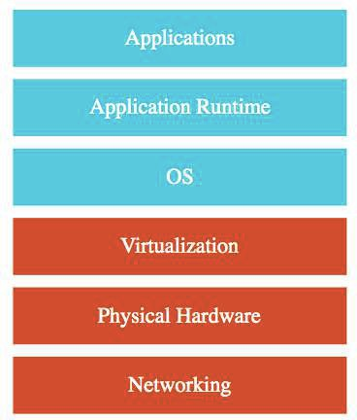
IAAS (Infrastructure as a Service)
Use only infrastructure from cloud provider
Example: Using VM to deploy your applications or databases
You are responsible for:
Application Code and Runtime
Configuring load balancing Auto scaling
OS upgrades and patches Availability
etc.. ( and a lot of things!)

Slide 85
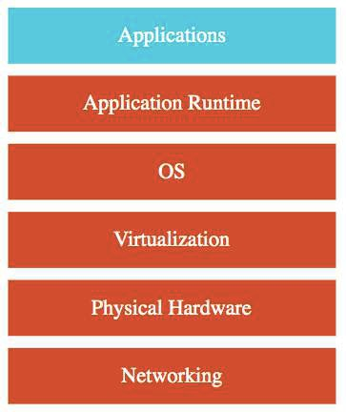
PAAS (Platform as a Service)
Use a platform provided by cloud
Cloud provider is responsible for:
OS (incl. upgrades and patches)
Application Runtime
Auto scaling, Availability & Load balancing etc..
You are responsible for:
Configuration (of Application and Services)
Application code (if needed)
Varieties:
CAAS (Container as a Service): Containers instead of Apps
FAAS (Function as a Service): Functions instead of Apps
Databases - Relational & NoSQL (Amazon RDS, Google Cloud SQL, Azure SQL Database etc), Queues, AI, ML, Operations etc!

Slide 86
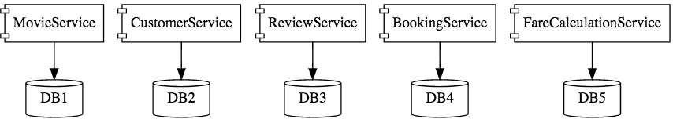
Microservices
Enterprises are heading towards microservices architectures
Build small focused microservices
Flexibility to innovate and build applications in diﬀerent programming languages (Go, Java, Python, JavaScript, etc)
BUT deployments become complex!
How can we have one way of deploying Go, Java, Python or JavaScript .. microservices?
Enter containers!

Slide 87
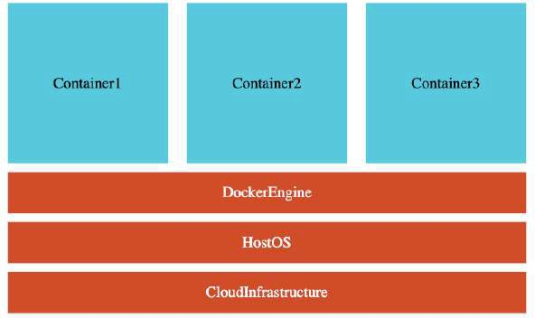
Containers - Docker
Create Docker images for each microservice
Docker image has all needs of a microservice:
Application Runtime (JDK or Python or NodeJS)
Application code and Dependencies
Runs the same way on any infrastructure:
Your local machine
Corporate data center Cloud
Advantages
Docker containers are light weight
Compared to Virtual Machines as they do not have a Guest OS
Docker provides isolation for containers Docker is cloud neutral

Slide 88
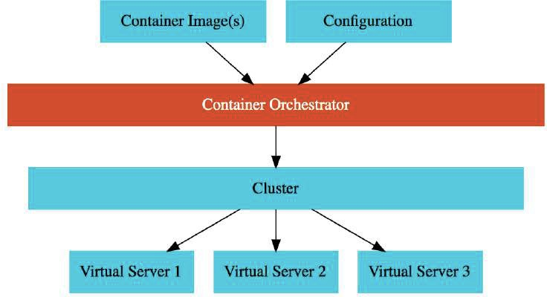
Container Orchestration
Requirement : I want 10 instances of Microservice A container, 15 instances of Microservice B container and ....
Typical Features:
Auto Scaling - Scale containers based on demand
Service Discovery - Help microservices find one another
Load Balancer - Distribute load among multiple instances of a microservice
Self Healing - Do health checks and replace failing instances
Zero Downtime Deployments - Release new versions without downtime

Slide 89
Serverless
What do we think about when we develop an application?
Where to deploy? What kind of server? What OS?
How do we take care of scaling and availability of the application?
What if you don't need to worry about servers and focus on your code?
Enter Serverless
Remember: Serverless does NOT mean "No Servers"
Serverless for me:
You don't worry about infrastructure (ZERO visibility into infrastructure)
Flexible scaling and automated high availability
Most Important: Pay for use
Ideally ZERO REQUESTS => ZERO COST
You focus on code and the cloud managed service takes care of all that is needed to scale your code to serve millions of requests!
And you pay for requests and NOT servers!

Slide 90
Serverless - My Perspective!
Serverless - Important Features:
1: Zero worry about infrastructure, scaling and availability
2: Zero invocations => Zero Cost (Can you scale down to ZERO instances?) 3: Pay for invocations and NOT for instances (or nodes or servers)
Serverless Level 1: Features (1 + 2)
Serverless Level 2: Features (1 + 2 + 3)
When I refer to Serverless, I'm referring to Level 2
HOWEVER cloud providers include managed services at Level 1 and Level 2: Level 1: Google App Engine (Google Calls it "App Engine is a fully managed, serverless platform"), AWS Fargate (AWS calls it "serverless compute engine for containers")
Scale down to ZERO instances when there is no load, BUT you pay for number (and type) of instances running!
Level 2: Google Functions, AWS Lambda, Azure Functions etc
You pay for invocations

Slide 91
GCP Managed Services for Compute
Service | Details | Category
Compute Engine | High-performance and general purpose VMs that scale globally | IaaS
Google Kubernetes Engine | Orchestrate containerized microservices on Kubernetes Needs advanced cluster configuration and monitoring | CaaS
App Engine | Build highly scalable applications on a fully managed platform using open and familiar languages and tools | PaaS (CaaS, Serverless)
Cloud Functions | Build event driven applications using simple, single- purpose functions | FaaS, Serverless
Cloud Run | Develop and deploy highly scalable containerized applications. Does NOT need a cluster! | CaaS (Serverless)

Slide 92
App Engine

Slide 93
App Engine
Simplest way to deploy and scale your applications in GCP
Provides end-to-end application management
Supports:
Go, Java, .NET, Node.js, PHP, Python, Ruby using pre-configured runtimes
Use custom run-time and write code in any language
Connect to variety of Google Cloud storage products (Cloud SQL etc)
No usage charges - Pay for resources provisioned
Features:
Automatic load balancing & Auto scaling
Managed platform updates & Application health monitoring Application versioning
Traﬀic splitting

Slide 94
Compute Engine vs App Engine
Compute Engine
IAAS
MORE Flexibility MORE Responsibility
Choosing Image
Installing Software Choosing Hardware
Fine grained Access/Permissions (Certificates/Firewalls) Availability etc
App Engine
PaaS
Serverless
LESSER Responsibility LOWER Flexibility

Slide 95
App Engine environments
Standard: Applications run in language specific sandboxes
Complete isolation from OS/Disk/Other Apps
V1: Java, Python, PHP, Go (OLD Versions)
ONLY for Python and PHP runtimes:
Restricted network Access
Only white-listed extensions and libraries are allowed
No Restrictions for Java and Go runtimes
V2: Java, Python, PHP, Node.js, Ruby, Go (NEWER Versions)
Full Network Access and No restrictions on Language Extensions
Flexible - Application instances run within Docker containers
Makes use of Compute Engine virtual machines
Support ANY runtime (with built-in support for Python, Java, Node.js, Go, Ruby, PHP, or .NET)
Provides access to background processes and local disks

Slide 96
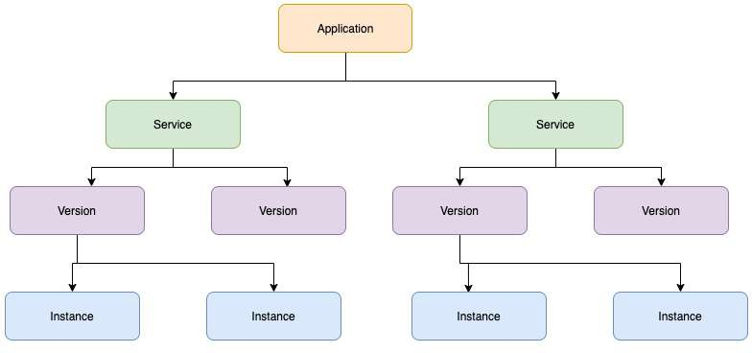
App Engine - Application Component Hierarchy
Application: One App per Project
Service(s): Multiple Microservices or App components
You can have multiple services in a single application
Each Service can have diﬀerent settings Earlier called Modules
Version(s): Each version associated with code and configuration
Each Version can run in one or more instances
Multiple versions can co-exist Options to rollback and split traﬀic

Slide 97
App Engine - Comparison
Feature | Standard | Flexible
Pricing Factors | Instance hours | vCPU, Memory & Persistent Disks
Scaling | Manual, Basic, Automatic | Manual, Automatic
Scaling to zero | Yes | No. Minimum one instance
Instance startup time | Seconds | Minutes
Rapid Scaling | Yes | No
Max. request timeout | 1 to 10 minutes | 60 minutes
Local disk | Mostly(except for Python, PHP). Can write to /tmp. | Yes. Ephemeral. New Disk on startup.
SSH for debugging | No | Yes

Slide 98
App Engine - Scaling Instances
Automatic - Automatically scale instances based on the load:
Recommended for Continuously Running Workloads
Auto scale based on:
Target CPU Utilization - Configure a CPU usage threshold.
Target Throughput Utilization - Configure a throughput threshold
Max Concurrent Requests - Configure max concurrent requests an instance can receive
Configure Max Instances and Min Instances
Basic - Instances are created as and when requests are received:
Recommended for Adhoc Workloads
Instances are shutdown if ZERO requests
Tries to keep costs low
High latency is possible
NOT supported by App Engine Flexible Environment Configure Max Instances and Idle Timeout
Manual - Configure specific number of instances to run:
Adjust number of instances manually over time

Slide 99
AppEngine Demo
Deploy an application to cloud using App Engine

Slide 100
app.yaml Reference
runtime: python28 #The name of the runtime environment that is used by your app api_version: 1 #RECOMMENDED - Specify here - gcloud app deploy -v [YOUR_VERSION_ID] instance_class: F1
service: service-name #env: flex
inbound_services:
warmup
env_variables: ENV_VARIABLE: "value"
handlers:
url: /
script: home.app
automatic_scaling: target_cpu_utilization: 0.65
min_instances: 5
max_instances: 100
max_concurrent_requests: 50 #basic_scaling:
#max_instances: 11 #idle_timeout: 10m
#manual_scaling: #instances: 5

Slide 101
AppEngine - Request Routing
You can use a combination of three approaches:
Routing with URLs:
https://PROJECT_ID.REGION_ID.r.appspot.com (default service called)
https://SERVICE-dot-PROJECT_ID.REGION_ID.r.appspot.com (specific service)
https://VERSION-dot-SERVICE-dot-PROJECT_ID.REGION_ID.r.appspot.com (specific version of service) Replace -dot- with . if using custom domain
Routing with a dispatch file:
Configure dispatch.yaml with routes
gcloud app deploy dispatch.yaml
Routing with Cloud Load Balancing:
Configure routes on Load Balancing instance

Slide 102
AppEngine - Deploying new versions without downtime
How do I go from V1 to V2 without downtime?
Option 1: I'm very confident - Deploy & shift all traﬀic at once:
Deploy and shift all traﬀic at once from v1 to v2: gcloud app deploy
Option 2: I want to manage the migration from v1 to v2
STEP 1: Deploy v2 without shifting traﬀic (--no-promote)
gcloud app deploy --no-promote
STEP 2: Shift traﬀic to V2:
Option 1 (All at once Migration): Migrate all at once to v2
gcloud app services set-traﬀic s1 --splits V2=1
Option 2 (Gradual Migration): Gradually shift traﬀic to v2. Add --migrate option.
Gradual migration is not supported by App Engine Flexible Environment
Option 3 (Splitting): Control the pace of migration
gcloud app services set-traﬀic s1 --splits=v2=.5,v1=.5
Useful to perform A/B testing
Ensure that new instances are warmed up before they receive traﬀic (app.yaml -
inbound_services > warmup)

Slide 103
How do you split traﬀic between multiple versions?
How do you decide which version receives which traﬀic?
IP Splitting - Based on request IP address
IP addresses can change causing accuracy issues! (I go from my house to a coﬀee shop)
If all requests originate from a corporate vpn with single IP, this can cause all requests to go to the same version
Cookie Splitting - Based on a cookie (GOOGAPPUID)
Cookies can be controlled from your application
Cookie splitting accurately assign users to versions
Random - Do it randomly
How to do it?
Include --split-by option in gcloud
command
Value must be one of: cookie, ip, random
gcloud app services set-traffic s1 by=cookie
app services set-traffic
--splits=v2=.5,v1=.5
--split-

Slide 104
Playing with App Engine
gcloud app browse/create/deploy/describe/open-console
gcloud app create --region=us-central
gcloud app deploy app.yaml
--image-url: Only for flexible environments. Deploy docker image.
gcloud app deploy --image-url gcr.io/PROJECT-ID/hello-world-rest-api:0.0.1.RELEASE
--promote --no-promote (Should new version receive traﬀic?)
--stop-previous-version --no-stop-previous-version (Should old version be stopped after new version receives all traﬀic?)
--version (Assign a version. Otherwise, a version number is generated.)
gcloud app browse --service="myService" --version="v1" (open in a web browser)
gcloud app open-console --service="myService" --version="v1" gcloud app open-console --logs
Other Commands
gcloud app logs tail
gcloud app regions list

Slide 105
Playing with App Engine Instances
gcloud app instances delete/describe/list/scp/ssh
gcloud app instances delete i1 --service=s1 --version=v1
gcloud app instances describe --service=s1 --version=v1 i1 gcloud app instances list
gcloud app instances scp --service=s1 --version=v1 --recurse local_dir i1:remote_dir
(Copy files to/from App Engine Flexible instances)
gcloud app instances ssh --service=s1 --version=v1 i1 (SSH into the VM of an App Engine Flexible instance)

Slide 106
Playing with App Engine Services and Versions
gcloud app services browse/delete/describe/list/set-traﬀic
gcloud app services list
gcloud app services browse myService --version="v1" gcloud app services delete service1 service2
gcloud app services describe service1
gcloud app services set-traﬀic APP1 --splits v1=0.9,v2=0.1
--split_by (ip, cookie, random)
gcloud app versions browse/delete/describe/list/migrate/start/stop
gcloud app versions list
--hide-no-traﬀic (Only show versions that are receiving traﬀic)
gcloud app versions browse/delete/describe v1 --service="myService"
gcloud app versions migrate v2 --service="myService" (migrate all traﬀic to new version)
gcloud app versions start/stop v1
--service=my-service Only start v1 of service my-service

Slide 107
App Engine - Cron Job
cron:
- description: "daily summary job" url: /tasks/summary
schedule: every 24 hours
Allows to run scheduled jobs at pre-defined intervals
Use cases:
Send a report by email every day
Refresh cache data every 30 minutes
Configured using cron.yaml
Run this command - gcloud app deploy cron.yaml
Performs a HTTP GET request to the configured URL on schedule

Slide 108
Others Important App Engine yaml files
dispatch.yaml - override routing rules
dispatch:
url: "*/mobile/*" service: mobile-frontend
url: "*/work/*" service: static-backend
queue.yaml - manage task queues
queue:
- name: fooqueue rate: 1/s retry_parameters:
task_retry_limit: 7 task_age_limit: 2d

Slide 109
App Engine - Remember
AppEngine is Regional (services deployed across zones)
You CANNOT change an Application's region
Good option for simple microservices (multiple services)
Use Standard v2 when you are using supported languages
Use Flexible if you are building containerized apps
Be aware - ATLEAST one container is always running when using
Flexible:
Go for Standard if you want to be able to scale down the number of instances to
zero when there is NO load
Use a combination of resident and dynamic instances
Resident Instances: Run continuously
Dynamic Instances: Added based on load
Use all dynamic instances if you are cost sensitive
If you are not very cost sensitive, keep a set of resident instances running always

Slide 110
App Engine - Scenarios
Scenario Solution
I want to create two Google App Engine Apps in the same project
Not possible. You can only have one App Engine App per project. However you can have multiple services and multiple version for each service.
I want to create two Google App Engine Services inside the same App
Yup. You can create multiple services under the same app. Each service can have multiple versions as well.
I want to move my Google App Engine App to a diﬀerent region
App Engine App is region specific. You CANNOT move it to diﬀerent region. Create a new project and create new app engine app in the new region.
Perform Canary deployments
Deploy v2 without shifting traﬀic (gcloud app deploy --no- promote)
Shift some traﬀic to V2 (gcloud app services set-traffic s1 --splits v1=0.9,v2=0.1)

Slide 111
Google Kubernetes Engine (GKE)

Slide 112
Kubernetes
Most popular open source container orchestration solution
Provides Cluster Management (including upgrades)
Each cluster can have diﬀerent types of virtual machines
Provides all important orchestration features:
Auto Scaling
Service Discovery
Load Balancer Self Healing
container
Zero Downtime Deployments

Slide 113
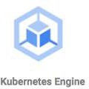
Google Kubernetes Engine (GKE)
Managed Kubernetes service
Minimize operations with auto-repair (repair failed nodes) and
auto-upgrade (use latest version of K8S always) features
Provides Pod and Cluster Autoscaling
Enable Cloud Logging and Cloud Monitoring with simple configuration
Uses Container-Optimized OS, a hardened OS built by Google Provides support for Persistent disks and Local SSD

Slide 114
Kubernetes - A Microservice Journey - Getting Started
Let's Have Some Fun: Let's get on a journey with Kubernetes:
Let's create a cluster, deploy a microservice and play with it in 13 steps!
1: Create a Kubernetes cluster with the default node pool
gcloud container clusters create or use cloud console
2: Login to Cloud Shell
3: Connect to the Kubernetes Cluster
gcloud container clusters get-credentials my-cluster --zone us-central1-a --project solid-course-258105

Slide 115
Kubernetes - A Microservice Journey - Deploy Microservice
4: Deploy Microservice to Kubernetes:
Create deployment & service using kubectl commands
kubectl create deployment hello-world-rest-api --image=in28min/hello-world-rest-api:0.0.1.RELEASE
kubectl expose deployment hello-world-rest-api --type=LoadBalancer --port=8080
5: Increase number of instances of your microservice:
kubectl scale deployment hello-world-rest-api --replicas=2
6: Increase number of nodes in your Kubernetes cluster:
gcloud container clusters resize my-cluster --node-pool my-node-pool --num-nodes 5
You are NOT happy about manually increasing number of instances and nodes!

Slide 116
Kubernetes - A Microservice Journey - Auto Scaling and ..
7: Setup auto scaling for your microservice:
kubectl autoscale deployment hello-world-rest-api --max=10 --cpu-percent=70
Also called horizontal pod autoscaling - HPA - kubectl get hpa
8: Setup auto scaling for your Kubernetes Cluster
gcloud container clusters update cluster-name --enable-autoscaling --min-nodes=1 -- max-nodes=10
9: Add some application configuration for your microservice
Config Map - kubectl create configmap todo-web-application-config --from- literal=RDS_DB_NAME=todos
10: Add password configuration for your microservice
Kubernetes Secrets - kubectl create secret generic todo-web-application-secrets-1 -- from-literal=RDS_PASSWORD=dummytodos

Slide 117
Kubernetes Deployment YAML - Deployment
apiVersion: apps/v1 kind: Deployment metadata:
labels:
app: hello-world-rest-api name: hello-world-rest-api namespace: default
spec:
replicas: 3 selector:
matchLabels:
app: hello-world-rest-api template:
metadata:
labels:
app: hello-world-rest-api spec:
containers:
- image: in28min/hello-world-rest-api:0.0.3.RELEASE name: hello-world-rest-api

Slide 118
Kubernetes Deployment YAML - Service
apiVersion: v1 kind: Service metadata:
labels:
app: hello-world-rest-api name: hello-world-rest-api namespace: default
spec:
ports:
- port: 8080 protocol: TCP targetPort: 8080
selector:
app: hello-world-rest-api sessionAffinity: None type: LoadBalancer

Slide 119
Kubernetes - A Microservice Journey - The End!
11: Deploy a new microservice which needs nodes with a GPU attached
Attach a new node pool with GPU instances to your cluster
gcloud container node-pools create POOL_NAME --cluster CLUSTER_NAME
gcloud container node-pools list --cluster CLUSTER_NAME
Deploy the new microservice to the new pool by setting up nodeSelector in the
deployment.yaml
nodeSelector: cloud.google.com/gke-nodepool: POOL_NAME
12: Delete the Microservices
Delete service - kubectl delete service
Delete deployment - kubectl delete deployment
13: Delete the Cluster
gcloud container clusters delete

Slide 120
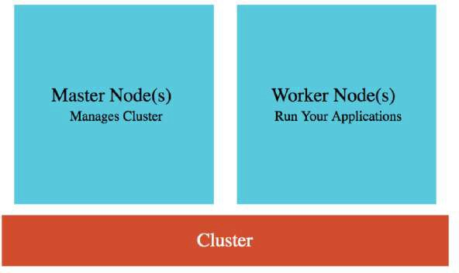
Google Kubernetes Engine (GKE) Cluster
Cluster : Group of Compute Engine instances:
Master Node(s) - Manages the cluster
Worker Node(s) - Run your workloads (pods)
Master Node (Control plane) components:
API Server - Handles all communication for a K8S cluster (from nodes and outside)
Scheduler - Decides placement of pods
Control Manager - Manages deployments & replicasets
etcd - Distributed database storing the cluster state
Worker Node components:
Runs your pods
Kubelet - Manages communication with master node(s)

Slide 121
GKE Cluster Types
Type Description
Zonal Cluster Single Zone - Single Control plane. Nodes running in the same zone.
Multi-zonal - Single Control plane but nodes running in multiple zones
Regional cluster
Replicas of the control plane runs in multiple zones of a given region. Nodes also run in same zones where control plane runs.
Private cluster
VPC-native cluster. Nodes only have internal IP addresses.
Alpha cluster
Clusters with alpha APIs - early feature API's. Used to test new K8S features.

Slide 122
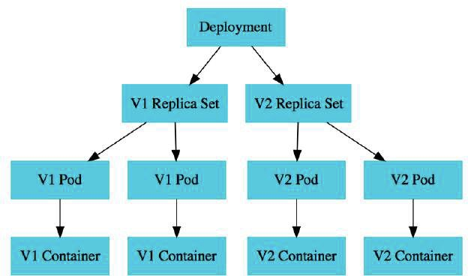
Kubernetes - Pods
Smallest deployable unit in Kubernetes A Pod contains one or more containers
Each Pod is assigned an ephemeral IP address
All containers in a pod share:
Network
Storage
IP Address Ports and
Volumes (Shared persistent disks)
POD statuses : Running /Pending /Succeeded
/Failed /Unknown

Slide 123
Kubernetes - Deployment vs Replica Set
A deployment is created for each microservice:
kubectl create deployment m1 --image=m1:v1
Deployment represents a microservice (with all its releases) Deployment manages new releases ensuring zero downtime
Replica set ensures that a specific number of pods are running for a specific microservice version
kubectl scale deployment m2 --replicas=2
Even if one of the pods is killed, replica set will launch a new one
Deploy V2 of microservice - Creates a new replica set
kubectl set image deployment m1 m1=m1:v2
V2 Replica Set is created
Deployment updates V1 Replica Set and V2 Replica Set based on the release strategies

Slide 124
Kubernetes - Service
Each Pod has its own IP address:
How do you ensure that external users are not impacted when:
A pod fails and is replaced by replica set
A new release happens and all existing pods of old release are replaced by ones of new release
Create Service
kubectl expose deployment name --type=LoadBalancer --port=80
Expose PODs to outside world using a stable IP Address
Ensures that the external world does not get impacted as pods go down and come up
Three Types:
ClusterIP: Exposes Service on a cluster-internal IP
Use case: You want your microservice only to be available inside the cluster (Intra cluster communication)
LoadBalancer: Exposes Service externally using a cloud provider's load balancer
Use case: You want to create individual Load Balancer's for each microservice
NodePort: Exposes Service on each Node's IP at a static port (the NodePort)
Use case: You DO not want to create an external Load Balancer for each microservice (You can create one Ingress

Slide 125
Container Registry - Image Repository
You've created docker images for your microservices:
Where do you store them?
Container Registry - fully-managed container registry provided by GCP (Alternative) Docker Hub
Can be integrated to CI/CD tools to publish images to registry
You can secure your container images. Analyze for vulnerabilities and enforce deployment policies.
Naming: HostName/ProjectID/Image:Tag - gcr.io/projectname/helloworld:1

Slide 126
GKE - Remember
Replicate master nodes across multiple zones for high availability (REMEMBER) Some CPU on the nodes is reserved by Control Plane:
1st core - 6%, 2nd core - 1%, 3rd/4th - 0.5, Rest - 0.25
Creating Docker Image for your microservices(Dockerfile):
Build Image: docker build -t in28min/hello-world-rest-api:0.0.1.RELEASE .
Test it Locally: docker run -d -p 8080:8080 in28min/hello-world-rest-api:0.0.1.RELEASE
Push it to Container Repository: docker push in28min/hello-world-rest-api:0.0.1.RELEASE
Kubernetes supports Stateful deployments like Kafka, Redis, ZooKeeper:
StatefulSet - Set of Pods with unique, persistent identities and stable hostnames
How do we run services on nodes for log collection or monitoring?
DaemonSet - One pod on every node! (for background services)
(Enabled by default) Integrates with Cloud Monitoring and Cloud Logging
Cloud Logging System and Application Logs can be exported to Big Query or Pub/Sub

Slide 127
GKE - Cluster Management - Command Line
Description Command
Create Cluster
gcloud container clusters create my-cluster --zone us-central1-a --node-locations us- central1-c,us-central1-b
Resize Cluster
gcloud container clusters resize my-cluster --node-pool my-node-pool --num-nodes 10
Autoscale Cluster
gcloud container clusters update cluster-name --enable-autoscaling --min-nodes=1 --max- nodes=10
Delete Cluster
gcloud container clusters delete my-cluster
Adding Node Pool
gcloud container node-pools create new-node-pool-name --cluster my-cluster
List Images
gcloud container images list

Slide 128
GKE - Workload Management - Command Line
Description Command
List Pods/Service/Replica kubectl get pods/services/replicasets Sets
Create Deployment kubectl apply -f deployment.yaml or kubectl create deployment
Create Service
kubectl expose deployment hello-world-rest-api --type=LoadBalancer -- port=8080
Scale Deployment
kubectl scale deployment hello-world --replicas 5
Autoscale Deployment
kubectl autoscale deployment --max --min --cpu-percent
Delete Deployment
kubectl delete deployment hello-world
Update Deployment
kubectl apply -f deployment.yaml
Rollback Deployment
kubectl rollout undo deployment hello-world --to-revision=1

Slide 129
Google Kubernetes Engine - Scenarios - 1
Scenario Solution
You want to keep your costs low and optimize your GKE implementation
Consider Preemptible VMs, Appropriate region, Committed-use discounts.
E2 machine types are cheaper than N1.
Choose right environment to fit your workload type (Use multiple node pools if needed).
You want an eﬀicient, completely auto scaling GKE solution
Configure Horizontal Pod Autoscaler for deployments and Cluster Autoscaler for node pools
You want to execute untrusted third-party code in Kubernetes Cluster
Create a new node pool with GKE Sandbox. Deploy untrused code to Sandbox node pool.

Slide 130
Google Kubernetes Engine - Scenarios - 2
Scenario Solution
You want enable ONLY internal communication between your Create Service of type ClusterIP
microservice deployments in a Kubernetes Cluster
My pod stays pending
Most probably Pod cannot be scheduled onto a node(insuﬀicient resources)
My pod stays waiting
Most probably failure to pull the image

Slide 131
Google Cloud Functions

Slide 132
Cloud Functions
Imagine you want to execute some code when an event happens?
A file is uploaded in Cloud Storage (OR) An error log is written to Cloud Logging (OR) A message arrives to Cloud Pub/Sub (OR) A http/https invocation is received
Enter Cloud Functions
Run code in response to events
Write your business logic in Node.js, Python, Go, Java, .NET, and Ruby
Don't worry about servers or scaling or availability (only worry about your code)
Pay only for what you use
Number of invocations
Compute time of the invocations Memory and CPU provisioned
Time Bound - Default 1 min and MAX 60 minutes (3600 seconds)
2 product versions
Cloud Functions (1st gen): First version
Cloud Functions (2nd gen): New version built on top of Cloud Run and Eventarc

Slide 133
Cloud Functions - Concepts
Event : Upload object to cloud storage
Trigger: Respond to event with a Function call
Trigger - Which function to trigger when an event happens?
Functions - Take event data and perform action?
Events are triggered from
Cloud Storage
Cloud Pub/Sub
HTTP POST/GET/DELETE/PUT/OPTIONS
Firebase
Cloud Firestore Stack driver logging

Slide 134
Example Cloud Function - HTTP - Node.js
const escapeHtml = require('escape-html');
/**
HTTP Cloud Function.
*
@param {Object} req Cloud Function request context.
More info: https://expressjs.com/en/api.html#req
@param {Object} res Cloud Function response context.
More info: https://expressjs.com/en/api.html#res
*/
exports.helloHttp = (req, res) => {
res.send(`Hello ${escapeHtml(req.query.name || req.body.name || 'World')}!`);
};

Slide 135
Example Cloud Function - Pub/Sub - Node.js
/**
Background Cloud Function to be triggered by Pub/Sub.
This function is exported by index.js, and executed when
the trigger topic receives a message.
*
@param {object} message The Pub/Sub message.
@param {object} context The event metadata.
*/
exports.helloPubSub = (message, context) => { const name = message.data
? Buffer.from(message.data, 'base64').toString()
: 'World';
console.log(`Hello, ${name}!`);
};

Slide 136
Cloud Functions - Remember
No Server Management: You dont need to worry about scaling or availability of your function
Cloud Functions automatically spin up and back down in response to events
They scale horizontally!
Cloud Functions are recommended for responding to events:
Cloud Functions are NOT ideal for long running processes
Time Bound - Default 1 min and MAX 60 minutes(3600 seconds)

Slide 137

Cloud Run & Cloud Run for Anthos
Cloud Run - "Container to Production in Seconds"
Built on top of an open standard - Knative
Fully managed serverless platform for containerized applications
ZERO infrastructure management
Pay-per-use (For used CPU, Memory, Requests and Networking)
Fully integrated end-to-end developer experience:
No limitations in languages, binaries and dependencies
Easily portable because of container based architecture
Cloud Code, Cloud Build, Cloud Monitoring & Cloud Logging Integrations
Anthos - Run Kubernetes clusters anywhere
Cloud, Multi Cloud and On-Premise
Cloud Run for Anthos: Deploy your workloads to Anthos clusters running on-premises or on Google Cloud
Leverage your existing Kubernetes investment to quickly run serverless workloads

Slide 138
Cloud Run - From the Command Line
Description Command
Deploy a new container
gcloud run deploy SERVICE_NAME --image IMAGE_URL --revision-suﬀix v1
First deployment creates a service and first revision
Next deployments for the same service create new revisions
List available revisions
gcloud run revisions list
Adjust traﬀic assignments
gcloud run services update-traﬀic myservice --to-revisions=v2=10,v1=90

Slide 139
Cloud Functions - Second Generation - What's New?
2 Product Versions:
Cloud Functions (1st gen): First version
Cloud Functions (2nd gen): New version built on top of Cloud Run and Eventarc
Recommended: Use Cloud Functions (2nd gen)
Key Enhancements in 2nd gen:
Longer Request timeout: Up to 60 minutes for HTTP-triggered functions
Larger instance sizes: Up to 16GiB RAM with 4 vCPU (v1: Up to 8GB RAM with 2 vCPU)
Concurrency: Upto 1000 concurrent requests per function instance (v1: 1 concurrent request per function instance)
Multiple Function Revisions and Traﬀic splitting supported (v1: NOT supported) Support for 90+ event types - enabled by Eventarc (v1: Only 7)
DEMO!

Slide 140
Cloud Functions - Scaling and Concurrency
Typical serverless functions architecture:
Autoscaling - As new invocations come in, new function instances are created
One function instance handles ONLY ONE request AT A TIME 3 concurrent function invocations => 3 function instances
If a 4th function invocation occurs while existing invocations are in progress, a new function instance
will be created
HOWEVER, a function instance that completed execution may be reused for future requests
(Typical Problem) Cold Start:
New function instance initialization from scratch can take time
(Solution) Configure Min number of instances (increases cost)
1st Gen uses the typical serverless functions architecture
2nd Gen adds a very important new feature:
One function instance can handle multiple requests AT THE SAME TIME
Concurrency: How many concurrent invocations can one function instance handle? (Max 1000)
(IMPORTANT) Your function code should be safe to execute concurrently

Slide 141
Cloud Functions - Deployment using gcloud
gcloud functions deploy [NAME]
--docker-registry (registry to store the function's Docker images)
Default -container-registry
Alternative - artifact-registry
--docker-repository (repository to store the function's Docker images)
Example: (projects/${PROJECT}/locations/${LOCATION}/repositories/${REPOSITORY})
--gen2 (Use 2nd gen. If this option is not present, 1st gen will be used)
--runtime (nodejs, python, java,...)
Reference - https://cloud.google.com/functions/docs/runtime-support
--service-account (Service account to use)
GEN - default - App Engine default service account - PROJECT_ID@appspot.gserviceaccount.com
GEN - Default compute service account - PROJECT_NO-compute@developer.gserviceaccount.com
--timeout (function execution timeout)
--max-instances (function execution exceeding max-instances times out)
--min-instances (avoid cold starts at higher cost)

Slide 142
Cloud Functions - Deployment using gcloud - 2
//Deploy Pubsub Triggered gen2 function from Cloud Storage Bucket gcloud functions deploy my-pubsub-function \
--gen2 \
--region=europe-west1 \
--runtime=nodejs16 \
--source=gs://my-source-bucket/source.zip \
--trigger-topic=my-pubsub-topic
gcloud functions deploy [NAME]
--source
Zip file from Google Cloud Storage (gs://my-source-bucket/my_function_source.zip) (OR)
Source Repo (https://URL/projects/${PROJECT}/repos/${REPO}) (OR) Local file system
--trigger-bucket (OR) --trigger-http (OR) --trigger-topic (OR) --trigger-event-filters (ONLY in gen2 - Eventarc matching criteria for the trigger)
--serve-all-traﬀic-latest-revision (ONLY in gen2)

Slide 143
Encryption

Slide 144

Data States
Data at rest: Stored on a device or a backup
Examples : data on a hard disk, in a database, backups and archives
Data in motion: Being transferred across a network
Also called Data in transit
Examples :
Data copied from on-premise to cloud storage
An application talking to a database
Two Types:
In and out of cloud (from internet)
Within cloud
Data in use: Active data processed in a non-persistent state
Example: Data in your RAM

Slide 145
Encryption
If you store data as is, what would happen if an unauthorized entity gets access to it?
Imagine losing an unencrypted hard disk
First law of security : Defense in Depth Typically, enterprises encrypt all data
Data on your hard disks
Data in your databases Data on your file servers
Is it suﬀicient if you encrypt data at rest?
No. Encrypt data in transit - between application to database as well.

Slide 146
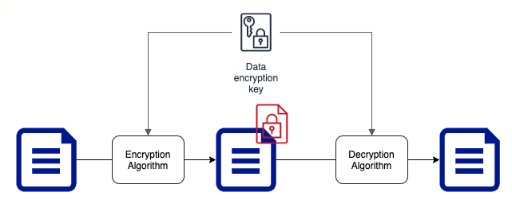
Symmetric Key Encryption
Symmetric encryption algorithms use the same key for encryption and decryption
Key Factor 1: Choose the right encryption algorithm Key Factor 2: How do we secure the encryption key? Key Factor 3: How do we share the encryption key?

Slide 147
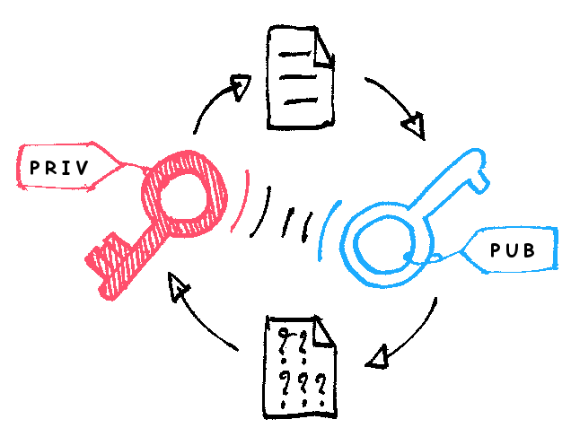
Asymmetric Key Encryption
Two Keys : Public Key and Private Key Also called Public Key Cyptography
Encrypt data with Public Key and decrypt with Private Key
Share Public Key with everybody and keep the Private Key with you(YEAH, ITS PRIVATE!)
No crazy questions:
Will somebody not figure out private key using the public key?
How do you create Asymmetric Keys?
https://commons.wikimedia.org/wiki/File:Asymmetric_encryption_(colored).

Slide 148
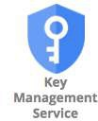
Cloud KMS
Create and manage cryptographic keys (symmetric and asymmetric)
Control their use in your applications and GCP Services Provides an API to encrypt, decrypt, or sign data
Use existing cryptographic keys created on premises
Integrates with almost all GCP services that need data encryption:
Google-managed key: No configuration required
Customer-managed key: Use key from KMS Customer-supplied key: Provide your own key

Slide 149
Storage

Slide 150
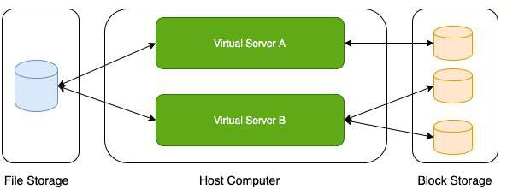
Storage Types - Block Storage and File Storage
What is the type of storage of your hard disk?
Block Storage
You've created a file share to share a set of files with your colleagues in a enterprise. What type of storage are you using?
File Storage

Slide 151
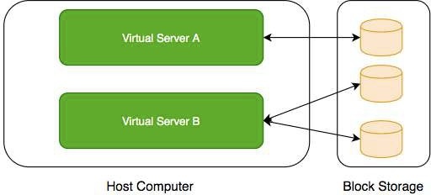
Block Storage
Use case: Harddisks computers
attached to your
Typically, ONE Block Storage device can be connected to ONE virtual server
(EXCEPTIONS) You can attach read only block devices with multiple virtual servers and certain cloud providers are exploring multi-writer disks as well!
HOWEVER, you can connect multiple diﬀerent block storage devices to one virtual server
Used as:
Direct-attached storage (DAS) - Similar to a hard disk
Storage Area Network (SAN) - High-speed network connecting a pool of storage devices

Slide 152
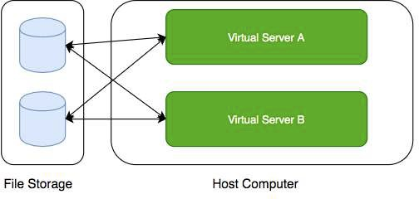
File Storage
Media workflows need huge shared storage for supporting processes like video editing
Enterprise users need a quick way to share files in a secure and organized way
These file shares are shared by several virtual servers

Slide 153

GCP - Block Storage and File Storage
Block Storage:
Persistent Disks: Network Block Storage
Zonal: Data replicated in one zone
Regional: Data replicated in multiple zone
Local SSDs: Local Block Storage
File Storage:
Filestore: High performance file storage

Slide 154
GCP - Block Storage
Two popular types of block storage can be attached to VM instances:
Local SSDs
Persistent Disks
Local SSDs are physically attached to the host of the VM instance
Temporary data
Lifecycle tied to VM instance
Persistent Disks are network storage
More durable
Lifecycle NOT tied to VM instance

Slide 155
Local SSDs
Physically attached to the host of VM instance:
Provide very high (IOPS) and very low latency
(BUT) Ephemeral storage - Temporary data (Data persists only until instance is running)
Enable live migration for data to survive maintenance events
Data automatically encrypted
HOWEVER, you CANNOT configure encryption keys!
Lifecycle tied to VM instance
ONLY some machine types support Local SSDs Supports SCSI and NVMe interfaces
Remember:
Choose NVMe-enabled and multi-queue SCSI images for best performance
Larger Local SSDs (more storage), More vCPUs (attached to VM) => Even Better Performance

Slide 156
Local SSDs - Advantages and Disadvantages
Advantages
Very Fast I/O (~ 10-100X compared to PDs)
Higher throughput and lower latency
Ideal for use cases needing high IOPs while storing temporary information
Examples: Caches, temporary data, scratch files etc
Disadvantages
Ephemeral storage
Lower durability, lower availability, lower flexibility compared to PDs
You CANNOT detach and attach it to another VM instance

Slide 157
Persistent Disks (PD)
Network block storage attached to your VM instance
Provisioned capacity
Very Flexible:
Increase size when you need it - when attached to VM instance
Performance scales with size
For higher performance, resize or add more PDs
Independent lifecycle from VM instance
Attach/Detach from one VM instance to another
Options: Regional and Zonal
Zonal PDs replicated in single zone. Regional PDs replicated in 2 zones in same Region.
Typically Regional PDs are 2X the cost of Zonal PDs
Use case : Run your custom database

Slide 158
Persistent Disks vs Local SSDs
Feature | Persistent Disks | Local SSDs
Attachment to VM instance | As a network drive | Physically attached
Lifecycle | Separate from VM instance | Tied with VM instance
I/O Speed | Lower (network latency) | 10-100X of PDs
Snapshots | Supported | Not Supported
Use case | Permanent storage | Ephemeral storage

Slide 159
Persistent Disks - Standard vs Balanced vs SSD
Feature | Standard | Balanced | SSD
Underlying Storage | Hard Disk Drive | Solid State Drive | Solid State Drive
Referred to as | pd-standard | pd-balanced | pd-ssd
Performance - Sequential IOPS (Big Data/Batch) | Good | Good | Very Good
Performance - Random IOPS (Transactional Apps) | Bad | Good | Very Good
Cost | Cheapest | In Between | Expensive
Use cases | Big Data (cost eﬀicient) | Balance between cost and performance | High Performance

Slide 160


Persistent Disks - Snapshots
Take point-in-time snapshots of your Persistent Disks You can also schedule snapshots (configure a schedule):
You can also auto-delete snapshots after X days
Snapshots can be Multi-regional and Regional You can share snapshots across projects
You can create new disks and instances from snapshots Snapshots are incremental:
Deleting a snapshot only deletes data which is NOT needed by other snapshots
Keep similar data together on a Persistent Disk:
Separate your operating system, volatile data and permanent data
Attach multiple disks if needed
This helps to better organize your snapshots and images

Slide 161
Persistent Disks - Snapshots - Recommendations
Avoid taking snapshots more often than once an hour
Disk volume is available for use but Snapshots reduce performance
(RECOMMENDED) Schedule snapshots during oﬀ-peak hours
Creating snapshots from disk is faster than creating from images:
But creating disks from image is faster than creating from snapshots
(RECOMMENDED) If you are repeatedly creating disks from a snapshot:
Create an image from snapshot and use the image to create disks
Snapshots are incremental:
BUT you don't lose data by deleting older snapshots
Deleting a snapshot only deletes data which is NOT needed by other snapshots (RECOMMENDED) Do not hesitate to delete unnecessary snapshots

Slide 162

Playing with Machine Images
(Remember) Machine Image is diﬀerent from Image
Multiple disks can be attached with a VM:
One Boot Disk (Your OS runs from Boot Disk)
Multiple Data Disks
An image is created from the boot Persistent Disk HOWEVER, a Machine Image is created from a VM instance:
Machine Image contains everything you need to create a VM instance:
Configuration
Metadata Permissions
Data from one or more disks
Recommended for disk backups, instance cloning and replication

Slide 163
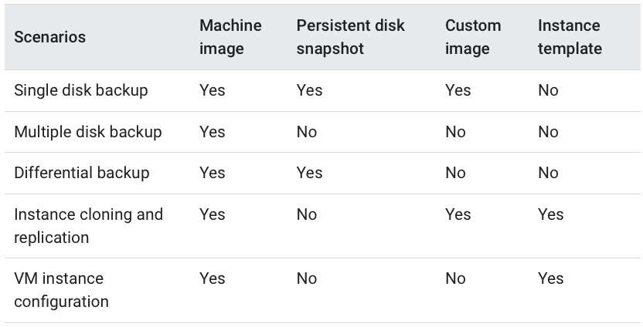
Let's Compare
https://cloud.google.com/compute/docs/machine-images

Slide 164
Playing with Disks - Command Line
gcloud compute disks list/create/delete/resize/snapshot
gcloud compute disks create my-disk-1 --zone=us-east1-a
What should be the size and type?
--size=SIZE (1GB or 2TB)
--type=TYPE (default - pd-standard) (gcloud compute disk-types list)
What should be on the disk?
--image --image-family --source-disk --source-snapshot
How should data on disk be encrypted?
--kms-key --kms-project
gcloud compute disks resize example-disk-1 --size=6TB
Only increasing disk size is supported
gcloud compute disks snapshot test names=snapshot-test
You can also play with the snapshots which are created:
gcloud compute snapshots list/describe/delete
--zone=us-central1-a
--snapshot-

Slide 165
Playing with Images - Command Line
gcloud compute images
Actions: create/delete/deprecate/describe/export/import/list/update
Creating Images
gcloud compute images create my-image
From a Disk - --source-disk=my-disk --source-disk-zone=us-east1-a
From a Snapshot - --source-snapshot=source-snapshot
From another image - --source-image=source-image --source-image-project=source-image-project
From latest non deprecated image from a family - --source-image-family=source-image-family --source-image- project=source-image-project
Deprecate Image
gcloud compute images deprecate IMAGE --state=DEPRECATED
Exports virtual disk images
gcloud compute images export --image=my-image --destination-uri=gs://my-bucket/my-image.vmdk -
-export-format=vmdk --project=my-project
Other Examples:
gcloud compute images delete my-image1 my-image2

Slide 166
Playing with Machine Images - Command Line
(Remember) gcloud commands for machine images are IN BETA Commands:
Create Machine Image:
gcloud beta compute machine-images create SOURCE_INSTANCE_NAME
Create an Instance from the Machine Image:
MACHINE_IMAGE_NAME --source-instance
gcloud beta compute instances create VM_NAME --zone ZONE --source-machine-image SOURCE_MACHINE_IMAGE_NAME

Slide 167
Storage - Scenarios - Persistent Disks
Scenario Solution
You want to improve performance of Persistent Disks (PD)
Increase size of PD or Add more PDs. Increase vCPUs in your VM.
You want to increase durability of Persistent Disks (PD)
Go for Regional PDs (2X cost but replicated in 2 zones)
You want to take hourly backup of Persistent Disks (PD) for disaster recovery
Schedule hourly snapshots!
You want to delete old snapshots created by scheduled snapshots
Configure it as part of your snapshot scheduling!

Slide 168
Cloud Filestore
Shared cloud file storage:
Supports NFSv3 protocol
Provisioned Capacity
Suitable for high performance workloads:
Up to 320 TB with throughput of 16 GB/s and 480K IOPS
Supports HDD (general purpose) and SSD (performance-critical workloads)
Use cases : file share, media workflows and content management

Slide 169
Review - Global, Regional and Zonal Resources
Global
Images
Snapshots
Instance templates (Unless you use zonal resources in your templates)
Regional
Regional managed instance groups
Regional persistent disks
Zonal
Zonal managed instance groups
Instances
Persistent disks
You can attach a disk only to instances in the same zone as the disk

Slide 170
Storage - Scenarios
Scenario
Solution
You want Very High IOPS but your data can be lost without a problem
Local SSDs
You want to create a high perfomance file sharing system in GCP which can be attached with multiple VMs
Filestore
You want to backup your VM configuration along with all its attached Persistent Disks
Create a Machine Image
You want to make it easy to launch VMs with hardened OS and customized software
Create a Custom Image

Slide 171
Object Storage - Cloud Storage

Slide 172

Cloud Storage
Most popular, very flexible & inexpensive storage service
Serverless: Autoscaling and infinite scale
Store large objects using a key-value approach:
Treats entire object as a unit (Partial updates not allowed)
Recommended when you operate on entire object most of the time
Access Control at Object level
Also called Object Storage
Provides REST API to access and modify objects
Also provides CLI (gsutil) & Client Libraries (C++, C#, Java, Node.js, PHP, Python & Ruby)
Store all file types - text, binary, backup & archives:
Media files and archives, Application packages and logs
Backups of your databases or storage devices
Staging data during on-premise to cloud database migration

Slide 173
Cloud Storage - Objects and Buckets
Objects are stored in buckets
Bucket names are globally unique
Bucket names are used as part of object URLs => Can contain ONLY lower case letters, numbers, hyphens, underscores and periods.
3-63 characters max. Can't start with goog prefix or should not contain
google (even misspelled)
Unlimited objects in a bucket
Each bucket is associated with a project
Each object is identified by a unique key
Key is unique in a bucket
Max object size is 5 TB
BUT you can store unlimited number of such objects

Slide 174
Cloud Storage - Storage Classes - Introduction
Diﬀerent kinds of data can be stored in Cloud Storage
Media files and archives
Application packages and logs
Backups of your databases or storage devices Long term archives
Huge variations in access patterns
Can I pay a cheaper price for objects I access less frequently?
Storage classes help to optimize your costs based on your access needs
Designed for durability of 99.999999999%(11 9’s)

Slide 175
Cloud Storage - Storage Classes - Comparison
Storage Class | Name | Minimum Storage duration | Typical Monthly availability | Use case
Standard | STANDARD | None | > 99.99% in multi region and dual region, 99.99% in regions | Frequently used data/Short period of time
Nearline storage | NEARLINE | 30 days | 99.95% in multi region and dual region, 99.9% in regions | Read or modify once a month on average
Coldline storage | COLDLINE | 90 days | 99.95% in multi region and dual region, 99.9% in regions | Read or modify at most once a quarter
Archive storage | ARCHIVE | 365 days | 99.95% in multi region and dual region, 99.9% in regions | Less than once a year

Slide 176
Features across Storage Classes
High durability (99.999999999% annual durability) Low latency (first byte typically in tens of milliseconds) Unlimited storage
Autoscaling (No configuration needed)
NO minimum object size
Same APIs across storage classes
Committed SLA is 99.95% for multi region and 99.9% for single region for Standard, Nearline and Coldline storage classes
No committed SLA for Archive storage

Slide 177
Cloud Storage - Uploading and Downloading Objects
Option Recommended for Scenarios
Simple Upload Small files (that can be re uploaded in case of failures) + NO object metadata
Multipart upload Small files (that can be re uploaded in case of failures) + object metadata
Resumable upload
Larger files. RECOMMENDED for most usecases
(even for small files - costs one additional HTTP request)
Streaming transfers
Upload an object of unknown size
Parallel composite uploads
File divided up to 32 chunks and uploaded in parallel.
Significantly faster if network and disk speed are not limiting factors.
Simple download
Downloading objects to a destination
Streaming download
Downloading data to a process
Sliced object download
Slice and download large objects

Slide 178
Object Versioning
Prevents accidental deletion & provides history
Enabled at bucket level
Can be turned on/oﬀ at any time
Live version is the latest version
If you delete live object, it becomes noncurrent object version
If you delete noncurrent object version, it is deleted
Older versions are uniquely identified by (object key + a generation number)
Reduce costs by deleting older (noncurrent) versions!

Slide 179
Object Lifecycle Management
Files are frequently accessed when they are created
Generally usage reduces with time
How do you save costs by moving files automatically between storage classes?
Solution: Object Lifecycle Management
Identify objects using conditions based on:
Age, CreatedBefore, IsLive, MatchesStorageClass, NumberOfNewerVersions etc
Set multiple conditions: all conditions must be satisfied for action to happen
Two kinds of actions:
SetStorageClass actions (change from one storage class to another)
Deletion actions (delete objects)
Allowed Transitions:
(Standard or Multi-Regional or Regional) to (Nearline or Coldline or Archive)
Nearline to (Coldline or Archive)

Slide 180
Object Lifecycle Management - Example Rule
{
"lifecycle": {
"rule": [
{
"action": {"type": "Delete"}, "condition": {
"age": 30, "isLive": true
}
},
{
"action": {
"type": "SetStorageClass", "storageClass": "NEARLINE"
},
"condition": {
"age": 365,
"matchesStorageClass": ["STANDARD"]
}
}
]
}
}

Slide 181

Cloud Storage - Encryption
Cloud Storage always encrypts data on the server side!
Configure Server-side encryption: Encryption performed by Cloud Storage
Google-managed encryption key - Default (No configuration required)
Customer-managed encryption keys - Created using Cloud Key Management Service (KMS). Managed by customer in KMS.
Cloud Storage Service Account should have access to keys in KMS for encrypting and decrypting using the Customer-Managed encryption key
(OPTIONAL) Client-side encryption - Encryption performed by customer before upload
GCP does NOT know about the keys used

Slide 182
Cloud Storage - Scenarios
Scenario
How do you speed up large uploads (example: 100 GB) to Cloud Storage?
You want to permanently store application logs for regulatory reasons. You don't expect to access them at all.
Log files stored in Cloud storage. You expect to access them once in quarter.
How do you change storage class of an existing bucket in Cloud Storage?
Description
Use Parallel composite uploads (File is broken in to small chunks and uploaded)
Cloud storage - Archive
Cold Line
Step 1: Change Default Storage Class of the bucket.
Step 2: Update the Storage Class of the objects in the bucket.

Slide 183
Cloud Storage - Command Line - gsutil - 1
(REMEMBER) gsutil is the CLI for Cloud Storage (NOT gcloud) Cloud Storage (gsutil)
gsutil mb gs://BKT_NAME (Create Cloud Storage bucket)
gsutil ls -a gs://BKT_NAME (List current and non-current object versions)
gsutil cp gs://SRC_BKT/SRC_OBJ gs://DESTN_BKT/NAME_COPY (Copy objects)
-o 'GSUtil:encryption_key=ENCRYPTION_KEY' - Encrypt Object
gsutil mv (Rename/Move objects)
gsutil mv gs://BKT_NAME/OLD_OBJ_NAME gs://BKT_NAME/NEW_OBJ_NAME
gsutil mv gs://OLD_BUCKET_NAME/OLD_OBJECT_NAME gs://NEW_BKT_NAME/NEW_OBJ_NAME
gsutil rewrite -s STORAGE_CLASS gs://BKT_NAME/OBJ_PATH (Ex: Change Storage Class for objects)
gsutil cp : Upload and Download Objects
gsutil cp LOCAL_LOCATION gs://DESTINATION_BKT_NAME/ (Upload)
gsutil cp gs://BKT_NAME/OBJ_PATH LOCAL_LOCATION (Download)

Slide 184
Cloud Storage - Command Line - gsutil - 2
Cloud Storage (gsutil)
gsutil versioning set on/oﬀ gs://BKT_NAME (Enable/Disable Versioning)
gsutil uniformbucketlevelaccess set on/oﬀ gs://BKT_NAME gsutil acl ch (Set Access Permissions for Specific Objects)
gsutil acl ch -u AllUsers:R gs://BKT_NAME/OBJ_PATH (Make specific object public)
gsutil acl ch -u john.doe@example.com:WRITE gs://BKT_NAME/OBJ_PATH
Permissions - READ (R), WRITE (W), OWNER (O)
Scope - User, allAuthenticatedUsers, allUsers(-u), Group (-g), Project (-p) etc
gsutil acl set JSON_FILE gs://BKT_NAME
gsutil iam ch MBR_TYPE:MBR_NAME:IAM_ROLE gs://BKT_NAME (Setup IAM role)
gsutil iam ch user:me@myemail.com:objectCreator gs://BKT_NAME
gsutil iam ch allUsers:objectViewer gs://BKT_NAME (make the entire bucket readable)
gsutil signurl -d 10m YOUR_KEY gs://BUCKET_NAME/OBJECT_PATH (Signed URL for temporary access)

Slide 185
Cloud Storage - Command Line - gcloud storage
Earlier, gsutil was the recommended CLI for Cloud Storage
GCLOUD STORAGE is now the recommended CLI for Cloud Storage
Advantages:
Upto 94% faster storage transfers
Better parallel processing
Do NOT worry about options/parameters/flags
gcloud storage will decide the optimal storage transfer approach for you Provides very simple to remember commands (consistent with gcloud):
gcloud storage buckets create gs://BKT_NAME (Create Cloud Storage bucket)
options: --default-encryption-key, --default-storage-class
gcloud storage buckets delete gs://BKT_NAME gcloud storage buckets list gs://B*
gcloud storage buckets describe gs://BKT_NAME gcloud storage buckets update gs://BKT_NAME
options: --default-encryption-key, --default-storage-class, --[no-]versioning
If you have existing scripts that make use of gsutil commands AND
You do NOT want to change the scripts AND
You want the performance benefits oﬀered by new features in gcloud storage
Check out shim (In boto configuration file, configure use_gcloud_storage=True under GSUtil section)

Slide 186
IAM

Slide 187

Typical identity management in the cloud
You have resources in the cloud (examples - a virtual server, a database etc)
You have identities (human and non-human) that need to access those resources and perform actions
For example: launch (stop, start or terminate) a virtual server
How do you identify users in the cloud?
How do you configure resources they can access?
How can you configure what actions to allow?
In GCP: Identity and Access Management (Cloud IAM) provides this service

Slide 188
Cloud Identity and Access Management (IAM)
Authentication (is it the right user?) and Authorization (do they have the right access?) Identities can be
A GCP User (Google Account or Externally Authenticated User)
A Group of GCP Users
An Application running in GCP
An Application running in your data center Unauthenticated users
Provides very granular control
Limit a single user:
to perform single action
on a specific cloud resource from a specific IP address

Slide 189
Cloud IAM Example
I want to provide access to manage a specific cloud storage bucket to a colleague of mine:
Important Generic Concepts:
Member: My colleague
Resource: Specific cloud storage bucket
Action: Upload/Delete Objects
In Google Cloud IAM:
Roles: A set of permissions (to perform specific actions on specific resources)
Roles do NOT know about members. It is all about permissions!
How do you assign permissions to a member?
Policy: You assign (or bind) a role to a member
1: Choose a Role with right permissions (Ex: Storage Object Admin)
2: Create Policy binding member (your friend) with role (permissions) IAM in AWS is very diﬀerent from GCP (Forget AWS IAM & Start FRESH!)
Example: Role in AWS is NOT the same as Role in GCP

Slide 190
IAM - Roles
Roles are Permissions:
Perform some set of actions on some set of resources
Three Types:
Basic Roles (or Primitive roles) - Owner/Editor/Viewer
Viewer(roles.viewer) - Read-only actions
Editor(roles.editor) - Viewer + Edit actions
Owner(roles.owner) - Editor + Manage Roles and Permissions + Billing EARLIEST VERSION: Created before IAM
NOT RECOMMENDED: Don't use in production
Predefined Roles - Fine grained roles predefined and managed by Google
Diﬀerent roles for diﬀerent purposes
Examples: Storage Admin, Storage Object Admin, Storage Object Viewer, Storage Object Creator
Custom Roles - When predefined roles are NOT suﬀicient, you can create your own custom roles

Slide 191
IAM - Predefined Roles - Example Permissions
Important Cloud Storage Roles:
Storage Admin (roles/storage.admin)
storage.buckets.*
storage.objects.*
Storage Object Admin (roles/storage.objectAdmin)
storage.objects.*
Storage Object Creator (roles/storage.objectCreator)
storage.objects.create
Storage Object Viewer (roles/storage.objectViewer)
storage.objects.get
storage.objects.list
All four roles have these permissions:
resourcemanager.projects.get
resourcemanager.projects.list

Slide 192
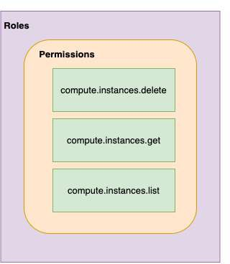
IAM - Most Important Concepts - A Review
Member : Who?
Roles : Permissions (What Actions? What Resources?)
Policy : Assign Permissions to Members
Map Roles (What?) , Members (Who?) and Conditions (Which Resources?, When?, From Where?)
Remember: Permissions are NOT directly assigned to Member
Permissions are represented by a Role
Member gets permissions through Role!
A Role can have multiple permissions
You can assign multiple roles to a Member

Slide 193
IAM policy
Roles are assigned to users through IAM Policy documents Represented by a policy object
Policy object has list of bindings
A binding, binds a role to list of members
Member type is identified by prefix:
Example: user, serviceaccount, group or domain

Slide 194
IAM policy - Example
{
"bindings": [
{
"role": "roles/storage.objectAdmin", "members": [
"user:you@in28minutes.com",
"serviceAccount:myAppName@appspot.gserviceaccount.com", "group:administrators@in28minutes.com", "domain:google.com"
]
},
{
"role": "roles/storage.objectViewer", "members": [
"user:you@in28minutes.com"
],
"condition": {
"title": "Limited time access", "description": "Only upto Feb 2022",
"expression": "request.time < timestamp('2022-02-01T00:00:00.000Z')",
}
}
]
}

Slide 195
Playing With IAM
gcloud: Playing with IAM
gcloud compute project-info describe - Describe current project
gcloud auth login - Access the Cloud Platform with Google user credentials gcloud auth revoke - Revoke access credentials for an account
gcloud auth list - List active accounts
gcloud projects
gcloud projects add-iam-policy-binding - Add IAM policy binding
gcloud projects get-iam-policy - Get IAM policy for a project
gcloud projects remove-iam-policy-binding - Remove IAM policy binding gcloud projects set-iam-policy - Set the IAM policy
gcloud projects delete - Delete a project
gcloud iam
gcloud iam roles describe - Describe an IAM role
gcloud iam roles create - create an iam role(--project, --permissions, --stage) gcloud iam roles copy - Copy IAM Roles

Slide 196
Service Accounts
Scenario: An Application on a VM needs access to cloud storage
You DONT want to use personal credentials to allow access
(RECOMMENDED) Use Service Accounts
Identified by an email address (Ex: id-compute@developer.gserviceaccount.com)
Does NOT have password
Has a private/public RSA key-pairs
Can't login via browsers or cookies
Service account types:
Default service account - Automatically created when some services are used
(NOT RECOMMENDED) Has Editor role by default
User Managed - User created
(RECOMMENDED) Provides fine grained access control
Google-managed service accounts - Created and managed by Google
Used by GCP to perform operations on user's behalf
In general, we DO NOT need to worry about them

Slide 197
Use case 1 : VM <-> Cloud Storage
1: Create a Service Account Role with the right permissions
2: Assign Service Account role to VM instance
Uses Google Cloud-managed keys:
Key generation and use are automatically handled by IAM when we assign a service account to the instance
Automatically rotated
No need to store credentials in config files
Do NOT delete service accounts used by running instances:
Applications running on those instances will lose access!

Slide 198
Use case 2 : On Prem <-> Cloud Storage (Long Lived)
You CANNOT assign Service Account directly to an On Prem App 1: Create a Service Account with right permissions
2: Create a Service Account User Managed Key
gcloud iam service-accounts keys create
Download the service account key file
Keep it secure (It can be used to impersonate service account)!
3: Make the service account key file accessible to your application
Set environment variable GOOGLE_APPLICATION_CREDENTIALS
export GOOGLE_APPLICATION_CREDENTIALS="/PATH_TO_KEY_FILE"
4: Use Google Cloud Client Libraries
Google Cloud Client Libraries use a library - Application Default Credentials (ADC)
ADC uses the service account key file if env var GOOGLE_APPLICATION_CREDENTIALS exists!

Slide 199
Use case 3 : On Prem <-> Google Cloud APIs (Short Lived)
Make calls from outside GCP to Google Cloud APIs with short lived permissions
Few hours or shorter
Less risk compared to sharing service account keys!
Credential Types:
OAuth 2.0 access tokens
OpenID Connect ID tokens
Self-signed JSON Web Tokens (JWTs)
Examples:
When a member needs elevated permissions, he can assume the service account role (Create OAuth 2.0 access token for service account)
OpenID Connect ID tokens is recommended for service to service authentications:
A service in GCP needs to authenticate itself to a service in other cloud

Slide 200
Service Account Use case Scenarios
Scenario Solution
Application on a VM wants to talk to a Cloud Storage bucket
Configure the VM to use a Service Account with right permissions
Application on a VM wants to put a message on a Pub Sub Topic
Configure the VM to use a Service Account with right permissions
Is Service Account an identity or a resource?
It is both. You can attach roles with Service Account (identity). You can let other members access a SA by granting them a role on the Service Account (resource).
VM instance with default service account in Project A needs to access Cloud Storage bucket in Project B
In project B, add the service account from Project A and assign Storage Object Viewer Permission on the bucket

Slide 201
ACL (Access Control Lists)
ACL: Define who has access to your buckets and objects, as well as what level of access they have
How is this diﬀerent from IAM?
IAM permissions apply to all objects within a bucket
ACLs can be used to customized specific accesses to diﬀerent objects
User gets access if he is allowed by either IAM or ACL! (Remember) Use IAM for common permissions to all objects in a bucket
(Remember) Use ACLs if you need to customize access to individual objects

Slide 202
Access Control - Overview
How do you control access to objects in a Cloud Storage bucket?
Two types of access controls:
Uniform (Recommended) - Uniform bucket level access using IAM
Fine-grained - Use IAM and ACLs to control access:
Both bucket level and individual object level permissions
Use Uniform access when all users have same level of access across all objects in a bucket
Fine grained access with ACLs can be used when you need to customize the access at an object level
Give a user specific access to edit specific objects in a bucket

Slide 203
Cloud Storage - Signed URL
You would want to allow a user limited time access to your objects:
Users do NOT need Google accounts
Use Signed URL functionality
A URL that gives permissions for limited time duration to perform specific actions
To create a Signed URL:
1: Create a key (YOUR_KEY) for the Service Account/User with the desired permissions
2: Create Signed URL with the key:
gsutil signurl -d 10m YOUR_KEY gs://BUCKET_NAME/OBJECT_PATH

Slide 204
Cloud Storage - Static website
1: Create a bucket with the same name as website name (Name of bucket should match DNS name of the website)
Verify that the domain is owned by you
2: Copy the files to the bucket
Add index and error html files for better user experience
3: Add member allUsers and grant Storage Object Viewer option
Select Allow Public Access

Slide 205
Database Fundamentals

Slide 206
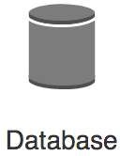
Databases Primer
Databases provide organized and persistent storage for your data
To choose between diﬀerent database types, we would need to understand:
Availability
Durability RTO
RPO
Consistency Transactions etc
Let's get started on a simple journey to understand these

Slide 207
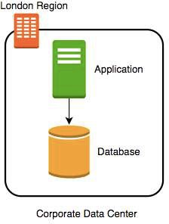
Database - Getting Started
Imagine a database deployed in a data center in London
Let's consider some challenges:
Challenge 1: Your database will go down if the data center crashes or the server storage fails
Challenge 2: You will lose data if the database crashes

Slide 208
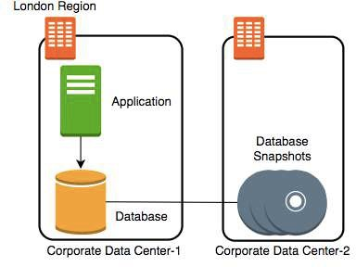
Database - Snapshots
Let's automate taking copy of the database (take a snapshot) every hour to another data center in London
Let's consider some challenges:
Challenge 1: Your database will go down if the data center crashes
Challenge 2 (PARTIALLY SOLVED): You will lose data if the database crashes
You can setup database from latest snapshot. But depending on when failure occurs you can lose up to an hour of data
Challenge 3(NEW): Database will be slow when you take snapshots

Slide 209
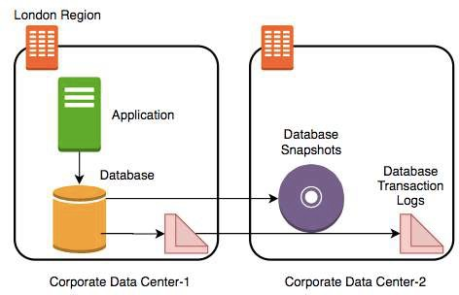
Database - Transaction Logs
Let's add transaction logs to database and create a process to copy it over to the second data center
Let's consider some challenges:
Challenge 1: Your database will go down if the data center crashes
Challenge 2 (SOLVED): You will lose data if the database crashes
You can setup database from latest snapshot and apply transaction logs
Challenge 3: Database will be slow when you take snapshots

Slide 210
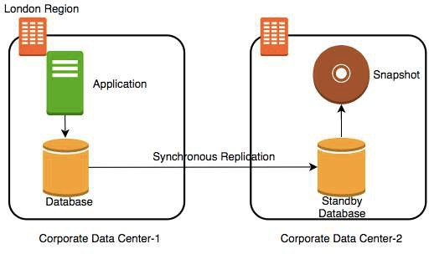
Database - Add a Standby
Let's add a standby database in the second data center with replication
Let's consider some challenges:
Challenge 1 (SOLVED): Your database will go down if the data center crashes
You can switch to the standby database
Challenge 2 (SOLVED): You will lose data if the database crashes
Challenge 3 (SOLVED): Database will be slow when you take snapshots
Take snapshots from standby.
Applications connecting to master will get good performance always

Slide 211
Availability and Durability
Availability
Will I be able to access my data now and when I need it?
Percentage of time an application provides the operations expected of it
Durability
Will my data be available after 10 or 100 or 1000 years?
Examples of measuring availability and durability:
4 9's - 99.99
11 9's - 99.999999999
Typically, an availability of four 9's is considered very good Typically, a durability of eleven 9's is considered very good

Slide 212
Availability
Availability | Downtime (in a month) | Comment
99.95% | 22 minutes
99.99% (4 9's) | 4 and 1/2 minutes | Typically online apps aim for 99.99% (4 9's) availability
99.999% (5 9's) | 26 seconds | Achieving 5 9's availability is tough

Slide 213
Durability
What does a durability of 11 9's
mean?
If you store one million files for ten million years, you would expect to lose one file
Why should durability be high?
Because we hate losing data
Once we lose data, it is gone

Slide 214
Increasing Availability and Durability of Databases
Increasing Availability:
Have multiple standbys distribute the database
in multiple Zones
in multiple Regions
available OR
Increasing Durability:
Multiple copies of data (standbys, snapshots, transaction logs and replicas)
in multiple Zones
in multiple Regions
Replicating data comes with its own challenges!
We will talk about them a little later

Slide 215
Database Terminology : RTO and RPO
Imagine a financial transaction being lost
Imagine a trade being lost
Imagine a stock exchange going down for an hour
Typically businesses are fine with some downtime but they hate losing data
Availability and Durability are technical measures
How do we measure how quickly we can recover from failure?
RPO (Recovery Point Objective): Maximum acceptable period of data loss
RTO (Recovery Time Objective): Maximum acceptable downtime
Achieving minimum RTO and RPO is expensive Trade-oﬀ based on the criticality of the data

Slide 216
Question - RTO and RPO
You are running an application in VM instance storing its data on a persistent data storage. You are taking snapshots every 48 hours. If the VM instance crashes, you can manually bring it back up in 45 minutes from the snapshot. What is your RTO and RPO?
RTO - 45 minutes
RPO - 48 hours

Slide 217
Achieving RTO and RPO - Failover Examples
Scenario Solution
Very small data loss (RPO - 1 minute) Very small downtime (RTO - 5 minutes)
Hot standby - Automatically synchronize data Have a standby ready to pick up load
Use automatic failover from master to standby
Very small data loss (RPO - 1 minute)
BUT I can tolerate some downtimes (RTO - 15 minutes)
Warm standby - Automatically synchronize data Have a standby with minimum infrastructure Scale it up when a failure happens
Data is critical (RPO - 1 minute) but I can tolerate downtime of a few hours (RTO - few hours)
Create regular data snapshots and transaction logs
Create database from snapshots and transactions logs when a failure happens
Data can be lost without a problem (for example: cached data)
Failover to a completely new server

Slide 218
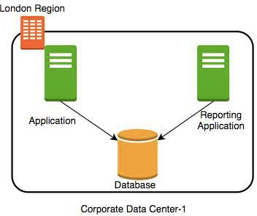
(New Scenario) Reporting and Analytics Applications
New reporting and analytics applications are being launched using the same database
These applications will ONLY read data
Within a few days you see that the database performance is impacted
How can we fix the problem?
Vertically scale the database - increase CPU and memory
Create a database cluster (Distribute the database) - Typically database clusters are expensive to setup
Create read replicas - Run read only applications against read replicas

Slide 219
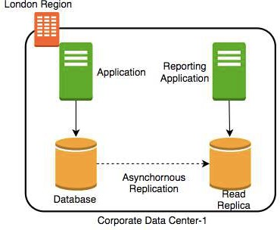
Database - Read Replicas
Add read replica
Connect reporting and analytics applications to read replica
Reduces load on the master databases
Upgrade read replica to master database (supported by some databases)
Create read replicas in multiple regions Take snapshots from read replicas

Slide 220
Consistency
How do you ensure that data in multiple database instances (standbys and replicas) is updated simultaneously?
Strong consistency - Synchronous replication to all replicas
Will be slow if you have multiple replicas or standbys
Eventual consistency - Asynchronous replication. A little lag - few seconds - before the change is available in all replicas
In the intermediate period, diﬀerent replicas might return diﬀerent values
Used when scalability is more important than data integrity
Examples : Social Media Posts - Facebook status messages, Twitter tweets, Linked in posts etc
Read-after-Write consistency - Inserts are available
However, updates would have eventual consistency
immediately

Slide 221
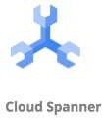

Database Categories
There are several categories of databases:
Relational (OLTP and OLAP), Document, Key Value, Graph, In Memory among others
Choosing type of database for your use case is not easy. A few factors:
Do you want a fixed schema?
Do you want flexibility in defining and changing your schema? (schemaless)
What level of transaction properties do you need? (atomicity and consistency) What kind of latency do you want? (seconds, milliseconds or microseconds)
How many transactions do you expect? (hundreds or thousands or millions of transactions per second)
How much data will be stored? (MBs or GBs or TBs or PBs) and a lot more...

Slide 222
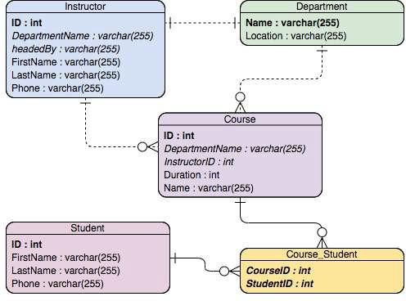
Relational Databases
This was the only option until a decade back!
Most popular (or unpopular) type of databases
Predefined schema with tables and relationships
Very strong transactional capabilities Used for
OLTP (Online Transaction Processing) use cases and
OLAP (Online Analytics Processing) use cases

Slide 223
Relational Database - OLTP (Online Transaction Processing)
Applications where large number of users make large number of small transactions
small data reads, updates and deletes
Use cases:
Most traditional applications, ERP, CRM, e-commerce, banking applications
Popular databases:
MySQL, Oracle, SQL Server etc
Recommended Google Managed Services:
Cloud SQL : Supports PostgreSQL, MySQL, and SQL Server for regional relational databases (upto a few TBs)
Cloud Spanner: Unlimited scale (multiple PBs) and 99.999% availability for global applications with horizontal scaling

Slide 224
Relational Database - OLAP (Online Analytics Processing)
Applications allowing users to analyze petabytes of data Examples : Reporting applications, Data ware houses, Business intelligence applications, Analytics systems
Sample application : Decide insurance premiums analyzing data from last hundred years
Data is consolidated from multiple (transactional) databases
Recommended GCP Managed Service
BigQuery: Petabyte-scale distributed data ware house

Slide 225
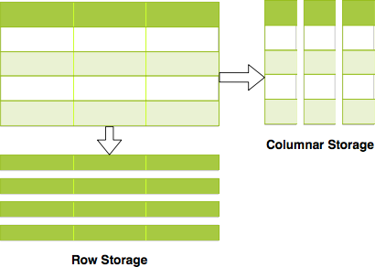
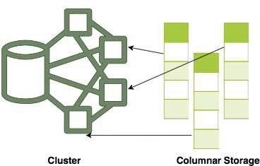
Relational Databases - OLAP vs OLTP
OLAP and OLTP use similar data structures
BUT very diﬀerent approach in how data is stored
OLTP databases use row storage
Each table row is stored together
Eﬀicient for processing small transactions
OLAP databases use columnar storage
Each table column is stored together
High compression - store petabytes of data eﬀiciently
Distribute data - one table in multiple cluster nodes
Execute single query across multiple nodes - Complex queries can be executed eﬀiciently

Slide 226
NoSQL Databases
New approach (actually NOT so new!) to building your databases
NoSQL = not only SQL
Flexible schema
Structure data the way your application needs it
Let the schema evolve with time
Horizontally scale to petabytes of data with millions of TPS
NOT a 100% accurate generalization but a great starting point:
Typical NoSQL databases trade-oﬀ "Strong consistency and SQL features" to achieve "scalability and high-performance"
Google Managed Services:
Cloud Firestore (Datastore)
Cloud BigTable

Slide 228
NoSQL Databases
Cloud Firestore (Datastore) vs Cloud BigTable
Cloud Datastore - Managed serverless NoSQL document database
Provides ACID transactions, SQL-like queries, indexes
Designed for transactional mobile and web applications
Firestore (next version of Datastore) adds:
Strong consistency
Mobile and Web client libraries
Recommended for small to medium databases (0 to a few Terabytes)
Cloud BigTable - Managed, scalable NoSQL wide column database
NOT serverless (You need to create instances)

Slide 229

In-memory Databases
Retrieving data from memory is much faster than retrieving data from disk
In-memory databases like Redis deliver microsecond latency by storing persistent data in memory
Recommended GCP Managed Service
Memory Store
Use cases : Caching, session management, gaming leader boards, geospatial applications

Slide 230
Databases - Summary
Database Type | GCP Services | Description
Relational OLTP | Cloud SQL, Cloud | Transactional usecases needing predefined schema and
databases | Spanner | very strong transactional capabilities (Row storage)
 |  | Cloud SQL: MySQL, PostgreSQL, SQL server DBs
 |  | Cloud Spanner: Unlimited scale and 99.999% availability
 |  | for global applications with horizontal scaling
Relational OLAP | BigQuery | Columnar storage with predefined schema.
databases |  | Datawarehousing & BigData workloads
NoSQL Databases | Cloud Firestore | Apps needing quickly evolving structure (schema-less)
 | (Datastore) , Cloud | Cloud Firestore - Serverless transactional document DB
 | BigTable | supporting mobile & web apps. Small to medium DBs (0 -
 |  | few TBs)
 |  | Cloud BigTable - Large databases(10 TB - PBs). Streaming
 |  | (IOT), analytical & operational workloads. NOT serverless.
In memory | Cloud Memorystore | Applications needing microsecond responses

Slide 231
Databases - Scenarios
Scenario
Solution
A start up with quickly evolving schema (table structure)
Cloud
Datastore/Firestore
Non relational db with less storage (10 GB)
Cloud Datastore
Transactional global database with predefined schema needing to process million of transactions per second
CloudSpanner
Transactional local database processing thousands of transactions per second
Cloud SQL
Cache data (from database) for a web application
MemoryStore
Database for analytics processing of petabytes of data
BigQuery
Database for storing huge volumes stream data from IOT devices
BigTable
Database for storing huge streams of time series data
BigTable

Slide 232
Cloud SQL
Fully Managed Relational Database service
Configure your needs and do NOT worry about managing the database
Supports MySQL, PostgreSQL, and SQL Server
Regional Service providing High Availability (99.95%) Use SSDs or HDDs (For best performance: use SSDs) Upto 416 GB of RAM and 30 TB of data storage
Use Cloud SQL for simple relational use cases:
To migrate local MySQL, PostgreSQL, and SQL Server databases
To reduce your maintenance cost for a simple relational database (REMEMBER) Use Cloud Spanner(Expensive $$$$) instead of Cloud SQL if:
You have huge volumes of relational data (TBs) OR
You need infinite scaling for a growing application (to TBs) OR
You need a Global (distributed across multiple regions) Database OR You need higher availability (99.999%)

Slide 233
Cloud SQL - Features
Important Cloud SQL Features:
Automatic encryption (tables/backups), maintenance and updates
High availability and failover:
Create a Standby with automatic failover
Pre requisites: Automated backups and Binary logging
Read replicas for read workloads:
Options: Cross-zone, Cross-region and External (NON Cloud SQL DB)
Pre requisites: Automated backups and Binary logging
Automatic storage increase without downtime (for newer versions) Point-in-time recovery: Enable binary logging
Backups (Automated and on-demand backups) Supports migration from other sources
Use Database Migration Service (DMS)
You can export data from UI (console) or gcloud with formats:
SQL (Recommended if you import data into other databases) and CSV

Slide 234
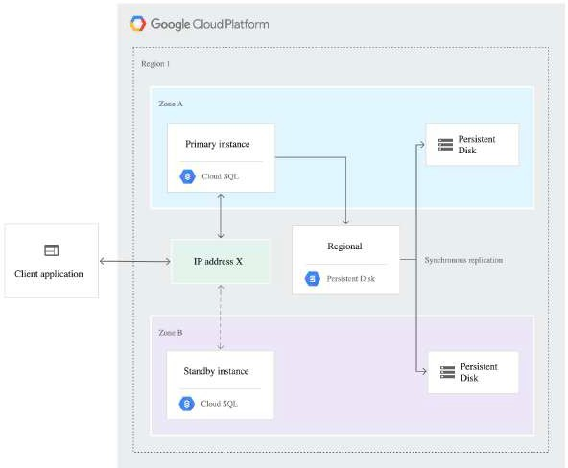
Cloud SQL - High Availability
Create a High Availability (HA) Configuration
Choose Primary and Secondary zones within a region
You will have two instances : Primary and Secondary
instances
Changes from primary are replicated
synchronously to secondary
In case of Zonal failure, automatic failover to secondary instance:
If Primary zone becomes available, failover does not revert automatically
(Remember) High Availability setup CANNOT be used as a Read Replica
source:cloud.google.com

Slide 235
Cloud Spanner
Fully managed, mission critical, relational(SQL), distributed database with VERY high availability (99.999%)
Strong transactional consistency at global scale
Scales to PBs of data with automatic sharding
Cloud Spanner scales horizontally for reads and writes
Configure no of nodes
(REMEMBER) In comparison, Cloud SQL provides read replicas:
BUT you cannot horizontally scale write operations with Cloud SQL!
Regional and Multi-Regional configurations
Expensive (compared to Cloud SQL): Pay for nodes & storage
Data Export: Use Cloud Console to export data
Other option is to use Data flow to automate export
No gcloud export option
globally

Slide 236
Cloud Datastore and Firestore
Datastore - Highly scalable NoSQL Document Database
Automatically scales and partitions data as it grows
Recommended for upto a few TBs of data
For bigger volumes, BigTable is recommended
Supports Transactions, Indexes and SQL like queries (GQL)
Does NOT support Joins or Aggregate (sum or count) operations
For use cases needing flexible schema with transactions
Examples: User Profile and Product Catalogs
Structure: Kind > Entity (Use namespaces to group entities)
You can export data ONLY from gcloud (NOT from cloud console)
Export contains a metadata file and a folder with the data
Firestore = Datastore++ : Optimized for multi device access
Oﬀline mode and data synchronization across multiple devices - mobile, IOT etc
Provides client side libraries - Web, iOS, Android and more

Slide 237

Cloud BigTable
Petabyte scale, wide column NoSQL DB (HBase API compatible)
Designed for huge volumes of analytical and operational data
IOT Streams, Analytics, Time Series Data etc
Handle millions of read/write TPS at very low latency
Single row transactions (multi row transactions NOT supported)
NOT serverless: You need to create a server instance (Use SSD or HDD)
Scale horizontally with multiple nodes (No downtime for cluster resizing)
CANNOT export data using cloud console or gcloud:
Either use a Java application (java -jar JAR export\import) OR
Use HBase commands
Use cbt command line tool to work with BigTable (NOT gcloud)
Ex: cbt createtable my-table

Slide 238
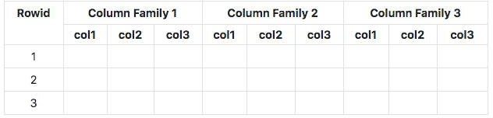
Cloud BigTable - Wide Column Database
At the most basic level, each table is a sorted key/value map
Each value in a row is indexed using a key - row key
Related columns are grouped into column families
Each column is identified by using column-family:column-qualifer(or name)
This structure supports high read and write throughput at low latency
Advantages : Scalable to petabytes of data with millisecond responses upto millions of TPS
Use cases : IOT streams, graph data and real time analytics (time-series data, financial data - transaction histories, stock prices etc)
Cloud Dataflow : Used to export data from BigTable to CloudStorage

Slide 239
Memorystore
In-memory datastore service: Reduce access times
Fully managed (Provisioning, Replication, Failover and Patching)
Highly available with 99.9% availability SLA
Monitoring can be easily setup using Cloud Monitoring
Support for Redis and Memcached:
Use Memcached for Caching
Reference data, database query caching, session store etc
Use Redis for low latency access with persistence and high availability
Gaming Leader Boards, Player Profiles, In memory Stream Processing etc

Slide 240
BigQuery - Datawarehouse
Exabyte scale modern Datawarehousing solution from GCP
Relational database (SQL, schema, consistency etc)
Use SQL-like commands to query massive datasets
Traditional (Storage + Compute) + Modern (Realtime + Serverless)
When we are talking about a Datawarehouse, importing and exporting data (and formats) becomes very important:
Load data from a variety of sources, incl. streaming data
Variety of import formats - CSV/JSON/Avro/Parquet/ORC/Datastore backup
Export to Cloud Storage (long term storage) & Data Studio (visualization)
Formats - CSV/JSON (with Gzip compression), Avro (with deflate or snappy compression)
Automatically expire data (Configurable Table Expiration)
Query external data sources without storing data in BigQuery
Cloud Storage, Cloud SQL, BigTable, Google Drive
Use Permanent or Temporary external tables

Slide 241
BigQuery - Accessing and Querying Data
Access databases using:
Cloud Console
bq command-line tool (NOT gcloud) BigQuery Rest API OR
HBase API based libraries (Java, .NET & Python)
(Remember) BigQuery queries can be expensive as you are running them on large data sets!
(BEST PRACTICE) Estimate BigQuery queries before running:
1: Use UI(console)/bq(--dry-run) - Get scanned data volume (estimate)
2: Use Pricing Calculator: Find price for scanning 1 MB data. Calculate cost.

Slide 242
Relational Database - Import and Export
Cloud SQL : to/from Cloud Storage (gcloud sql export/import csv/sql)
From Console/gcloud/REST API
SQL and CSV formats
For large databases, use serverless mode
Reduces performance impact of export on the live database
Cloud Spanner: to/from Cloud Storage
From Console (uses Cloud Data Flow)
BigQuery: to/from Cloud Storage and Others (bq extract/load)
From Console/bq
Formats - CSV/JSON (with Gzip compression), Avro (with deflate or snappy compression)
Variety of options to import data:
Load data from Cloud Storage
Example Use Case: Data Store > Cloud Storage > Big Query
Batch Loading with BigQuery Data Transfer Service Use Dataflow to setup streaming pipeline

Slide 243

NoSQL Databases - Import and Export
Cloud Datastore/Firestore: to/from Cloud Storage
From Console/gcloud/REST API
gcloud datastore/firestore export/import --kinds --namespaces
Cloud BigTable: to/from Cloud Storage
Create Dataflow jobs
Formats: Avro/Parquet/SequenceFiles
(REMEMBER) Ensure that service accounts have access to Cloud Storage Buckets
ACL (gsutil acl ch -U SERVICE_ACCOUNT :W BUCKET) OR
Roles Storage Admin or Storage Object Admin or Storage Object Creator

Slide 244
Cloud SQL - CommandLine
gcloud sql
gcloud sql instances create/clone/delete/describe/patch
gcloud sql instances create INSTANCE
gcloud sql instances patch --backup-start-time
gcloud sql databases create/delete/describe/list/patch
gcloud sql databases create DATABASE --instance=INSTANCE
gcloud sql connect INSTANCE [--database=DATABASE --user=root]
gcloud sql backups create/describe/list
gcloud sql backups create --async --instance [INSTANCE] (one time backup)

Slide 245
BigQuery - Command Line
BigQuery (bq)
bq show bigquery-public-data:samples.shakespeare
bq query 'QUERY-STRING'
--dry-run - To estimate the bytes scanned by a query
bq extract (export data)
bq load (load data)
(Remember) Use the standard way to set the project
gcloud config set project my-project

Slide 246
cbt tool - Cloud Bigtable - CommandLine
cbt - CLI for Cloud Bigtable (NOT gcloud)
Installing - gcloud components install cbt
Verify Installation - cbt listinstances
Create .cbtrc file with the configuration
echo project = project-id > ~/.cbtrc
echo instance = quickstart-instance >> ~/.cbtrc
Commands (cbt):
cbt createinstance - Create an instance
cbt createcluster - Create a cluster within configured instance! cbt createtable/deleteinstance/deletecluster/deletetable
cbt listinstances/listclusters
cbt ls - list tables and column families
(Remember) You can configure your project with cbt in .cbtrc file

Slide 247
Databases - Remember
(Remember) BigQuery, Datastore, Firebase does NOT need VM configuration
whereas Cloud SQL and BigTable need VM configuration
Relational Databases
Small Local Databases - Cloud SQL
Highly scalable global databases - Cloud Spanner Datawarehouse - BigQuery
NoSQL Databases
Transactional database for a few Terabytes of data - Cloud Datastore
Huge volumes of IOT or streaming analytics data - Cloud BigTable

Slide 248
Decoupling Applications with Pub/Sub

Slide 249
Need for Asynchronous Communication
Why do we need asynchronous communication?

Slide 250
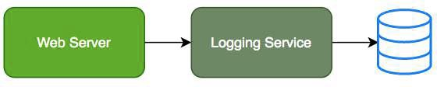
Synchronous Communication
Applications on your web server make synchronous calls to the logging service
What if your logging service goes down?
Will you applications go down too?
What if all of sudden, there is high load and there are lot of logs coming in?
Log Service is not able to handle the load and goes down very often

Slide 251

Asynchronous Communication - Decoupled
Create a topic and have your applications put log messages on the topic Logging service picks them up for processing when ready
Advantages:
Decoupling: Publisher (Apps) don't care about who is listening
Availability: Publisher (Apps) up even if a subscriber (Logging Service) is down Scalability: Scale consumer instances (Logging Service) under high load Durability: Message is not lost even if subscriber (Logging Service) is down

Slide 252

Pub/Sub
Reliable, scalable, messaging service
fully-managed asynchronous
Backbone for Highly Available and Highly Scalable
Solutions
Auto scale to process billions of messages per day
Low cost (Pay for use)
Usecases: Event ingestion and delivery for streaming analytics pipelines
Supports push and pull message deliveries

Slide 253
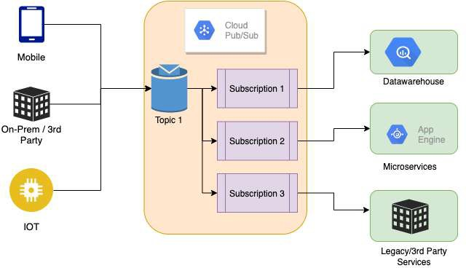
Pub/Sub - How does it work?
Publisher - Sender of a message Publishers send messages by making HTTPS requests to pubsub.googleapis.com
Subscriber - Receiver of the message
Pull - Subscriber pulls messages when ready Subscriber makes HTTPS requests to pubsub.googleapis.com
Push - Messages are sent to subscribers Subscribers provide a web hook endpoint at the time of registration
When a message is received on the topic, A HTTPS POST request is sent to the web hook endpoints
Very Flexible Publisher(s) and Subscriber(s) Relationships: One to Many, Many to One, Many to Many

Slide 254
Pub/Sub - Getting Ready with Topic and Subscriptions
Step 1 : Topic is created
Step 2 : Subscription(s) are created
Subscribers register to the topic
Each Subscription represents discrete pull of messages from a topic:
Multiple clients pull same subscription
=> messages split between clients
Multiple clients create a subscription each => each client will get every message

Slide 255
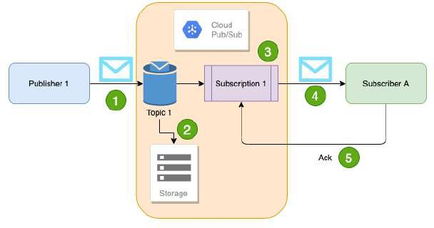
Pub/Sub - Sending and Receiving a Message
Publisher sends a message to Topic
Message individually delivered to each and every subscription
Subscribers can receive message either by:
Push: Pub/Sub sends the message to Subscriber
Pull: Subscribers poll for messages
Subscribers send acknowledgement(s)
Message(s) are removed from subscriptions message queue
Pub/Sub ensures the message is retained per subscription until it is acknowledged

Slide 256
Managing Pub/Sub
Pub/Sub pubsub
gcloud pubsub topics create my-topic
gcloud pubsub subscriptions create my-subscription --topic=my-topic
--enable-message-ordering - ordered message delivery
--ack-deadline - how long to wait for acknowledgment?
--message-filter - criteria to filter messages
gcloud pubsub subscriptions pull my-subscription
--auto-ack --limit
gcloud pubsub subscriptions ack my-subscription --ack-ids=[ACK_ID,…]
Topic: gcloud pubsub topics
gcloud pubsub topics delete my-topic
gcloud pubsub topics list
gcloud pubsub topics list-subscriptions my-topic

Slide 257
Networking

Slide 258
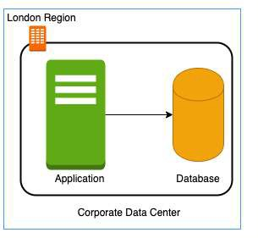
Need for Google Cloud VPC
In a corporate network or an on-premises data center: Can anyone on the internet see the data exchange between the application and the database?
No
Can anyone from internet directly connect to your database?
Typically NO.
You need to connect to your corporate network and then access your applications or databases.
Corporate network provides a secure internal network protecting your resources, data and communication from external users
How do you do create your own private network in the cloud?
Enter Virtual Private Cloud (VPC)

Slide 259

Google Cloud VPC (Virtual Private Cloud)
Your own isolated network in GCP cloud
Network traﬀic within a VPC is isolated (not visible) from all other Google Cloud VPCs
You control all the traﬀic coming in and going outside a VPC
(Best Practice) Create all your GCP resources (compute, storage, databases etc) within a VPC
Secure resources from unauthorized access AND
Enable secure communication between your cloud resources
VPC is a global resource & contains subnets in one or more region
(REMEMBER) NOT tied to a region or a zone. VPC resources can be in any region or zone!

Slide 260


Need for VPC Subnets
Diﬀerent types of resources are created on cloud - databases, compute etc
Each type of resource has its own access needs
Load Balancers are accessible from internet (public resources) Databases or VM instances should NOT be accessible from internet
ONLY applications within your network (VPC) should be able to access them(private resources)
How do you separate public resources from private resources inside a VPC?
Create separate Subnets!
(Additional Reason) You want to distribute resources across multiple regions for high availability

Slide 261
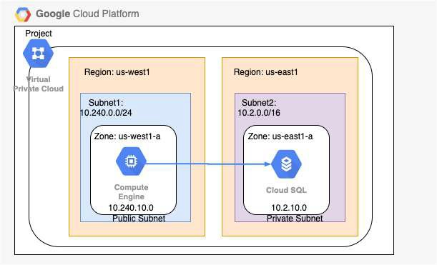
VPC Subnets
(Solution) Create diﬀerent subnets for public and private resources
Resources in a public subnet CAN be accessed from internet
Resources in a private subnet CANNOT be accessed from internet
BUT resources in public subnet can talk to resources in private subnet
Each Subnet is created in a region
Example : VPC - demo-vpc => Subnets - region us-central1, europe-west1 or us-west1 or ..

Slide 262
Creating VPCs and Subnets
By default, every project has a default VPC You can create YOUR own VPCs:
OPTION 1: Auto mode VPC network:
Subnets are automatically created in each region
Default VPC created automatically in the project uses auto mode!
OPTION 2: Custom mode VPC network:
No subnets are automatically created
You have complete control over subnets and their IP ranges Recommended for Production
Options when you create a subnet:
Enable Private Google Access - Allows VM's to connect to Google API's using private IP's
Enable FlowLogs - To troubleshoot any VPC related network issues

Slide 263
CIDR (Classless Inter-Domain Routing) Blocks
Resources in a network use continuous IP addresses to make routing easy: Example: Resources inside a specific network can use IP addresses from 69.208.0.0 to 69.208.0.15
How do you express a range of addresses that resources in a network can have?
CIDR block
A CIDR block consists of a starting IP address(69.208.0.0) and a range(/28) Example: CIDR block 69.208.0.0/28 represents addresses from 69.208.0.0 to 69.208.0.15 - a total of 16 addresses
Quick Tip: 69.208.0.0/28 indicates that the first 28 bits (out of 32) are fixed.
Last 4 bits can change => 2 to the power 4 = 16 addresses

Slide 264
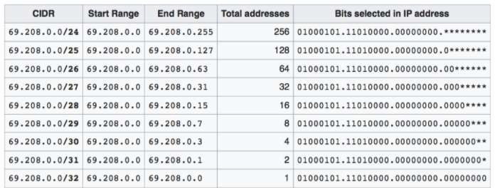
CIDR Exercises
Exercise : How many addresses does 69.208.0.0/26 represent?
2 to the power (32-26 = 6) = 64 addresses from 69.208.0.0 to 69.208.0.63
Exercise : How many addresses does 69.208.0.0/30 represent?
2 to the power (32-30 = 2) = 4 addresses from 69.208.0.0 to 69.208.0.3
Exercise : What is the diﬀerence between 0.0.0.0/0 and 0.0.0.0/32?
0.0.0.0/0 represent all IP addresses. 0.0.0.0/32 represents just one IP address 0.0.0.0.

Slide 265
Examples of Recommended CIDR Blocks - VPC Subnets
Recommended CIDR Blocks
Private IP addresses RFC 1918: 10.0.0.0/8, 172.16.0.0/12, 192.168.0.0/16
Shared address space RFC 6598: 100.64.0.0/10 IETF protocol assignments RFC 6890: 192.0.0.0/24
Restricted Range Examples
You CANNOT use these as CIDR for VPC Subnets
Private Google Access-specific virtual IP addresses: 199.36.153.4/30, 199.36.153.8/30
Current (local) network RFC 1122: 0.0.0.0/8 Local host RFC 1122: 127.0.0.0/8
(REMEMBER) You CAN EXTEND the CIDR Block Range of a Subnet (Secondary CIDR Block)

Slide 266
Firewall Rules
Configure Firewall Rules to control traﬀic going in or out of the network:
Stateful
Each firewall rule has priority (0-65535) assigned to it
0 has highest priority. 65535 has least priority Default implied rule with lowest priority (65535)
Allow all egress
Deny all ingress
Default rules can't be deleted
You can override default rules by defining new rules with priority 0-65534
Default VPC has 4 additional rules with priority 65534
Allow incoming traﬀic from VM instances in same network (default-allow-internal)
Allow Incoming TCP traﬀic on port 22 (SSH) default-allow-ssh
Allow Incoming TCP traﬀic on port 3389 (RDP) default-allow-rdp
Allow Incoming ICMP from any source on the network default-allow-icmp

Slide 267
Firewall Rules - Ingress and Egress Rules
Ingress Rules: Incoming traﬀic from outside to GCP targets
Target (defines the destination): All instances or instances with TAG/SA
Source (defines where the traﬀic is coming from): CIDR or All instances or instances with TAG/SA
Egress Rules: Outgoing traﬀic to destination from GCP targets
Target (defines the source): All instances or instances with TAG/SA
Destination: CIDR Block
Along with each rule, you can also define:
Priority - Lower the number, higher the priority
Action on match - Allow or Deny traﬀic
Protocol - ex. TCP or UDP or ICMP
Port - Which port?
Enforcement status - Enable or Disable the rule

Slide 268
Shared VPC
Scenario: Your organization has multiple projects. You want resources in diﬀerent projects to talk to each other?
How to allow resources in diﬀerent projects to talk with internal IPs securely and eﬀiciently?
Enter Shared VPC
Created at organization or shared folder level (Access Needed: Shared VPC Admin)
Allows VPC network to be shared between projects in same organization Shared VPC contains one host project and multiple service projects:
Host Project - Contains shared VPC network
Service Projects - Attached to host projects
Helps you achieve separation of concerns:
Network administrators responsible for Host projects and Resource users use Service Project

Slide 269
VPC Peering
Scenario: How to connect VPC networks across diﬀerent organizations?
Enter VPC Peering
Networks in same project, diﬀerent projects and across projects in diﬀerent organizations can be peered
All communication happens using internal IP addresses
Highly eﬀicient because all communication happens inside Google network
Highly secure because not accessible from Internet
No data transfer charges for data transfer between services
(REMEMBER) Network administration is NOT changed:
Admin of one VPC do not get the role automatically in a peered network

Slide 270
Hybrid Cloud

Slide 271

Cloud VPN
Cloud VPN - Connect on-premise network to the GCP network
Implemented using IPSec VPN Tunnel
Traﬀic through internet (public)
Traﬀic encrypted using Internet Key Exchange protocol
Two types of Cloud VPN solutions:
HA VPN (SLA of 99.99% service availability with two external IP addresses)
Only dynamic routing (BGP) supported
Classic VPN (SLA of 99.9% service availability, a single external IP address)
Supports Static routing (policy-based, route-based) and dynamic routing using BGP

Slide 272

Cloud Interconnect
High speed physical connection between on-premise and VPC networks:
Highly available and high throughput
Two types of connections possible
Dedicated Interconnect - 10 Gbps or 100 Gpbs configurations
Partner Interconnect - 50 Mbps to 10 Gbps configurations
Data exchange happens through a private network:
Communicate using VPC network's internal IP addresses from on-premise network
Reduces egress costs
As public internet is NOT used
(Feature) Supported Google API's and services can be privately accessed from on-premise
Use only for high bandwidth needs:
For low bandwidth, Cloud VPN is recommended

Slide 273
Direct Peering
Connect customer network to google network using network peering
Direct path from on-premises network to Google services
Not a GCP Service
Lower level network connection outside of GCP
NOT RECOMMENDED:
Use Cloud Interconnect and Cloud VPN

Slide 274
Cloud Operations

Slide 275

Cloud Monitoring
To operate cloud applications eﬀectively, you should know:
Is my application healthy?
Are the users experiencing any issues? Does my database has enough space?
Are my servers running in an optimum capacity?
Cloud Monitoring - Tools to monitor your infrastructure
Measures key aspects of services (Metrics)
Create visualizations (Graphs and Dashboard) Configure Alerts (when metrics are NOT healthy)
Define Alerting Policies:
Condition
Notifications - Multiple channels Documentation

Slide 276
Cloud Monitoring - Workspace
You can use Cloud Monitoring to monitor one or more GCP projects and one or more AWS accounts
How do you group all the information from multiple GCP projects or AWS Accounts?
Create a Workspace
Workspaces are needed to organize monitoring information
A workspace allows you to see monitoring information from multiple projects
Step I: Create workspace in a specific project (Host Project)
Step II: Add other GCP projects (or AWS accounts) to the workspace

Slide 277

Cloud Monitoring - Virtual Machines
Default metrics monitored include:
CPU utilization
Some disk traﬀic metrics
Network traﬀic, and Uptime information
Install Cloud Monitoring agent on the VM to get more disk, CPU, network, and process metrics:
collectd-based daemon
Gathers metrics from VM and sends them to Cloud Monitoring

Slide 278

Cloud Logging
Real time log management and analysis tool
Allows to store, search, analyze and alert on massive volume of data
Exabyte scale, fully managed service
No server provisioning, patching etc
Ingest Log data from any source Key Features:
Logs Explorer - Search, sort & analyze using flexible queries
Logs Dashboard - Rich visualization
Logs Metrics - Capture metrics from logs (using queries/matching strings) Logs Router - Route diﬀerent log entries to diﬀerent destinations

Slide 279

Cloud Logging - Collection
Most GCP Managed services automatically send logs to Cloud Logging:
GKE
App Engine Cloud Run
Ingest logs from GCE VMs:
Install Logging Agent (based on fluentd)
(Recommended) Run Logging Agent on all VM instances
Ingest logs from on-premises:
(Recommended) Use the BindPlane tool from Blue Medora
Use the Cloud Logging API

Slide 280
Cloud Logging - Audit and Security Logs
Access Transparency Log: Captures Actions performed by GCP team on your content (NOT supported by all services):
ONLY for organizations with Gold support level & above
Cloud Audit Logs: Answers who did what, when and where:
Admin activity Logs
Data Access Logs
System Event Audit Logs Policy Denied Audit Logs

Slide 281
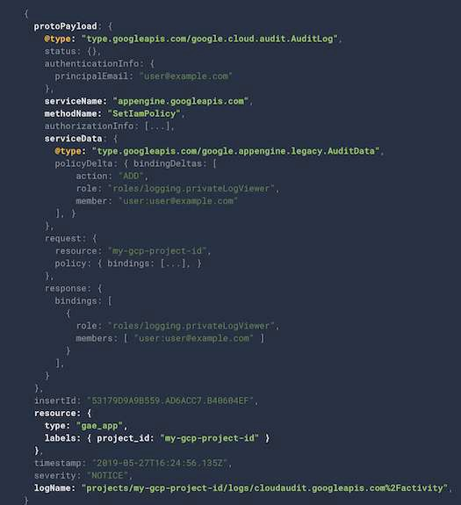
Cloud Logging - Audit Logs
Which service?
protoPayload.serviceName
Which operation?
protoPayload.methodName
What resource is audited?
resource.Type
Who is making the call?
authenticationInfo.principalEmail

Slide 282
Cloud Audit Logs
Feature | Admin Activity Logs | Data Access Logs | System Event Logs | Policy Denied Logs
Logs for | API calls or other | Reading | Google Cloud | When user or
 | actions that modify | configuration of | administrative | service account is
 | the configuration of | resources | actions | denied access
 | resources
Default | ✓ | X | ✓ | ✓
Enabled
VM Examples | VM Creation, Patching | Listing resources | On host | Security policy
 | resources, Change in | (vms, images etc) | maintenance, | violation logs
 | IAM permissions |  | Instance preemption,
 |  |  | Automatic restart
Cloud Storage | Modify bucket or | Modify/Read bucket
 | object | or object
Recommended | Logging/Logs Viewer | Logging/Private | Logging/Logs Viewer | Logging/Logs

Slide 283

Cloud Logging - Controlling & Routing
How do you manage your logs?
Logs from various sources reaches Log Router
Log Router checks against configured rules
What to ingest? what to discard?
Where to route?
Two types of Logs buckets:
_Required: Holds Admin activity, System Events & Access Transparency Logs (retained for 400 days)
ZERO charge
You cannot delete the bucket
You cannot change retention period
_Default: All other logs (retained for 30 days)
You are billed based on Cloud Logging pricing
You cannot delete the bucket:
But you can disable the _Default log sink route to disable ingestion!
You can edit retention settings (1 to 3650 days (10 years))
source: (https://cloud.google.com)

Slide 284
Cloud Logging - Export
Logs are ideally stored in Cloud Logging for limited period
For long term retention (Compliance, Audit) logs can be exported to:
Cloud Storage bucket (ex: bucket/syslog/2025/05/05)
Big Query dataset (ex: tables syslog_20250505 > log)
Cloud Pub/Sub topic (base64 encoded log entries)
How do you export logs?
Create sinks to these destinations using Log Router:
You can create include or exclude filters to limit the logs
columns timestamp,

Slide 285
Cloud Logging - Export - Use Cases
Use Case 1: Troubleshoot using VM Logs:
Install Cloud logging agent in all VM's and send logs to Cloud Logging
Search for logs in Cloud Logging
Use Case 2: Export VM logs to BigQuery for querying using SQL like queries:
Install Cloud logging agent in all VM's and send logs to Cloud Logging
Create a BigQuery dataset for storing the logs
Create an export sink in Cloud Logging with BigQuery dataset as sink destination
Use Case 3: You want to retain audit logs for external auditors at minimum cost
Create an export sink in Cloud Logging with Cloud Storage bucket as sink destination
Provide auditors with Storage Object Viewer role on the bucket You can use Google Data Studio also (for visualization)

Slide 286

Cloud Trace
Distributed tracing system for GCP: Collect latency data from:
Supported Google Cloud Services
Instrumented applications (using tracing libraries) using Cloud Trace API
Find out:
How long does a service take to handle requests?
What is the average latency of requests?
How are we doing over time? (increasing/decreasing trend)
Supported for:
Compute Engine, GKE, App Engine (Flexible/Standard) etc
Trace client libraries available for:
C#, Go, Java, Node.js, PHP, Python & Ruby

Slide 287

Cloud Debugger
How to debug issues that are happening only in test or production environments?
Cloud Debugger: Capture state of a running application
Inspect the state of the application directly in the GCP environment
Take snapshots of variables and call stack No need to add logging statements
No need to redeploy
Very lightweight => Very little impact to users
Can be used in any environment: Test, Acceptance, Production

Slide 288

Cloud Profiler
How do you identify performance bottlenecks in production?
Cloud Profiler - Statistical, low-overhead profiler
Continuously gathers CPU and Memory usage from production systems
Connect profiling data with application source code
Easily identify performance bottlenecks
Two major components:
Profiling agent (collects profiling information)
Profiler interface (visualization)

Slide 289

Error Reporting
How do you identify production problems in real time? Real-time exception monitoring:
Aggregates and displays errors reported from cloud services (using stack traces)
Centralized Error Management console:
Identify & manage top errors or recent errors
Use Firebase Crash Reporting for errors from Android & iOS client applications
Supported for Go, Java, .NET, Node.js, PHP, Python, and Ruby
Errors can be reported by:
Sending them to Cloud Logging OR
By calling Error Reporting API
Error Reporting can be accessed from desktop
Also available in the Cloud Console mobile app for iOS and Android

Slide 290
Cloud Operations Scenarios
Scenario
You would like to record all operations/requests on all objects in a bucket (for auditing)
You want to trace a request across multiple microservices
You want to identify prominent exceptions (or errors) for a specific microservice
You want to debug a problem in production by executing step by step
You want to look at the logs for a specific request
Solution
Turn on data access audit logging for the bucket
Cloud Trace
Error Reporting
Cloud Debugger Cloud Logging

Slide 291
Organizing GCP Resources

Slide 292

Resource Hierarchy in GCP
Well defined hierarchy: Organization > Folder > Project > Resources
Resources are created in projects
A Folder can contain multiple projects
Organization can contain multiple Folders
source: (https://cloud.google.com)

Slide 293
Resource Hierarchy - Recommendations for Enterprises
Create separate projects for diﬀerent environments:
Complete isolation between test and production environments
Create separate folders for each department:
Isolate production applications of one department from another
We can create a shared folder for shared resources
One project per application per environment:
Let's consider two apps: "A1" and "A2"
Let's assume we need two environments: "DEV" and "PROD"
In the ideal world you will create four projects: A1-DEV, A1-PROD, A2-DEV, A2-PROD:
Isolates environments from each other
DEV changes will NOT break PROD
Grant all developers complete access (create, delete, deploy) to DEV Projects Provide production access to operations teams only!

Slide 294
Billing Accounts
Billing Account is mandatory for creating resources in a project:
Billing Account contains the payment details
Every Project with active resources should be associated with a Billing Account
Billing Account can be associated with one or more projects You can have multiple billing accounts in an Organization
(RECOMMENDATION) Create Billing Accounts representing your organization structure:
A startup can have just one Billing account
A large enterprise can have a separate billing account for each department
Two Types:
Self Serve : Billed directly to Credit Card or Bank Account
Invoiced : Generate invoices (Used by large enterprises)

Slide 295
Managing Billing - Budget, Alerts and Exports
Setup a Cloud Billing Budget to avoid surprises:
(RECOMMENDED) Configure Alerts
Default alert thresholds set at 50%, 90% & 100%
Send alerts to Pub Sub (Optional)
Billing admins and Billing Account users are alerted by e-mail
Billing data can be exported (on a schedule) to:
Big Query (if you want to query information or visualize it)
Cloud Storage (for history/archiving)

Slide 296
IAM Best Practices
Principle of Least Privilege - Give least possible privilege needed for a role!
Basic Roles are NOT recommended
Prefer predefined roles when possible
Use Service Accounts with minimum privileges
Use diﬀerent Service Accounts for diﬀerent apps/purposes
Separation of Duties - Involve atleast 2 people in sensitive tasks:
Example: Have separate deployer and traﬀic migrator roles
AppEngine provides App Engine Deployer and App Engine Service Admin roles
App Engine Deployer can deploy new version but cannot shift traﬀic
App Engine Service Admin can shift traﬀic but cannot deploy new version!
Constant Monitoring: Review Cloud Audit Logs to audit changes to IAM policies and access to Service Account keys
Archive Cloud Audit Logs in Cloud Storage buckets for long term retention
Use Groups when possible
Makes it easy to manage users and permissions

Slide 297
User Identity Management in Google Cloud
Email used to create free trial account => "Super Admin"
Access to everything in your GCP organization, folders and projects
Manage access to other users using their Gmail accounts
However, this is NOT recommended for enterprises
Option 1: Your Enterprise is using Google Workspace
Use Google Workspace to manage users (groups etc)
Link Google Cloud Organization with Google Workspace
Option 2: Your Enterprise uses an Identity Provider of its own
Federate Google Cloud with your Identity Provider

Slide 298
Corporate Directory Federation
Federate Cloud Identity or Google Workspace with your external identity provider (IdP) such as Active Directory or Azure Active Directory.
Enable Single Sign On:
1: Users are redirected to an external IdP to authenticate
2: When users are authenticated, SAML assertion is sent to Google Sign-In
Examples:
Federate Active Directory with Cloud Identity by using Google Cloud Directory Sync (GCDS) and Active Directory Federation Services (AD FS)
Federating Azure AD with Cloud Identity

Slide 299
IAM Members/Identities
Google Account - Represents a person (an email address)
Service account - Represents an application account (Not person)
Google group - Collection - Google & Service Accounts
Has an unique email address
Helps to apply access policy to a group
Google Workspace domain: Google Workspace (formerly G Suite) provides collaboration services for enterprises:
Tools like Gmail, Calendar, Meet, Chat, Drive, Docs etc are included
If your enterprise is using Google Workspace, you can manage permissions using your Google Workspace domain
Cloud Identity domain - Cloud Identity is an Identity as a Service (IDaaS) solution that centrally manages users and groups.
You can use IAM to manage access to resources for each Cloud Identity account

Slide 300
IAM Members/Identities - Use Cases
Scenario Solution
All members in your team have G Suite accounts. You are creating a new production project and would want to provide access to your operations team
Create a Group with all your operations team. Provide access to production project to the Group.
All members in your team have G Suite accounts. You are setting up a new project. You want to provide a one time quick access to a team member.
Assign the necessary role directly to G Suite email address of your team member
If it is not a one time quick access, the recommended approach would be to create a Group
You want to provide an external auditor access to view all resources in your project BUT he should NOT be able to make any changes
Give them roles/viewer role (Generally basic roles are NOT recommended BUT it is the simplest way to provide view only access to all resources!)
Your application deployed on a GCE VM (Project A) needs to access cloud storage bucket from a diﬀerent project (Project B)
In Project B, assign the right role to GCE VM service account from Project A

Slide 301
Organization Policy Service
How to enable centralized constraints on all resources created in an Organization?
Configure Organization Policy
Example: Disable creation of Service Accounts
Example: Allow/Deny creation of resources in specific regions Needs a Role - Organization Policy Administrator (Remember) IAM focuses on Who
Who can take specific actions on resources?
(Remember) Organization Policy focuses on What
What can be done on specific resources?

Slide 302

Resource Hierarchy & IAM Policy
IAM Policy can be set at any level of the hierarchy
Resources inherit the policies of All parents
The eﬀective policy for a resource is
the union of the policy on resource and its parents
Policy inheritance is transitive:
For example: Organization policies are applied at resource level
that
You can't restrict policy at lower level if permission is given at an higher

Slide 303
Organization, Billing and Project Roles
Organization Administrator
Define Resource Hierarchy
Define Access Management Policies Manage other users and roles
Billing Account Creator - Create Billing Accounts
Billing Account Administrator - Manage Billing Accounts (payment instruments, billing exports, link and unlink projects, manage roles on billing account)
CANNOT create a Billing Account
Billing Account User - Associate Projects with Billing Accounts
Typically used in combination with Project Creator
These two roles allow user to create new project and link it with billing account
Billing Account Viewer - See all Billing Account details

Slide 304
Billing Roles - Quick Review
Roles | Description | Use Case
Billing Account Creator | Permissions to create new billing accounts | Finance Team
Billing Account Administrator | Manages billing account but can't create them | Finance Team
Billing Account User | Assigns projects to billing accounts | Project Owner
Billing Account Viewer | View only access to billing account | Auditor

Slide 305
Organization, Billing and Project Roles - Scenarios
Scenario 1: I'm creating a project and I want to associate an existing billing account with the project
Roles needed : Project Creator and Billing Account User (link project to billing account)
Scenario 2: I'm a billing auditor
Roles needed : Billing Account Viewer role

Slide 306
Compute Engine Roles
Compute Engine IAM Roles
Compute Engine Admin - Complete control of compute - Instances, Images, Load Balancers, Network, Firewalls etc...
Compute Instance Admin - Create, modify, and delete virtual machine instances and disks
Compute Engine Network Admin - Complete access to networking resources (routes, networks, health checks, VPN, Gateways etc) and READ ONLY access to (firewall rules and SSL certificates)
Compute Engine Security Admin - Complete access to firewall rules and SSL certificates
Compute Storage Admin - Complete access to disks, images, snapshots
Compute Engine Viewer - Read ONLY access to everything in compute
Compute OS Admin Login - Log in to a Compute Engine instance as an administrator user
Compute OS Login - Log in to a Compute Engine instance as a standard user

Slide 307
App Engine Roles
App Engine Roles (CRUD - Create, Read (get/list), Update, Delete)
App Engine Creator - applications(CD) (Responsible for creating an application)
App Engine Admin - applications(RU), services/instances/versions(CRUD), operations
App Engine Viewer - applications/services/instances/versions(R), operations
App Engine Code Viewer - appengine.versions.getFileContents (ONLY role that can view code)
App Engine Deployer - versions(CRD), applications/services/versions(R)
Deploy a new version of an app (if you also grant the Service Account User role)
App Engine Service Admin - versions(RUD), applications(R), services/instances(CRUD), operations: Split or migrate traﬀic, Start and stop a version
App Engine Roles DO NOT allow you to
View and download application logs
View Monitoring charts in the Cloud Console Enable and Disable billing
Access configuration or data stored in other services

Slide 308
Compute Engine and App Engine Roles - Few Scenarios
Scenario 1: What is the diﬀerence between Compute Engine Admin vs Compute Instance Admin?
Compute Instance Admin can do everything with instances and disks ONLY. Compute Engine Admin is admin for everything in compute - instances, disks, images, network, firewalls etc.
Scenario 2: What is a secure way of setting up application deployment?
Application Deployer - Roles: App Engine Deployer + Service Account User
Limited to deploying new versions and deleting old versions that are not serving traﬀic
Will NOT be able to configure traﬀic
Operations - Role: App Engine Service Admin
CANNOT deploy a new version of an app
Change traﬀic between versions

Slide 309
Google Kubernetes Engine (GKE) IAM Roles
Kubernetes Engine Admin (roles/container.admin) - Complete Access to Clusters and Kubernetes API objects
Kubernetes Engine Cluster Admin - Provides access to management of clusters (Cannot access Kubernetes API objects - Deployments, Pods etc)
Kubernetes Engine Developer - Manage Kubernetes API objects (and read cluster info)
Kubernetes Engine Viewer - get/list cluster and kubernetes api objects

Slide 310
Cloud Storage - Roles
Storage Admin - storage.buckets.*, storage.objects.* Storage Object Admin - storage.objects.* (DOES NOT storage.buckets.*)
HAVE
Storage Object Creator - storage.objects.create
Storage Object Viewer - storage.objects.get, storage.objects.list
(REMEMBER) Container Registry stores container images in Cloud Storage buckets
Control access to images in Container Registry using Cloud Storage permissions!
(REMEMBER) Storage Admin vs Storage Object Admin
Storage Admin can create buckets and play with objects
Storage Object Admin CANNOT create buckets but can play with objects in a bucket!

Slide 311
Cloud BigQuery Roles
Cloud BigQuery IAM Roles
BigQuery Admin - bigquery.*
BigQuery Data Owner -
bigquery.datasets.*, bigquery.models.*, bigquery.routines.*,
bigquery.tables.* (Does NOT have access to Jobs!)
BigQuery Data Editor - bigquery.tables.(create/delete/export/get/getData/getIamPolicy/ list/update/updateData/updateTag), bigquery.models.*, bigquery.routines.*, bigquery.datasets.(create/get/getIamPolicy/updateTag)
BigQuery Data Viewer - get/list bigquery.(datasets/models/routines/tables)
BigQuery Job User - bigquery.jobs.create
BigQuery User - BigQuery Data Viewer + get/list (jobs, capacityCommitments, reservations etc)
To see data, you need either BigQuery User or BigQuery Data Viewer roles
You CANNOT see data with BigQuery Job User roles
BigQuery Data Owner or Data Viewer roles do NOT have access to jobs!

Slide 312
Logging IAM Roles and Service Account Roles
Logging and Audit Logging:
roles/logging.viewer (Logs Viewer): Read all Logs except Access Transparency logs and Data Access audit logs.
roles/logging.privateLogViewer (Private Logs Viewer): Logs Viewer + Read Access Transparency logs and Data Access audit logs
roles/logging.admin (Logging Admin): All permissions related to Logging
Service Accounts:
roles/iam.serviceAccountAdmin: Create and manage service accounts
roles/iam.serviceAccountUser: Run operations as the service account roles/iam.serviceAccountUser => create and manage instances that use a service account. This needs to be added to Admin roles if you want them to attach service accounts with instances.
roles/iam.serviceAccountTokenCreator - Impersonate service accounts (create OAuth2 access tokens, sign blobs or JWTs, etc).
roles/iam.serviceAccountKeyAdmin - Create and manage (and rotate) service account keys.

Slide 313
Other Important IAM Roles
roles/iam.securityAdmin - Get and set any IAM policy
roles/iam.securityReviewer - List all resources & IAM policies
roles/iam.organizationRoleAdmin - Administer all custom roles in the organization and the projects below it
roles/iam.organizationRoleViewer - Read all custom roles in the organization and the projects below it
roles/iam.roleAdmin - Provides access to all custom roles in the project roles/iam.roleViewer - Provides read access to all custom roles in the project
roles/browser - Read access to browse the hierarchy for a project, including the folder, organization, and IAM policy
This role doesn't include permission to view resources in the project

Slide 314
SSHing into Linux VMs - Options
Compute Engine Linux VMs uses key-based SSH authentication
Two Options:
Metadata managed: Manually create and configure individual SSH keys
OS Login: Manage SSH access without managing individual SSH keys!
Recommended for managing multiple users across instances or projects
Your Linux user account is linked to your Google identity To enable: Set enable-oslogin to true in metadata
gcloud compute project-info/instances add-metadata --metadata enable-oslogin=TRUE
(Advantage) Ability to import existing Linux accounts from on premises AD and LDAP Users need to have roles : roles/compute.osLogin or roles/compute.osAdminLogin
(Windows) Windows instances use password
authentication(username and password)
Generate using console or gcloud (gcloud compute reset-windows-password)

Slide 315
SSHing into Linux VMs - Details
Option 1: Console - SSH Button
Ephemeral SSH key pair is created by Compute Engine
Option 2: Gcloud - gcloud compute ssh
A username and persistent SSH key pair are created by Compute Engine
SSH key pair reused for future interactions
Option 3: Use customized SSH keys
(Metadata managed): Upload the public key to project metadata OR
(OS Login): Upload your public SSH key to your OS Login profile
gcloud compute os-login ssh-keys add OR
Use OS Login API : POST https://oslogin.googleapis.com/v1/users/ACCOUNT_EMAIL:importSshPublicKey
You can disable Project wide SSH keys on a specific compute instance gcloud compute instances add-metadata [INSTANCE_NAME] --metadata block- project-ssh-keys=TRUE

Slide 316
IAM - Scenarios
Scenario
You want to give permanent access to a sub set of objects in a Cloud Storage bucket
You want to give permanent access to the entire bucket in a Cloud Storage bucket
You want to provide time limited access to a specific object in a Cloud Storage bucket
You want to give access to a set of resources to your development team
Which Role? Upload objects to Cloud Storage Which Role? Manage Kubernetes API objects Which Role? Manage service accounts
Which Role? View Data in BigQuery
Description
Use ACLs
Use IAM
Create a Signed URL
Create a Group with your development team as member. Bind the right Predefined Roles to your Group.
Storage Object Creator
Kubernetes Engine Developer
Service Account Admin
BigQuery Data Viewer

Slide 317
Other Google Cloud Platform Services

Slide 318
Pricing Calculator
Estimating the cost of a Google Cloud solution is NOT easy You would need to take a number of factors into account How do you estimate the cost of your GCP solution?
Use Google Cloud Pricing Calculator
Estimates for 40+ Services:
Compute Engine
Google Kubernetes Engine Cloud Run
App Engine
Cloud Storage etc
(REMEMBER) These are Estimates! (NOT binding on GCP)

Slide 319

Google Cloud Deployment Manager - Introduction
Lets consider an example:
I would want to create a new VPC and a subnet
I want to provision a Load balancer, Instance groups with 5 Compute Engine instances and an Cloud SQL database in the subnet
I would want to setup the right Firewall
AND I would want to create 4 environments
Dev, QA, Stage and Production!
Deployment Manager can help you do all these with a simple (actually NOT so simple) script!

Slide 320
Google Cloud Deployment Manager - Advantages
Automate deployment and modification of Google Cloud resources in a controlled, predictable way
Deploy in multiple environments easily!
Avoid configuration drift
Avoid mistakes with manual configuration
Think of it as version control for your environments
Important Note - Always modify the resources created by Deployment Manager using Deployment Manager

Slide 321
Google Cloud Deployment Manager
All configuration is defined in a simple text file - YAML
I want a VPC, a subnet, a database and ...
Deployment Manager understands dependencies
Creates VPCs first, then subnets and then the database
(Default) Automatic rollbacks on errors (Easier to retry)
If creation of database fails, it would automatic delete the subnet and VPC
Version control your configuration file and make changes to it over time
Free to use - Pay only for the resources provisioned
Get an automated estimate for your configuration

Slide 322
Cloud Deployment Manager - Example
type: compute.v1.instance name: my-first-vm properties:
zone: us-central1-a
machineType: <<MACHINE_TYPE>> disks:
  deviceName: boot type: PERSISTENT
boot: true autoDelete: true initializeParams:
sourceImage: <<SOURCE_IMAGE>>
networkInterfaces:
  network: <<NETWORK>>
# Give instance a public IP Address accessConfigs:
- name: External NAT type: ONE_TO_ONE_NAT

Slide 323
Cloud Deployment Manager - Terminology
Configuration file: YAML file with resource definitions for a single deployment Templates: Reusable resource definitions that can be used in multiple configuration files
Can be defined using:
Python (preferred) OR
JinJa2 (recommended only for very simple scripts)
Deployment: Collection of resources that are deployed and managed together
Manifests: Read-only object containing original deployment configuration (including imported templates)
Generated by Deployment Manager
Includes fully-expanded resource list Helpful for troubleshooting

Slide 324

Getting Started with Cloud Foundation Toolkit
When moving to Google Cloud, every enterprise need to decide:
How do I setup my cloud as per Google recommended practices?
How to setup Organization & Folder structure?
How do I setup my projects for various departments consistently with only required privileges?
What are the constraints I want?
(Which VM's are allowed?, Can VM's have public IP addresses?)
How to setup Security, Logging and Monitoring?
Solution: Cloud Foundation Toolkit

Slide 325

Exploring Cloud Foundation Toolkit Components
Scenario
Solution
I need to provision cloud resources using best practices
Use ready made terraform modules
I need setup my end to end cloud infrastructure including Org and Projects
Use end to end samples provided and adjust based on your need
We don't know Terraform but have experience in Kubernetes. Can I setup infrastructure?
No problem. Use Config Connector to provision your Infra using Kubernetes.
How do I enforce compliance for my existing and new cloud resources?
Use Policy Library to setup and audit compliance of Cloud resources

Slide 326

Cloud Foundation Toolkit - Reusable Terraform Modules
A set of ready-made reference- templates/blue-prints of Terraform modules.
Can be used to build compliant, secure & repeatable enterprise ready foundation
40+ modules for various GCP resources &
Infrastructure as code for easy updates
Blueprint Terraform Module Examples: bootstrap - Bootstrap Terraform usage in Google Cloud
org-policy - Manage Google Cloud Organization Policies
network - Easily setup a new VPC network etc

Slide 327


Cloud Foundation Toolkit - End to End Samples
A repository of end to end examples
Combine multiple modules from Cloud Foundation Toolkit
Example Foundation:
How modules can be combined to build a secure cloud foundation?
Running boot-strap module creates a Terraform setup
Running VPC module creates various VPC structures
CFT Fabric - Advanced example designed for prototyping

Slide 328

Cloud Foundation Toolkit - Config Connector
Open source Kubernetes add-on
Uses Kubernetes (instead of Terraform) to manage Google Cloud resources
Leverage your Kubernetes
instead of learning an IaaC Terraform)
experience
tool (like
Use Kubernetes manifests to manage resources like VM, Storage bucket etc
Provides a pre-built collection of Kubernetes
Custom Resource Definitions (CRDs)
Needs Config Connector to be installed on your Kubernetes Cluster

Slide 329
Config Connector - Example Manifest Files
apiVersion: sql.cnrm.cloud.google.com/v1beta1 kind: SQLInstance
metadata:
name: my-sql-instance spec:
region: us-central1
databaseVersion: MYSQL_5_7 settings:
tier: db-n1-standard-1 backupConfiguration:
enabled: true
apiVersion: storage.cnrm.cloud.google.com/v1beta1 kind: Bucket
metadata:
name: my-storage-bucket spec:
location: US
storageClass: MULTI_REGIONAL
Easy creation: Create resources using kubectl apply -f file.yaml
Easy updates: Change manifest file and use kubectl apply command

Slide 330

Cloud Foundation Toolkit - Policy Library
How to ensure that your Google Cloud resources are complaint and secure?
Manual validation: Impossible
even for small enterprises
Solution: Policy library Source: https://cloud.google.com
Allows administrators to setup and
verify guard rails automatically
Contains templates and constraints
sample
Enterprises can use the templates to create their own constraints

Slide 331

Policy Constraint - Template Examples
Predefined templates: Use them to customize policies
Example Constraint:
GCPAllowedResourceTypesConstraintV2 - What resources are allowed/denied?
Ancestries defines at what level the policy validation should happen
organizations/** - runs the validations on all the organizations
organizations/123/folders/456/projects/789
- Everything in project 789 in folder 456 in organization 123
gcloud beta terraform vet: Enforce policy compliance in a CI/CD pipeline

Slide 332
Cloud Foundation Toolkit - Recap
A set of resources, templates, and best practices to help organizations get started with Google Cloud.
Can be used as-is to quickly build
enterprise ready foundation
Benefits:
Accelerates cloud adoption and migration.
Provides a framework for secure and compliant cloud operations.
Reduces costs and complexity.
Increases productivity and collaboration.

Slide 333
Cloud Marketplace (Cloud Launcher)
Installing custom software might involve setting up multiple resources:
Example: Installing WordPress needs set up of compute engine and a relational database
How do you simplify the set up of custom software solutions like Wordpress or even more complex things like SAP HANA suite on GCP?
Cloud Marketplace: Central repo of easily deployable apps & datasets
Similar to App Store/Play Store for mobile applications
You can search and install a complete stack
Commercial solutions - SAP HANA etc
Open Source Packages - LAMP, WordPress, Cassandra, Jenkins etc OS Licenses: BYOL, Free, Paid
Categories: Datasets/Developer tools/OS etc
When selecting a solution, you can see:
Components - Software, infrastructure needed etc
Approximate price

Slide 334

Cloud DNS
What would be the steps in setting up a website with a domain name (for example, in28minutes.com)?
Step I : Buy the domain name in28minutes.com (Domain Registrar)
Step II : Setup your website content (Website Hosting)
Step III : Route requests to in28minutes.com to the my website host server (DNS)
Cloud DNS = Global Domain Name System (Step III)
Setup your DNS routing for your website (in28minutes.com)
Route api.in28minutes.com to the IP address of api server
Route static.in28minutes.com to the IP address of http server
Route email (ranga@in28minutes.com) to the mail server(mail.in28minutes.com)
Public and private managed DNS zones (container for records)

Slide 335
Cloud DNS - CLI
gcloud dns managed-zones create ZONE_NAME
--description (REQUIRED - Short description for the managed-zone)
--dns-name (REQUIRED - DNS name suﬀix that will be managed with the created zone)
--visibility (private/public)
--networks (List of networks that the zone should be visible in if the zone visibility is [private])
Three Steps to add records to a managed zone:
Start Transaction for Zone
gcloud dns record-sets transaction start --zone
Make Changes
gcloud dns record-sets transaction add --name=REC_NAME --ttl --type A/CNAME -- zone=ZONE_NAME
End Transaction for Zone
gcloud dns record-sets transaction execute --zone

Slide 336

Cloud Dataflow
Cloud Dataflow is a diﬀicult service to describe:
Let's look at a few example pipelines you can build:
Pub/Sub > Dataflow > BigQuery (Streaming)
Pub/Sub > Dataflow > Cloud Storage (Streaming - files)
Cloud Storage > Dataflow > Bigtable/CloudSpanner/Datastore/BigQuery (Batch - Load data into databases)
Bulk compress files in Cloud Storage (Batch)
Convert file formats between Avro, Parquet & csv (Batch)
Streaming and Batch Usecases
Realtime Fraud Detection, Sensor Data Processing, Log Data Processing, Batch Processing (Load data, convert formats etc)
Use pre-built templates
Based on Apache Beam (supports Java, Python, Go ...) Serverless (and Autoscaling)

Slide 337

Cloud Dataproc
Managed Spark and Hadoop service:
Variety of jobs are supported:
Spark, PySpark, SparkR, Hive, SparkSQL, Pig, Hadoop
Perform complex batch processing
Multiple Cluster Modes:
Single Node / Standard/ High Availability (3 masters)
Use regular/preemptible VMs
Use case: Move your Hadoop and Spark clusters to the cloud
Perform your machine learning and AI development using open source frameworks
(REMEMBER) Cloud Dataproc is a data analysis platform
You can export cluster configuration but NOT data
(ALTERNATIVE) BigQuery - When you run SQL queries on Petabytes
Go for Cloud Dataproc when you need more than queries (Example: Complex batch processing Machine Learning and AI workloads)

Slide 338
Get Ready

Slide 339
Certification Resources
Title Link
Home Page
https://cloud.google.com/certification/cloud-engineer
Exam Guide
https://cloud.google.com/certification/guides/cloud-engineer
Sample Questions
https://cloud.google.com/certification/sample-questions/cloud-engineer
Registering For Exam
https://support.google.com/cloud-certification/#topic=9433215

Slide 340
Certification Exam
50 questions and Two hours No penalty for wrong answers Questions:
Type 1 : Multiple Choice - 4 options and 1 right answer
Type 2 : Multiple Select - 5 options and 2 right answers
Result immediately shown after exam completion Email (a couple of days later)
My Recommendations:
Read the entire question
Identify and write down the key parts of the question
Read all answers at least once
If you do NOT know the answer, eliminate wrong answers first
Flag questions for future consideration and review them before final submission

Slide 341
You are all set!

Slide 342
Let's clap for you!
You have a lot of patience! Congratulations
You have put your best foot forward to be an Google Cloud Certified Associate Cloud Engineer
Make sure you prepare well Good Luck!

Slide 343
Do Not Forget!
Recommend the course to your friends!
Do not forget to review!
Your Success = My Success
Share your success story with me on LinkedIn (Ranga Karanam)
Share your success story and lessons learnt in Q&A with other learners!

Slide 344
What Next?

