Slide 1
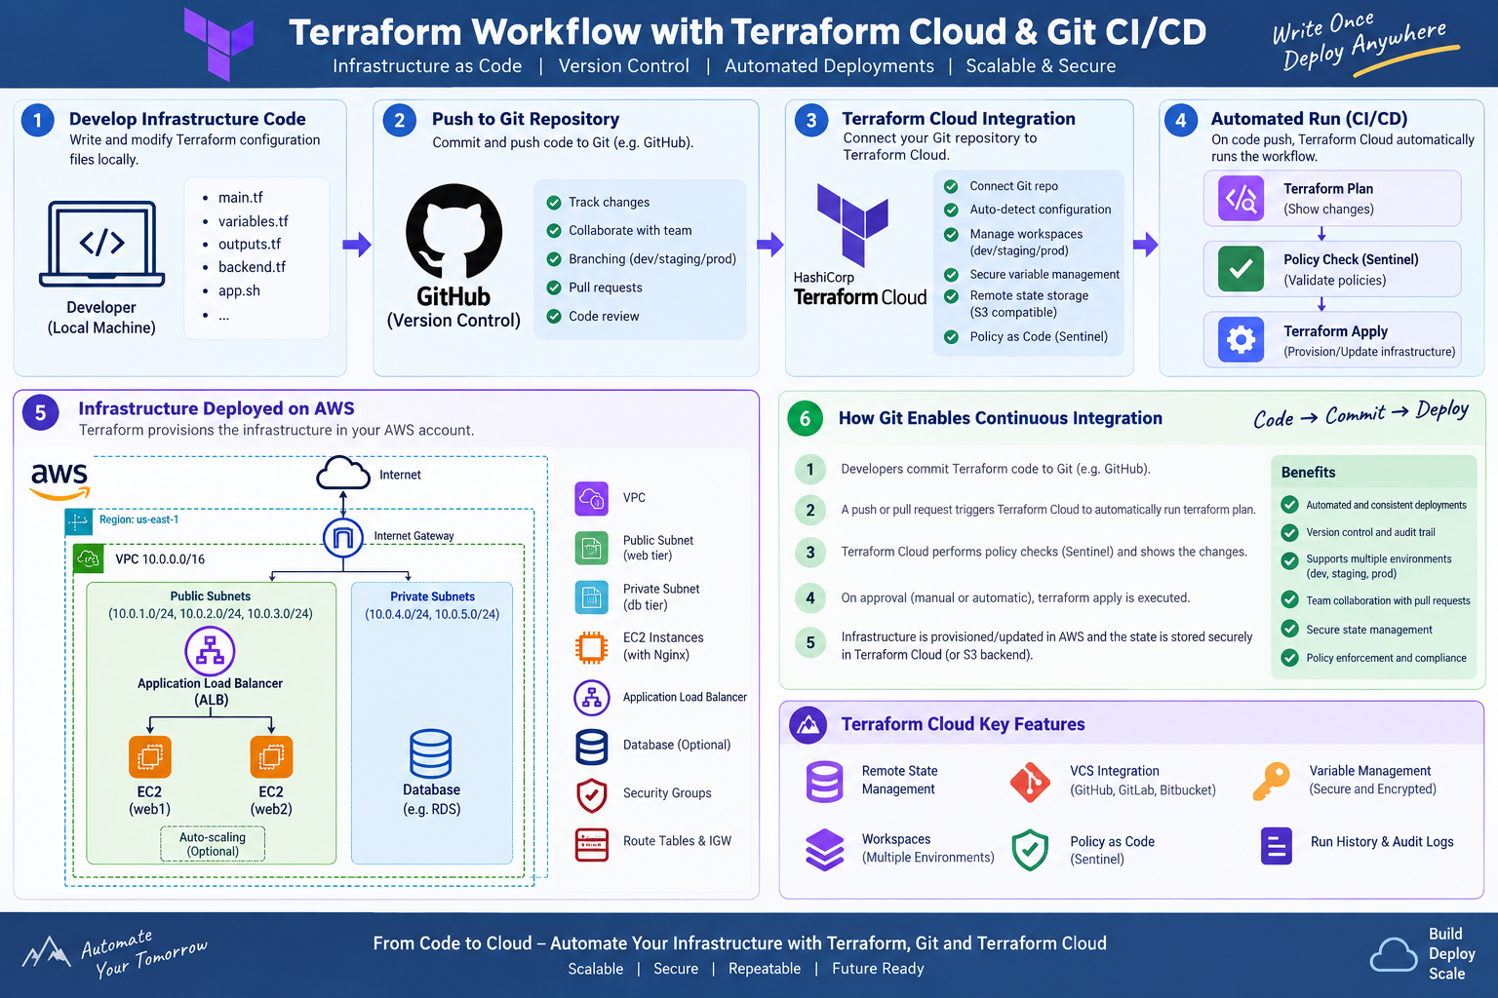
Terraform Workflow with Terraform Cloud & Git CI/CD
AWS Infrastructure as Code • Remote State • VCS Integration • Automated Plan / Apply
Terraform + Terraform Cloud + Git CI/CD | Slide 1

Slide 2
Learning Objectives
By the end, learners can explain and implement the complete Git → Terraform Cloud → AWS workflow.
1. Terraform Foundation
2. AWS Network
3. Compute & Load Balancing
Understand providers, resources, variables, locals, data sources, outputs and for_each.
Understand VPC, public/private subnets, Internet Gateway, route tables and security groups.
Deploy multiple EC2 instances with Nginx and distribute traffic through an Application Load Balancer.
4. Remote State
5. Terraform Cloud
6. Git CI/CD
Use an S3 backend and native S3 lockfile-based state locking as shown in the supplied configuration.
Connect a VCS repository, manage workspaces/variables, review plans and control applies.
Use commits and pull requests to trigger automated validation and Terraform plans, followed by controlled apply.
Terraform + Terraform Cloud + Git CI/CD | Slide 2

Slide 3
End-to-End Workflow
The central idea: infrastructure changes become versioned, reviewable and repeatable.
Developer
Terraform code
GitHub
repository
Terraform Cloud
workspace
Terraform
Plan
Policy / Approval
(optional)
Terraform Apply
→ AWS
1. Developer edits .tf files and tests locally.
2. Commit + push to Git; a pull request can trigger a speculative/preview plan.
3. Terraform Cloud receives the change and runs Terraform.
4. Plan shows what will be created, changed or destroyed.
5. Policy checks and human review can gate the apply.
6. Approved apply provisions/updates AWS and records the run.
Terraform + Terraform Cloud + Git CI/CD | Slide 3

Slide 4
Recommended Project Structure
Map the supplied configuration into small, understandable Terraform files.
terraform-project/
├── versions.tf # required providers / versions
├── provider.tf # AWS provider
├── backend.tf # S3 backend + lockfile
├── variables.tf # scalar variables
├── subnet.tf # public subnet resources
├── db-subnet.tf # private subnet resources
├── vpc.tf # VPC
├── igw.tf # Internet Gateway
├── route-table.tf # route table + associations
├── security-group.tf # EC2 SG
├── alb-sg.tf # ALB SG
├── alb.tf # ALB
├── target-group.tf # target group + attachments
├── instance.tf # EC2 instances
├── data.tf # Ubuntu AMI data source
├── locals.tf # naming / common tags
├── outputs.tf # IDs, IPs, ALB DNS
├── app.sh # Nginx bootstrap
└── terraform.tfvars # environment-specific values
Keep reusable infrastructure definitions in .tf files; Terraform loads all .tf files in the working directory.
Use variables for values that should change by environment.
Use locals for naming/tagging expressions reused throughout the configuration.
Keep bootstrap logic such as app.sh separate from Terraform resource definitions.
Commit the whole configuration to Git so the repository becomes the source of truth.
Terraform + Terraform Cloud + Git CI/CD | Slide 4

Slide 5
Terraform Building Blocks
What each major Terraform construct is doing in the supplied project.
terraform block
provider
Declares required providers and, in backend.tf, remote state configuration.
Configures the AWS provider and region.
resource
data source
Declares infrastructure Terraform should manage, e.g. aws_vpc, aws_subnet and aws_instance.
Reads existing information; the supplied aws_ami data source locates an Ubuntu image.
variable
locals
Defines inputs such as region, VPC CIDR, environment and instance map.
Creates reusable expressions such as gopal-project-dev and common tags.
for_each
output
Creates multiple resource instances from a map, preserving stable keys such as web1/web2.
Publishes useful values such as VPC ID, subnet IDs, instance IPs and ALB DNS.
Terraform + Terraform Cloud + Git CI/CD | Slide 5

Slide 6
Map Variables + for_each
The supplied design uses maps of objects to avoid duplicating similar resource blocks.
variable "instance" {
type = map(object({
instance_type = string
availablity_zone = string
subnet_key = string
}))
default = {
web1 = {
instance_type = "t2.micro"
availablity_zone = "us-east-1a"
subnet_key = "subnet1"
}
web2 = {
instance_type = "t2.micro"
availablity_zone = "us-east-1b"
subnet_key = "subnet2"
}
}
}
var.instance is a map. Each key identifies one EC2 instance.
for_each = var.instance creates aws_instance.web_vm["web1"] and ["web2"].
each.key is the instance name; each.value contains that instance's object.
subnet_id = aws_subnet.web_subnet[each.value.subnet_key].id connects the instance to the requested public subnet.
The same pattern is used for public and private subnet maps.
Benefit: add web3 by adding one map entry instead of copying another resource block.
Terraform + Terraform Cloud + Git CI/CD | Slide 6

Slide 7
AWS Infrastructure Architecture
Logical path of the supplied configuration.
Internet
Custom route table has 0.0.0.0/0 → Internet Gateway.
Public subnets are associated with that route table.
EC2 instances receive public IPs in the supplied configuration.
ALB spans the public subnets and forwards HTTP to the target group.
Internet Gateway
VPC 10.0.0.0/16
Public Subnet 1
10.0.1.0/24
EC2 web1
Public Subnet 2
10.0.2.0/24
EC2 web2
Public Subnet 3
10.0.3.0/24
Private Subnets
10.0.4.0/24
10.0.5.0/24
Terraform + Terraform Cloud + Git CI/CD | Slide 7

Slide 8
Networking: VPC, Subnets, Routes & IGW
VPC
Public Subnets
Private Subnets
Internet Gateway
aws_vpc.web_vpc creates the isolated network using var.aws_vpc_cidr (10.0.0.0/16 in the supplied defaults).
var.public_subnet is a map. for_each creates subnet1–subnet3 in us-east-1a/b/c with 10.0.1.0/24–10.0.3.0/24.
var.private_subnet creates subnet4 and subnet5 with private Type tags. The supplied configuration does not attach a NAT Gateway.
aws_internet_gateway.igw attaches an IGW to the VPC. It provides a path for public IPv4 traffic when routing and public addressing are configured.
Custom Route Table
Important distinction
0.0.0.0/0 points to the Internet Gateway. aws_route_table_association uses for_each to associate every public subnet.
A subnet is not 'public' merely because it has a Type=public tag. Public routing plus public addressing/IGW path are what make Internet connectivity possible.
Terraform + Terraform Cloud + Git CI/CD | Slide 8

Slide 9
Security Groups & Traffic Flow
The supplied configuration defines separate SGs for the web instances and ALB.
aws_security_group.web_sg
inbound: 80, 443, 22 from 0.0.0.0/0 and ::/0
outbound: all
aws_security_group.alb_sg
inbound: 80, 443 from 0.0.0.0/0 and ::/0
outbound: all
web_sg protects the EC2 instances.
alb_sg protects the public Application Load Balancer.
Port 80 is used by the HTTP listener and target group.
Port 443 is allowed in the supplied SGs, but the supplied ALB listener is HTTP-only; no HTTPS listener/certificate is configured.
Port 22 is open to the world in the supplied web_sg. For production, restrict SSH to a trusted source or use AWS Systems Manager instead.
Production hardening: allow EC2 port 80 only from the ALB security group rather than from the entire Internet.
Terraform + Terraform Cloud + Git CI/CD | Slide 9

Slide 10
Application Load Balancer Workflow
EC2 web1
Nginx
Client
ALB
Port 80
Listener
HTTP :80
Target Group
HTTP :80
EC2 web2
Nginx
aws_lb creates an external Application Load Balancer using the public subnet IDs.
aws_lb_listener listens on HTTP port 80 and forwards to aws_lb_target_group.alb-tg.
The target group registers every aws_instance.web_vm instance using for_each.
Health checks use HTTP on the traffic port, with matcher 200.
output "alb_dns" exposes the ALB DNS name after apply.
Terraform + Terraform Cloud + Git CI/CD | Slide 10

Slide 11
EC2 Bootstrap with app.sh
Terraform passes the shell script as user_data; cloud-init executes it during instance initialization.
#!/bin/bash
apt-get update -y
apt-get install nginx -y
HOSTNAME=$(hostname)
PRIVATE_IP=$(hostname -I | awk '{print $1}')
OS_NAME=$(lsb_release -ds)
cat <<EOF > /var/www/html/index.html
<h1>Hello from Terraform!</h1>
<h2>Ubuntu EC2 + Nginx</h2>
<p>Hostname: $HOSTNAME</p>
<p>Private IP: $PRIVATE_IP</p>
<p>Operating System: $OS_NAME</p>
<p>Web Server: Nginx</p>
EOF
systemctl enable nginx
systemctl restart nginx
user_data = file("${path.module}/app.sh") reads app.sh from the Terraform module directory.
apt-get update refreshes package metadata.
nginx is installed and enabled at boot.
Runtime values are captured from the instance itself and embedded in index.html.
Because each EC2 instance runs the same script, each server can display its own hostname and private IP.
Troubleshooting: inspect cloud-init logs on the instance if Nginx does not start.
Terraform + Terraform Cloud + Git CI/CD | Slide 11

Slide 12
Remote State: S3 + Lockfile
The supplied state configuration stores Terraform state remotely and enables native S3 lockfile-based locking.
terraform {
backend "s3" {
bucket = "terraform-state-gopal14"
key = "dev/gopal.tfstate"
region = "us-east-1"
use_lockfile = true
encrypt = true
}
}
Bucket
Key
Stores the state object remotely rather than leaving terraform.tfstate only on a developer laptop.
dev/gopal.tfstate identifies the state object path for this environment.
Encryption
Locking
encrypt = true requests server-side encryption for the state object.
use_lockfile = true enables S3 lockfile-based state locking. The supplied state JSON shows no DynamoDB table configured.
Why remote state? Multiple operators/runs need one authoritative state.
Why locking? Prevents concurrent Terraform operations from modifying the same state at the same time.
Protect the S3 bucket with least-privilege IAM, versioning, encryption and restricted access.
Do not commit state files or credentials to Git.
Terraform + Terraform Cloud + Git CI/CD | Slide 12

Slide 13
Terraform Cloud / HCP Terraform
Terraform Cloud can become the execution and collaboration layer around the Git repository.
VCS Connection
Workspace
Variables & Secrets
Remote Execution
Connect a GitHub/GitLab/Bitbucket repository to a workspace. Changes in the tracked branch can trigger Terraform runs.
A workspace associates configuration, variables, state and run history with an environment or deployment boundary.
Store Terraform variables and sensitive values in the workspace rather than hard-coding credentials in .tf files.
Terraform Cloud can run Terraform in its managed execution environment, giving teams a consistent execution location.
Run Lifecycle
Auditability
A typical VCS-driven run is: configuration fetch → init → validate/plan → policy checks where configured → apply when approved/allowed.
Run history captures plans/applies and helps teams understand when infrastructure changed and which run performed the change.
Important: choose one clear state/execution model per workspace. Do not casually mix a local S3 backend workflow with a Terraform Cloud-managed state workflow without understanding the backend/execution design.
Terraform + Terraform Cloud + Git CI/CD | Slide 13

Slide 14
How Git Enables Continuous Integration
Git provides the change-control mechanism; Terraform Cloud provides infrastructure execution and run visibility.
1
Branch
2
Edit
3
Commit
4
Push / PR
5
Automated Plan
6
Review
7
Merge
8
Apply
Developer creates feature branch.
Modify Terraform, variables or modules.
Record a small, traceable change.
Push branch and open pull request.
Terraform Cloud runs a preview/plan for the change.
Team reviews code + Terraform plan.
Approved change is merged to the tracked branch.
Controlled run applies the approved infrastructure change.
CI principle
CD principle
Every change is validated early. A pull request can expose syntax errors, provider/resource problems and the expected infrastructure diff before merge.
After approval, the controlled pipeline applies the exact reviewed configuration to the target environment, with state and run history retained.
Terraform + Terraform Cloud + Git CI/CD | Slide 14

Slide 15
Recommended Pull Request Pipeline
A practical Git-based CI flow for the supplied project.
Protect main with pull-request review and status checks.
Require the plan to succeed before merge.
Use separate workspaces/environments for dev, staging and prod.
Use approvals for production applies where appropriate.
Keep secrets out of Git; use Terraform Cloud/HCP Terraform variables or an approved secrets system.
Checkout
Validate
Review
Fetch repository
terraform validate
Review code + plan
Format
Lint / Security
Merge
terraform fmt -check
Optional tflint, Checkov, tfsec, etc.
Merge to protected branch
Init
Plan
Apply
terraform init
terraform plan / Terraform Cloud speculative plan
Terraform Cloud controlled apply
Terraform + Terraform Cloud + Git CI/CD | Slide 15

Slide 16
Terraform Cloud Run Lifecycle
What happens after Git sends a change to the workspace.
VCS Event
Commit / PR / merge
Plan is not Apply
Queue
Workspace receives run
A plan describes the proposed infrastructure changes. Apply is the operation that makes those changes in AWS.
Init
Provider + modules
Plan
Calculate desired changes
Failure handling
Policy
Optional policy checks
If validation, policy, credentials, provider operations or AWS API calls fail, the run should stop rather than silently progressing to the next stage.
Approval
Manual/automatic gate
Apply
Create/update/destroy
Audit trail
State
Record resulting state
The workspace retains run information so teams can correlate Git changes with infrastructure operations.
Terraform + Terraform Cloud + Git CI/CD | Slide 16

Slide 17
Managing Dev / Staging / Production
Use Git and Terraform Cloud workspace boundaries to make environment changes explicit.
dev
staging
prod
Feature development and experimentation. Lower blast radius. Automatic plans can be used frequently.
Integration validation. Mirror important production patterns before release.
Protected environment. Strong review, approvals, restricted credentials and controlled apply.
Use environment-specific variables rather than editing the same .tf code for every environment.
Workspace naming example: gopal-project-dev, gopal-project-staging, gopal-project-prod.
Use branch protection and required checks for production.
Keep state isolated per environment.
Promotion should be a deliberate Git change, not a manual edit inside AWS.
Terraform + Terraform Cloud + Git CI/CD | Slide 17

Slide 18
Outputs: Making Deployment Information Visible
output "instance_details" {
value = {
for name, instance in aws_instance.web_vm :
name => {
instance_id = instance.id
public_ip = instance.public_ip
private_ip = instance.private_ip
}
}
}
output "alb_dns" {
value = aws_lb.web_lb.dns_name
}
instance_details uses a for expression to produce one structured object per EC2 key.
public_ip is useful for direct testing in the supplied lab configuration.
private_ip is useful for internal identification and troubleshooting.
alb_dns is the preferred application entry point once the ALB is healthy.
Terraform Cloud can expose run outputs to authorized users after a successful run.
Terraform + Terraform Cloud + Git CI/CD | Slide 18

Slide 19
Demo Walkthrough: From Code to Working Web App
1. terraform init — initialize providers/backend.
2. terraform fmt — format configuration.
3. terraform validate — validate syntax and configuration.
4. terraform plan — inspect the infrastructure change.
5. terraform apply — create VPC, subnets, IGW, routes, SGs, EC2 and ALB.
6. Wait for EC2 user_data to install Nginx.
7. ALB health checks verify the EC2 targets return HTTP 200.
8. Read terraform output alb_dns and open it in a browser.
9. Make a Git change, create a pull request and inspect the Terraform Cloud plan.
10. Merge and execute the controlled apply; verify the changed infrastructure.
Terraform + Terraform Cloud + Git CI/CD | Slide 19

Slide 20
Troubleshooting Checklist
Use the layer where the failure occurs to narrow the problem.
Terraform errors
Backend errors
AWS networking
EC2/Nginx
Run fmt/validate; inspect references, types, map keys and provider versions.
Check bucket name, region, IAM permissions, key path and S3 lockfile access.
Check subnet route table association, IGW attachment, public IP and security group.
Check instance status, user_data/cloud-init logs and Nginx service status.
ALB unhealthy
Git/TFC run
State drift
Verify target registration, port 80, SG rules, Nginx and HTTP 200 response.
Check VCS connection, workspace working directory, variables, credentials and run logs.
Use Terraform plan to identify differences; avoid manual AWS edits when possible.
Always identify whether the issue is in Git, Terraform configuration, backend/state, Terraform Cloud execution, AWS API, networking, or application bootstrap.
Terraform + Terraform Cloud + Git CI/CD | Slide 20

Slide 21
Production Hardening Recommendations
These are improvements to consider beyond the supplied lab configuration.
Restrict SSH (22) rather than allowing 0.0.0.0/0.
Allow EC2 HTTP only from the ALB security group.
Add HTTPS on the ALB with an ACM certificate and redirect HTTP → HTTPS.
Consider private EC2 subnets with a NAT Gateway or another controlled egress design.
Use IAM roles/instance profiles rather than long-lived AWS access keys.
Enable S3 bucket versioning and strong access controls for state protection.
Use separate environment states/workspaces and least-privilege credentials.
Add automated Terraform formatting, validation, linting and security scanning to CI.
Pin provider/module versions deliberately and review upgrades.
Use policy-as-code and approval gates for sensitive production changes.
Terraform + Terraform Cloud + Git CI/CD | Slide 21

Slide 22
Key Takeaways
Terraform defines AWS infrastructure as code and calculates the desired state.
Git provides version control, collaboration, pull requests and an auditable history of infrastructure changes.
Terraform Cloud connects Git changes to repeatable Terraform runs, remote state/run history and optional policy/approval controls.
The supplied project demonstrates VPC → public/private subnets → routing → security groups → EC2/Nginx → ALB.
Continuous Integration means validating changes early; Continuous Delivery/Deployment means applying approved changes through a controlled automation path.
Treat state, credentials and production applies as protected resources.
Terraform + Terraform Cloud + Git CI/CD | Slide 22

