Slide 1
Elements of Enterprise Software Development
CS 512 Software Systems
Prof. Chandrashekar R

Slide 2
Outline
Elements
Enterprise
Software
Development
Deployment

Slide 3
Enterprise Software
What is it for?
Where is used?
How is it used?
When is it used?
Who is it for?

Slide 4

Enterprise Software Deliverables
What makes these deliverables “good”?
Requirements (“What”)
Architecture and Design (“How”)
Code

Slide 5
Development Process
Environments
Configuration Management
Quality Management

Slide 6

Development Process
Environments
Dev
Test
Prod

Slide 7
Development Process
Code
Test
Check-in
Check-out
Configuration Management

Slide 8
Development Process
Quality Management
Process Quality
Product QUality

Slide 9
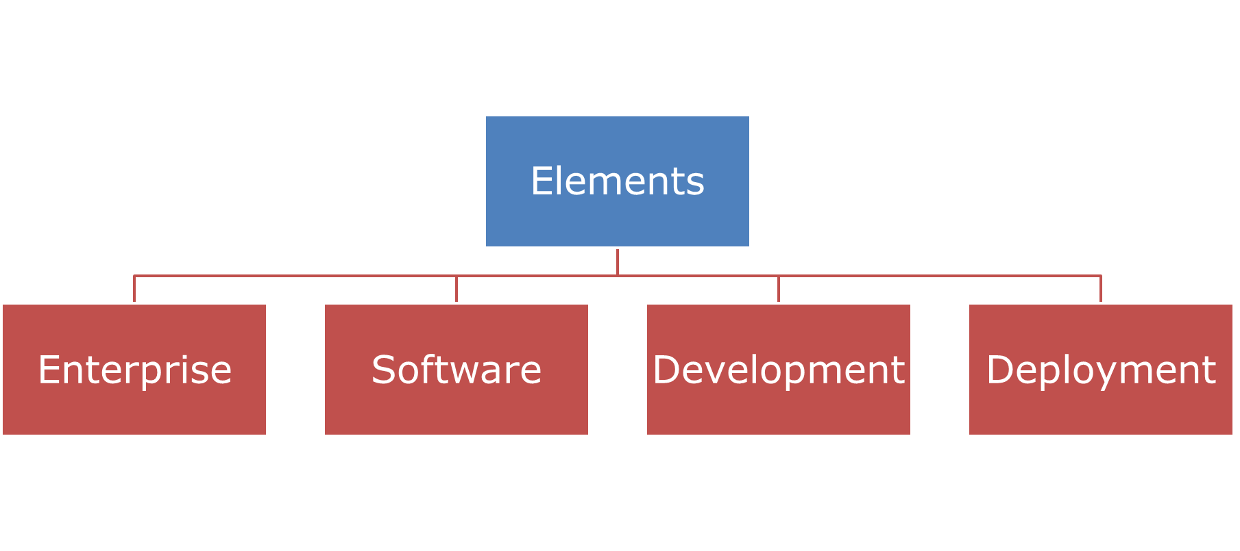
Elements of Deployment
Compute
Storage
Network
CPU & RAM
System Software
DAS
SAN
NAS
SSD
Routers and Switches
Node
Load balancer
Firewall
Umm, What is the role of developer here?

Slide 10
Summary
Many diverse elements need to come together to make Enterprise Software work
Developer plays a critical role in this
But remember, Developer is not the ONLY one in the picture!
I promise to be nice to everyone from business analyst to sys-admin!!

