Slide 1
Database Programming
DS 501 Database Systems
View in Slide Show Mode (Press F5)

Slide 2
Outline
Need for database programming
Six database programming options

Slide 3
Motivation
Databases hide and protect data in proprietary hidden files and formats
Applications need specific interfaces to access and manipulate data
Imperative programming constructs
The interfaces must be “easy” to use

Slide 4
Database Programming Approaches

Slide 5
DB Programming Approaches
SQL
Procedural Extensions to SQL
Embedded SQL
Database APIs
ODBC / JDBC variants
Database Frameworks

Slide 6
1 – SQL
DB
Application
Queries in SQL
Results

Slide 7
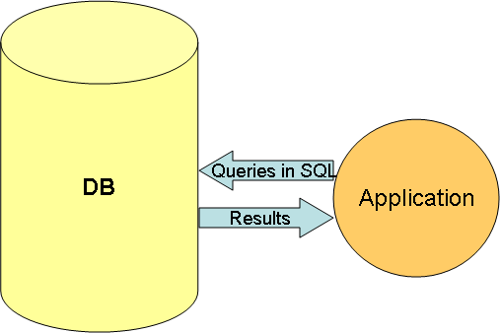
1 - SQL
SQL is the industry standard non-procedural language for relational database access
Advantages
Easy to use (for developers)
Behaves consistently across all vendor implementations (to a large extent)
Disadvantages
Difficult to use! (for end-users)
Difficult to implement complex scenarios (e.g., end user interaction, complex data validations, etc.)

Slide 8
2 – Procedural Extensions to SQL
DB
Stored Procedure
Compiled stored procedure
Application
Compilation
Invoke
Results

Slide 9
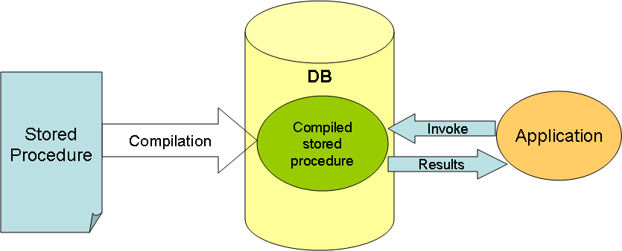
2 – Procedural Extensions to SQL
SQL is extended with imperative programming constructs (conditionals, looping, exceptions, etc.)
Typically implemented as stored procedures
Examples
PL/SQL in Oracle, T/SQL in MS SQL Server
Advantages
Finer control in processing logic
Better performance because of server-side processing
Disadvantages
Not portable across DBMS

Slide 10
Oracle PL/SQL Example
create or replace
procedure changesalary (
ide number, ch_salary number) IS
sal number;
begin
select salary
into sal
from employee
where employee.id=ide;
sal := sal+sal*ch_salary*.01
update employee
set salary=sal
where employee.id=ide;
end;
Local Variables
Assigning SQL output to local variables
Running SQL queries with run time parameters
Assignment statements
And you can include IF statements, LOOPs, EXCEPTIONS and so on

Slide 11
3 – Embedded SQL
HLL
+ embedded SQL
HLL
+
Library calls
Pre-Compilation
DB
Compilation
Application
Queries in API
Results

Slide 12
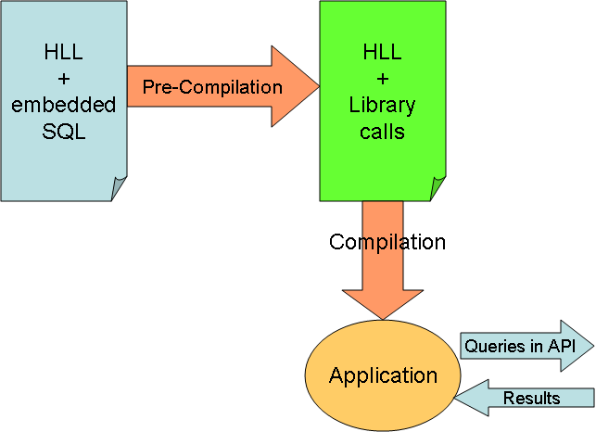
3 – Embedded SQL
SQL statements can be embedded in a general-purpose host programming language such as COBOL, C, Java
Pre-compilers convert SQL statements into database calls
Examples
Oracle’s Pro*C and SQLJ
Advantages
No need for a learning a new procedural language
Disadvantages
Not portable across DBMS
Impedance mismatch: mixing of incompatible programming paradigms

Slide 13
Pro*C Example
int loop;
EXEC SQL BEGIN DECLARE SECTION;
varchar dname[16], fname[16], …;
char ssn[10], bdate[11], …;
int dno, dnumber, SQLCODE, …;
EXEC SQL END DECLARE SECTION;
loop = 1;
while (loop) {
prompt (“Enter SSN: “, ssn);
EXEC SQL
select FNAME, LNAME, ADDRESS, SALARY
into :fname, :lname, :address, :salary
from EMPLOYEE where SSN == :ssn;
if (SQLCODE == 0) printf(“%s”, fname, …);
else printf(“SSN does not exist: “, ssn);
prompt(“More SSN? (1=yes, 0=no): “, loop);
END-EXEC
}
This is a C program with embedded SQL calls

Slide 14
4 – Database APIs
HLL
+ embedded SQL
HLL
+
Library calls
Pre-Compilation
DB
Compilation
Application
Queries in API
Results

Slide 15
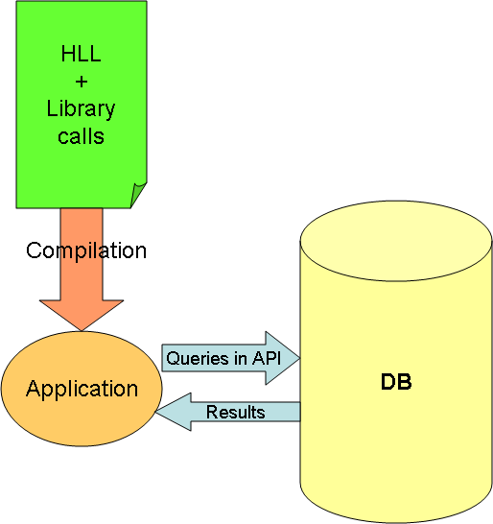
4 – Database APIs
Database vendors publish proprietary API’s that give low level access to the database
Examples
OCI (Oracle Call Level Interface)
Advantages
No impedance mismatch: no need to mix two different languages
Better performance because it is low-level
Disadvantages
Not portable across DBMS
APIs may be complex to use

Slide 16
Sample API Code
rc = OCIInitialize((ub4) OCI_DEFAULT, (dvoid *)0, /* Initialize OCI */
(dvoid * (*)(dvoid *, size_t)) 0,
(dvoid * (*)(dvoid *, dvoid *, size_t))0,
(void (*)(dvoid *, dvoid *)) 0 );
/* Initialize evironment */
rc = OCIEnvInit( (OCIEnv **) &p_env, OCI_DEFAULT, (size_t) 0, (dvoid **) 0 );
/* Initialize handles */
rc = OCIHandleAlloc( (dvoid *) p_env, (dvoid **) &p_err, OCI_HTYPE_ERROR,
(size_t) 0, (dvoid **) 0);
rc = OCIHandleAlloc( (dvoid *) p_env, (dvoid **) &p_svc, OCI_HTYPE_SVCCTX,
(size_t) 0, (dvoid **) 0);
/* Connect to database server */
rc = OCILogon(p_env, p_err, &p_svc, "scott", 5, "tiger", 5, "d458_nat", 8);
if (rc != 0) {
OCIErrorGet((dvoid *)p_err, (ub4) 1, (text *) NULL, &errcode, errbuf, (ub4) sizeof(errbuf), OCI_HTYPE_ERROR);
printf("Error - %.*sn", 512, errbuf);
exit(8);
}
/* prepare SQL statement */
rc = OCIStmtPrepare(p_sql, p_err, "select ename from emp where deptno=:x",
(ub4) 37, (ub4) OCI_NTV_SYNTAX, (ub4) OCI_DEFAULT);

Slide 17
5 – ODBC / JDBC
HLL
+
JDBC Library calls
DB
Compilation
Application
Queries in JDBC
JDBC Driver
Queries in API
Results
Results

Slide 18
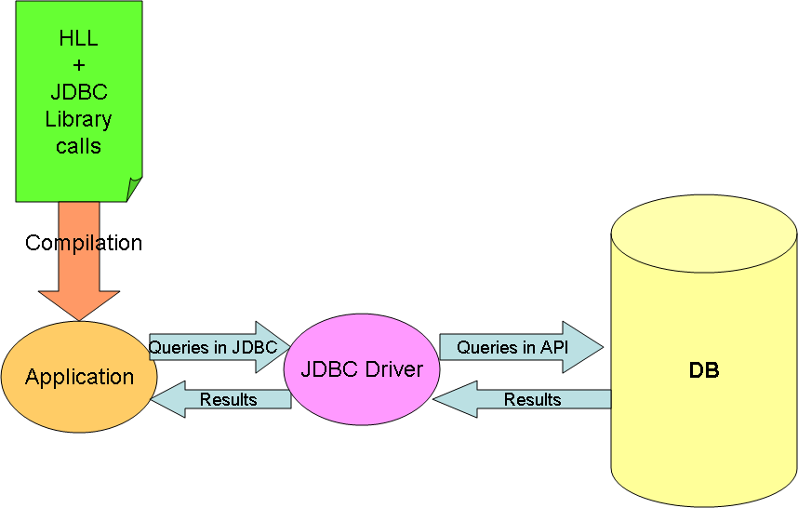
5 – ODBC / JDBC
ODBC (Open Database Connectivity) was originally proposed by Microsoft as a DBMS-independent way to connect to any compliant data source
JDBC is the java-equivalent of ODBC
The JDBC API defines interfaces and classes for writing database applications in Java
Advantages
Highly portable and standardized across DBMS
Disadvantages
Impedance mismatch in programming styles
No other significant disadvantages compared to other approaches discussed earlier

Slide 19
JDBC Sample Code
// Load the database driver
Class.forName( "com.mysql.jdbc.Driver" ) ;
// Get a connection to the database
Connection conn = DriverManager.getConnection( "jdbc:mysql:retaildb" ) ;
// Get a statement from the connection
Statement stmt = conn.createStatement() ;
// Execute the query
ResultSet rs = stmt.executeQuery( "SELECT * FROM Customer" ) ;
// Loop through the result set
while( rs.next() )
System.out.println( rs.getString(1) ) ;
// Close the result set, statement and the connection
rs.close() ;
stmt.close() ;
conn.close() ;

Slide 20
6 - Database Frameworks
HLL
+
Framework calls
Application
Compilation
Object access
Results
Mapping
JDBC Driver
Framework
Queries in JDBC
Results
Query
Results
DB

Slide 21
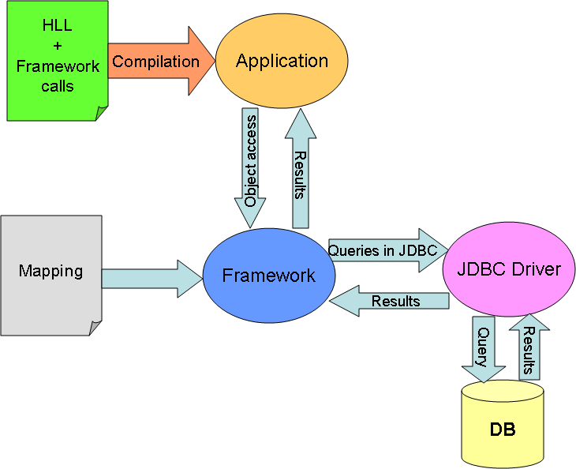
6 - Database Frameworks
Frameworks help with database access without the need to mix two different languages like Java and SQL
They primarily rely on providing automatic mapping between relational rows and objects
Examples
Hibernate
Advantages
No impedance mismatch (no need for SQL)
Disadvantages
Not portable, some times hard to debug

Slide 22
JPA – Java Persistence API
Equivalent of JDBC for ORM (object-relational mapping)
JPA operates directly with Java objects
Just like JDBC, JPA is also an interface specification
Needs to be combined an ORM implementation framework like Hibernate, Toplink, etc.

Slide 23
JPA Sample Mapping
@Entity
@Table(name = "USERS")
public class User {
private Integer id;
private String fullname;
private String email;
private String password;
@Column(name = "USER_ID")
@Id
@GeneratedValue(strategy = GenerationType.IDENTITY)
public Integer getId() {
return id;
}

Slide 24
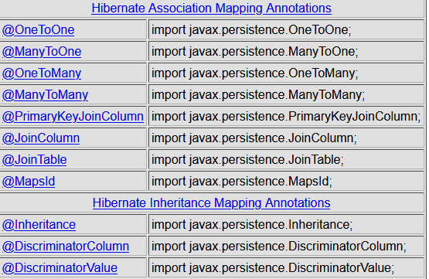
JPA Relationship Annotations
Ref: http://www.techferry.com/articles/hibernate-jpa-annotations.html

Slide 25
JPA Sample Code
EntityManagerFactory factory = Persistence.createEntityManagerFactory(“xyz");
EntityManager entityManager = factory.createEntityManager();
entityManager.getTransaction().begin();
User newUser = new User();
newUser.setEmail("billjoy@gmail.com");
newUser.setFullname("bill Joy");
newUser.setPassword("billi");
// To INSERT
entityManager.persist(newUser);
entityManager.getTransaction().commit();
entityManager.close();
factory.close();
}
}
// To UPDATE
entityManager.merge(existingUser);
// To SELECT
String querystring = “xxxxxxxxxxxxx";
Query query = entityManager.createQuery(querystring);
Customer cust = (Customer) query.getSingleResult();
// To DELETE
User reference = entityManager.getReference(User.class, primaryKey);
entityManager.remove(reference);

Slide 26
Summary
Programming interfaces are required to build real world applications
These interfaces require more capabilities than those provided by SQL
We looked at several database programming strategies
Procedural extensions to SQL, Embedded SQL, proprietary APIs, ODBC/JDBC and database frameworks

