Slide 1
Technology Architecture
CS 752 Software Architecture and Design Practices
Prof. Chandrashekar R
Ref: Software Architecture Patterns by Mark Richards

Slide 2
Outline
Purpose
Components and Elements of Technology Architecture
Software Architecture Styles
Deep Dive – Layered Architecture

Slide 3

Technology Architecture
The purpose of Technology Architecture is to specify a structure comprised of hardware and software for implementing an IT Solution
Same as Technical Architecture?
Contrast with Functional Architecture

Slide 4
Relation with other architectures
With Zachman Architecture Framework
Addresses the “How” column from the “Designer”/”Logical” row downwards

Slide 5
Relation with other architectures
With Functional Architecture
The “WHAT” of Functional Architecture drives the specifics of “HOW” of Technical Architecture

Slide 6
Relation with other architectures
With Deployment Architecture
The “HOW” of Technical Architecture drives the specifics of “WHERE” and “WHO” of Deployment Architecture

Slide 7
Technology Architecture Matrix
Technology Architecture Matrix
 | Elements
Components |  | Hardware | Software
 | Compute
 | Storage
 | Network
Elements
Hardware
Software
Components
Compute
Storage
Network
Deployment Architecture
Software Architecture

Slide 8
Components
Compute
How does the processing take place?
Storage
How is information persistence managed?
Network
How is the communication with users established
How does this compare with Von Neuman Architecture

Slide 9
Elements
Software Elements
COTS vs Bespoke
Open Source vs Proprietary
Hardware Elements
Compute, Storage and Network
Architecture Principles
Rules governing the interfacing between H/W and S/W
Rules governing choice and use of Hardware
Rules governing choice, creation and use of software

Slide 10
Example Elements and Components
 | Elements
Components |  | Hardware | Software
 | Compute | Web server Database server | Operating Systems Web Server Application Server DBMS
 | Storage | SAN NAS SATA | Storage O/S Backup Software
 | Network | Routers Switches Cabling media | Network O/S Firewall Proxy servers Load Balancer

Slide 11
Software Architecture

Slide 12
Software Architecture
Software Architecture is concerned with all necessary computing needs of a given IT solution
It includes the software needed to provide compute, storage and networking capabilities
 | Elements
Components |  | Software
 | Compute
 | Storage
 | Network

Slide 13
Software Architecture Styles
A style specifies a consistent mechanism for designing software
A given IT solution may choose a mixture of styles to suit the specific needs of the solution
A given Application in an IT solution generally is based on only one style

Slide 14
Principle of Cohesion
Low
Degree to which different components of WITHIN a layer are focused on a single objective

Slide 15
Cohesion Characteristics
Advantages of High Cohesion
Improves consistency
Increase reuse
Plug-and-play
Engineering eases (development and testing)
Localization of expertise

Slide 16
Binding forces of cohesion
Logical
Credit card payment + NEFT payment
Temporal
Init of DB + Init of Web server + Init O/S
Procedural
Loan verification + Loan evaluation + Loan underwriting
I/O oriented
PO printing + PO saving + PO mailing
Sequential
Search → Select → Add → Checkout
Functional
Self-contained (search to payment)

Slide 17
Separation of Concerns
Governs relationships ACROSS layers
Minimize overlap of responsibilities across layers
Responsibilities are well-defined
Advantages
Avoid duplication
Better maintainability
Reduces coupling / dependencies across layers

Slide 18
Architecture Styles to be Covered
Layered
Event-Driven
Microkernel
Micro-services

Slide 19
deployment Architecture

Slide 20
Deployment
What?
Deployment is the process implementing an IT solution comprised of all necessary hardware and software
Where?
On-Premise
Cloud
Who?
Sys Admin, Hardware Specialists, Network Admins, etc.
When?
Once a “ready-to-use” product is available
How?
Manual
Automated
Why
Easy of use
Better agility
Cost efficiency
Ready-to-use vs Finished?

Slide 21
WHAT – Components of Deployment
Compute
Comprised of servers needed to carry out “computations”
Software gets deployed on “Compute” nodes
Storage
Comprised of servers needed to store information
Storage hardware like HDD, Flash, Tapes get deployed
Software for managing the hardware gets deployed
Network
Comprised of networking hardware components like routers, switches, connectivity media
Software for managing the network gets deployed
 | Elements
Components |  | Hardware
 | Compute
 | Storage
 | Network

Slide 22
WHERE - Location of deployment
On-Premise (“On-Prem”)
Cloud
Dedicated “Data center”
Owned by the Enterprise
Includes all physical infrastructure (space, cooling, power, cabling, hardware, monitoring tools)
Managed by locally by the enterprise personnel
Typically separate hardware stack dedicated to specific applications
Shared “Data Center”
Owned by service provider and used by multiple enterprises
Includes all physical infrastructure (space, cooling, power, cabling, hardware, monitoring tools)
Managed centrally by service provider personnel
Shared hardware stack across multiple applications

Slide 23
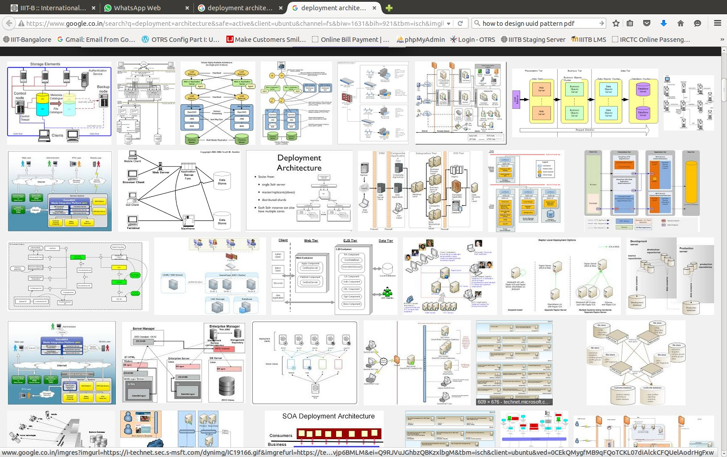
Examples: Zoom and see! ☺

Slide 24
GOING forward

Slide 25
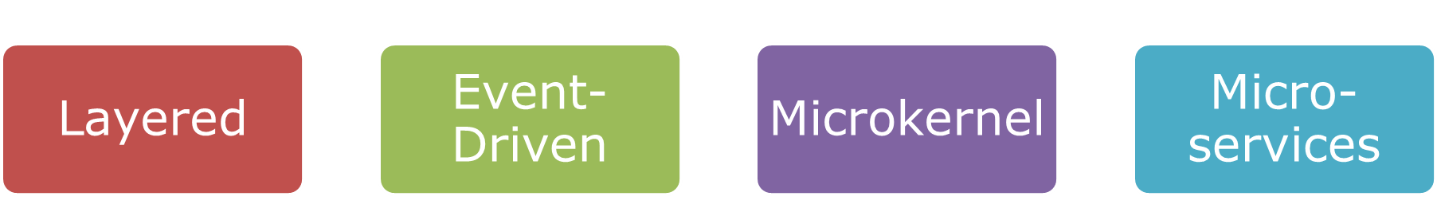
Looking ahead

