Slide 1
Layered Architecture
CS 752 Software Architecture and Design Practices
Prof. Chandrashekar R
Ref: Software Architecture Patterns by Mark Richards

Slide 2
What constitutes a “Layer”?
“Layered Architecture” is a software architecture style / pattern
Layer is a collection of services / functions
Layer has to be cohesive
No overlap with other layers (“Separation”)
There has to be a well-defined list of concerns for each layer
Can depend on other layers or be a dependency for other layers (“provider” and “consumer”)
Layers can “OPEN” or “CLOSED”

Slide 3
Closed and Open Layers
Closed Layer
A layer is be considered to “closed” if its interaction is permitted only across adjacent layers
Open layer
A layer is considered to be “open” if it provides shared services accessible across all layers

Slide 4
Example layered architecture

Slide 5
N-Tier Architecture
Choice of different cohesion forces leads to different types of layered architecture
N-Tier Architecture is a type of layered architecture in which FUNCTIONAL forces are dominant
The layers in N-Tier Architecture are strictly CLOSED
Following is an example of Web Application N-Tier Architecture

Slide 6
1-Tier Architecture
Tier
Technology
Tools
1-Tier System
(Monolithic Design)
Dumb Terminals
Mainframe servers
Legacy Databases
COBOL
IMS
Etc.

Slide 7
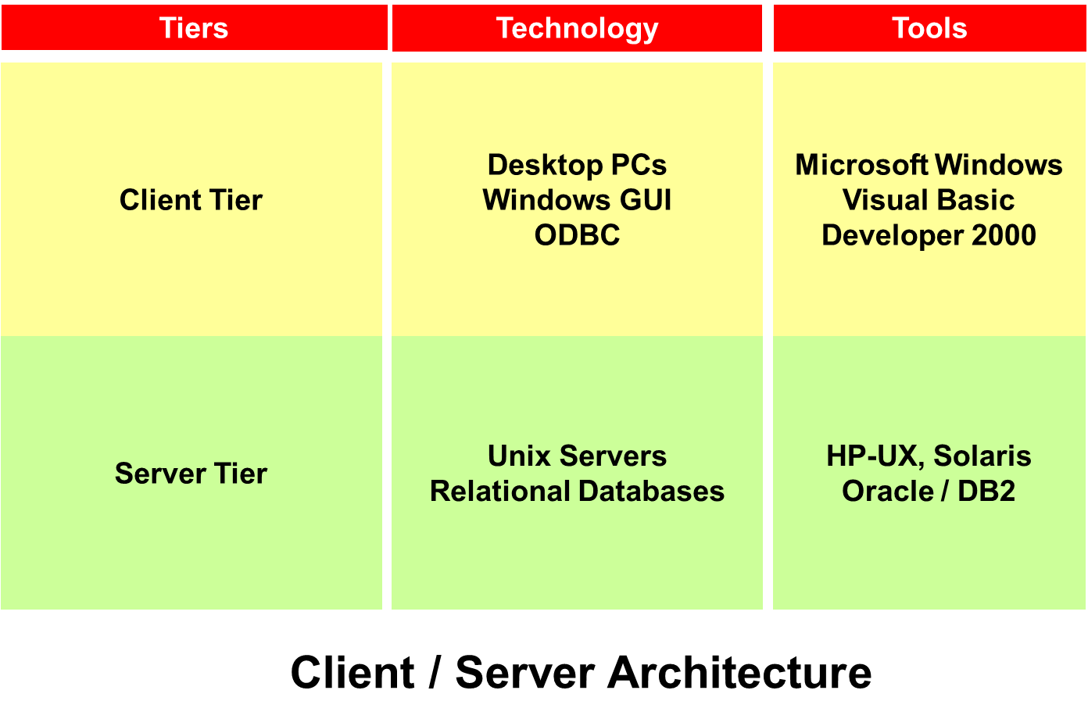
2-Tier Architecture

Slide 8
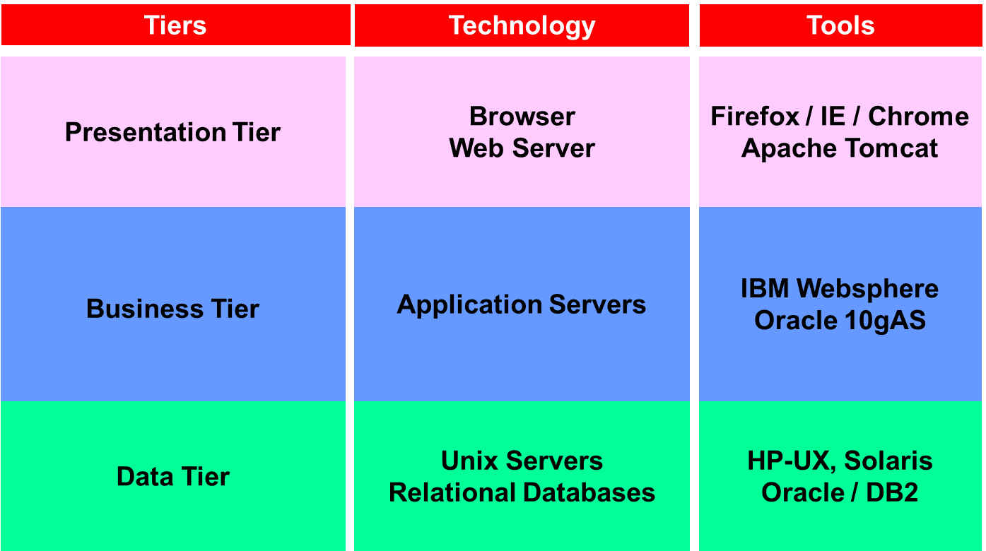
3-Tier Architecture

Slide 9
4-Tier Architecture
Tiers
Technology
Tools
Presentation Tier
Client Tier
Browser
Web Server
Javascript, AJAX
Firefox / IE / Chrome
Apache Tomcat
Flash, HTML5
Presentation Tier
Web Server
Apache Tomcat
Business Tier
Application Servers
IBM Websphere
Oracle 10gAS
Data Tier
Unix Servers
Relational Databases
HP-UX, Solaris
Oracle / DB2
And so-on for N-Tier Architectures!

Slide 10
Example
Ref: Software Architecture Patterns by Mark Richards

Slide 11
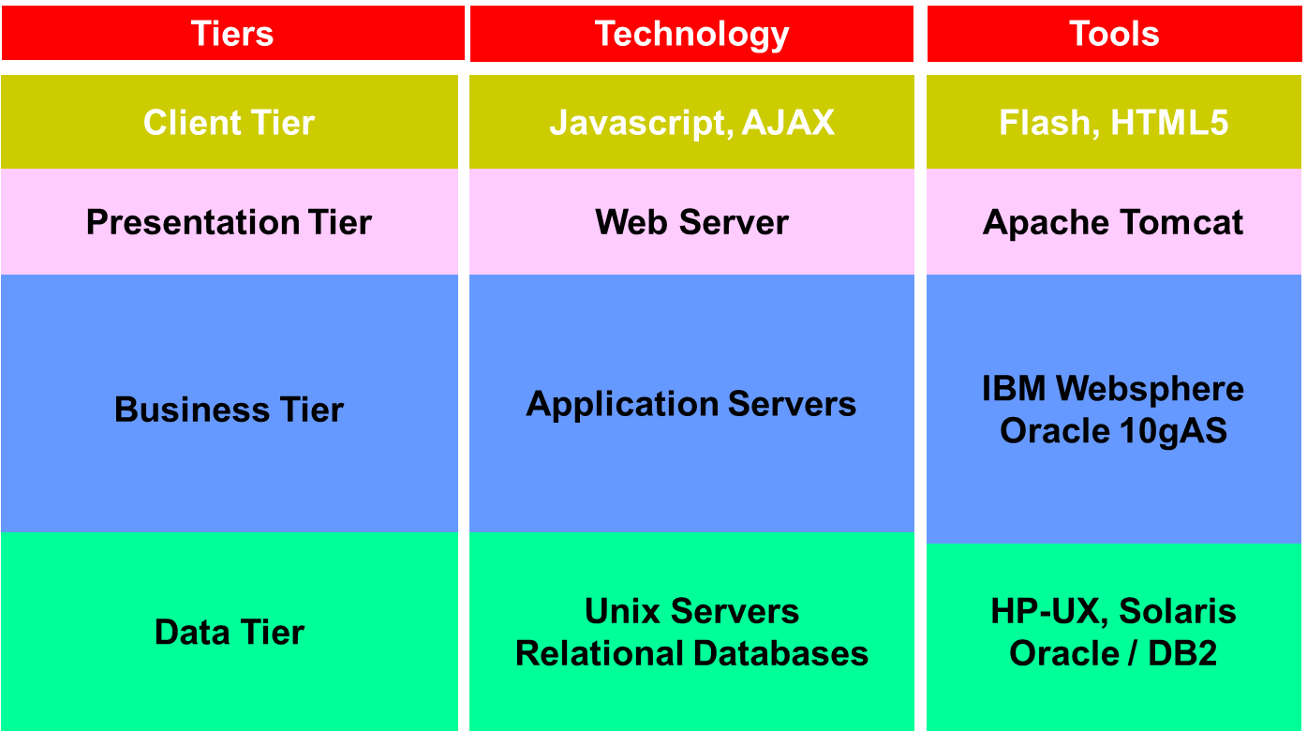
Closed Layer Property
Presentation Tier not allowed to access Data Tier
Data Tier not allowed to send data to Client Tier

Slide 12
Adding Open Layers
Presentation Tier can use authentication services provided by the security services layer
Data Tier can use encryption keys provided by security services layer to send data to business tier
Data Packaging Services
Security Services

Slide 13
Impact on Deployment Architecture
Greater the number of tiers greater the deployment flexibility
Provides multiple deployment options
N software tiers may be deployed on UPTO N hardware tiers
Provides options to scale horizontally

Slide 14
Evaluation of Layered Architecture Style
Strengths
Weakness
Ease of engineering (dev, test, deploy)
Better control on quality attributes
Eases project management
Too many layers leads to effort fragmentation
May be an “over-kill” for less complex solutions
Increases monitoring and trouble-shooting complexity
More “moving parts” leads more points of failure

Slide 15
Hands on CASE STUDY

Slide 16
Exercise – OAES Technical Architecture
Create software architecture for OAES “ASSESSMENT” application software as per the given tiers
Conceptual | Technology | Tools
1.1 | 1.2 | 1.3
2.1 | 2.2 | 2.3
3.1 | 3.2 | 3.3
4.1 | 4.2 | 4.3
5.1 | 5.2 | 5.3
1. Client Tier
2. Presentation Tier
3. Business Logic
4. Persistence Management
5. Database

Slide 17
OAES Technical Architecture Principles
The architecture will follow LAYERED architecture principle
All layers will be CLOSED by default unless specified otherwise
Information across layers shall be transmitted securely

Slide 18
OAES Assessment Module
Assessment software used in examination centers for students to write online examinations
The software caters to the following user classes (“actors”)
Center administrator to monitor ongoing exam
Students writing the exam
Invigilators
Assessment software does not include question paper creation, registration, etc.

Slide 19
Exercise Deliverable
Minimum 15 slide presentation (one slide per cell, at least!)
Principles associated with each cell of the given layers
Specific modules / tools / technologies as applicable to that cell
Target audience for presentation: Software Designers and Developers

Slide 20
Summary
Layered architecture can be created as per the desired dominant cohesive forces
Layers need NOT be closed always
N-Tier architecture is a popular architecture style for web-based applications

Slide 21
GOING forward

Slide 22
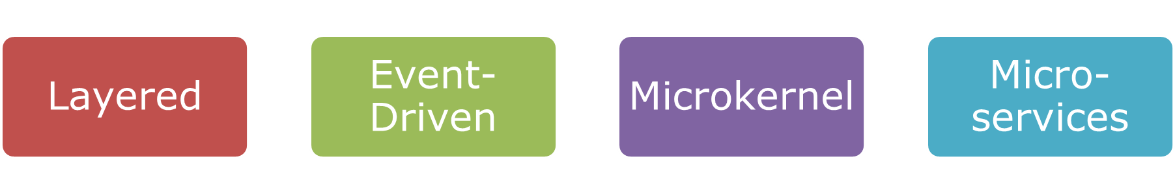

Looking ahead

