Slide 1
Service Oriented Architcture
CS 752 Software Architecture and Design Practices
Prof. Chandrashekar R
Ref: Service-Oriented Architecture: Concepts, Technology, and Design By Thomas Erl

Slide 2
Outline
Introduction
2. Architecture Principles
3. Sub-Architectures (“under the hood”)
4. Implementation Approaches
5. Example

Slide 3
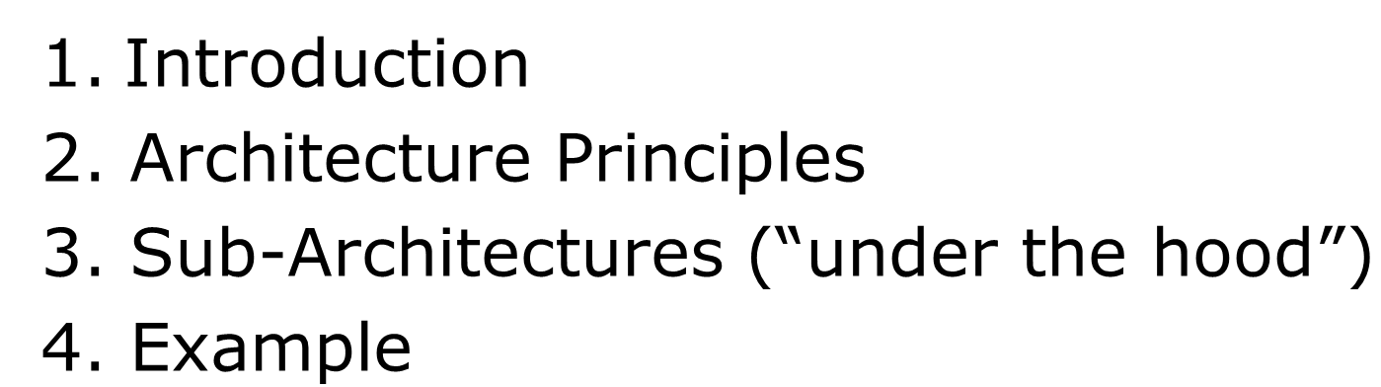
1. Introduction

Slide 4
Business Process Concepts
Business Process
A formally defined method for achieving a specific goal
Task
Steps involved in a specific business process
Process Input
Information provided when process is triggered
Process Output
Information generated after a process is completed
Manual Process
Process in which all tasks are exclusively done by humans
Automated Process
Process that is made up of tasks that are fully automated
Hybrid Process
Process that where some tasks are manual and some are automated

Slide 5
SOA Motivation – Shared Services Model
EMBEDDED SERVICES
EMBEDDED SERVICES
HR
IT
FIN
HR
IT
FIN
TR
PROC
FAC
TR
PROC
FAC
Domestic Customers Biz Unit
International Customers Biz Unit
Domestic Customers Biz Unit
International Customers Biz Unit
HR
PROC
IT
FAC
FIN
TR
SHARED SERVICES

Slide 6

Comparison
Embedded Services
Shared Services
Services are provisioned within the divisions
Services are optimized for the specific needs of the division
Possibility of under-utilization and over-provisioning of resources
High cost, high efficiency
Multiple divisions share the same services
Services are optimized for least common denominator
Resources provisioned and utilized optimally across all the divisions
Reduced cost, reduced efficiency (if not managed properly)
Analogy: How will it be if each PROCESS in an operating system gets its own physical CPU, physical RAM, physical DISK?
Analogy: Multiple processes share the services provided by a small group of CPU, RAM and DISK resources

Slide 7
Service-oriented Architecture (SOA)
SOA is an architecture style for enterprise IT systems
Inspired by the “shared-services” model
At a conceptual level, WHAT needs to be done in a business process remains the same
At the logical and physical level, HOW it needs to be done will vary in SOA

Slide 8
SOA Characteristics
Functionality divided into composable services (and not single use “local” functions)
Loose coupling between service provider and service consumer
Serves as building blocks for more complex services
Make business processes more dynamic
Task vs Service?

Slide 9
Service Concepts
Business Process
Service Capability
Every service is capable of carrying out certain FUNCTION
Service Contract
Capability is formally published in the form of a CONTRACT
Service Discovery
Service consumers should be able find out about both services available from a CATALOG and their capabilities via contracts
Service Invocation
Compose a set of capabilities to carry out TASKS
Service Catalog
Business Process

Slide 10
Key Elements of SOA
Open Standards
Integration points
Virtualization (location, platform, service provider)
Automation (business process vs workflow)
Orchestration
Choreography

Slide 11
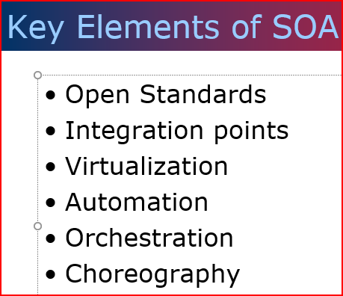

Open Standards
Standards are needed
Standards need to be Open
Standards need to be used!
What does “closed” mean?
Duh, it is opposite of “open”!
Card Issuance
JAX/RPC
JSR 109
SAAJ
Credit Check
KYC
Printing and Delivery

Slide 12
Integration Points
Entry points needed for integration
Possibility of multiple entry points for the same service
Platform-neutral integration
Card Issuance
Credit Check
KYC
Printing and Delivery

Slide 13
Virtualization
Location
Service consumer not be worried about location from where service is being delivered
Platform
Technology platform of consumer and provider need not be same
Service Provider
Service consumer not worried which specific “worker” is providing the service
Just like call center!

Slide 14
Virtualized services
Card Issuance
Credit Check
KYC
Printing and Delivery
Running in cloud
Implemented in .Net
Service provided multiple vendors

Slide 15
Automation
From an architecture perspective, services can be delivered manually or through automation
SOA’s abstractions allow seamless conversion of manual services to automated services
E.g., Document Verification

Slide 16
Automation
From an architecture perspective, services can be delivered manually or through automation
SOA’s abstractions allow seamless conversion of manual services to automated services
The processes can span within the organization (“workflow automation”) or across organizations (“business process automation”)
E.g., Document Verification

Slide 17
Hybrid Service
Card Issuance
Credit Check
KYC
Printing and Delivery
Automated
Automated
Manual
E.g., Hybrid process vs Hybrid service

Slide 18
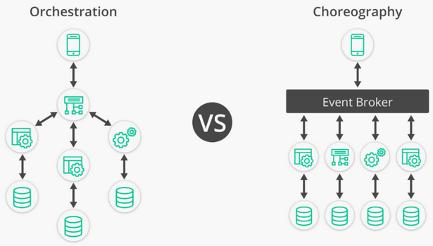
Service Execution Models
Orchestration
Choreography
The “controller” for each business process invokes services as part of the implementing process
The “controller” for each business process announces tasks that need to be done as part of the implementing process. Services pick up the tasks and do what is needed
E.g., Analogous to a conductor conducting an orchestra… no musician plays unless asked to be by the conductor!
E.g., Analogous to dancers doing their own moves once music starts playing!
Ref: Microservices Choreography vs Orchestration

Slide 19
Flavors of SOA
SOA for Enterprise Architecture
SOA for IT Systems Architecture
SOA for Technical Architecture
Focuses on Business
Business Processes Management
Business Process Execution
Focuses on IT needs of the enterprise
IT Services are modeled as shared services
Software architecture for implementing services
Hardware infrastructure

Slide 20
Definition of a “Service”
Services encapsulate a reusable business function
Services are defined by explicit, implementation−independent interfaces
Services are invoked through communication protocols that stress location transparency and interoperability

Slide 21
Service Granularity
Technical Function Services
auditEvent, checkUserPassword, and checkUserAuthorization
Business Function Services
calculateDollarValueFromYen and getStockPrice
Business Transaction Services
checkOrderAvailability and createBillingRecord
Business Process Services
openAccount, createStockOrder, reconcileAccount, and renewPolicy

Slide 22
Architecture principles
Ref: Appendix A. Service Orientation Principles Reference

Slide 23
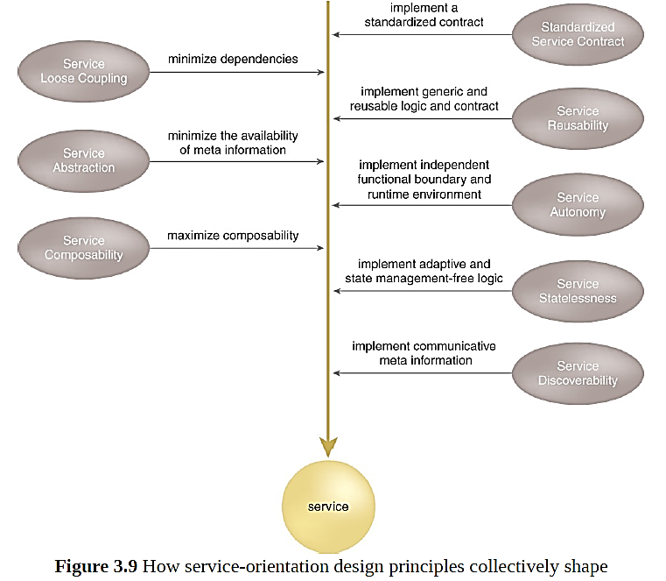
Architecture Principles

Slide 24
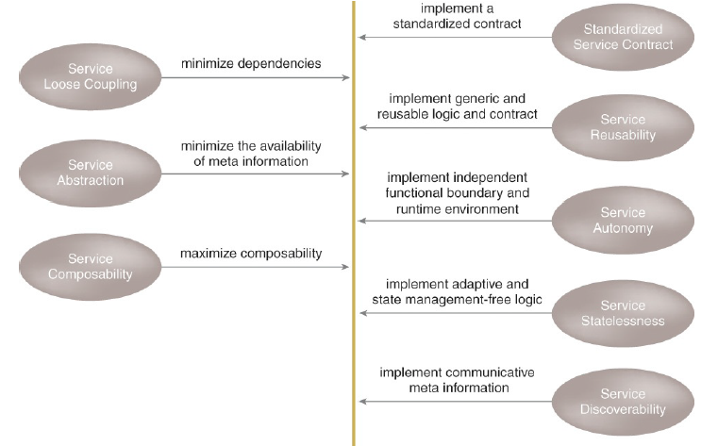
Standardized Service Contract
Services within the same service inventory are in compliance with the same contract design standards.
Services publish and perform their capabilities in a standardized way

Slide 25
Loose Coupling
Service contracts impose low consumer coupling requirements and are themselves decoupled from their surrounding environment.
Loose coupling between contract, implementation and consumption
Enables independent evolution of design, implementation innovations without large scale changes

Slide 26
Service Abstraction
Service contracts only contain essential information and information about services is limited to what is published in service contracts
Hide underlying details
Necessary to enable loose-coupling

Slide 27
Service Abstraction
Service contracts only contain essential information and information about services is limited to what is published in service contracts
Hide underlying details
Necessary to enable loose-coupling

Slide 28
Service Reusability
Services contain and express agnostic logic and can be positioned as reusable enterprise resources
Reusability necessary to take advantage of “shared services” benefits
Not hardcoding for single-purpose makes it agnostic

Slide 29
Service Autonomy
Services exercise a high level of control over their underlying runtime execution environment
Significant degree of control over its environment and resources
Enables evolution and improvements without impacting others

Slide 30
Service Statelessness
Services minimize resource consumption by deferring the management of state information when necessary
Eliminates need of services to “remember” multiple execution threads
Helps keep the service implementation “light-weight” – reduces memory requirements

Slide 31
Service Discoverability
Services are supplemented with communicative metadata by which they can be effectively discovered and interpreted
If services are not discoverable, there can be wasted effort in implementing multiple embedded services for same the same service
Like a repair shop without customers - each one gets down to repairing their own equipment

Slide 32
Service Composability
Services are effective composition participants, regardless of the size and complexity of the composition
Same service can be used in multiple varying contexts
Many other principles like loose coupling, statelessness, etc. contribute towards this principle

Slide 33
GOING forward

Slide 34

Looking ahead

Slide 35
SOA Sub-architectures

Slide 36
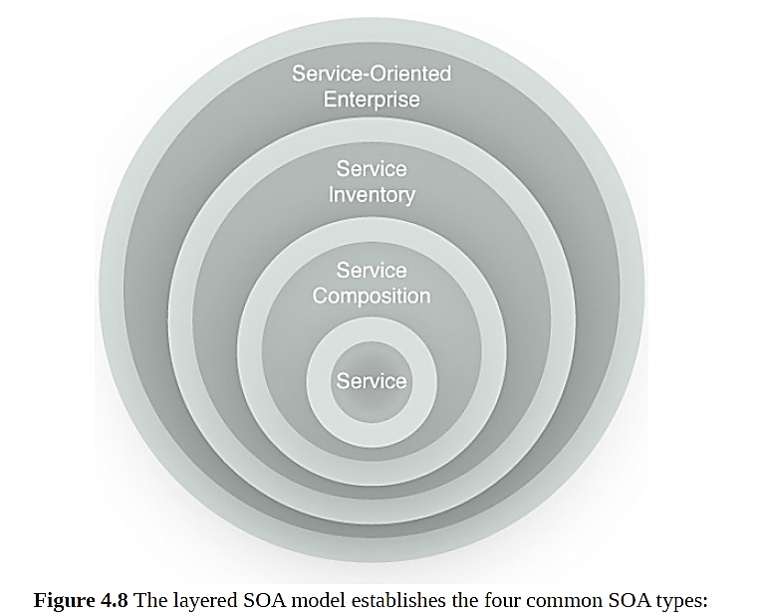
Sub-Architecture Types
Service Architecture
Service Composition Architecture
Service Inventory Architecture
Enterprise SOA

Slide 37
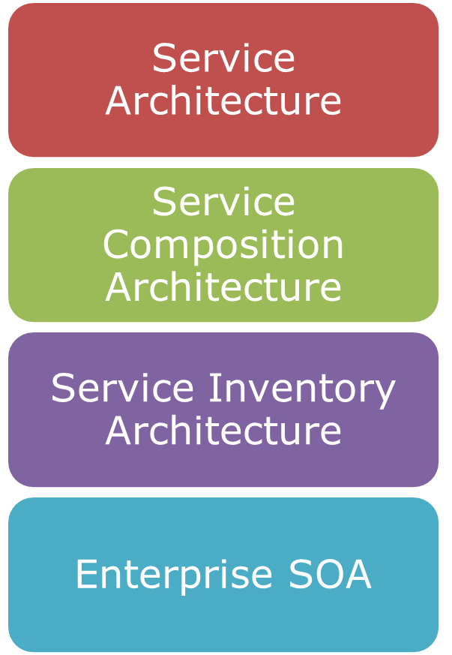
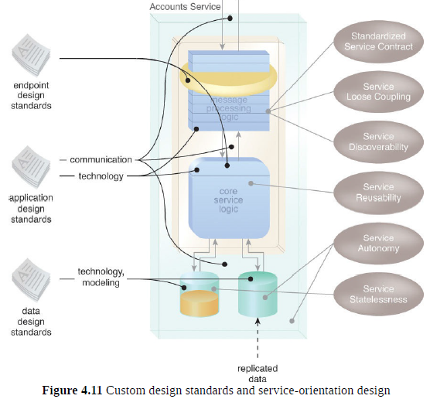
Service Architecture
Technology architecture of the actual service
[Recall] Characteristics of a services (loosely coupled, composable, abstraction, etc.)
Services can be grouped into inventories that follow similar architecture style like layered, event driven, etc.

Slide 38
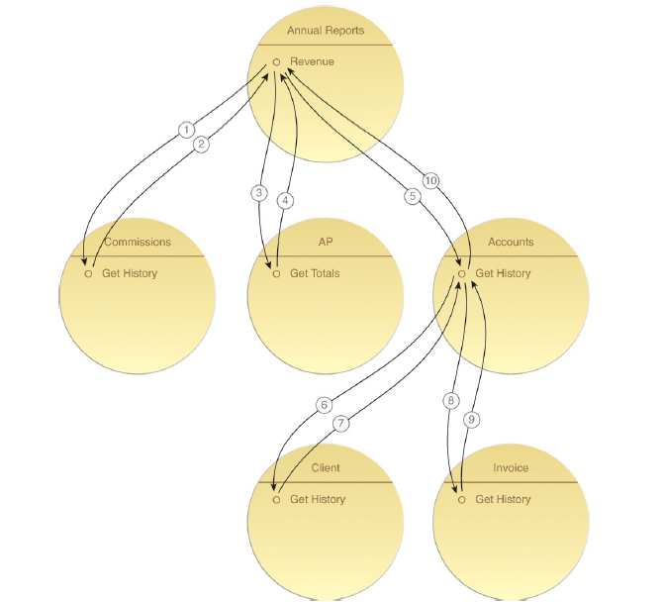
Service Composition Architecture
Specifies architecture of composite services that use existing services
Analogous to modular design that shows sub-modules of a module

Slide 39
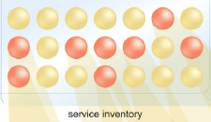
Service Inventory Architecture
How are the services organized made available for use?
What are the rules governing addition, removal and retiring of services?
What are the principles governing composition using services from the inventory?

Slide 40
Enterprise SOA
A collection of service inventories on which entire enterprise relies on
Rules governing design standards for inventories and services within inventories
Enterprise SOA

Slide 41
Implementation approaches

Slide 42
SOA using Web Services
Web Service is an open-standards based protocol for implementing SOA over the web
Web services provide an open−standard and machine−readable model for creating explicit, implementation−independent descriptions of service interfaces.
Web services provide communication mechanisms that are location−transparent and interoperable.
Key Standards
TCP/IP, XML, HTTP
WSDL, SOAP, UDDI

Slide 43
SOA using REST
REST stands REpresentational State Transfer
Light weight alternative to SOAP-based Web Services
Key behavior characteristics
Stateless, Idempotent or Non-Idempotent, RO/RW
Key protocols
HTTP based methods such as GET, POST, PUT, DELETE
JAX-RS for Java implementations

Slide 44
Summary of soa

Slide 45
Summary of SOA
SOA is one of the most widely used technology architecture styles
SOA is amenable to be implemented at multiple levels
SOA is widely implemented using SOAP Web Services or REST micro-services

