Slide 1
Jenkins
Improving Your productivity
Continuous Integration
Jenkins for a Developer
Jenkins User Interface
Jenkins Plugins

Slide 2
Improving Your Productivity
Continuous integration can help you go faster
Detect build breaks sooner
Report failing tests more clearly
Make progress more visible

Slide 3

Jenkins for Continuous Integration
Jenkins – open source continuous integration server
Jenkins (http://jenkins-ci.org/) is
Easy to install
Easy to use
Multi-technology
Multi-platform
Widely used
Extensible
Free

Slide 4
Jenkins for a Developer
Easy to install
Download one file – jenkins.war
Run one command – java –jar jenkins.war
Easy to use
Create a new job – checkout and build a small project
Checkin a change – watch it build
Create a test – watch it build and run
Fix a test – checkin and watch it pass
Multi-technology
Build C, Java, C#, Python, Perl, SQL, etc.
Test with Junit, Nunit, MSTest, etc.

Slide 5
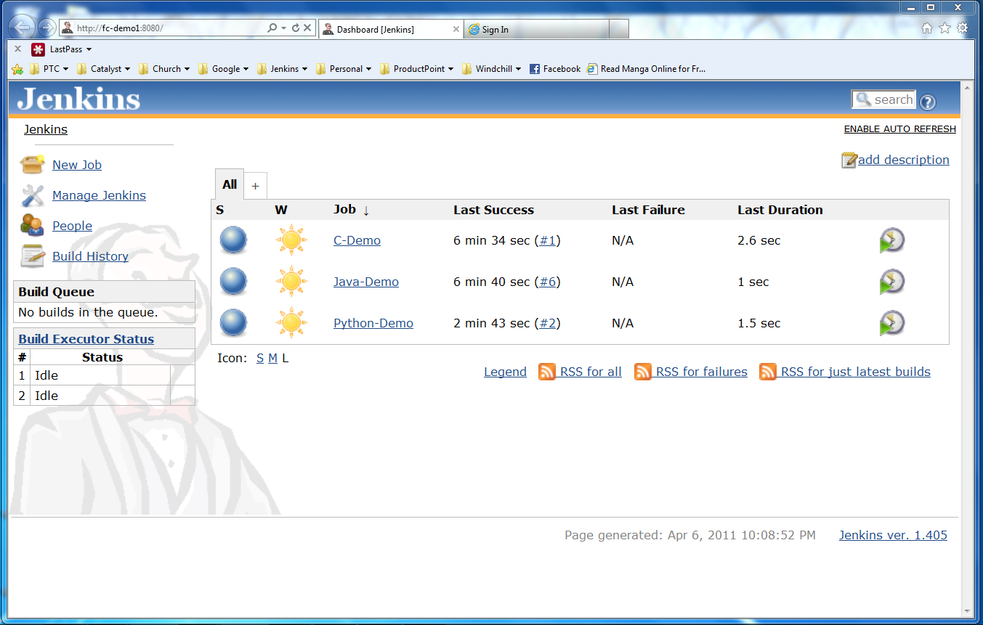
Jenkins User Interface
Actions
Nodes
Jobs

Slide 6
Developer demo goes here…
Create a new job from a Subversion repository
Build that code, see build results
Run its tests, see test results
Make a change and watch it run through the system
Languages
Java
C
Python

Slide 7
More Power – Jenkins Plugins
Jenkins has over 300 plugins
Software configuration management
Builders
Test Frameworks
Virtual Machine Controllers
Notifiers
Static Analyzers

Slide 8
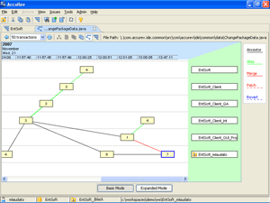

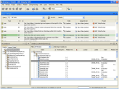




Jenkins Plugins - SCM
Version Control Systems
Accurev
Bazaar
BitKeeper
ClearCase
Darcs
Dimensions
Git
Harvest
MKS Integrity
PVCS
StarTeam
Subversion
Team Foundation Server
Visual SourceSafe

Slide 9
Jenkins Plugins – Build & Test
Build Tools
Ant
Maven
MSBuild
Cmake
Gradle
Grails
Scons
Groovy
Test Frameworks
Junit
Nunit
MSTest
Selenium
Fitnesse

Slide 10
Jenkins Plugins – Analyzers
Static Analysis
Checkstyle
CodeScanner
DRY
Crap4j
Findbugs
PMD
Fortify
Sonar
FXCop
Code Coverage
Emma
Cobertura
Clover
GCC/GCOV

Slide 11
Jenkins Plugins – Other Tools
Notification
Twitter
Campfire
Google Calendar
IM
IRC
Lava Lamp
Sounds
Speak
Authorization
Active Directory
LDAP
Virtual Machines
Amazon EC2
VMWare
VirtualBox
Xen
Libvirt

Slide 12
Jenkins for Teams
Multi-configuration jobs
Multi-stage jobs
Swarms to dynamically contribute capacity

Slide 13
Jenkins for Teams Demo here…
This is where the bigger Jenkins demo is inserted

Slide 14
Jenkins – Integration for You
Jenkins can help your development be
Faster
Safer
Easier
Smarter

