Slide 1
Virtual Reality
Definition:
A computer generated,
‘immersive’ (or wide field),
multi-sensory information
program which tracks a user in real time.
© www.ozedweb.com

Slide 2
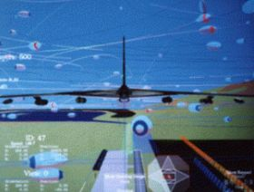
What use is VR?
VR provides:
Augmented
Reality
© www.ozedweb.com

Slide 3
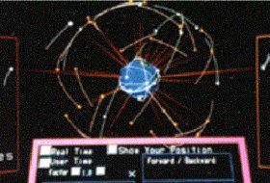
OK, OK, the Military use it.
So...?
Many organisations
do.
On the left is a VR
view of earth with
satellites. This is
used in the space
shuttle simulator.
© www.ozedweb.com

Slide 4
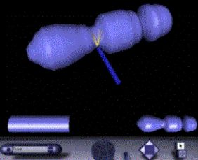
Military…Space… what about normal people…?
Normal? Well…
how about trades
people?
This is a virtual
lathe.
© www.ozedweb.com

Slide 5
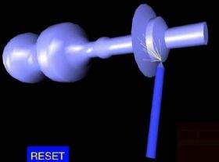
Well that’s better...
This lathe is used
to train
apprentices.
Unlimited free
material and no
clean up!
© www.ozedweb.com

Slide 6
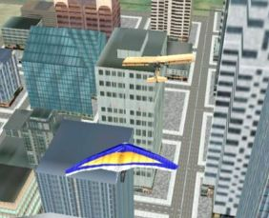
Anything else?
How about… learning to hang-glide?
© www.ozedweb.com

Slide 7
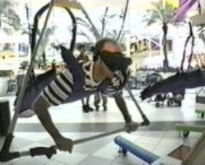
Umm...
Is it as
easy as it
looks?
© www.ozedweb.com

Slide 8
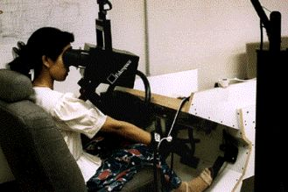
I’m more of the down to earth type...
How about
learning to
drive a car?
© www.ozedweb.com

Slide 9
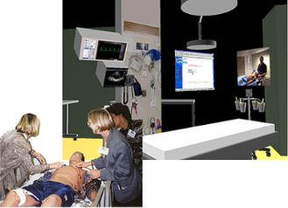
I think I’m feeling ill.
Well, that’s not
a problem.
We’ll find a
cure with the
Virtual
patient...
© www.ozedweb.com

Slide 10
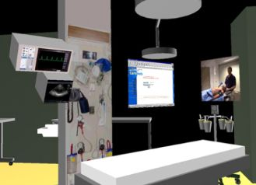
…now I’m sure I am.
…in our virtual
hospital.
Why not?
© www.ozedweb.com

Slide 11
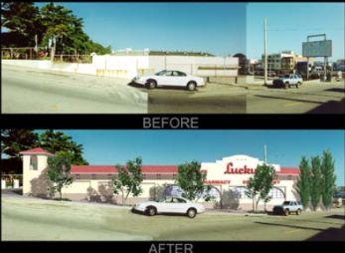
Hey, that wasn’t there a moment ago...
Things are easy
with VR.
Real Estate Agents
use it every day.
© www.ozedweb.com

Slide 12
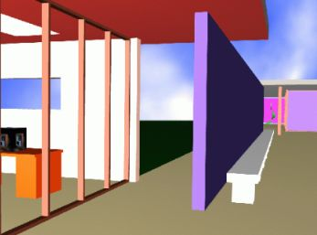
And Architects love it!
Wait till you
Walk
through!
© www.ozedweb.com

Slide 13
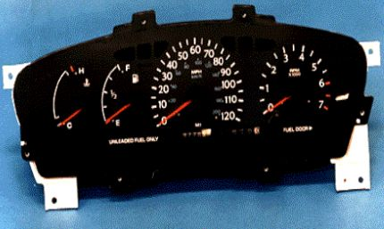
At last… something real.
Sorry…
That’s VR
too.
© www.ozedweb.com

Slide 14
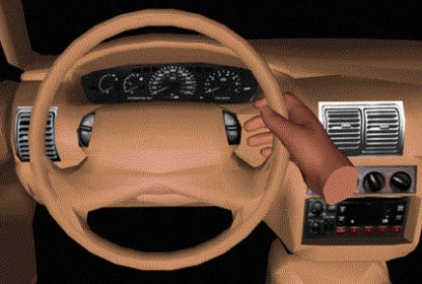
Ahh...
It goes here.
© www.ozedweb.com

Slide 15
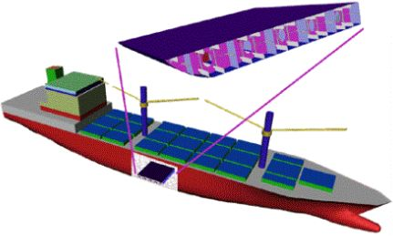
Well, that ship is not…
Reality.
© www.ozedweb.com

Slide 16
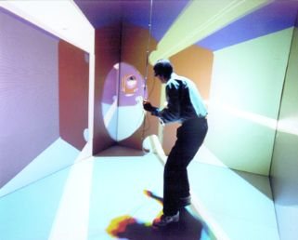
Ohh...
But none the less,
Professor Bryant is
inspecting it.
…or he thinks he is.
© www.ozedweb.com

Slide 17
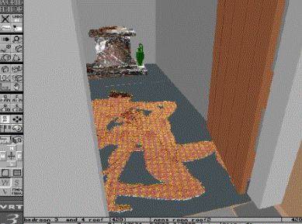
What the ???
30 year 11
students went
through this
door to do their
senior history.
© www.ozedweb.com

Slide 18
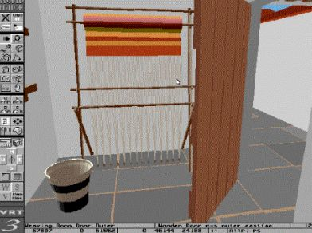
VR is looming...
... yes that is a loom.
It is inside a house in
Ancient Greece.
‘It’ is part of a VR
course in Ancient
History at an
American secondary
school.
© www.ozedweb.com

Slide 19
The End of the Beginning
VR is in its early stages, but is used
commercially, globally. There are
61,400 international commercial companies
producing VR.
While VR is at an early stage, it is used
educationally throughout the world.
There are approximately 3,600 educational institutions which use VR.
How many are in Australia?
© www.ozedweb.com

