Slide 1

Augmented Reality
Bobby Phimmasane

Slide 2
What is Augmented Reality?
Augmented reality (AR) is a field of computer research which deals with the combination of real-world and computer-generated data. At present, most AR research is concerned with the use of live video imagery which is digitally processed and "augmented" by the addition of computer-generated graphics. Advanced research includes the use of motion-tracking data, fiducial marker recognition using machine vision, and the construction of controlled environments containing any number of sensors and actuators.

Slide 3
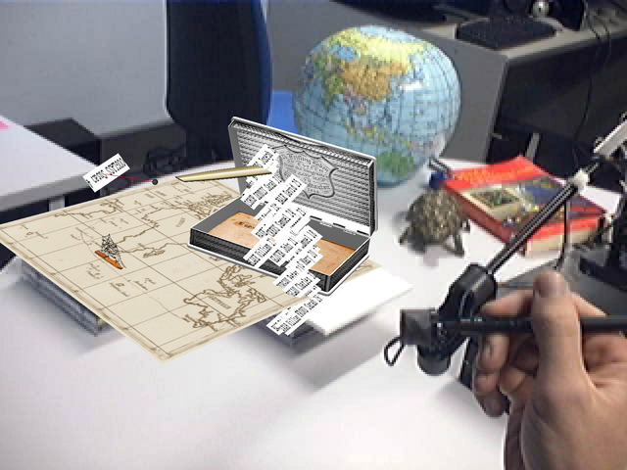
What are benefits of Augmented Reality?
Combines real-world environments and virtual reality
  Real-world environments can interact with virtual objects.
  Virtual objects will respond to real-world physical actions.
To find Video Demonstrations of Augmented Reality
Click Here

Slide 4
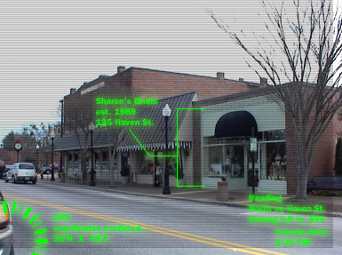
What are benefits of Augmented Reality?
Interactive in real-time
  Real time processing
  Data can be generated in real time
To find Video Demonstrations of Augmented Reality
Click Here

Slide 5
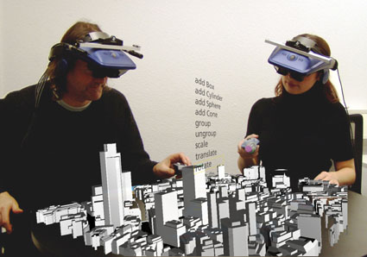
What are benefits of Augmented Reality?
Registered in three dimensions
  Imagery is in 3D
  Graphics and Models are created by Designers
To find Video Demonstrations of Augmented Reality
Click Here

Slide 6
What are uses of Augmented Reality?
Video Games
  Physical interactions with 3D models
Presentations
  Can now be more interactive
Television
  You will be able to watch TV in 3D any where
Theme Park
  Rides can now be even more realistic
Simulations
  Driving, Flying, Etc…

Slide 7
Limitations of Augmented Reality?
Programming Physics
  Programmer must be able to write code based on physical input and output
Cost
  Currently you can only partner or license with companies like Total Immersion
Under Development
  The research is still under development
Graphics
  When including more detailed graphics, processing can be more intense

