Slide 1
Combining real imagery with computer generated imagery
Virtual reality;
Augmented reality;
Teleorobotics

Slide 2
Combining real imagery with computer generated imagery
Robot-assisted surgery
Virtual real estate tours
Virtual medical tours
Urban planning
Map-assisted navigation
Computer games

Slide 3
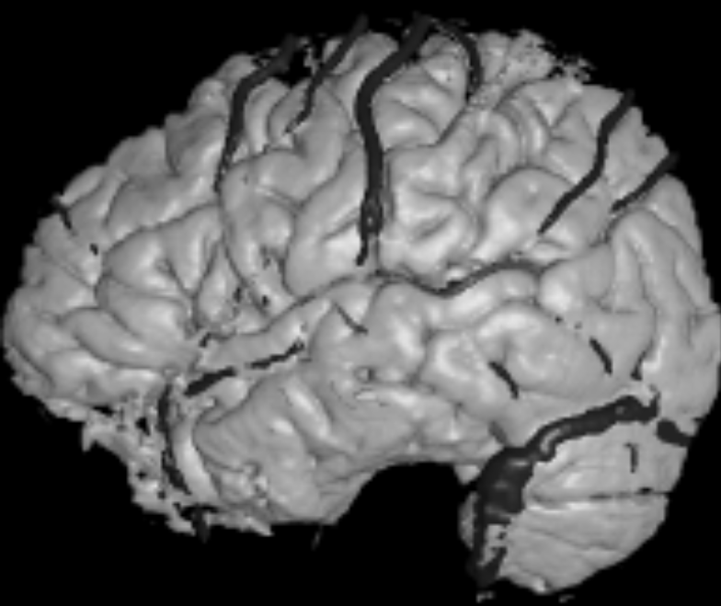
Virtual image of real data
3D sensed data can be studied for surgical paths to be followed by a surgeon or a robot.
In the future, real-time sensing and registration can be used for feedback in the process.

Slide 4
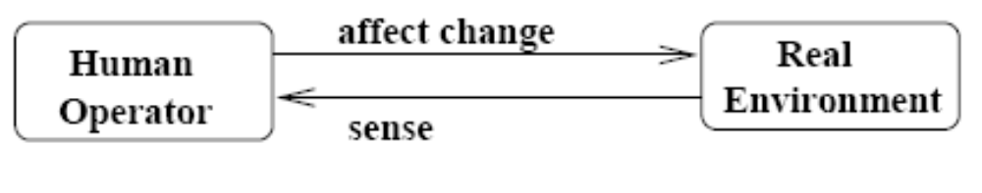
Human operating in a real environment: brain surgery.
All objects are real; we cook food, chop wood, do brain surgery

Slide 5
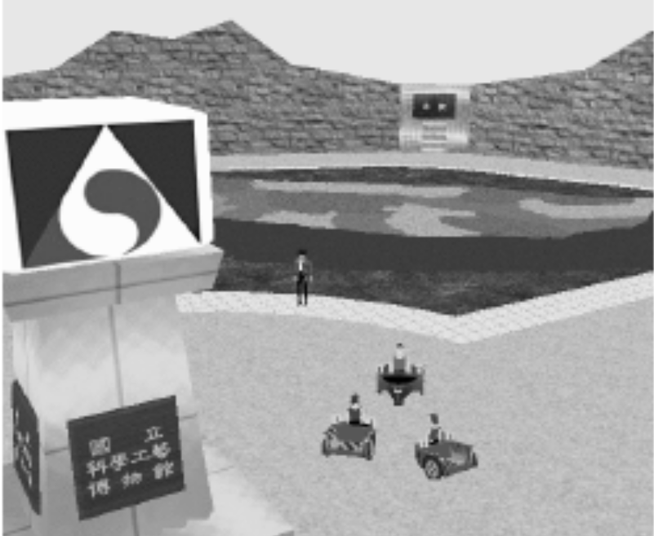
Most computer games / videos are entirely virtual
IMMERSION, or engagement, can be very high, however, with
Quality spatial resolution
Stereo
Smooth motion
Little time delay between user interactions and visual effects
Synchronized audio and force feedback are important
Courtesy of University of Washington HIT Lab

Slide 6
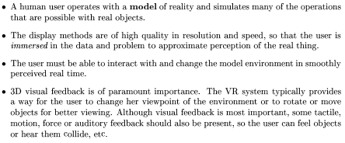
Virtual immersive environments

Slide 7
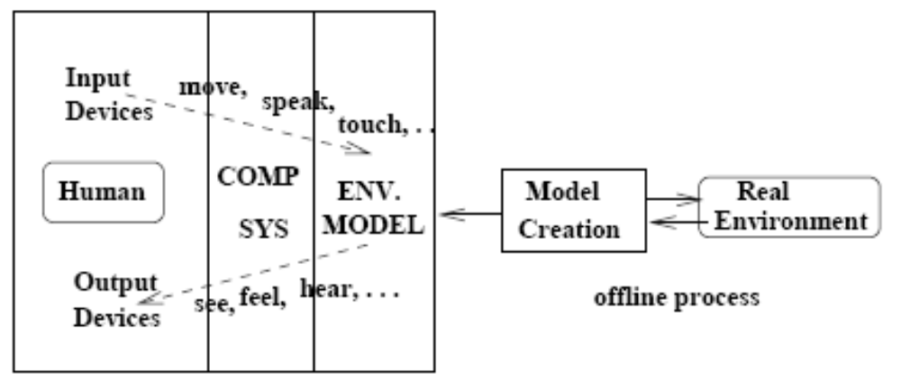
Virtual environment schematic
Example: nurse gets training on giving injections using a system with stereo imagery and haptic feedback

Slide 8
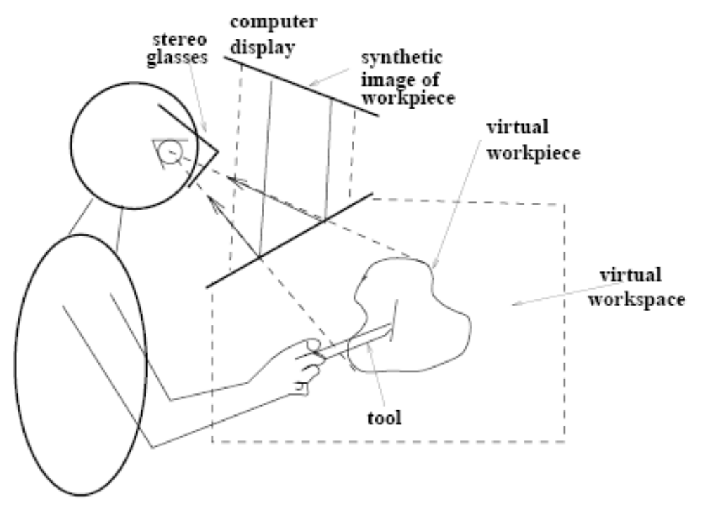
Virtual dextrous work
http://www.sensable.com/products-haptic-devices.htm
Medical personnel practice surgery or injection, etc. Artist can carve a virtual 3D object. Haptic system pushes back on tool appropriate to its penetration (intersection) of the model space. User’s free hand grabs a physical arm model under the table in injection training.

Slide 9
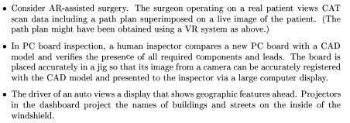
Augmented reality: views of real objects + augmentation

Slide 10
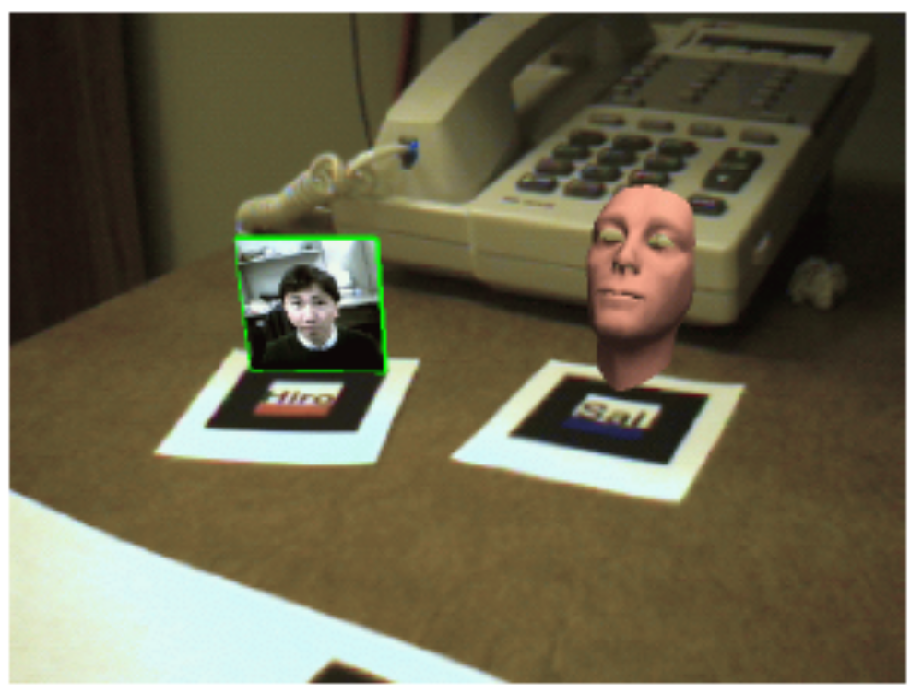
AR in teleconferencing
person works at real desk
remote collaborator represented by picture or video or “talking head”
objects of discussion; e.g. a patient’s brain image, might also be fused into visual field
HOW IS THIS ACHIEVED?
From University of Washington HIT Lab

Slide 11
Imagine the virtual book
Real book with empty identifiable pages
AR headset
Pay and download a story
System presents new stereo images when the pages are turned
Is this better than a .pdf file?
Is this better than stereo .pdf?

Slide 12
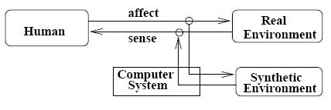
Human operating with AR
Think of a heads up display on your auto windshield, or on the instrument panel. What could be there to help you navigate?
(Vectors to nearby eating places? Blinking objects we might collide with? Congestion of nearby intersections? Web pages?)

Slide 13
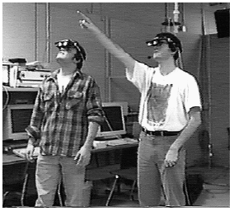
Special devices needed to fuse/register real and generated images
Human sees real environment – optics design problem
Human sees graphics generated from 3D/2D models – computer graphics problem
Graphics system needs to know how the human is viewing the 3D environment – difficult pose sensing problem
From University of Washington HIT Lab.

Slide 14
Devices that support AR
Need to fuse imagery;
Need to compute pose of user relative to the real world

Slide 15
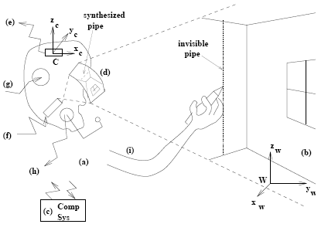
Fusing CAD models with real env.
Plumber marks the wall where the CAD blueprint shows the pipe to be.

Slide 16
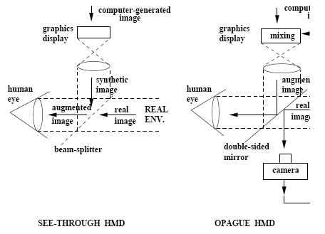
Two types of HMD

Slide 17
Difficult augmentation problem
How does computer system know where to place the graphic overlay?
Human very sensitive to misregistration
Some applications OK – such as circuit board inspection.
Can use trackers on HMD to give approximate head pose
Tough calibration procedures for individuals (see Charles Owens’ work)

Slide 18
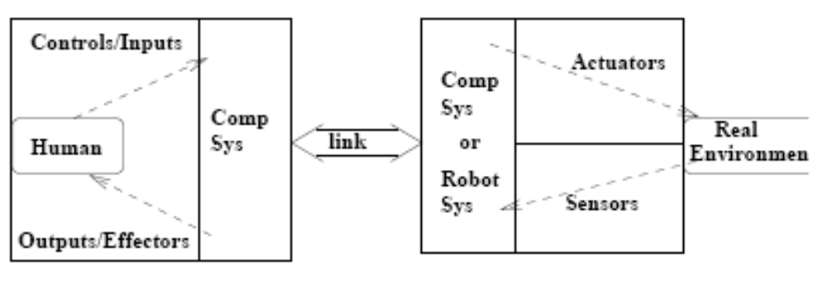
Teleoperation
remotely guided police robot moves a suspected bomb
teleoperated robot cleans up nuclear reactor problem
surgeon in US performs surgery on a patient in France
Dr in Lansing does breast exam on woman in Escanaba (work of Mutka, Xi, Mukergee, et al.)

Slide 19
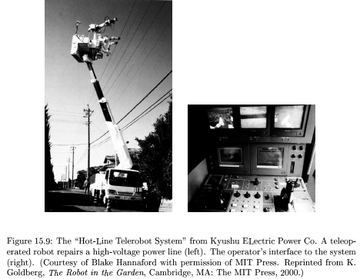
Teleoperation on power lines

Slide 20
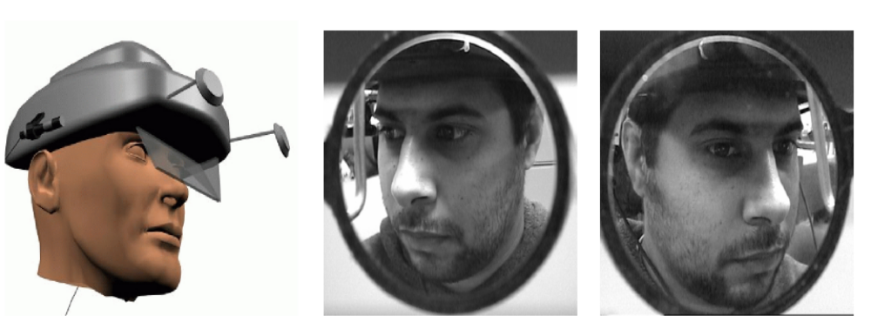
Face2face mobile telecommunication
Concept HMD at left; actual images from our prototype HMD at right.
Problem is to communicate the face to a remote communicator.

Slide 21
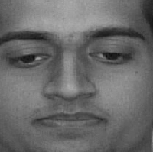
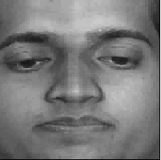
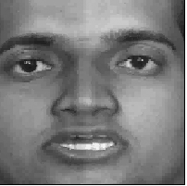
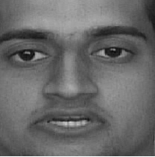
Reddy/Stockman used geometric transformation and mosaicking
Which 2 are real video frames and which are composed of 2 transformed and mosaicked views?

Slide 22
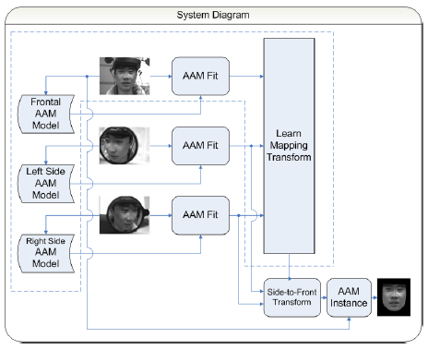
Miguel Figueroa’s system
Face image is fit as a blend of basis faces from training images
c1F1+c2F2+ … cnFn
Coefficients [c1, c2, …, cn] sent to receiver embedded in the voice encoding.
Receiver already has the basis vectors F1, F2, …, Fn and a mapping from side view to frontal view and can reconstruct the current frame.

Slide 23
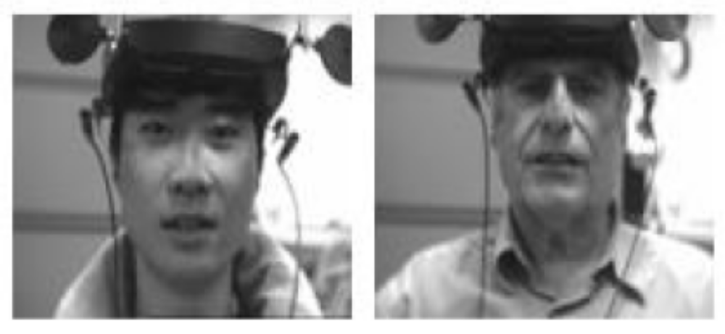
Actual prototype in operation
Mirror size is exaggerated in these images by perspective; however they are larger than desired. Consider using the Motorola headsets that football coaches use – with tiny camera on the microphone boom.

Slide 24
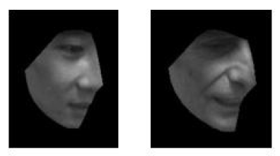
Captured side view projected onto basis of training samples

Slide 25
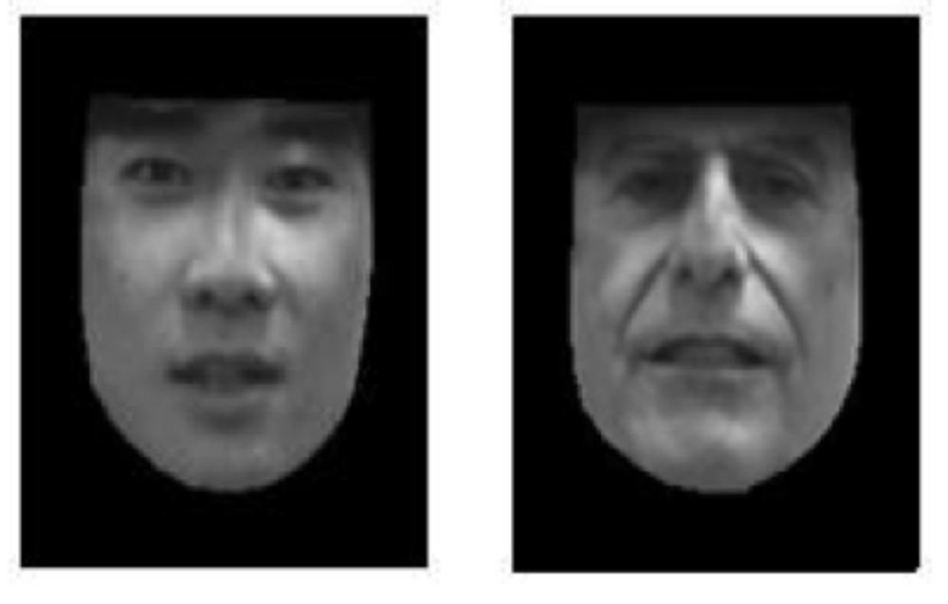
Frontal views contructed by mapping from side views
This approach avoids geometrical reconstruction of distorted left and right face parts by using AAM methods -- training and mapping.

Slide 26
Summary of issues
All systems (VR,AR,TO) require sensing of human actions or robot actions
All systems need models of objects or the environment
Difficult registration accuracy problem for AR, especially for see-through displays, where the fusion is done in the human’s visual system

