Slide 1
LAMAD
iOS
25.03.2013

Slide 2
The Platform and SDK

Slide 3




iOS
iPad
iPhone
iPad Mini

Slide 4
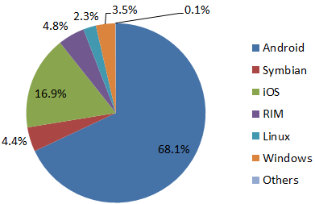
Market share
Second mobile OS in usage
First mobile OS in revenue
First mobile OS in internet traffic
Market Share 2012

Slide 5
iOS: Advantages and disadvantages
+ Highest revenue for mobile OS
+ Little fragmentation (just iPhone and iPad)
+ Runs on high-end devices
+ Big developer community and excellent support
+ Many open-source libraries available
- Strictly controlled by Apple
- Development only possible in Mac OS
- Objective C is the main programming language

Slide 6

Technology
Application development in Objective C – a language that adds Smalltalk-style messaging to C
Development done in Xcode on Mac OS devices
Debugging and running on phone done also in Xcode

Slide 7
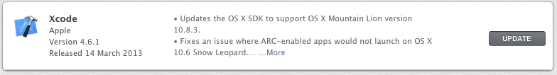
Installing development kit
Install Xcode IDE – newest version 4.6.1
Installing Xcode automatically installs iOS SDK
Xcode is free to download from Mac App store

Slide 8
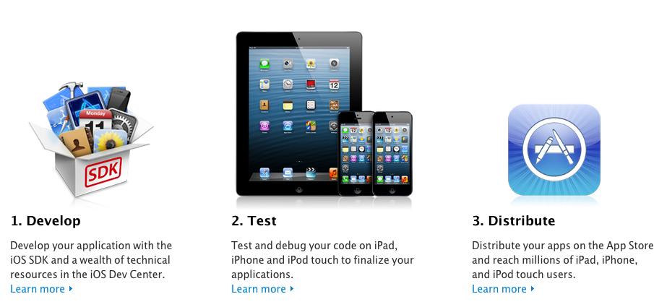
Apple developer program
Apple developer account is free
Apple developer program is not free – 99$/year
Registration done from https://developer.apple.com/programs/ios/
Registration process takes 3-5 days

Slide 9






iOS development
1010
1010
1010
1010
Develop
Debug
Test
Deploy
No cost
Potential cost
Requires Developer
Program
Requires Developer
Program

Slide 10




iOS debugging
1010
1010
Simulator does not require
a developer program
1010
1010
1010
1010
Device requires a Developer
Provisioning Profile – 99$/year
Develop
Debug

Slide 11
App Store / Marketplace summary
 | iOS | Android | Windows Phone
Approval Process | Yes | No | Yes
Distribution outside the store | No | Yes | No
Fragmentation | Very Little | Yes | Yes
Multiple stores / Marketplaces | No | Yes | No

Slide 12
Objective C
Objective-C is an object oriented language
Follows ANSI C style coding with methods from Smalltalk
Flexible because almost everything is done at runtime:
Dynamic Binding
Dynamic Typing
Dynamic Linking
It is used for both iOS and Mac OS development
Source files: .m, header files: .h
Has protocols, which work like interfaces in Java they specify a number of methods a class must implement

Slide 13
Messages
Almost every object manipulation is done by sending objects a message
Two words within a set of brackets, the object identifier and the message to send:
[self.mainLabel setText:[self.mainTextInput text]];
Dot syntax:
self.mainLabel.text = self.mainTextInput.text;
Equivalent to C++ or Java’s:
this.mainLabel.setText( this.mainTextInput.text() );
Static methods start with +, instance methods with -:
+(id)defaultController vs. -(void)initLocationManager

Slide 14
Cocoa API
A collection of libraries developed by Apple to aid GUI development
Has a set of predefined classes and types such as NSNumber, NSString, NSDate (NS stands for NeXT-sun)
Includes a root class NSObject where keywords like alloc, retain, and release come from
Apple Human Interface Guidelines: http://developer.apple.com/library/ios/#documentation/UserExperience/Conceptual/MobileHIG/Introduction/Introduction.html

Slide 15
Memory allocation
Objects are created dynamically using alloc keyword
Objects are automatically deallocated in latest Objective-C through automatic reference counting (ARC)
ARC keeps an internal count of how many times an Object is 'needed'
System makes sure that objects that are needed are not deleted, and when an object is not needed it is deleted

Slide 16
C++ vs. Objective-C
C++ | Objective C
Adds OOP, metaprogramming and generic programming to C | Only adds OOP to C
Comes with a std library | Has no standard library; is dependant on other libraries
Has numerous uses | Mostly used for application building
Large and complex code for OOP | Simpler way of handling classes and objects

Slide 17
Hello world example

Slide 18
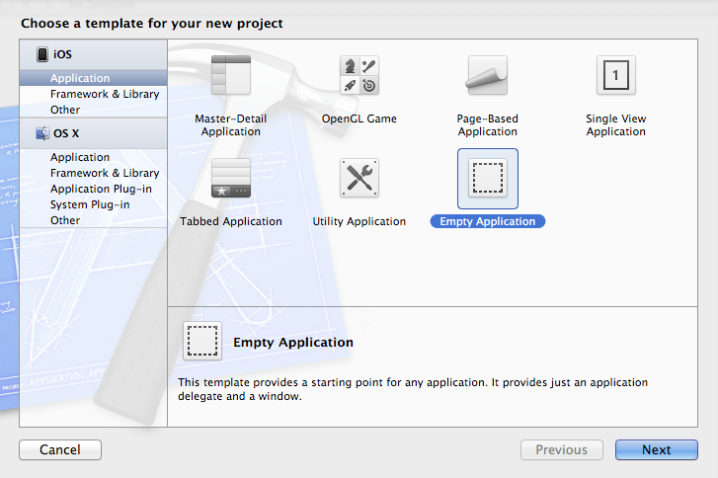
Hello World
Task: “Change a label’s text using a button and an input box.”
Create a new empty project:

Slide 19
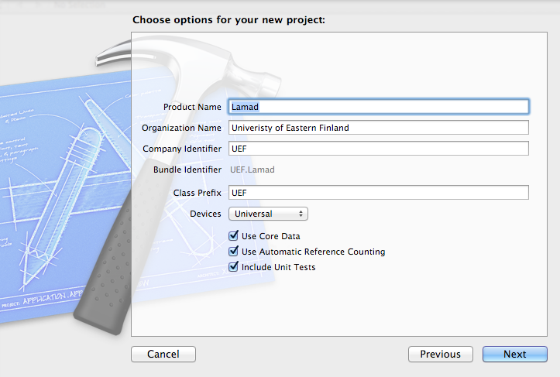
New Project
Name the project and check “Use Core Data” and “User Automatic Reference Counting”

Slide 20
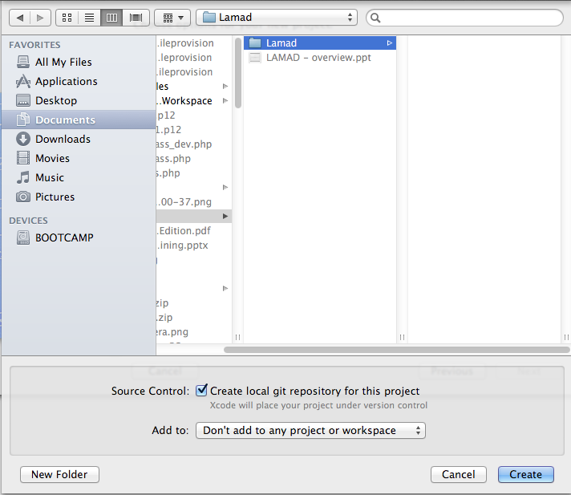
New Project
Create the project and also create local git repository for source control

Slide 21
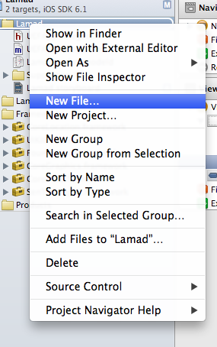
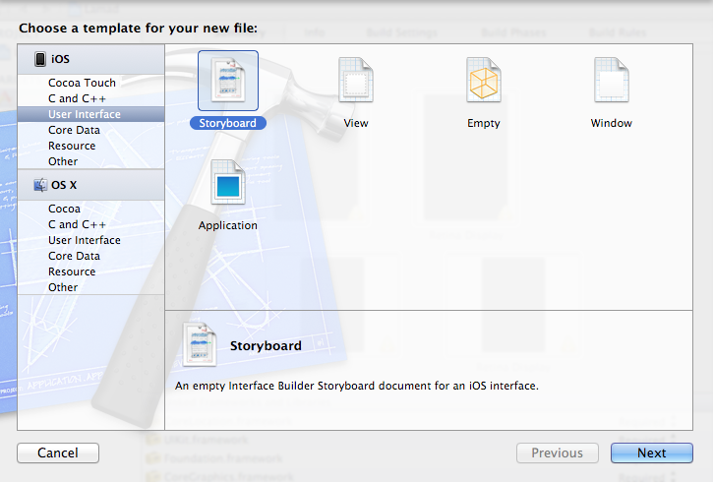
Create interface
Create a new storyboard file
Empty storyboard will be created

Slide 22
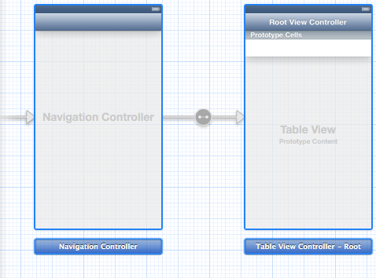
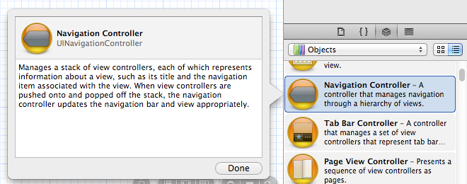
Creating main screen
Click on the storyboard
Create a navigation controller from the storyboard designer by drag and drop

Slide 23
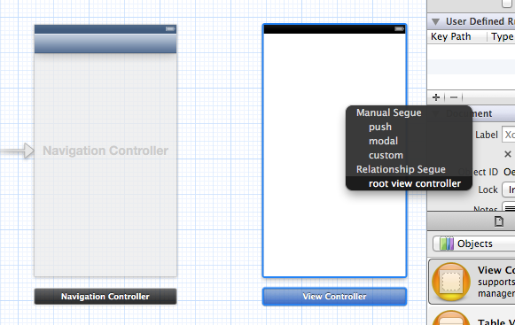
Delete default screen
Delete the default Table View Controller and add your own View Controller by drag and drop
Right click from the navigation controller to View Controller and choose root view controller relationship

Slide 24
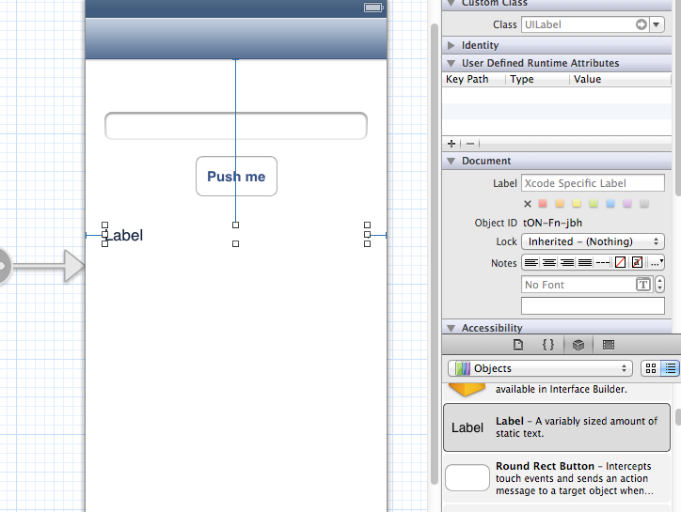
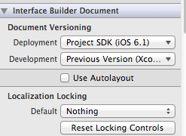
Add items to screen
Add items to screen by using drag and drop: label, button and text edit
Attention!
Disable “Use Autolayout” from View Controller properties if you want application to work in iOS 5 and earlier

Slide 25
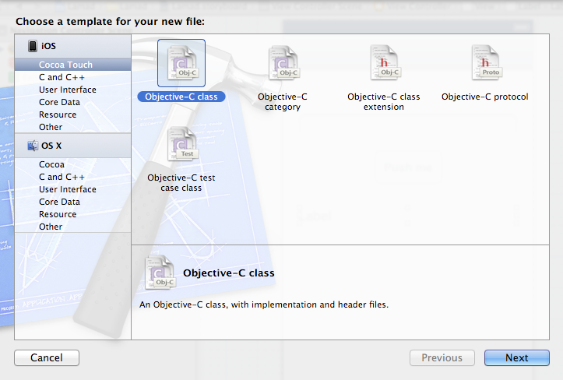
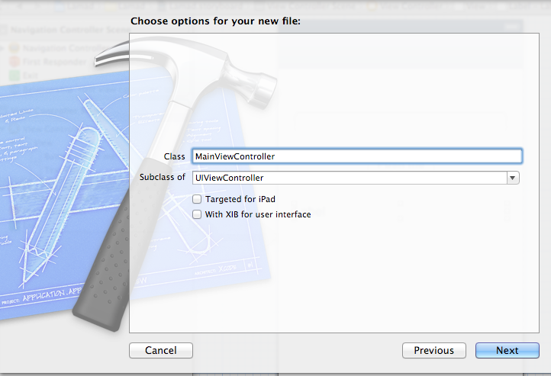
Create a class for the screen
The class should subclass UiViewController

Slide 26
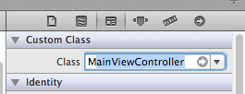

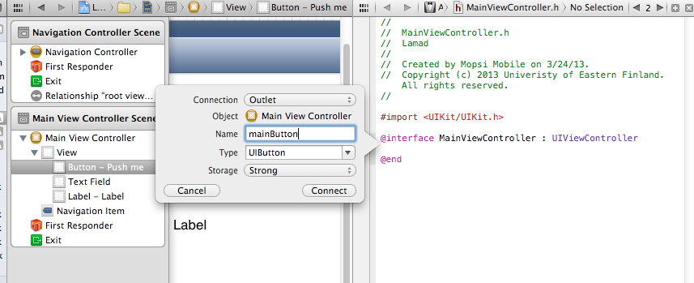
Connect your class to the storyboard
Make the View Controller in the storyboard to be you class
Open Assistant editor
Drag and drop interface objects to you class h file to create connections

Slide 27
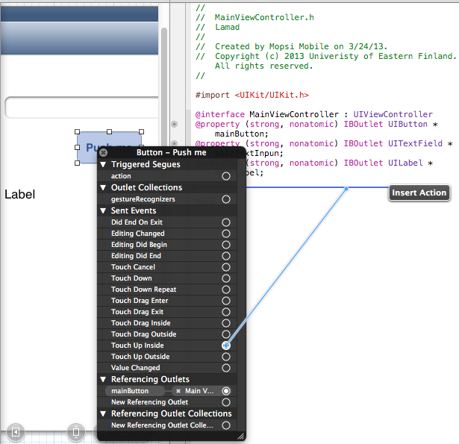
Add an action to the button
Right click on the button
Choose “Touch Up Inside” and drag and drop to the h file
Name the method that will be executed when button is touched

Slide 28
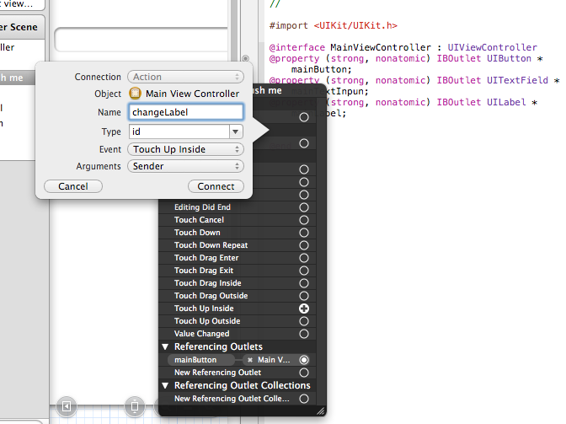
Add an action to the button
Name the method that will be executed when button is touched

Slide 29
Source files
Header file will look like this:
#import <UIKit/UIKit.h>
@interface MainViewController : UIViewController
@property (strong, nonatomic) IBOutlet UIButton *mainButton;
@property (strong, nonatomic) IBOutlet UITextField *mainTextInput;
@property (strong, nonatomic) IBOutlet UILabel *mainLabel;
- (IBAction)changeLabel:(id)sender;
@end
Change label text:
- (IBAction)changeLabel:(id)sender {
// Change the text
[self.mainLabel setText:[self.mainTextInput text]];
}

Slide 30
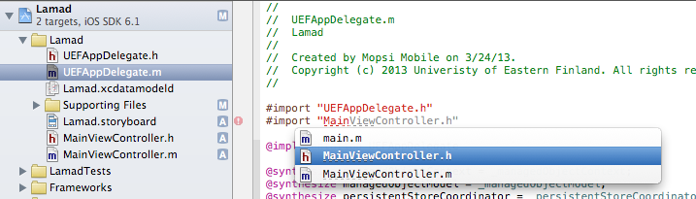
Prepare application
Go to the auto-generated AppDelegate file and include your own Ui class
Delete the gray bold text from didFinishLaunchingWithOptions
- (BOOL)application:(UIApplication *)application didFinishLaunchingWithOptions:(NSDictionary *)launchOptions
{
self.window = [[UIWindow alloc] initWithFrame:[[UIScreen mainScreen] bounds]];
// Override point for customization after application launch.
self.window.backgroundColor = [UIColor whiteColor];
[self.window makeKeyAndVisible];
return YES;
}

Slide 31
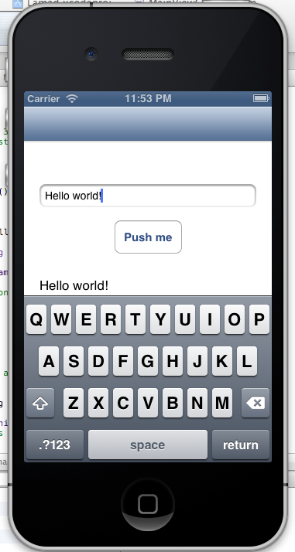
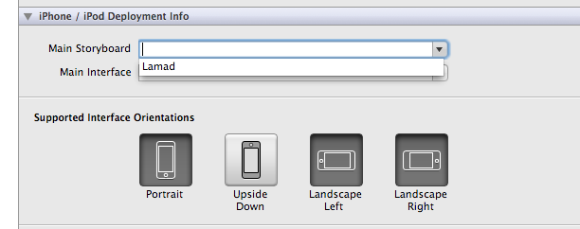

Run the application
Go to project properties and set your storyboard as Main Storyboard
Press run in simulator

Slide 32

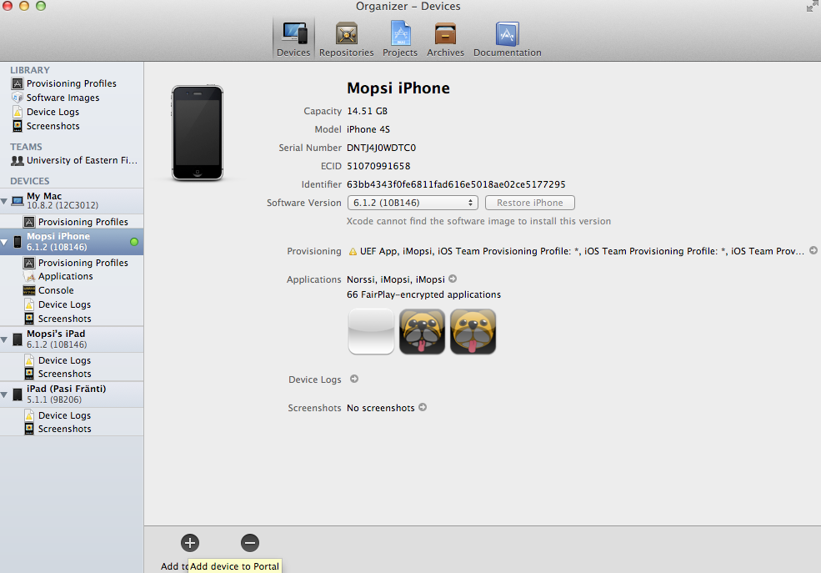
Run the application on phone
Open the organizer
Log in with your developer id
You need to be enroller in developer program
Connect the phone to the computer
Add the device to your provisioning portal

Slide 33
Maps and location

Slide 34
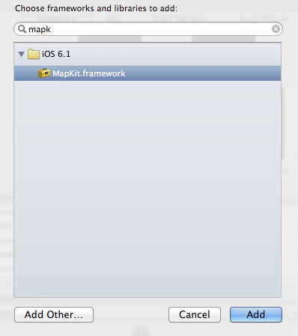
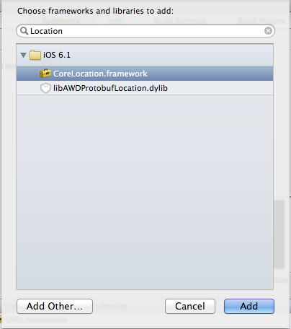
Include CoreLocation and MapKit
Go to your project properties, libraries and press to add CoreLocation and MapKit for location and map support
By default, they are not added to your project

Slide 35
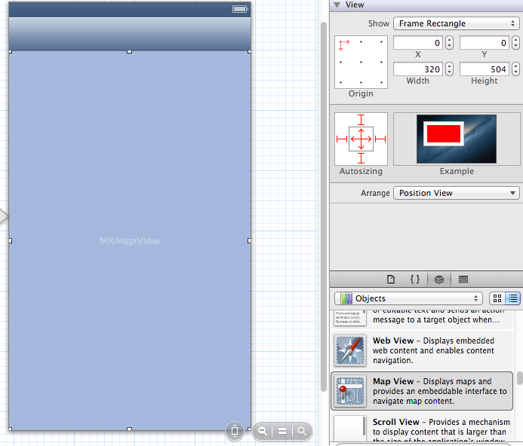
Adding a Map View
Add a Map View to you main screen from the designer

Slide 36
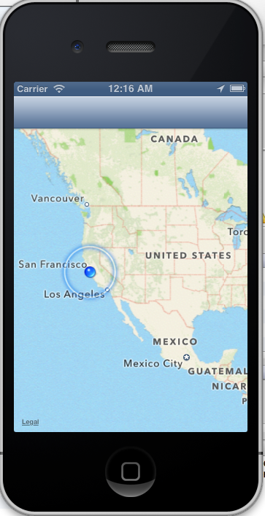
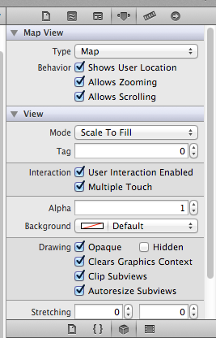
Displaying location on the map
Check “Shows User Location” from Map View properties
Run the application

Slide 37
Show a pin on the map
Create a class which implements MKAnnotation protocol
.h file:
#import <UIKit/UIKit.h>
#import <MapKit/MapKit.h>
@interface UEFPin : NSObject <MKAnnotation>
@property (nonatomic, assign) CLLocationCoordinate2D coordinate;
@property (nonatomic, strong) NSString *title;
@property (nonatomic, strong) NSString *subtitle;
-(id)initWithCoordinate:(CLLocationCoordinate2D)location andTitle:(NSString*)aTitle;
@end
.m File:
#import "UEFPin.h"
@implementation UEFPin
@synthesize title, subtitle, coordinate;
-(id)initWithCoordinate:(CLLocationCoordinate2D)location andTitle:(NSString*)aTitle {
self = [super init];
if(self) {
self.coordinate = location;
self.title = aTitle;
}
return self;
}
@end

Slide 38
Show a pin on the map
In your view controller viewDidAppear create the pin and zoom to it
- (void)viewDidAppear:(BOOL)animated {
[super viewDidAppear:animated];
CLLocationCoordinate2D location;
location.latitude = 62.598;
location.longitude = 29.745;
MKCoordinateRegion region;
MKCoordinateSpan span;
span.latitudeDelta=0.01;
span.longitudeDelta=0.01;
region.span=span;
region.center=location;
[mapView setDelegate:self];
[mapView addAnnotation:[[UEFPin alloc] initWithCoordinate:location andTitle:@"Joensuu Science Park"]];
[mapView setRegion:region animated:TRUE];
[mapView regionThatFits:region];
}
Create a location
Create a region centered on location
Set self as map delegate
Create the pin
Zoom to the region

Slide 39
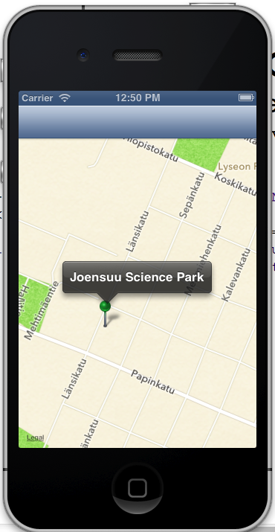
Show a pin on the map
Make your view controller implement MKAnnotation protocol and implement viewForAnnotation method
- (MKAnnotationView *) mapView:(MKMapView *)mapView viewForAnnotation:(id <MKAnnotation>) annotation{
MKPinAnnotationView *annView=[[MKPinAnnotationView alloc] initWithAnnotation:annotation reuseIdentifier:@"MapPin"];
annView.pinColor = MKPinAnnotationColorGreen;
annView.animatesDrop=YES;
annView.showsCallout=YES;
return annView;
}

Slide 40
Handling location
Create a class which implements CLLocationManagerDelegate protocol and has a CLLocationManager object
Header file:
@interface LocationController : NSObject <CLLocationManagerDelegate>
// Class members: Location manager and current location container
@property (nonatomic, retain) CLLocationManager *locationManager;
@property (nonatomic, retain) CLLocation *currentLocation;
+ (id)defaultController; // Static singleton
// Init, start and stop Location Manager
- (void) initLocationManager;
- (void) startLocationManager:(CLLocationAccuracy)accuracy;
- (void) stopLocationManager;
@end

Slide 41
Handling location
#import "LocationController.h"
@implementation LocationController
@synthesize locationManager, currentLocation; // Autogenerate getters and setters
+ (id)defaultController {// Static singleton
static LocationController *sharedController = nil;
static dispatch_once_t onceToken;
dispatch_once(&onceToken, ^{
sharedController = [[self alloc] init];
});
return sharedController;
}
- (id) init {// This will be called when instantiating object
  self = [super init];
  if (self != nil) {
  [self initLocationManager]; // Custom init code
  }
return self;
}
-(void) dealloc { // Called when deleting objects
if(self.locationManager != nil) [self.locationManager stopUpdatingLocation];
// Make sure all objects are nil so Automatic Reference Count will delete them
[self setLocationManager:nil];
[self setCurrentLocation:nil];
}

Slide 42
Handling location
- (void) initLocationManager {
self.locationManager = [[CLLocationManager alloc] init];
self.locationManager.delegate = self; // send loc updates to myself
currentLocation = [[CLLocation alloc] initWithLatitude:0 longitude:0];
// start location
[self startLocationManager:kCLLocationAccuracyBestForNavigation];
}
-(void) startLocationManager:(CLLocationAccuracy)accuracy {
if(self.locationManager != nil) {
self.locationManager.desiredAccuracy = accuracy;
self.locationManager.distanceFilter = 0;
self.locationManager.headingFilter = 0;
// Start location updates
if([CLLocationManager locationServicesEnabled]){
[self.locationManager startUpdatingLocation];
}
}
}
-(void) stopLocationManager {
[self.locationManager stopUpdatingLocation];
}

Slide 43
Handling location
// This is called when location is updated
- (void)locationManager:(CLLocationManager *)manager didUpdateToLocation:(CLLocation *)newLocation fromLocation:(CLLocation *)oldLocation
{
NSDate* eventDate = newLocation.timestamp;
NSTimeInterval howRecent = [eventDate timeIntervalSinceNow];
if (abs(howRecent) < 60.0)
{
//Location timestamp is within the last 60.0 seconds, let's use it!
if(newLocation.horizontalAccuracy < kMaxGpsAccuracy){
currentLocation = newLocation;;
}
}
}

Slide 44
Handling location
// Error handling
- (void)locationManager:(CLLocationManager *)manager didFailWithError:(NSError *)error
{
NSString *errorString; switch([error code]) {
case kCLErrorDenied:
//Access denied by user
errorString = @"Access to Location Services denied by user“;
break;
case kCLErrorLocationUnknown:
//Probably temporary...
errorString = @"Location data unavailable“; break;
default:
errorString = @"An unknown error has occurred";
break;
}
NSLog(@"Error: %@“, errorString);
}
@end // End of class implementation

