Slide 1
Skill Based Assessment
JavaScript - Spring Core – Spring MVC
Orientation Deck

Slide 2

What is JavaScript – Spring Core -Spring MVC Skill Based Assessment?
JavaScript - Spring MVC – Spring Core –
Skill Based Assessment,
“Certifies the Programming
Skills of associates in the
Skill, JavaScript – Spring Core –
Spring MVC”
JavaScript
Spring Core
Spring MVC
1

Slide 3
JavaScript - Spring Core – Spring MVC Assessment
Model
The JavaScript - Spring Core – Spring MVC assessment model is split into 2 levels
Level 1 – Multiple Choice Questions.
Level 2 – Case study will be provided for Problem Solving (associates must implement the solution for the case study)
  Note:
The total duration of the Skill Based Assessment is 3 hours.
There is no restriction between the time slots available for MCQ and Case study sections. Associates can manage the total available duration (3hrs) per their convenience and need.

Slide 4
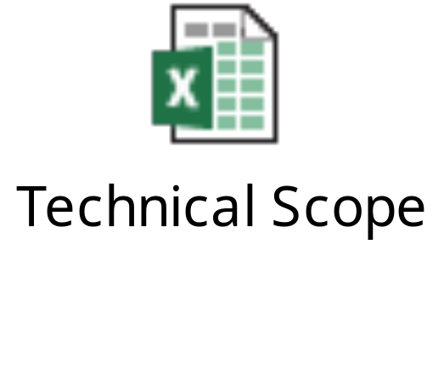
JavaScript – Spring Core- Spring MVC Technical Scope
The technical scope is attached below
  Important – Please note:
A skeleton zip file with the project structure, necessary xml’s and library files will be provided to the associate prior to the assessment. Associate should use this Skeleton file to develop the solution.
Note: The assessment will be based only on the features listed in the attached sheet.

Slide 5
JavaScript – Spring Core –Spring MVC Version and Software Details
  Software which will be provided in the assessment hall for the Multiple Choice Questions and Case Study:
  SDE 7.0
  JDK 1.6.X
  Tomcat 6.0

Slide 6
Do’s for JavaScript - Spring Core - MVC Assessment
You must need to logon to the virtual environment for taking up the assessment
You can add any methods as necessary
Ensure that your uploaded code has no compilation errors
Ensure you test your program with success and failure criteria's.
The requirement should be implemented based on the design consideration specified. Otherwise candidates will not be awarded marks.
Note: Associates are given access to manuals and reference materials in advance for preparing well before profiling.

Slide 7
Don’ts for JavaScript - Spring Core – Spring MVC Assessment
  Do not change the Context root and the imported zip file name.
  Do not add or remove Library files
  Do not change the package and file names given in the case study
  Do not hard code the input parameters inside the program
  Do not log off the machines while the assessment is in progress
Note: Internet access will be provided during profiling.

Slide 8
How to take JavaScript – Spring Core- Spring MVC Assessment Case Study?
Once you enter the Exam Hall, you will be provided with the URL to take up the exam.
First, you will be presented with MCQ questions
On clicking Submit after completing the MCQ questions, you will be presented with one case study.
Download the skeleton code slice given in the case study.
Import into SDE and create a project
Configure Tomcat server (Refer configuration manuals)

Slide 9
How to take JavaScript - Spring Core – Spring MVC Assessment Case Study?
Implement the solution.
Deploy and run the application in Tomcat.
For all these steps, please refer manuals
During the course of assessment, DO NOT close the browser window and do not click on HOME button/any other link. You can just minimize the browser.

Slide 10
Enabling yourself for the Assessments
For each Assessment we have an Enablement Program associated with it.
Enablement Programs are available in the ‘Learn and Develop’ section of the RDP App. Enroll for the Enablement Program from the RDP.

Slide 11
Assessment Program for JavaScript – Spring Core- Spring MVC
Assessment Code | Assessment Program Code
LAB_ATKJE062 | Certified Developer Beginner– JavaScript, Spring Core, Spring MVC

Slide 12
JavaScript - Spring Core – Spring MVC Assessment Observations
Few of the common mistakes done by associates which can result in the assessment moving to a not completed status
File Format mismatch in the expected code and the code uploaded.
Code upload post expiry of time allotted
Changing the skeleton code ( as applicable)
Compilation errors
Skeleton code uploaded as solution file by mistake

Slide 13
How to crack Multiple Choice Questions?
Try to attempt all the questions that you find easy first!
Do not spend too much time in a single question, you will be able to revisit the question later
If you need to try a question in your IDE before answering please go ahead and do it

Slide 14
How to crack Case Study?
Read the requirement/case study document carefully. Follow the design considerations provided in the requirement/case study document
Ensure you test your program with various functional, implicit and negative test scenarios.
Do not submit the solution files with compilation errors*.
  * Note that once you log off, the code in the assessment environment (VDI/VM) will be refreshed/cleaned and cannot be retrieved back so take care!

Slide 15
Thank you

