Slide 1


Slide 2
Rapid Application Development using the Kuali Architecture
(Struts, Spring and OJB)
A Case Study
Bryan Hutchinson
bh79@cornell.edu

Slide 3
Agenda
Kuali Application Architecture
CATS Case Study
CATS Demo
CATS Source Code
Q & A

Slide 4
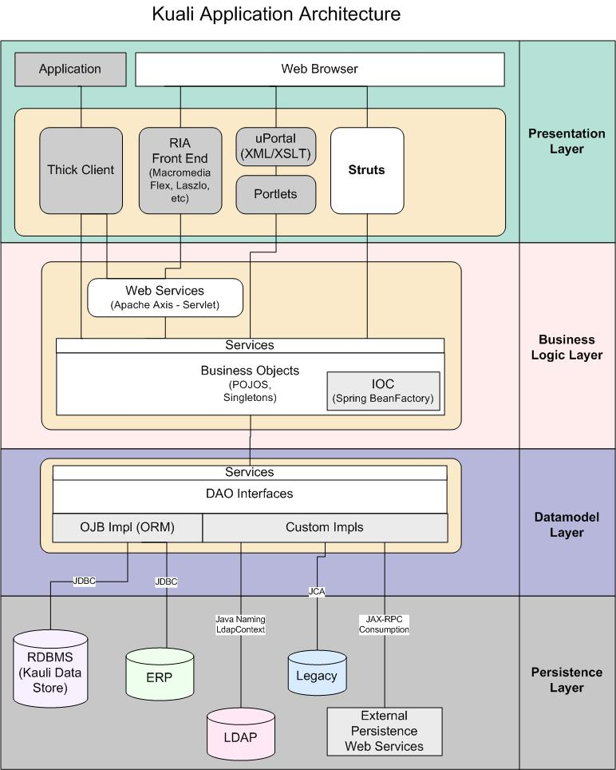
Kuali Application Architecture

Slide 5
Application Layers
Components should be designed to build the application into three layers: Presentation, Business, and Persistence Layer
Components should be container agnostic with Servlet and JSP API
All system-to-system interoperability that cannot be done within the container should be JAX-RPC/Apache Axis compliant

Slide 6
Presentation Layer
Focuses on the presentation of the data to the user in the context of the user interface, e.g., the Web browser or a rich client
Struts 1.2.4
Will work within a portal framework

Slide 7
Struts
Open source web application framework
Flexible control layer based on standard technologies like Java Servlets, JavaBeans, ResourceBundles, and XML, as well as various Jakarta Commons packages
Provides Controller component and integrates with other technologies to provide the Model (JDBC, EJB, Hibernate) and the View (JSPs)
Encourages application architectures based on the Model 2 approach, a variation of the classic Model-View-Controller (MVC) design paradigm
Notes:
http://struts.apache.org/index.html
MVC - http://java.sun.com/blueprints/guidelines/designing_enterprise_applications_2e/web-tier/web-tier5.html

Slide 8
Struts Benefits
Widely used web framework
Includes nice validation capabilities
Includes good set of custom jsp taglibs

Slide 9
Business Layer
Provides the enterprise logic
Includes the components that capture the business rules of the enterprise
May support multiple Presentation tiers
Spring framework 1.1.4

Slide 10
Spring
Aims to…
  make J2EE easier to use
  promote good programming practice
  make existing technologies easier to use (logging, O/R mapping, transactions JTA)
Portable across application servers
Lightweight Inversion of Control (IoC) Container (Don’t call me, I’ll call you)
Notes:
The concept behind Inversion of Control is often expressed in the Hollywood Principle: "Don't call me, I'll call you." IoC moves the responsibility for making things happen into the framework, and away from application code. Where configuration is concerned this means that while in traditional container architectures such as EJB, a component might call the container to say "where's object X, which I need to do my work", with IoC the container figures out that the component needs an X object, and provides it to it at runtime. The container does this figuring out based on method signatures (such as JavaBean properties) and, possibly, configuration data such as XML.
IoC has several important benefits. For example:
* Because components don't need to look up collaborators at runtime, they're much simpler to write and maintain. In Spring's version of IoC, components express their dependency on other components via exposing JavaBean setter methods. The EJB equivalent would be a JNDI lookup, which requires the developer to write code.
* For the same reasons, application code is much easier to test. JavaBean properties are simple, core Java and easy to test: just write a self-contained JUnit test method that creates the object and sets the relevant properties.
* A good IoC implementation preserves strong typing. If you need to use a generic factory to look up collaborators, you have to cast the results to the desired type. This isn't a major problem, but it is inelegant. With IoC you express strongly typed dependencies in your code and the framework is responsible for type casts. This means that type mismatches will be raised as errors when the framework configures the application; you don't have to worry about class cast exceptions in your code.
* Most business objects don't depend on IoC container APIs. This makes it easy to use legacy code, and easy to use objects either inside or outside the IoC container. For example, Spring users often configure the Jakarta Commons DBCP DataSource as a Spring bean: there's no need to write any custom code to do this. We say that an IoC container isn't invasive: using it won't invade your code with dependency on its APIs. Any JavaBean can become a component in a Spring bean factory.
This last point deserves emphasis. IoC is unlike traditional container architectures, such as EJB, in this minimization of dependency of application code on container. This means that your business objects can potentially be run in different IoC frameworks - or outside any framework - without code changes.
http://www.theserverside.com/articles/article.tss?l=SpringFramework
http://www.springframework.org/statement.html

Slide 11
Spring Benefits
Services can be easily provided at runtime based on xml config file
Wraps other services (JavaMail, Quartz, OJB) to make them easier to use
Service classes are POJOs (plain old java objects) and easier to write, more maintainable and more testable than other J2EE frameworks (EJBs!)

Slide 12
Spring Benefits
Adds Transaction support (without programmer writing any code!)
Provides Aspect Oriented Programming (AOP) hooks; could be used for things such as caching and instrumentation of code at runtime (again without programmer writing any code!)

Slide 13
Persistence Layer
The data repository for the application
Provides Data storage, retrieval, and maintenance
Data Access Objects (DAOs) should be employed to encapsulate the data sources using the Spring/OJB (Object Relational Bridge) framework to isolate access to the database

Slide 14
Persistence Layer
No business logic should be present in the data tier
No business object should access the database directly; any need for this should be met through service calls
Object Relational Bridge (OJB) 1.0.1

Slide 15
ObJectRelationalBridge (OJB)
Object/Relational mapping tool
Allows transparent persistence for Java Objects against relational databases
Supports multiple persistence APIs
Designed for a large range of applications
Uses an XML based Object/Relational Mapping
Notes:
http://db.apache.org/ojb/

Slide 16
OJB Benefits
No need to write SQL code
Database schema changes are isolated in xml config file (and perhaps Java Beans)
Very nice query facility (easily add ordering, grouping, where clauses based on field names in Java Beans not database columns)

Slide 17
Architecture Benefits
Clean separation of presentation logic, business logic and data access code
Maintainable and Extensible
Agile
Specific application layers can be removed or replaced without affecting the rest of the application

Slide 18
CATS Case Study
Cornell Asset Transfer System
Essentially a matchmaking service between Cornell Faculty and staff members who wish to exchange Cornell Assets

Slide 19
CATS Requirements
Users must be able to post available assets, post descriptions of assets wanted, and browse available assets
Limited to Cornell Faculty and Staff
The System will NOT facilitate or track the actual exchange of assets

Slide 20
CATS Requirements
Need ability to add picture to asset listing
Maximum expiration date of listings
Automatic removal of expired listings
Email feedback to users after their listing expires

Slide 21
CATS Implementation
Oracle database
Tomcat 5.5 application server
Apache web server
Web application using Struts, Spring and OJB
Email and job scheduling using Spring services

Slide 22
CATS Sequence Diagram

Slide 23
Benefits to CATS Project
Rapid Development (Approx. 120 hours)
  20 hours analysis/design/prototyping
  60 hours core development
  20 hours admin enhancements
  20 hours implementation/bug fixes
Extensible, Maintainable system
Happy Customer (Phase II already approved)

Slide 24
Room for Improvement
My first project from scratch with these technologies
We’ll get better with practice
Struts is a weak link

Slide 25
CATS Demo

Slide 26
CATS Source Code

Slide 27
Q & A

Slide 28
Resources
http://struts.apache.org/
http://www.springframework.org
http://db.apache.org/ojb/

