Slide 1
Symantec Case Study
Delivering Support with Spring
Jim Moore & Patrick Peralta

Slide 2

About Us
We work for the Enabling Technology and Services (ETS) group at Symantec
ETS’s mission is to provide the technology solutions required for Technical Support operations
Our primary project is the Case Management tool (known as Titan) which will be the focus of this case study

Slide 3
Overview
The evolving business requirements and technical solutions, focusing on lessons (technical and non-technical) learned along the way
The move from client-server to middle-tier
How Spring has helped us meet our customer’s needs

Slide 4

In The Beginning…
Titan initially started life needing to replace a vended solution for Seagate Software.
Business drivers:
  Support was seen as a core differentiator for the company by the head of the department, so while we had a “cost center budget,” we were given tremendous freedom to innovate.
  Needed to do everything the product that it was replacing did.
  Needed to allow us to evolve the tool to the way we do business, not the other way around.
Notes:
“everything” that the Support dept needed, to be more accurate. The old product did lots of things that were essentially dead weight for our processes.

Slide 5

Overview of Past Versions
Titan 1.0 was a Java 1.0 AWT application connecting to Sybase (1 ½ developers).
  Pre-1.0 was an applet, but the problems of running a business-critical application in a web-browser (especially in 1997) forced us to make it an application.
Titan 2.0 made the move to Swing, with proper menus and the like (2 ½ developers).
Titan 3.0 was the result of merging with Veritas Software. It had to incorporate a large set of new business practices, tightly integrate with ERP customer (and contract) data, run on Oracle, and was a significant rewrite (3 ½ developers)
“Titan” usually refers to the client, since that’s the visible part, but it’s actually the entire system.
Notes:
T1 looked and felt like an applet, whereas T2 felt much more like a proper application.

Slide 6
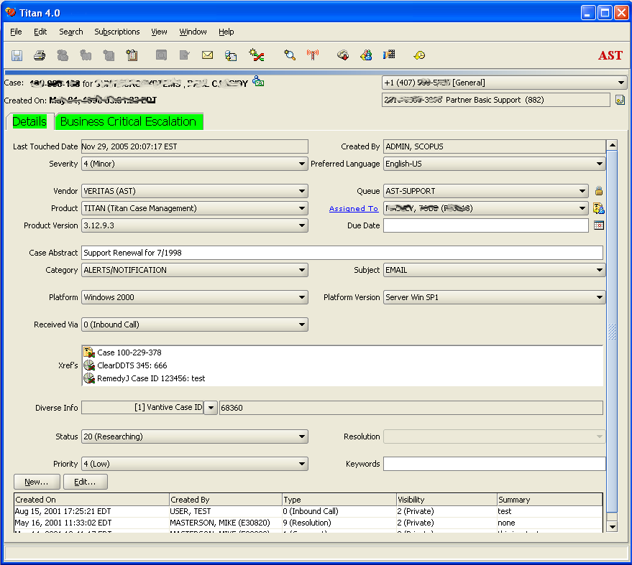
What It Looks Like

Slide 7
Some Important Early Technical Decisions
The application would be a rich desktop client rather than web-based.
The database uses multi-master asynchronous replication.

Slide 8
Rich Client vs. Web Client
Pros:
  A vastly better experience for users that have to use it 8 hours a day.
  Can maintain its own state and provide a much more responsive & flexible workflow than web applications.
Cons:
  Harder to patch/upgrade.
  The “richness of experience” makes for much more complex interactions, and therefore can make development much more complex.
Notes:
It’s not unusual for a tech to be actively working on the same case for 4 or 5 hours at a time, so a “30 minute timeout” is unacceptable.
Basic things like prompting before leaving the screen (or closing the app) are possible but much more clunky in a web app.
AJAX and other new technologies partially address some of the usability concerns, but they are new technologies that have their own sets of problems and still don’t solve some fairly fundamental problems.

Slide 9
Multi-master Replication
Business Requirements:
  “The Availability Company” can’t be unavailable when you call for support, so Titan must be extremely available, regardless of where the technician is located.
  We have extremely large customers with extremely complex issues, so multiple techs around the world need to be able to work on the same case and pass it around the world in real time.

Slide 10
Multi-master Replication
Solution:
  A highly normalized multi-master replicated database, where things are broken into as discrete tasks as possible.
  That brings a number of challenges, though, such as making it extremely painful to make changes to the database
  But it lets us have vastly better responsiveness and availability for our users
Notes:
Something as “simple” as adding a field requires kicking everyone off every database around the world, making sure everything is completely in-sync, turning off replication, applying the DDL, verifying everything is still in sync, adding each database back into replication, then verifying that everything is replicating correctly

Slide 11
Outgrowing Client-Server
The business has grown tremendously, with much more complex interactions between systems
Titan had more “clients” than the desktop client
  This results in duplication of business logic across multiple code-bases
  Server-side integration happened at the database
  Desktop application integration happened via socket calls to the client
We needed to move as much logic as possible to the server.
Notes:
Example server side integration: web tools; client integration: the telephony system
*Patrick speaks next *

Slide 12
How Does a Middle Tier Help?
Making changes to logic doesn’t require a client redeploy
It helps decouple us from the database
Business logic is consolidated

Slide 13
Exploring a Middle Tier
The first attempt at a middle tier was made with Apache SOAP and Apache Axis soon after
Advantages
  Open Source implementation
  Uses technology we were familiar with
    POJO
    JDBC
    Servlets
  Clients can be written in any language with SOAP support

Slide 14
Concerns with the first Middle Tier
Performance
Authentication
Exception handling
Notes:
Authentication and exception handling have been vastly improved since we first started with SOAP.

Slide 15
Performance
Having to perform XML serialization / deserialization for every remote call placed a lot of overhead on each call
This resulted in poor performance for the desktop client

Slide 16
Authentication
Authentication was performed by creating tokens that had to be passed around for every call
  saveContact(String session,
  ContactDto contact)
  getProducts(String session)

Slide 17
Exception handling
Early versions of Apache SOAP threw exceptions only via SOAPException and fault codes
This meant that big if-then blocks were required to handle errors
  try{ … } catch (SOAPException ex) {
  if (“1”.equals(ex.getFaultCode()) { …}
  if (“2”.equals(ex.getFaultCode()) { …}
  }

Slide 18
Plans for a second Middle Tier
In order to solve some of these shortcomings, we migrated to an EJB platform
  Using EJB/RMI drastically improved remote invocation performance (8x)
  A Java (checked) exception hierarchy was used in place of fault codes
  Authentication remained the same for this phase

Slide 19
The second Middle Tier
The services layer was defined using interfaces from the start, so placing a stateless session EJB façade was not too difficult
The client was using proxies to call the SOAP services, so we had to rewrite the proxies to use EJB

Slide 20
Reevaluating the Middle Tier (Again)
Improvements were made over the first attempt, but the following problems were carried over:
  Static methods
  Hand coded transaction management
  Checked Exceptions
  Authentication

Slide 21
Static methods
All functionality, including service implementations and data access methods were implemented with static methods
This resulted in tight coupling and made it very difficult to create and maintain unit tests

Slide 22
Example
class ContactService {
public long saveContact(Contact c) {
//some business logic here...
return ContactSQL.saveContact(c);
}
}
class ContactSQL {
public static long saveContact(Contact c) {
String sql = // create either insert or update
try {
Connection connection = ConnectionFactory.getConn();
// perform insert/update
connection.commit();
} catch (SQLException ex) { connection.rollback() }
finally { connection.close(); }
}
Notes:
TDD is really hard here!
Can’t use a mock to test the service layer in isolation
Hard to test the data layer
Transition to transaction management

Slide 23
Hand coded transaction management
In the desktop Titan, transaction management is hand coded (try, catch, finally sprinkled everywhere)
The same approach was taken in the middle tier
This makes it impossible to reuse data access methods in an ACIDic fashion; each operation requires a new data access method
Notes:
Atomic, Consistent, Isolated, and Durable

Slide 24
Example
class CustomerSQL {
public static long saveCustomer(Customer c) {
try {
Connection conn = ConnectionFactory.getConn();
// perform insert/update
conn.commit();
} catch (SQLException ex) { conn.rollback }
finally { connection.close(); }
...
class ContactSQL {
public static long saveContact(Contact c) {
try {
Connection conn = ConnectionFactory.getConn();
// perform insert/update
conn.commit();
} catch (SQLException ex) { conn.rollback }
finally { connection.close(); }

Slide 25
Checked Exceptions
Each service call had at least one checked exception thrown, sometimes several
This makes multi tier programming very difficult because a checked exception cannot always be handled where it is thrown
This results in wrapping of exceptions into other exceptions, which makes debugging difficult (or worse, the swallowing of exceptions)

Slide 26
Example
public long[] getOpenCaseIdsForExternalLoginId(
String sessionId, long externalLoginId)
throws TSGeneralServicesException,
TSCaseException, TSWebaccountException,
TSContactException;

Slide 27
Security
Each service method required a parameter to indicate the identity of the caller using a token
  Product[] ProductService.getProducts(String token)
This resulted in a lot of extra code server side to pass tokens around under the various contexts where it was required (ThreadLocal was unknown to us at the time)
This also resulted in pollution of the service APIs, since they introduced parameters that had nothing to do with the business method that was being executed
Notes:
* Jim speaks next *

Slide 28
Changing Business Needs
In addition to these infrastructure changes, there were business requirements that needed to be addressed
There was a major initiative across the company to go to a single source for customer data, and implement full Sarbanes-Oxley compliance.

Slide 29
Single Customer SOx
Major upgrade to the ERP system
Installation of an enterprise message bus to perform integration among the various users of customer data
Significant changes to the structure of fundamental data

Slide 30
Starting Over
Because so much was changing, we decided to use it as the “opportunity” to finally make the move from client-server to n-tier.
There was a lot of cruft that had built up in the client code-base over the years, so we decided to scrap what we had and do a complete rewrite.
Notes:
* Patrick speaks next *

Slide 31
Refactoring the Middle Tier
Inspired by Expert One-on-One J2EE Design and Development, we set out to redesign the middle tier to address these issues
At this point, Spring was at version 1.0 RC2

Slide 32
The Initial Plan
Security: use the J2EE container to handle authentication instead of doing it in the application itself, propagate user identification via a ThreadLocal
Transactions: leverage Container Managed Transactions (CMT) as provided by the J2EE container
Exceptions: switch to using runtime exceptions instead of checked exceptions
Static Methods: replace with service objects and DAO objects using Spring’s JDBC template and dependencies configured via an application context bean factory.

Slide 33
Initial Results
JDBC template drastically reduces the amount of code required for JDBC operations
Wiring beans with the bean factory turns out to be simple and intuitive. (It just worked the first time I try it!)
Dependency injection makes testing a layer/component easier

Slide 34
Features of Spring that we discovered
We were happy with the initial results
Soon we started looking into other areas
  Spring Rich Client Platform
  Automatic EJB client proxy
  Declarative Transaction Management
  …and more

Slide 35
Spring Rich
An enormous amount of the code in the client was framework code (commands, multiple windows, changing screens, validation, etc.)
At the time (June ‘04) there were very few Swing frameworks available.
Keith Donald had recently submitted some of his work to Spring, and while it was essentially undocumented and “early access,” it was good quality and did most of what I needed.
Notes:
This saved an enormous amount of time, and it’s now much better than we had developed. (A lot more people using and improving it, so it’s not that big a kick to the ego. :)
The biggest problem is, though, is that there was no documentation (not terribly different than the in-house framework), the API has changed significantly over time, and without proper “versioning” it’s been a continual challenge to keep things up to date.

Slide 36
EJB Client Proxy
Spring provides the ability to create a proxy that performs EJB calls transparently
Clients don’t need to worry about InitialContext or about creating business delegates or service locators.

Slide 37
Before Spring
/**
* Connects to JNDI to obtain a home
* reference, and creates a new remote
* reference to the stateless session
* bean. This will assign the reference
* to <code>serviceRemoteStub</code>
*
* @throws Throwable This method uses
* reflection to invoke remote network
* calls. Needless to say, an almost
* infinite number of things can go wrong.
*/
private void initServiceRemoteStub() throws Throwable {
Object serviceHome = null;
Method createMethod = null;
Object remoteObj = null;
try {
InitialContext initialContext =
new InitialContext(jndiProperties);
serviceHome = initialContext.lookup(jndiLookupName);
createMethod =
serviceHomeClass.getMethod("create",null);
remoteObj = createMethod.invoke(serviceHome, null);
serviceRemoteStub = (EJBObject)remoteObj;
}
catch (InvocationTargetException e) {
throw e.getTargetException();
}
}
...
/**
* This method will invoke the requested interface
* method on the remote stub. If the stub does
* not exist or if an exception is thrown
* that is not declared in the service interface's
* method signature, the stub will be re-created.
* @param proxy the proxy instance that
the method was invoked on
* @param interfaceMethod the method of the interface
that should be invoked
* on the remote stub
* @param args arguments for said method
* @return result of the method invocation
* @throws Throwable Will either be one of the
declared exceptions of the
* interface, or TSServiceException
for everything else.
*/
public Object invoke(Object proxy, Method interfaceMethod,
Object[] args) throws Throwable {
Method remoteMethod = serviceRemoteClass.getMethod(interfaceMethod.getName(),
interfaceMethod.getParameterTypes());
for (int i = 0; i < NETWORK_RETRIES; i++) {
try {
getLogger().debug("Invoking service method " +
"(attempt "+(i+1)+" of "+NETWORK_RETRIES +") :"+
"interfaceMethod);
return remoteMethod.invoke(getServiceRemoteStub(), args);
}
catch (Throwable ex) {
getLogger().warn("Error was thrown while calling remote method "+
...

Slide 38
After Spring
public class Client {
private CustomerService customerService;
public CustomerService getCustomerService() {
return customerService);
}
// Spring will populate an EJB client proxy here
public void setCustomerService(CustomerService cs) {
customerService = cs;
}
public long saveCustomer(Customer c) {
return getCustomerService().saveCustomer(c);
}

Slide 39
After Spring
<bean id="customerService" class="org.springframework.ejb.access.SimpleRemoteStatelessSessionProxyFactoryBean">
<property name="jndiName">
<value>CustomerServiceBean</value>
</property>
<property name="businessInterface">
<value>org.my.CustomerService</value>
</property>
</bean>

Slide 40
Declarative Transaction Management
Spring provides declarative transaction support
  Makes testing DAOs against a database easier (no container required)
  Allows for more fine grained transactional behavior
  Provides the ability to scale up to JTA/2PC if need be

Slide 41
Enter Hibernate
JDBC template makes writing JDBC code much easier, but persisting objects using SQL is still tedious
Hibernate provides much easier APIs for loading and saving objects
Using Middlegen, we generated an entire object domain layer (over 100 objects) based on the existing Titan schema

Slide 42
Spring, Hibernate, and Oracle 9i CLOBS
In the past we have written (multiple versions of ) tedious routines to deal with Oracle 8i and 9i CLOBS
The combination of Spring and Hibernate makes this a non-issue for developers

Slide 43
Oracle CLOBS before Spring & Hibernate
public static String getClobValue(
Connection connection,
Clob clob)
throws CodedSQLException {
...
StringBuffer data = new StringBuffer();
try{
// Open a stream to read Clob data
Reader clobStream = clob.getCharacterStream();
int nchars = 0; // Number of characters read
//Buffer holding characters being transferred
char[] buffer = new char[(int)getChunkSize(connection, clob)];
// Read from the Clob stream and write to the stringbuffer
while((nchars = clobStream.read(buffer)) != -1) // Read from Clob
data.append(buffer, 0, nchars); // Write to StringBuffer
// Close the Clob input stream
clobStream.close();
}
catch (Exception e){
...
public static void writeClobValue(Connection
connection,
Clob clob,
String value)
throws CodedSQLException, ClassCastException {
if (clob == null || value == null)
throw new IllegalArgumentException("Either the clob or the string is null");
Writer clobWriter=null;
StringReader reader = new StringReader(value);
try {
clobWriter = ((oracle.sql.CLOB)clob).getCharacterOutputStream();
IOUtilities.redirectFromReaderToWriter(reader, clobWriter, (int)getChunkSize(connection, clob));
}
catch (SQLException sexp){
throw new CodedOracleSqlException(sexp);
}
catch (IOException e) {
throw new CodedSQLException("TITAN-006-000-006", new Object[]{e.getMessage()}, e);
}
finally {
IOUtilities.closeReader(reader);
IOUtilities.closeWriter(clobWriter);
}
...

Slide 44
Oracle CLOBS with Spring & Hibernate
If using XDoclet:
/**
* @hibernate.property column="ACTIVITY_NOTE"
* type="org.springframework.orm.hibernate.support.ClobStringType"
*/
public String getActivityNote() {
return this.activityNote;
}

Slide 45
Oracle CLOBS with Spring & Hibernate
<bean id="nativeJdbcExtractor" class="org.springframework.jdbc.support.nativejdbc.JBossNativeJdbcExtractor"
lazy-init="true"/>
<bean id="oracleLobHandler" class="org.springframework.jdbc.support.lob.OracleLobHandler">
<property name="nativeJdbcExtractor">
<ref bean="nativeJdbcExtractor"/>
</property>
</bean>
<bean id="sessionFactory"
class="org.springframework.orm.hibernate.LocalSessionFactoryBean">
<property name="lobHandler"><ref bean="oracleLobHandler"/></property>
...

Slide 46
Enter HTTP Invoker & Acegi
Since Spring was providing transaction management, the only features tying us to an EJB container were remoting and container security
With Spring 1.1 came the addition of HTTP Invoker, a Spring MVC controller that exposes service methods over HTTP via Java serialization
Meanwhile, Acegi was providing declarative security for Spring applications
Notes:
Hessian and Burlap existed before

Slide 47
About HTTP Invoker
HTTP Invoker exposes service calls via HTTP, servlets, and Java serialization
It requires the use of Spring on both client and server, but it is very lightweight and easy to use
In our case, it was a great replacement for EJB/RMI
As a result, we were able to deploy the application to Tomcat

Slide 48
About Acegi
Acegi Security provides comprehensive authentication and authorization services for enterprise applications based on Spring (http://acegisecurity.sourceforge.net/faq.html)
Web security aspect of Acegi is implemented via servlet filters that have access to the application context

Slide 49
Multiple Methods of Invocation
After migrating to Acegi and setting up HTTP Invoker in the project, we provided the ability to invoke service methods without using EJB
  No more slow InitialContext and JNDI for remote clients
  No more bulky JAAS callbacks for authentication

Slide 50
Acegi Challenges
No standard way to propagate authentication with HTTP invoker
Still wanted to provide the ability to execute services via EJB

Slide 51
Using HTTP Invoker with Basic Auth
import org.apache.commons.codec.binary.Base64;
//other imports...
public class MyHttpInvokerRequestExecutor extends SimpleHttpInvokerRequestExecutor {
private String username, password;
//setters & getters...
protected void prepareConnection(HttpURLConnection con,
int contentLength) throws IOException {
super.prepareConnection(con, contentLength);
String base64 = getUsername() + ":" + getPassword();
con.setRequestProperty("Authorization",
"Basic " + new String(Base64.encodeBase64(base64.getBytes())));
}
Notes:
I hear that using Acegi in RCP client will handle this for you nowadays

Slide 52
Using Acegi and EJB
Acegi supports integration with container managed security
However, this means placing Acegi and Spring libraries in the container’s lib directory instead of deploying it with the EAR
At best, this forces all applications to use the same version of Spring/Acegi

Slide 53
Using Acegi and EJB: Our Approach
For web security (including HTTP Invoker), Acegi provides a servlet filter that has access to the application context
Although filters don’t exist for EJB, JBoss does provide the ability to filter calls to EJBs via org.jboss.security.SecurityProxy
Using the Acegi filter as an example, we implemented a JBoss SecurityProxy that extracts authentication information and passes it along to Acegi

Slide 54
HTTP Invoker Security

Slide 55
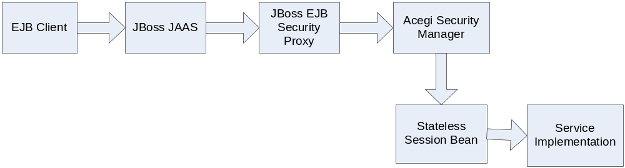
EJB Security

Slide 56
Enter Axis/SOAP
Our organization expressed a desire to experiment consuming Titan services with .NET
This provided an opportunity to expose our functionality via SOAP in addition to HTTP Invoker and EJB

Slide 57
Setting up Axis with Spring
Create a class that extends ServletEndpointSupport and delegates all calls to the service implementation
Add the Axis servlet to web.xml
Place server-config.wsdd under WEB-INF
  This file is a deployment descriptor for Axis web services

Slide 58
Axis challenges
The first two steps are easy
The third is a challenge
The Spring documentation implies that this file is created by hand, but that would be tedious and error prone for large projects

Slide 59
Steps for generating the Axis deployment descriptor
Generate WSDL using the tool java2wsdl that ships with Axis
Generate deployment descriptor (deploy.wsdd) for each individual service by executing wsdl2java
Use the Axis Admin tool to generate server-config.wsdd based on the deploy.wsdd files previously generated
All Java source generated by the WSDL tools can be discarded; the deployment descriptor is all that is needed

Slide 60
Extending Spring
Method cache interceptor
JMS Invoker

Slide 61
Method cache interceptor
Using instructions found in the community message boards, we implemented an interceptor that provides caching for our services using EHCache
This change was 100% transparent; no changes to existing code were performed

Slide 62
JMS Invoker
Our web applications have communicated with the middle tier via HTTPS through the firewall
Security policy is to not allow external access to the internal network, even through the DMZ
This makes RPC style communication between the DMZ and the internal network impossible…or does it?

Slide 63
JMS Invoker
Following the framework and standards put forth by HTTP Invoker, we set out to write a JMS Invoker
This will allow for asynchronous communication between client and server, yet allow for RPC style programming

Slide 64
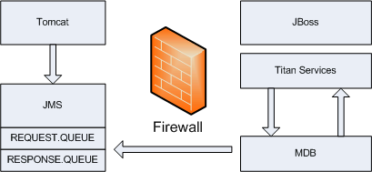
JMS Invoker

Slide 65
JMS Invoker
Our implementation was completed in less than a week
It allowed our new external facing case management system (also developed with Spring) to conform to the security policy
  No code changes on either end
  Long before any other applications met the proposed standard

Slide 66
Extending Spring
After implementing these extensions to Spring, other projects that extend Spring have been formed
  Lingo (http://lingo.codehaus.org/) implements RPC style invocations for Spring and JMS
  Spring Modules (https://springmodules.dev.java.net/) has some useful extensions to Spring, including method result caching

Slide 67
Making Titan Portable
With no code changes and minimal deployment descriptor tweaking, Titan runs on WebSphere and WebLogic in addition to Tomcat and JBoss
  Deployed as a WAR, not an EAR
The only container dependency is the configuration of a DataSource connection pool

Slide 68
Portable J2EE Applications
With Spring, it is possible to create portable J2EE application that require little or no configuration on the part of the container
App Fuse, a project for jump starting J2EE web development by Matt Raible, can now be deployed with no container configuration
  See http://jroller.com/page/raible/20050916

Slide 69
The Big Picture: Application Architecture
Remote Exporters
Business Services
Data Transfer Objects (DTO)
Domain Objects
Assembler
Data Access Objects (DAO)

Slide 70
Remote Exporters
Allows remote access to the business service layer
Spring makes it easy to support multiple export strategies
Titan uses the following
  EJB Stateless Session Façade
  Spring HTTP Invoker
  Apache Axis (SOAP)

Slide 71
Business Services
Exposes business functionality to clients
Indicates transaction boundaries
Contains business logic

Slide 72
Data Transfer Objects (DTO)
Serializable objects used to transfer data between client and server
Very simple data structures
  Only arrays, no Java Collections
  Allows for easier interoperability with SOAP
  Examination of JavaDoc makes it obvious which data type an array holds

Slide 73
Domain Objects
Objects that represent entities in the domain
These objects have Hibernate mappings, and are created/maintained for easy Hibernate usage
  Does not mean that they are only for Hibernate; these are POJOs!
  Uses Sets for collections
  Have equals(), hashCode() implementations

Slide 74
Assembler
Translates between DTOs and Domain Objects
Why have DTOs and domain objects?
Decoupling
  Domain objects have links to all known entities; this is usually too much data for a client
  Changes to domain objects don’t have to affect DTOs (and thus break serialization)
Notes:
Entity beans are not serializable; DTOs were required
No longer required for Hibernate web applications since everything is in the same tier
They are required for remoting applications

Slide 75
Data Access Objects (DAO)
DAOs have interfaces that define what data can be saved/queried
The interface does NOT define the data access strategy
DAO implementations do use various data access strategies
Titan uses Hibernate and Spring JDBC

Slide 76
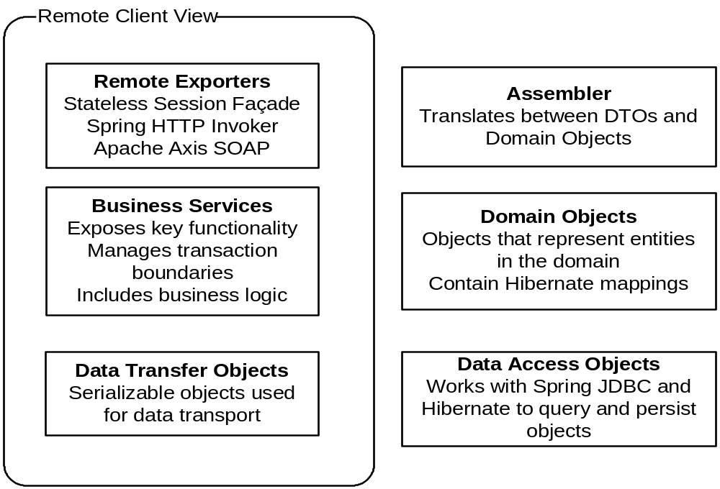
The Result: Application Architecture
Notes:
* Jim speaks next *

Slide 77
Current Status
The new services are in production and used by various systems, with more scheduled to come on-line early next year.
The client is… “in limbo.”
  The technologies have worked great.
  The biggest fundamental problem was the “let’s rewrite everything from the ground up” decision.
Notes:
Even Spring Rich, being still in alpha, has performed very well, though solid versioning and documentation would be wonderful.
Titan was far too massive a project to not develop incrementally from an established base. I had only intellectually bought the “iterative development” religion when the rewrite decision was made, so I didn’t argue very forcefully when it came down to it. Now I’m an Apostle…

Slide 78
In Conclusion, Spring has…
just worked, with very few problems
been wonderfully consistent
made it vastly easier to change implementations as business needs changed
allowed us to focus far more attention on UI and business logic rather than boilerplates or framework code
let us implement new features of the framework as we grew comfortable with them
made iterative development of the application much easier
an extremely active and responsive community

