Slide 1
End-User Services Budget & Efficiency Benchmark
Practitioners Guide
Notes:
End-User Services & Business Applications Budget & Efficiency Tool
Presenter's Name
Presenter's Name

Slide 2

Overview
Recommended Sprints
Recommended Sprints
Gartner-recommended sprints to cover various business objectives
Add Text
Step-by-Step Instructions
Step-by-Step Instructions
Launch and Set Up Your Assessment Survey Delegation
End-User Services Budget & Efficiency Guide
Use this document to help you complete the End-User Services Budget & Efficiency Tool Benchmark survey. This guide provides details on the mentioned topics.
Participation Process
Participation Process
Describes the step-by-step process included in the IT Budget and Efficiency Tool
It will be helpful, but you may need not to read each part of this guide before completing your survey; it is a reference guide. We do recommend reviewing slides 17 through 19 prior to beginning the benchmark. Please do not hesitate to contact us through the channels below if you have any questions throughout the survey process.
Have Questions?
Notify your service team
E-mail our team at inquiry@gartner.com

Slide 3
End-User Services & Application Portfolio Budget & Efficiency Tool comprises End-User Services and Application Budget & Efficiency Tool
End-User Services & Application Portfolio Budget & Efficiency Tool
End-User Services Budget & Efficiency Tool
The End-User Services Budget & Efficiency tool provides CIOs and their teams with self-assessment tools to benchmark their organization vs. published IT Key Metrics Data cohorts related to End-user Services.
Application Budget & Efficiency Tool
The Application Budget & Efficiency tool provides CIOs and their teams with self-assessment tools to benchmark their organization vs. published IT Key Metrics Data cohorts related to application development and support.

Slide 4
Participation Process

Slide 5
Participation Process
Step 1: Gather and Enter Your Data
Step 2: Review and Finalize Your Data
Step 3: Review Your
Results
Step 4:
Take Action
Review step-by-step benchmark instructions
Delegate sections of the survey to peers to complete. Submit your response using our online tool
Ensure all survey warning messages are resolved
Check your responses against benchmark charts instantaneously
investigate potential data input issues or outlier results
Instantly interact with your results directly in our online tool
Reach out to your service team if you would like to contextualize your custom results with an industry expert
Build business case for action
Use results to pursue cost optimization efforts.
Ensure smarter budgeting for your company
Expert Support available upon Request:
Participation Support
Receive an overview of the assessment
Identify key stakeholders who will submit the survey and review results
Provide context/clarification around survey questions
Survey Response Quality Review
Review your submitted responses with our experts
Review potential outliers and missing data
Discuss peer group comparisons
Review calculated metrics
Results Delivery
Schedule a 30-minute report discussion to review results and discuss key findings
Subsequent calls can be scheduled with your team to start taking action based on results
Leverage Gartner’s vast resources to develop next steps
Request Expert Support?
Notify your service team
E-mail our team at inquiry@gartner.com

Slide 6







How difficult will it be?
Sponsorship
Make sure you have a project sponsor who can establish and communicate clear objectives.
Use the documentation
Leverage the Framework Document for Digital Workplace Services & IT Service Desk
Check the FAQ
Some issues specific to industries or unique situations covered in our FAQ document.
Self-Validation
You can see if your data “makes sense” by performing checks. Does your personnel spending divided by your IT staff FTEs come out to a reasonable
Project management
Assign a single, accountable project manager and project team.
Get help
Gartner experts perform hundreds of assessments. Contact your account team to get in touch.
Use estimates
It is ideal to be able to gather your data directly from your general ledger or accounting reports. Where you can’t, use estimates (Eg. FTEs)
Audit Trails
Keeping track of five assumptions and sources of data helps if you want to repeat the exercise in the future.
Source: Gartner (2023)

Slide 7
Step-by-Step Instructions Launch and Set Up Your Assessment

Slide 8
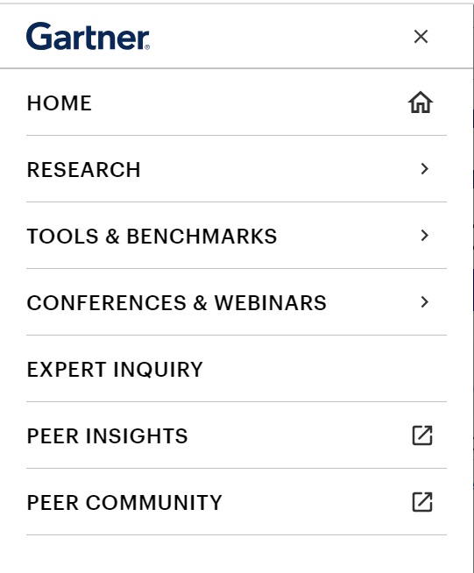
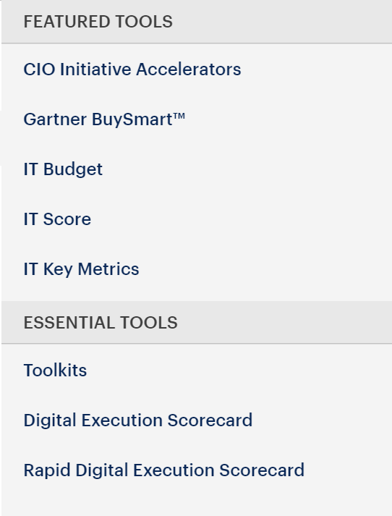
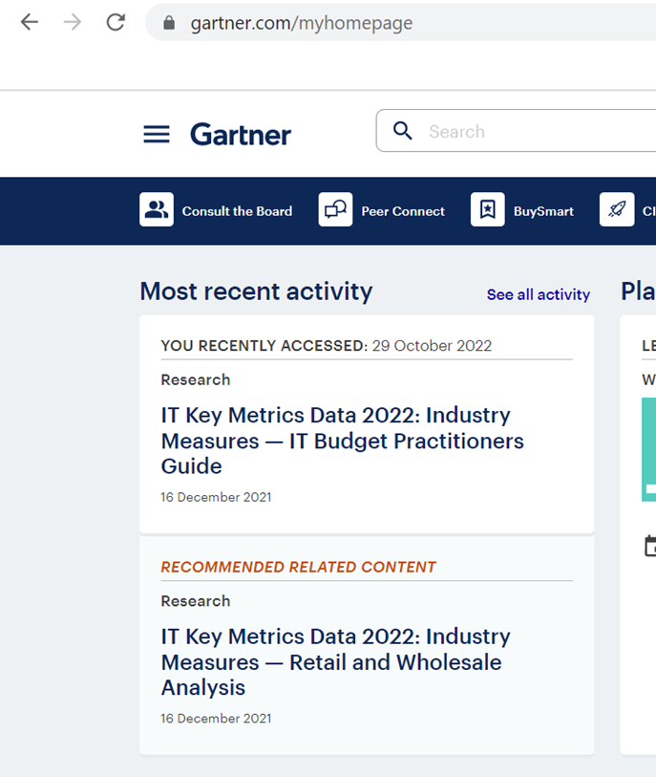
End-User Services & Application Budget & Efficiency Tool Location
Step 01
Step 02
Step 03
Select the bars near Gartner logo
Click on “Tools & Benchmarks”
Navigate Down To “IT Budget”
*On the IT Budget landing page you get an option to choose End User Services and Applications Tool

Slide 9
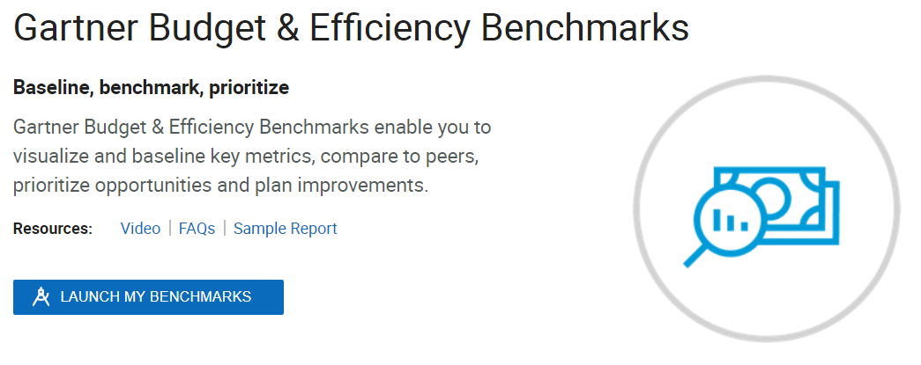
Launch and Set Up Your Assessment
Navigate to your Gartner Benchmarks homepage via Gartner.com.
Option 1:
Click on “Tools & Benchmark” in the list at the top left end of the page and select “IT Budget”.
The page will be redirected to “Gartner Budget & Efficiency Benchmarks.” Select “Launch My Benchmarks”.
Note: Use the same navigation to return to in progress and completed benchmark assessments.

Slide 10
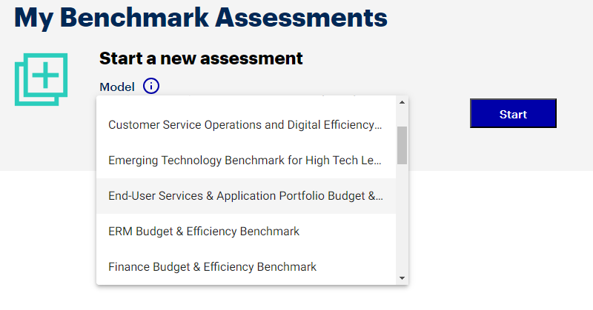
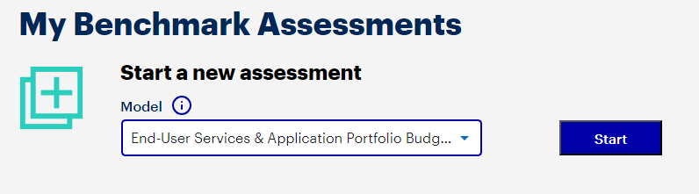
Launch and Set Up Your Assessment (Continued)
Input set up details.
From the drop-down list, select the option ‘IT Budget and Efficiency Benchmark’
Click on “Start” to start a new assessment.
Items one through three will be pre-populated with your membership specifications. Adjust those inputs as appropriate.

Slide 11
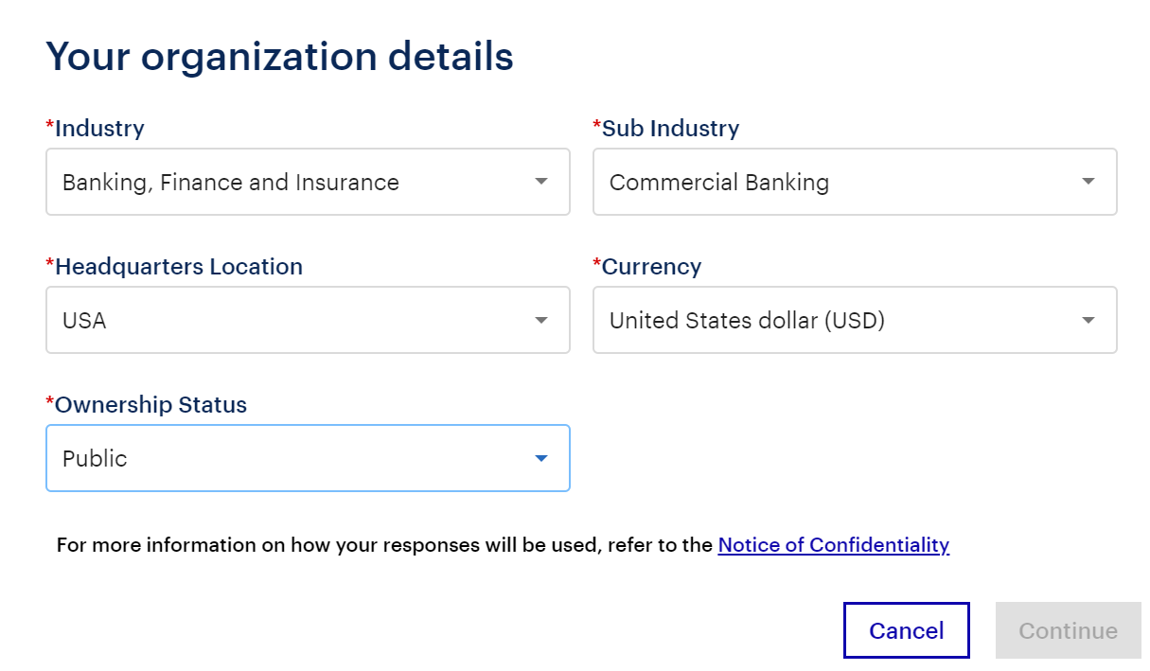
Launch and Set Up Your Assessment (Continued)
Input set up details (continued).
The industry selection here only represents the clients’ general Gartner industry classification. It does not represent peer selection which uses a different categorization scheme and is set on the digital results page.

Slide 12
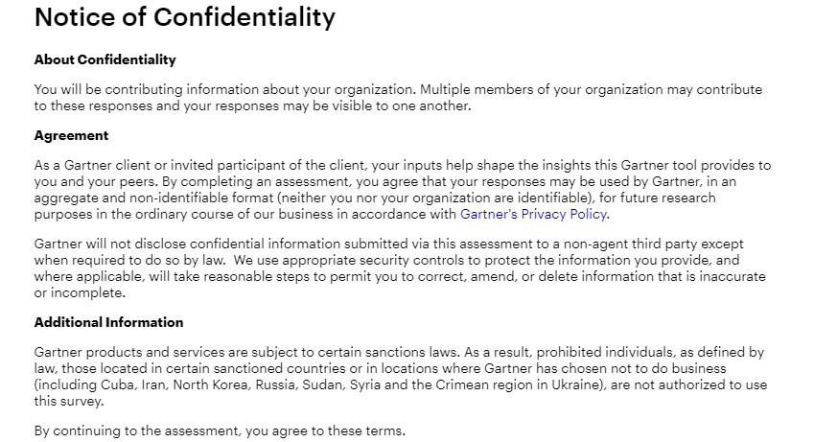
Launch and Set Up Your Assessment (Continued)
Agree to the standard Gartner Note of Confidentiality and Privacy Policy.

Slide 13
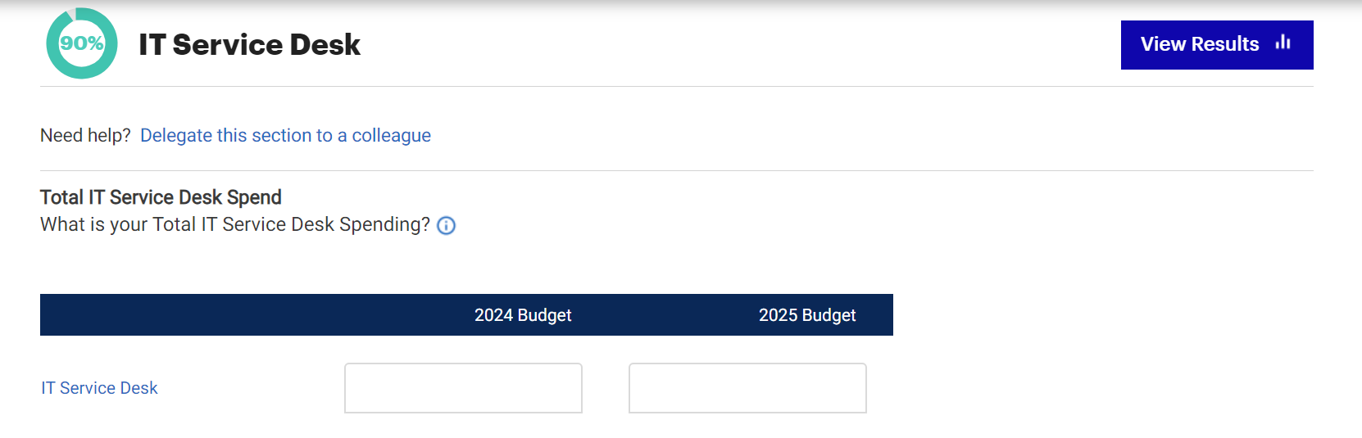
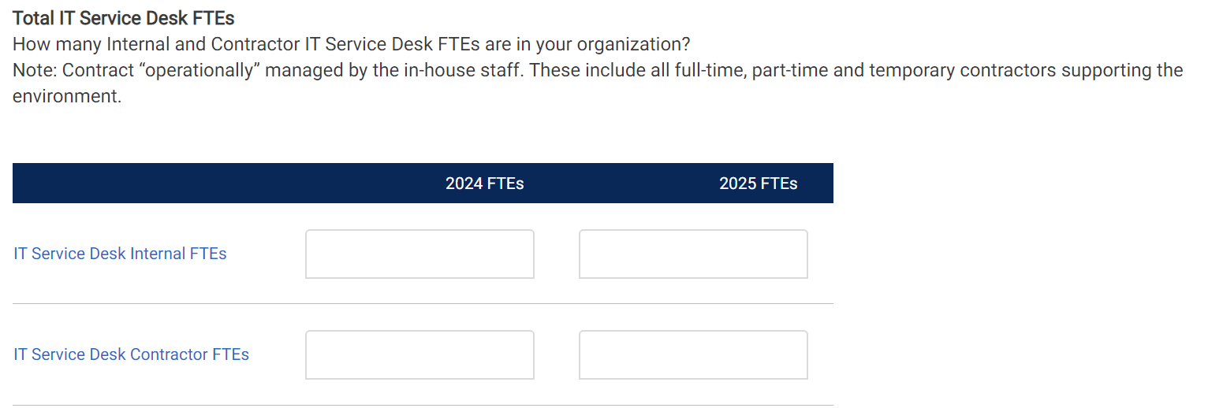
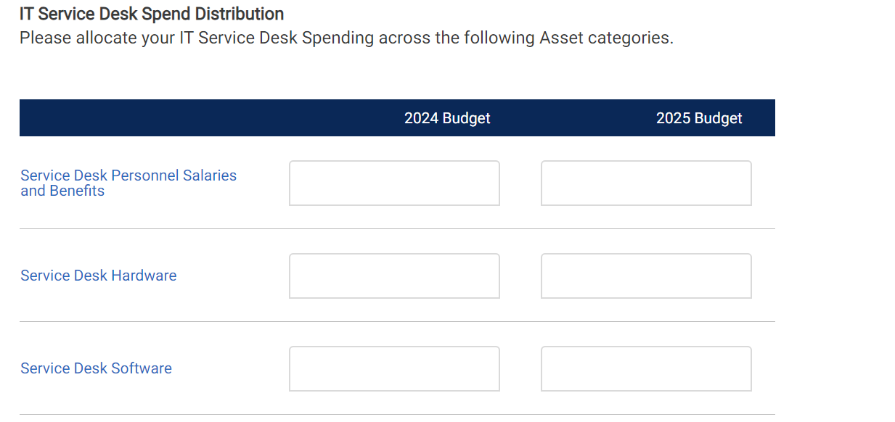
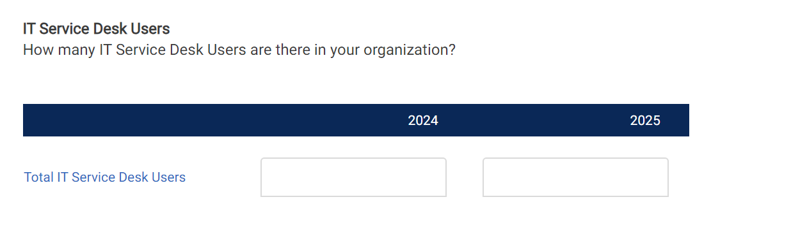
Launch and Set Up Your Assessment (IT Service Desk)
Input set up details.
*At any point in the survey, the current input can be saved by bookmarking the page which can be retrieved later
*At any point in the survey, the current input can be saved by bookmarking the page which can be retrieved later

Slide 14
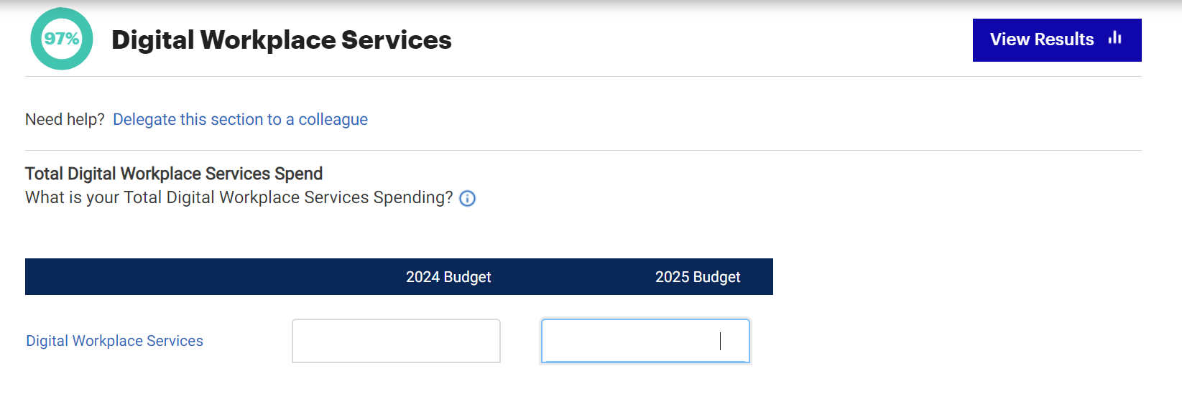
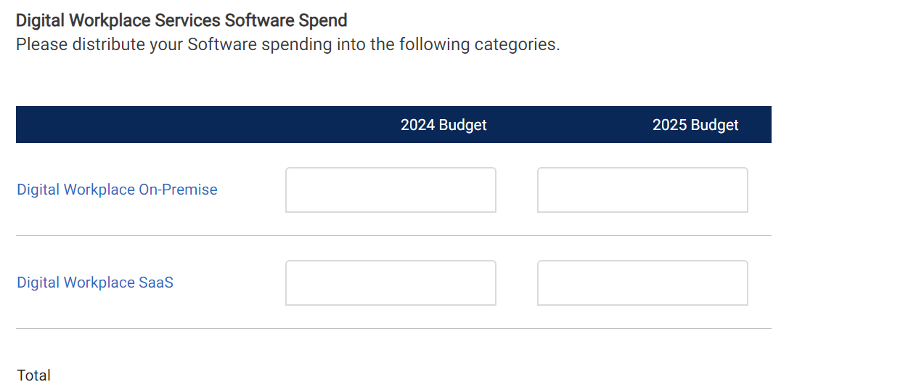
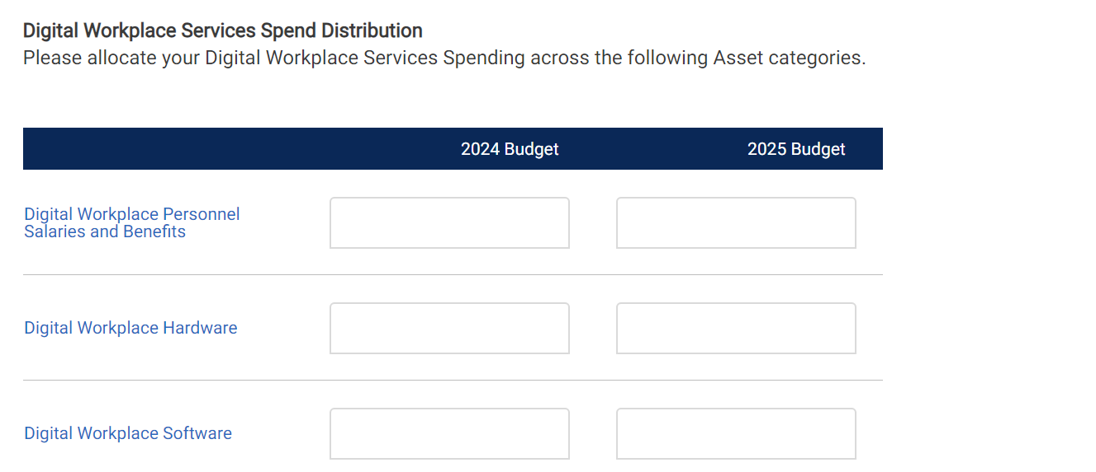
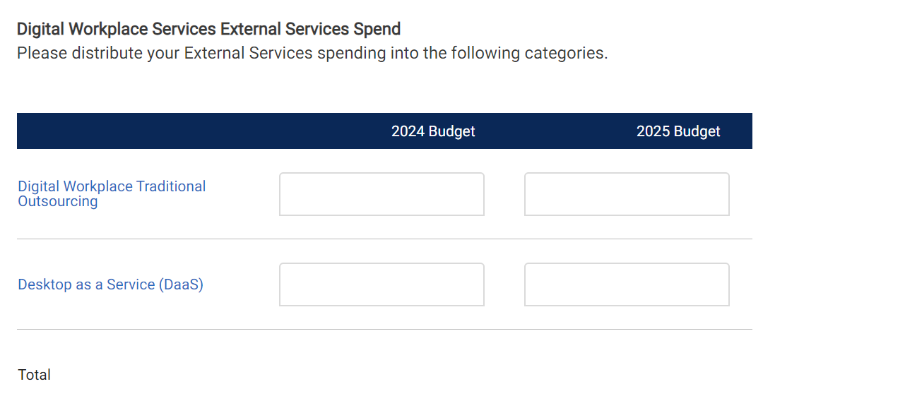
Launch and Set Up Your Assessment (Digital Workplace Services)
Input set up details.
*At any point in the survey, the current input can be saved by bookmarking the page which can be retrieved later
*At any point in the survey, the current input can be saved by bookmarking the page which can be retrieved later

Slide 15
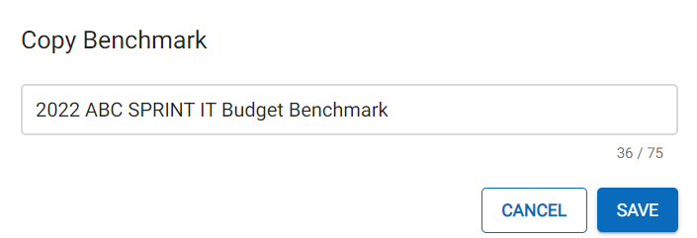
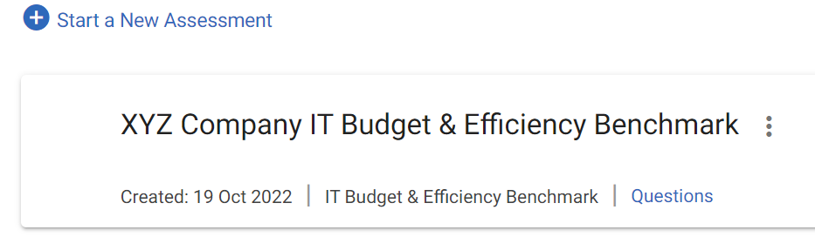

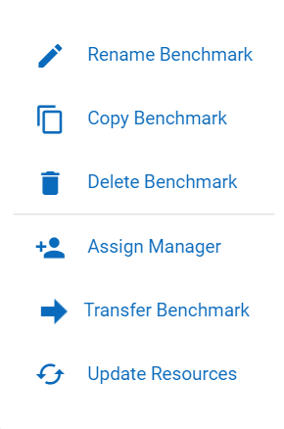
Create Additional Benchmark Assessments
You can complete a benchmark assessment for different scenarios based on changes to your organization’s demographic details or changes to functional resources:
1. Create a copy of your baseline assessment. Click the three vertical dots next to your assessment’s name and a menu will appear. Select “Copy Benchmark”. Do not overwrite your actual benchmark data.
2. Rename your new, copied assessment in the next step, describing the specific scenario and click save.
3. Make the necessary adjustments for your scenario to the copied benchmark assessment that will show under “My Benchmarks” and run a new report.
This name will appear on the first page of your report and allow you to identify your benchmark later.
When naming your benchmark, we recommend including descriptors that will indicate the point in time and content. This is especially important as you add more benchmarks in the years to come.

Slide 16
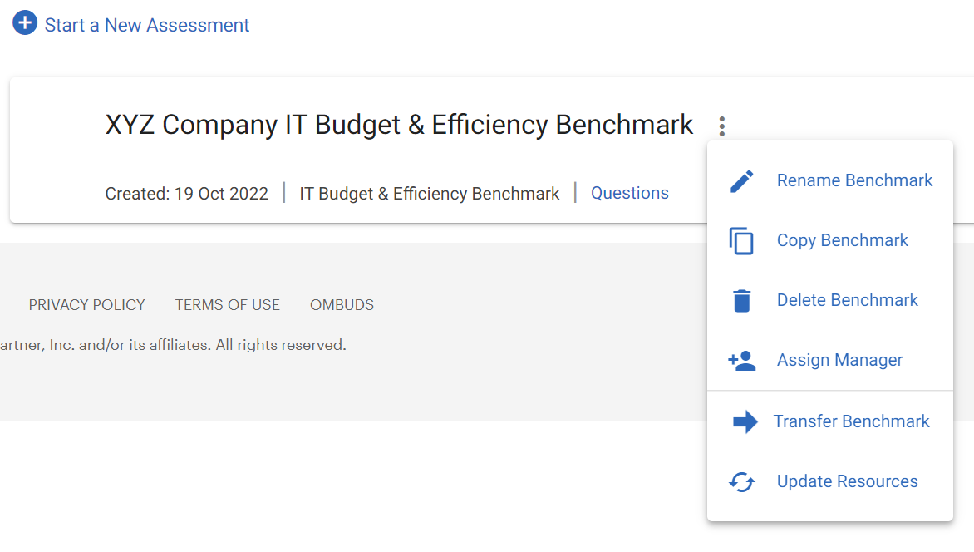
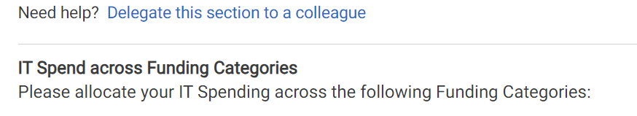
Survey Delegation
Although many clients complete the survey independently, there are three ways you can collaborate with your team.
1. Assign Manager | Assign an individual on your team to manage the question response input. This individual will have full access to the questions and the final benchmarking results.
2. Transfer Benchmark | Fully transfer ownership to an individual on your team. Common use cases include if you as the assessment owner are moving a new role or leaving the company. After doing so, you will no longer have access to the assessment.
3. Delegate Specific Sections | For support on individual sections of the survey, you can delegate the questions to an individual on your team. This individual will only have access to the questions delegated to them.
How to Assign Manager and Transfer Benchmark:
Click the three vertical dots next to your assessment’s name and a menu will appear. Select “Assign Manager” or “Transfer Benchmark” as needed. Note that in order to transfer a benchmark your team member must be an active Gartner client. Your assessment manager does not need to be an active Gartner client.
How to Delegate Specific Sections:
Once in the survey, open a specific module you wish to delegate and click “Delegate this section to a colleague”. This individual does not need to be an active Gartner client.

Slide 17
Recommended Sprint

Slide 18
Recommended Journeys
The EUC and Applications Benchmarking tool can be completed incrementally at different times by choosing different journeys. We recommend the below journeys/ sprints to shape your digital business optimization and transformation journey in order to achieve your strategic business outcomes.
Objectives
Description
Journey (Sections to Cover)
For End-User Services comparisons, opt for this journey.
Getting Started > IT Service Desk > Digital Workplace Services
End-User Services
Getting Started
Applications Spend and Staff
Applications Practices
IT Service Desk
Digital Workplace Services
Sections to Cover

Slide 19
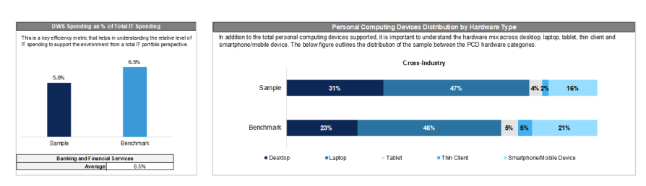
Sample report
What does the output look like?
Source: Gartner (2023)

Slide 20
Key KPIs Covered
Key End-user Services Metrics
Digital Workplace Services & ITSD Spending as a Percent of IT Spending
Digital Workplace Services & ITSD Staffing as a Percent of IT Staffing
Cost per Applications Staff
Distribution by Asset (ITSD & Digital Workplace Spending)
Personnel
Hardware
Software
External Services
Distribution by Activity
Digital Workplace Services workload
IT Service Desk workload
Source: Gartner (2023)

Slide 21
Recommended Readings
1
End-User Services & Business Applications Budget & Efficiency Tool
2
IT Key Metrics Data 2024: End-User Services Measures — Digital Workplace Services Framework Definitions
3
IT Key Metrics Data 2024: End-User Services Measures — IT Service Desk Framework Definitions
Additional Readings
4
IT Key Metrics Data 2024: End-User Services Measures — Digital Workplace Services Analysis
5
IT Key Metrics Data 2024: Definition of Industries

