Slide 1
Building an Analytics and AI Architecture Using Google Cloud Platform
Downloadable Figures
Christopher Long, Prasad Pore
Notes:
Presenter's Name
Presenter's Name

Slide 2
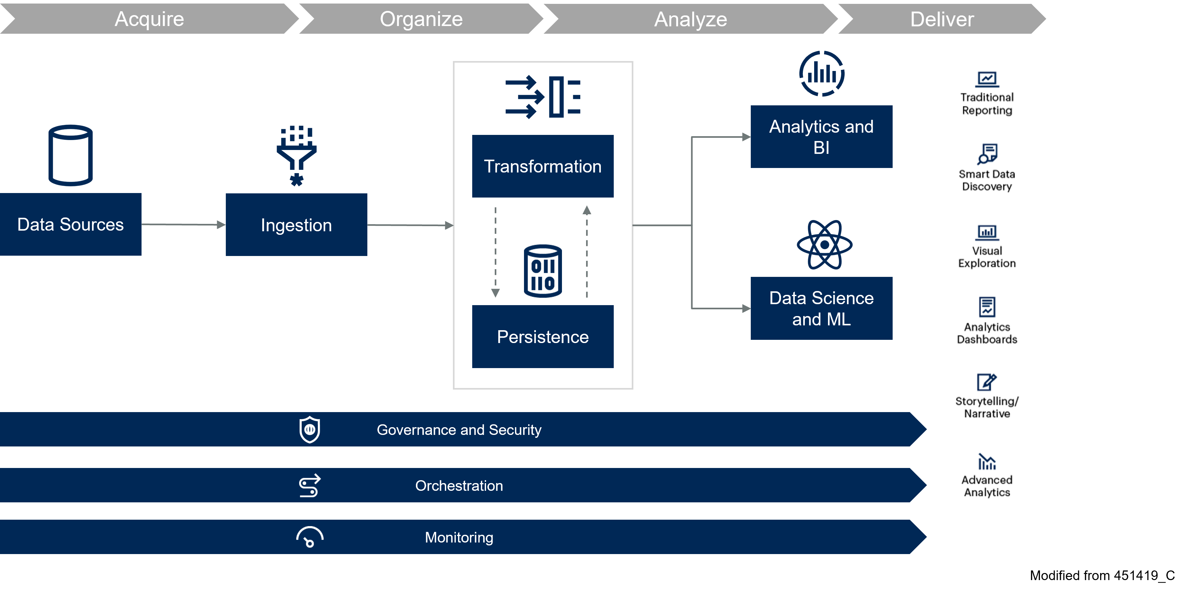
Figure 1

Slide 3
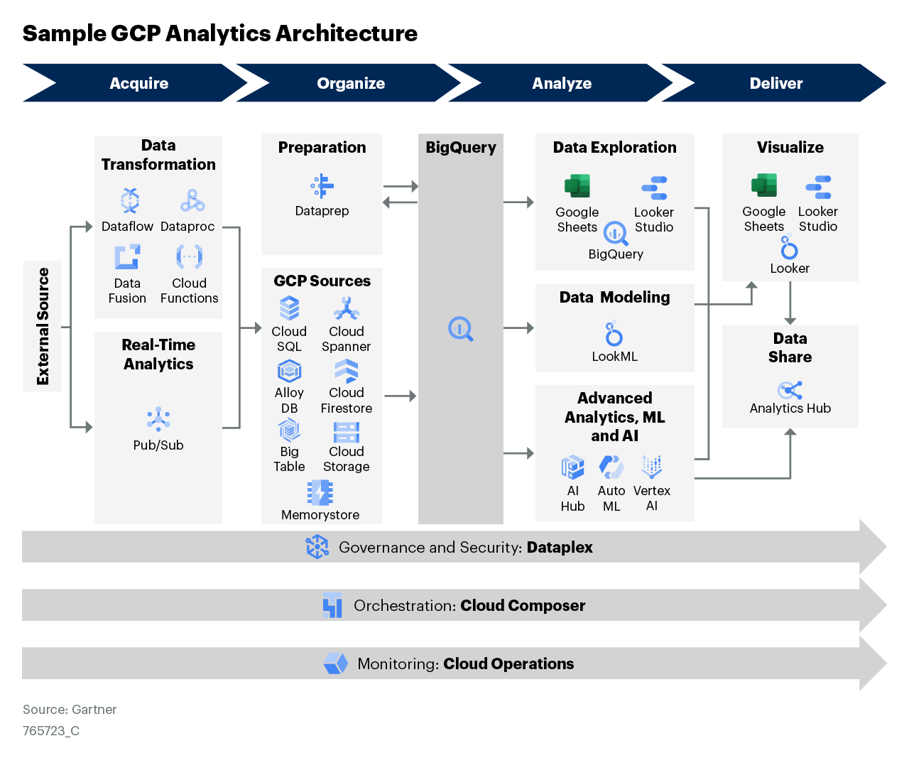
Figure 2

Slide 4
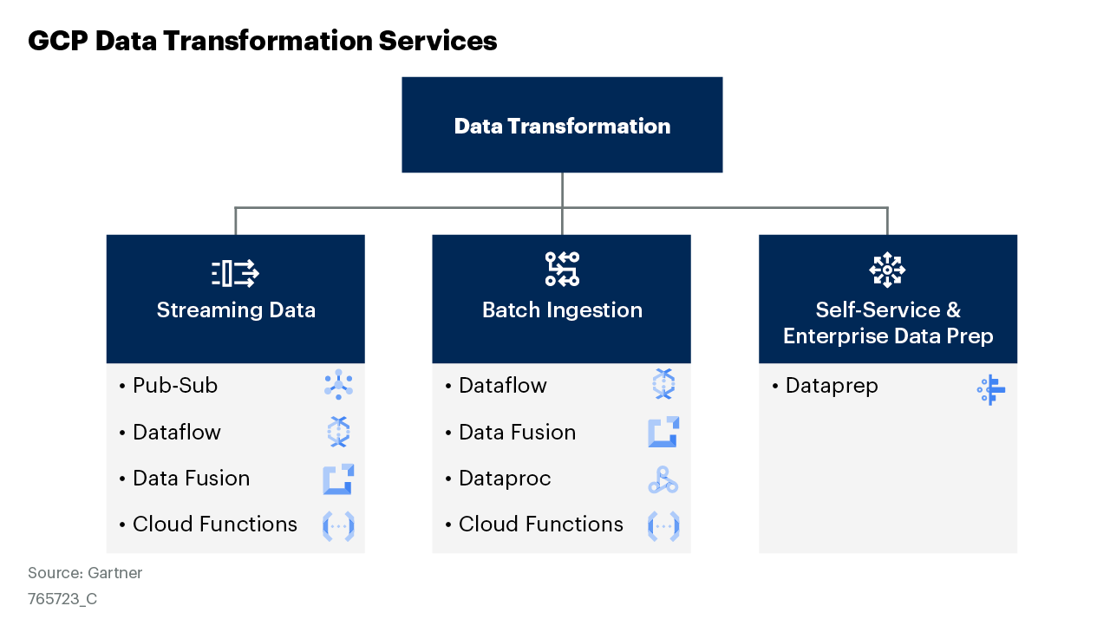
Figure 3

Slide 5
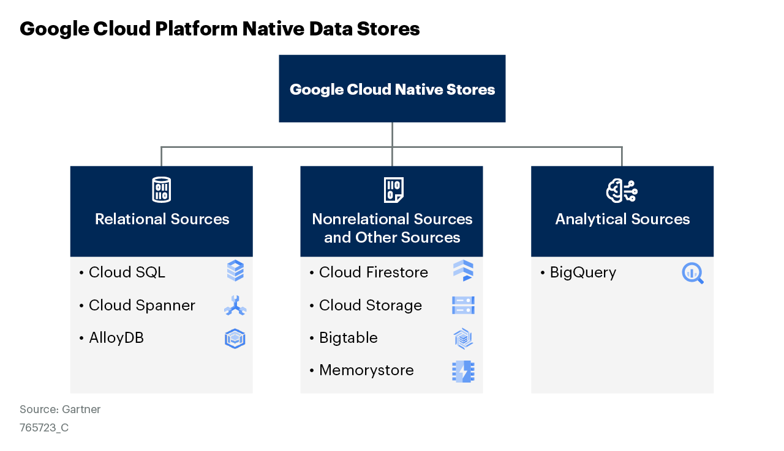
Figure 4

Slide 6
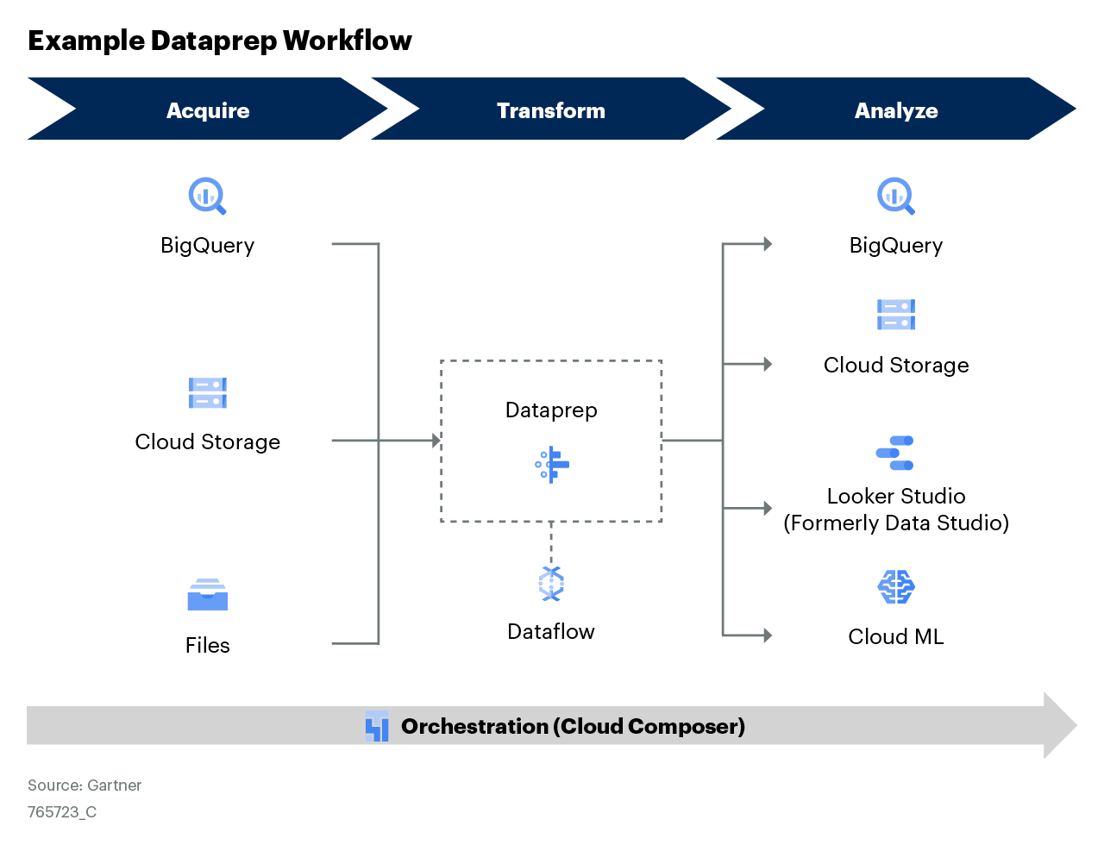
Figure 5

Slide 7
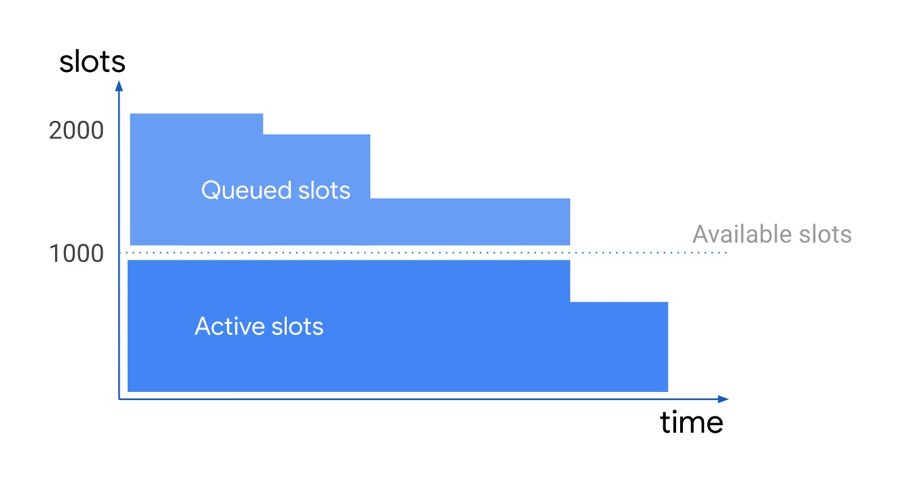
Figure 6

Slide 8
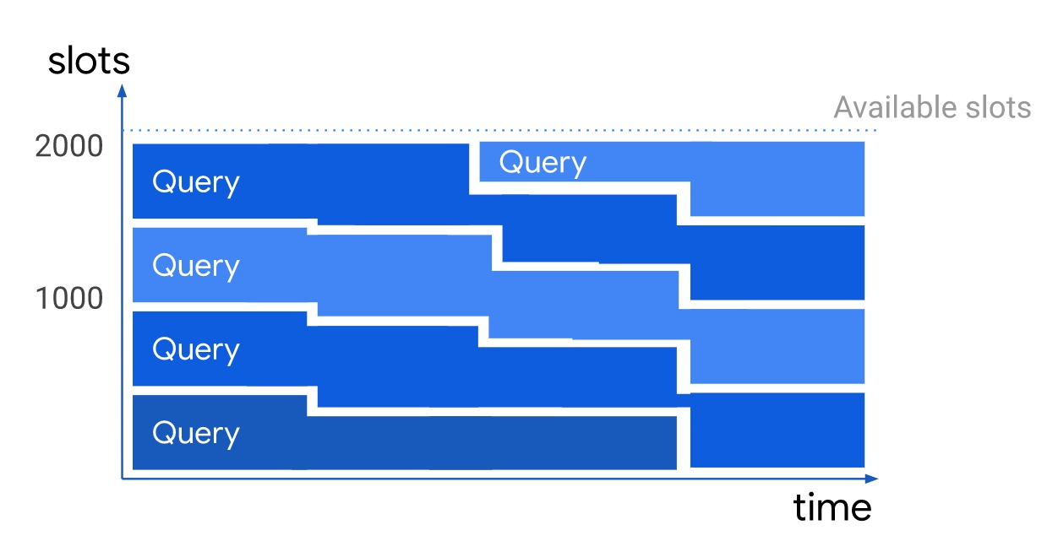
Figure 7

Slide 9
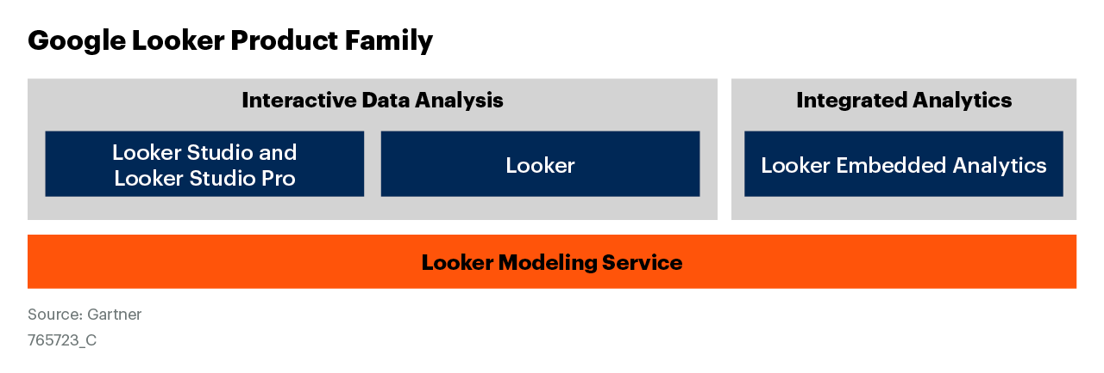
Figure 8

Slide 10
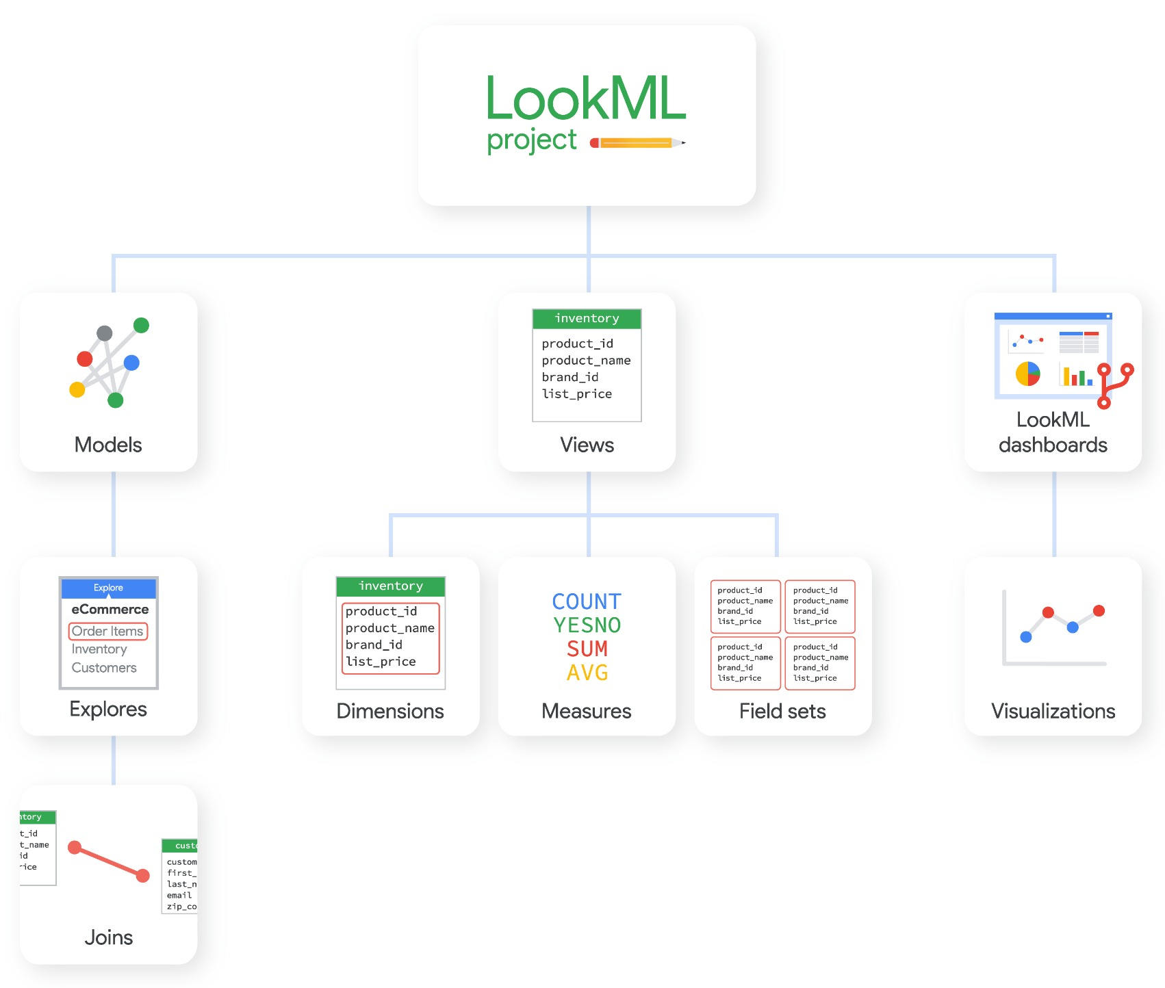
Figure 9

Slide 11
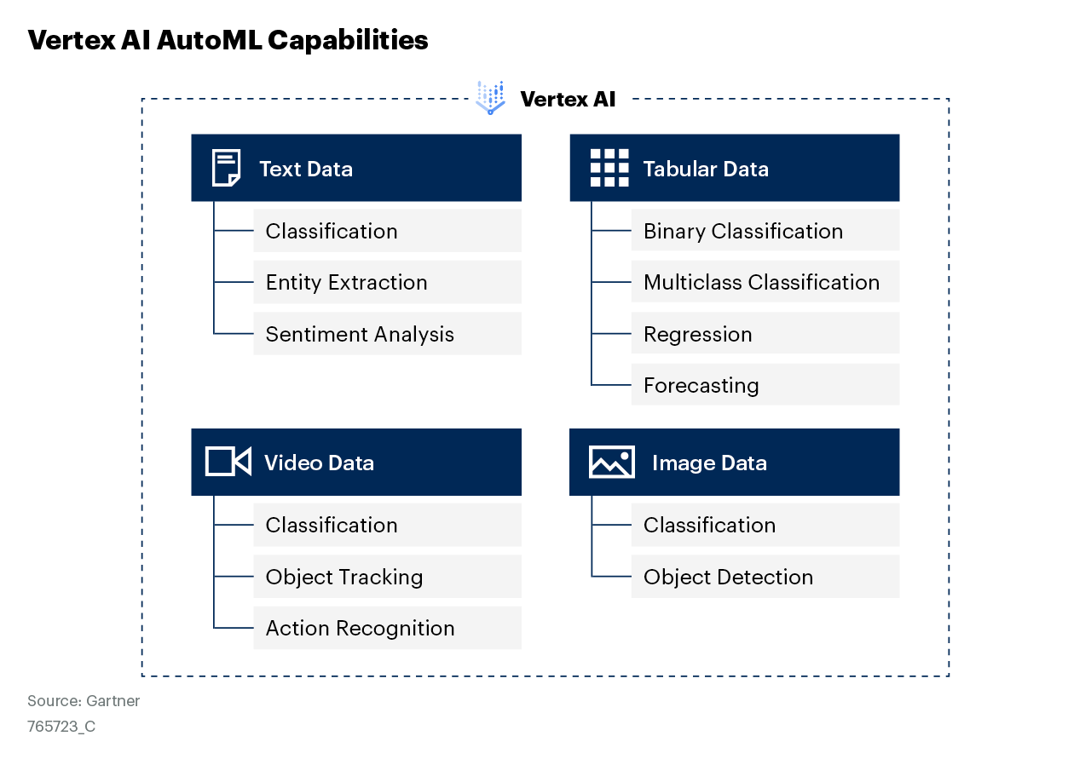
Figure 10

Slide 12
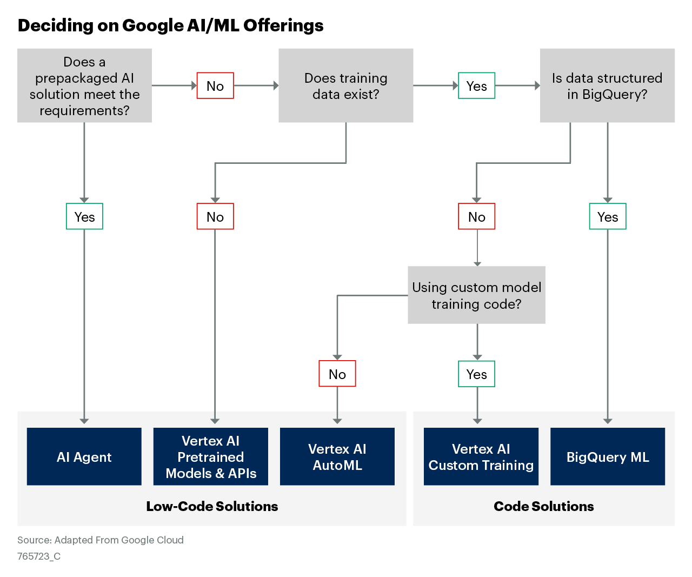
Figure 11

Slide 13
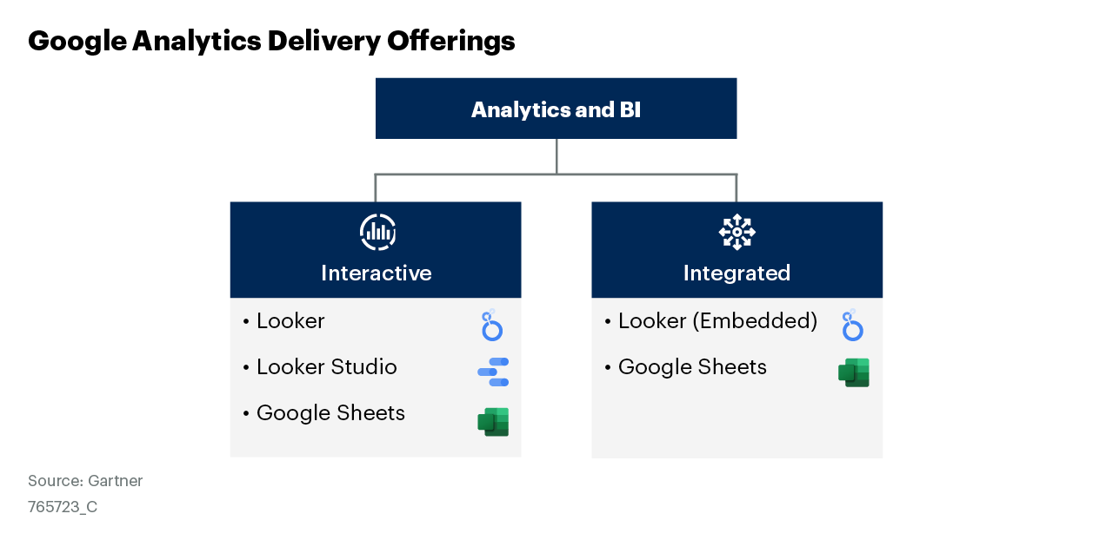
Figure 12

Slide 14
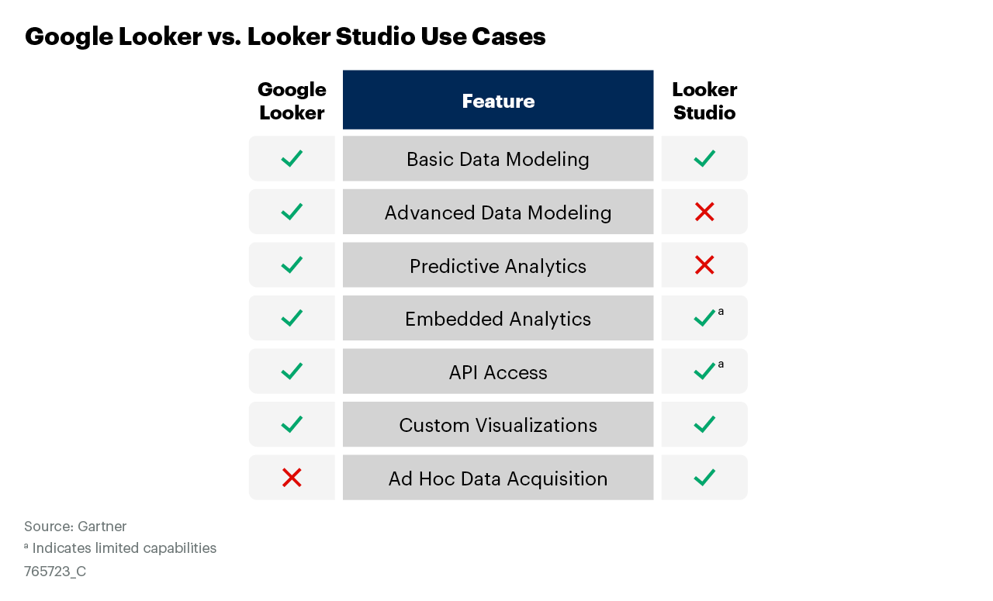
Figure 13

Slide 15
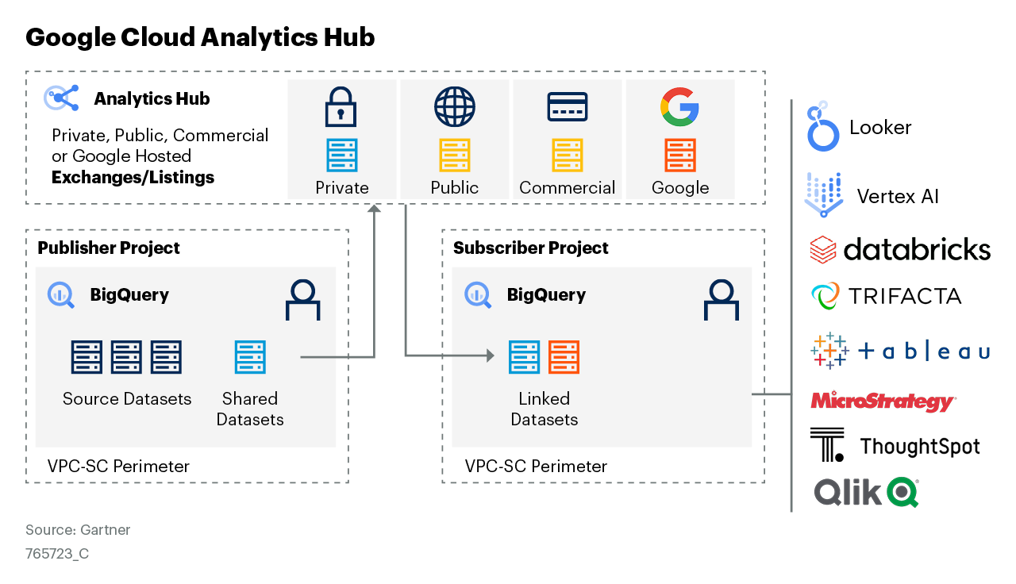
Figure 14

Slide 16
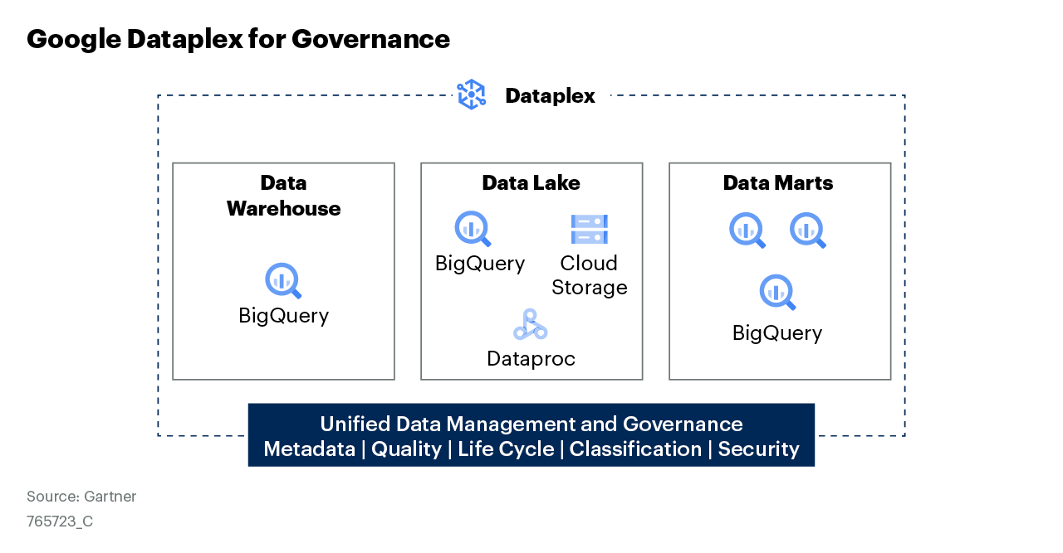
Figure 15

Slide 17
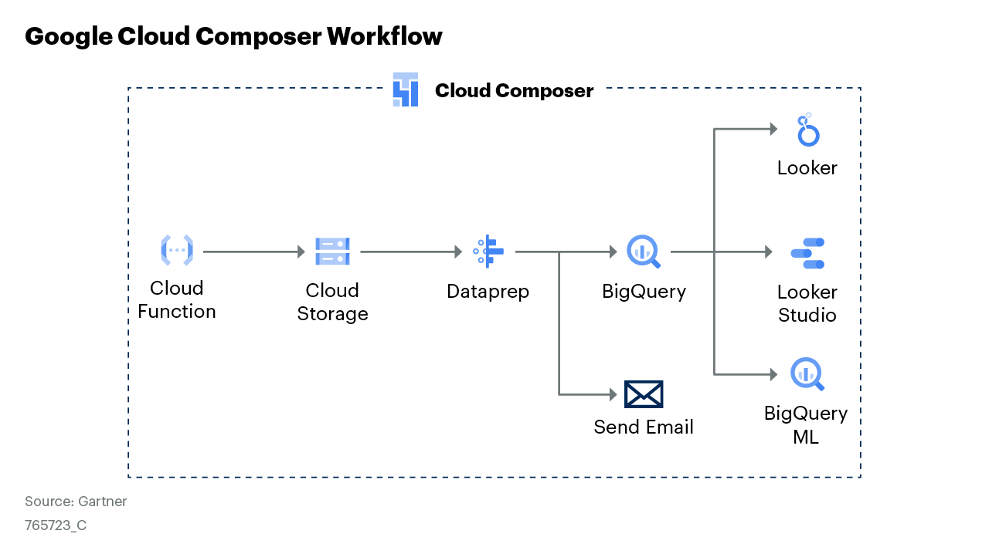
Figure 16

Slide 18
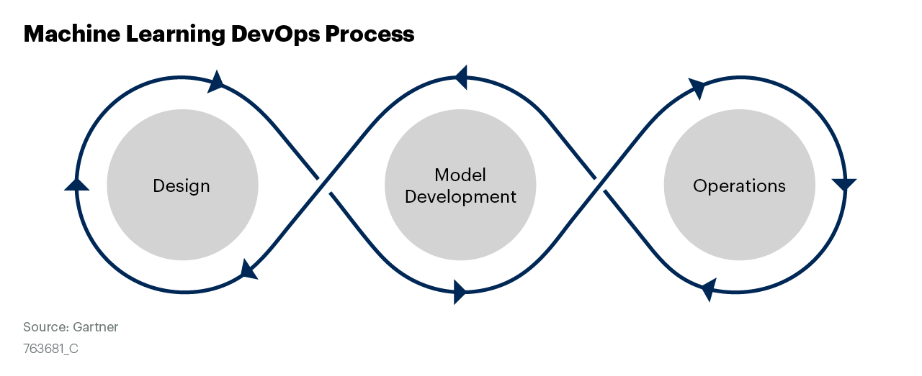
Figure 17

Slide 19
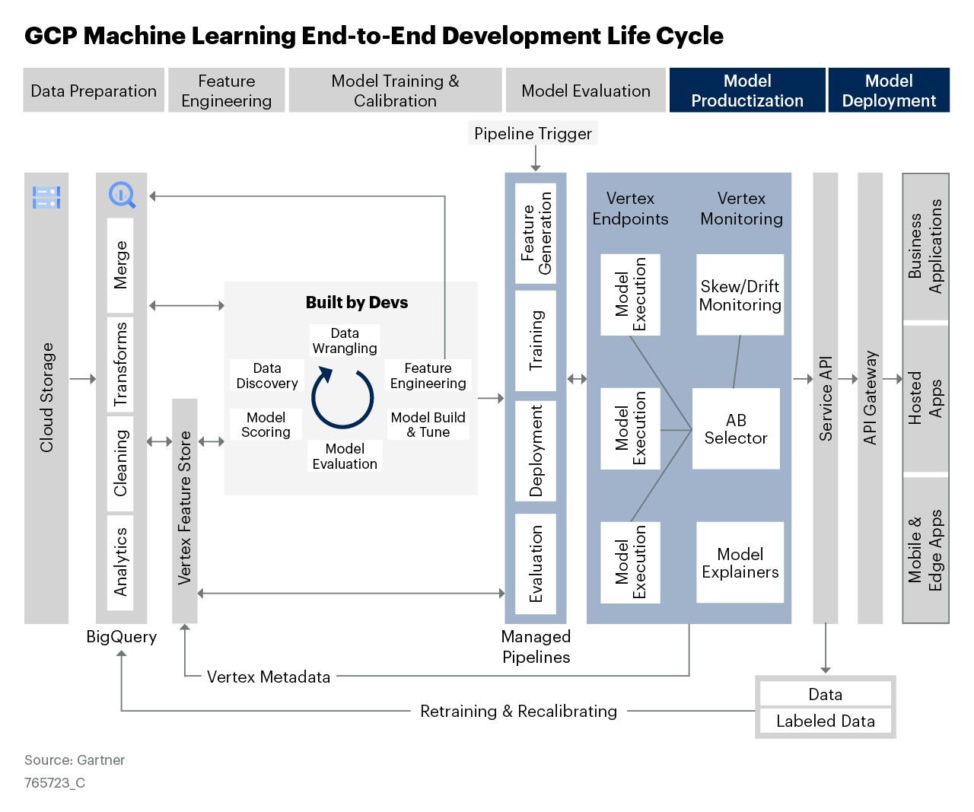
Figure 18

Slide 20
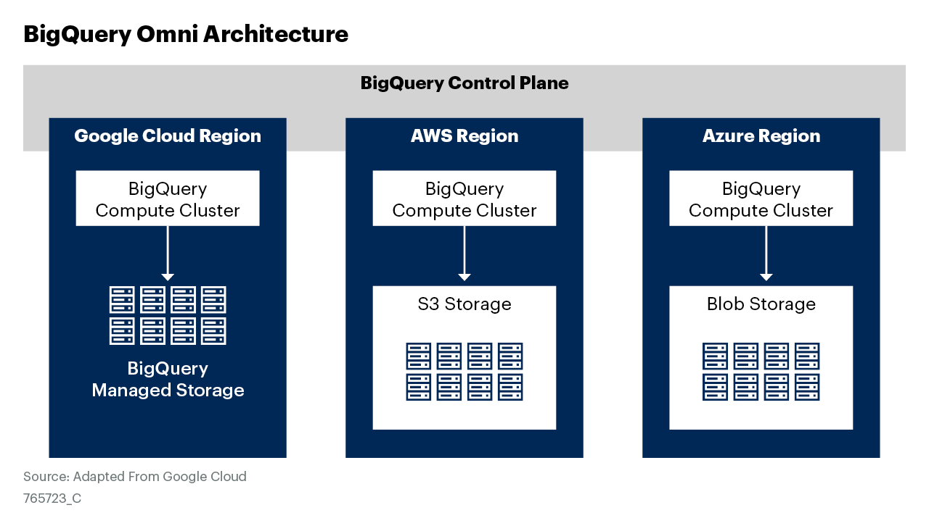
Figure 19

