Slide 1
IT Budget & Efficiency Benchmark
Practitioners Guide
Notes:
Presenter's Name
Presenter's Name

Slide 2

Overview
Recommended Sprints
Recommended Sprints
Gartner-recommended sprints to cover various business objectives
Add Text
Step-by-Step Instructions
Step-by-Step Instructions
Launch and Set Up Your Assessment Survey Delegation
IT Budget & Efficiency Benchmark Participation Guide
Use this document to help you complete the IT Budget & Efficiency Benchmark survey. This guide provides details on the mentioned topics.
Participation Process
Participation Process
Describes the step-by-step process included in the IT Budget and Efficiency Tool
It will be helpful, but you may need not to read each part of this guide before completing your survey; it is a reference guide. We do recommend reviewing slides 15 through 20 prior to beginning the benchmark. Please do not hesitate to contact us through the channels below if you have any questions throughout the survey process.
Have Questions?
Notify your service team
E-mail our team at inquiry@gartner.com

Slide 3
IT Budget & Efficiency Tool comprises Enterprise IT budget and IT Security Benchmarking Tool
IT Budget & Efficiency Tool
IT Enterprise
The IT Budget & Efficiency tool provides CIOs and their teams with self-assessment tools to benchmark their organization vs. published IT Key Metrics Data cohorts. Benchmark results help identify where smarter spending opportunities may exist to improve cost management practices.
IT Security
Provides a framework to define exactly what is included in IT security spending from a financial perspective and what is not. The framework also defines asset and operations distributions so you can understand what types of investments you are making.
Gartner IT Budget and IT Security Survey Tool

Slide 4
Participation Process
Notes:
Checked – Same as Reference

Slide 5
Participation Process
Step 1: Gather and
Enter Your Data
Step 2: Review and Finalize Your Data
Step 3: Review Your
Results
Step 4:
Take Action
Review step-by-step benchmark instructions
Delegate sections of the survey to peers to complete. Submit your response using our online tool
Ensure all survey warning messages are resolved
Check your responses against benchmark charts instantaneously
investigate potential data input issues or outlier results
Instantly interact with your results directly in our online tool
Reach out to your service team if you would like to contextualize your custom results with an industry expert
Build business case for action
Use results to pursue cost optimization efforts.
Ensure smarter budgeting for your company
Expert Support available upon Request:
Participation Support
Receive an overview of the assessment
Identify key stakeholders who will submit the survey and review results
Provide context/clarification around survey questions
Survey Response Quality Review
Review your submitted responses with our experts
Review potential outliers and missing data
Discuss peer group comparisons
Review calculated metrics
Results Delivery
Schedule a 30-minute report discussion to review results and discuss key findings
Subsequent calls can be scheduled with your team to start taking action based on results
Leverage Gartner’s vast resources to develop next steps
Request Expert Support?
Notify your service team
E-mail our team at inquiry@gartner.com

Slide 6







How difficult will it be?
Sponsorship
Make sure you have a project sponsor who can establish and communicate clear objectives.
Use the documentation
Leverage the Framework Document for Industry Measures
Check the FAQ
Some issues specific to industries or unique situations are covered in our FAQ document.
Self-Validation
You can see if your data “makes sense” by performing checks. Does your personnel spending divided by your IT staff FTEs come out to a reasonable
Project management
Assign a single, accountable project manager and project team.
Get help
Gartner experts perform hundreds of assessments. Contact your account team to get in touch.
Use estimates
It is ideal to be able to gather your data directly from your general ledger or accounting reports. Where you can’t, use estimates (Eg. FTEs)
Audit Trails
Keeping track of five assumptions and sources of data helps if you want to repeat the exercise in the future.
Source: Gartner (2023)

Slide 7
Step-by-Step Instructions Launch and Set Up Your Assessment
Notes:
Checked – Same as Reference

Slide 8
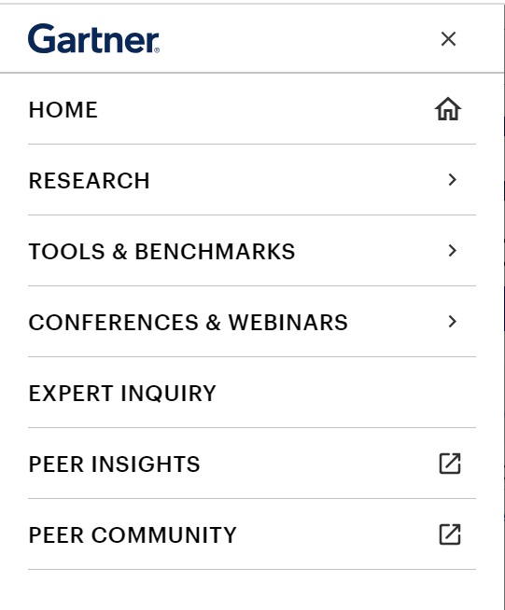
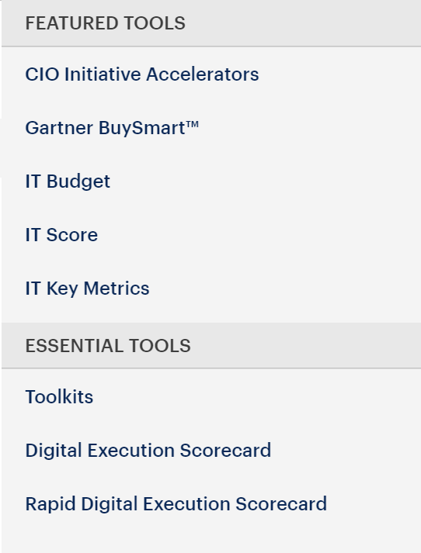
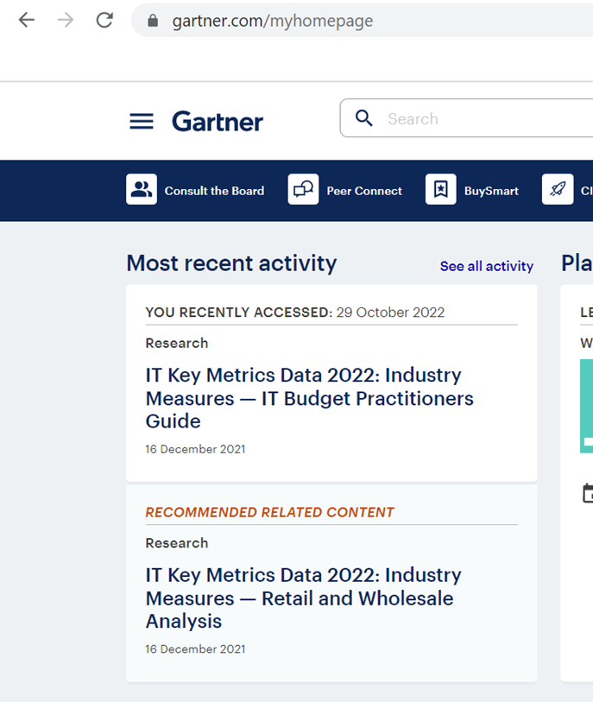
IT Budget Tool Location
Vanity-link- www.gartner.com/itbudget
Step 01
Step 02
Step 03
Select the bars near Gartner logo
Click on “Tools & Benchmarks”
Navigate Down To “IT Budget”

Slide 9
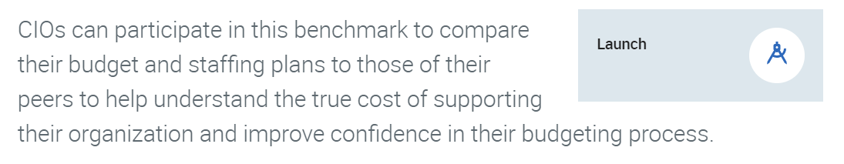
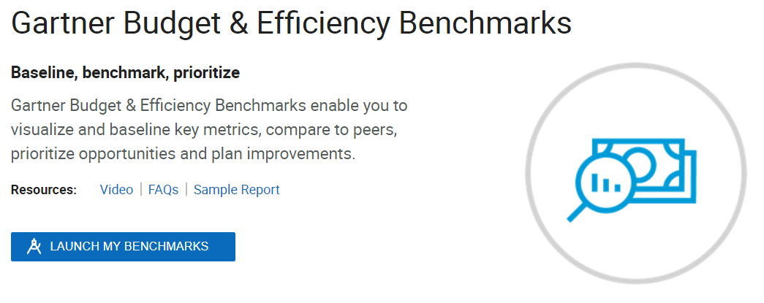
Launch and Set Up Your Assessment
Navigate to your Gartner Benchmarks homepage via Gartner.com.
Option 1:
Option 2:
Click on “Tools & Benchmark” in the list at the top left end of the page and select “IT Budget”.
The page will be redirected to “Gartner Budget & Efficiency Benchmarks.” Select “Launch My Benchmarks”.
Option 2: Search for the “IT Budget & Efficiency Benchmark” webpage and click “Launch”.
Note: Use the same navigation to return to in progress and completed benchmark assessments.

Slide 10
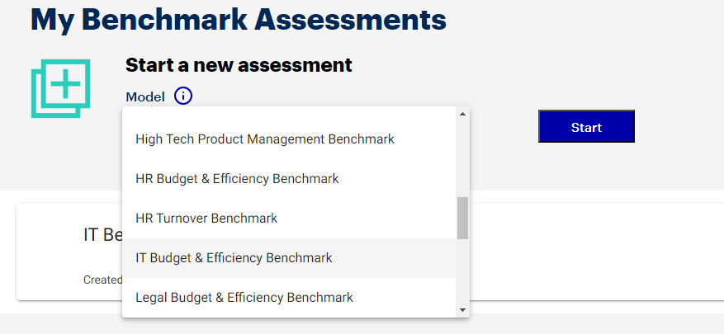
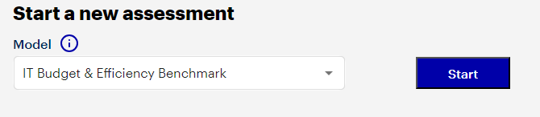
Launch and Set Up Your Assessment (Continued)
Input set up details.
From the drop-down list, select the option ‘End-User Services & Application Portfolio Budget & Efficiency Benchmark’
Click on “Start” to start a new assessment.

Slide 11
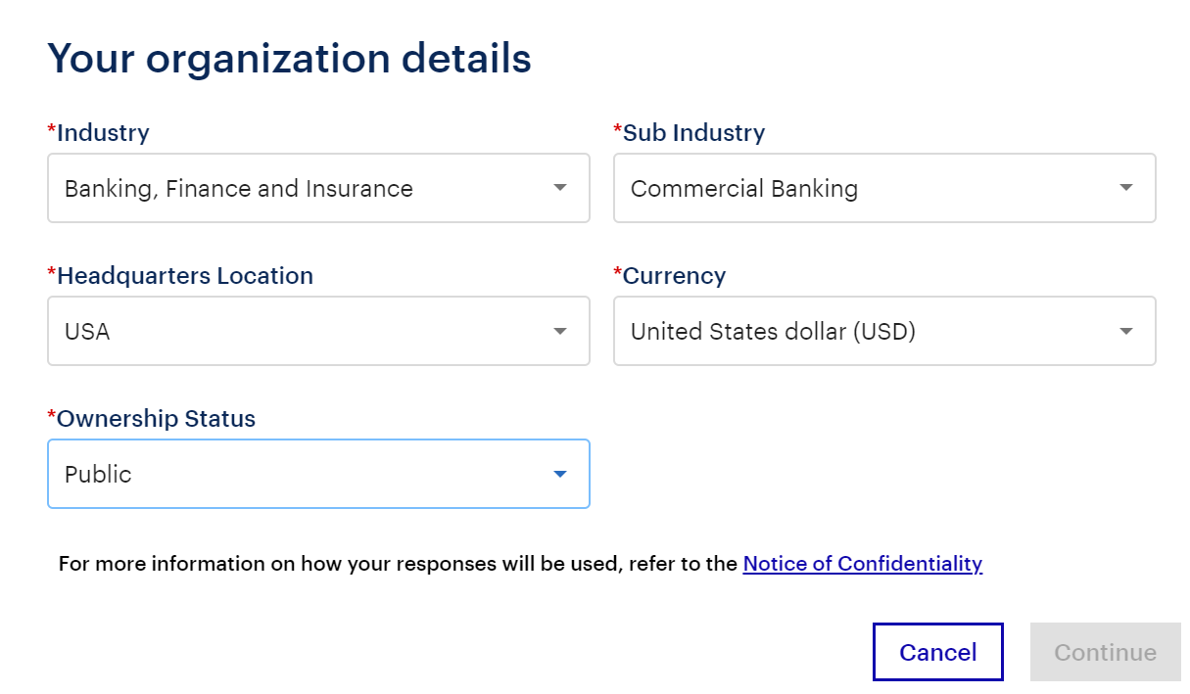
Launch and Set Up Your Assessment (Continued)
Input set up details (continued).
The industry selection here only represents the clients’ general Gartner industry classification. It does not represent peer selection which uses a different categorization scheme and is set on the digital results page.

Slide 12
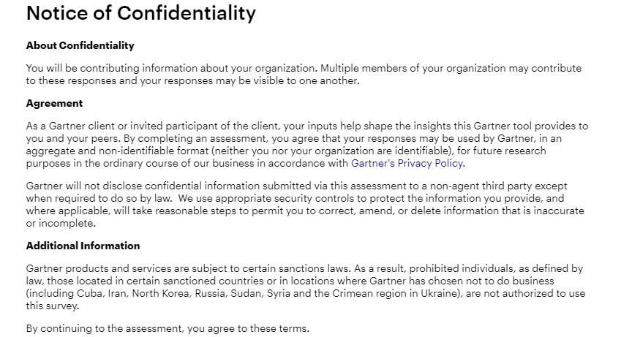
Launch and Set Up Your Assessment (Continued)
Agree to the standard Gartner Note of Confidentiality and Privacy Policy.

Slide 13
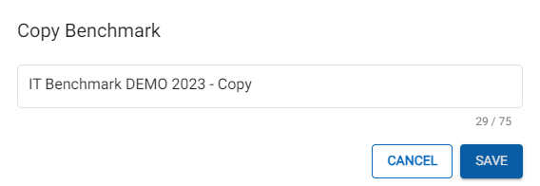
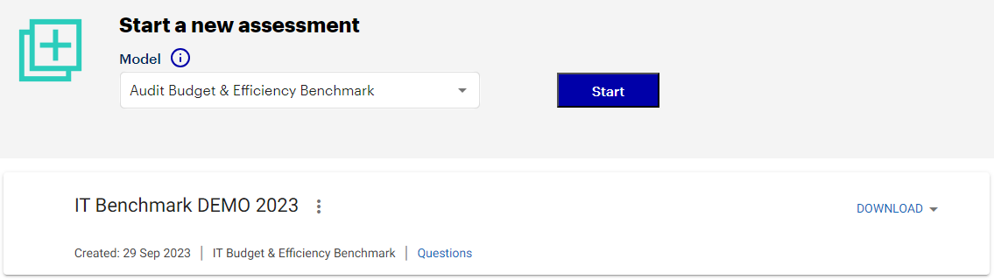
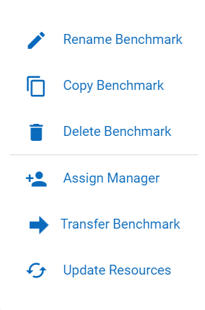
Create Additional Benchmark Assessments
You can complete a benchmark assessment for different scenarios based on changes to your organization’s demographic details or changes to functional resources:
1. Create a copy of your baseline assessment. Click the three vertical dots next to your assessment’s name and a menu will appear. Select “Copy Benchmark”. Do not overwrite your actual benchmark data.
2. Rename your new, copied assessment in the next step, describing the specific scenario and click save.
3. Make the necessary adjustments for your scenario to the copied benchmark assessment that will show under “My Benchmarks” and run a new report.
This name will appear on the first page of your report and allow you to identify your benchmark later.
When naming your benchmark, we recommend including descriptors that will indicate the point in time and content. This is especially important as you add more benchmarks in the years to come.

Slide 14

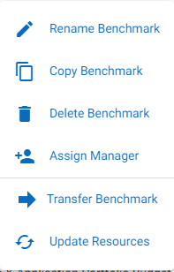
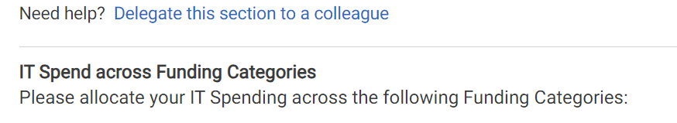
Survey Delegation
Although many clients complete the survey independently, there are three ways you can collaborate with your team.
1. Assign Manager | Assign an individual on your team to manage the question response input. This individual will have full access to the questions and the final benchmarking results.
2. Transfer Benchmark | Fully transfer ownership to an individual on your team. Common use cases include if you as the assessment owner are moving a new role or leaving the company. After doing so, you will no longer have access to the assessment.
3. Delegate Specific Sections | For support on individual sections of the survey, you can delegate the questions to an individual on your team. This individual will only have access to the questions delegated to them.
How to Assign Manager and Transfer Benchmark:
Click the three vertical dots next to your assessment’s name and a menu will appear. Select “Assign Manager” or “Transfer Benchmark” as needed. Note that in order to transfer a benchmark your team member must be an active Gartner client. Your assessment manager does not need to be an active Gartner client.
How to Delegate Specific Sections:
Once in the survey, open a specific module you wish to delegate and click “Delegate this section to a colleague”. This individual does not need to be an active Gartner client.

Slide 15
Recommended Sprints

Slide 16
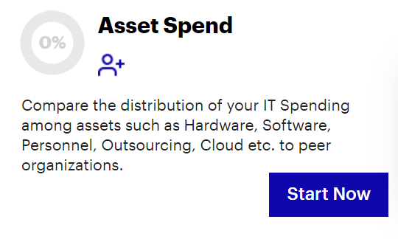
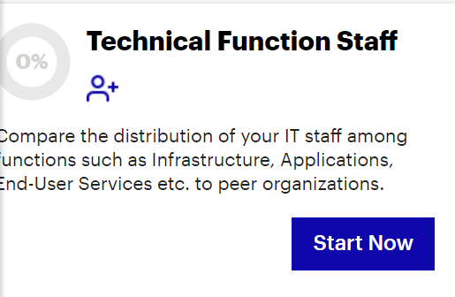
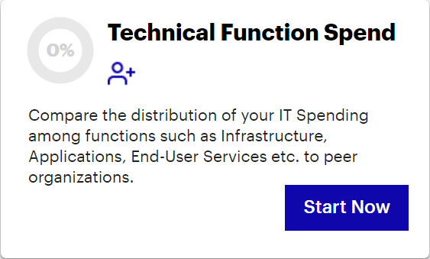
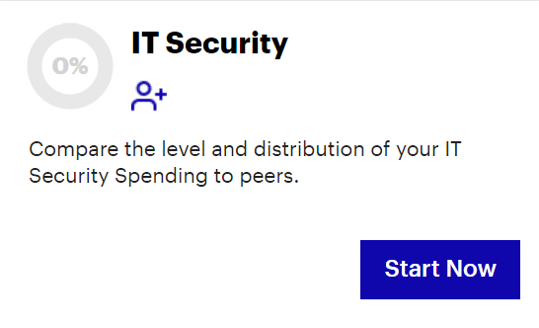
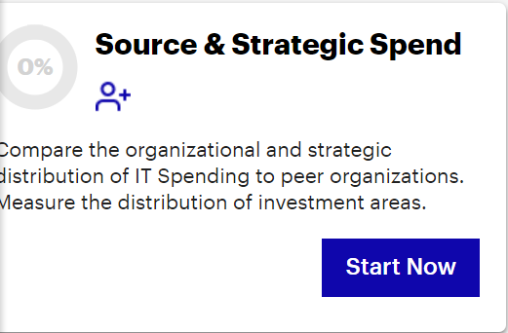
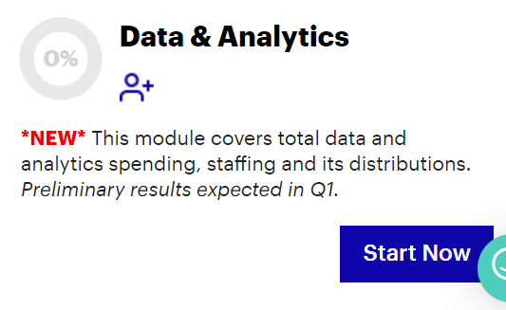

7 Sections under IT Budget Tool
3
4
2
5
1
Getting Started
6

Slide 17
7 Sections under IT Budget Tool - Significance
Getting Started
Source and Strategic Spend
IT Security
Technical Functional Spend
Asset Spend
Technical Function Staff
Data & Analytics
Significance
Significance
Significance
Significance
Significance
Significance
Significance
Determines what IT Spending and Staffing will be included in analysis (only that which matches the business scope)
The basis for all top-level IT efficiency and productivity metrics
The data entered here will be allocated in other tabs to create all of distribution metrics.
This exercise can help sharpen alignment with business perception around key investments
Can help IT articulate spending variances due to business change and implications of cost cutting.
Identifies deeper knowledge of the technology portfolio and highlight in-depth distribution around IT Technical Functions which signifies an overall IT Budget planning and execution
Aids in understanding allocation and possible tradeoffs between types of assets e.g., Hardware versus IaaS, Personnel versus Traditional Outsourcing, Traditional Software vs SaaS
Understanding of the types of functions where human capital is leveraged.
Can aid in analysis around distribution of resources and/or sourcing decisions.
Insight into relative level of security investment relative to Total IT, Employees and Revenue.
Understanding of types of investments e.g. firewalls/anti-virus vs Vulnerability/ Analytics
Understanding of Data & Analytics investments done relative to Total IT spend
Insights on software spend like DBMS, middleware, data management software, and analytics applications along with personnel and traditional outsourcing spend
Benchmark data will be available after Q1

Slide 18


Ways to Leverage Results
The IT Budget Tool has 7 different modules which gives you the flexibility to cover only areas you want to assess.*
First section Getting Started is compulsory.
With the help of Recommended Journeys (on the next slide), CIOs can achieve their objectives.
The questions and distributions in each module is categorized as Level 1 and Level 2.
It is recommended you take all the Level 1 questions. At the same time, diving into Level 2 questions will improve data quality and help you get granular results and benchmarks.
*Getting Started section being mandatory

Slide 19
Recommended Journeys (1/3)
The IT Budget tool can be completed incrementally at different times by choosing different journeys. We recommend the below journeys/ sprints to shape your digital business optimization and transformation journey in order to achieve your strategic business outcomes.
Objectives
Description
Journey (Sections to Cover)
This will deliver high level benchmarks to establish a baseline. Additional detail can be added later to enhance your results and opportunities.
Getting Started > Source and Strategic Spend
> Asset Spend/ Technical Function Staff
Establish Baseline
Getting Started
Source and Strategic Spend
Technical Functional Spend
Asset Spend
Technical Function Staff
IT Security
Data & Analytics
Align to Business
To get strategic & project spend peer comparisons chose this journey.
Getting Started > Source and Strategic Spend
Getting Started
Source and Strategic Spend
Technical Functional Spend
Asset Spend
Technical Function Staff
IT Security
Data & Analytics
Sections to Cover

Slide 20
Recommended Journeys (2/3)
The IT Budget tool can be completed incrementally at different times by choosing different journeys. We recommend the below journeys/ sprints to shape your digital business optimization and transformation journey in order to achieve your strategic business outcomes.
Objectives
Description
Journey (Sections to Cover)
For IT Security comparisons, opt for this journey.
Getting Started > Source and Strategic Spend > IT Security
Measure IT Security
Getting Started
Source and Strategic Spend
Technical Functional Spend
Asset Spend
Technical Function Staff
IT Security
Data & Analytics
Cut Costs or Optimize Spend
To get asset spend, functional spend and staffing comparisons, opt for this journey.
Getting Started > Source and Strategic Spend >Technical Functional Spend >Asset Spend > Technical Function Staff
Getting Started
Source and Strategic Spend
Technical Functional Spend
Asset Spend
Technical Function Staff
IT Security
Data & Analytics
Sections to Cover

Slide 21
Recommended Journeys (3/3)
The IT Budget tool can be completed incrementally at different times by choosing different journeys. We recommend the below journeys/ sprints to shape your digital business optimization and transformation journey in order to achieve your strategic business outcomes.
Objectives
Description
Journey (Sections to Cover)
This includes all spend and staffing peer comparisons.
Getting Started > Source and Strategic Spend > Asset Spend > Technical Function Spend > Technical Function Staff
Invest to Grow
Getting Started
Source and Strategic Spend
Technical Functional Spend
Asset Spend
Technical Function Staff
IT Security
Data & Analytics
Sections to Cover

Slide 22
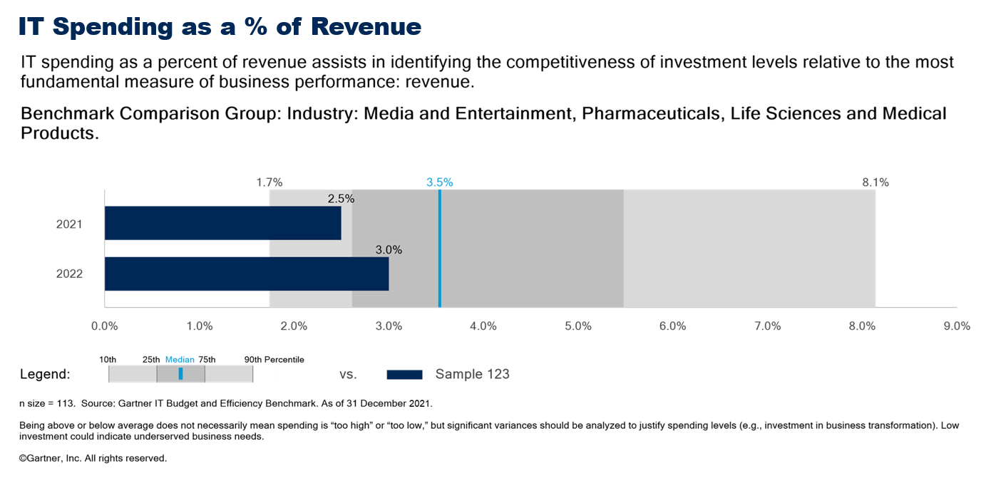
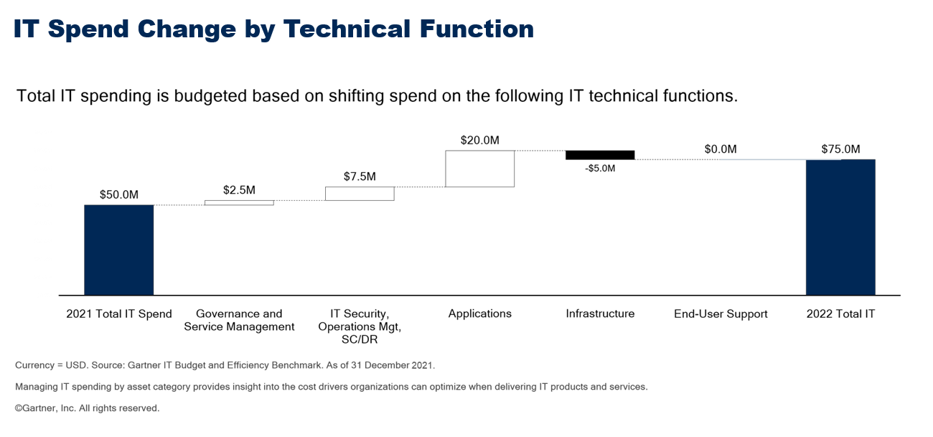
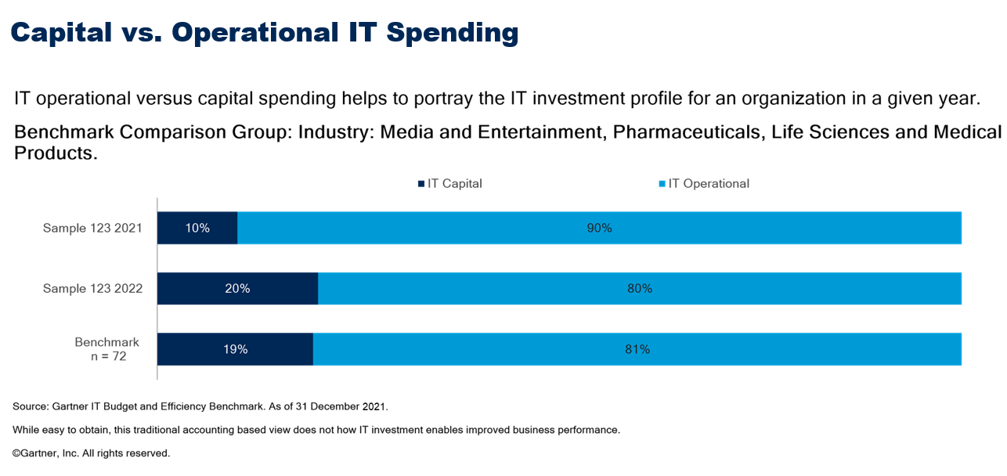
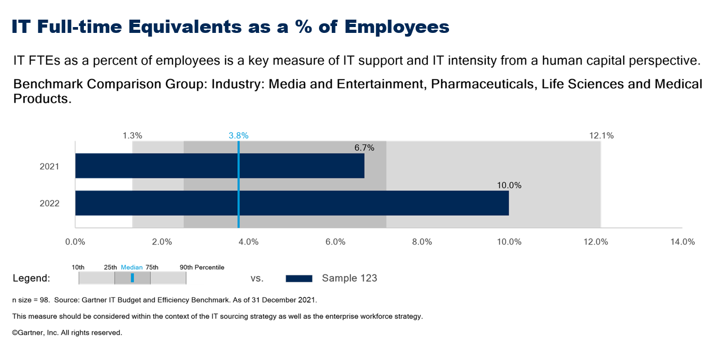
Sample report
What does the output look like?
Source: Gartner (2023)

Slide 23
Recommended Readings
1
IT Budget & Efficiency Benchmark Application
2
IT Key Metrics Data 2024: Industry Measures — Framework Definitions
Additional Readings
3
IT Key Metrics Data 2024: Industry Measures — IT Budget Next Steps
4
IT Key Metrics Data 2024: Definition of Industries

