Slide 1
Tool: The CTO’s Guide to CxO Partnerships: How CTOs and CDAOs Can Build Collaborative Relationships
Ankita Khilare, Samantha Searle and Melissa Davis
Notes:
Ver 2022-1208
Presenter's Name
Presenter's Name

Slide 2




How Effective are CTO-CDAO Partnerships?
Conclusions:
CTOs and CDAOs can work effectively together.
CTOs and CDAOs do not work together in all organizations.
CDAOs could engage CTOs more to advise on D&A strategy development.
An effective CTO-CDAO partnership is critical to leveraging data as a strategic organizational asset.
30% of CTOs work regularly (at least monthly) with CDAOs.¹
From those CTOs, 71% said their relationship with the CDAO was effective or highly effective.¹
Only 17% of CTOs have influence on D&A strategy development.²
40% of CDAOs are highly effective at contributing to the agendas of other CxOs.²
1. Results taken from Gartner’s 2023 “The Changing Role of the CTO Function” Survey
2. Results taken from Gartner’s 2023 CDAO Agenda Survey
Notes:
Context: This slide highlights some key data from survey results for CTO-CDAO partnerships and areas of collaboration. CTO and CDAO can collaborate effectively in various aspects of technology strategy and D&A initiatives. They should leverage this partnership guide to establish a symbiotic relationship.

Slide 3
Six Steps to Building CTO and CDAO Partnerships
This guide will help CTOs building collaborative relationships with CDAOs.
It outlines six steps to kick-off CTO-CDAO partnership discussions as follows
Create Action Plan and
Set up Regular Check-Ins
1
6
Establish Shared Priorities
Define Shared Outcomes and Metrics
5
2
Identify Common Challenges That You Can Tackle Together
Leverage Governance To Avoid Conflicts
4
3
Determine Activities To Collaborate on

Slide 4
Step 1: Establish Shared Priorities

Slide 5

Questions for CTOs and CDAOs to Ask Each Other to Identify Common Priorities
What is going well (and not so well)?
What are your aspirations (for next six months, 12 months and 24 months)?
How do you see yourselves as contributors to enterprise-level goals?
What technology and operational obstacles prevent you from achieving your business goals?
What can the CTO do to enable you to develop technology solutions for the business, autonomously?
What can the CDAO do to improve data quality for technology innovation projects (especially with training data for AI models)?
What can the CDAO do to explore opportunities for data monetization with new technology?
Notes:
Context: CTOs and CDAOs need to identify common priorities for identifying the collaboration activities. Use these questions to initiate the discussion around individual aspirations, goals and challenges in order to explore collaboration opportunities.

Slide 6
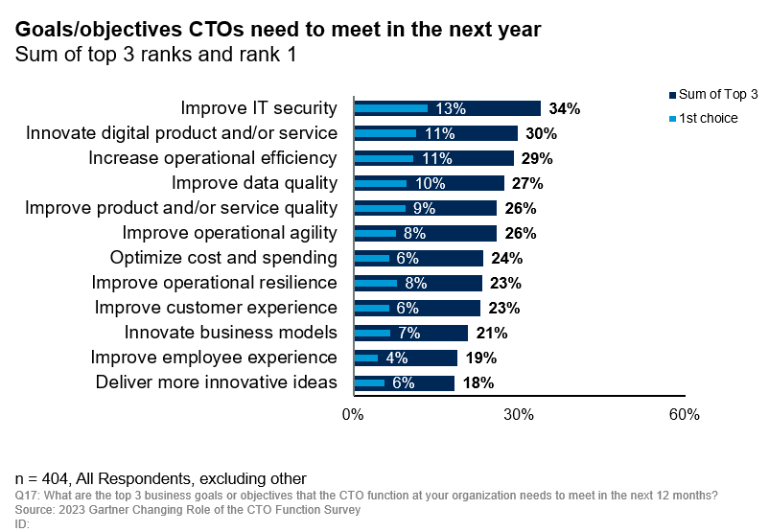
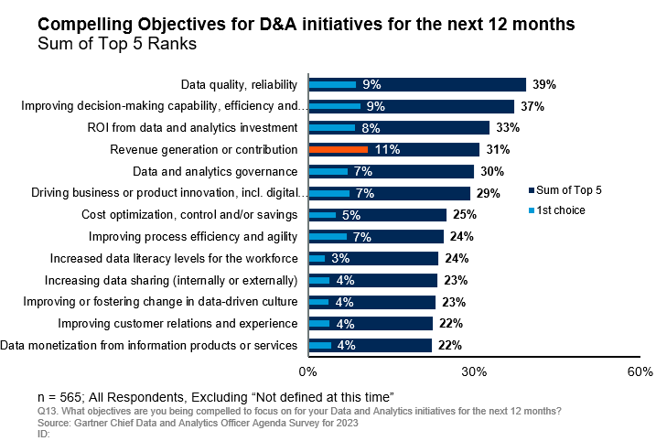
Examples of CTO and CDAO Key Priorities
Common priorities for CTOs and CDAOs include product innovation, data quality, operational efficiency and agility and customer experience
CTO Priorities
CDAO Priorities
Notes:
Context: This slide represents the key priorities for CTOs and CDAOs. They must vet these priorities in order find the synergies and define the action plan for achieving those.

Slide 7
Identify Shared Priorities
Action: Document your shared priorities with the CDAO
CDAO CTO | Priority #1 e.g. Improve data quality | Priority #2 e.g. Digital product innovation | Priority #3 e.g. Cost Optimization | Priority #4 e.g. Improve customer experience | Priority #5 e.g. Improve process efficiency and agility
Priority #1 e.g. Technology innovation |  | ✔
Priority #2 e.g. Cost Optimization |  |  | ✔
Priority #3 e.g. Improve operational efficiency |  |  |  |  | ✔
Priority #4 e.g. Improve data quality | ✔
Priority #5 e.g. Improve customer experience |  |  |  | ✔
Notes:
Context: The slide provides a sample roster for documenting shared priorities.
Instructions for customization: Use this template to list down individual priorities and identify points of intersection to identify common priorities to work on.

Slide 8
Step 2: Identify Common Challenges That You Can Tackle Together

Slide 9
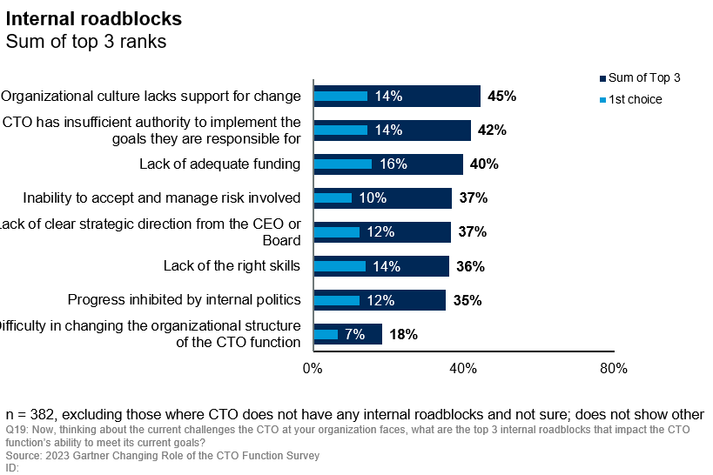
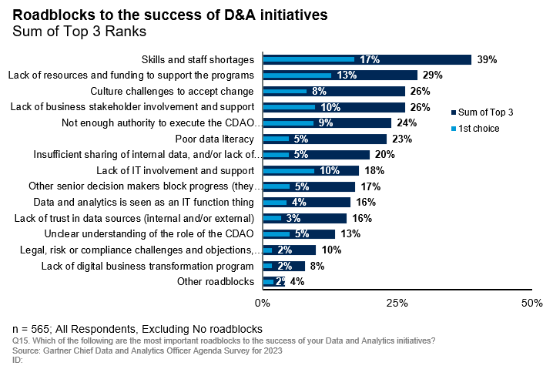
Top Roadblocks Faced by CTOs and CDAOs
They both face challenges with cultural change, insufficient authority to execute, skills shortages and inadequate funding
CTO Top 3 Roadblocks
CDAO Top 3 Roadblocks
Notes:
Context: This slide highlights data points from survey results regarding the key challenges faced by CTO and CDAO operations.

Slide 10
Decide What Actions to Take to Address Common Challenges Together (Example)
Common Challenges | Action Required
Skills and Staff Shortage | Develop compelling EVP to attract, develop and retain talent
Cultural Challenges | Developing innovation program to boost innovation culture Improve data literacy Collaboration and DEI
Lack of adequate funding | Link Tech and D&A initiatives to business strategy
Stakeholder involvement | Address the “What’s in it for me” scenario for those stakeholders Stakeholder impact map
Authority to execute individual responsibilities | Clarify governance by creating decision-rights matrix
Notes:
Context: The slide shows some of the common challenges faced by CTO and CDAO and recommended actions to tackle them.

Slide 11
Template: Note Common Challenges That You Can Tackle Together
Action: Use the table below to highlight the common areas of challenges and required action to resolve them
Common Challenges | Action Required
Notes:
Instructions for Customization: Use this template to highlight the common areas of challenges and required action to resolve them.

Slide 12
Step 3: Determine Activities to Collaborate On

Slide 13
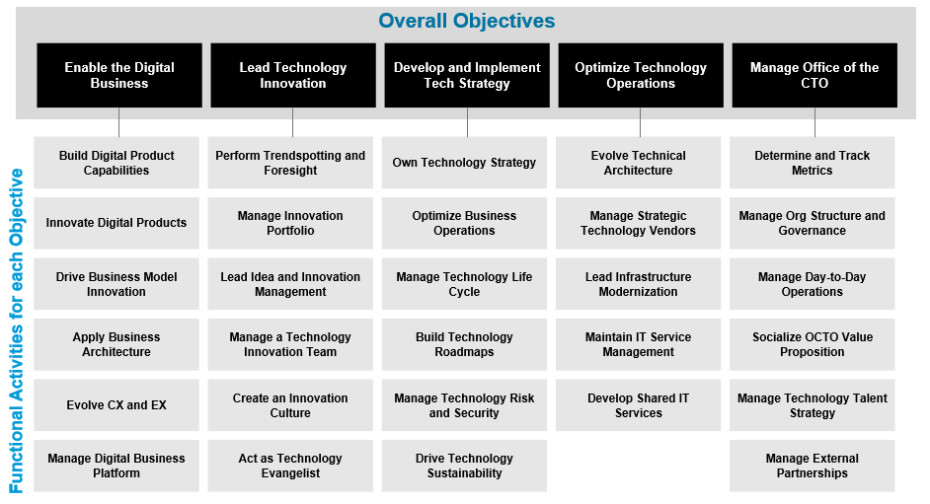
Key Activities That CTO Is Responsible For
ACTION: CTOs should use this slide as a discussion point with the CDAO to identify common activities
Notes:
Context: The slide highlights the key objectives and respective functional activities for the CTOs. CTOs should refer this slide as a discussion point with the CDAO to identify common activities.

Slide 14
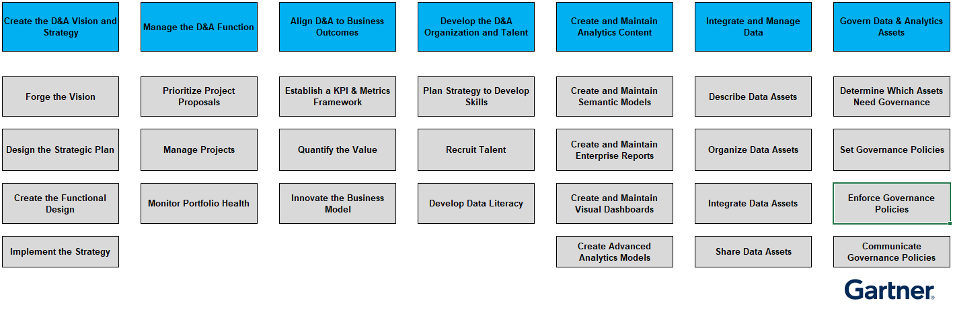
Key Activities That CDAO Is Responsible For
ACTION: CDAOs should use this slide as a discussion point with the CTO to identify common activities
Notes:
Context: This slide highlights the key activities for CDAOs. CDAOs should refer this slide as a discussion point with the CTO to identify common activities.

Slide 15
Examples of Activities That CTOs and CDAOs Can Collaborate On
Key:
CTO Activities
CDAO Activities
Own Technology Strategy and Create Roadmaps
Create an Actionable D&A Strategy
Identify Business and Emerging Technology Trends
Perform Trendspotting and Continuous Foresight
Evolve Technical Architecture
Integrate and Manage Data Architecture
Lead Ideation and Innovation Management
Innovate the Business Model
Lead Infrastructure Modernization
Create an innovation culture
Drive Culture Change to Support Data-Driven Decisions
Manage Evolution of Digital Business Platform
Scale D&A Platforms and Ecosystems
Notes:
Context: The slide depicts key areas where CTO and CDAOs have synergies to actively collaborate for achieving business outcomes. Most activities are taken from Gartner’s ITScore for CTO and ITScore for Data and Analytics models

Slide 16
Map Common Activities to Your Shared Priorities (Example)
Shared Priorities | Activities | Measurable business outcome
Contribution to revenue through leveraging AI | CTO: Lead technology innovation CDAO: Driving data-driven business innovation and monetization opportunities | ROI from D&A initiatives Business process automation
Operational excellence and ROI on technology investment | CTO: Prove efficiency of IT and/or business operations and value derived from technology investments CDAO: Drive execution of steady, pragmatic business value through applied insight, leveraging D&A platforms | Operational efficiency Cost optimization
Empower employees to innovate through data-driven decision making | CTO: Create a culture of innovation CDAO: Lead the orchestration of the change to a data-driven culture | Data literacy Innovation pipeline
Notes:
Context: After discussing the individual aspirations and priorities, identify the shared priorities and determine individual responsibility for achieving them.
This slide provides an example of shared priorities and individual activities/responsibilities.

Slide 17
Template: Map Common Activities to Your Shared Priorities
Action: Use the table below to highlight top shared priorities and decide the individual responsibilities
Shared Priorities | Activities | Measurable business outcome
#Priority 1 | CTO Responsibility CDAO Responsibility | Shared, measurable business outcome
#Priority 2 | CTO Responsibility CDAO Responsibility
Notes:
Instructions for Customization: Use this template to highlight top shared priorities and determine individual responsibilities for achieving them.

Slide 18
Step 4: Leverage Governance to Avoid Conflicts

Slide 19
Step 4a: Expose Any Areas of Potential Conflict and Identify Solutions (Examples)
Potential Conflict | Proposed Solution
The CTO responsible for AI engineering teams finds that their AI models lack good quality data to use as training data | Work with the CDAO on improving data quality and removing any biases from the data set
The CTO need access to personally identifiable data to improve customer-facing digital products, but this might conflict with data protection regulations | Ask the CDAO to provide synthetic data that is representative of the customer population
The CDAO needs to embed governance in digital platforms to IT Score facilitate self-service access for business stakeholders | Work with the CTO to build and architect a cloud-native data infrastructure that is secure and compliant
The CDAO needs to roll out a data visualization tool for the organization | Collaborate with the CTO on tool selection, data quality and technical rollout
Notes:
Context: Governance issues or conflicts arise when no one owns something or both the roles think they own it! Identify these areas and key actions to avoid these conflicts.
The slide highlights some examples of potential conflict areas and solution to overcome them.

Slide 20
Template: Record Any Areas of Potential Conflict and Identify Solutions
Action: Use the table below to note any potential areas of conflict and propose how to resolve them
Potential Conflict | Proposed Solution
Notes:
Instructions for Customization: Use this template to note any potential areas of conflict and propose the resolution.

Slide 21
Step 4b: Set Up a Decision Rights Matrix to Avoid Conflict (Example)
Activity or Decision or Deliverable | CTO | CDAO
Develop enterprise technology strategy | Accountable | Consulted
Define D&A strategy | Consulted | Accountable
Build digital business platform | Accountable for entire platform | Responsible for D&A platform
Evolve enterprise architecture | Accountable (EA team responsible for EA deliverables) | Responsible for data architecture and ensuring alignment with EA
Improve digital products | Consulted | Accountable
Trendspotting analysis and emerging technology radars | Accountable | Consulted on trends relevant to D&A strategy
Notes:
Context: The best way to avoid these conflicts in future is to establish proper governance rights.
At CxO level, most decisions will either be accountable or consulted, as direct reports will have certain tasks e.g. EA delegated to them, so they are responsible for performing that task, but CTO/CxO retains accountability. Similarly, CTOs and CxOs will often be consulted but then inform their direct reports of decisions. Exceptions are CEO setting strategy, announcing M&A etc. and CFO setting budgets.

Slide 22
Template: Decision Rights Matrix
Action: Agree decision rights for the activities or deliverables you will work on together and document them below.
Activity or Decision or Deliverable | CTO | CDAO
Notes:
Instructions for Customization: Use this template to create a decision matrix which while clearly highlight the owners for particular action item/decision.

Slide 23
Step 5: Define Shared Outcomes and Metrics

Slide 24

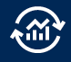

Measure Shared Digital Business Outcomes
The Primary Value Drivers for All Businesses
‸‸
1
Create metrics to measure impact on primary value drivers.
Cost Savings
2
Align business and technology outcomes to the drivers.
3
Connect value to outcomes to metrics in a taxonomy that supports better business decision making for priorities and investments.
Revenue Growth
Risk Reduction
Notes:
Context: People often measure what they can measure, not what they should measure!
Recognize the difference between technology outcomes like 90% of apps moved to the cloud in 12months and business outcomes like 80% customer retention over 6 months
Operational IT metrics are disconnected from business outcomes! Need to make a link between tech investment, innovation and DB outcomes
THIS IS CRITICAL BECAUSE THE CTO WILL ONLY GAIN CREDIBILITY AND INFLUENCE WITH OTHER CxOs IF THEY DELIVER RESULTS!!!
Think in terms of VALUE DRIVERS that influence outcomes in order to design meaningful metrics.
Key value drivers should focus on revenue growth, cost savings and risk reduction. Should start to include attainment of environmental, societal and governance goals as well.
Chief Data Officer and team should provide the analytics to ID the value drivers for a certain outcome
Bridge: Metrics drive behaviors and impact culture…

Slide 25
Measure Success: Goals and Metrics
Innovation | D&A Capabilities | User Experience | Cost Optimization | IT Risk
No. of ideas generated | Business impact of D&A | Net Promoter Score (NPS) | IT Spending as a Percent of Revenue | Security breaches
Innovation cycle time | Time from insight to action | Customer lifetime value | IT Spending as a Percent of Operating Expense | Top risks
Innovation pipeline | Data quality | Customer retention rate | IT Spending per Employee | No. of incidents
Conversion rate | Data literacy level | Churn rate | Revenue per Employee | System availability
Failure rate | D&A Risk | Customer acquisition cost | IT Operational Versus Capital Spending | MTTR or MTTI(Mean Time To Resolve or Isolate)
IT Spending as a Percent of Revenue
Figure 3: IT Spending as a Percent of Operating Expense
Figure 4: IT Spending per Employee
Figure 5: Revenue per Employee
Figure 6: Operating income per Employee
Figure 7: Profitability
Figure 8: IT Operational Versus Capital Spending
Notes:
Context: The slides provides some sample metrics and goals in terms of innovation, business operations and security and customer experience. Refer these to identify your metrics and KPIs for measuring success.

Slide 26
Step 6: Create Action Plan and Set Up Regular Check-Ins

Slide 27
Template: Action Plan for Proposed Initiatives
Action: Fill this in with priority action items or initiatives and the required details to create an action plan
Sr. No. | Priority Action Item or Initiative | Business Objectives | Owner | Implementation Time Frame | Required Investment | Key Metrics | Guidance Needed
Notes:
Context: Once identified key collaboration areas, CTOs and CDAOs need to draft an action plan for the initiatives and review the progress.
Instructions for Customizations: Use this template to document your priority action items/deliverable along with planning details like implementation timeline, owner, investments, metrics in order to track progress

Slide 28
Storyboard for Check-In Discussions
Action: Use this storyboard for check-in discussions to plan your agenda.
Introduction
Discussion Points
Summary
Set Context
Follow-up points from the last meeting
Decide key discussion points
Discuss Key Activities/Strategy
Discussion Point 1
Discussion Point 2
Discussion Point 3
Review and Decide Next Actions
Agree on decisions made
Prioritize next actions/deliverable
Timeline for next check-in
Sample Check-in Questions
How are we progressing towards our shared outcomes?
Have our priorities changed since our last meeting?
Have any new obstacles emerged?
Notes:
Context: This slide provides a storyboard for CTO-CDAO meeting conversations and deciding discussion points.
Instructions for Customization: Use this template to set context for discussions, determine key activities to discuss and set follow-up actions.

Slide 29
Template: Plan to Set Up Regular Check-Ins
Action: Fill this in with the questions you want to cover in your regular check-ins and follow-ups
Points to discuss | Notes / Follow-ups/ Decisions Taken
How are we progressing towards our shared outcomes?
Have our priorities changed since our last meeting?
Have any new obstacles emerged?
Notes:
Instructions for Customization: Use this template to list the discussion points for the meetings and documenting notes, decision outcomes and set follow-ups.

Slide 30
Appendix

Slide 31
CTO Profile
Aspect | Description
Role | The CTO empowers the organization with the technology to boost business performance and increase customer satisfaction
Goals | Develop and implement the technology strategy Optimize the organization’s current business and/or IT operations Lead technology innovation to drive transformation and enable new business models Enable digital business by providing the right technologies to build digital business platforms and creating digital products and services Evolve talent within the IT organization to acquire the skills to better exploit technology Manage the OCTO
Key Activities | Evolving architecture Modernizing infrastructure Building a digital business platform Driving trendspotting Developing digital products Managing technology talent Managing external partnerships
Success Metrics | Customer Experience IT Employee Productivity Contribution to Revenue Innovation pipeline
Notes:
Context: The slide summarizes typical role and key responsibilities of the CTO. CDAOs should refer this understand CTO profile and align discussion with key priorities.

Slide 32
CDAO Profile
Aspect | Description
Role | CDAO has the primary enterprise accountability of the organization’s data and analytics assets to drive value for business stakeholders.
Goals | Foster data literacy Drive data-driven culture Define and implement D&A strategy and initiatives for business transformation
Key Activities | Define and create D&A strategy Identifying D&A strategy and stakeholder value opportunities Institute enterprise operating model for D&A Foster data literacy and data driven culture change plan Establish governance mechanism to build trust in data assets Manage Risk Aspects of D&A
Success Metrics | Data literacy levels ROI from D&A investments Customer engagement Data quality Business impact of data insights Cost optimization
Source: Tool: Sample Job Description — Chief Data and Analytics Officer
Notes:
Context: The slide summarizes typical role and key responsibilities of the CDAO. CTOs should refer this understand CDAO profile and align discussion with key priorities.

Slide 33
Clarify Interpretations of Business Strategy
What unique value do we provide to our stakeholders?
What financial targets must we meet to provide value?
What is the value proposition to the customer that will get us to those targets?
Which processes need to change in order to deliver that value proposition?
What capabilities do we need to learn and develop to sustain that model?
What risks may emerge that could prevent us from achieving those targets?
What might our competitors do that could impact our strategic execution?
Notes:
Context: This slide provides discussion points in the form of questions for CTOs and CDAOs to understand implications of Business Strategy.

