Slide 1
Tool: How CTOs and CISOs Can Enable a Secure Digital Future
Ankita Khilare, Samantha Searle & Zachary Smith
Notes:
Presenter's Name
Presenter's Name

Slide 2


How Effective are CTO-CISO Partnerships?
49% of CTOs regularly work (at least once a month) with CISOs.¹
Key Insights:
CTOs & CISOs can work together effectively.
Fifty-one percent of the CTOs are missing out on the opportunity to engage in risk and security discussions for new technology adoption.
Of those CTOs, 69% said their relationship with the CISO was effective or highly effective.¹
1. Results taken from Gartner’s 2023 “The Changing Role of the CTO Function” Survey
Notes:
Context: This slide highlights some key data from survey results for CTO-CISO partnerships and areas of collaboration. CTO & CISO can collaborate effectively in various aspects of technology strategy and D&A initiatives. They should leverage this partnership guide to establish a symbiotic relationship.

Slide 3
6 Steps to Building CTO and CISO Partnerships
This guide will help CTOs build collaborative relationships with CISOs. It outlines six steps to kick-off CTO-CISO partnership discussions.
Create Action Plans &
Set up Regular Check-ins
1
6
Establish Shared Priorities
Define Shared Outcomes & Metrics
5
2
Identify Common Challenges That You Can Tackle Together
Leverage Governance To Avoid Conflicts
4
3
Determine Activities To Collaborate on

Slide 4
Step 1: Establish Shared Priorities

Slide 5

Questions for CTOs & CISOs to Ask Each Other to Identify Common Priorities
What is going well (and not so well)?
What are your business aspirations (for next six, 12 and 24 months)?
How do you see yourselves as contributors to enterprise-level goals?
What technology and operational obstacles prevent you from achieving your business goals?
How can the CTO help you achieve your goals and outcomes?
What can the CISO do to improve data security for technology solutions?
What technologies can be used to develop robust cybersecurity programs?
What does success look like for you team? How do you measure it?
Notes:
Context: CTOs and CISOs need to identify common priorities for identifying the collaboration activities. Use these questions to initiate the discussion around individual aspirations, goals and challenges in order to explore collaboration opportunities.
Refer to appendix section to understand CXO profiles in detail.

Slide 6
Examples of CTO & CISO Key Priorities
Common priorities for CTOs and CISOs include product innovation, data quality, operational efficiency and agility and customer experience
CTO Priorities
Improve IT Security
Innovate Digital Products
Increase Operational Efficiency
Improve Data Quality
Improve Customer Experience
Reduce Cybersecurity Threat Exposure
Improve Organization Resiliency
Effectiveness of Security Systems
Increase Operational Efficiency
Reporting of Cyber Risk
CISO Priorities
Source: 2023 Gartner Changing Role of the CTO Function Survey
Source: Chief Information Security Officer Persona Priorities
Notes:
Context: This slide represents the key priorities for CTOs & CISOs. They must vet these priorities in order find the synergies and define the action plan for achieving those.

Slide 7
Identify Shared Priorities
Action: Document your shared priorities with the CISO
CISO CTO | Priority #1 Assess & Manage Cyber Risk | Priority #2 Platform Effective Incident Response | Priority #3 Design & Maintain Security Tools | Priority #4 Increase Organization Resilience | Priority #5 Secure Technology & Data Assets
Priority #1 Improve IT Security | ✔ | ✔
Priority #2 Innovate Digital Products & Services |  |  | ✔ |  | ✔
Priority #3 Improve Operational Efficiency |  |  | ✔ |  | ✔
Priority #4 Improve Data Quality | ✔ | ✔ |  | ✔
Priority #5 Improve Customer Experience | ✔ | ✔
Notes:
Context: The slide provides a sample roster for documenting shared priorities.
Instructions for customization: Use this template to list down individual priorities and identify points of intersection to identify common priorities to work on.

Slide 8
Step 2: Identify Common Challenges that You Can Tackle Together

Slide 9

Top Roadblocks Faced by CTOs and CISOs
They both face challenges with cultural change, insufficient authority to execute, skills shortages and inadequate funding
Key:
CTO Challenges
CISO Challenges
Organization culture change
Embedding Security Culture
Manage technology risks
Evolving threat landscape
Lack of technology talent
Lack of cyber- security skills
Insufficient execution authority
Stakeholder relationship & influence
Lack of funding
Communicate security
function value
Source: 2023 Gartner Changing Role of the CTO Function Survey
Source: Chief Information Security Officer Persona Priorities
Notes:
Context: This slide highlights data points from survey results regarding the key challenges faced by CTO and CISO operations.

Slide 10
Decide What Actions to Take to Address Common Challenges Together (Example)
Here are the top four challenges where CTOs & CISOs can work together
Common Challenges | Action Required
Lack of right talent & skills | CTO & CISO: Addressing skill gap and requirement for emerging technologies & security. Attract and train diverse talent, while providing the support needed for employees to stay at the company and continue to grow.
Organization cultural challenges | CTO: Developing innovation programs to boost innovation culture. CISO: Creating secure culture by enabling employees to make cyber-risk-informed decisions.
Evolving technology & security landscape | CTO: Continuously tracking emerging technologies and measure impact using Trendspotting. CISO: Monitoring security trends and instilling secure culture in innovation projects.
Stakeholder collaboration & communicating value | CTO & CISO: Involving stakeholders in major technology and security decisions. Address the “what’s in it for me” scenario for the stakeholders. Creating stakeholder impact map.
Notes:
Context: The slide shows some of the common challenges faced by CTO & CISO and recommended actions to tackle them.

Slide 11
Template: Note Common Challenges That You Can Tackle Together
Action: Use the table below to highlight the common areas of challenges and required action to resolve them
Common Challenges | Action Required
Notes:
Instructions for Customization: Use this template to highlight the common areas of challenges and required action to resolve them.

Slide 12
Step 3: Determine Activities to Collaborate On

Slide 13
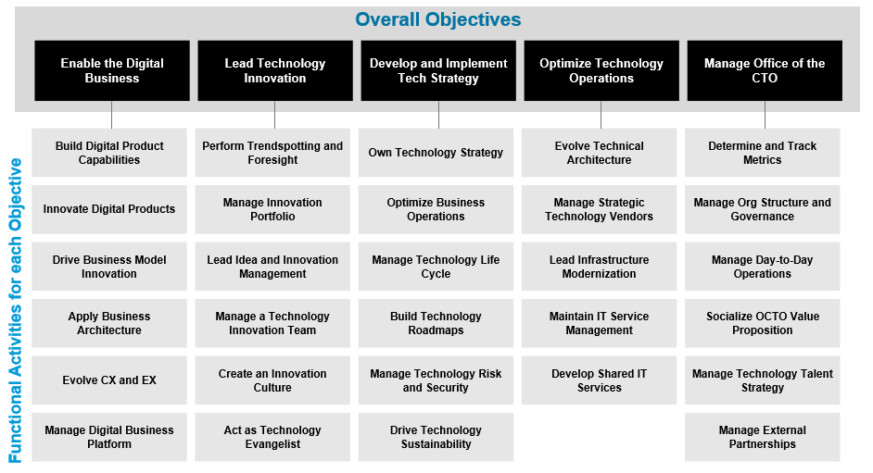
Key Activities That CTO is Responsible For
ACTION: CTOs should use this slide as a discussion point with the CISO to identify common activities
Notes:
Context: The slide highlights the key objectives and respective functional activities for the CTOs. CTOs should refer this slide as a discussion point with the CISO to identify common activities.

Slide 14
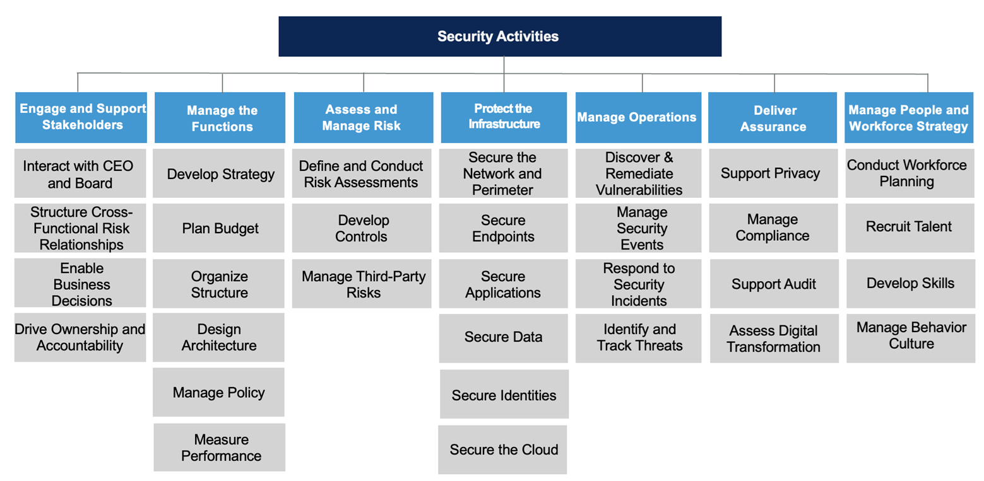
Key Activities That CISO is Responsible For
ACTION: CISOs should use this slide as a discussion point with the CTO to identify common activities
Notes:
Context: This slide highlights the key activities for CISOs. CISOs should refer this slide as a discussion point with the CTO to identify common activities.

Slide 15
Examples of Activities that CTOs & CISOs Can Collaborate
Key:
CTO Activities
CISO Activities
Own Technology Strategy and Create Roadmaps
Emerging Technology Security & Risk Assessment
Perform Trendspotting and Continuous Foresight
Emerging Security Trends & Threat Landscape Analysis
Evolve Technical Architecture
Evolve Security Architecture
Technology Talent Strategy
Cybersecurity Talent Management
Lead Infrastructure Modernization
Cybersecurity Mesh Modernization
Create an Innovation Culture
Create Security Culture
Manage Evolution of Digital Business Platform
Manage Security Tools & Services
Notes:
Context: The slide depicts key areas where CTO and CISOs have synergies to actively collaborate for achieving business outcomes.

Slide 16
Map Common Activities to Your Shared Priorities (Example)
Shared Priorities | Activities | Business Metrics
Emerging technology adoption & roadmap | CTO: Analyzing business impact, applicability, feasibility of the technology and creating effective roadmaps for the implementation CISO: Assessing emerging technology risk and investments security technologies | ROI from security investments Reduction in technology risk
Organization culture change | CTO: CTOs are responsible for developing futuristic mindset and innovation culture in an organization CISO: CISOs can engage with CTOs to embed security aspect in innovation activities for secure digital operations | Innovation pipeline Improvement in cybersecurity program
Manage Digital Business Platforms | CTO: CTOs are digital business enablers responsible for creating new digital business capabilities, products and platforms CISO: CISOs can engage in developing security tools & services as an integral part of digital business | Faster security incident response Reduction in business cyber risk
Notes:
Context: After discussing the individual aspirations and priorities, identify the shared priorities and determine individual responsibility for achieving them.
This slide provides an example of shared priorities and individual activities/responsibilities.

Slide 17
Template: Map Common Activities to Your Shared Priorities
Action: Use the table below to highlight top shared priorities and decide the individual responsibilities
Shared Priorities | Activities | Measurable business outcome
Priority 1 | CTO Responsibility CISO Responsibility | Shared, measurable business outcome
Priority 2 | CTO Responsibility CISO Responsibility
Notes:
Instructions for Customization: Use this template to highlight top shared priorities and determine individual responsibilities for achieving them.

Slide 18
Step 4: Leverage Governance to Avoid Conflicts

Slide 19
Step 4a: Expose Any Areas of Potential Conflict and Identify Solutions (Examples)
Potential Conflict | Proposed Solution
CTOs bring in emerging technologies that pose a potential security risk to the organization | Work with CISOs to develop and conduct IT security risk assessments when evaluating the adoption of new technologies
CTOs focusing on improving IT security | CTOs should work with CISOs to clarify roles & responsibilities with decision right matrix. They should identify collaboration opportunities in identifying & tracking threats to ensure IT services are up & running effectively.
CISOs decide to automate the security functionality by adopting AI for advanced threat detection | Work CTOs to identify latest AI trends and use cases in security. Collaborate to finalize areas of application & feasibility.
CISOs may need to suggest different approaches to the CTO for evolving or modernizing technology architecture considering security & compliance requirements | Work with CTOs to to identify and prioritise security requirements to keep pace with technology optimization efforts.
Notes:
Context: Governance issues or conflicts arise when no one owns something or both the roles think they own it! Identify these areas and key actions to avoid these conflicts.
The slide highlights some examples of potential conflict areas and solution to overcome them.

Slide 20
Template: Record Any Areas of Potential Conflict and Identify Solutions
Action: Use the table below to note any potential areas of conflict and propose how to resolve them
Potential Conflict | Proposed Solution
Notes:
Instructions for Customization: Use this template to note any potential areas of conflict and propose the resolution.

Slide 21
Step 4b: Set up a Decision Rights Matrix to Avoid Conflict (RACI Matrix Example)
Activity or Decision or Deliverable | CTO | CISO
New technology adoption | Accountable | Consulted
Developing cyber risk program | Consulted | Accountable
Digital business platform | Accountable for entire platform | Responsible for security tools & services
Evolve enterprise architecture | Accountable (EA team responsible for EA deliverables) | Responsible for security control architecture
Deliver secure digital products | Consulted | Accountable
Trendspotting | Accountable | Consulted on trends relevant security & advanced threat
Notes:
Context: The best way to avoid these conflicts in future is to establish proper governance rights.
RACI matrix
R: Responsible for task or decision
A: Accountable for completing a task
C: Consulted for opinion/inputs
I: Informed of the activity progress
At CxO level, most decisions will either be accountable or consulted, as direct reports will have certain tasks e.g. EA delegated to them, so they are responsible for performing that task, but CTO/CxO retains accountability. Similarly, CTOs and CxOs will often be consulted but then inform their direct reports of decisions.

Slide 22
Template: Decision Rights Matrix (RACI)
Action: Agree on decision rights for the activities/deliverables you will work on together and document them below.
Activity or Decision or Deliverable | CTO | CISO
Notes:
Instructions for Customization: Use this template to create a decision matrix which while clearly highlight the owners for particular action item/decision.

Slide 23
Step 5: Define Shared Outcomes & Metrics

Slide 24

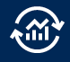

Measure Shared Digital Business Outcomes
The Primary Value Drivers for All Businesses
‸‸
1
Create metrics to measure impact on primary value drivers
Cost Savings
2
Align business and technology outcomes to the drivers
3
Connect value to outcomes to metrics in a taxonomy that supports better business decision making for priorities and investments
Revenue Growth
Risk Reduction
Notes:
Context: People often measure what they can measure, not what they should measure!
Recognise the difference between technology outcomes like 90% of apps moved to the cloud in 12months and business outcomes like 80% customer retention over 6 months
Operational IT metrics are disconnected from business outcomes! Need to make a link between tech investment, innovation and DB outcomes
THIS IS CRITICAL BECAUSE THE CTO WILL ONLY GAIN CREDIBILITY AND INFLUENCE WITH OTHER CxOs IF THEY DELIVER RESULTS!!!
Think in terms of VALUE DRIVERS that influence outcomes in order to design meaningful metrics.
Key value drivers should focus on revenue growth, cost savings and risk reduction. Should start to include attainment of environmental, societal and governance goals as well.
Chief Data Officer & team should provide the analytics to ID the value drivers for a certain outcome
Bridge: Metrics drive behaviours and impact culture…

Slide 25
Measure Success: Goals & Metrics
Innovation | Security Capabilities | IT Security Spending | Security Risk
Number of ideas generated | Effectiveness of cyber security program | IT security spending as a percent of of total IT spending | Number of security events detected
Innovation cycle time | Reduction in business cyber risk | IT spending as a Percent of revenue | Number of risks remediated
Innovation pipeline | Data security | IT security spending per Employee | Patching cadence
Conversion rate | ROI from security investments | IT security FTEs as a percent of total IT FTE | MTTR or MTTI(Mean Time To Resolve or Isolate)
Source: IT Key Metrics Data 2023: IT Security Measures — Analysis
Notes:
Context: The slides provides some sample metrics and goals in terms of innovation, business operations & security and customer experience. Refer these to identify your metrics & KPIs for measuring success.

Slide 26
Step 6: Create Action Plans and Set up Regular Check-ins

Slide 27
Template: Action Plan for Proposed Initiatives
Action: Fill this in with priority action items or initiatives and the required details to create an action plan
# | Priority Action Item or Initiative | Business Objectives | Owner | Implementation Time Frame | Required Investment | Key Metrics | Guidance Needed
Notes:
Context: Once identified key collaboration areas, CTOs and CISOs need to draft an action plan for the initiatives and review the progress.
Instructions for Customizations: Use this template to document your priority action items/deliverable along with planning details like implementation timeline, owner, investments, metrics in order to track progress

Slide 28
Storyboard for Check-In Discussions
Action: Use this storyboard for check-in discussions to plan your agenda.
Introduction
Discussion Points
Summary
Set Context
Follow-up points from the last meeting. e.g. Review metrics
Decide key discussion points
Discuss Key Activities and Strategies
Discussion Point 1
Discussion Point 2
Discussion Point 3
Review & Decide Next Actions
Agree on decisions made
Prioritize next actions/deliverable
Timeline for next check-in
Sample Check-in Questions
How are we progressing towards our shared outcomes?
Have our priorities changed since our last meeting?
Have any new obstacles emerged?
Notes:
Context: This slide provides a storyboard for CTO-CISO meeting conversations and deciding discussion points. Executives can struggle to find time for regular check-ins but they can always opt for ad-hoc meetings or delegate their reports for meetings.
Instructions for Customization: Use this template to set context for discussions, determine key activities to discuss and set follow-up actions.

Slide 29
Template: Plan to Set Up Regular Check-Ins
Action: Fill this in with the questions you want to cover in your regular check-ins and follow-ups
Points to discuss | Notes / Follow-ups/ Decisions Taken
How are we progressing towards our shared outcomes?
Have our priorities changed since our last meeting?
Have any new obstacles emerged?
Notes:
Instructions for Customization: Use this template to list the discussion points for the meetings and documenting notes, decision outcomes and set follow-ups.

Slide 30
Appendix

Slide 31
CTO Profile
Aspect | Description
Role | The CTO empowers the organization with the technology to boost business performance and increase customer satisfaction
Goals | Develop and implement the technology strategy Optimize the organization’s current business and/or IT operations Lead technology innovation to drive transformation and enable new business models Enable digital business by providing the right technologies to build digital business platforms and creating digital products and services Evolve talent within the IT organization to acquire the skills to better exploit technology Manage the OCTO
Key Activities | Evolving architecture Modernizing infrastructure Building a digital business platform Driving trendspotting Developing digital products Managing technology talent Managing external partnerships
Success Metrics | Customer Experience IT Employee Productivity Contribution to Revenue Innovation pipeline
Notes:
Context: The slide summarizes typical role and key responsibilities of the CTO. CISOs should refer this understand CTO profile and align discussion with key priorities.

Slide 32
CISO Profile
Aspect | Description
Role | CISOs are responsible for addressing compliance within fast-changing regulatory and privacy landscapes and addressing C-suite and board-level executives’ concerns about organizations’ resilience and cybersecurity posture.
Goals | Reduce and manage cybersecurity threat exposure and increasing organizational resilience Increase operational efficiency and effectiveness of security systems and talent
Key Activities | Enabling effective secure operations for their organizations Build business case for cybersecurity investments Establishing a risk-aware culture and effective cyber judgment Communicating cyber risk and the value of the cybersecurity program to executive leaders Managing security talent and services to meet security outcome Addressing compliance in fast-changing regulatory landscapes Ensure resilience and business continuity
Success Metrics | Reduction and management of the business cyber risk Continuous reduction in the impact of security incidents Constant optimization of response and recovery to security incidents Improvement of the cybersecurity program Returns on security investment
Notes:
Context: The slide summarizes typical role and key responsibilities of the CTO. CISOs should refer this understand CTO profile and align discussion with key priorities.

Slide 33
Clarify Interpretations of Business Strategy
What unique value do we provide to our stakeholders?
What financial targets must we meet to provide value?
What is the value proposition to the customer that will get us to those targets?
Which processes need to change in order to deliver that value proposition?
What security capabilities do we need to learn and develop to sustain that model?
What risks may emerge that could prevent us from achieving those targets?
What might our competitors do that could impact our strategic execution?
Notes:
Context: This slide provides discussion points in the form of questions for CTOs & CISOs to understand implications of Business Strategy.

