Slide 1

Use-Case Prism: AI for Technology Planning and Innovation
Arnold Gao, Samantha Searle, Ankita Khilare, Sandy Shen

Slide 2
Overview
AI is an enabler of specific use cases for technology planning and innovation. This Use-Case Prism plots these use cases against business value and feasibility axes, inviting strategic conversations and driving investment decisions.

Slide 3
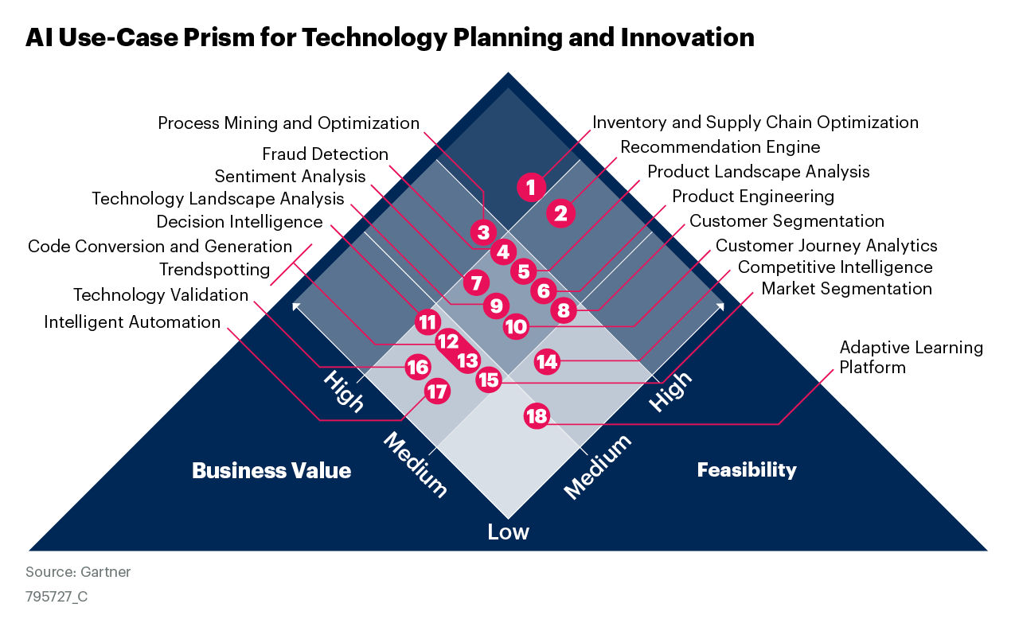
AI Use-Case Prism for Technology Planning and Innovation

Slide 4

How to Use
AI is an enabler of specific use cases for technology planning and innovation. This Use-Case Prism plots these use cases against business value and feasibility axes, inviting strategic conversations and driving investment decisions.
Review the AI use cases plotted on the Prism, comparing them with the maturity and requirements of your own technology planning and innovation strategy.
Likely Wins offer a great combination of high feasibility and high business value.
Marginal Gains are highly feasible but offer low business value.
Calculated Risks offer high business value but low feasibility.
Selective Exceptions offer low business value and low feasibility.

Slide 5
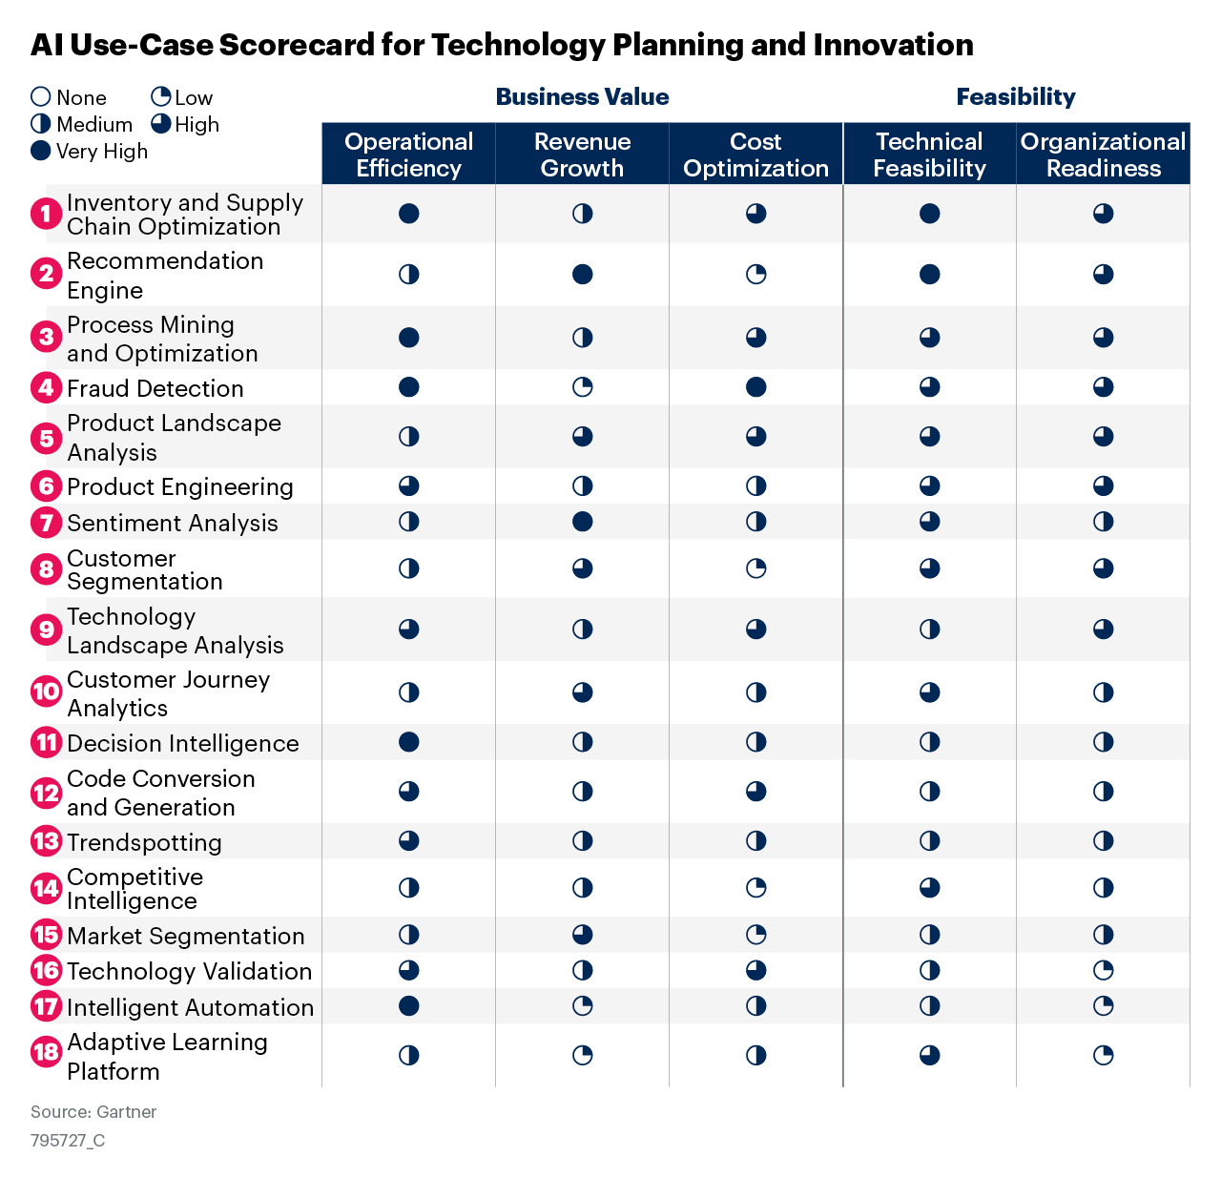
AI Use-Case Scorecard for Technology Planning and Innovation

Slide 6
Use-Case Dimension Explanations
Dimension | Explanation
Operational Efficiency | The ability to meet or exceed performance goals with equal or fewer resources, such as capital investments, staff, technology or time duration.
Revenue Growth | The ability to support new business opportunities that drive top-line growth.
Cost Optimization | The ability to drive spending and cost reduction, while maximizing business value.
Technical Feasibility | The ability to meet the technical requirements of a use case, including the capabilities of the AI technology itself, the availability of vendor support and the current state of the organization’s technology infrastructure.
Organizational Readiness | The ability of the organization to use and incorporate the use case, including the willingness of internal stakeholders, the availability of data, talent and culture readiness.

Slide 7
About This Research
These use cases have been selected and positioned based on an assessment by Gartner analysts and customer feedback. Their applicability may vary across organizations and industries.
For detailed customization, use Gartner’s Prism Toolkit:
Toolkit: Discover and Prioritize Your Best AI Use Cases With a Gartner Prism (732696)

