Slide 1
2024 Outlook Presentation: Enterprise IT Spending Forecast for

Slide 2
Overview
This presentation provides technology and service providers with a graphical representation of the Forecast: Enterprise IT Spending by Vertical Industry Market, Worldwide, 2021-2027, 3Q23 Update
This presentation can be used to support industry planning and strategy activities for 2024 and beyond.
Highlight colors (orange/dark blue) are used to indicate points of interest, such as the coming year, the highest growth or the largest segment.
The first section of the presentation presents multiyear total overviews of forecast IT spend categories for the industry.
The second part of the presentation uses bubble charts to present the forecast IT spend for 2024, by forecast CAGR and expected share of the five-year growth. It also lists 2024 IT spend and YoY growth percentage for each segment.
The last sections show breakdowns by subvertical and region.
This presentation uses constant currency; see the methodologies slide for a more in-depth discussion of currencies.

Slide 3
Forecast Industry IT Spend and Growth

Slide 4
Forecast Yearly IT Spend in the Vertical per Year and Expected YoY Growth

Slide 5
Forecast YoY Growth Compared to Other Industries and Compared to Average Across Vertical Industries

Slide 6
Forecast Yearly IT Spend in the Vertical by Spend Category (IT Market Segment)

Slide 7
Annual Growth/Decline in the Vertical by Spend Category (IT Market Segment)

Slide 8
Forecast Segment IT Spend in the Vertical by Year With Five-Year CAGR

Slide 9
Forecast IT Spend, Growth and Growth Share by Enterprise IT Spend Segment

Slide 10
2024 IT Spend, by CAGR and Growth Share per IT Market Segment

Slide 11
2024 Software Spend, by CAGR and Growth Share per IT Software Subsegment

Slide 12
2024 Services Spend, by CAGR and Growth Share per IT Services Spend Subsegment
Notes:
*See note regarding IaaS on slide 2

Slide 13
2024 Data Center Systems Spend, by CAGR and Growth Share per Data Center Spend Subsegment

Slide 14
2024 Devices and Communications Spend, by CAGR and Growth Share per Subsegment for Devices and Communications Spend

Slide 15
Forecast IT Spend, Growth and Growth Share by Subvertical

Slide 16
2024 IT Spend, by CAGR and Growth Share per Subvertical

Slide 17
Forecast YoY Growth/Decline in IT Spend per Subvertical

Slide 18
Forecast IT Spend, Growth and Growth Share by Region

Slide 19
2024 IT Spend, by CAGR and Growth Share per Major Geographic Region

Slide 20
2024 IT Spend, by CAGR and Growth Share per Geographic Region

Slide 21
Methodology and Background

Slide 22
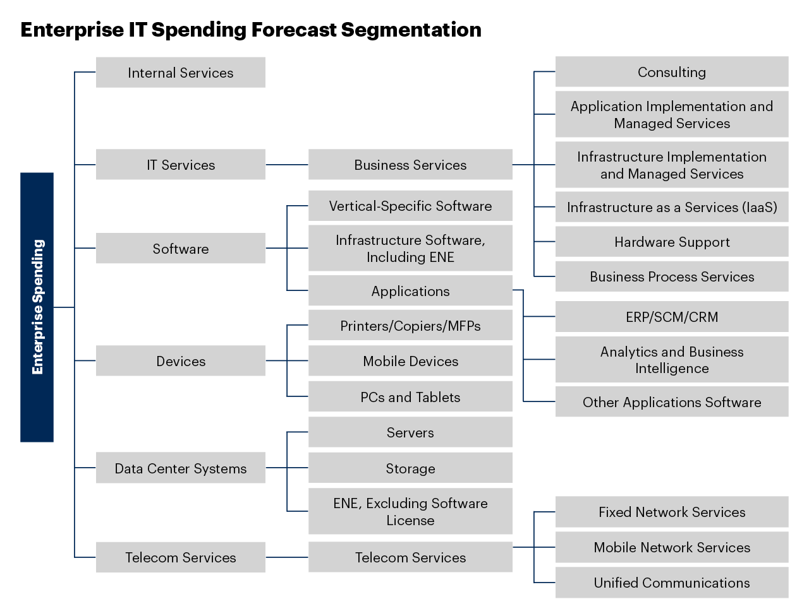
Additional Sources
Forecast: Enterprise IT Spending by Vertical Industry Market, Worldwide, 2021-2027, 3Q23 Update
Market Definitions and Methodology: Vertical Industries
This presentation is to be used for visualization purposes only. In case of any conflict or difference between the numbers in the above-published forecast and the numbers shown in this presentation, the official published Gartner forecast will be leading.

Slide 23
Research Metrics and Methodology
Gartner’s vertical industry forecasts are reported in current and constant currency (this presentation depicts constant currency in $ millions).
Current-dollar figures indicate the U.S. dollar end-user spending that vendors/providers could expect to earn, given prevailing exchange rates.
Constant-dollar figures, on the other hand, reflect the equivalent U.S. dollar value of market spending at fixed exchange rates.
Compound annual growth rate (CAGR)
The annualized rate of revenue, spend or unit shipment growth between two given years, assuming growth takes place at an exponentially compounded rate. The CAGR between years X and Z, where Z - X = N is the number of years between the two given years, is calculated as follows:
CAGR Year X to Year Z = [(Value in Last Year Z/Value in First Year X) ^ (1/N) - 1]
Further information on exchange rates and metric calculations can be found in Market Definitions and Methodology: Gartner Market Databook
Growth Share
In the bubble chart of this presentation, the horizontal axis is used to depict an indicator called “growth share.”
Growth share acts as a proxy for the long-term (2020-2026) relative growth of the segment, compared to the absolute growth of all the segments in the chart.
If the IT spend growth in the chart is expected to be 200 million and the overall absolute growth of the segment is 600 million, the growth share is 33%.
In case the growth is negative (a declining segment), then the growth rate is calculated as a share of the overall absolute change (if two segments increase 100 million and one segment decreases 300 million then the absolute change [volatility] is 500 million). The 100 million growth segment then makes up 20% of the change; the 300 million declining segment makes up −60%.
The dotted line center bubble depicts the total segment size and is shown at the average growth point across the shown segments (e.g., 25% if four segment bubbles making up 100%).

Slide 24
End of Presentation
Please contact your Gartner representative or our RES team if you are interested in scheduling an inquiry to discuss the industry forecast, assumptions or trends
North America +1 203 316 1200 inquiry@gartner.com | EMEA +44 1784 26 7770 euro.inquiry@gartner.com | APAC +61 7 3243 1567 asiapac@gartner.com | JAPAN +81 3 3481 3673 japan.inquiry@gartner.com

