Slide 1
Enterprise Infrastructure Hardware Market View, 2020-2021
Amit Goyal, Suzie Low, Kiyomi Yamada, Christian Canales, Naveen Mishra
Amit Goyal, Robert Preston

Slide 2
The Gartner Enterprise Infrastructure Hardware Market View, 2020-2021
Enterprise infrastructure hardware providers can gain share and grow revenue by examining and acting on their competitive position, market trends and relevant forecast assumptions.
This document provides examples of Gartner’s research on the future of the Enterprise Infrastructure marketplace. The content is presented in five sections:
Market Share and Forecast: Coverage, Taxonomy and Schedule
Forecast Analysis
Market Share Analysis
Competitive Landscape
Market Trends

Slide 3
Market Share and Forecast: Coverage, Taxonomy and Schedule

Slide 4








Enterprise Infrastructure Hardware Market Coverage
Market Share (Published Quarterly)
Forecast (Published Quarterly)
2-4 Years of Data
7 Years of Data
2 Historical, 5 Forecast
4 Major Market
25 Segments
4 Major Market
25 Segments
4 Deliverables
4 Deliverables
4 Deliverables
Server
Storage
Enterprise Network Equipment (ENE)
Integrated System (IS)
Server & Storage - 43 Country Markets
IS & ENE - Worldwide
Server
Storage
Enterprise Network Equipment (ENE)
Integrated system (IS)
Server, Storage & ENE-
43 Country Markets
IS - Worldwide
U.S. Dollars, Constant and Local Currency
U.S. Dollars, Constant and Local Currency

Slide 5
Enterprise Infrastructure Hardware Market Top-Level Taxonomy*
Enterprise Infrastructure Hardware Markets
Server
External Controller-Based Storage
Enterprise Network Equipment
Integrated System
* For the full taxonomy, see Market Definitions and Methodology: Servers; Storage; Networking; Integrated System

Slide 6
Forecast Analysis

Slide 7
Forecast Market Model — Servers
Server Market Forecast Model
Server End-User Spending by Segment
Server Market End User Spending
Five-year market growth = $27.2 billion (CAGR 5.7%)
Based on three components
Shipments + End-User Spending / Vendor Revenue
That are dependent on these influencing factors
Enterprise IT Budgets — Recovering IT Demand Technology Preferences— Technology Demand Shift: Blade Servers Supply — Pricing: Component Price Increases Supply — Technology Roadmap: Server Processors
With these associated assumptions
Enterprise Server Recovery Will Start in 2021, but Regional Variances Exist. The Blade Server Installed Base Will Decline at a 9% CAGR From 2020 Through 2025. More Than Half of Component Price Increases Will Pass to End Users, Who Will See a Modest Server System Price Increase in 2021. Itanium Will Cease to Be Sold in New Systems From the End of 2021 in Most Regions
Note: IA64 CAGR is for three years only, 2020-2023, as we forecast IA64 market to be negligible by 2024-25
Note: The size of each bubble represents 2020 end-user spending by segment in current U.S. dollars
Source: Gartner (xxx 2021)
Source: “Forecast Analysis: Servers, Worldwide” (G00751941) “Forecast: Servers, All Countries, 2019-2025, 2Q21 Update” (G00751942)

Slide 8
Forecast Market Model — External Storage Systems
External Storage Systems End-User Spending by Segments
ECB Storage Market Forecast Model
Worldwide External Storage Systems Revenue, 2020-2025
Five-year market growth = $2.0 billion (CAGR 1.9%)
Based on four components
Shipments + End-User Spending / Capacity (TB) x Vendor Revenue
That are dependent on these influencing factors
Firmographics and Geopolitical — Buy China 2025 Initiative Technology Preferences — Technology Demand Hybrid Storage Resiliency
With these associated assumptions
Growth in Greater China will buoy the ECB markets through 2025 while the rest of the world displays flat-to-down ECB revenue. In 2025, 50% of enterprises will more knowledgeably test the viability of, and creatively use, cloud data storage services, up from 20% in 2020, but ECB on-premises storage will display a surprising resilience. Through 2025, HDD/hybrid arrays will continue to be a cost-effective driver of overall ECB demand, enabling total ECB revenue to expand to more than $23 billion.
Note: The size of each bubble represents 2020 end-user spending by segment in current U.S. dollars
Source: Gartner (August 2021)
Source: “Forecast Analysis: External Controller-Based Storage, Worldwide” (G00717907) “Forecast: External Storage Systems, Worldwide, All Countries, 2019-2025, 2Q21 Update” (G00752099)

Slide 9
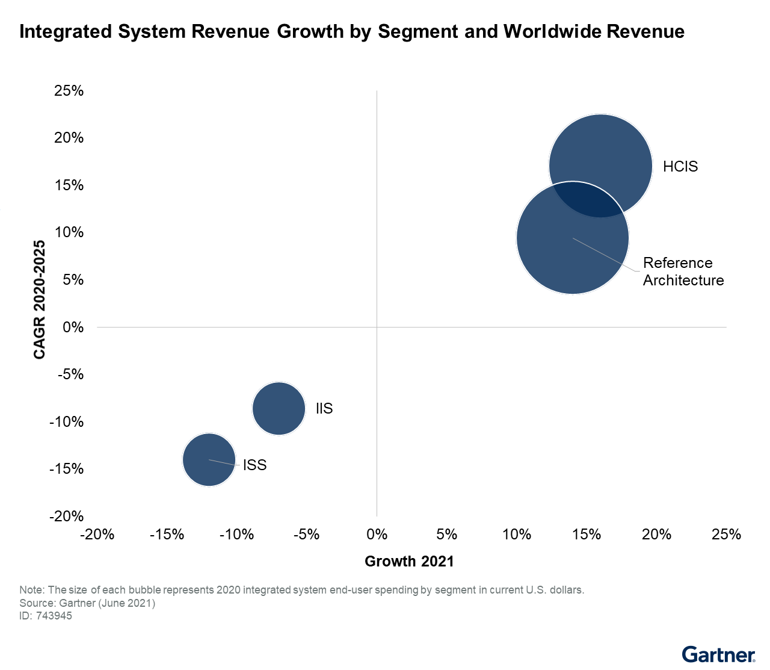
Forecast Market Model — Integrated Systems
Integrated Systems Market Model
Integrated Systems Market
Five-Year Market Growth = $7.0 Billion (CAGR 9.7%)
Based on two components
Shipments + Vendor Revenue
That are dependent on these influencing factors
Enterprise IT Budgets — Improved Hardware Refresh Cycles. Supply: Pricing — Component Price Increases. User Preference — Considering Reference Architecture for Newer Workloads.
With these associated assumptions
In 2021 and 2022, IT leaders will continue with their integrated system refresh cycle, with an emphasis on flexibility, hybrid cloud, automation and cost optimization. More than half of component price increases will be passed on to end users, who will see a modest integrated system price increase in 2021. By 2023, the number of customers leveraging reference architecture solutions for emerging workloads will increase to 30% from the 2020 level of 10%
Source: “Forecast Analysis: Integrated Systems, Worldwide” (G00743945)

Slide 10
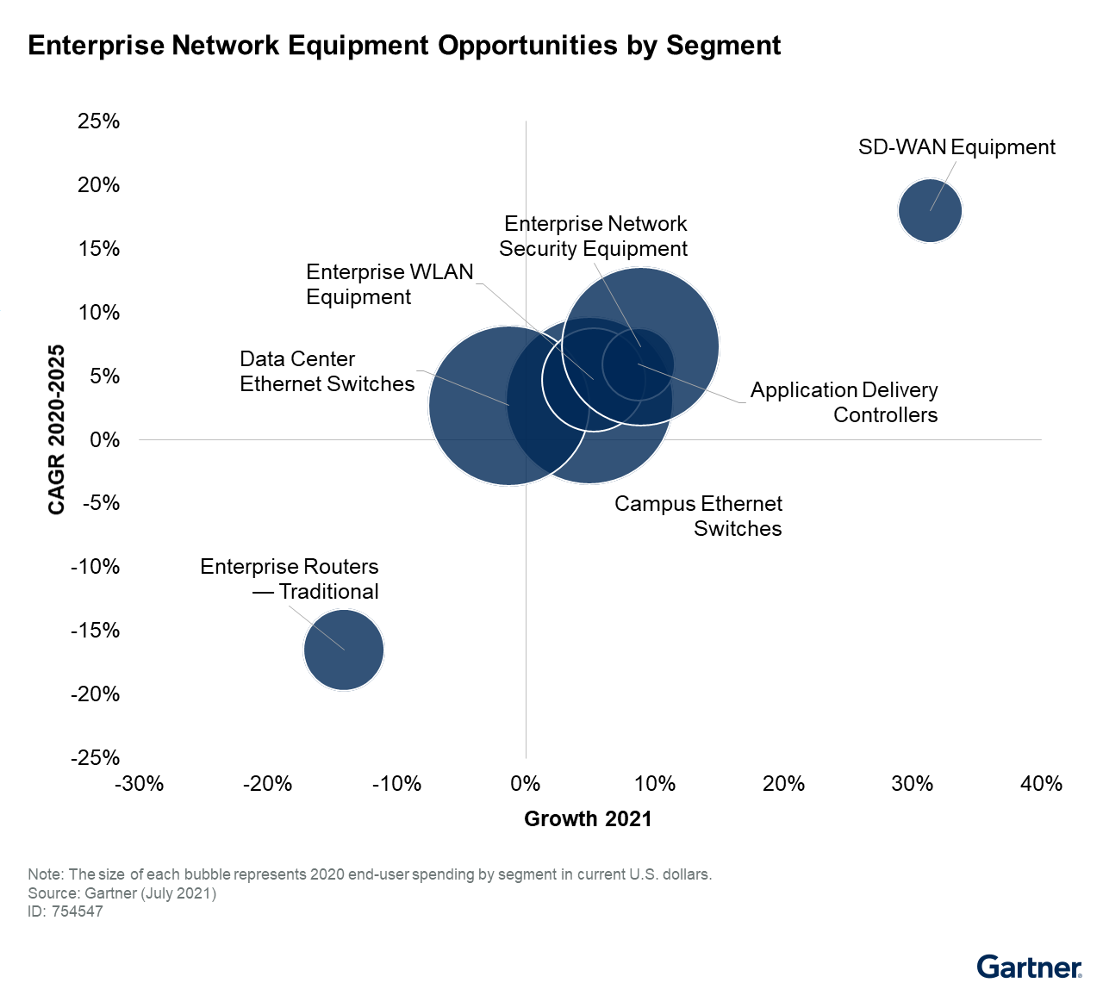
Forecast Market Model — Enterprise Network Equipment
Enterprise Network Equipment Market Model
Enterprise Network Equipment
Five-year market growth = $15.61 billion (CAGR 4.3%)
Based on two components
End-User Spending + Units/Ports
That are dependent on these influencing factors
Application Requirements as a Result of COVID-19’s Impact Pricing Trend of Data Center Ethernet Switches
With these associated assumptions
Digital application/platform requirements will drive a fresh round of data center network refresh in service provider cloud and edge infrastructures from 2021 through 2025. As component availability improves, the ASP of 400G Ethernet will drop to less than twice the ASP of 100G Ethernet by 2025, from the current level of three to three-and-a-half times. This will drive a faster transition from 100G in the fast-growing service provider markets.
Source: “Forecast Analysis: Enterprise Network Equipment, Worldwide” (G00754547)

Slide 11
Market Share Analysis

Slide 12
Server Competitive Landscape: Top Five Vendors Accounted for 56.1% Market Share in 2020
Top 10 Server Vendor Revenue in ($M)
Top 10 Server Vendor Revenue in ($M)
1
Dell Technologies continued leading the global server market in both shipments and revenue, but both declined by 4.9% and 6.6%, respectively, in 2020.
2
Among the top five vendors, all China-based vendors (Inspur, Lenovo and Huawei) saw revenue growth due to demand from the hyperscale and enterprise segments in the China market.
3
The self-build/original design manufacturer (ODM) segment grew by 17.9% in shipments due to hyperscale data centers and service provider demand for cloud.
Source: “Market Share: Servers, All Countries, 1Q21 Update” (G00751819); “Market Share Analysis: Servers, Worldwide, 2020” (G00743568)

Slide 13
ECB Storage Competitive Landscape: Top Five Vendors Accounted For 71.5% Market Share In 2020
Top 10 ECB Storage Vendor Revenue in ($M)
1
All the major ECB suppliers, except Fujitsu and Huawei, reported year-over-year (YoY) revenue declines in 2020.
2
Of the providers with more than $2 billion in annual ECB revenue, Dell Technologies fell by 6.9%, NetApp declined 7.6%, and Hewlett Packard Enterprise decreased 9.1%, while Huawei expanded its revenue by 34.1%.
3
Substantial upticks China and Eurasia demand are primary drivers of Huawei’s ECB revenue growth.
Source: “Market Share: External Storage Systems, All Countries, 1Q21 Update” (G00752494); “Market Share Analysis: External Controller-Based Disk Storage, Worldwide, 2020” (G00743566)

Slide 14
Enterprise Network Equipment Competitive Landscape: Top Five Vendors Accounted for 57.6% Revenue Market Share in 2020
Top 5 Enterprise Network Equipment Vendors
1
While Cisco lost share in the enterprise network equipment (ENE) market, it consolidated its leading network detection and response (NDR) revenue share and displaced Forescout Technologies in the network access control (NAC) market.
2
Huawei increased its ENE market revenue share to 9.0%, with most of its 2020 revenue growth generated by campus and data center switching sales.
When it comes to revenue, Cisco dominates the market capturing almost 35% of it, this is largely because of Cisco’s big price premium. The interesting and relevant metric is port shipments/unit shipments, which tells a very different story.
Hewlett Packard Enterprise’s (HPE’s) revenue grew for campus switching, but WLAN and NAC declined. HPE has expanded into the SD-WAN market following its acquisition of Silver Peak.
3
Source: “Market Share: Enterprise Network Equipment by Market Segment, Worldwide, 1Q21” (G00742296); “Market Share Analysis: Enterprise Network Equipment, Worldwide, 2020” (G00742292)

Slide 15
Integrated Systems Competitive Landscape: Top Five Vendors Accounted For 79.4% Market Share In 2020
Top 10 Integrated Systems Vendor Revenue in ($M)
1
Dell EMC emerged as the overall market leader, with revenue totaling at $5.65 billion in 2020 while registering a year-over-year increase of 18.7%. HCIS and Reference architecture fueled this growth for the provider
2
H3C grew at the highest pace in 2020 (82% YoY) among all the Integrated system vendors. This growth primarily came from strong HCIS demand in its domestic market.
3
Nutanix retains its leadership position in the HCI software segment (share 50.3%) with $769.1 million revenue, followed by VMware (share 41.2%) with $ 630.3 million in 2020.
*Cisco/NetApp refers to Flexpod revenue.
Source: “Market Share: Data Center Hardware Integrated Systems, Worldwide, 1Q21 Update” (G00753731); “Market Share Analysis: Data Center Hardware Integrated Systems, Worldwide, 2H20” (G00743570)

Slide 16
North America, China and Western Europe Covers Almost 80% of Server and Storage Market in 2019 and 2020
Source: “Market Share: Servers, All Countries, 1Q21 Update” (G00751819); “Market Share: External Storage Systems, All Countries, 1Q21 Update” (G00752494)

Slide 17
Competitive Landscape

Slide 18






The Data Center and Cloud B&R* Market Is Rapidly Changing Under Increased Demand for Simpler, More Agile and Cost-Optimized Solutions to Protect Workloads Across Core, Cloud and Edge Environments
Competitive Trends | Backup and Recovery Vendors Measuring Up Against Competitive Trends
 | Cloud Backup Agentless |  |  | Ransomware |  |  |  | Purchase Option
Vendors | AWS | Azure | GCP | Detection Real Time | Detection Postprocess | Immutability | Analysis-Based Recovery | Perpetual | Subscription | BaaS (Vendor-Hosted) | Cloud SaaS Data Management
Recommendation: Prioritize integration with public cloud services to support backup to and from core, cloud and edge, and drive appropriate go-to-market programs by working closely with the three major public cloud vendors
Source: “Competitive Landscape: Enterprise Data Center and Cloud Backup and Recovery Market” (G00721220)
*B&R – Backup and recovery

Slide 19





Decoupling HCI Software and Hardware Increases Hardware Choice for Enterprise Buyers and Expands Deployment Options to Include Public Cloud
Key Findings: Enterprises are increasingly evaluating HCI software providers based on their automation capabilities, integration with public cloud providers, simplified software maintenance and upgrade coupled with Kubernetes support
Competitive Trends | Five HCI Software Vendors Measuring Up Against Competitive Trends
 | Hypervisor Support |  |  |  | HCI Features |  |  |  |  |  | Purchase Option
Vendors | Hyper-V | vSphere | KVM | Xen | Hybrid Cloud | Networking | Kubernetes | File | S3 Object | Security | Perpetual | Subscription
*
Recommendation: Improve hybrid cloud features by building simple administration GUIs with customizable dashboards with multicloud and on-premises management
Source: “Competitive Landscape: Hyperconverged Infrastructure Software” (G00727693)
*Note: Pivot3 entered into an agreement to sell their video surveillance business to Quantum Corporation in July 2021

Slide 20
The Self-Build/ODM Server Vendors Saw Tremendous Growth in Shipments in 2020 Mainly Because of Increased Cloud Demand From the Hyperscale Segment
1
The worldwide server market saw growth of 1.0% in shipments in 2020, mainly due to the self-build/ODM segment’s tremendous growth
2
The self-build/original design manufacturer (ODM) segment grew by 17.9% in shipments versus -3.3% growth for rest of the vendors combined
Source: “Market Share Analysis: Servers, Worldwide, 2020” (G00743568)

Slide 21
Market Trends

Slide 22
Trends That Will Shape Integrated Systems Market
Top Integrated Systems Trends
In 2021 and 2022, IT leaders will continue with their integrated system refresh cycle, with an emphasis on flexibility, hybrid cloud, automation and cost optimization
Gartner Peer Insights for the last 12 months suggest that AI capabilities and software stack features are among the top three criteria driving the user satisfaction for HCIS. It also indicates a lower importance of hardware and hypervisor
Partners will increasingly position integrated reference architecture (IRA) for newer enterprise workloads, especially those requiring a high level of customization such as AI, analytics and high-performance computing (HPC)
More than half of component price increases will be passed on to end users, who will see a modest integrated system price increase in 2021.
Source: “Forecast Analysis: Integrated Systems, Worldwide” (G00743945)

Slide 23
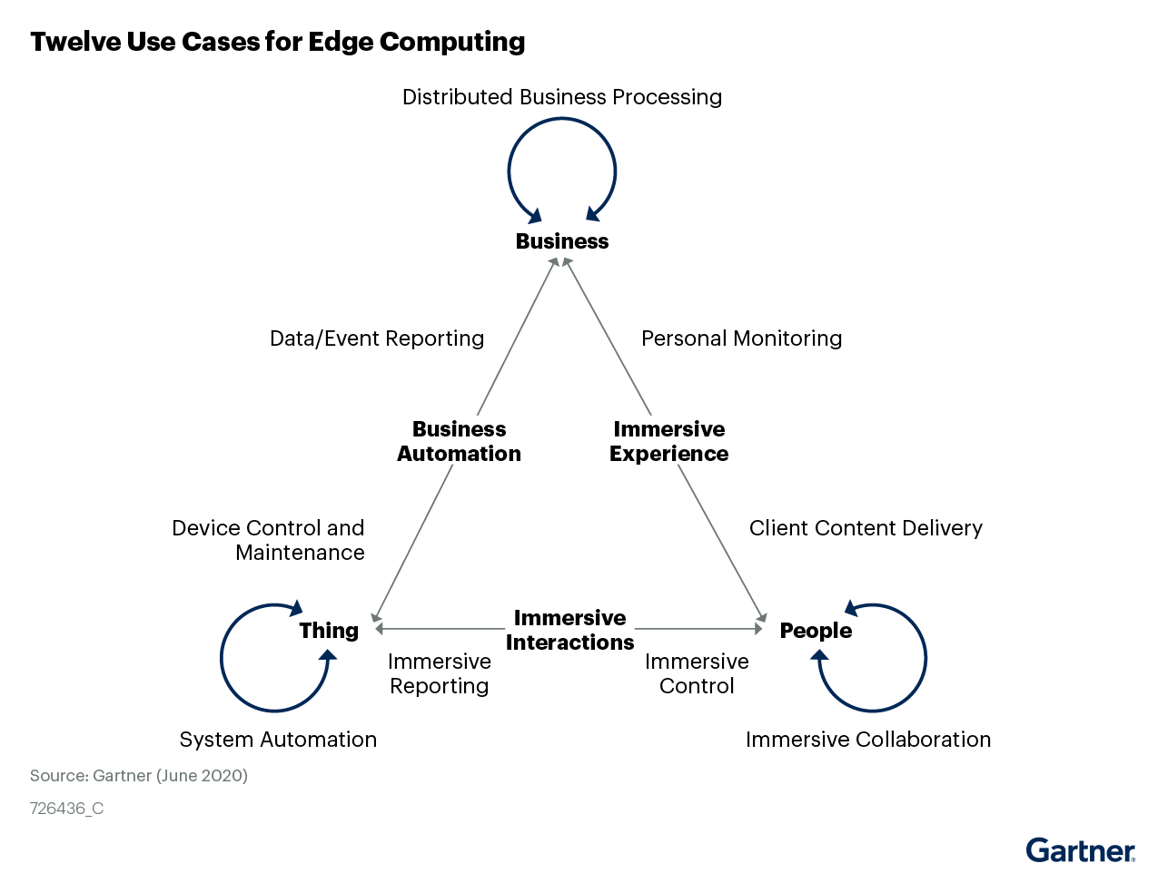
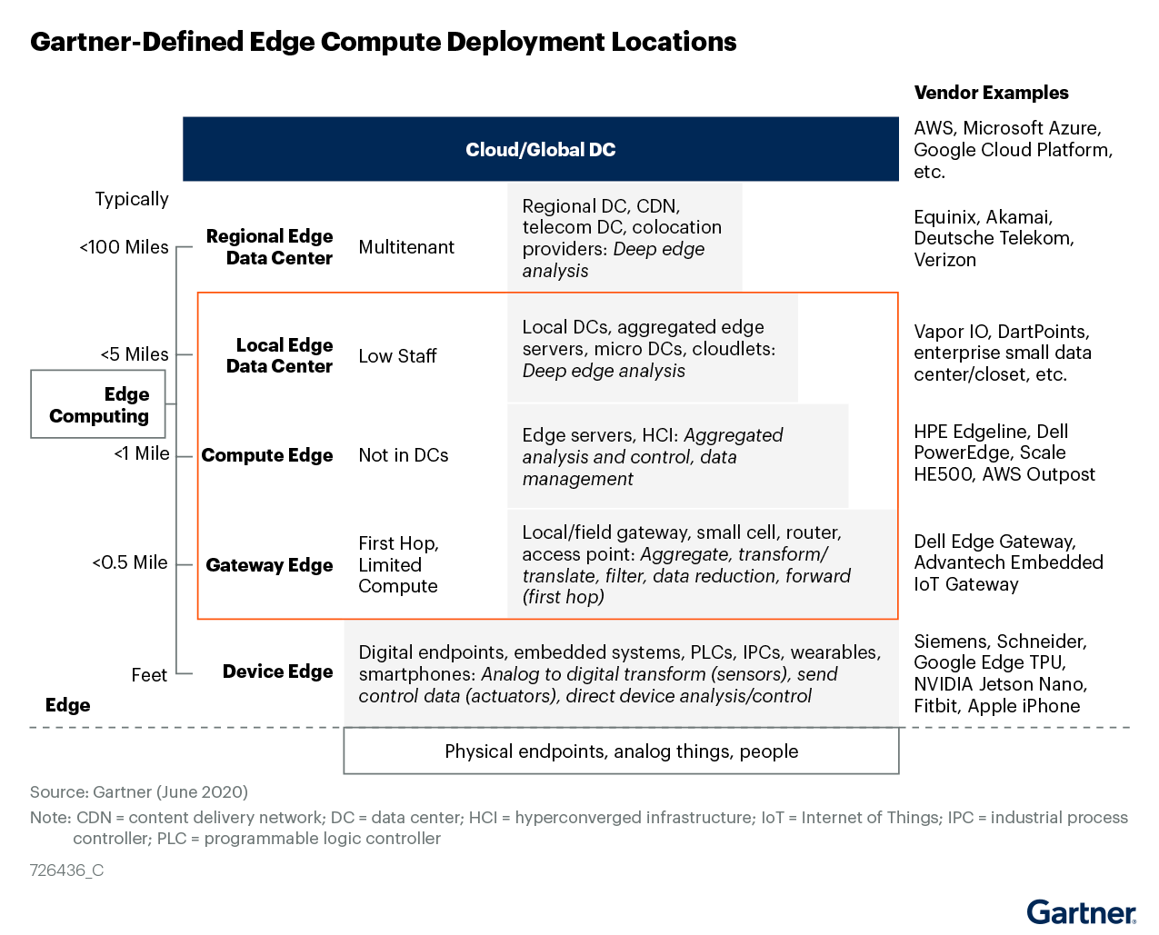
Through 2025, the Edge Hardware Infrastructure Opportunity Will Grow to $17 Billion But Is Skewed Toward Incremental Growth of Existing Applications
Key Findings: Edge hardware infrastructure represents 4% of revenue opportunity presented by edge, with software and services making up the other 96%
Recommendation: Technology and service providers must combine hardware with software, integration and services to capitalize on the opportunities at the edge
Source: “Leading the Edge: Gartner’s Initial Edge Hardware Infrastructure Forecast” (G00726436)

Slide 24
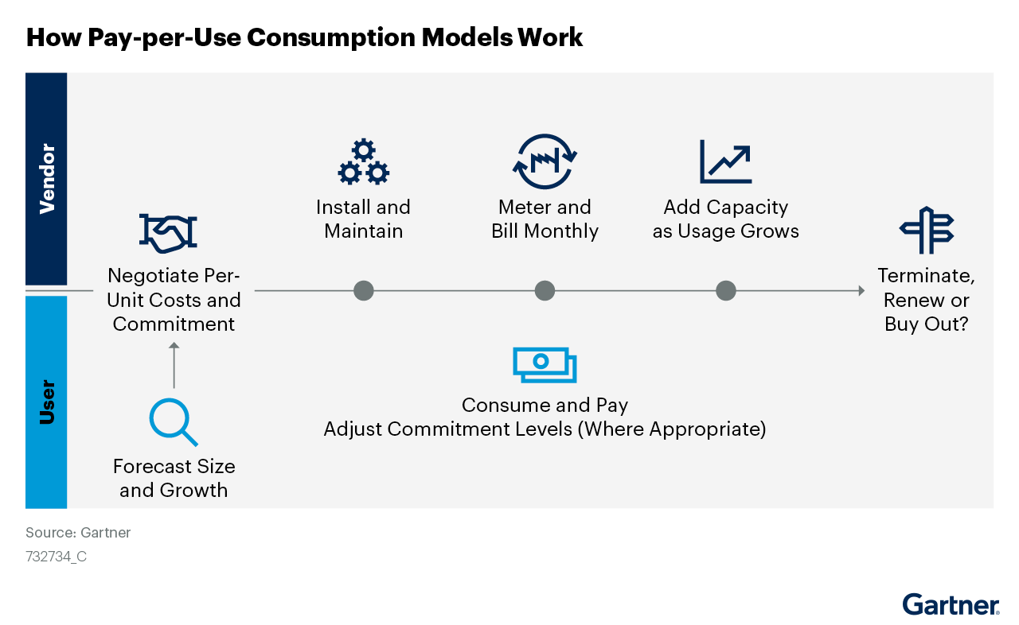
Consumption-Based Pricing for On-Premises Data Center Infrastructure Is Gaining Traction, as Users Exploit Hardware Vendor Programs to Align Resource Costs With Use
Strategic Planning Assumption: By 2025, at least 50% of enterprises will shift toward operating expenditure (opex)-based storage consumption models, compared to less than 10% today
Key Trends in CBP
Within the last two years, most large data center hardware vendors have introduced or expanded their programs to sell infrastructure on a consumption basis (for example, pay per use or as a service) Storage as a service (STaaS) programs are the most mature of the consumption-based offerings, while consumption programs for data center networking hardware have gained minimal traction
Recommendation: To maximize the chances of success in their CBP offerings, TSP must sell to the business unit by transforming (and partnering with) the infrastructure and operations (I&O) department
Source: “Market Guide for Consumption-Based Pricing for Data Center Infrastructure” (G00732734)

Slide 25
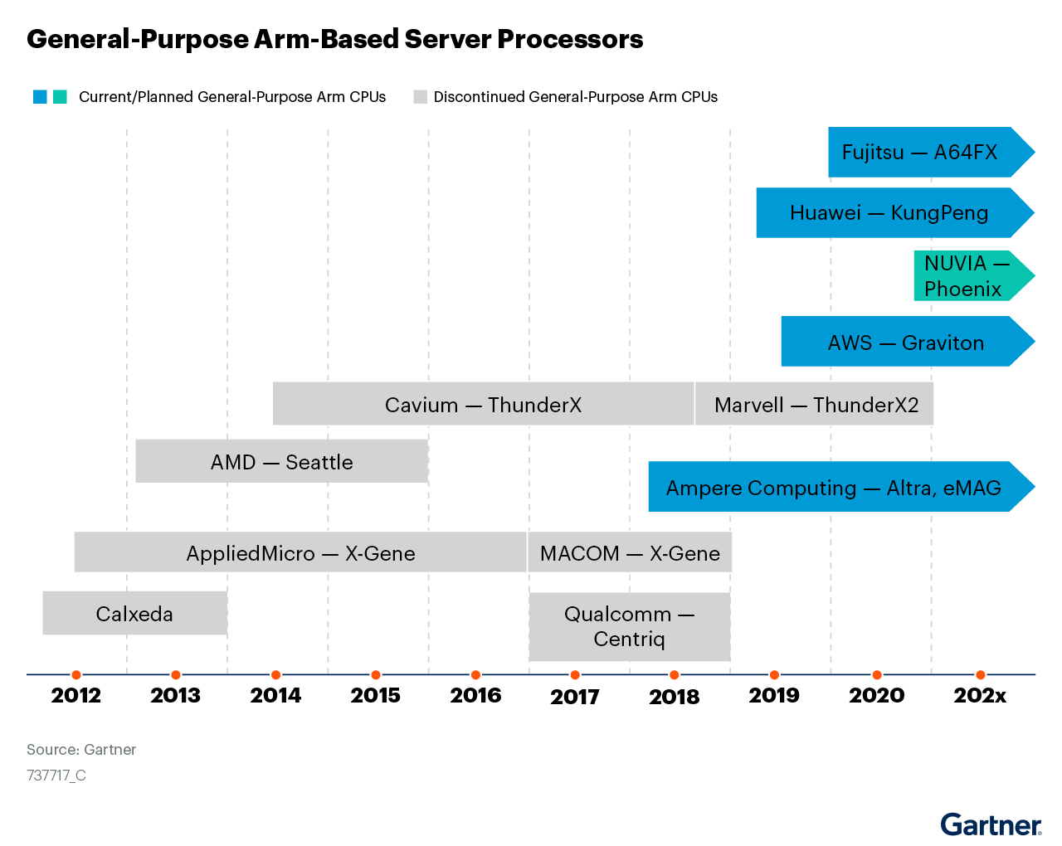
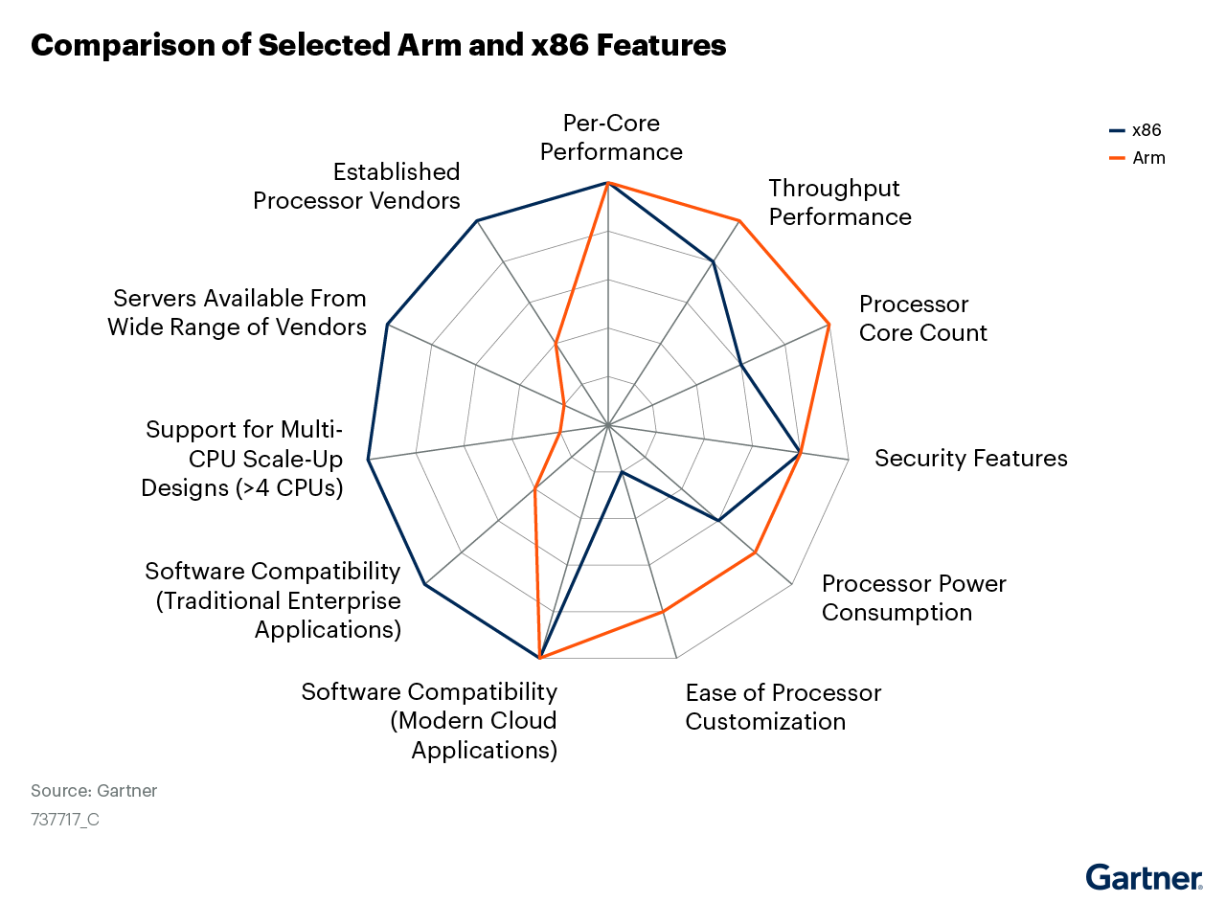
There Is a Growing Interest in the Use of Arm-Based Processors Within the Data Center
While previously, Arm has had little impact on the data center (ripples on the x86 mill pond), a growing wave of Arm-based solutions is anticipated. While this adoption will be primarily driven by hyperscale, enterprise adoption will be significantly constrained by the existing software stack
Recommendation: Re-evaluate the server processor choices by assessing the performance of the latest-generation server-optimized Arm processor cores versus existing x86-based processors
Source: “Market Trends: Arm in the Data Center: Act Now to Develop Plans to Address This Shifting Market” (G00737717)

Slide 26
Market Trends — Enterprise Network Equipment Market
Trends That will shape ENE market
The original design manufacturer (ODM)/self-build market segment will benefit mostly from the major refresh being undertaken by the large cloud providers. However, OEMs will also get a good share of the demand from cloud providers, as well as non-cloud service provider deployments
Growing bandwidth requirements among cloud and communications service providers will lead to a need for greater transport speed to architect an optimized and scalable data center network at the core and edge. This will set off a faster transition from 100G to 400G in their data center core layers
With digital initiatives getting a boost following COVID-19 lockdowns, wireless deployments to support these initiatives are expected to be a major focus area in networking among enterprise users. Users need more bandwidth and greater reliability as wireless has become the primary connectivity mode in the majority of offices throughout most parts of the world.
Source: “Forecast Analysis: Enterprise Network Equipment, Worldwide” (G00754547)

Slide 27
Market Trends — External Controller-Based Storage
Key Market Findings
Primary ECB storage revenue fell 7.4% in 2020 but remained predominant with 76.1% share of total ECB revenue. Worldwide secondary ECB revenue grew by 30.2% in 2020 to $3.3 billion, buttressed by new products designed to cost-effectively manage growing pools of unstructured data Backup and recovery (B&R) appliance revenue grew slightly by 0.3% in 2020 to $1.7 billion despite hybrid cloud backup solutions becoming mainstream for more enterprises
Market Impacts
The Greater China ECB storage market will increase 12.6% in 2021 and display an 11.6% compound annual growth rate (CAGR) from 2020 through 2025. Greater China’s ECB revenue share will grow to 32% in 2025 from 22% in 2021. Most of this share gain will come at the expense of North America, whose share will decline from 38% to 34%. It is certainly true that there will be increasing cloud model demand. But this is nothing new. A recent reexamination and analysis of history has shown that — after an uneven $14 billion-to-$18 billion up/down pattern from 2005 through 2009 — from 2010 through 2020, there was a surprising kind of chaos theory “strange attractor” around $20 billion in ECB revenue
Source: “Market Share Analysis: External Controller-Based Disk Storage, Worldwide, 2020” (G00743566); “Forecast Analysis: External Controller-Based Storage, Worldwide” (G00717907)

Slide 28
Gartner Recommended Research
Market Share: Servers, All Countries, 1Q21 Update (G00751819)
Market Share Analysis: Servers, Worldwide, 2020 (G00743568)
Market Share: External Storage Systems, All Countries, 1Q21 Update (G00752494)
Market Share Analysis: External Controller-Based Disk Storage, Worldwide, 2020 (G00743566)
Market Share: Enterprise Network Equipment by Market Segment, Worldwide, 1Q21 (G00742296)
Market Share Analysis: Enterprise Network Equipment, Worldwide, 2020 (G00742292)
Market Share: Data Center Hardware Integrated Systems, Worldwide, 1Q21 Update (G00753731)
Market Share Analysis: Data Center Hardware Integrated Systems, Worldwide, 2H20 (G00743570)
Competitive Landscape: Enterprise Data Center and Cloud Backup and Recovery Market (G00721220)
Competitive Landscape: Hyperconverged Infrastructure Software (G00727693)
Forecast Analysis: Integrated Systems, Worldwide (G00743945)
Leading the Edge: Gartner’s Initial Edge Hardware Infrastructure Forecast (G00726436)
Market Guide for Consumption-Based Pricing for Data Center Infrastructure (G00732734)
Market Trends: Arm in the Data Center: Act Now to Develop Plans to Address This Shifting Market (G00737717)
Forecast Analysis: Enterprise Network Equipment, Worldwide (G00754547)
Forecast Analysis: External Controller-Based Storage, Worldwide (G00717907)
Forecast Analysis: Servers, Worldwide (G00751941)

