Slide 1
Leadership Vision for 2022 Infrastructure and Operations September 2021

Slide 2



Adaptive Resilience Model for Continuous Change
Use Infrastructure-Led Innovation (I-LI) to Drive Digital Business Acceleration
Increase Resilience
Transformational
Leadership
Operational
Excellence
Customer Centricity
Improve Agility
Mature Governance
Breakthrough
Technology
Mature a Resilient I&O Practice Without Sacrificing Agility
Notes:
Last year, the Leadership Vision for Infrastructure and Operations (I&O) focused on the core elements of transformational leadership, operational excellence and breakthrough technology that were driving innovation in I&O, and supporting organizations grappling with the effects of the global pandemic.
This model serves to enable renewed growth and transformation focusing on customer centricity. The voice of the enterprise’s customer should always be at the heart of everything that I&O does. I&O needs to build a platform that enables digital products that meet external customer needs. I&O must structure its capabilities as standing, cross-functional and highly collaborative fusion teams empowered to continuously deliver new functionality (as well as eliminate technical debt and modernize the digital foundations).
The core ingredients for success are:
Transformational leadership: Partner with the CFO/CIO to guide cost-intelligent value investments in the enterprise’s digital foundations. Build I&O’s brand, change perceptions and drive new conversations around I&O’s value. Move to a reality where stakeholders outside of I&O perceive and understand the value they could receive and are willing and open to invest resources into I&O (including money, budget, sanction, credibility and advocacy) in order to obtain that value.
Operational excellence: Drive process excellence. Invest in critical skills and behaviors. The time has come to completely rethink talent strategies and the overall culture as an integral part of success and to maximize employee engagement.
Breakthrough technology: Take advantage of breakthrough technologies such as distributed and hybrid cloud techniques, intelligent infrastructure, artificial intelligence (AI) and automation to build a platform that is “innovation-ready.”
I&O was a key player in accelerating digital initiatives and enabling remote work to keep businesses operational, but this rapid change has put a strain on people, process, technology and governance. I&O leaders want to press pause — creating time to recover and rebuild the strong foundations that ensure the stability of I&O services. However, business needs are ever-changing, bringing new challenges that will require both a solid foundation built on the resilience of organizational processes and technology, and the ability to rapidly respond to change.
Delivering adaptive resilience is I&O’s imperative. I&O must build, integrate, broker and govern technology platforms that balance resilience and agility to enhance customer experiences and solutions, and deliver optimal business outcomes and growth. This “adaptive resilience” will help meet new challenges, each of which strengthens the overall organization and its ability to adapt continues to grow.
This model must be dynamic, resilient and adaptive. It must enable and absorb continuous change. It must acknowledge I&O’s role, not only to deliver technology services, but to govern and guide services wherever they live.
Evidence and Related Research
Tool: I&O Leader’s Response to COVID-19 Crisis — G00725754
Building Organizational Resilience Is a Strategic Imperative — G00730396
3 Areas for Security and I&O to Improve IT Resilience — G00722397

Slide 3
Key Issues
What are the top challenges facing the infrastructure and operations leader?
What are the major trends affecting the infrastructure and operations leader?
What actions should an infrastructure and operations leader take to address these challenges?
Notes:
We’ll start with the top challenges and opportunities based on Gartner client interactions and survey data (combined with analyst insight).

Slide 4
Key Issues
What are the top challenges facing the infrastructure and operations leader?
What are the major trends affecting the infrastructure and operations leader?
What actions should an infrastructure and operations leader take to address these challenges?

Slide 5
Insufficient Skills/Resources and Managing Technical Debt
IT I&O Challenges
Top 5 Rank
n = 96 respondents; excluding “unsure”
Q. What are the biggest challenges or threats to your IT infrastructure and operations (IT I&O) organization for next 12 months?
Source: Gartner 2021 I&O Leaders Survey
Gartner’s One Circle Research Circle members
Notes:
When we look at the top challenges I&O leaders face, the two biggest constraints are skills, and managing technical debt.
Insufficient Skills/Resources
Skills and resources will continue to be a challenge. Developing versatilists will be key, as will investing in DevOps, site reliability engineering (SRE) and other skills that drive agility.
There must be a sense of urgency with skills and resources, due to the long runway often needed for development, upskilling, hiring, sourcing and other activities.
I&O leaders should carry out a comprehensive skills and behavioral gap analysis to assess the current shortfalls — but more importantly, to assess the future (12 to 18 month) gap. They can then develop a plan for bridging that gap now.
Managing Technical Debt
Managing technical debt is another ongoing challenge. It is important to realize that reducing technical debt requires a mindset of making continuous improvements, and it is not a one-time or finite project. I&O leaders must start working on technical debt overhead to free up resources for innovation.
Technical debt is not just a technology challenge caused by legacy infrastructure — it also greatly impacts resources, workflows, capabilities and mindsets in that environment. Technical debt does not foster a culture of agility and creating disruption, and this is a big constraint. Technical debt and managing change are directly related. Technical debt is an urgent imperative for I&O leaders.
I&O leaders should not be victims of technical debt. Application development leaders and line of business (LOB) leaders have driven this technical debt — I&O has just responded. This needs to change. I&O must lead the discussion to lower technical debt and ally with sourcing, procurement and vendor management to execute on this strategy. Reducing technical debt is necessary for innovation.
Evidence and Related Research
Gartner’s 2021 Annual I&O Leaders Survey was conducted online from 14 June 2021 to 25 June 2021 to track burning issues for I&O leaders and where they are prioritizing their investments over the next year. It also explored investments in cost optimization and innovation strategies. In total, 96 Research Circle members participated.
Members from North America (45%), EMEA Region (35%) Asia/Pacific (11%) and Latin America (9%) responded to the survey.
The survey was developed collaboratively by a team of Gartner analysts and was reviewed, tested, and administered by Gartner’s Research Data Analytics team.
Toolkit: Skills and Competency Assessment to Maximize Your IT Workforce Effectiveness — G00439820
Transforming I&O Skills to Remain Viable Through 2022 and Beyond — G00406615
New Roles and Skills for I&O Professionals in DevOps — G00720642
Building the I&O Talent Strategy: Key Insights From the 2020 IT Skills Roadmap — G00721659
I&O Leaders Should Future-Proof Team Skills and Competencies With a Skills Alignment Quadrant — G00721645
Attract Top I&O Talent by Treating Job Descriptions as Branding Documents — G00722086
How to Assess Infrastructure Technical Debt to Prioritize Legacy Modernization Investments — G00728674
I&O Leaders Must Ally With SPVM Leaders to Optimize Cost and Minimize Technical Debt — G00722683
Case Study: Stakeholder Incentives for Technical Debt Management (Intel) — G00740371

Slide 6
Improving Maturity and Reducing Risk
IT I&O Goals
Top 3 Rank
n = 96 respondents; excluding “unsure”
Q. What are the most important goals of your IT infrastructure and operations (IT I&O) organization over next 12 months?
Source: Gartner 2021 I&O Leaders Survey
Gartner’s One Circle Research Circle members
*Note Values 2% and below not shown
Notes:
The biggest shift this year is the elevation of “improving maturity” to a top challenge and goal (from fifth position last year). The last 12 months have been especially challenging for I&O leaders and the constant need to react and respond can destabilize the fabric of infrastructure services. It’s perhaps not surprising that I&O leaders want to focus on renovating the core to improve the maturity of their services — stretching across their people, process, technology and how they govern technology services.
Organizations have been increasingly focused on enterprise speed and agility over cost optimization and reliability in the last few years. The imperative for speed and agility and responding to business needs hasn’t let up. For CIOs, the priority remains speed and innovation and they look to I&O leaders to support these goals, ultimately supporting growth and profitability for the CEO and business. But we now see that the core needs attention. Without introducing some more sustainable characteristics, such as resilience and adaptability, I&O cannot continue to succeed on its existing path.
However, I&O leaders must not sacrifice agility and speed by shifting to their previous modes of execution. They must make intelligent decisions that can ensure resilience and sustainability while still supporting the pace of business. Stability (in the sense of controlling all change at low to near zero risk) is a desirable but unrealistic goal.
I&O leaders must avoid the temptation to focus on stability of services; especially considering that application development — a top consumer of I&O services — is more concerned with agility. This should drive I&O toward developing PlatformOps and nurturing a more product-oriented approach to I&O products and services. This will inherently help drive the focus on business need, quality, continual improvement and agility, now with an emphasis on adaptive resilience.
Evidence and Related Research
Gartner’s 2021 Annual I&O Leaders Survey was conducted online from 14 June 2021 to 25 June 2021 to track burning issues for I&O leaders and where they are prioritizing their investments over the next year. It also explored investments in cost optimization and innovation strategies. In total, 96 Research Circle members participated.
IT Resilience — 7 Tips for Improving Reliability, Tolerability and Disaster Recovery — G00746016
3 Areas for Security and I&O to Improve IT Resilience — G00722397
2021 IT Score for I&O: Top 3 Strategic Priorities for I&O Leaders — G00737149

Slide 7
Lowering Costs
Percentage of IT I&O Organizations Who Selected ”Lower Costs” as a Top 3 Important Goal for Next 12 Months
IT I&O Cost Optimization
Top 3 Rank
Implementing Automation
Accelerating Adoption of Cloud
Discontinuing Some I&O Services
More Strategic
Focusing Only on Mission-Critical Areas
46%
Working With Sourcing Colleagues to Get Better Deals From Vendors/Service Providers
n = 96 respondents; excluding “unsure”
Q. What are the most important goals of your IT infrastructure and operations (IT I&O) organization over next 12 months?
n = 44 respondents with goals to lower IT I&O costs; excluding “unsure’”
Q. Which of these cost optimization approaches is your organization looking to employ in next 12 months?
Source: Gartner 2021 I&O Leaders Survey; Gartner’s One Circle Research Circle members
*Note Values 2% and below not shown
Notes:
Lowering cost is a perennial challenge for I&O leaders. It's never been out of the top-three positions in the last five years of running the Gartner annual
Results from the survey conducted in June 2021 highlight lowering costs as the No. 2 priority, dropping one position from 2020 (usurped by improving maturity as shown in the previous slide).
The Infrastructure and Operations Leaders Survey is an annual survey where we track burning issues for I&O leaders and the areas where they are prioritizing their investments.
Of respondents, 46% (slightly down from 2020) selected lowering costs as one of their top three responses. When drilling into the various approaches, we can see a positive change in shifting to more strategic measures to optimize cost. As strategies, renegotiating existing contracts or only focusing on mission-critical areas have dropped and implementing automation and accelerating cloud transformation have risen to the top. The necessary priorities driven by the COVID-19 pandemic have given way to activities that can help meet the maturity goals in a sustainable manner.
Evidence and Related Research
Gartner’s 2021 Annual I&O Leaders Survey was conducted online from 14 June 2021 to 25 June 2021 to track burning issues for I&O leaders and where they are prioritizing their investments over the next year. It also explored investments in cost optimization and innovation strategies. In total, 96 Research Circle members participated.
Ignition Guide to Efficient Cost Management in I&O — G00731762
From Firefighters to Trusted Experts: Preparing I&O Teams to Succeed With Cloud Cost Optimization — G00727411

Slide 8
Key Issues
What are the top challenges facing the infrastructure and operations leader?
What are the major trends affecting the infrastructure and operations leader?
What actions should an infrastructure and operations leader take to address these challenges?
Notes:
What are the major trends affecting the infrastructure and operations leader?

Slide 9
Employees Outside IT Increasingly Perform Technology Work
6%
Business Unit IT Staffª
4%
IT Staff Reporting to CIO^{b}
Gartner’s definition of business technologists: Employees who report outside of IT departments and create technology or analytics capabilities for work.
41%
Business Technologists
49%
Technology “End Users”
n = 11,848 employees across the entire workforce
Source: 2021 Gartner Reimagining Technology Work Survey combined with 2020 Gartner Digital Friction Survey;
ª Business unit IT staff reporting into divisional or BU CIOs. By CIO, we mean the senior most IT executive, but actual titles may vary.
^{.b} By CIO, we mean the senior most IT executive, but actual titles may vary.
Notes:
In the 2020 Gartner Digital Friction Survey and the 2021 Reimaging Technology Work Survey, we questioned almost 12,000 employees across functions, levels, industries and geographies to assess the analytics- and technology-related activities they do in their jobs. We found that, for many employees, all work has become technology work. Technology work, once primarily the purview of IT departments, is being democratized. A growing share of business leaders are setting up their own teams to digitalize internal business capabilities or create market-facing offerings — a trend that has been accelerated by the COVID-19 pandemic.
Evidence and Related Research
The Gartner 2020 Digital Friction Survey was conducted via an online survey platform with a total of approximately 4,500 panel participants.
The 2021 Gartner Reimagining Technology Work Survey was conducted via an online platform in March 2021 among over 6,000 employees across functions, levels, industries and geographies. The survey examined, among other things, the extent to which employees outside of IT were involved in customizing and building analytics or technology solutions, the types of activities they performed, the teams and structures they worked in, and the types of support they received. To determine the key factors that help business technologists be more successful, we used logistic regression analysis to assess the impact of over 150 factors on successful achievement of business technologists’ key objectives.
How CIOs Are Redefining Their Role and Responsibilities to Contribute to Digitalization — G00736974
Presentation: Democratized Technology Delivery: The CIO’s New Opportunity to Boost the Value of IT — G00754237
Placeholder for text (substitute your own text; delete when not used)

Slide 10
The Skills Gap Affecting I&O Is Growing
Demand for I&O Framework-Oriented Skills, 2018 to 2021
Percentage of IT Job Postings, 2018 to 2021
n = 16,535,683
Source: Gartner TalentNeuron
Notes:
Recruiting for I&O talent is certainly changing. Significantly more job postings are now emphasizing skills such as automation and DevOps more than traditional frameworks such as ITIL and ITSM.
I&O leaders must invest in skills that support iterative, customer-focused frameworks and ways of working, such as DevOps, product management and agile.
This time trend data comes from Gartner’s TalentNeuron, which helps clients drive strategic talent-related decisions using competitive insights from the job market. The data includes relative demand (percentage of IT job posts that include references to the respective skill) for each year since 2018 (for 2021, the time range includes all jobs posted from January to June 2021).
Evidence and Related Research
Gartner TalentNeuron data — n = 16,535,683 is the total number of IT job postings since 2018
(01/01/21- 06/20/21) = 2,669,100
(01/01/20- 12/31/20) = 4,588,700
(01/01/19- 12/31/19) = 4,801,950
(01/01/18- 12/31/18) = 4,475,933
Building the I&O Talent Strategy: Key Insights From the 2020 IT Skills Roadmap — G00721659
Transforming I&O Skills to Remain Viable Through 2022 and Beyond — G00406615
Enable I&O Teams to Succeed With Infrastructure-Led Disruptions Using 3 Techniques — G00463980
2020 IT Skills Roadmap — G00717934

Slide 11

Adaptive Resilience Is Essential for Future Growth
Adaptability
Efficiency
Pre-COVID-19
2021+
2020
Resiliency
Source: Gartner
Notes:
Prior to the COVID-19 pandemic, the primary value contribution of information technology was to drive efficiency and operational excellence. As the crisis expanded, many I&O leaders experienced what might be considered their biggest win for their business since Y2K. By enabling remote work in support of the CIO, I&O helped save many enterprises during the COVID-19 lockdown.
Resiliency — the ability to recover quickly from disruption — was the watchword of 2020. Now, adaptability — being able to adjust to new conditions — will shape the way I&O leaders see their role in 2021 and beyond. Why? Because disruptions will continue through the decade.
Furthermore, an adaptable organization is also resilient. Thus, the challenge for I&O is how to make sure that their services can be all three things — efficient, resilient and adaptable — where and when needed. Parts of the business will still need to be efficient, whereas other parts will likely need frequent adaptation. All three characteristics may be simultaneously needed in different parts of the organization. Overemphasis on any one vertex will inhibit growth. ​
Evidence and Related Research
Related disruptions are discussed in COVID-19 Is Part of a Multifactor Crisis That Will Reshape the 2020s — G00722877

Slide 12
Automation is a Key Strategy to Lower Costs
IT I&O Automation Areas
Top 3 Rank
n = 90 respondents; excluding “unsure”
Q. Which area(s) of your IT infrastructure and operations (IT I&O) organization most urgently require automation?
Source: Gartner 2021 Annual I&O Leaders Survey; Gartner’s One Circle Research Circle members
Notes:
Automation promises significant cost, quality, availability and speed improvements and it is one of the key strategies for I&O to control technical debt growth as it responds to business technology service needs. However, it is not without its pitfalls.
Many attempt automation initiatives either exceed their ability to deliver or, worse, add limited value for their customers. For example, organizations with low maturity plan aggressive IT initiatives (such as container orchestration for critical production applications), which, without the fundamentals of automation in place, have a low probability for success.
Additionally, organizations with a high level of automation maturity underachieve with their automation initiatives, targeting tactical initiatives when they should be targeting strategic projects.
The 2021 I&O Leaders Survey showed that automation was seen as the No. 1 strategy for lowering cost. It also highlighted that many leaders are focusing their automation initiatives on the data center where the level of technical debt is seen to be highest. Interestingly the primary goal for data center infrastructure is service availability, whereas many of the other automation targets were positioned as service quality improvement for customers.
Evidence and Related Research
Gartner’s 2021 Annual I&O Leaders Survey was conducted online from 14 June 2021 to 25 June 2021 to track burning issues for I&O leaders and where they are prioritizing their investments over the next year. It also explored investments in cost optimization and innovation strategies. In total, 96 Research Circle members participated.
Hype Cycle for I&O Automation, 2021 — G00747580
Market Guide for Service Orchestration and Automation Platforms — G00721991
How to Start Executing a Successful Automation Strategy — G00721030
To Automate Your Automation, Apply Agile and DevOps Practices to Infrastructure and Operations — G00720955

Slide 13
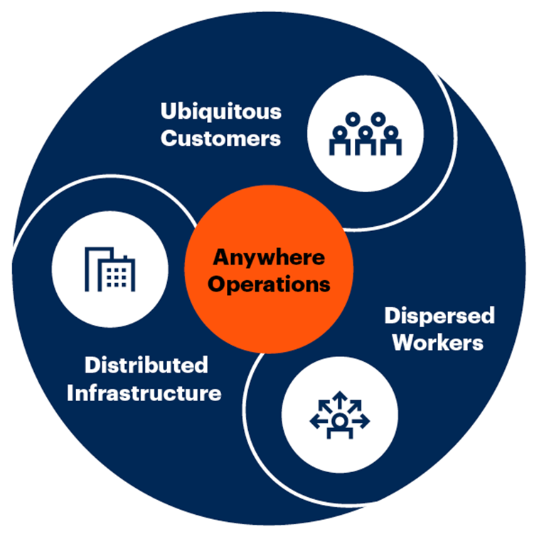
I&O Must Enable “Anywhere Operations”
Anywhere Operations Model
Source: Gartner
Notes:
“Anywhere operations” is an important concept that goes far beyond a remote workforce. However, enabling a remote workforce is the key priority for I&O leaders today and is a starting point for anywhere operations. The increase in remote work will be sustained long after the pandemic. The future of work will be the hybrid workplace and I&O customers will be ubiquitous. Infrastructure will be everywhere, and employees will be dispersed. This trifecta of forces — within and outside of the organization will trigger a ripple effect across the business.
So, what exactly is anywhere operations? Anywhere operations creates an IT operating model designed to support customers everywhere, enable employees everywhere and manage the deployment of business services across distributed infrastructure. Such an IT operating model will be a prerequisite to succeed in a post-COVID-19 economic environment that will be uncertain, volatile, complex and ambiguous.
This technology foundation comprises five building blocks:
Collaboration and productivity — Workstream collaboration, meeting solutions, cloud office suites, digital whiteboarding and smart workspaces.
Secure remote access — Passwordless and multifactor authentication, zero-trust network access (ZTNA), secure access service edge (SASE), and identity as the new security perimeter.
Cloud and edge infrastructure — Distributed cloud, the Internet of Things (IoT), API gateways, artificial intelligence (AI) at the edge and edge processing.
Quantification of the digital experience — Digital experience monitoring, workplace analytics, remote support and contactless interactions.
Automation to support remote operations — AI for IT operations (AIOps), endpoint management, SaaS management platforms, self-service and zero-touch provisioning.
For many organizations, the priority for anywhere operations right now is supporting and sustaining hybrid work for their employees.
Evidence and Related Research
Tool: Prepare I&O for the Everywhere Enterprise — G00727166
Top Strategic Technology Trends for 2021: Anywhere Operations — G00740658
Top Trends Impacting Infrastructure and Operations for 2021 — G00748316

Slide 14
Key Issues
What are the top challenges facing the infrastructure and operations leader?
What are the major trends affecting the infrastructure and operations leader?
What actions should an infrastructure and operations leader take to address these challenges?

Slide 15
Inspire and Engage to Lead in a Technology Democratized World
Envision
Enable
Share
Permit
Inspire
Engage
Compose
Attract
Use the ESCAPE Model to Drive Continuous Change
Source: Gartner
Notes:
This democratization of technology work is pervasive, and this CIO challenge is a trend that I&O leaders will have to continue to adapt to. We will continue to see an increasing in the importance of maturing a governance model that accommodates infrastructure (especially cloud), services and technology work that are not directly sourced out of I&O. I&O leaders have a key role to play to ensure organization enablement.
Traditional leadership approaches and organizational change management (OCM) is insufficient in a digital era of uncertainty, constant change and where technology governance and support is as important as technology service delivery.
In today's world, where uncertainty abounds and a response brings stability that lasts a few months at best, IT systems are produced and evolved through agile deployment based on adaptation or change. In such a business environment, classic change management alone is not enough. Digital business demands cultural and organizational transformation beyond change management. Many Gartner clients struggle with this transformation because they are missing a key ingredient — I&O leaders and their leadership teams must evolve first.
We are in an environment of constant change. I&O leaders must evolve their role in change management and become change leaders. They must commit to changing ingrained leadership practices that hold an organization to the past. Change-leading I&O leaders do not dictate changes. Instead, they must set an inspiring course and capitalize on open-source change management to co-create a path forward. They must engage the entire organization on the change journey.
The ESCAPE model can help change-leading I&O leaders to attain success.
Notice that the ESCAPE model is an infinity sign because it is important to circle back through the steps continuously. We are no longer in a world where we can set a direction that stays the same for years. I&O leaders need to constantly be surveying the environment — externally and internally — and adapting their plans and strategies.
For the ENGAGE phase, employees evolve. Roadblocks that were a problem for them in the previous quarter might not be in the next, and a different set will crop up.
I&O should be continuously engaged and should inspire. It should not fall back into the traditional response mode. A command-and-control leadership style does not foster servant leadership in I&O teams. In fact, it can inhibit the team’s ability to drive innovation and agility. I&O leaders must assess and adapt their leadership style to better support digital transformation using the 10 key competencies of servant leaders.
Evidence and Related Research
Use the ESCAPE Model to Develop Change Leadership — G00360911
Open Source Change: Making Change Management Work — G00347078
2021 IT Score for I&O: Top 3 Strategic Priorities for I&O Leaders — G00737149
An I&O Leader’s Framework for Essentialism — G00733801
The Infrastructure and Operations Leader’s First 100 Days — G00390177

Slide 16
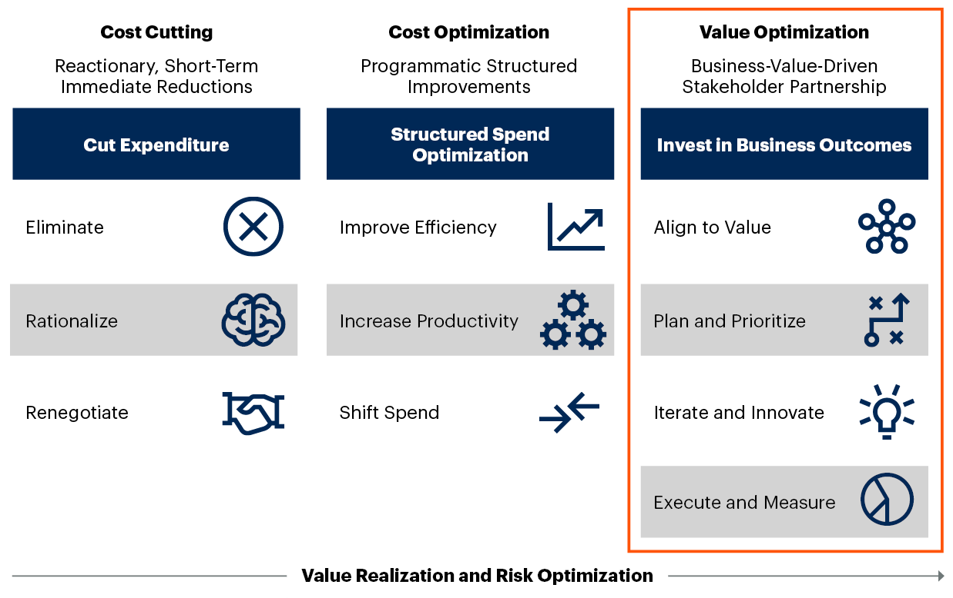
Prioritize Value Optimization
Cost Management Approaches
Evolving Cost Management Approach With Enterprise Needs
Source: Gartner
Notes:
I&O leaders must examine their mindsets regarding costs. All are familiar with the perennial reality of cost optimization (and most often cost cutting). It’s time to cultivate acumen around a balanced and intelligent cost management strategy. I&O leaders must seek a balance between cost cutting, cost optimization and value optimization (from net new investments) to maximize customer value.
Effective cost management requires balancing these three activities to achieve business outcomes in a sustainable fashion. The balance must consider the macro effects on I&O’s annual budget (which may be a decrease or an increase).
For 2021, the I&O Leaders Survey findings show an average budget increase of between 1% and 5%, which should be viewed as net new investment in innovation. Being able to invest at a time when there is incredible financial pressure on many organizations is an opportunity not to be missed — especially when the I&O leader has a newfound visibility and is in the senior leadership spotlight.
Evidence and Related Research
Gartner’s 2021 Annual I&O Leaders Survey was conducted online from 14 June 2021 to 25 June 2021 to track burning issues for I&O leaders and where they are prioritizing their investments over the next year. It also explored investments in cost optimization and innovation strategies. In total, 96 Research Circle members participated.
Cost Optimization for Value Realization — G00720156
Revamp Your I&O Finance and Budgeting Process for Digital Innovation — G00741233
Case Study: CIO-CFO Partnership on IT Cost Optimization (Net4Gas) — G00713782
Ignition Guide to Efficient Cost Management in I&O — G00731762

Slide 17
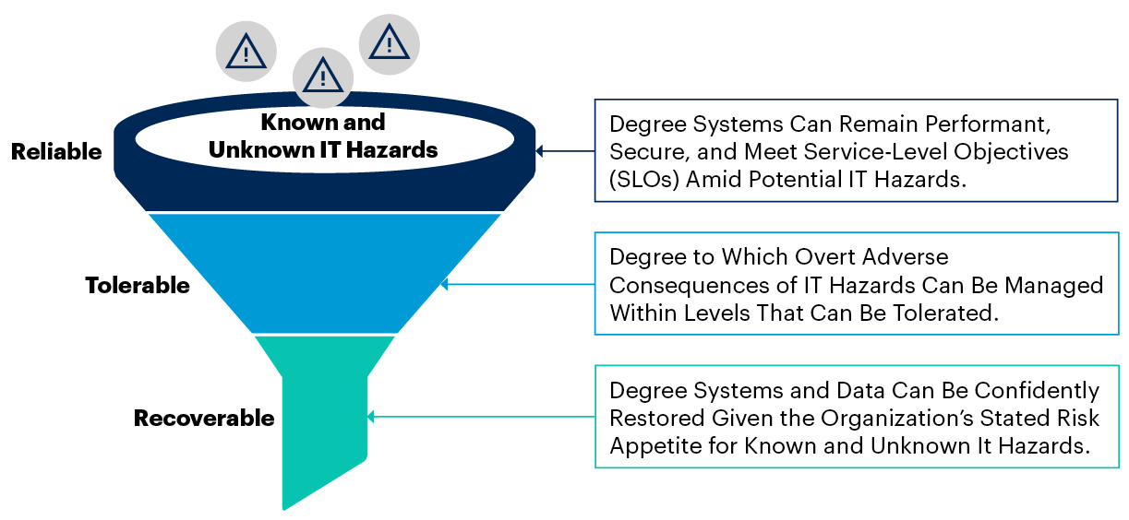
Balance Resilience With Agility
High-Level IT Resilience Taxonomy
Tailor Resilience to I&O Product
Source: Gartner
Notes:
Change and release management are often treated as a final, rushed afterthought. However, improvements in this area can be a significant payoff for most organizations because they provide positive dividends across all three IT resilience elements — reliability, tolerability and recoverability. Done right, this can minimize technical debt and enable, not restrict I&O agility.
Improving resilience can be hard battle to fight when trying to get stakeholder approval and investment. The global COVID-19 pandemic has shone a light on areas of necessity, but I&O leaders mustn’t be lax in pursuing improved resilience to fit their product needs.
There are two general approaches:
Carrot: Evangelize that the intent is to help the organization grow and persevere by improving productivity, quality and effectiveness. Focus on quick wins, iterative improvement and co-created risk narratives to build credibility and buy-in. Most successful programs are directly aligned to meet the defined objectives of the business. This is the preferred strategic approach for most initiatives.
Stick: This approach tends to lead to more short-lived, box-ticking projects than the others. But befriending audit teams has served to compel support for many teams desperately wanting to improve IT resilience.
To improve resilience and security without impacting agility, I&O leaders must balance reliability, tolerability and recoverability with agility appropriate to each I&O product.
Evidence and Related Research
IT Resilience — 7 Tips for Improving Reliability, Tolerability and Disaster Recovery — G00746016
3 Areas for Security and I&O to Improve IT Resilience — G00722397

Slide 18
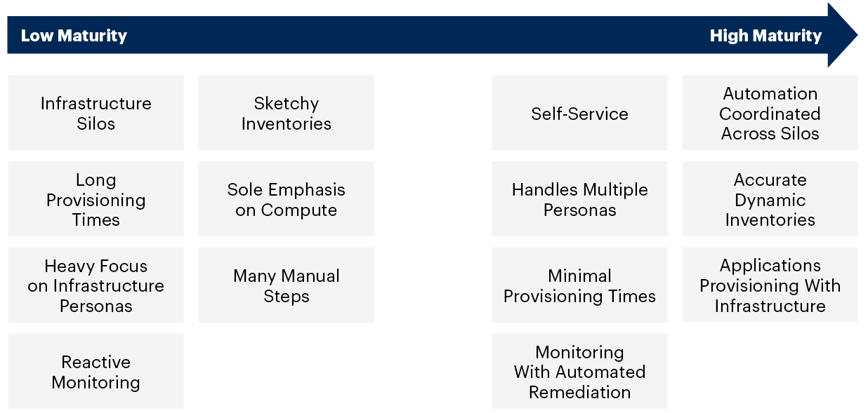
Improve Automation Maturity
Automation Maturity Characteristics
Source: Gartner
Notes:
Organizations with high automation maturity show the characteristics on the right of the graphic. But this isn’t achieved over night. It requires the right resources, skills, tools and a focused plan aligned to goals and outcomes.
The I&O Leaders Survey showed that lowering costs was the No. 1 goal for applying automation, but automation has many goals. For some, the ability to maintain services with limited staff overrides their ambition for cost reduction. This goal cannot be achieved without upskilling those existing teams to mature automation capabilities.
Evidence and Related Research
Gartner’s 2021 Annual I&O Leaders Survey was conducted online from 14 June 2021 to 25 June 2021 to track burning issues for I&O leaders and where they are prioritizing their investments over the next year. It also explored investments in cost optimization and innovation strategies. In total, 96 Research Circle members participated.
Hype Cycle for I&O Automation, 2021 — G00747580
Market Guide for Service Orchestration and Automation Platforms — G00721991
How to Start Executing a Successful Automation Strategy — G00721030
To Automate Your Automation, Apply Agile and DevOps Practices to Infrastructure and Operations — G00720955

Slide 19
Identify, Then Forward-Fill Critical Skills
Critical Skills
Advanced Analytics
Automation
More personalization of customer demand
Reducing errors from manual work, improving quality and freeing up staff
Continuous
Delivery
High
Core
Cloud
More frequent and iterative customer feedback
Greater flexibility and speed to market
Current Job Openings
Medium
Low
Legacy
Niche
Low
Medium
High
Demand Pressure
The categories of skills consist of:
Cloud: PaaS, IaaS, Kubernetes and Cloud Architecture.
Advanced Analytics: Artificial Intelligence, R, Machine Learning, Python, Data Science, Data Integration, Business Analysis and Business Intelligence.
Continuous Delivery: Agile Software Delivery, DevOps, Scrum Methodology, User Experience (UX) and Continuous Integration.
Automation
Source: Gartner
Notes:
When determining which I&O skills to prioritize for the future, I&O leaders should generally focus on the skills that are expected to be in high demand, which are also difficult to find — for example, the skills in the critical skills quadrant. Based on the analysis of all segments in the IT talent quadrant, the skills in the critical need's quadrant are also the ones that can help I&O achieve its customer-centric goals of speed, agility and efficiency. Specifically, they include four types of IT skills:
Advanced analytics skills that support the personalization of demand from I&O’s customers — such as artificial intelligence (AI), R, ML, Python, data science, data integration, business analysis and business intelligence (BI) skills.
Continuous delivery skills that enable frequent and iterative customer feedback — such as agile software delivery, DevOps, scrum methodology, user experience and continuous integration.
Cloud-related skills that support greater flexibility and speed to market — such as platform as a service (PaaS), infrastructure as a service (IaaS), Kubernetes and cloud architecture.
Automation skills that encourage the reduction of errors from manual work.
In the 2021 I&O Leaders Survey the top three skills categories included:
Cloud and edge (PaaS, Kubernetes, IoT, infrastructure as a service [IaaS] and SaaS)
Automation
Continuous delivery (Scrum management, agile, DevOps and SRE)
These all fall within the critical skills quadrant.
Going forward with the expected skills and labor shortage, combined with job shifting that has occurred, employee retention will require improved internal processes. Hence the importance of adaptive resilience, combined with automation to remain agile — empowering employees and creating sustainable work patterns.
Evidence and Related Research
Gartner’s 2021 Annual I&O Leaders Survey was conducted online from 14 June 2021 to 25 June 25 2021 to track burning issues for I&O leaders and where they are prioritizing their investments over the next year. It also explored investments in cost optimization and innovation strategies. In total, 96 Research Circle members participated.
Building the I&O Talent Strategy: Key Insights From the 2020 IT Skills Roadmap — G00721659
2020 IT Skills Roadmap Workshop Tool: Roadmap Your IT Skills of the Future — G00723578

Slide 20
Enable Hybrid and Distributed Work
Adapt to multiple physical employee work locations
Embrace zero-trust and perimeter security
Optimize change and release — especially onboarding and offboarding
Measure experience, leverage analytics to target automation investments
Cloudify application access
Implement workplace resource scheduling applications
Source: Gartner
Notes:
In a post-COVID-19 working environment, over 80% of employees will be working in some kind of “hybrid working” environment. This means that I&O leaders need to prepare for many different working scenarios that require the organization to address the following parameters:
Connectivity — IT needs to be prepared to support wired, Wi-Fi or cellular connectivity from the workplace, in the office or in a coffee shop. This requirement adds another dimension to the “anywhere operations” scenario because today’s connectivity will be different tomorrow.
Security — Security will remain a critical issue and with devices connecting from “anywhere,” it is important that IT embraces zero-trust. If you don’t know who they are, they don’t get on the network. This helps not only for known corporate devices, but also provides a cohesive strategy that addresses discovery, identification, authentication and policy for any device that is added to the network whether it is IT, the line of business or facilities.
IT cannot be everywhere and while this have always been true for distributed work environments such as retail, utilities, oil and gas or banking, it now holds true for corporate campuses where skill shortages contribute to the lack of resources. For this, IT needs to optimize remote change and release processes, especially with onboarding and offboarding for asset provisioning and recovery. They need to “step away from the management console” and let the network automatically resolve issues to meet SLAs that require high availability and bandwidth performance.
And where possible, eliminate the bottleneck of going through the corporate network. This means moving applications to the cloud.
Lastly, hybrid work means that employees will be returning at different times on different days. To maximize the working environment will require more than Outlook calendars for each cube or conference room. It will require enhancing the employee experience with workplace resource scheduling applications that assist employees in finding the right desk, with the right attributes, at the right time.
Evidence and Related Research
Tool: Prepare I&O for the Everywhere Enterprise — G00727166
Top Strategic Technology Trends for 2021: Anywhere Operations — G00740658
Top Trends Impacting Infrastructure and Operations for 2021 — G00748316
Enhance Digital Workplace Operations With Machine Learning and Automation — G00725778

Slide 21

Action Plan for Adaptive Resilience
Lead in a Technology Democratized World
Balance Resilience With Agility
Improve Automation Maturity
Prioritize Value Optimization
Forward-Fill Critical Skills
Enable Hybrid and Distributed Work
Source: Gartner
Notes:
I&O leaders must:
Lead in a technologically democratized world. Implement a new operating model. Embrace risk and help drive market disruption. Focus on a culture that is adaptable, agile, innovative and highly collaborative. Govern, consult, influence, build, support and deliver.
Balance resilience with agility. Balance the three IT resilience elements (reliability, tolerability and recoverability). Done right, this can minimize technical debt and enable — not restrict — I&O agility.
Improve automation maturity. Shift to high-maturity automation states and unlock reduced cost, increased value, faster service deployment and improvements in quality and availability.
Prioritize value optimization. Strike a balance between cost cutting, cost optimization and net new investment to maximize customer value. Put the emphasis on value creation.
Forward-fill critical skills. Recruit for the future skills gap and get out of the backfill trap. The gap is growing so act now.
Enable hybrid and distributed work. Take the next step on the journey to supporting employees, customers and infrastructure that will be anywhere and everywhere by focusing on the new hybrid working models.

Slide 22
Recommended Gartner Research
Adopt New I&O Organizational Structures to Drive Digital Transformation Mark Margevicius, Duncan Prosser (G00722295)
Top Strategic Technology Trends for 2021: Anywhere Operations
Manjunath Bhat, Tony Harvey (G00740658)
Top Trends Impacting Infrastructure and Operations for 2021
Jeffrey Hewitt (G00748316)
Transforming I&O Skills to Remain Viable Through 2022 and Beyond Mark Margevicius (G00727166)
Ignition Guide to Building a Cloud Center of Excellence Infrastructure and Operations Research Team (G00710097)
Hype Cycle for I&O Automation, 2021 Chris Saunderson (G00747580)
Top Strategic Technology Trends for 2021: Distributed Cloud
David Smith and Others (G00742691)

Slide 23
Appendix

Slide 24
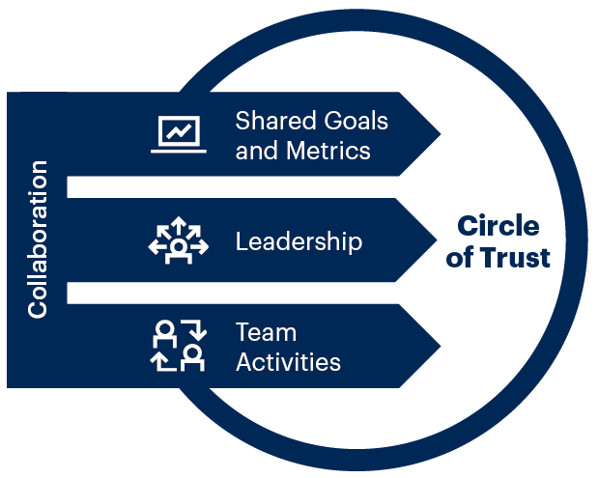
Foster Culture Change to Enable a New I&O Operating Model
People
How to Build a Collaborative DevOps Culture
Source: Gartner
Notes:
Culture is the set of behavioral norms and unwritten rules that shape the organizational environment and how individuals interact and get work done in that environment. Because culture is vast, nebulous and deeply ingrained in the organization, it can, at times, feel daunting to tackle. However, the time is now.
I&O organizations must transform their culture to be more agile and customer-focused. However, cultural change can be complex and time-consuming, but it must be done in order to move forward with everything outlined in this Leadership Vision.
It is important to realize that I&O leaders who pursue complex, large-scale cultural interventions often fail to deliver the desired change, leading to wasted resources and change fatigue. Hacks, open-source change and other alternative techniques have proven to be much more viable for driving incremental and sustainable culture change. I&O leaders must:
Improve employee engagement in collaborative initiatives by establishing shared goals and metrics for DevOps team members.
Adopt a servant-leadership style by empowering decision-making autonomy, embracing acceptable levels of risk, rewarding innovation and not penalizing failure.
Drive cultural transformation by implementing trust-building practices.
Evidence and Related Research
How to Build a Collaborative DevOps Culture — G00732451

Slide 25
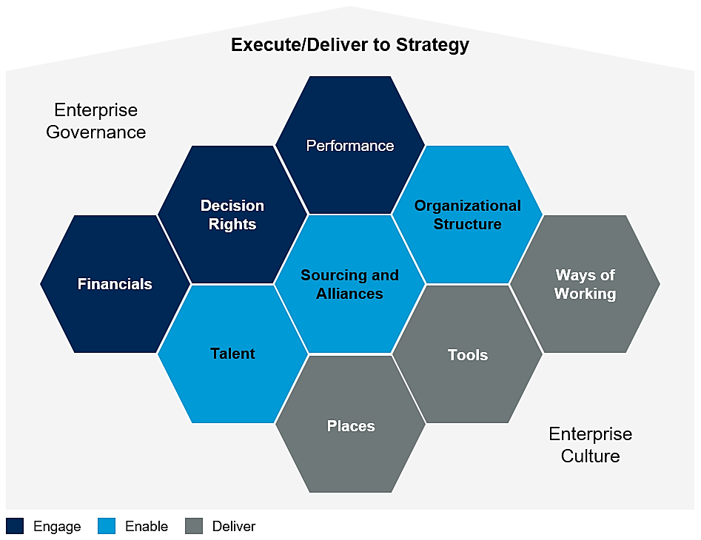
Optimize the I&O Operating Model
Business Mgmt.
Source: Gartner
Notes:
An operating model explains how things get done in the organization. As a critical function within information and technology (I&T), infrastructure and operations leaders must establish and manage their own operating models in alignment with their organizations’ overall plans to support the execution of I&O strategies.
I&O leaders often conflate an I&O operating model with their organizational structure. Although organizational structure is the most visible component of the operating model, it is only one of nine essential components and does not show how work is performed or how outcomes are achieved.
I&O leaders must define and implement a complete I&O operating model that aligns with the organization’s overall I&T operating model and the enterprise’s strategic objectives. Design the I&O operating model to support the roles that contribute to running, enhancing and growing the business. In doing so, I&O leaders will greatly enhance their ability to improve the organization’s maturity, align and adapt to business change, and achieve transformation goals.
Evidence and Related Research
Embrace an I&O Operating Model to Support Digital Transformation — G00721439
Adopt New I&O Organizational Structures to Drive Digital Transformation — G00722295

Slide 26
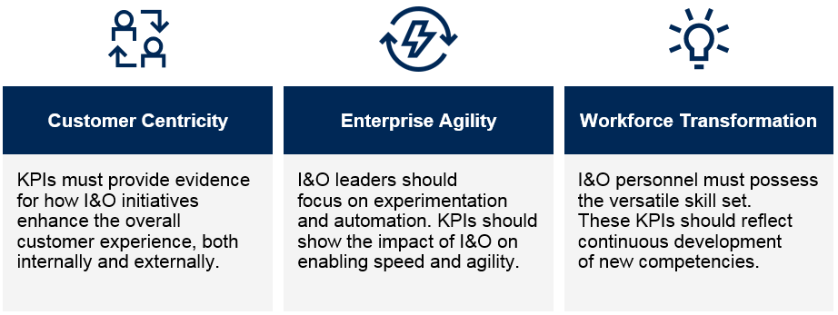
Share I&O KPIs Relevant to Business Goals
Business Mgmt.
Primary Areas of Focus for I&O KPIs
Business Value
Source: Gartner
Notes:
Rethinking key performance indicators (KPIs) and reporting is a critical aspect of telling I&O’s value story, changing perception and shifting the optics. It is time to completely overhaul the metrics portfolio. Rather than just demonstrating I&O’s adherence to standard service cost and quality expectations, I&O KPIs in digital business transformation demonstrate I&O’s contributions to IT’s overall mission. That mission is to enable enterprise agility, scalability and customer centricity.
As such, infrastructure scorecards expose shared metrics that demonstrate the extent to which IT enables digital business transformation.
I&O KPIs that are part of a digital transformation should demonstrate:
Customer centricity: Contributing to internal and external customers’ success, rather than just maintaining infrastructure service.
Enterprise agility: Assisting IT and the enterprise to go faster and quickly meet new demands, rather than just making infrastructure processes go faster.
Workforce transformation: Demonstrating how infrastructure’s workforce is transforming work in DevOps and other agile paradigms, and in multidisciplinary and interconnected teams.
Other Focus 1 KPIs might include handoffs minimization scores, before-and-after cloud comparisons, defect-based release quality, mean time to recovery, or cloud cost efficiency.
Other Focus 2 KPIs might include end-to-end service line health impact.
Other Focus 3 KPIs might include skills change velocity index, digital skills recruitment and versatile experiences distribution.
One KPI that is never far from an I&O leader is cost.
Evidence and Related Research
15 Infrastructure KPIs for Digital Business Transformation — G00704096
Adopt I&O Key Performance Indicators to Deliver Digital Business Value — G00385601
8 KPIs That Demonstrate How Self-Service Initiatives Advance Your IT Service Desk — G00316090

Slide 27
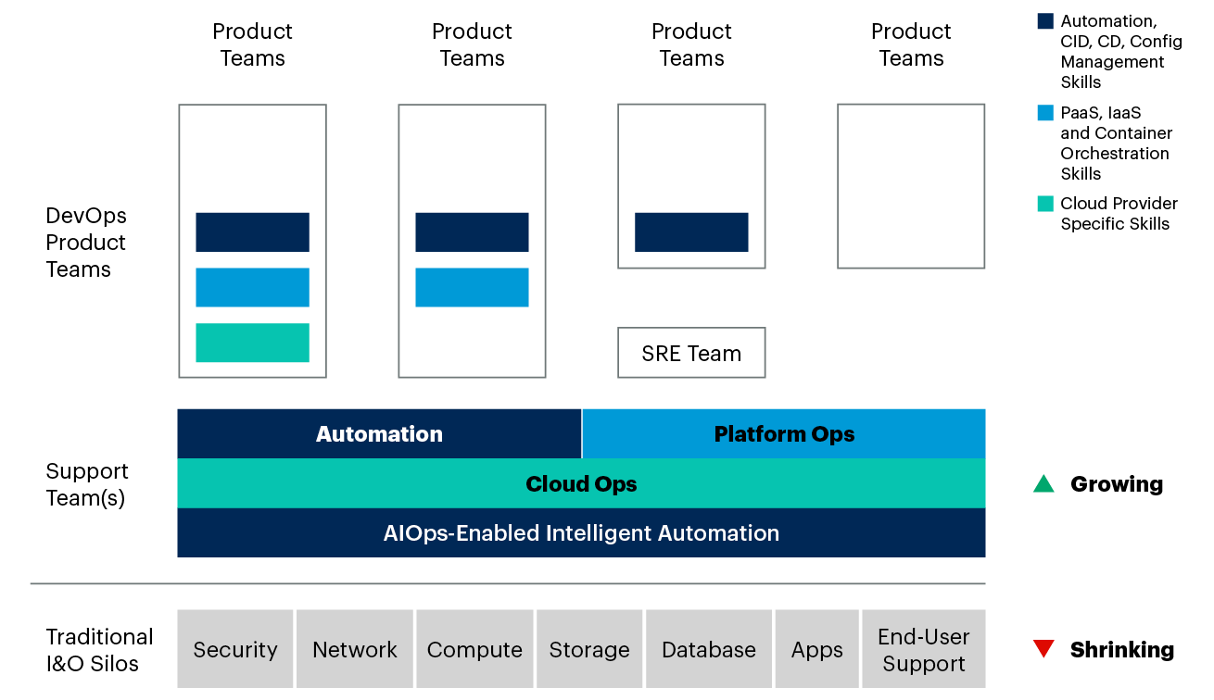
Create an Effective Organization Structure
People
I&O Leaders Need to Refocus Their Teams to Scale Digital Journeys
Source: Gartner
Notes:
I&O organizations must transform their structures to meet evolving digital business needs driven by adoption of cloud, DevOps and product delivery. I&O leaders should evaluate organizational structure models and implement the optimal combination of structures based on their operating model.
I&O leaders must identify organizational structure models that best align with their I&O operating model and business needs. To do this, they must evaluate common models that can support hybrid models (both new and “legacy”). As things evolve and shift, this will become a reality for most organizations.
There is no single best organizational structure model for I&O. In many cases, I&O leaders should combine multiple organizational structure models into their overall structure.
I&O leaders must supplement their traditional model with one or more agile structures to become more efficient at organizing their teams, assigning work and establishing efficient workflows.
Creating agile product teams and cross-functional support teams to supplement and perhaps replace traditional siloed domain teams is a common trend. I&O leaders will complement these changes with more agile organizational structure models (for example, a cloud center of excellence, or agile communities of practice). This allows them to create an I&O organization that better supports:
Cloud platforms
DevOps
Pace-layered application portfolios
Agile development cycles
Product-aligned delivery
Evidence and Related Research
Adopt New I&O Organizational Structures to Drive Digital Transformation — G00722295
Design the I&O Organization for Digital Transformation Using a Cloud Service Brokerage — G00727002

Slide 28
Lower Technical Debt Using This Framework
Process
Infrastructure Technical Debt Management
Leave It
Love It
Low
Sustainable Infrastructure
Platform Infrastructure
Technical Debt (Complexity)
Lose It
Modernize It
Intractable Infrastructure
Upgradable Infrastructure
High
Low
Business Value (ROI)
High
Source: Gartner
Notes:
As with financial debt, taking on technical debt can be beneficial for accomplishing tasks that would otherwise require additional resources to deploy. Thus, when facing constraints on time, resources and skills, I&O leaders may deploy suboptimal practices for short-term expediency. However, when the scale of technical debt becomes unmanageable, these leaders are forced to refactor or replace complex legacy systems.
Evidence and Related Research
How to Assess Infrastructure Technical Debt to Prioritize Legacy Modernization Investments — G00728674
Case Study: Stakeholder Incentives for Technical Debt Management (Intel) — G00740371

Slide 29
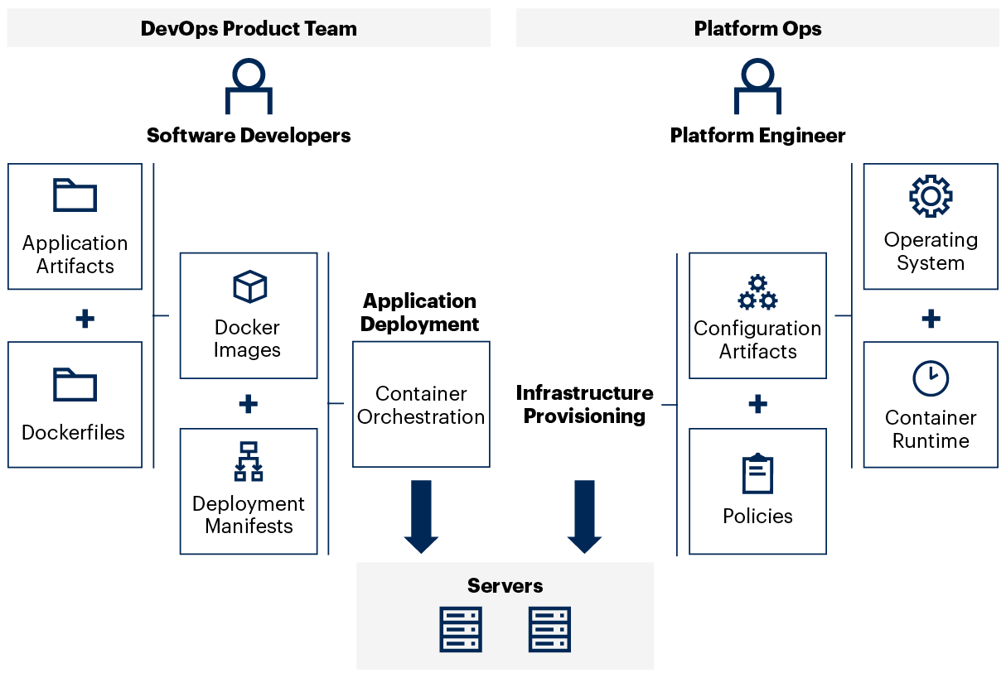
Combine DevOps With Platform Ops
Process
Platform Operations
Source: Gartner
Notes:
Running containers in production with a continuous delivery pipeline requires new processes, skills and tools. I&O leaders must automate tasks associated with container orchestration, create roles to manage continuous integration/continuous delivery (CI/CD) infrastructure pipelines and implement version control for container artifacts.
Foster a culture of collaboration between I&O and the development community by collaborating with application development teams to define roles for creating, securing, deploying, managing and monitoring containers in production.
For larger organizations with multiple development teams practicing DevOps, it is recommended that I&O leaders look toward a platform-operations orientation. Here, platform operations is a separate group that sits between application development teams and the I&O group. Once multiple DevOps teams are formed, I&O should embrace platform operations that manage and share the same container orchestration platform.
Evidence and Related Research
Quick Answer: How Should I&O Leaders Introduce Software Engineering Skills to DevOps Platform Teams? — G00746096
Best Practices to Enable Continuous Delivery With Containers and DevOps — G00720015
Using Platform Ops to Scale and Accelerate DevOps Adoption — G00720736
Infographic: Top 10 Technology Trends Impacting DevOps — G00738803
Why DevOps Success Requires Platform Teams — G00733282

Slide 30
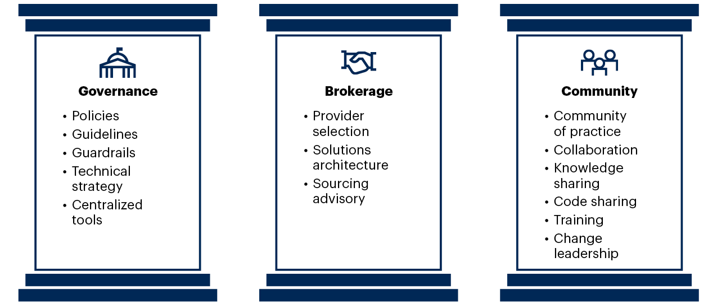
Use Centers of Excellence to Mature Governance of Federated Services
Process
The Three Pillars of a Cloud Center of Excellence
Source: Gartner
Notes:
The I&O leader’s role as service broker and governor is becoming more important and the role of infrastructure custodian is receding in an increasingly technologically democratized world. I&O leaders must change their leadership style (explored in the ESCAPE model), to influence multiple stakeholders. One effective way to mature a governance strategy is via a center of excellence. The most pressing need from a governance perspective is for external cloud service enablement and growth. A cloud center of excellence (CCOE) is focused on answering “how” to do cloud (while a cloud advisory council is more focused on addressing “why”). The I&O leader will often lead or be a primary contributor, influencer and stakeholder for the CCOE.
The CCOE has three core pillars:
Governance: The CCOE creates cloud-computing-related policies and selects governance tools. Policy is created via IT collaboration with a cross-functional team and enforced by a mixture of tools and appropriate organizational processes. This approach provides appropriate risk management, and financial management.
Brokerage: The CCOE assists users in selecting cloud providers, architects cloud solutions and collaborates with the sourcing team for contract negotiation and vendor management.
Community: The CCOE raises the level of cloud knowledge in the organization, and captures and disseminates best practices. This is accomplished using a knowledge base, source-code repository, cloud community of practice councils, training events, and outreach and collaboration throughout the organization.
Evidence and Related Research
How to Deploy a Cloud Center of Excellence — G00739627
Ignition Guide to Building a Cloud Center of Excellence — G00710097
Innovation Insight for the Cloud Center of Excellence — G00726566
The Future of Cloud in 2025: From Technology to Innovation — G00736407

Slide 31
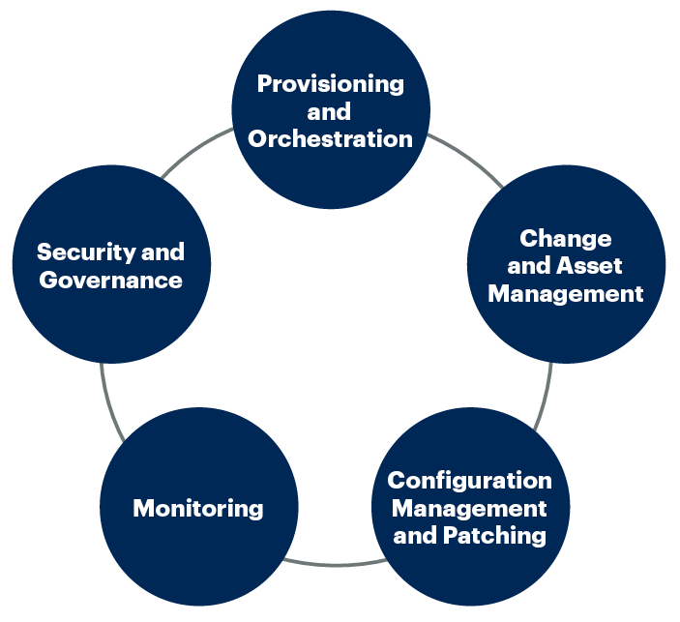
Five Key I&O Process Areas to Automate
Process
Source: Gartner
5
Notes:
I&O Automation is primarily targeted in five areas:
Provisioning and orchestration
Change and asset management
Configuration management and patching
Monitoring
Security and governance
The key efficiencies that I&O leaders gain by automating these processes are:
Cost and value — The elimination of repetitive tasks, allowing staff to focus on higher-value activities.
Speed — The elimination of manual handoffs or wait states, allowing services to be delivered more rapidly.
Quality and availability — Higher quality of services delivered, embedding best practices and predictability into delivered services, improving supportability.
Evidence and Related Research
Hype Cycle for I&O Automation, 2021 — G00747580
Market Guide for Service Orchestration and Automation Platforms — G00721991
How to Start Executing a Successful Automation Strategy — G00721030
To Automate Your Automation, Apply Agile and DevOps Practices to Infrastructure and Operations — G00720955

Slide 32



Think Platform, Not Infrastructure
Tech
Developer-Centric
Self-Service
Environment-Aware
Intelligence
Programmable
Orchestration (Modular)
Abstraction (Programmable)
Public Cloud Infrastructure
Modular
Virtualization Layer
Composable Infrastructure
Traditional Infrastructure
Converged/ Hyperconverged
Intelligent
Source: Gartner
Notes:
I&O leaders will have to architect and implement a platform, and decouple themselves from pure, discrete infrastructure-thinking.
As many organizations start to scale digital business projects, their goals (for example, reduced time to market, rapid functionality releases, and the ability to make rapid infrastructure changes) become critical. The urgency is clear, but how should organizations invest to create a platform to achieve these goals?
By designing, provisioning and operating a secure, API-driven infrastructure.
This will help to deliver continuous insights across IT operations management, and move beyond limited, “point-in-time” status updates. A continuous-delivery approach requires continuous insight and the ability to automate responses. This ensures that the right infrastructure resources are available at the right time and in the right place.
This approach must be environment-aware to achieve the best possible user experience given whatever infrastructure constraints may exist. The platform empowers the applications that are running on it to be self-sufficient. If the application requires more instances, it will request them using templates based on AI recommendations. If the environment needs more bandwidth, it will adjust what is currently available to it, and the same goes for every infrastructure component or any configuration in the platform that could satisfy its requirements. The platform also protects the app (and the developer) by ensuring that the app only uses proven, secure best-practice designs.
Shared, self-service platforms reduce the overlap and redundancy between teams — meaning you can achieve the economies of scale and the improved governance needed. The platform team builds infrastructure to be consumed as a product — by each product team. We invest in the products to meet our customers’ needs — and we learn those through collaborative organizational learning processes.

Slide 33
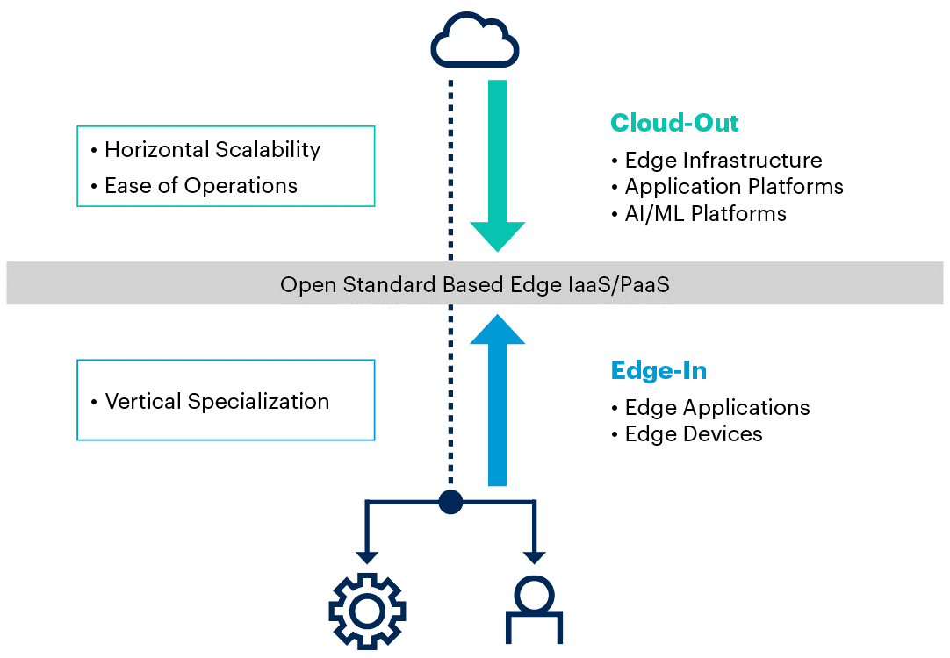
Distributed Cloud and Edge Provide a Platform for Innovation
Tech
The Combination of Cloud-Out and Edge-In
Source: Gartner
Notes:
Distributed cloud computing is a style of cloud computing where the location of the cloud services is a critical component of the model.
Most enterprises have a robust cloud computing strategy, focused on modernizing for a more agile and scalable back office. But digital business requires more. It requires an agile and real-time front office, at the “edge,” where customers, employees, assets and equipment interact with each other and the enterprise.
“Cloud-out” pushes the cloud architecture to edges, enabling consistent API and management between core and edges. Hyperscale cloud service providers are driving this architecture with distributed cloud concepts.
“Edge-in” involves designing edge infrastructure and applications independently from any public cloud that they may connect to. Independent software vendors (ISVs) and system integrators (SIs) that have strengths in edge are typically using this architecture for cloud-independent solutions.
This model aims to allow layers close to the core cloud to be designed with cloud-out, and the other layers close to the edge to be designed with edge-in. A common combination will be cloud-out for IaaS and PaaS or cloud infrastructure and platform services (CIPS) layers (where horizontal scalability and simple operations are important), and edge-in for device/application layers (where vertical specialization is important).
Evidence and Related Research
‘Distributed Cloud’ Fixes What ‘Hybrid Cloud’ Breaks — G00441616
Infographic: How to Make the Right Choice Between Hyperconverged, Traditional and Distributed Cloud Infrastructure — G00718873
A Guide to Distributed Cloud: The Next Frontier of Cloud Computing — G00726544
Top Strategic Technology Trends for 2021: Distributed Cloud — G00742691

Slide 34
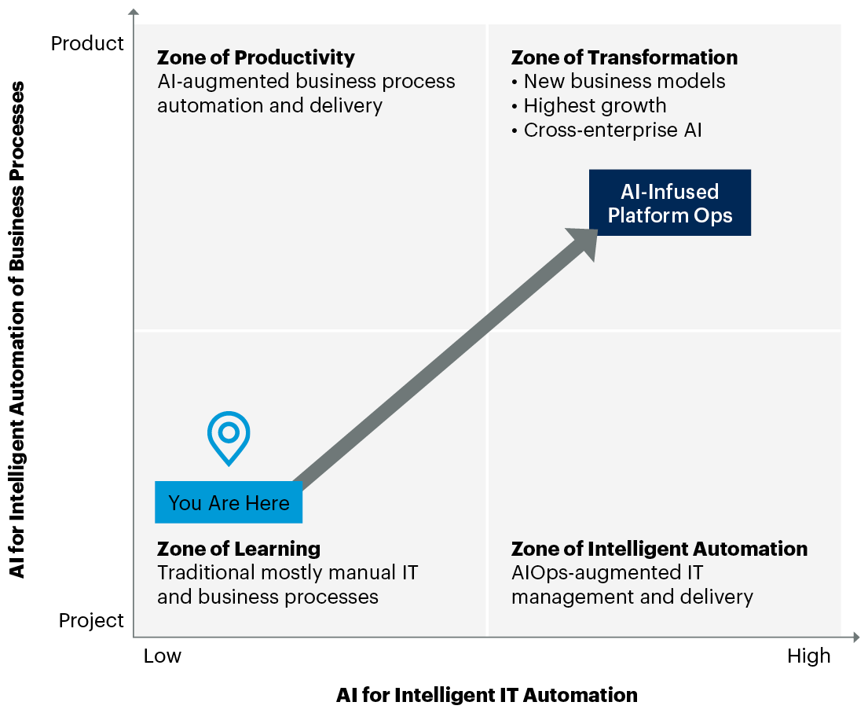
Use Artificial Intelligence to Drive New Business Growth
Tech
Gartner AI Zone Framework
Source: Gartner
Notes:
I&O leaders must look beyond optimization for AI deployments. Most IT and I&O organizations start their AI initiatives in the zone of learning. This is where they develop their understanding of AI and the skills necessary to implement it. They then progress to driving automation using AI, which results in improved efficiency and optimization of the services and products they provide.
Likewise, business unit AI projects begin in the zone of learning and then progress into the zone of productivity as they embark on a product-oriented approach for their digital initiatives. This leads to improved results and productivity from their business processes.
However, the most valuable aspect of AI is that it can aid in the transformation of the business. AI allows new business models, which enable an organization to drive additional growth, and improve customer satisfaction. I&O leaders should work with their line-of-business managers to move from the zone of automation and zone of productivity to the zone of transformation.
I&O leaders can use AI to drive many of their I&O initiatives, such as service management, application performance monitoring (APM), workload optimization and cloud management.
Evidence and Related Research
5 Steps to Practically Implement AI Techniques — G00383797
Innovation Insight for AI in IT Transformation — G00734609

