Slide 1
How Radio Spectrum Impacts CSPs’ 5G Deployment and Monetization
Example Cases From the U.S. and Japan
Kosei Takiishi
CSP Industry Team | July 2021
Notes:
Ver 2020-1119
Presenter's Name
Presenter's Name

Slide 2
Contents
5G Spectrum Standardization and Fragmentation
Factors Affecting CSPs’ 5G Spectrum Strategies
Example Cases: T-Mobile in the U.S. and KDDI in Japan

Slide 3
Tentative Timeline of Standards Development for 5G and 6G
WRC, held every 3 to 4 years, is the main mechanism for updating the ITU Radio Regulations — the global agreement on how to define, allocate and use airwaves.
2013
2014
2015
2016
2017
2018
2019
2020
2021
2022
2023
2024
2025
2026
2027
2028
2029
2030
ITU
ITU-R establishes harmonized global standards of IMT-2000 (3G) and IMT-Advanced (4G) and IMT-2020 (5G).
WRC revises the Radio Regulations and any associated frequency assignment and allotment plans
IMT-2020/5G
Concept, Vision, Techs
KPI
Proposal
Specs
5G-Advanced
IMT-2030/6G
Concept, Vision, Techs
KPI
Proposal
Specs
WRC-15
WRC-19
WRC-23
WRC-**
3GPP
develops protocols for mobile telecommunications
3GPP Releases
R14
R15
R16
R17
R18
R19
R20
R21
R22
R23
Source: Gartner
Notes:
The International Telecommunication Union (ITU) is a specialized agency of the United Nations (UN) responsible for all matters related to information and communication technologies
The ITU Radiocommunication Sector (ITU-R) plays a vital role in the global management of the radio-frequency spectrum and satellite orbits — limited natural resources which are increasingly in demand from a large and growing number of services such as fixed, mobile, broadcasting, amateur, space research, emergency telecommunications, meteorology, global positioning systems, environmental monitoring and communication services.
The World Radiocommunication Conference (WRC) is a conference organized by the ITU to review and, as necessary, revise the Radio Regulations, the international treaty governing the use of the radio-frequency spectrum as well as geostationary and non-geostationary satellite orbits.
The 3rd Generation Partnership Project (3GPP) is an umbrella term for a number of standards organizations which develop protocols for mobile telecommunications

Slide 4
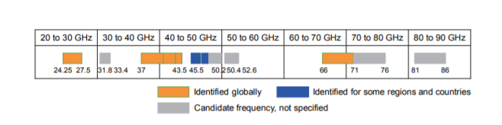
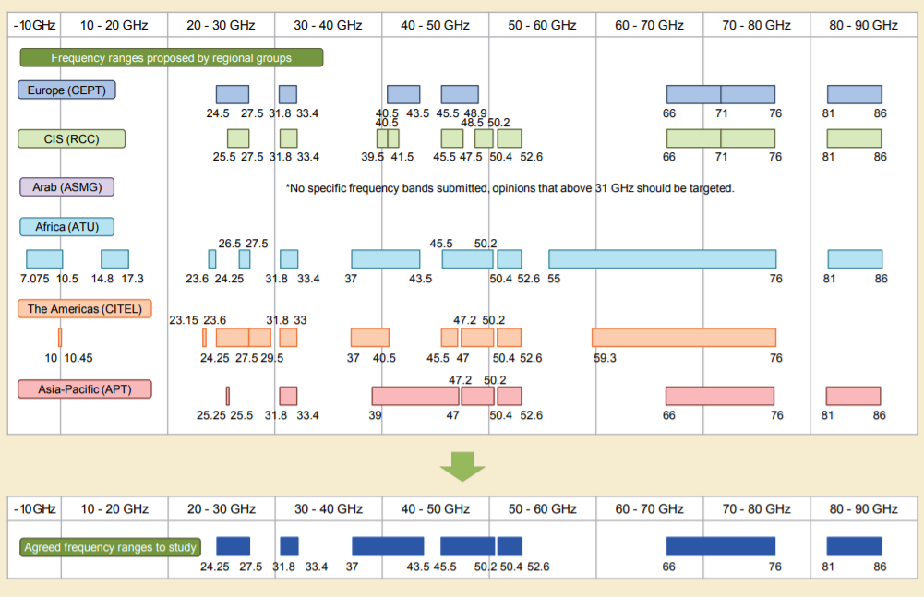
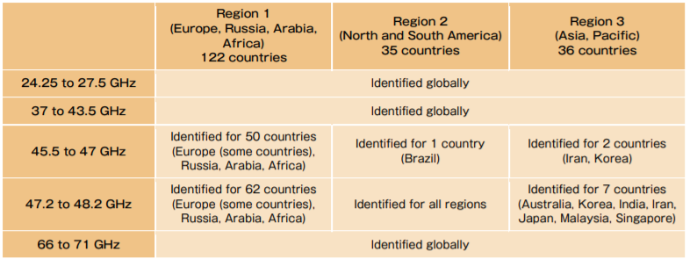
ITU WRC Results for 5G Frequency Candidates
Frequency fragmentation is the product of a compromise after coordination by stakeholders around the world
ITU WRC-15 result from NTT DOCOMO Technical Journal Vol.18 No.1
ITU WRC-19 result from NTT DOCOMO Technical Journal Vol.22 No.1
Source: NTT DOCOMO
Notes:
On each WRC, representatives from each country/region discuss frequency allocation and set global directions.
NTT Docomo sources:
https://www.nttdocomo.co.jp/english/binary/pdf/corporate/technology/rd/technical_journal/bn/vol18_1/vol18_1_010en.pdf
https://www.nttdocomo.co.jp/english/binary/pdf/corporate/technology/rd/technical_journal/bn/vol22_1/vol22_1_006en.pdf

Slide 5
3GPP R14 4G Spectrums Standardization
3GPP R14 only standardizes less than 6GHz for 4G.
E‑UTRA Operating Band | Uplink (UL) operating band BS receive UE transmit |  |  | Downlink (DL) operating band BS transmit UE receive |  |  | Duplex Mode
 | F_{UL_low} – F_{UL_high} |  |  | F_{DL_low} – F_{DL_high}
1 | 1920 MHz | – | 1980 MHz | 2110 MHz | – | 2170 MHz | FDD
2 | 1850 MHz | – | 1910 MHz | 1930 MHz | – | 1990 MHz | FDD
3 | 1710 MHz | – | 1785 MHz | 1805 MHz | – | 1880 MHz | FDD
4 | 1710 MHz | – | 1755 MHz | 2110 MHz | – | 2155 MHz | FDD
5 | 824 MHz | – | 849 MHz | 869 MHz | – | 894MHz | FDD
6 | 830 MHz | – | 840 MHz | 875 MHz | – | 885 MHz | FDD
7 | 2500 MHz | – | 2570 MHz | 2620 MHz | – | 2690 MHz | FDD
8 | 880 MHz | – | 915 MHz | 925 MHz | – | 960 MHz | FDD
9 | 1749.9 MHz | – | 1784.9 MHz | 1844.9 MHz | – | 1879.9 MHz | FDD
10 | 1710 MHz | – | 1770 MHz | 2110 MHz | – | 2170 MHz | FDD
11 | 1427.9 MHz | – | 1447.9 MHz | 1475.9 MHz | – | 1495.9 MHz | FDD
12 | 699 MHz | – | 716 MHz | 729 MHz | – | 746 MHz | FDD
13 | 777 MHz | – | 787 MHz | 746 MHz | – | 756 MHz | FDD
14 | 788 MHz | – | 798 MHz | 758 MHz | – | 768 MHz | FDD
15 | Reserved |  |  | Reserved |  |  | FDD
16 | Reserved |  |  | Reserved |  |  | FDD
17 | 704 MHz | – | 716 MHz | 734 MHz | – | 746 MHz | FDD
18 | 815 MHz | – | 830 MHz | 860 MHz | – | 875 MHz | FDD
19 | 830 MHz | – | 845 MHz | 875 MHz | – | 890 MHz | FDD
20 | 832 MHz | – | 862 MHz | 791 MHz | – | 821 MHz | FDD
21 | 1447.9 MHz | – | 1462.9 MHz | 1495.9 MHz | – | 1510.9 MHz | FDD
22 | 3410 MHz | – | 3490 MHz | 3510 MHz | – | 3590 MHz | FDD
23 | 2000 MHz | – | 2020 MHz | 2180 MHz | – | 2200 MHz | FDD
24 | 1626.5 MHz | – | 1660.5 MHz | 1525 MHz | – | 1559 MHz | FDD
25 | 1850 MHz | – | 1915 MHz | 1930 MHz | – | 1995 MHz | FDD
26 | 814 MHz | – | 849 MHz | 859 MHz | – | 894 MHz | FDD
E‑UTRA Operating Band | Uplink (UL) operating band BS receive UE transmit |  |  | Downlink (DL) operating band BS transmit UE receive |  |  | Duplex Mode
 | F_{UL_low} – F_{UL_high} |  |  | F_{DL_low} – F_{DL_high}
27 | 807 MHz | – | 824 MHz | 852 MHz | – | 869 MHz | FDD
28 | 703 MHz | – | 748 MHz | 758 MHz | – | 803 MHz | FDD
29 | N/A |  |  | 717 MHz | – | 728 MHz | FDD
30 | 2305 MHz | – | 2315 MHz | 2350 MHz | – | 2360 MHz | FDD
31 | 452.5 MHz | – | 457.5 MHz | 462.5 MHz | – | 467.5 MHz | FDD
32 |  | N/A |  | 1452 MHz | – | 1496 MHz | FDD
33 | 1900 MHz | – | 1920 MHz | 1900 MHz | – | 1920 MHz | TDD
34 | 2010 MHz | – | 2025 MHz | 2010 MHz | – | 2025 MHz | TDD
35 | 1850 MHz | – | 1910 MHz | 1850 MHz | – | 1910 MHz | TDD
36 | 1930 MHz | – | 1990 MHz | 1930 MHz | – | 1990 MHz | TDD
37 | 1910 MHz | – | 1930 MHz | 1910 MHz | – | 1930 MHz | TDD
38 | 2570 MHz | – | 2620 MHz | 2570 MHz | – | 2620 MHz | TDD
39 | 1880 MHz | – | 1920 MHz | 1880 MHz | – | 1920 MHz | TDD
40 | 2300 MHz | – | 2400 MHz | 2300 MHz | – | 2400 MHz | TDD
41 | 2496 MHz |  | 2690 MHz | 2496 MHz |  | 2690 MHz | TDD
42 | 3400 MHz | – | 3600 MHz | 3400 MHz | – | 3600 MHz | TDD
43 | 3600 MHz | – | 3800 MHz | 3600 MHz | – | 3800 MHz | TDD
44 | 703 MHz | – | 803 MHz | 703 MHz | – | 803 MHz | TDD
45 | 1447 MHz | – | 1467 MHz | 1447 MHz | – | 1467 MHz | TDD
46 | 5150 MHz | – | 5925 MHz | 5150 MHz | – | 5925 MHz | TDD
47 | 5855 MHz | – | 5925 MHz | 5855 MHz | – | 5925 MHz | TDD
48 | 3550 MHz | – | 3700 MHz | 3550 MHz | – | 3700 MHz | TDD
…
64 | Reserved
65 | 1920 MHz | – | 2010 MHz | 2110 MHz | – | 2200 MHz | FDD
66 | 1710 MHz | – | 1780 MHz | 2110 MHz | – | 2200 MHz | FDD
67 |  | N/A |  | 738 MHz | – | 758 MHz | FDD
68 | 698 MHz | – | 728 MHz | 753 MHz | – | 783 MHz | FDD
69 |  | N/A |  | 2570 MHz | – | 2620 MHz | FDD
70 | 1695 MHz | – | 1710 MHz | 1995 MHz | – | 2020 MHz | FDD
Source: 3GPP TS 36.101 V14.5.0 (2017-09)
Notes:
3GPP Release 14’s TS 36.101 only covers radio spectrum bands for E-UTRA (Evolved Universal Terrestrial Radio Access, same meaning as 4G).
This specification covers both FDD (Frequency Division Duplex) and TDD (Time Division Duplex) systems.

Slide 6
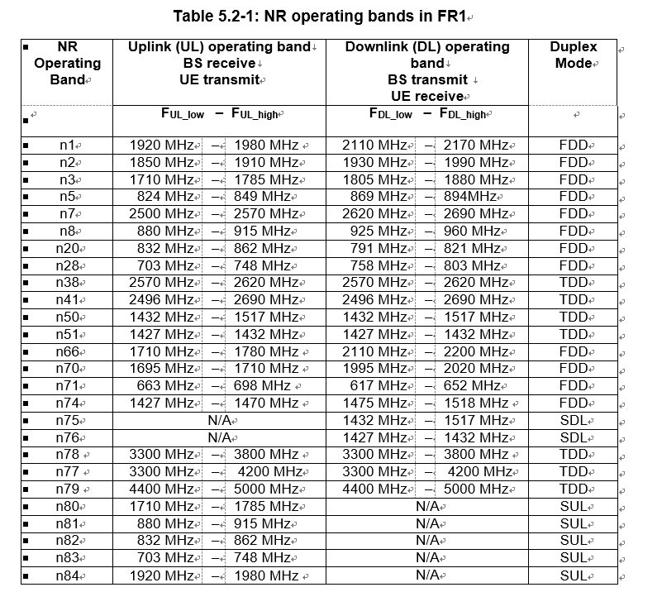
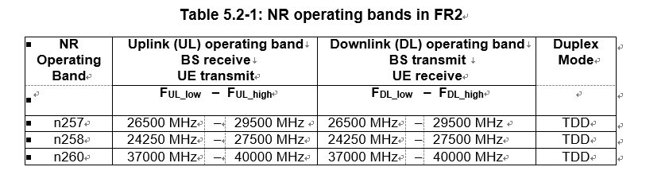
3GPP R15 5G Spectrums Standardization
5G NR bands are newly defined. Sub-6GHz/28GHz are major bands.
Source: 3GPP TS 38.101-1 V15.0.0 (2017-12) and TS 38.101-2 V15.0.0 (2017-12)
Notes:
3GPP Release 15’s TS 38.101-1 and TS 38.101-2 are the first specifications which cover radio spectrum bands for 5G NR (New Radio).
TS 38.101-1 covers spectrum bands up to 6GHz same as 4G’s TS 36.101 on the previous page.
TS 38.101-2 covers spectrum bands more than 6GHz such as millimeter waves including 28GHz and 39GHz.

Slide 7

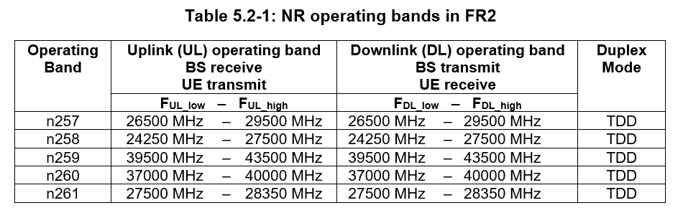

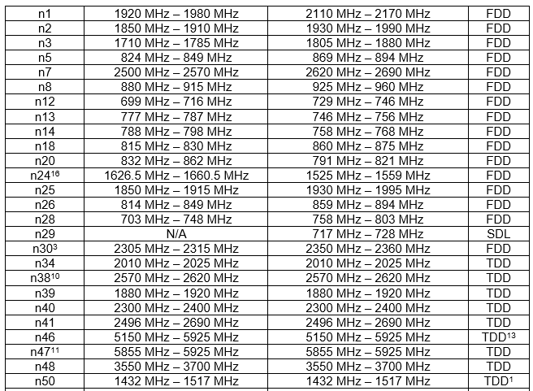
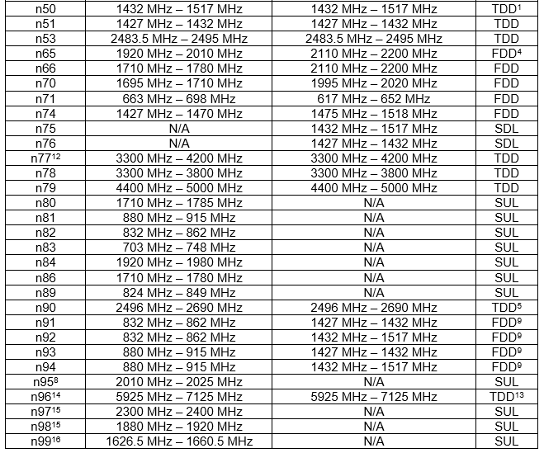
3GPP R17 5G Spectrums Standardization
More and more lower bands have been added for 5G, and the number of 5G NR bands will increase in the future
Source: 3GPP TS 38.101-1 V17.1.0 (2021-03) and TS 38.101-2 V17.1.0 (2021-03)
Notes:
From the migration and evolution from 3GPP Release 15 to 17, more and more lower bands have been added for 5G.

Slide 8
Contents
5G Spectrum Standardization and Fragmentation
Factors Affecting CSPs’ 5G Spectrum Strategies
Example Cases: T-Mobile in the U.S. and KDDI in Japan

Slide 9
Factors Affecting CSP CTIOs’ 5G Spectrum Strategies
Government and Regulation
Existing radio spectrum assets
Competitive landscape
5G business models and services
Legacy and future network architecture
Network, device chipset vendors’ capabilities
CSPs’ 5G radio spectrum strategy
Notes:
There are six major factors that affect CSP CTIOs’ 5G spectrum strategies.

Slide 10
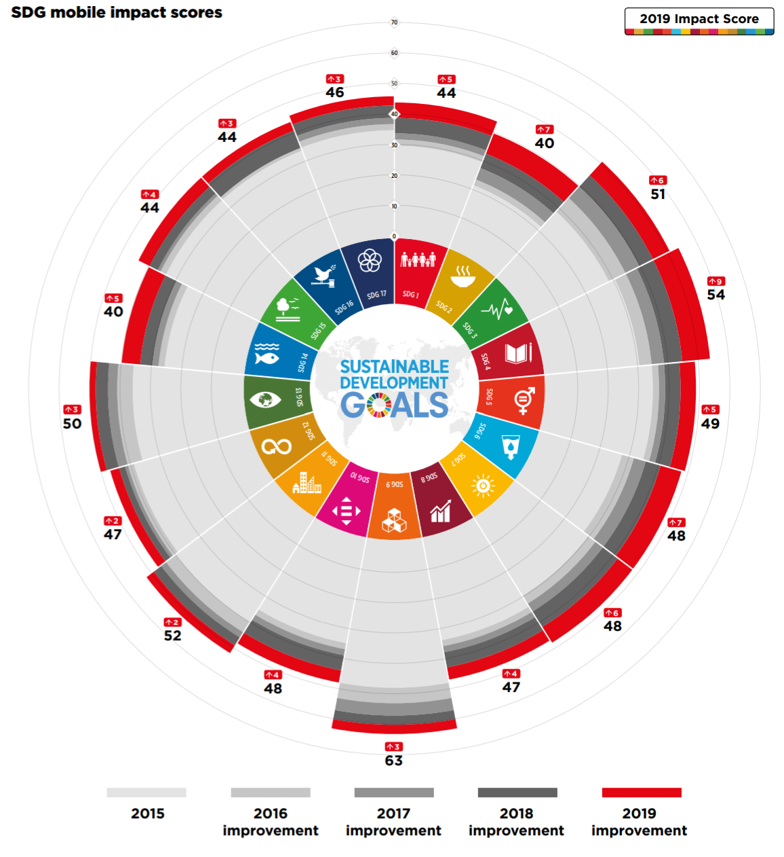
Government and Regulations
5G success is heavily linked to government/regulator policy and goal, and spectrum is their patent
Government
17 SDGs of the UNs are heavily impacted by mobile
Competition for 5G and even 6G leadership
Local vendor incubation and protection
Subsidy/funding for 5G launch and ecosystem creation
Digital agenda: 5G everywhere
Regulation
New spectrum allocation/auction for public/private 5G
Spectrum obligation for early coverage enhancement
Spectrum reallocation/redistribution for competition promotion
Spectrum cap for monopoly prevention
Source: GSMA
SDG: Sustainable development goal, UN: United Nation
Notes:
GSMA sources:
https://www.gsma.com/betterfuture/2020sdgimpactreport/wp-content/uploads/2020/09/2020-Mobile-Industry-Impact-Report-SDGs.pdf?utm_source=better_future_site&utm_medium=search_engine&utm_campaign=2020_SDG_impact_report

Slide 11
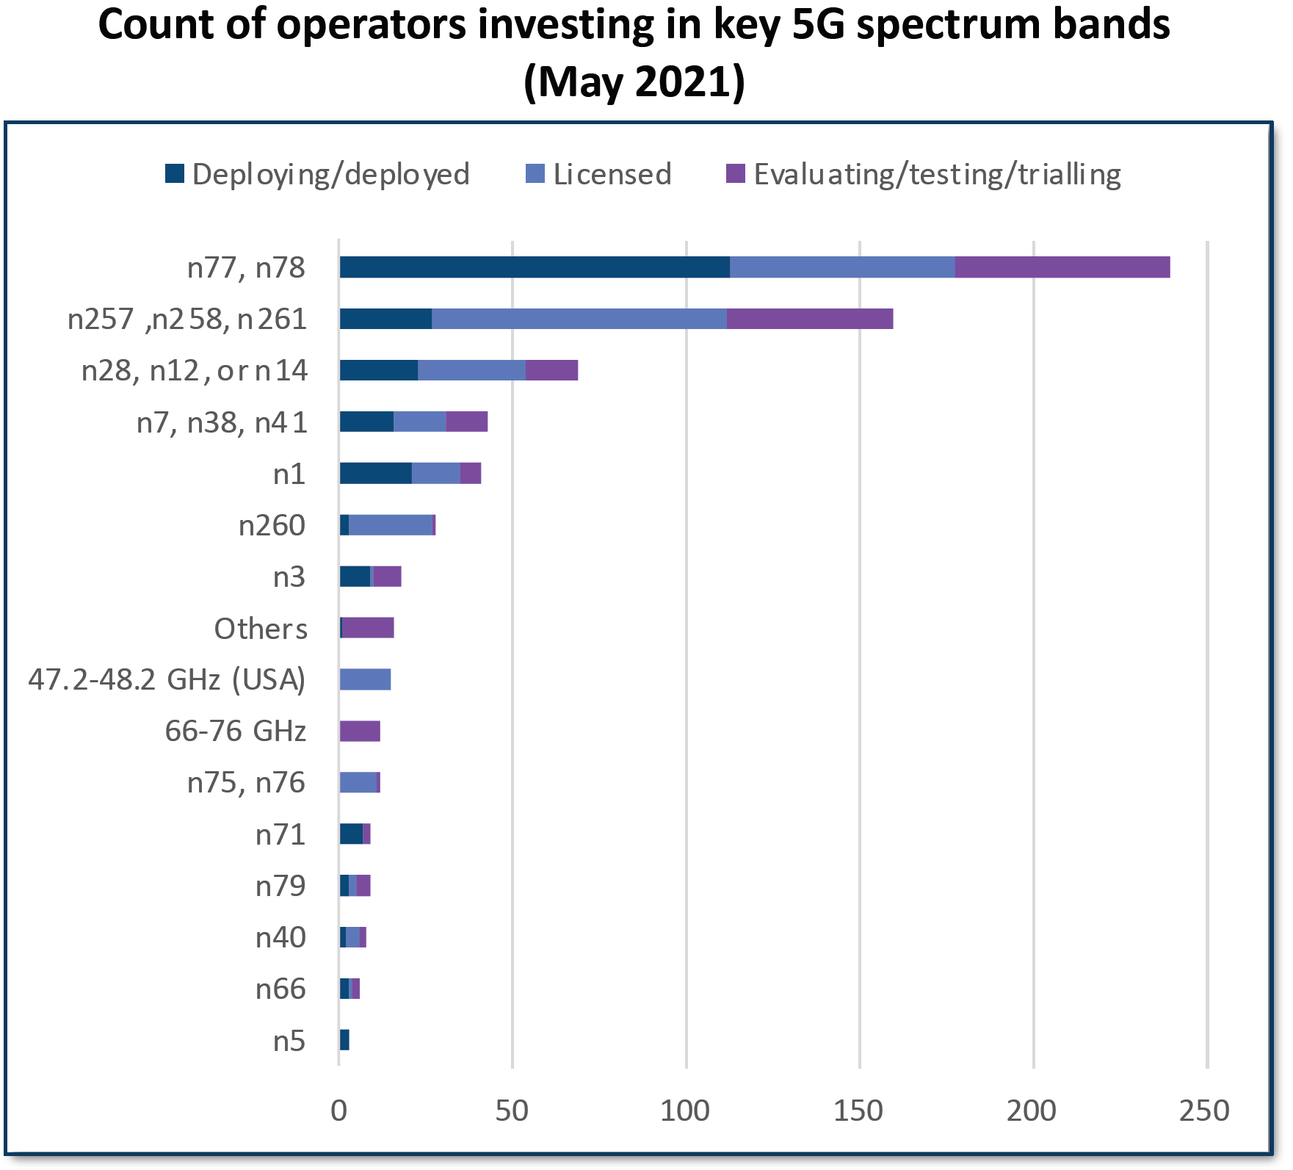
Existing Radio Spectrum Assets
The key to success is how to use existing frequencies efficiently for initial 5G
5G does not necessarily require a new asset
Reuse of existing 4G LTE bandwidths by DSS
4G and 5G co-dependence by 5G NSA architecture that requires tight integration with 4G infrastructure
Throughput enhancement by LTE-5G dual connectivity (ENDC)
4G / 5G refarming of vacant assets by 2G / 3G shutdowns
Uplink improvement by combining with FDD uplink bandwidth (SUL)
A new hundreds of MHz bandwidth is required to achieve 5G vision (e.g., 20Gbps downlink)
Middle band, High band
Source: GSA
Notes:
GSA sources:
https://gsacom.com/paper/h1-2021-review-5g-spectrum-networks-and-devices/

Slide 12
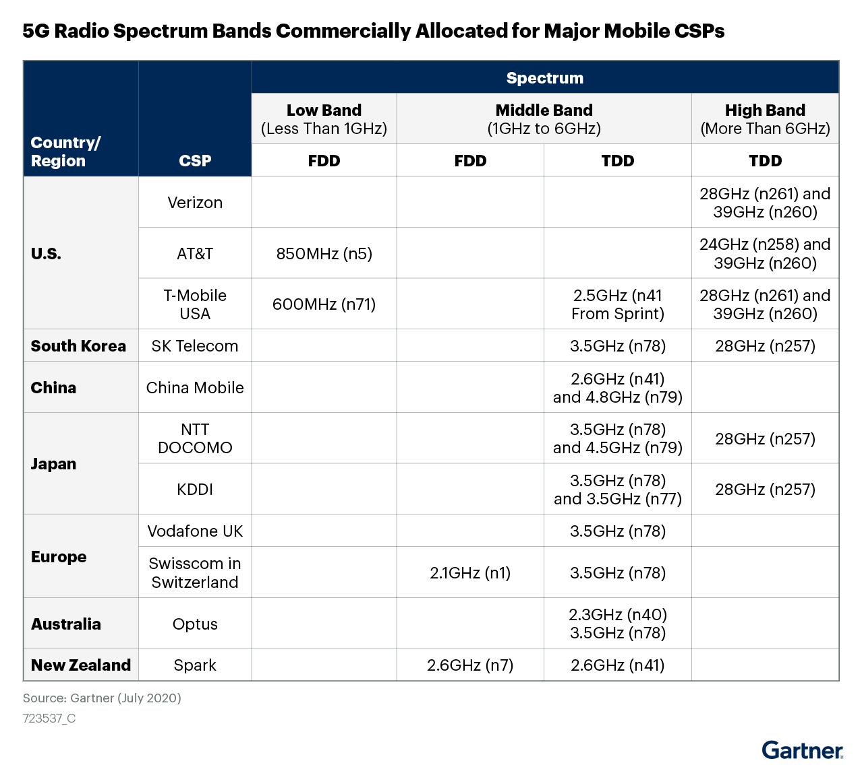
Competitive Landscape by CSPs
It is very complicated and difficult to acquire new spectrum bandwidths CSPs want
Radio spectrum usage is a major differentiator
This difference will impact on the overall strategy (Infrastructure, consumer/enterprise business, pricing)
Public network: More and more CSPs are trying to enlarge their 5G coverage by Low / Middle band DSS
Private network: Various CSPs in the USA acquired CBRS PAL band for its enterprise business solution
Big spectrum allocation is only 1-2 times per each cellular generation per country
Spectrum auction requires large investment
E.g., Verizon spent $52.9 billion for an average of 161 MHz of C-Band nationwide
Elaborate preparation and negotiation are required
850MHz (n5)
3.7GHz (n77)
/ CBRS (n48)
700MHz (n28)
700MHz (n28)
3.5GHz (n78)
26GHz (n257/258)
Black: data as of July 2020
Red: data as of May 2021
3.5GHz (n78)
Source: Gartner, “Market Insight: Impact of 5G Radio Spectrum Fragmentation”

Slide 13
5G Business Models and Services
Making good use of radio spectrum assets is the key to 5G monetization
Future 5G
-eMBB/eMTC/URLLC with platform/AI/Edge/New use cases
-Each spectrum asset is automatically assigned on demand and used appropriately
5G evolution
-eMBB + eMTC/URLLC gradually
-Combination of low/middle/high bands to improve user experience
Current 5G
-eMBB focus
-Low band for consumer coverage
-Middle/high band for capacity increase in specific areas (e.g., FWA)

Slide 14
Legacy and Future Network Architecture
Desired spectrum bands depend on CSPs’ network architecture
Legacy network architecture | Future network architecture
Passive antenna | Active antenna
Purpose built RAN | vRAN
Proprietary RAN | Open RAN
Distributed RAN | Centralized RAN
EPC | 5G NG core
Lower bands → higher bands of TDD
Lower bands priority due to limited capacity capability
Lower bands priority due to increased network complexity
Lower bands → higher bands by cell densification
Current bands → New bands due to no dependency on 4G

Slide 15
Network, Device/Chipset Vendors’ Capabilities
Spectrum fragmentation is a big issue for both vendors and CSPs
Network
A Massive MIMO antenna and a RU usually do not support multiple spectrums
Prioritization is needed on which spectrum solution to deploy under vendor capabilities and location restrictions
Devices
Spectrum capabilities depend on device/chipset vendors strategy
Device variations with different spectrum capabilities (e.g., iPhone 12)
Devices need to support more spectrums than network for the international roaming
Not only each spectrum support but also spectrum combinations by CA / DC* are considered
iPhone12 pro max models | 5G spectrum support
A2342 (USA) | n1, n2, n3, n5, n7, n8, n12, n20, n25, n28, n38, n40, n41, n66, n71, n77, n78, n79, n260, n261
A2410 (Canada and Japan) | n1, n2, n3, n5, n7, n8, n12, n20, n25, n28, n38, n40, n41, n66, n71, n77, n78, n79
A2411 (Europe and others) | n1, n2, n3, n5, n7, n8, n12, n20, n25, n28, n38, n40, n41, n66, n77, n78, n79
A2412 (China) | n1, n2, n3, n5, n7, n8, n12, n20, n25, n28, n38, n40, n41, n66, n77, n78, n79
*CA= Carrier Aggregation, DC = Dual connectivity
Source: Gartner

Slide 16
Contents
5G Spectrum Standardization and Fragmentation
Factors Affecting CSPs’ 5G Spectrum Strategies
Example Cases :T-Mobile in the U.S. and KDDI in Japan

Slide 17
T-Mobile in the U.S.
Strategic frequency acquisition leads to new service provision ahead of competitors
2G GSM / 3G UMTS / 4G LTE
2G / 3G utilizes B2/B4
4G mainly utilizes B2/4/5/66
Its coverage has been enhanced by B12/71
5G NR
Commercial 5G NR was launched by n260/n261 in June 2019 and enlarged the coverage by n71
Over 200M pops as of Dec 2019
In April 2020, the company launched Ultra-Capacity 5G by n41 that come from the Sprint merger.
In August 2020, the company launched World’s first 5G SA Network that can expand 5G coverage by 30%
B48/n77 acquisitions to supplement n41 in the future
Spectrum band | Technology | Acquisition schedule
600MHz (B71, n71) | 4G LTE / 5G NR | 2017
700MHz (B12) | 4G LTE | 2014
850MHz (B5) | 4G LTE | Before 2014
AWS (B4, B66) | 3G UMTS/4G LTE | Added in 2015
1.9GHz (B2) | 2G GSM/3G UMTS/4G LTE | Before 2014
2.5GHz (n41) | 5G NR | Sprint merger in 2020
CBRS (B48) | Not yet used | 2020
3.7GHz (n77) | Not yet used | 2021
28GHz (n261) | 5G NR | 2019
39GHz (n260) | 5G NR | 2020
Source: Gartner
As of June 2021, 600 MHz network covers an estimated 295M pops.
Ultra-Capacity 5G (including 2.5 GHz and 28/39 GHz) covers 125M pops and plan to reach 200M by 2021, 285M by 2023

Slide 18
KDDI in Japan
Balanced 5G spectrum strategy with low/middle/high bands is essential by reusing current infrastructure
3G CDMA2000 / 4G LTE
3G/4G mainly utilizes B1/B11/B18/B41
Early commitment to shut down 3G in March 2022
B3/B28/B42 were allocated later and these 4G usage are partial.
5G NR
Commercial 5G NR was launched in March 2020 by newly allocated n78 and n257 was added in September 2020.
KDDI has added 5G n42 in December 2020 ahead of other competitors
5G by other 4G LTE bands will be accelerated
B28: 8827 sites* in March 2021 and 11402 sites in March 2022
B3: 14806 sites in March 2024 and 20985 sites in March 2026
Spectrum band | Bandwidth | Technology | Allocation schedule
700MHz (B28, n28) | 10MHzx2 | 4G LTE / 5G NR | Before 2014
800MHz (B18) | 15MHzx2 | 3G CDMA2000 / 4G LTE | Before 2014
1.5GHz (B11) | 10MHzx2 | 4G LTE | Before 2014
1.8GHz (B3) | 20MHzx2 | 4G LTE | April 2018
2.1GHz (B1) | 20MHzx2 | 3G CDMA2000 / 4G LTE | Before 2014
2.5GHz (B41) | 50MHz | 4G LTE | Before 2014
3.5GHz (B42, n42) | 40MHz | 4G LTE / 5G NR | December 2014
3.7GHz (n78) | 100MHz | 5G NR | April 2019
4.0GHz (n77) | 100MHz | 5G NR | April 2019
28GHz (n257) | 400MHz | 5G NR | April 2019
*Current base station number of 4G LTE is around 220,000
Source: Gartner
50,000 5G base stations by March 2022, aiming to cover 90% of the entire population

Slide 19
Key Take-Aways
Obtaining desired radio spectrum bandwidths is very difficult and time-consuming.
Reusing existing spectrum assets and network infrastructure depends on your vendors’ strategy and capabilities.
CSPs will compete to acquire more and more bandwidths for both public network and private network.
Future 5G radio spectrum usage will be very flexible to assign bandwidths based on user demands.
Mixture of TDD and FDD bands is fundamental for the migration from legacy to future network architecture.
Network, device and chipset vendors might not support your preferred bands without your early commitment.

Slide 20
Recommendations for CSP CTIOs
Enrich radio spectrum portfolio by supporting regulatory affairs demand regulators to allocate any new spectrums for 5G.
Keep in mind that several hundred MHz is required to realize 5G vision.
Secure frequency assets that are more advantageous (e.g., globally adopted, locally occupied) than other competitors.
Identify spectrum requirements of various industries use cases by working with them and classification of various bands for various business requirements.
Adopt appropriate radio spectrums for new 5G services in line with your network strategy.
Collaborate with vendors in supporting your preferred spectrum bands and band combinations by explaining your future strategy in advance.

Slide 21
Gartner Recommended Reading
2021 CIO Agenda: Industry Perspectives Overview
Predicts 2021: CSP Technology and Operations Strategy
Routes to the Future for CSPs — Technology Strategy
Magic Quadrant for 5G Network Infrastructure for Communications Service Providers
Competitive Landscape: 5G RAN Vendors
Hype Cycle for the Future of CSP Networks Infrastructure, 2021
Hype Cycle for Communications Service Provider Operations, 2021
CSP Digital Transformation and Innovation Primer for 2021
Market Insight: Impact of 5G Radio Spectrum Fragmentation
5G as a Service: Deployment Scenarios of Private Networks in the 5G Era
Market Guide for 4G and 5G Private Mobile Networks
CSPs’ Success With 5G Initiatives Requires O-RAN and vRAN
CSP CIOs’ Role in 5G Platforms as Accelerators for New Value Creation Across Industries
Create Value and Drive Revenue With 5G Network Slicing Phased Approach

