Slide 1
AI for the Board
Peter Krensky, Jorge Lopez, Whit Andrews
Notes:
AI for the Board
Peter Krensky, Jorge Lopez, Whit Andrews
Ver 2021-0330
1 © 2021 Gartner, Inc. and/or its affiliates. All rights reserved. Gartner is a registered trademark of Gartner, Inc. and its affiliates.

Slide 2
THIS IS WHAT AI WILL DO FOR YOU

Slide 3

The business value of AI will reach $5.1 billion by 2025 23% of CIOs claim to have already deployed AI (2021) 51% of organizations with AI deployed do financial/risk analysis on every project

Slide 4
Popular Use Cases With Obvious Value
Price Optimization
Asset Predictive Maintenance
Autonomous Operations
Customer Segmentation/Personalization
Cross-Selling and Upselling
High
High
Business Value
Medium
Medium
Feasibility
Low
Notes:
That’s exactly why we developed the Use Case Prism … where use cases are visually presented according to their estimated business value and feasibility ….
AI for the Board
4 © 2021 Gartner, Inc. and/or its affiliates. All rights reserved. Gartner is a registered trademark of Gartner, Inc. and its affiliates.
— NOT FOR EXTERNAL DISTRIBUTION —
— NOT FOR EXTERNAL DISTRIBUTION —

Slide 5
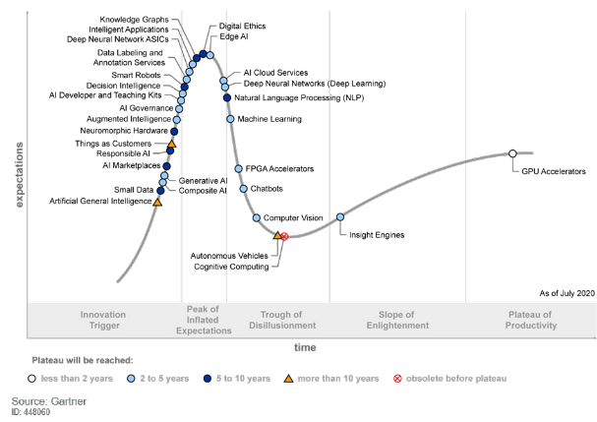
Hype Cycle for Artificial Intelligence

Slide 6
THIS IS THE NECESSARY AI INVESTMENT

Slide 7
AI Must Be Built Upon Quality Data and Processes
Frame
Problem
Measure and Evolve
Prepare
Data
Strategize
and Plan
Develop and Evaluate
Deploy
Notes:
Often D&A leaders do not consider all the necessary tasks involved in building data pipelines
and the difficulties in sourcing the right data, which is critical to analytics success.
Building data pipelines is a resource-intensive task, which requires a strong focus on various activities:
Data integration, building optimized data structures, reusability
Data quality, security
Governance — Governance requires “human consensus” which by definition is slow
When it comes to making decisions based on correct data, you have three options:
You can do “fast and wrong”
You can do “slow and right”
By the way, “slow and wrong” is also available — “fast and right” is not available.
Analytics without data is a wasted exercise.
Data without analytics is a wasted resource.
They both must be coordinated.
Analytics must be backed with right data and right processes!

Slide 8
The Necessary Talent
Product Manager
Data Scientist
Business/Domain
Expert
AI Architect
Data Engineer
AI Engineer

Slide 9
THIS IS WHAT COULD GO WRONG

Slide 10
“Nearly half of consumers believe the organization providing or using the AI should be held accountable if AI goes wrong.”
2018 Gartner Consumer Artificial Intelligence Perceptions Study

Slide 11
What are the inherent risks of enterprise AI?
Accountability
Regulatory compliance
Fairness and bias
Explainability
Failure to deliver value
Failure to develop trust

Slide 12
What are the risks of doing nothing?
Competitors differentiate and gain advantage using AI
Hidden costs and inefficiencies stay hidden
Organization fails to learn about and combat systemic bias
Organization becomes less attractive to top talent
Failure to reap full benefits of digital transformation
AI is spreading throughout your organization whether you like it or not

Slide 13
APPENDIX

Slide 14
INDUSTRY EXAMPLES AND GUIDANCE
Banking, Financial Services and Insurance
Healthcare
Manufacturing
Retail

Slide 15
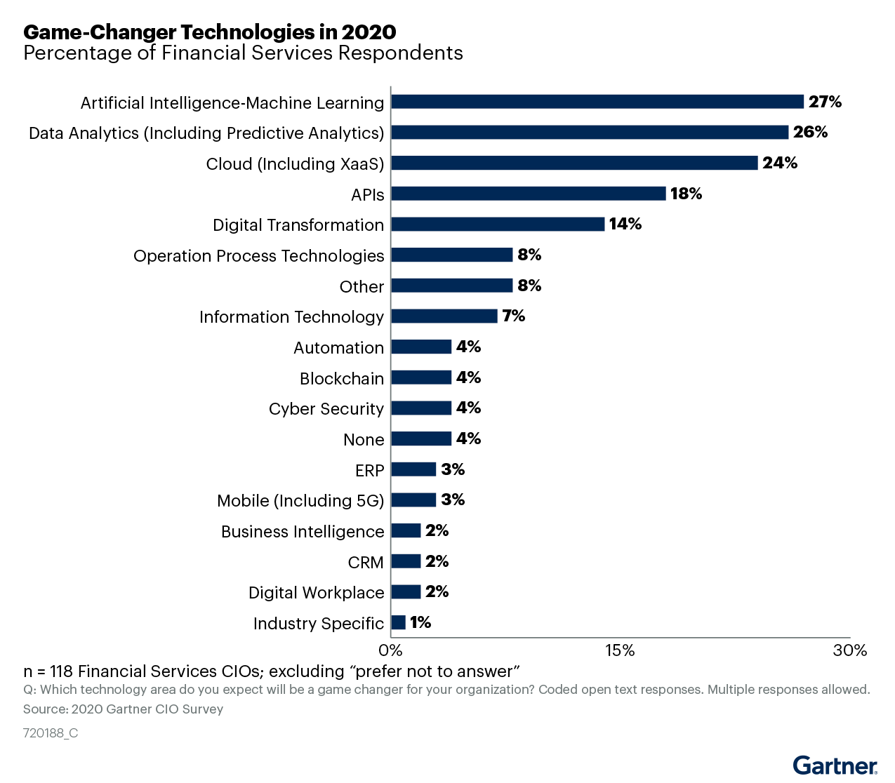
Game Changers for Financial Services CIOs

Slide 16
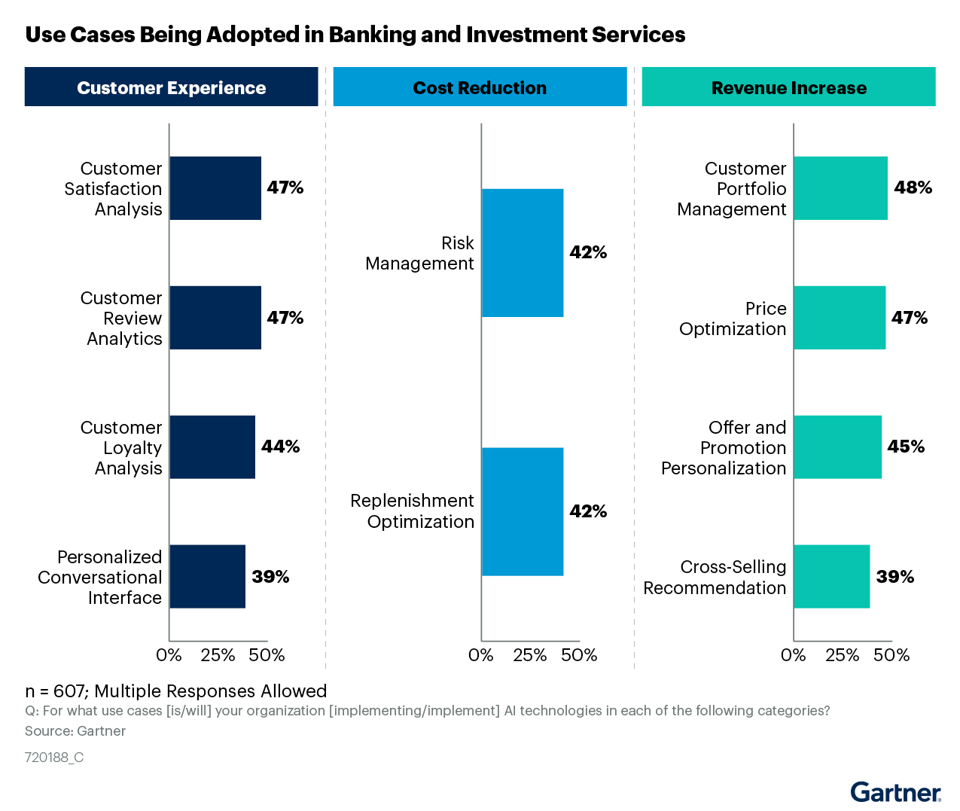
AI in Banking
(2019 AI in Organizations Survey)

Slide 17
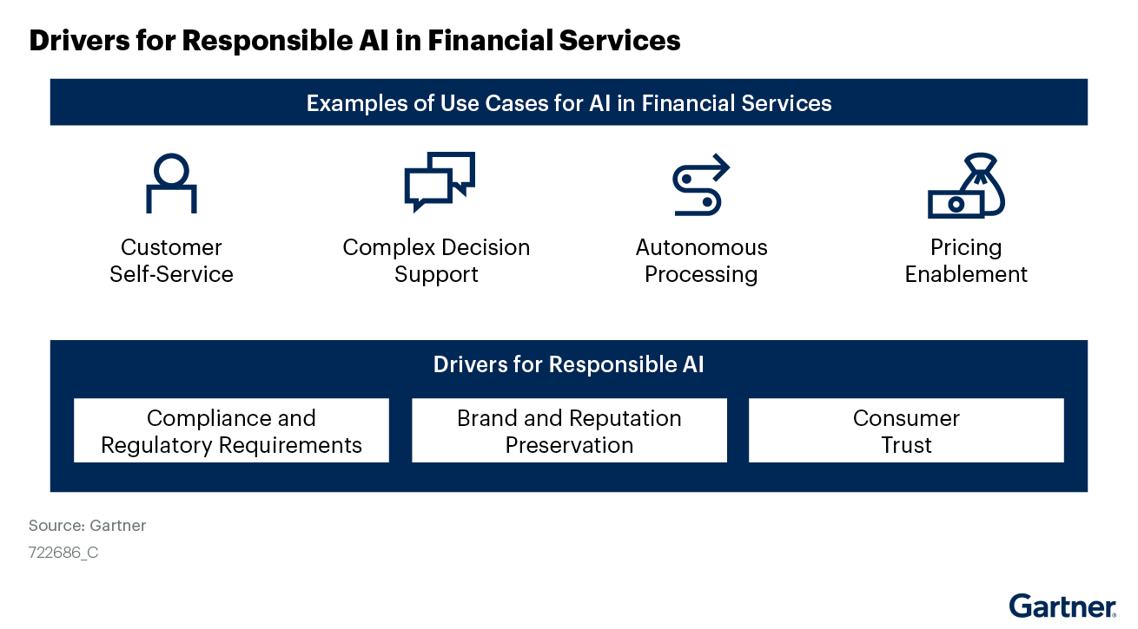
AI in Financial Services and Insurance
Source: Financial Services CIOs Must Focus AI Investments on ‘Responsible AI’ in 2021

Slide 18


Banking/Financial Services Use Case: Maximize Return/Financial Risk
Goal
Caution
Fraud
Insider Trading
Collusion
Money Laundering
Ethnicity
Gender
Age
Social
Trust
False alerts of fraud cut in half
Prevented losses of $9 million from fake invoices for small business customers
Notes:
Facilitator Notes:
Use Case: Maximize Return
How does this apply to manufacturing? Are you in business to make money? Do you want to capture as much on the dollar of your receivables as possible? Companies are using AI to prevent and detect everything from routine employee theft to insider trading.
Traditional program alerts/flags have a generally low success rate in that ~2% of flagged suspicions ultimately reflect a true crime or malicious intent.
However, the advanced algorithms within AI reduce false alerts while also uncovering potential issues.
Even though banks now file 20 times more suspicious activity reports than in 2012, the recovery rate has tremendously grown because people are investigating more reliable alerts. Said another way, false alerts have fallen by as much as half, refocusing investigators on real threats.
PayPal has cut its false alerts in half.
Royal Bank of Scotland prevented losses of over $9 million using AI to scan small business transaction alerts for fake invoices.
Before embarking on an AI risk management initiative, managers must first understand where machine learning is already making a big difference. Banks, for example, are halting financial crimes much more quickly and cheaply than they used to by using AI for automating processes and conducting multilayered “deep learning” analyses.

Slide 19
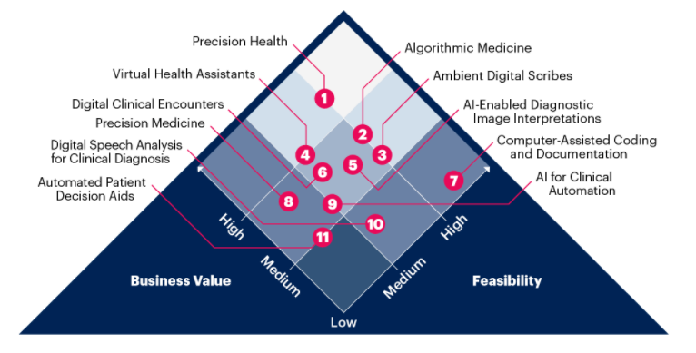
AI in Healthcare Use Cases
Source: Infographic: Artificial Intelligence Use Case Prism for the Healthcare Provider Industry

Slide 20





5 Fundamental AI Roles for Manufacturing
Plan
and
Invent
Procure
to
Pay
Make
to
Stock
Order
to
Cash
Deliver
to
Experience
Ideation
Proactive Sourcing
Demand
Forecast
Revenue Contribution
Customer Delight
Notes:
Facilitator Notes:
There are five fundamental roles that AI can participate in or contribute to in manufacturing:
Plan and Invent
Procure to Pay
Make to Stock
Order to Cash
Deliver to Experience
For example, AI can:
Incorporate results and regulations and optimize efficiency in ideation.
Help reveal the best, most reliable sources of ingredients, parts and raw materials.
Improve forecasting and help with supplier reconciliations.
Ensure that you get paid what you are owed, identify credit risk and manage contracted penalty clauses.
Comprehensively measure your customers’ experience and identify what delights them.
What makes all this possible are four “super strengths” that AI brings to any business:
Automated sorting
Automated predictions
Clear, consistent parameters
The ability to process massive amounts of data
Let’s take a look at some real-life use cases where AI has made a difference.
AI for the Board
20 © 2021 Gartner, Inc. and/or its affiliates. All rights reserved. Gartner is a registered trademark of Gartner, Inc. and its affiliates.
— NOT FOR EXTERNAL DISTRIBUTION —
— NOT FOR EXTERNAL DISTRIBUTION —

Slide 21


Manufacturing Use Case: Machine Vision
Inspection
Controlling and automation
Calibration and tuning
Automated issue identification
Extracted Image
Defect Detection
Source: Landing.AI
Notes:
Facilitator Notes:
Use Case: Machine Vision
This example is a circuit board, but you can also envision seal surface, fill accuracy, or any number of inspections in a highly regulated industry.
If your company believes “x” number of defects will occur, but quality or specificity is essential, consider something like AI machine vision.

Slide 22
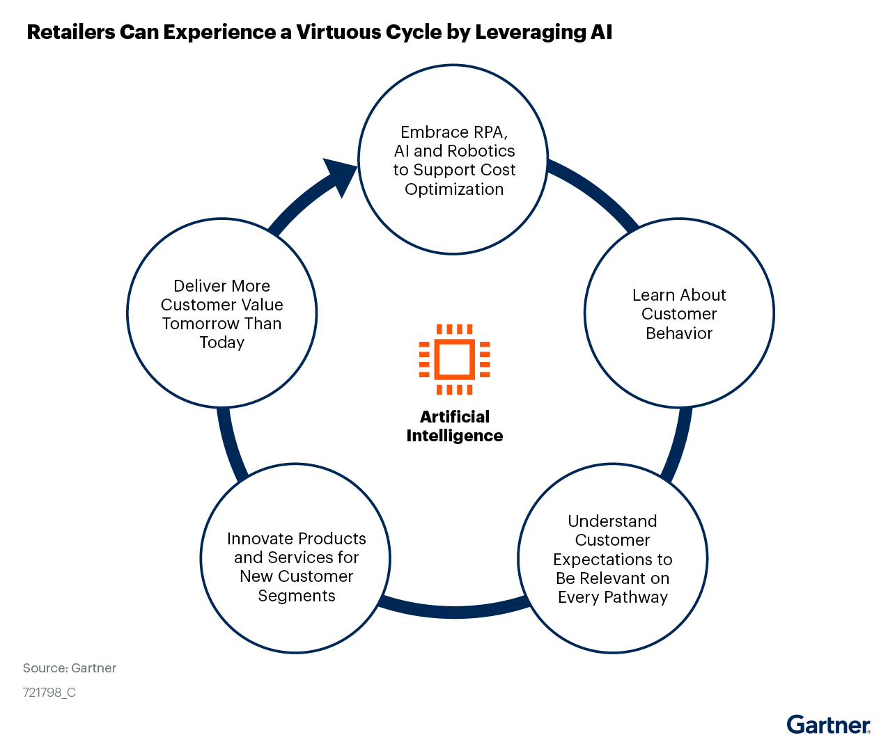
AI in Retail

Slide 23
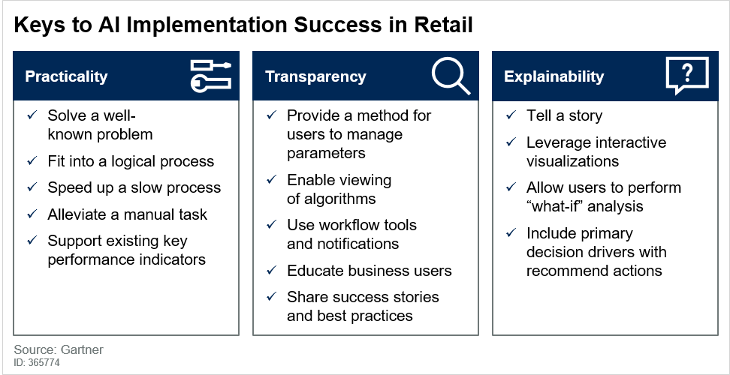
AI in Retail

