Slide 1
Examples of IT Job Architecture Designs
Notes:
TEMPLATE UPDATED 1 JANUARY 2021
Presenter's Name
Presenter's Name

Slide 2
Guiding Principles for Job Architecture Design
Defined to reflect the new ways of working necessary to support the business strategy
Operationalizes the target operating model
Supports IT strategy and technical architecture
Guiding Principles
Designed for scalability and flexibility
Structured to support clear career movement
Promotes consistent and market-appropriate job levels and job titles
Delineates roles and responsibilities
Notes:
For the purpose of this toolkit, we focus on “operationalizes the target operating model” as a key guiding principle for evolving the Job architecture to be adaptable to the changing maturity of I&T operating model.

Slide 3
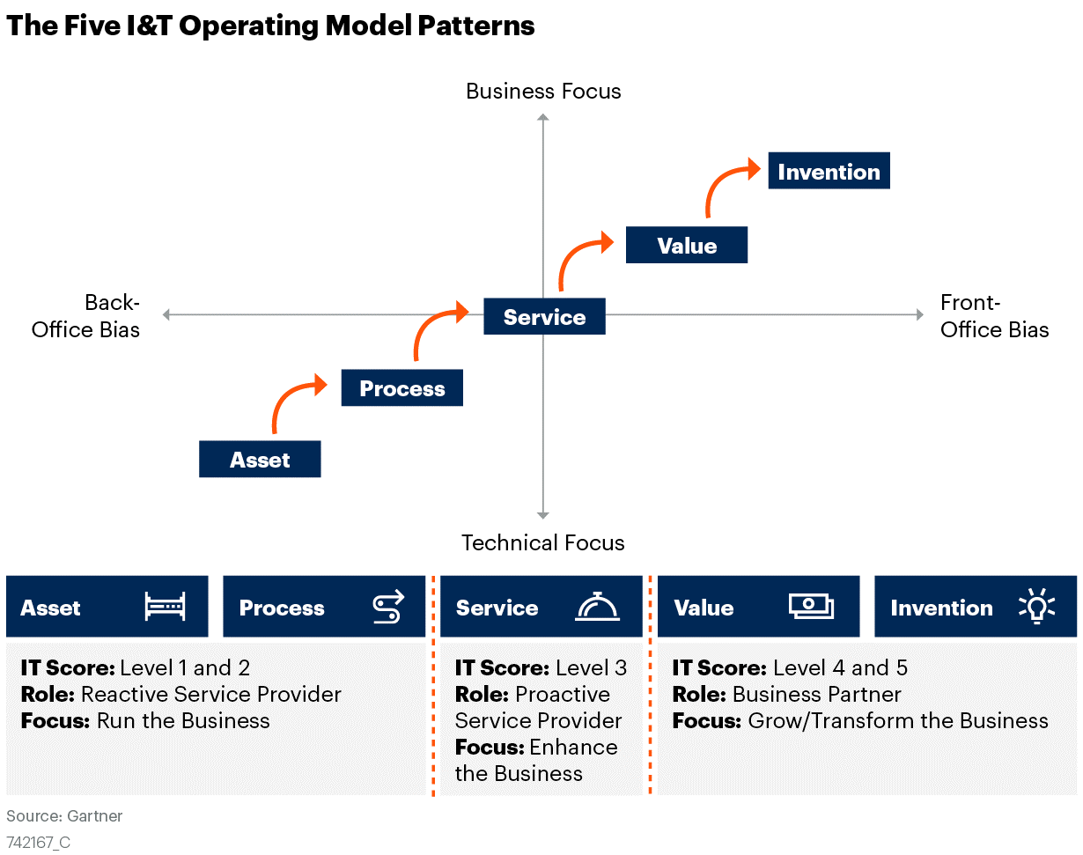
The Five I&T Operating Model Patterns
Notes:
Gartner has defined five I&T operating model patterns. These patterns enable CIOs to understand, define and plan for the required target state of I&T operating model components based on their business strategies and digital business ambitions.
Talent is often thought of as the most critical part of the operating model, as it is people that “get things done” in an enterprise. As the operating model evolves, so too must the talent. Any change in business and IT strategy can affect each of these components, for example, adopting agile ways of work, transition to a hybrid workplace, moving to a product-centric organization structure, distributing decision rights, all of which will impact talent and skills needs. Our research and client interactions indicate that talent remains one of the top challenges for CIOs to reconfiguring their I&T operating model to scale business transformation initiatives.

Slide 4
IT Job Architecture Connects With I&T Operating Model Components
Performance
How does individual performance align to organizational performance?
Decision Rights
Organization Structure
Which jobs have which responsibilities and accountabilities?
Where do jobs fit within the organization? How do teams organize with defined responsibilities and accountabilities for success?
Performance
Financial
Decision Rights
Organizational Structure
How does the mix of Jobs and levels influence the finances?
Financial
Sourcing & Alliances
Ways of Working
Ways of Working
How does culture and ways of working need to shift to drive optimal performance at individual job levels and across the organization?
Talent
Tools/Assets
Talent
What skills and competencies do you have today, and what do you need to perform jobs in the future?
Places
Tools/ Assets
Places
What tools/assets are necessary to perform the job?
Sourcing
Which jobs are located where? Which jobs are remote?
How do jobs and talent requirements change in support of the organization’s approaches to partnership?
Notes:
IT job architecture enables I&T operating model transformation. As I&T operating model evolves:
Job architecture articulates what jobs are required to enable a new or changed operating model
Organizational structure reflects where do jobs fit within the organization and how do teams organize with defined responsibilities and accountabilities for success
Changes jobs and skills require leaders to assess and realign sourcing strategy to properly fill the new roles and close skills gaps.

Slide 5
Key Questions for Designing Your IT Job Architecture
Question
Outcome
What capabilities does IT deliver to operationalize the target I&T operating model? How do we deliver them through jobs organized into job families? |  | Descriptions of job families, job series and responsibilities
What skills and knowledge are needed to perform the work? |  | Industry, technical, business skills and knowledge requirements
What behaviors are predictors of success in jobs/roles within and across job families? |  | Behavioral competency requirements
What job growth opportunities can we offer in a job family? |  | Job series and number of career levels necessary to differentiate work performed in a job family
How do we guide employees in the development of needed skills and competencies to realize their career aspiration and advance their contribution and impact to the business? |  | Roadmaps (career paths with connected learning activities) for progression within and across job families

Slide 6
Gartner’s IT Job Architecture Baseline Framework
Job Families
Job Series
Sample Job Titles (Illustrative)
Architecture
Enterprise
Solution
Domain
Business
Domain: Cloud Architect, Information Architect
Engineering
Infrastructure
Software
Data
Security: Network Security Engineer, Information Security Engineer | Infrastructure: Network Engineer, Cloud Engineer
Automation
QA/Test
Developer
Security
Analysis
Business
Data
BI/Analytics
Business: Business Systems Analyst, Business Analyst
Security
Data Science
Data Modeler
Product and Platform Management
Product Manager
Platform Manager
Product Owner
BRM
Platform Manager: CRM Platform Manager, Infrastructure Platform Manager
Platform Owner
Portfolio Manager
Service Owner
Delivery
Scrum Master
Project Manager
Coach
Coach: Agile Coach, Lean Coach
Resource Manager
Program Manager
Technical
Administration
Infrastructure
Security
ITSM
DBA
Infrastructure: Network Administrator, Systems Administrator
Technical Support
Service Desk
On-Site
On-Site: Field Support Specialist, Client Technology Manager, Office Technology Manager, Multimedia Specialist
UX
UX Designer
Researcher
Content Strategist
Job titles typically aligned to job series naming
IT Functional Support
Finance
Vendor Mgmt.
Communications
Training Mgmt.
Job titles typically aligned to job series naming
Knowledge Mgmt.
Sourcing/Prcmt.
Org Change Mgmt.
IT Leadership
Manager
Technical Principal
Job titles typically aligned to function and scope of responsibility
Notes:
Here is the Gartner’s IT Job Architecture Baseline Framework. This framework is developed based on Gartner extensive research on IT job architecture and career model designs and consulting experience with hundreds of client organizations in addressing their IT talent management and workforce transformation initiatives.
Job families and Job Series are relative stable over time, but individual Jobs and their descriptions may be added, modified or removed.

Slide 7
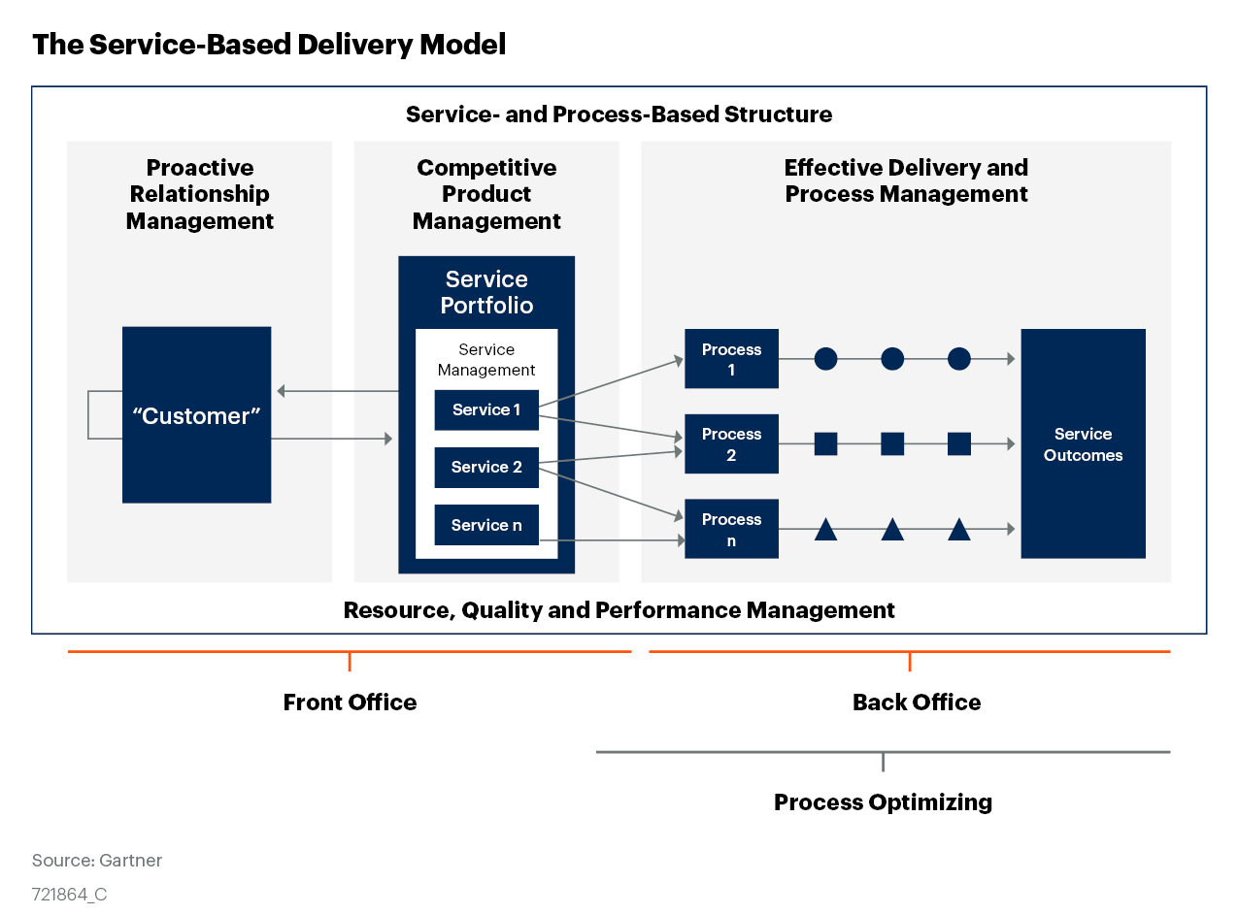
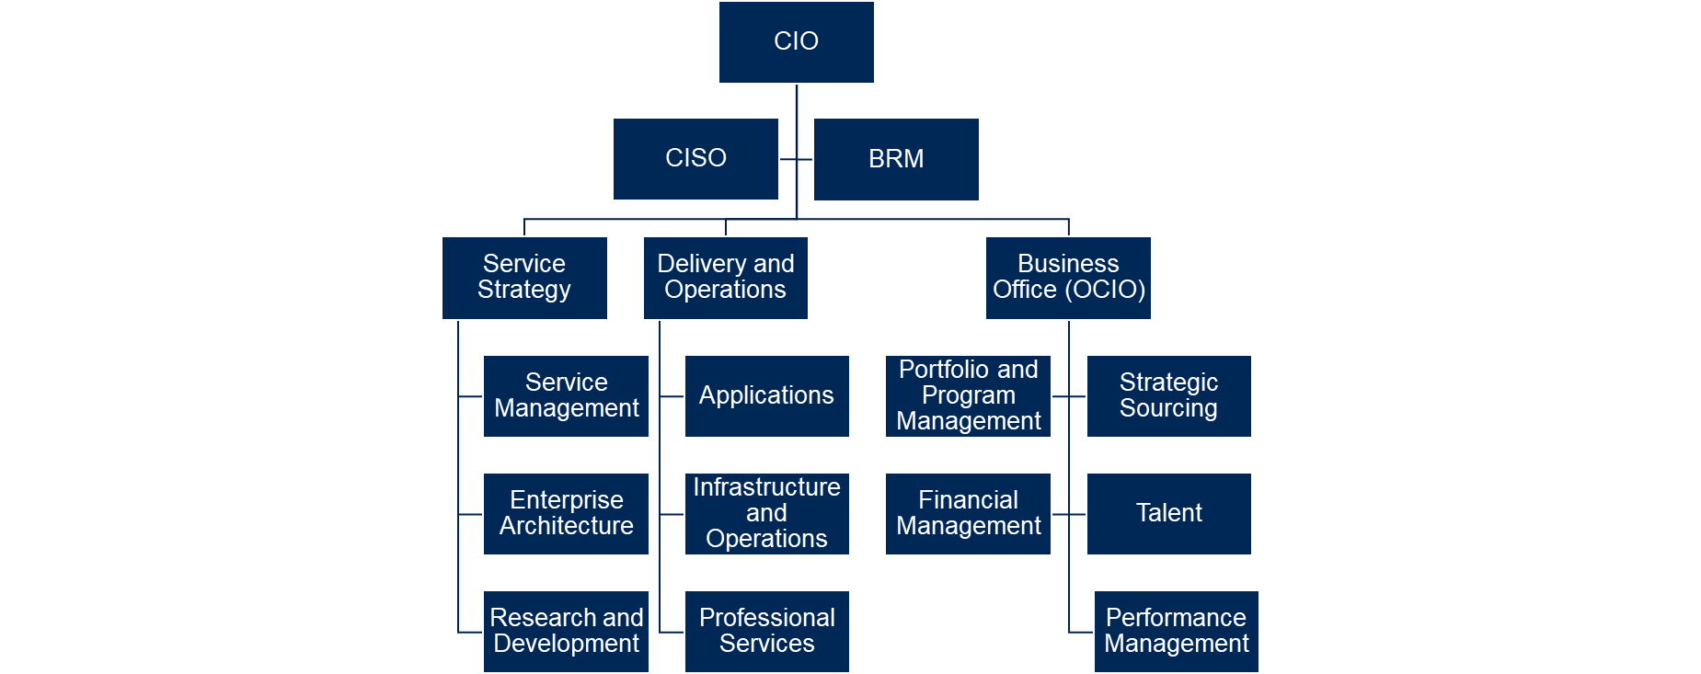
Service-Optimized IT Organizations
CIO’s Organizational Structure
Run IT Like a Business by Applying the Service-Optimizing I&T Operating Model
How to Structure IT Like a Service Provider
Defining and Applying I&T Conceptual Delivery Models
Notes:
Through the lens of the I&T operating model, the delivery model articulates how I&T will execute its capabilities to design, deliver and evolve I&T products and services. Once the operating model has been determined, the delivery model can be leveraged to provide insight into the configuration of operating components or capabilities.
To attain the service-optimizing operating model, a service-based conceptual delivery model is used in this illustration. The service-based delivery model focuses on optimizing the internal customer experience. Services are defined from an end-to-end perspective, in ways that connect to the value desired by the buyer and consumer of the services.
The service-based delivery model is where the IT organization becomes proactive, getting half-a-step ahead of the business, shaping demand rather than simply being an order-taker. This establishes the foundation for becoming a trusted partner, which enables the IT organization to build the capabilities needed to take the next step. This involves adopting a bimodal approach, enabling it to add to the core capabilities of the service-based delivery model, with selective development and application of agile, adaptive and innovation related capabilities. To achieve this, they adopt many of the attributes and front-office capabilities of a competitive business, such as an external service provider.
Choose the service-based delivery model where IT needs to be a collaborative service provider to the business to deliver enhanced business value through I&T.

Slide 8
Sample Job Architecture for Service-Optimizing Operating Model
Job Families
Job Series
Sample Job Titles (illustrative)
Architecture
Enterprise
Solution
Domain
Business
Domain: Cloud Architect, Information Architect
Engineering
Security: Network Security Engineer, Information Security Engineer | Infrastructure: Network Engineer, Cloud Engineer
Infrastructure
Developer
Software
Data
Analysis
Business
Data
BI/Analytics
Security
Business: Business Systems Analyst, Business Analyst
Business and Service Management
BRM
Portfolio Manager
Service Owner
Jobs Titles typically aligned to Products/Platforms/Services
Delivery
Resource Manager
Program Manager
Project Manager
Scrum Master
Job Titles typically align to Business Unit or Service
Technical
Administration
Infrastructure
Security
ITSM
DBA
Infrastructure: Network Administrator, Systems Administrator
Technical Support
Service Desk
On-Site
On-Site: Field Support Specialist, Client Technology Manager, Office Technology Manager, Multimedia Specialist
UX
UX Designer
Job titles typically aligned to job series naming
IT Functional Support
Finance
Vendor Mgmt.
Sourcing/Prcmt.
Knowledge Mgmt.
Job titles typically aligned to job series naming
Process Owner
IT Leadership
Manager
Technical Principal
Job titles typically aligned to function and scope of responsibility
Notes:
Job families and Job Series are relative stable over time, but individual Job descriptions may be added, modified or removed.
Highlights for this illustration:
Scrum Master is introduced as organizations start to experiment and adopt agile approaches formally in some functional areas (e.g., software engineering).
Moving to a service-optimized model implies a transition away from application and process owners often defined/aligned by legacy applications or technology silos.
Technical support may be outsourced. There are several variations possible dependent on your organization’s sourcing/delivery model for technical support.

Slide 9
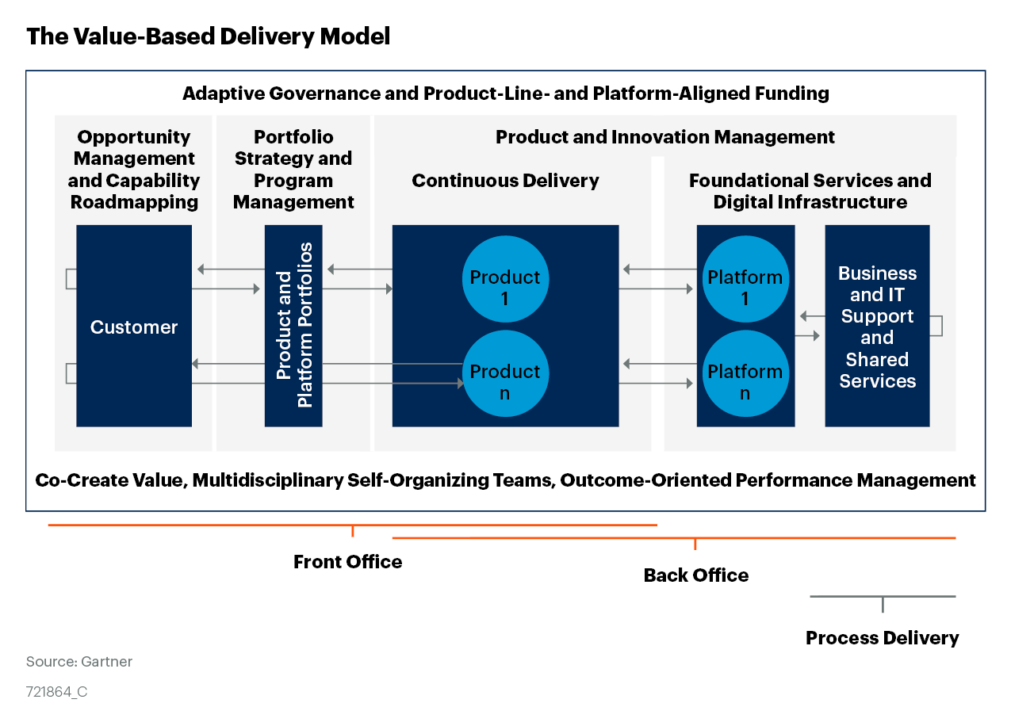
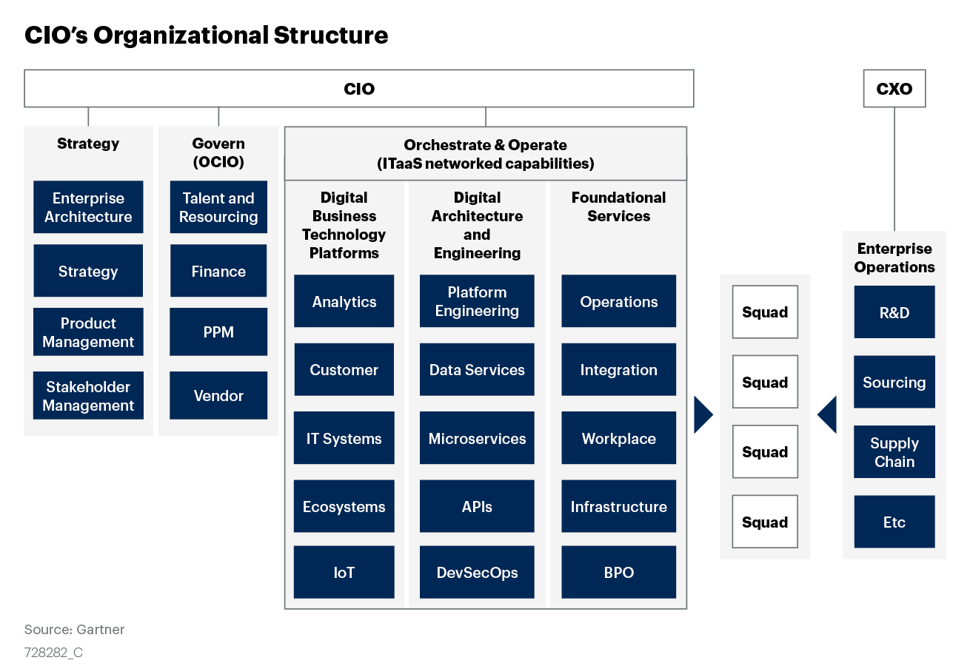
Value-Optimized IT Organizations
How to Structure I&T Into an Interconnected, Value-Optimized Organization
Notes:
Through the lens of the I&T operating model, the delivery model articulates how I&T will execute its capabilities to design, deliver and evolve I&T products and services. Once the operating model has been determined, the delivery model can be leveraged to provide insight into the configuration of the remaining operating components or capabilities.
To attain the value-optimizing operating model, a cross-enterprise, product-based conceptual delivery model is used in this illustration. It combines I&T practices such as agile development, service management, IT life cycle management and traditional business practices, such as R&D, product management and product marketing. In doing so, the model forms something unique — an entrepreneurial, fast-iterating approach to managing IT as a set of services and solutions as a set of products from ideation to retirement. This enables more robust and targeted feature sets that center on customer needs, facilitate quicker deployment and validation of emerging technologies, and clearly define service and solution ownership and reporting structures throughout the enterprise.
Choose the value-centric delivery model where the enterprise is seeking to optimize speed, agility and innovation, and where the business is exploiting new business models and opportunities.

Slide 10
Sample Job Architecture for Value-Optimizing Operating Model
Job Families
Job Series
Sample Job Titles (illustrative)
Architecture
Enterprise
Solution
Domain
Business
Domain: Cloud Architect, Information Architect
Engineering
Infrastructure
Software
Data
Security
Security: Network Security Engineer, Information Security Engineer | Infrastructure: Network Engineer, Cloud Engineer
Automation
Developer
Analysis
Business
Data
BI/Analytics
Data Science
Business: Business Systems Analyst, Business Analyst
Product and Platform Management
Product Manager
Product Owner
Platform Manager
Platform Owner
Platform Manager: CRM Platform Manager, Infrastructure Platform Manager
Delivery
Resource Manager
Program Manager
Scrum Master
Coach
Coach: Agile Coach, Lean Coach
Technical
Administration
Infrastructure
Security
ITSM
Infrastructure: Network Administrator, Systems Administrator
Technical Support
On-Site
On-Site: Field Support Specialist, Client Technology Manager, Office Technology Manager, Multimedia Specialist
UX
UX Designer
Researcher
Content Strategist
Job titles typically aligned to job series naming
IT Functional Support
Finance
Vendor Mgmt.
Org Change Management & Communications
Job titles typically aligned to job series naming
Knowledge Mgmt.
Sourcing/Prcmt.
IT Leadership
Manager
Technical Principal
Job titles typically aligned to function and scope of responsibility
Notes:
Job families and Job Series are relative stable over time, but individual Job descriptions may be added, modified or removed.
The assumption for this illustration is that this would be for a fully product-based, agile organization.
There are nuances for potential Job Series included in the Product and Platform Management Family dependent on the frameworks used by the organization.
Within this operating model, the role of the project manager and business relationship managers disappears.
IT Leadership may take on responsibilities associated with managing guilds or communities of practice.
Job Series now cover Jobs residing in both IT and business areas, such as Product Manager, Product Owner, Data Analyst, Software Engineer, Data Science Job Series.

Slide 11
Evolve From Service-Optimizing to Value-Optimizing I&T Operating Model
Job Family | Add | Remove | Guiding Principles
Engineering | Automation and Security |  | Supports IT strategy and technical architecture (e.g., investment in data science/AI & ML); Designed for scalability and flexibility (e.g., security engineer to cover both analysis and engineering functions)
Analysis | Data Science |  | Supports IT strategy and technical architecture (e.g., investment in data science/AI & ML);
Product and Platform Management | Product Manager; Product Owner; Platform Manager; Platform Owner | BRM; Service Owner | Operationalizes the target operating model Defined to reflect the new ways of working (moving from project to product)
Delivery | Coach | Project manager | Defined to reflect the new ways of working (e.g., agile, product-centric model)
Technical Administration |  | DBA | Designed for scalability and flexibility (e.g., outsource Tier 1 and Tier 2 support function of DBA role and redistribute Tier 3 into Data Analyst or Data Engineer role)
Technical Support |  | Services Desk Series | Supports IT strategy and technical architecture (e.g., hyperautomation tech such as RPAs)
UX | Researcher; Content Strategist |  | Structured to support clear career movement Delineates roles and responsibilities
IT Functional Support | Org. Change Management and Communications Series |  | Operationalizes the target operating model Defined to reflect the new ways of working (moving from project to product)
Notes:
In this example, Service Desk is removed due to automation or possible outsourcing. This is a possibilty with other Job Series, but illustrated with Services Desk Services.

Slide 12
Sample Job Architecture for MSE Organizations
Job Families
Job Series
Sample Job Titles (illustrative)
Architecture and Engineering
Solution
Infrastructure
Software/Developer
Typically, Solution Architect job titles are domain, technology, or product based
Infrastructure: Network Engineer, System Engineer or Architect
Analysis and Delivery
Business
Data/BI & Analytics
Product Manager
Technical Operation
Infrastructure
Security
Service Desk
Applications Support
Infrastructure: Network Administrator, Systems Administrator
IT Functional Support
Business Management
Job titles typically aligned to job series naming
IT Leadership
Manager
Job titles typically aligned to function and scope of responsibility
Notes:
For MSE:
Merged Architecture and Engineering, named as “Architecture & Engineering”
Merged Analysis, Product/Platform Management and Delivery families, named as “Analysis & Delivery”
Merged Technical Administration and Technical Support, named as “Technical Operation”

Slide 13



Digitally Dexterous Versatilists Are Developed by Applying the Concept of “Roles,” Where People Learn by Wearing Many Hats
The introduction of roles allows employees to “skill up”, expanding their breadth of competency, as they are able to take on new responsibilities and learn, while still building and maintaining deep skills in key areas related to their job.
Example: A Software Engineer
Introduce “breadth” as a dimension of a Job level
</>
Expertise
may take on the role of:
Breadth
Product owner
QA/Tester
Scrum Master
Experience
and other roles
Notes:
This approach may also help reduce hand offs, optimize communication, do more with fewer people (especially in MSE organizations).

Slide 14

About the Concept of “Roles”
What is the purpose of a role?
To distinguish full-time job responsibilities from additional experiences that can be pursued to drive career development.
What is a role?
A part-time “hat” someone wears, or additive title representative of composable activities someone performs in addition to the core responsibilities of their job.
Are Roles required to do the job?
Roles are in addition to the job’s core responsibilities. Roles are not meant to be a requirement of the job but to serve as experience boosters and/or stepping-stones to gain experience and knowledge through other activities not common to the job series.
The mix of jobs and roles can vary from organization to organization. In one organization a collection of activities may be a job, someplace else it may be role.

Slide 15
Specifying “roles” by Job Level Helps Develop Versatile Talent
Job Family | Job Series (Levels I — III) | +Job Descriptions | Potential Roles
Engineering | Infra Engineer Data Engineer Full Stack Engineer Security Engineer QA/Test Engineer Cloud Engineer |  | Agile Team Member (I) Development Team Member (I) Quality Assistant (I) Scrum Master (I) Developer (II) Release Train Engineer (II) Kanban Master (II) Product Owner (II) Delivery Manager (III) Solution Train Engineer (III) CoP Leader (III)
Engineering Job Family | Role Mapping (Illustrative)
Job Series/Levels I- III | Engineer I |  |  |  | Engineer II |  |  |  | Engineer III
 | Agile Team Member | Development Team Member | Quality Assistant | Scrum Master | Developer | Release Train Engineer | Kanban Master | Product Owner | Delivery Manager | Solution Train Engineer | CoP Leader
Infrastructure Engineer |  |  | X |  | X |  | X |  |  |  | X
Data Engineer |  |  | X |  | X |  | X |  |  |  | X
Full Stack Engineer | X | X | X | X | n/a | X | X | X | X | X | X
Security Engineer |  |  | X |  | X |  | X |  |  |  | X
QA/Test Engineer | X | X | n/a | X | X | X | X | X | X | X | X
Cloud Engineer |  |  | X |  | X |  | X |  |  |  | X
</>

Slide 16

Manufacturing Co. Case Example: Potential Roles
Roles are taken depending on personal career development needs, as well as organization need. Roles are not required, and not everyone will play every, or any, role.
Coach
Contract Manager
CoP Leader
Data Steward
Demand Manager
Integration Specialist
Learning Lead
M&A Specialist
Portfolio Manager
Project Admin
Project Leader
Project Manager
Relationship Manager
Release Manager
Resource Manager
Scrum Master
Site Manager
Solution Architect
Staffing Coordinator
Tester
Vendor Manager

Slide 17
Role Descriptions (1/2)
Role | Description
Coach | Responsible for coaching, training, and mentoring teams on implementing principles to incrementally develop and deliver solutions that meet business needs.
Contract Manager | Responsible for managing the contract lifecycle, which includes changes and modifications and the enforcement of performance clauses, including incentives and remedies. Acts as the key contact for all contract-related and tender activities for a given vendor.
CoP Leader | Responsible for coordinating and facilitating a community of practice on an ongoing basis by managing the health and direction of the CoP, driving maturity of the CoP, tracking and encouraging member participation, and communicating CoP results and success stories.
Data Steward | Responsible for monitoring data quality efforts, executing data standardization activities, resolving data issues, and enforcing approved data standards.
Demand Manager | Responsible for the creation and maintenance of forecast models to support planning, budgeting, and management for IT services.
Integration Specialist | Responsible for planning, executing, and managing the integration of applications or services within the IT systems portfolio and/or existing cloud services.
Learning Lead | Responsible for educating, guiding, and facilitating training for individuals and/or teams to understand a concept, method, process, etc.
M&A Specialist | Responsible for working with project teams during the case of acquisition or divestiture and providing appropriate subject matter expertise.
Portfolio Manager | Responsible for supporting organizational and IT leadership in overseeing, managing, and using the entire lifecycle of IT investments and initiatives to achieve goals and objectives.
Project Administrator | Responsible for assisting Project Managers with organizing and controlling project activities by developing timelines, creating schedules, communicating with stakeholders, and overseeing progress to make sure goals are met on time.
Project Leader | Responsible for working together with Project Managers to oversee execution of operational aspects of initiatives.
Project Manager | Responsible for facilitating the planning, development, and implementation of initiatives that utilize technology solutions, and maximizing realized business value.

Slide 18
Role Descriptions (2/2)
Role | Description
Relationship Manager | Responsible for building and maintaining relationship with customers / stakeholders.
Release Manager | Responsible for planning software, firmware, and hardware releases into test and production environments. Also responsible for monitoring and analyzing the production pipeline and ensuring the quality and integrity of releases are maintained.
Resource Manager | Responsible for ensuring the optimal and effective use of IT staff and, often, contractors by matching workers’ capabilities and skills to initiatives, business-as-usual activities, staffing plans, and requirements.
Scrum Master | Responsible for facilitating the Scrum process for agile team(s). Coaches the team and works to optimize the Scrum process to be the most efficient and effective by anticipating complications, facilitating flow, eliminating obstacles, and fostering a high-performing environment.
Site Manager | Responsible for executing and ensuring effective IT work at a specific facility, serving as the local IT operations support leader.
Solution Architect | Responsible for assessing systems, designing and developing new solutions / systems and integrating hardware and software to achieve business objectives.
Staffing Coordinator | Responsible for identifying new opportunities for recruiting and participating in recruiting activities across the organization.
Tester | Responsible for testing software products that are either built in-house, customized, or configured. Partners with developers to plan, test, and implement software changes to ensure products conform to the desired quality standard.
Vendor Manager | Responsible for building, maintaining, and enhancing relationships with IT vendors and internal stakeholders in an effort to optimize contract and service value.

Slide 19

Case Example: City of San Antonio Proposed Changes to the Target State Job Architecture to Support a Shift Toward a Product-Oriented Operating Model
Gartner Consulting recommends to focus on three key areas to initiate the transition to a product organization
1
Consolidation of 32 to 12 Broad Job Families (Including 7 New Job Families)
Drive efficiency into the current job architecture through reduction of siloes, creation of technology agnostic job families and standardized levels across job families
Provide individuals with more mobility and visibility into other jobs that hold similar characteristics
job families align with market trends, be indicative of work, reflect the job itself to ensure consistency within the marketplace and support a shift to a horizontal job title structure
2
Development of 39 Job Series Strategically Aligned to the Most Relevant Job Family
Built out job series within each job family based on shared common characteristics and skills required to support the product-based capabilities of the organization
Clearly defined job series provide guidance and insight into an individual's career progression within a single job family, and the opportunities within other job families across the organization
3
Identification of 14 Potential Agile and Versatilist Roles to Support a Product Shift
Identify typical agile and versatilist roles individuals will play to ensure employees across the job architecture obtain the skills and competencies to foster a product-oriented organizational environment and expand adoption of agile principles and techniques
Some job families do not have any identified roles at this point (i.e., technical support), while other job families such as engineer have nine

Slide 20
Case Example: City of San Antonio Job Architecture Framework With 12 Job Families Aligned With 39 Job Series
Current State Family | Target State Job Family | Target State Job Series
Business Analyst GIS Solutions Web Applications Applications Solutions Mainframe Apps Solutions SAP Business Solutions GIS Data Business Intelligence | Analyst | Product Analyst Data Analyst Cyber Security Analyst Physical Security Analyst
N/A | Data Science | Data Scientist Statistician
Web Design SAP Development Security Network Messaging Telecom Radio | Engineer | Cloud Computing Engineer Infrastructure & Operations Engineer Network/Telecom Engineer Quality/Test Engineer Software Engineer Security Engineer Data Engineer
Portfolio Manager Business Relationship Manager IT Project Manager | Delivery Manager | Project Manager Program Manager
N/A | Product Management | Product Manager Platform Manager Portfolio Manager
* Indicates overlay Family

Slide 21
Case Example: City of San Antonio Job Architecture Framework With 12 Job Families Aligned With 39 Job Series (cont.)
Current State Family | Target State Job Family | Target State Job Series
N/A | Technical Principal* | N/A
UNIX System Administrator Mainframe System Administrator Windows System Administrator System Administrator Virtual System Administrator Backup/Storage System Administrator Database Administrator SAP Basis Administrator | Technical Administrator | Infrastructure Administrator
Architect | Architect | Automation Architect Enterprise Architect Solution Architect Domain (Network/Cloud/Information) Architect
Client Services Customer Support | Technical Support | Service Desk Coordinator On-Site Support Coordinator
N/A | IT Organizational Change & Development | OCM Specialist Learning & Development Specialist Business Transformation Manager
Manager | Leadership | Supervisor* Manager Senior Leadership
* Indicates overlay Family

Slide 22
Case Example: City of San Antonio Job Architecture Framework With 12 Job Families Aligned With 39 Job Series (cont.)
Current State Family | Target State Job Family | Target State Job Series
Technical Writer | IT Functional Support | Technical Writer Knowledge Management Specialist Communications Specialist IT Sourcing & Procurement Specialist Vendor Management Specialist IT Finance Specialist Resource Management Specialist IT Asset Management Specialist
* Indicates overlay Family

Slide 23
Case Example: City of San Antonio Target State Job Architecture Framework Introduces Versatilist and Agile Roles
Current State Family | Target State Job Family | Potential Roles
Analyst | Product Analyst Data Analyst Cyber Security Analyst Physical Security Analyst | Requirements Lead Agile Team Member Market Researcher Product Owner Community of Practice (CoP) Leader
Data Science | Data Scientist Statistician | CoP Leader Developer
Engineer | Cloud Computing Engineer Infrastructure & Operations Engineer Network/Telecom Engineer Quality/Test Engineer Software Engineer Security Engineer Data Engineer | Agile Team Member Developer Scrum Master Product Owner CoP Leader Test Lead Quality Assistant Requirements Lead Technical Lead
Delivery Manager | Project Manager Program Manager | Scrum Master Product Owner CoP Leader
Product Management | Product Manager Platform Manager Portfolio Manager | CoP Leader Product Owner Risk Management Monitor
Technical Principal* | N/A
* Indicates overlay Family

Slide 24
Case Example: City of San Antonio Target State Job Architecture Framework Introduces Versatilist and Agile Roles (cont.)
Current State Family | Target State Job Family | Potential Roles
Technical Administrator | Infrastructure Administrator | Developer Requirements Lead Quality Assistant Compliance Lead
Architect | Automation Architect Enterprise Architect Solution Architect Domain (Network/Cloud/Information) Architect | Technical Lead CoP Leader
Technical Support | Service Desk Coordinator On-Site Support Coordinator
IT Organizational Change & Development | OCM Specialist Learning & Development Specialist Business Transformation Manager | Lean-Agile Coach Implementation Lead CoP Leader
Leadership | Supervisor* Manager Senior Leadership
IT Functional Support | Technical Writer Knowledge Management Specialist Communications Specialist IT Sourcing & Procurement Specialist Vendor Management Specialist IT Finance Specialist Resource Management Specialist IT Asset Management Specialist
* Indicates overlay Family

