Slide 1

Use-Case Prism: Generative AI for CRM
Ilona Hansen
Guy Wood

Slide 2
Overview
Artificial intelligence (AI), including generative AI, is an enabler of specific use cases that are now embedded in cloud CRM solutions.
This Use-Case Prism plots15 use cases against business value and feasibility axes, inviting strategic conversations and driving investment decisions related to specific vendor solutions.

Slide 3
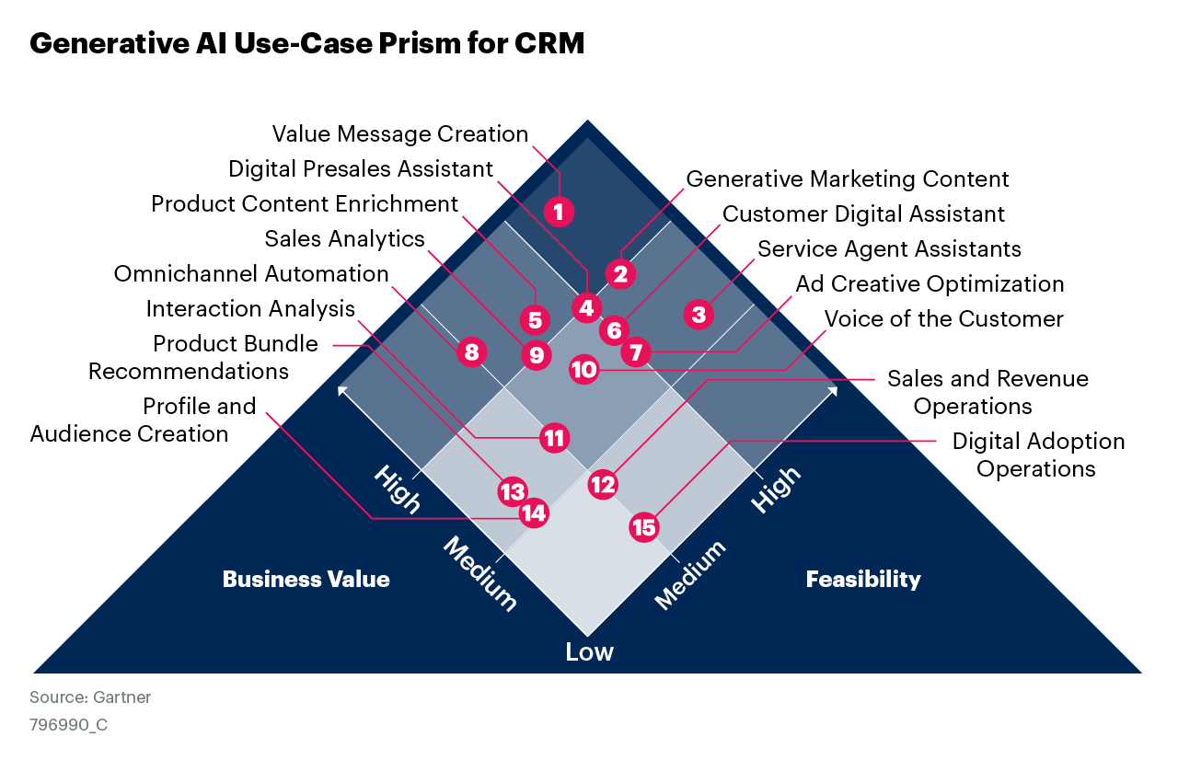

Slide 4

How to Use
Generative AI is an enabler of specific use cases for CRM. This Use-Case Prism plots 15 use cases against business value and feasibility axes, inviting strategic conversations and driving investment decisions.
Review the generative AI for CRM use cases plotted on the Prism, comparing them with the maturity and requirements of your own organization.
Likely Wins offer a great combination of high feasibility and high business value.
Marginal Gains are highly feasible but offer low business value.
Calculated Risks offer high business value but low feasibility.
Selective Exceptions offer low business value and low feasibility.

Slide 5
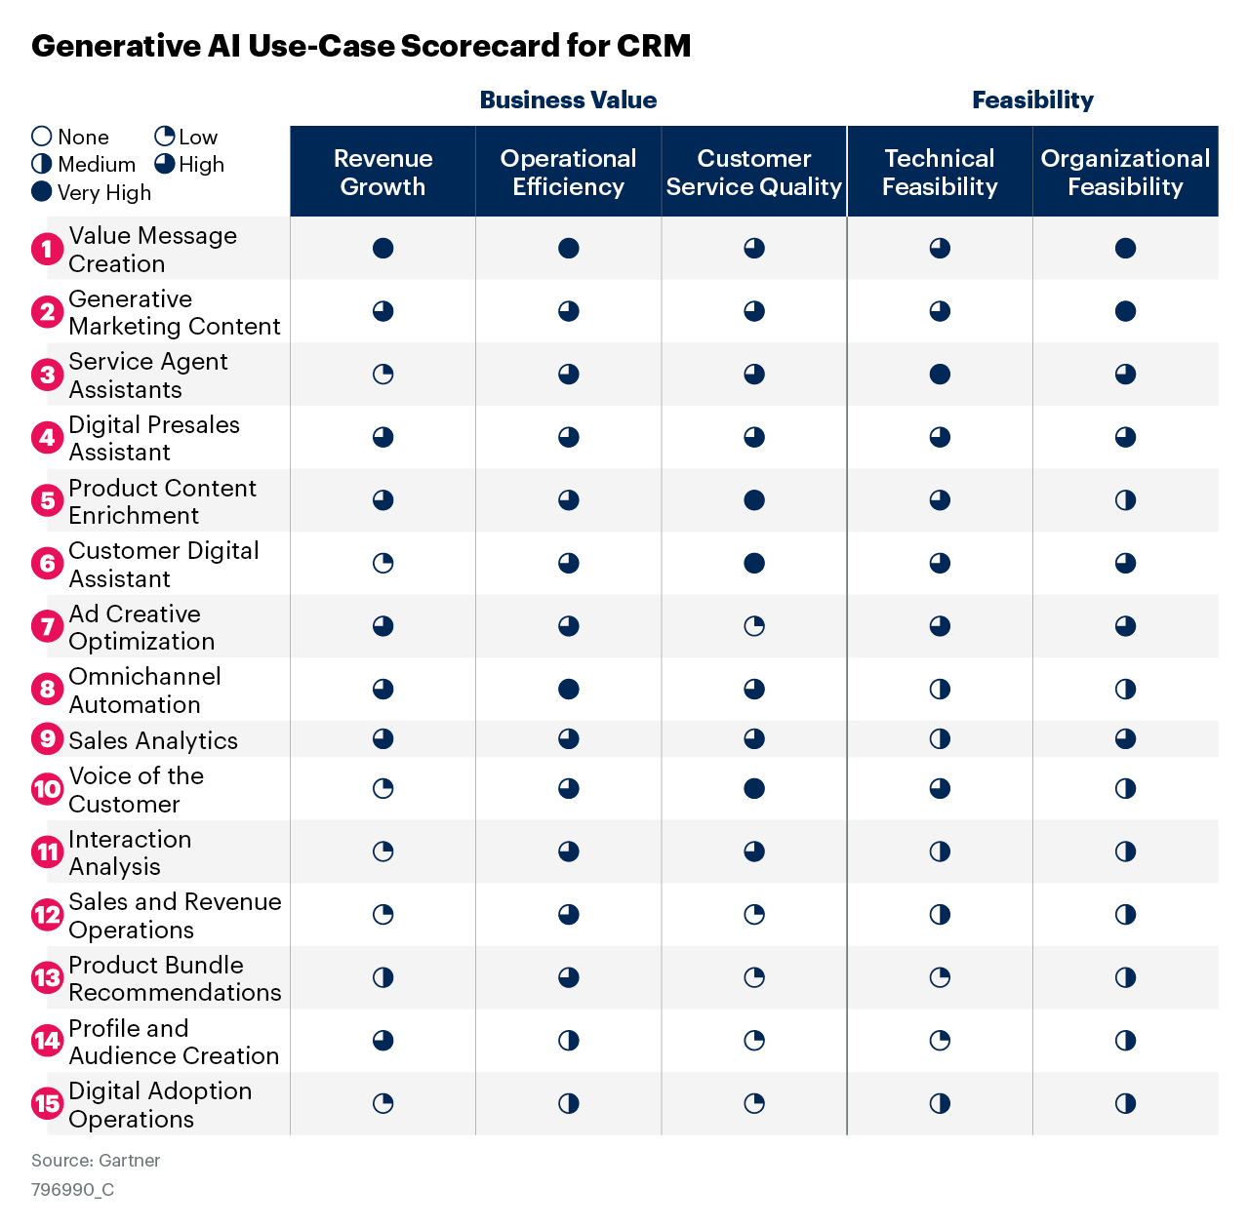

Slide 6
Use-Case Dimension Explanations
Dimension | Explanation
Revenue Growth | The ability of the use case to support existing and new business opportunities through the sale of products and services that drive top-line growth.
Operational Efficiency | The ability to meet or exceed performance goals with equal or fewer resources such as capital investments, staff, technology or time duration.
Customer Service Quality | The ability to improve the satisfaction of customers through processes, UX and product changes that support customer relationship management (such as handled by marketers, sellers, customer service agents, etc.) and face-to-face interactions.
Technical Feasibility | The availability of technology solutions and infrastructure to support building and deploying A.I
Organizational Feasibility | The ability and openness of the organization to use and incorporate AI technology and insights into its decision making. This includes readiness to rely on AI to augment or automate decision making.

Slide 7
Generative AI Use-Case Pipeline for CRM
The pipeline shows how these 15 use cases are distributed across relevant CRM functions:
Marketing
Sales
Customer Service
Digital Commerce
Cross-CRM
It allows prioritization, as you can easily see which use cases have a chance of improving a particular enterprise business process.
Typically, use cases that have a longer span across the pipeline should have better total business value.
The pipeline serves as a map to pinpoint the relevant stakeholders to trigger desirable discussions.

Slide 8
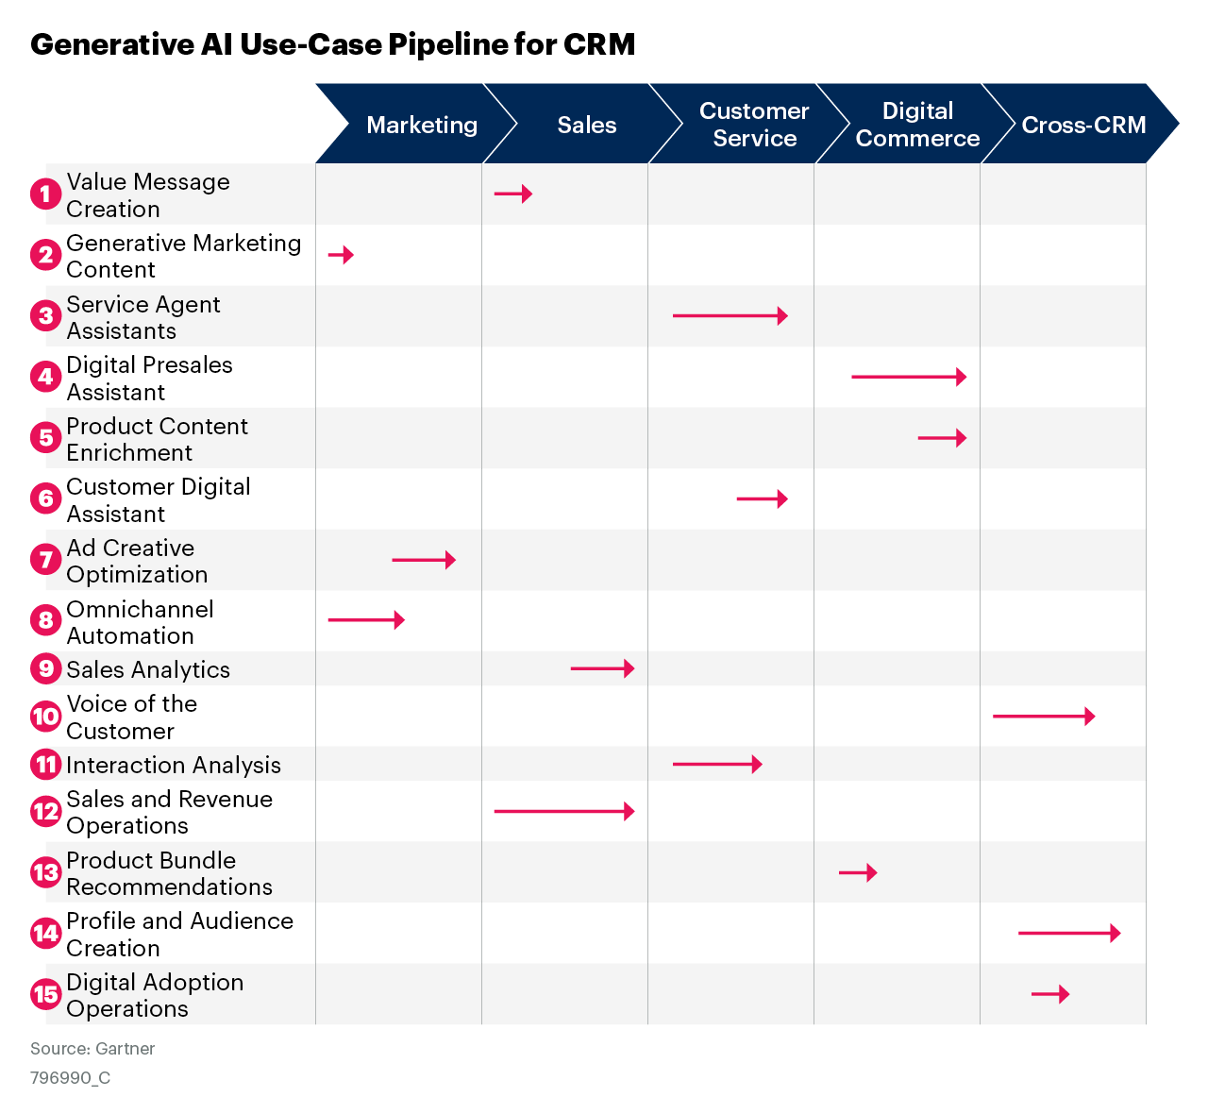

Slide 9
About This Research
These use cases have been selected and positioned based on an assessment by Gartner SMA methodology.
Approved Methodology: Gartner conducts social listening analysis leveraging third-party data tools to complement or supplement the other fact bases presented in this research. Due to its qualitative and organic nature, the results should not be used separately from the rest of this research. No conclusions should be drawn from this data alone. Social media data in reference is from 1 June 2022 to 15 July 2023 in all geographies (except China) and recognized languages.
The SMA Team: The Social Media Analytics team contributed to this research.
For detailed customization, use Gartner’s Prism Toolkit:
Toolkit: Discover and Prioritize Your Best AI Use Cases With a Gartner Prism (732696)
(Social Media Analytics study results do not represent “global” findings or the market as a whole, but reflect the aggregate crowdsourced opinion of the respondents commenting about the topic on social media.)

