Slide 1
Toolkit Slides: Build Your Own Prism
David Norrie, Alexander Linden,
Farhan Choudhary Data and Analytics Team

Slide 2
The Prism Workflow
2
4
6
Focus on Relevant Use Cases
Determine Business Value & Feasibility Dimensions
Score Use Cases
1
3
5
7
Gather Use Cases
Add Use Cases
Customize Weightings
Refinement
P*
*P - Pipeline

Slide 3
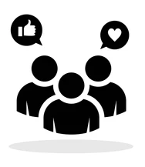


3
Determine Business Value & Feasibility Dimensions
2
4
5
6
7
1
Focus on Relevant Use Cases
Customize Weightings
Gather Use Cases
Score Use Cases
Add Use Cases
Refinement
Search Gartner.com for available Prisms, Hype Cycles and Use Case Toolkits
Engage with Business, IT and domain stakeholders for identifying business priorities
Don’t know where to start? Check out our Understanding Use-Case Prisms for Prioritizing Artificial Intelligence Investments for some further direction
Notes:
Placeholder for text (substitute your own text; delete when not used)

Slide 4




3
Determine Business Value & Feasibility Dimensions
2
4
5
6
7
1
Focus on Relevant Use Cases
Customize Weightings
Gather Use Cases
Score Use Cases
Add Use Cases
Refinement
Relevant business use cases:
Business Activity
Risk Management
Knowledge Management
Human Capital Management
Are a specific business activity
Highly Composed
Poor Examples
Mediocre Examples
Metadata Management
Have significant observable / measurable business outcomes
Claims Management
Predictive Maintenance
Mediocre Examples
Are well-phrased and to the point
Great Examples
Sales Forecasting
Price Optimization
Claim Fraud Detection
Do not overlap with other use cases
Specific
Clear
Business Outcome
Vague
Notes:
A prism’s primary purpose is to trigger the right conversations between business, IT and AI stakeholders. Those conversations should not be too high-level or low-level. They should ideally target concrete improvement projects coupled with tangible business outcomes. Therefore, great care has been taken to select which business use cases to be included.
Typically, one can assess use cases as:
Great, if their outcomes are clearly defined, easy to measure, and success criteria or KPI can be identified.
Mediocre, if their outcomes are already fairly difficult to measure, or indirectly impact other use cases which may further have direct business impact.
Poor, if they contain a plethora of business activities and are vague in their business outcomes application. For example, knowledge graphs, metadata management or customer segmentation don't have any direct business outcomes, and therefore are more hidden or technical business cases. Indirect use cases support or enable other relevant business use cases, and only this way may become absolutely pivotal to producing great business outcomes.

Slide 5
What use- case conversations look like
3
Determine Business Value & Feasibility Dimensions
2
4
5
6
7
1
Focus on Relevant Use Cases
Customize Weightings
Gather Use Cases
Score Use Cases
Add Use Cases
Refinement
Use Case | Drivers for inclusion
Sentiment Analysis | High volume of interest from organizations, highly searched on gartner.com
Next Best Action / Next Best Recommendation | Many case studies showing value, surveys of Gartner clients show this is a high value activity
Customer Journey Analytics | High priority investment areas for organizations with CX focus
Notes:
Placeholder for text (substitute your own text; delete when not used)

Slide 6
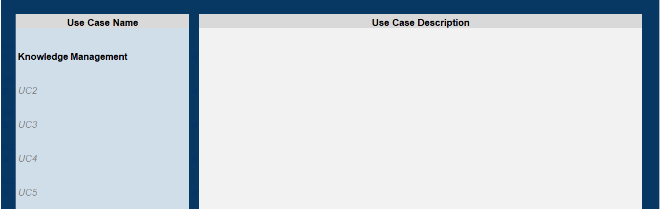
3
Determine Business Value & Feasibility Dimensions
2
4
5
6
7
1
Focus on Relevant Use Cases
Customize Weightings
Gather Use Cases
Score Use Cases
Add Use Cases
Refinement
Fill in the use case name here, line by line. You only need to make edits/changes to use case names etc. in this pane - it gets auto-populated in the rest of the sheet
Add descriptions of these use cases. E.g., what technologies, techniques, outcomes do you see. Helps keep track of the objective.
For the sake of illustration, let’s use an example of knowledge management
Notes:
Placeholder for text (substitute your own text; delete when not used)

Slide 7
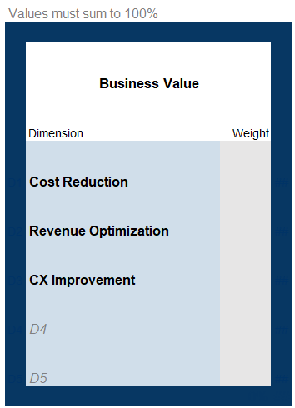
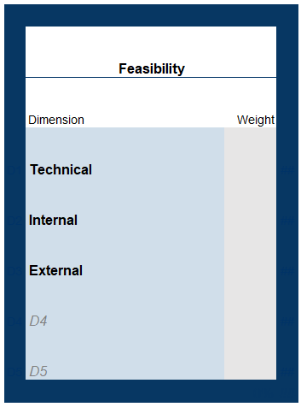
3
Determine Business Value & Feasibility Dimensions
2
4
5
6
7
1
Focus on Relevant Use Cases
Customize Weightings
Gather Use Cases
Score Use Cases
Add Use Cases
Refinement
Fill in the business value dimensions - which are the top 3 to 5 areas of priority, this is linked to the next step of assigning weights too
Fill in the feasibility dimensions for your organization. Typically it gets encapsulated in technical, internal and external feasibility.
Ask yourself:
How different are the measures of value and/or feasibility to my organization against the norm?
Notes:
Placeholder for text (substitute your own text; delete when not used)

Slide 8
Here some definitions of business value dimensions
3
Determine Business Value & Feasibility Dimensions
2
4
5
6
7
1
Focus on Relevant Use Cases
Customize Weightings
Gather Use Cases
Score Use Cases
Add Use Cases
Refinement
Revenue Optimization | Includes market expansion, new product innovation, better customer retention to grow or at least preserve revenues.
Cost Efficiency | Includes process automation, better utilization of staff.
Customer Experience | Includes all activities driving customer satisfaction, creating better long-lasting customer relations, increasing customer lifetime value, and retention.
Risk Reduction | Includes all activities to be in compliance with legal requirements, and all activities aimed at preventing hazardous situations (attacks, legal prosecution, supply chain outages).
Service Quality | Includes timely resolution to customer problems, maintenance, upgrades. This can overlap significantly with “customer experience” and it may be unadvisable to have both business value dimensions.
Social Acumen | Includes issues like environment sustainability, social responsibility (see The Gartner Digital Business Value Model).
Notes:
Placeholder for text (substitute your own text; delete when not used)

Slide 9
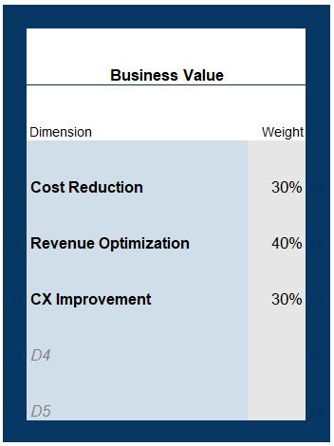
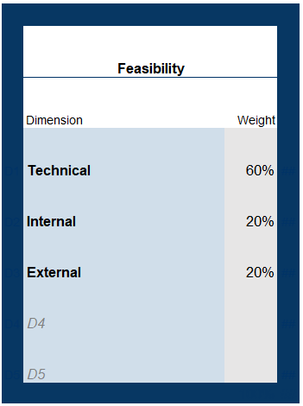
3
Determine Business Value & Feasibility Dimensions
2
4
5
6
7
1
Focus on Relevant Use Cases
Customize Weightings
Gather Use Cases
Score Use Cases
Add Use Cases
Refinement
Note that all weightages must sum up to 100
Define or readjust the weightings according to your feasibility constraints. For instance, external feasibility might not apply to your industry or domain, or may play a huge factor.
Define or Readjust the weightings according to your business priorities
⇒ Make sure they sum to 100%.
Notes:
Placeholder for text (substitute your own text; delete when not used)

Slide 10

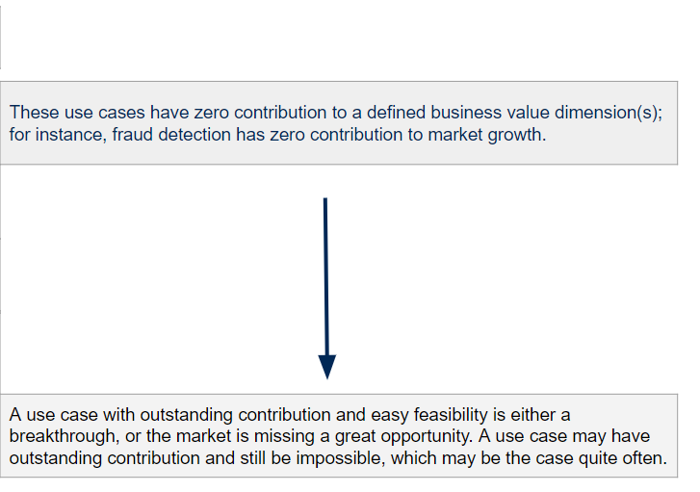
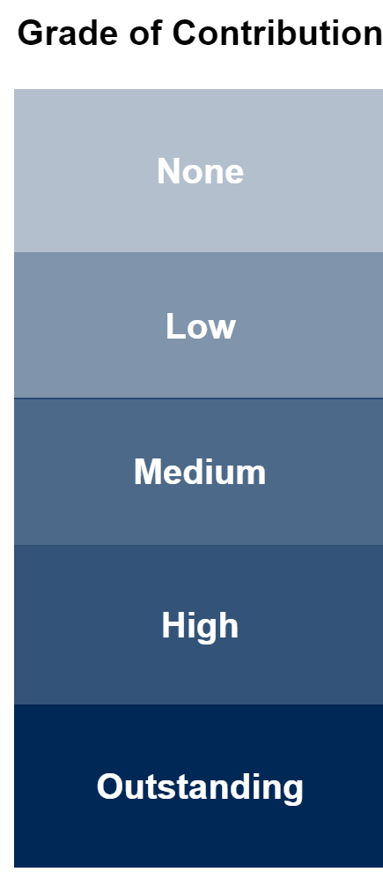
3
Determine Business Value & Feasibility Dimensions
2
4
5
6
7
1
Focus on Relevant Use Cases
Customize Weightings
Gather Use Cases
Score Use Cases
Add Use Cases
Refinement
Your dimensions and weights get automatically copied here
….
0
Your use cases entered in Step 3 get auto-
populated here
Your final scores get calculated here - we’ll view the prism later
Use the scale on the top of the scoring page, this would help you in translating the scorecard too.
1
2
3
4
Notes:
Placeholder for text (substitute your own text; delete when not used)

Slide 11

3
Determine Business Value & Feasibility Dimensions
2
4
5
6
7
1
Focus on Relevant Use Cases
Customize Weightings
Gather Use Cases
Score Use Cases
Add Use Cases
Refinement
One done scoring the first dimension, move on to the next. Put good thought into the scoring exercise.
See your final score changing as we put add scores across dimensions.
Notes:
Placeholder for text (substitute your own text; delete when not used)

Slide 12

3
Determine Business Value & Feasibility Dimensions
2
4
5
6
7
1
Focus on Relevant Use Cases
Customize Weightings
Gather Use Cases
Score Use Cases
Add Use Cases
Refinement
Here we are scoring “Knowledge Management” as a “2”.
and obtain a final business value score (for now)
Note: Always revisit the scale guidance (in Slide 10 and in the Excel spreadsheet) when in doubt. You can also enter fractional values to have more precision.
Notes:
Placeholder for text (substitute your own text; delete when not used)

Slide 13

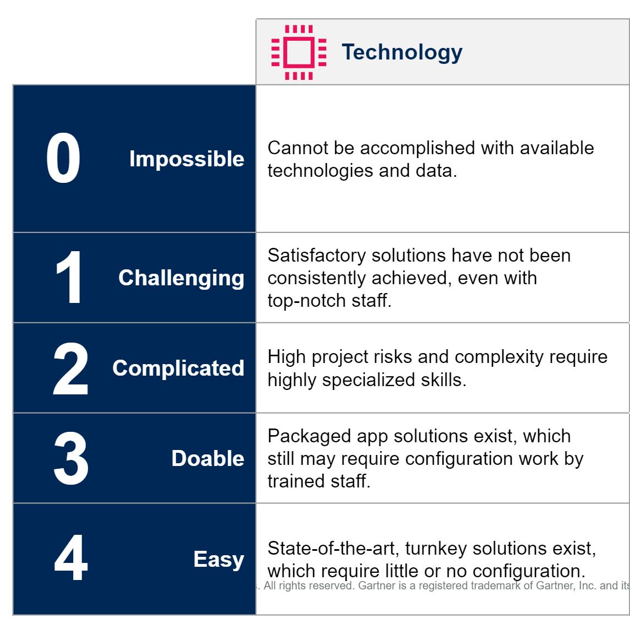
3
Determine Business Value & Feasibility Dimensions
2
4
5
6
7
1
Focus on Relevant Use Cases
Customize Weightings
Gather Use Cases
Score Use Cases
Add Use Cases
Refinement
Now we start the feasibility scoring by evaluating technical feasibility first. On the left is a quick refresher on how to understand technical feasibility.
In the same fashion, the feasibility value starts to populate.
Notes:
Placeholder for text (substitute your own text; delete when not used)

Slide 14

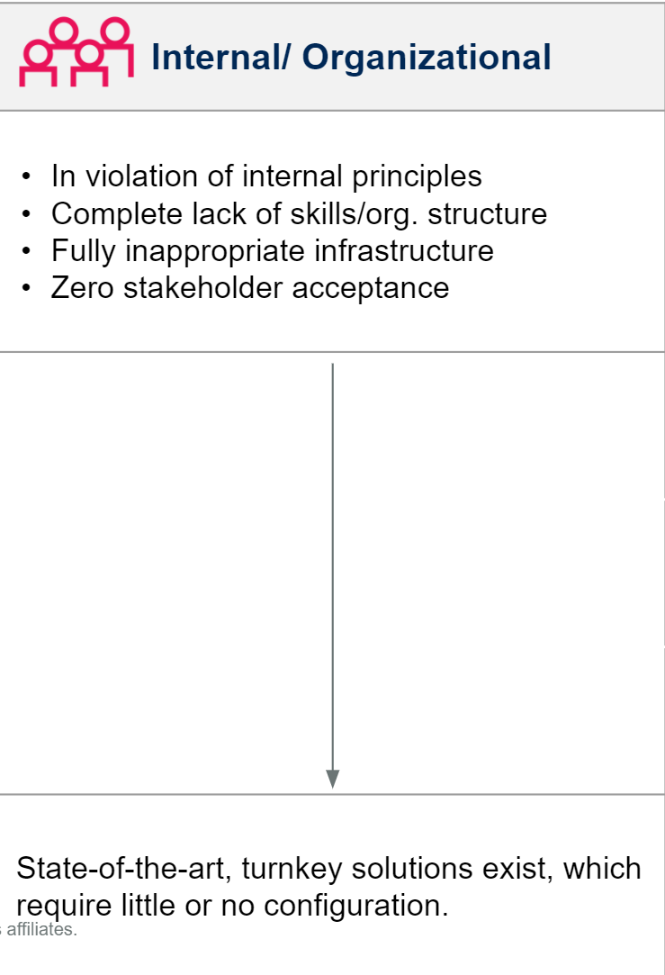
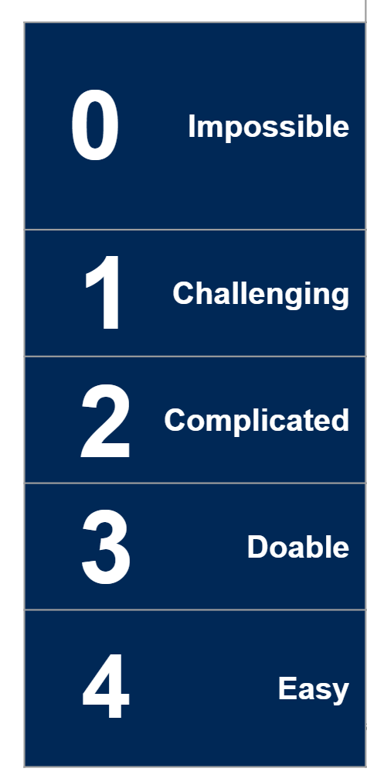
3
Determine Business Value & Feasibility Dimensions
2
4
5
6
7
1
Focus on Relevant Use Cases
Customize Weightings
Gather Use Cases
Score Use Cases
Add Use Cases
Refinement
Moving on to internal feasibility. On the left is a quick refresher on how to score from 0 to 4.
once entered, the feasibility value starts to update.
Notes:
Placeholder for text (substitute your own text; delete when not used)

Slide 15

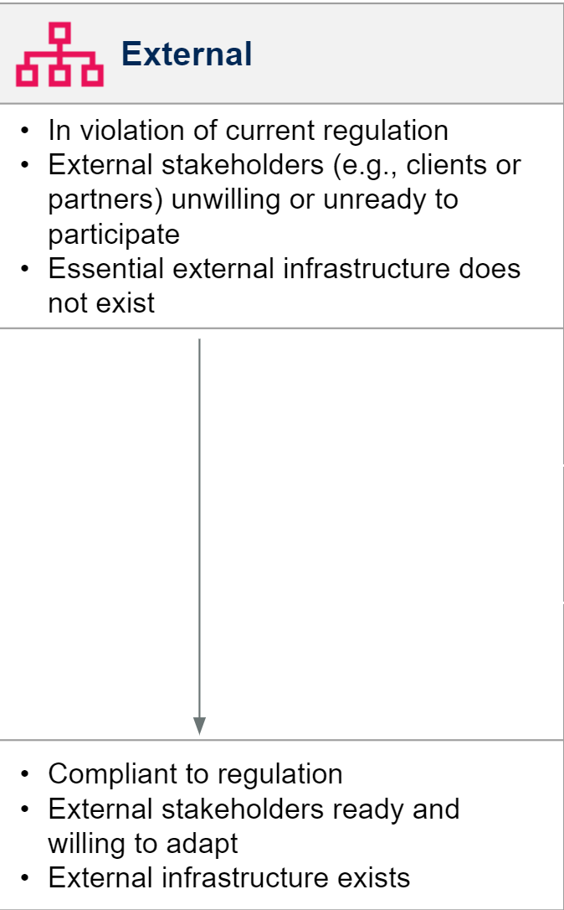
3
Determine Business Value & Feasibility Dimensions
2
4
5
6
7
1
Focus on Relevant Use Cases
Customize Weightings
Gather Use Cases
Score Use Cases
Add Use Cases
Refinement
as we enter a “4” here….
… the feasibility is being again updated.
Notes:
Placeholder for text (substitute your own text; delete when not used)

Slide 16

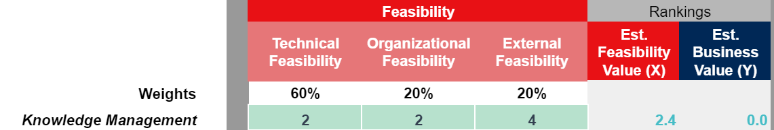
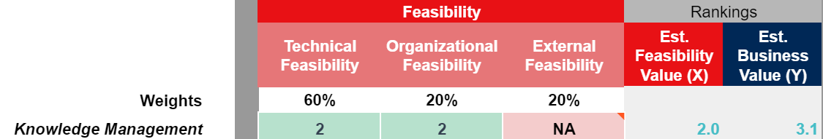

In some cases there is no external influence on a use case ….
3
Determine Business Value & Feasibility Dimensions
2
4
5
6
7
1
Focus on Relevant Use Cases
Customize Weightings
Gather Use Cases
Score Use Cases
Add Use Cases
Refinement
Instead of assuming a “4” in external feasibility:
You can see the Prism building up in the (VIEW) Prism tab of the spreadsheet as you go through each step of the scoring.
1
One can enter “N/A” instead of “4”
1’
2
High
High
Business Value
Medium
Medium
Feasibility
Low
This change may appear as cosmetic, but in some instances, we have seen significant reprioritization coming out of it.
Notes:
Placeholder for text (substitute your own text; delete when not used)

Slide 17
3
Determine Business Value & Feasibility Dimensions
2
4
5
6
7
1
Focus on Relevant Use Cases
Customize Weightings
Gather Use Cases
Score Use Cases
Add Use Cases
Refinement
Interpretation of Dot Placement
A natural dot placement should follow the financial laws of risk vs. return.
1
Typically, you’d expect this: The higher the risk (lower the feasibility), the higher the returns.
2
3
Most use cases should cluster in the middle, with average risks and average returns.
4
5
7
6
9
8
11
10
12
13
High
High
14
Business value
Medium
Medium
Feasibility
Low

Slide 18
3
Determine Business Value & Feasibility Dimensions
2
4
5
6
7
1
Focus on Relevant Use Cases
Customize Weightings
Gather Use Cases
Score Use Cases
Add Use Cases
Refinement
This dot distribution indicates …
… the domain may represent a new terrain for AI, where everything is still very difficult.
Note that “high” is very relative. There are no absolute metrics here in terms of monetization. Therefore, we advise taking full advantage of the whole space, and to rescale the scoring appropriately.
1
3
2
4
5
High
7
6
High
8
9
11
10
Business value
12
13
Medium
Feasibility
Medium
14
Low

Slide 19
3
Determine Business Value & Feasibility Dimensions
2
4
5
6
7
1
Focus on Relevant Use Cases
Customize Weightings
Gather Use Cases
Score Use Cases
Add Use Cases
Refinement
This dot distribution may indicate …
… that turnkey solutions are not yet available.
1
3
4
5
6
7
8
9
10
High
11
12
High
Business value
14
Medium
Feasibility
Medium
Low

Slide 20
3
Determine Business Value & Feasibility Dimensions
2
4
5
6
7
1
Focus on Relevant Use Cases
Customize Weightings
Gather Use Cases
Score Use Cases
Add Use Cases
Refinement
This dot distribution indicates …
… this domain has mostly AI solutions as turnkeys already, and AI is still underrated.
For example: AI applications in the corporate legal space where many turnkey solutions are available for the taking
1
2
3
6
4
5
8
7
9
10
11
12
13
14
High
High
Business value
Medium
Medium
Feasibility
Low

Slide 21
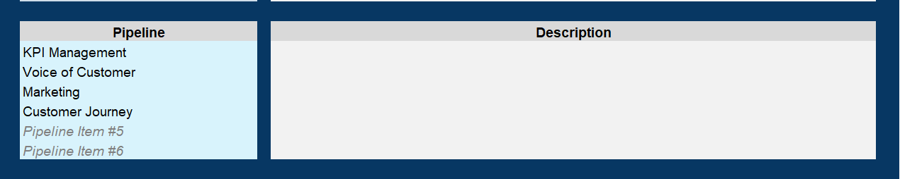
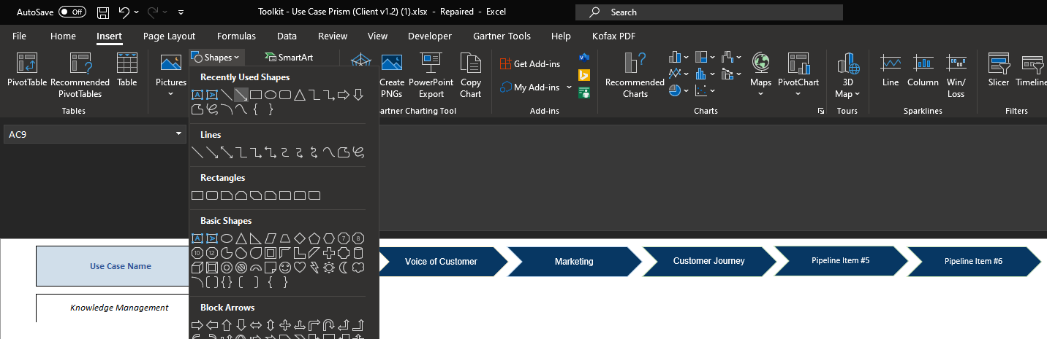
Pipeline
1
Add Pipeline elements in Step 1: Fill in Details section of the spreadsheet
2
Click Insert → Shapes → Line Arrow for selecting the unidirectional arrow
3
Simply draw the Line Arrow next to your use case

Slide 22


