Slide 1
A CTO’s Guide to Build the Right Executive Partnerships
Samantha Searle and Ankita Khilare
Notes:
Ver 2022-1208
Presenter's Name
Presenter's Name

Slide 2
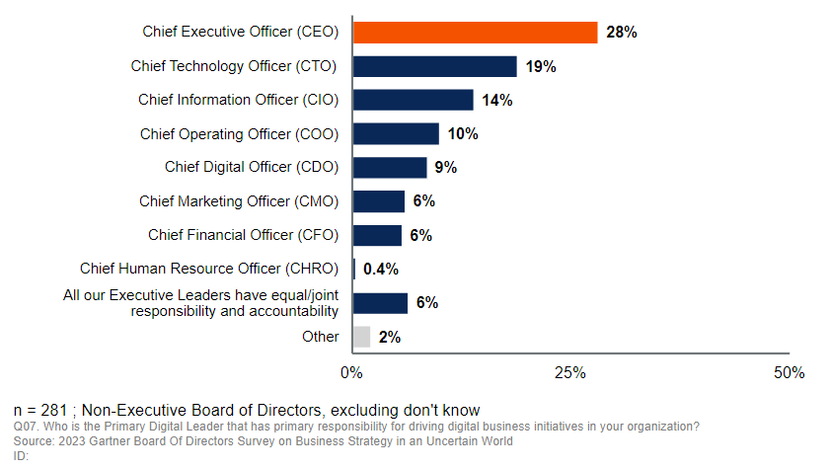
CTOs are Second in Line to Driving Digital Business Initiatives
Primary Digital Leader Responsible for Driving Digital Business Initiatives

Slide 3
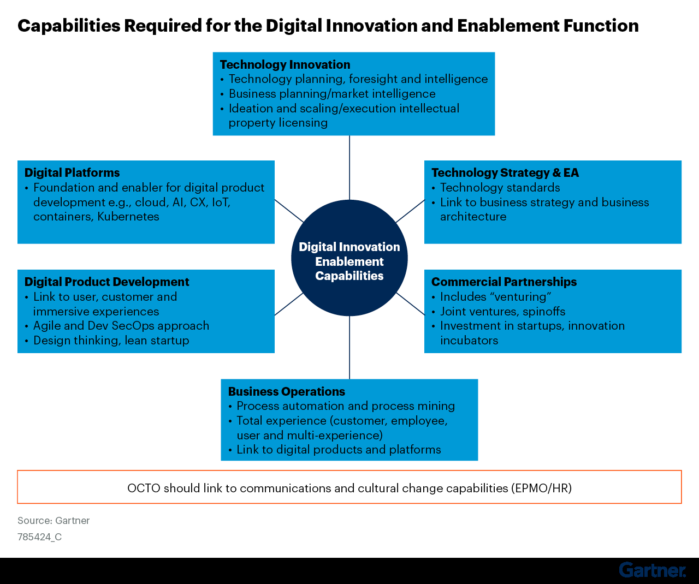
However, CTOs Cannot Succeed Alone
CTOs either lead or support these capabilities in partnership with CIOs, Chief Digital Officers and other CxOs where relevant.
It is too much for one executive leader to deliver all 6 capabilities.
Effective CxO partnerships are the key to success!

Slide 4
CTOs Regularly Work with Other CxOs…
…but these partnerships could be more effective!
How would you describe the relationship of the CTO at the organization with the following stakeholder(s)? (1 means not effective at all and 5 means highly effective)
Which of the following key stakeholders has the CTO at your organization worked with regularly (at least once a month)? - (Multiple Responses allowed)
Chief Finance Officer (CFO)
33%
Chief Information Officer (CIO)
63%
CxO | Effectiveness
CDAO | 3.93
CIO | 3.88
COO | 3.86
CISO | 3.81
CDO | 3.81
CFO | 3.74
CMO | 3.38
Chief Operating Officer (COO)
36%
CTOs regularly work with these CxOs
Chief Information Security Officer (CISO)
49%
Chief Marketing Officer (CMO)
25%
Chief Digital Officer
34%
Other CxO
2%
Chief Data & Analytics Officer (CDAO)
30%
Notes:
Data taken from Gartner’s 2023 Changing Role of the CTO Function Survey

Slide 5
Why Invest in Building CTO and CxO Partnerships?
Benefits of Effective CTO and CxO Partnerships
Ensure strategic alignment on executing digital transformation
Find allies to gain support and navigate political roadblocks
Leverage each other’s complementary skills and expertise to solve problems
Identify new opportunities to create business value

Slide 6





The Synergies that the CTO Role Has With Other CxO Technology Roles
CIO Drives digital business and operational execution
Digital Transformation
Chief Digital Officer Digital business advisor and catalyst
CTO
Chief Data & Analytics Officer Drives data literacy and establishes a data-driven culture
Digital Platforms
Data
Driven
DevSecOps
CISO
Balances assurance with enablement and invests in digital security technology
Notes:
Chief technology officers (CTOs) should make a note of the four most common CxO IT roles and their prerogatives to identify the areas of partnership:
The Chief Information Officer has the responsibility to drive digital business and strive toward excellence in IT operational execution.
The Chief Digital Officer (CDO) advises the enterprise on digital initiatives and acts as a catalyst for these initiatives.
The Chief Data Officer works to make the enterprise decisions driven by data rather than perceptions.
The Chief Information Security Officer (CISO) has the responsibility to digitally secure the enterprise and balance that with investments in newer digital security technologies.
CTOs should use these roles to build partnerships with their peers in the enterprise. Often a Chief Digital Officer is also hired to accelerate the transition to a digital business.
Even if your organization doesn’t have all these roles, elements of these roles (and the responsibilities they represent) are essential to building an adaptive and resilient organization that can navigate turbulent and volatile environments.
How these roles partner depends on org maturity & digital maturity
CAVEATs:
1. Not all orgs will have all 4 roles BUT they will probably have some tech leader with a subset of these responsibilities who the CTO should work with
2. the precise focus and set of responsibilities for each tech CxO role will differ in each organization, in order to provide the right set of responsibilities, skills and experience to facilitate the digital business journey

Slide 7




The Synergies the CTO Role Has With Other CxO Business Roles
CEO Sets strategic direction and tracks execution
Digital Transformation
CTO
Digital Technology Investment
CMO Customer experience
Digital Experience
CFO Financial performance
Business Process Agility
COO
Business operational efficiency, resilience and agility
Notes:
Chief technology officers (CTOs) should make a note of the four most common CxO business roles and their prerogatives to identify the areas of partnership:
The CEO sets digital business ambition and the plan to achieve it
The CFO decides how much money to dedicate to digital technology investments and tracks value generated from them
The COO focuses on operational efficiency/resilience/agility and product/service quality
The CMO optimizes an omni-channel customer experience through hybrid marketing (both digital and non-digital)
CTOs should collaborate with these roles to build partnerships, seeking to understand how each role strives to deliver the CEO's digital business ambition

Slide 8
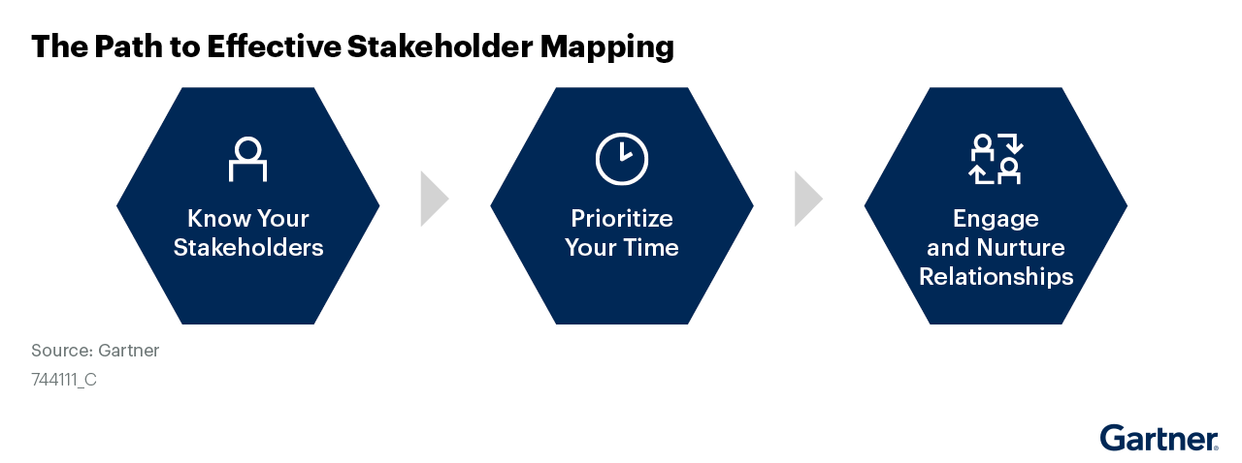
ACTION: Identify and Map Your Stakeholder Relationships to Build Effective CxO Partnerships
Source: Use Stakeholder Maps to Boost Your Executive Transition

Slide 9
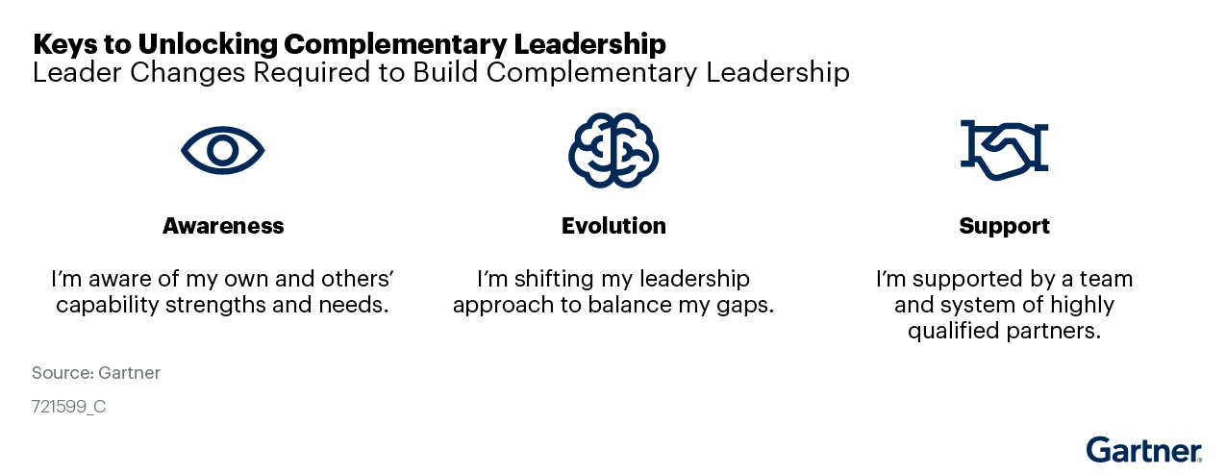
Leverage Complementary Leadership to Succeed
Use Complementary Leadership to Develop Future-Ready IT Leaders
Action: Identify the CxOs that CTOs can work with to complement their strengths and help them address any skills gaps
Notes:
This research addresses leveraging existing skills to develop robust leadership across the IT management team, and examines the key components of building complementary leadership:
Complementary support: How do we fill leaders’ urgent capability gaps quickly?
Contextual awareness: How do we help leaders focus on the right capabilities?
Practical evolution: How do we get leaders to change their behaviors?

Slide 10
Create a Stakeholder Engagement Action Plan
Sr. No. | Priority Action Item or Initiative | Business Objectives | Owner | Implementation Time Frame | Required Investment | Key Metrics | Guidance Needed

Slide 11
Six Steps to Building CTO and CXO Partnerships
This guide will help CTOs building collaborative relationships with CXOs.
It outlines six steps to kick-off CTO-CXO partnership discussions as follows
Create Action Plan &
Set up Regular Check-ins
1
6
Establish Shared Priorities
Define Shared Outcomes & Metrics
5
2
Identify Common Challenges That You Can Tackle Together
Leverage Governance To Avoid Conflicts
4
3
Determine Activities To Collaborate on

Slide 12
Step 1: Establish Shared Priorities

Slide 13
Questions for CTOs & CxOs to ask each other to identify common priorities
What is going well (and not so well)?
What are your aspirations (in the next 6 months, 12 months and 24 months)?
How do you see yourselves as contributors to enterprise-level goals?
What risks or challenges might prevent you from delivering your strategies?
What technology obstacles prevent you from achieving your business goals?
What can the CTO do to enable you to develop technology solutions for the business, autonomously?
What new trends might impact our priorities over the next 6 months?

Slide 14
ACTION: Write Down Your Shared Priorities with other CxOs
CTO | Priority #1 | Priority #2 | Priority #3 | Priority #4 | Priority #5 | Priority #6
CIO | ✔ |  |  | ✔ | ✔ | ✔
CDO | ✔ | ✔ | ✔ |  | ✔ | ✔
CISO |  |  |  |  | ✔ | ✔
CDAO |  |  | ✔ |  | ✔
COO |  |  | ✔ |  |  | ✔
CFO |  |  |  |  | ✔ | ✔
CMO |  | ✔ | ✔
CEO | ✔ |  | ✔ | ✔ | ✔

Slide 15
Step 2: Identify Common Challenges That You Can Tackle Together

Slide 16
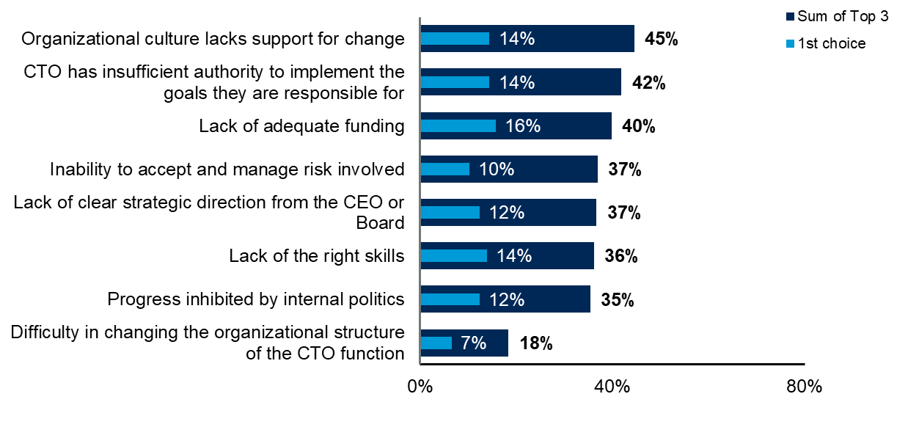
Top Challenges Faced by CTOs in Meeting Their Goals
Gartner research surveys show that other CxOs face similar challenges:
Lack of funding
Organizational culture is a barrier to change
Insufficient authority to implement their goals
Therefore CTOs and CxOs can work together to overcome them
n = 382, excluding those where CTO does not have any internal roadblocks and not sure; does not show other
Q19: Now, thinking about the current challenges the CTO at your organization faces, what are the top 3 internal roadblocks that impact the CTO function’s ability to meet its current goals?
Source: 2023 Gartner Changing Role of the CTO Function Survey
ID:

Slide 17
CTOs and CxOs Must Decide What Actions to Take to Address Common Challenges Together
Common Challenges | Action Required
Skills & Staff Shortage | Develop compelling EVP to attract, develop & retain talent
Cultural Challenges | Collaboration & DEI PRISM Model
Lack of adequate funding | Link Tech & D&A initiatives to business strategy
Stakeholder involvement | Address the “What’s in it for me” scenario for those stakeholders Stakeholder impact map
Authority to execute individual responsibilities | Clarify governance by creating decision-rights matrix

Slide 18
Step 3: Determine Activities to Collaborate On

Slide 19
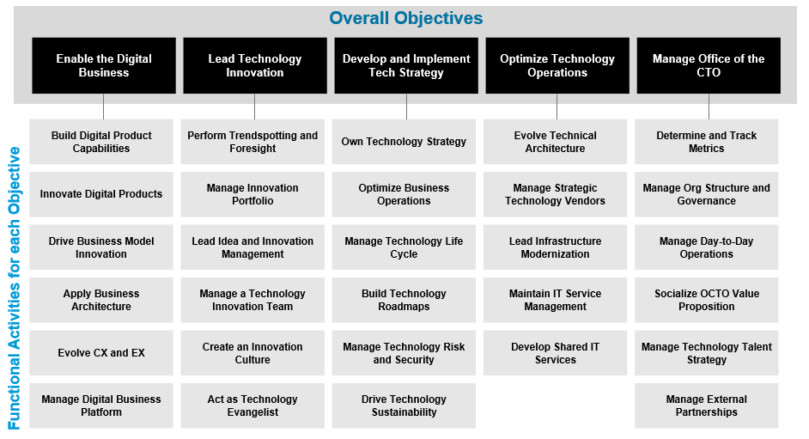
Key Activities That the CTO is Responsible For
ACTION: CTOs should use this slide as a discussion point with CxOs to identify common activities to collaborate on

Slide 20
Which CxOs Should the CTO Partner With To Deliver These Activities (Sample Key Stakeholder Map)
CxO | Build Digital Platform | Drive Product Innovation | Improve Customer Experience | Develop Technology Strategy | Drive Technology Innovation | Manage Technology Risk
CIO | ✔ |  |  | ✔ | ✔ | ✔
CDO | ✔ | ✔ | ✔ |  | ✔ | ✔
CISO |  |  |  |  | ✔ | ✔
CDAO |  |  | ✔ |  | ✔
COO |  |  | ✔ |  |  | ✔
CFO |  |  |  |  | ✔ | ✔
CMO |  | ✔ | ✔
CEO | ✔ |  | ✔ | ✔ | ✔

Slide 21
Step 4: Leverage Governance to Avoid Conflict

Slide 22
Expose Any Areas of Potential Conflict and Identify Solutions - Examples
Potential Conflict | Proposed Solution
The CTO responsible for AI engineering teams finds that their AI models lack good quality data to use as training data | Work with the CDAO on improving data quality and removing any biases from the data set
The CTO need access to personally identifiable data to improve customer-facing digital products, but this might conflict with data protection regulations | Ask the CDAO to provide synthetic data that is representative of the customer population
CTO brings in emerging technologies that pose a potential security risk to the organization | Work with CISO to develop and conduct IT security risk assessments when evaluating the adoption of new technologies
CTO requires more funds to invest in experimenting with AI technologies but technology budgets will be flat for the next financial year | Work with the CEO and CFO to prioritize which specific AI technologies could be most beneficial for addressing key business opportunities or challenges and prioritize those ones

Slide 23
Set up a Decision Rights Matrix to Avoid Conflict (Example)
Activity or Decision or Deliverable | CTO | CxO
Develop enterprise technology strategy | Accountable | Consulted
Define AI strategy | Consulted | Consulted
Build digital business platform | Accountable for entire platform | Responsible
Evolve customer experience | Consulted | Responsible for data architecture and ensuring alignment with EA
Improve digital products | Consulted | Accountable
Trendspotting analysis and emerging technology radars | Accountable | Consulted on relevant trends
Notes:
At CxO level, most decisions will either be accountable or consulted, as direct reports will have certain tasks e.g. EA delegated to them, so they are responsible for performing that task, but CTO/CxO retains accountability. Similarly, CTOs and CxOs will often be consulted but then inform their direct reports of decisions. Exceptions are CEO setting strategy, announcing M&A etc and CFO setting budgets.

Slide 24
Step 5: Define Shared Outcomes & Metrics

Slide 25

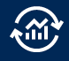

Measure Shared Digital Business Outcomes
The Primary Value Drivers for All Businesses
‸‸
1
Create metrics to measure impact on primary value drivers.
Cost Savings
2
Align business and technology outcomes to the drivers.
3
Connect value to outcomes to metrics in a taxonomy that supports better business decision making for priorities and investments.
Revenue Growth
Risk Reduction
Notes:
People often measure what they can measure, not what they should measure!
Recognise the difference between technology outcomes like 90% of apps moved ot the cloud in 12months and business outcomes like 80% customer retention over 6 months
Operational IT metrics are disconnected from business outcomes! Need to make a link between tech investment, innovation and DB outcomes
THIS IS CRITICAL BECAUSE THE CTO WILL ONLY GAIN CREDIBILITY AND INFLUENCE WITH OTHER CxOs IF THEY DELIVER RESULTS!!!
Think in terms of VALUE DRIVERS that influence outcomes in order to design meaningful metrics.
Key value drivers should focus on revenue growth, cost savings and risk reduction. Should start to include attainment of environmental, societal and governance goals as well.
Chief Data Officer & team should provide the analytics to ID the value drivers for a certain outcome
Bridge: Metrics drive behaviours and impact culture…

Slide 26
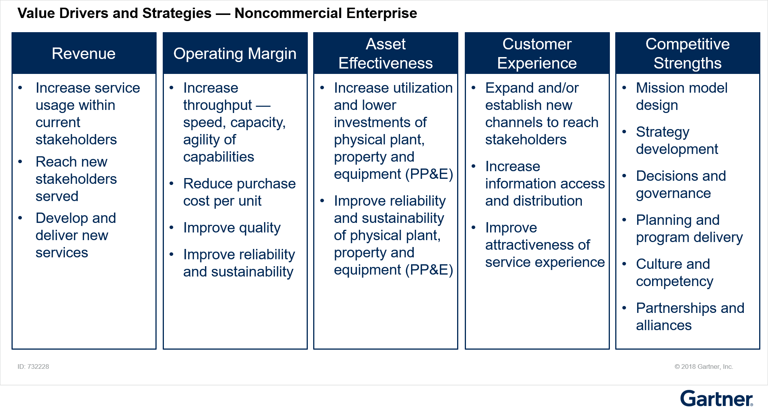
Identify Metrics by Mapping Value Drivers to Strategic Goals — Examples for a Noncommercial Enterprise
Notes:
People often measure what they can measure, not what they should measure!
Recognise the difference between technology outcomes like 90% of apps moved ot the cloud in 12months and business outcomes like 80% customer retention over 6 months
Operational IT metrics are disconnected from business outcomes! Need to make a link between tech investment, innovation and DB outcomes
THIS IS CRITICAL BECAUSE THE CTO WILL ONLY GAIN CREDIBILITY AND INFLUENCE WITH OTHER CxOs IF THEY DELIVER RESULTS!!!
Think in terms of VALUE DRIVERS that influence outcomes in order to design meaningful metrics.
Key value drivers should focus on revenue growth, cost savings and risk reduction. Should start to include attainment of environmental, societal and governance goals as well.
Chief Data Officer & team should provide the analytics to ID the value drivers for a certain outcome
Bridge: Metrics drive behaviours and impact culture…

Slide 27
Measure Success with Goals & Metrics
Innovation | D&A Capabilities | User Experience | Cost Optimization | IT Risk
No. of ideas generated | Business impact of D&A | Net Promoter Score (NPS) | IT Spending as a Percent of Revenue | Security breaches
Innovation cycle time | Time from insight to action | Customer lifetime value | IT Spending as a Percent of Operating Expense | Top risks
Innovation pipeline | Data quality | Customer retention rate | IT Spending per Employee | No. of incidents
Conversion rate | Data literacy level | Churn rate | Revenue per Employee | System availability
Failure rate | D&A Risk | Customer acquisition cost | IT Operational Versus Capital Spending | MTTR or MTTI (Mean Time To Resolve or Isolate)

Slide 28
Step 6: Create an Action Plan and Set Up Regular Check-ins

Slide 29
Create an Action Plan for Working with CxOs
Action No. | Priority Action Item or Initiative | Business Objectives | Owner | Implementation Time Frame | Required Investment | Key Metrics | Guidance Needed

Slide 30
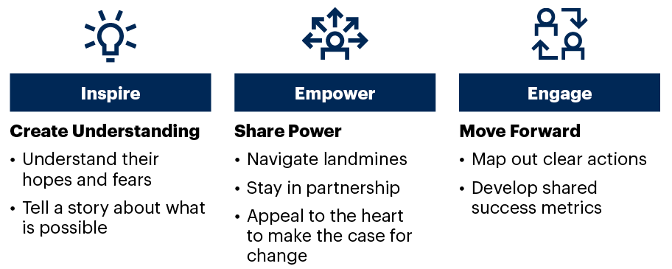
Guide for Effective Digital Conversations
Three Goals of a Digital Conversation
Notes:
Use this guide to frame conversations with other CxO leaders to:
Inspire your partners by understanding digital business from their perspective, using their language and focus. Then share a vision about what is possible with digital technology (see “Create a Compelling Vision That Everyone Understands” and “Using Digital Business Narratives to Speed Digital Business Transformation”).
Empower yourselves by discussing how to navigate cultural issues and political landmines, and sustain a strong partnership. Appeal to shared objectives and purpose to make the case for change (see “Selling Digital Transformation: A CIO’s Guide to Crafting Better Stories”).
Engage your partners in the change by mapping out an action plan, a set of metrics and things they can contribute toward the shared success of the enterprise in a digital world (see “Use the ESCAPE Model to Develop Change Leadership”).
Source: The 5 Conversations CIOs Must Have to Support Digital Business Acceleration, Chris Howard and Don Scheibenreif, G00730876
Leverage scenario planning
Prep for conversations with a list of questions and/or discussion points

Slide 31
Create a Plan for Regular Check-in Discussions
Introduction
Discussion Points
Summary
Inspire
Follow-up points from the last meeting
Identify any fears or concerns
Share stories of what each of you hope to achieve in the next few months
Review shared metrics performance
Decide key discussion points
Empower
Discussion Point 1
Discussion Point 2
Discussion Point 3
Engage
Agree on decisions made
Prioritize next actions/deliverable
Revised shared metrics if necessary
Timeline for next check-in
<Examples>
How are we progressing towards our shared outcomes?
Have our priorities changed since our last meeting?
Have any new obstacles emerged?
Where can we work together to overcome obstacles together

Slide 32
Recommendations
Meet regularly with each CxO to discuss their perception of current challenges and opportunities that might require strategies to be revised.
Review priorities each quarter to evaluate whether evolving business conditions warrant a re-assessment of current priorities.
Identify and leverage synergies to create meaningful partnerships with each role.
Pick out areas of conflict that needs to be resolved with each role and use governance mechanisms to minimize issues.
Determine the common business outcomes that all roles can meaningfully contribute to, in order to succeed in strategy execution.

Slide 33
CTO Profile
Aspect | Description
Role | The CTO empowers the organization with the technology to boost business performance and increase customer satisfaction
Goals | Develop and implement the technology strategy Optimize the organization’s current business and/or IT operations Lead technology innovation to drive transformation and enable new business models Enable digital business by providing the right technologies to build digital business platforms and creating digital products and services Evolve talent within the IT organization to acquire the skills to better exploit technology Manage the OCTO
Key Activities | Evolving architecture Modernizing infrastructure Building a digital business platform Driving trendspotting Developing digital products Managing technology talent Managing external partnerships
Success Metrics | Customer Experience IT Employee Productivity Contribution to Revenue Innovation pipeline

Slide 34
Clarify Interpretations of Business Strategy
What unique value do we provide to our stakeholders?
What financial targets must we meet to provide value?
What is the value proposition to the customer that will get us to those targets?
Which processes need to change in order to deliver that value proposition?
What capabilities do we need to learn and develop to sustain that model?
What risks may emerge that could prevent us from achieving those targets?
What might our competitors do that could impact our strategic execution?

