Slide 1
Sample IT Career Pathing Guide

Slide 2
Table of Contents
Career Enablers Framework
Career & Growth Path Examples
Career Path Framework

Slide 3
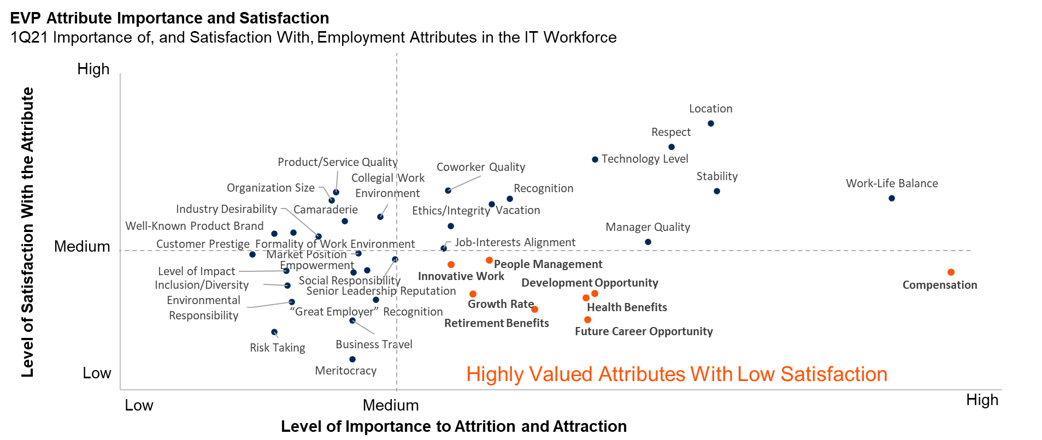
Providing IT Employees With Better Career Pathing Support Can Rapidly Increase Engagement and Minimize the Risk of Attrition
Employees cite future career and development opportunities among their top-valued EVP attributes but rank them among the lowest in terms of satisfaction.
Cultures with strict silos, process-centricity, and restrictive ladder-based career structures create a perceived limitation on employees’ ability to grow and develop.
n= 1,836 IT employees Source: Gartner 1Q21 Global Labor Market Survey

Slide 4
The IT Job Series Map
Illustrative
The boxes below represent jobs which may or may not currently be filled. Ability to move into a new job depends on both individual qualifications and need/opportunity. Opportunity to develop into formal leadership jobs (e.g., manager) exists, and is shown in career paths.
Tech Administration Family
Analysis Family
UX Family
Engineering Family
Architecture Family
Delivery Family
Product Mgt Family
Leadership Family
VP
Tech. Principal II
Director
Enterprise Architect II
Sr. Resource Manager
Sr. Product Manager
Tech. Principal I
Sr. Manager
UX Designer IV
Software Engineer IV
Data Engineer IV
Infra Engineer
IV
Information Architect III
Solution Architect III
Enterprise Architect
I
Sr. Scrum Master
Resource Manager
Product Manager
Manager
Job Complexity & Scope of Responsibility
UX Designer III
Software Engineer III
Data Engineer III
Infra Engineer
III
Information Architect II
Solution Architect II
Scrum Master
Business Analyst IV
Data Analyst IV
Security Analyst IV
Analytics Analyst IV
Sys Admin III
DBA
III
Business Analyst III
Data Analyst III
Security Analyst III
Analytics Analyst III
UX Designer II
Software Engineer II
Data Engineer II
Infra Engineer
II
Information Architect I
Solution Architect I
Sys Admin II
DBA
II
Business Analyst II
Data Analyst II
Security Analyst II
Analytics Analyst II
UX Designer I
Software Engineer I
Data Engineer I
Infra Engineer
I
Sys Admin II
DBA
I
Business Analyst I
Data Analyst I
Security Analyst I
Analytics Analyst I
Progression and Level mapping is based on Job Complexity & Scope of Responsibility. This mapping does not include direct compensation implications as multiple other factors are considered for grading.
Notes:
The boxes represent jobs which may or may not currently be filled. Ability to move into a new job depends on both individual qualifications and need/opportunity. Opportunity to develop into formal Leadership jobs (e.g., Manager) exists, and is shown in career paths.
Progression and Level mapping is based on Job Complexity & Scope of Responsibility. This mapping does not include direct compensation implications as multiple other factors are considered for grading. See “Introduction to the IT Job Architecture” for an illustrative examples of mapping job series to compensation structure.

Slide 5
The Job Series Map Can Be Used as a Tool to Plot Individual Journeys
Illustrative
Roles can be taken to gain experiences to help prepare individuals for next steps, and personal qualifications may influence the “level” of job someone moves into.
Tech Administration Family
Analysis Family
UX Family
Engineering Family
Architecture Family
Delivery Family
Product Mgt Family
Leadership Family
VP
Tech. Principal II
Director
Enterprise Architect II
Sr. Resource Manager
Sr. Product Manager
Tech. Principal I
Sr. Manager
UX Designer IV
Software Engineer IV
Data Engineer IV
Infra Engineer
IV
Information Architect III
Solution Architect III
Enterprise Architect
I
Sr. Scrum Master
Resource Manager
Product Manager
Manager
Job Complexity & Scope of Responsibility
UX Designer III
Software Engineer III
Data Engineer III
Infra Engineer
III
Information Architect II
Solution Architect II
Scrum Master
Business Analyst IV
Data Analyst IV
Security Analyst IV
Analytics Analyst IV
Sys Admin III
DBA
III
Business Analyst III
Data Analyst III
Security Analyst III
Analytics Analyst III
UX Designer II
Software Engineer II
Data Engineer II
Infra Engineer
II
Information Architect I
Solution Architect I
Sys Admin II
DBA
II
Business Analyst II
Data Analyst II
Security Analyst II
Analytics Analyst II
UX Designer I
Software Engineer I
Data Engineer I
Infra Engineer
I
Sys Admin II
DBA
I
Business Analyst I
Data Analyst I
Security Analyst I
Analytics Analyst I
Breadth & Skill Expansion
Notes:
Roles can be taken to gain experiences to help prepare individuals for next steps, and personal qualifications may influence the “level” of job someone moves into. See “Examples of IT Job Architecture Designs” for introducing the concept of Roles with the job architecture framework. Also see “Career Enablers Framework” section in this deck for examples of combining roles and career enabler frameworks to develop high-value, leadership skills.

Slide 6
From Ladder- to Lattice-Based Career Pathing
Illustrative
Ladder-Based Career Pathing
Lattice-Based Career Pathing
Chief Architect/CTO
Tech. Principal
Enterprise Architect
Tech Principal
Analyst IV
Engineer IV
Engineer IV
Architect III
Tech. Principal
Architect III
Analyst III
Engineer III
Analyst IV
Engineer III
Architect II
Architect II
Engineer II
Analyst II
Analyst III
Engineer II
Architect I
Analyst I
Architect I
Engineer I
Analyst II
Analyst
Architect
Engineer
Analyst I/Engineer I

Slide 7
Career Experience Discussion Template
Instructions: Use the categories of questions and example questions below to identify the skills and experiences required to be successful in a job position, as well as extract other insights from employees’ career path.
Category | Sample Questions
Challenges Faced in the Job/Role | What challenges did you face in your job/role? What were the particular difficulties of your job/role compared to other jobs/roles in your team/business unit? Given how your performance was generally measured, what made it challenging to meet performance objectives?
Skills/Experiences Required to Succeed | What skills do you think are necessary to succeed in this job/role and why? What experiences do you think are necessary to succeed in this role and why? Were there skills/experiences not required when you moved into the job/role, but proved very helpful during your tenure? What skills/experiences do you think will be necessary to succeed in the job/role three to five years down the line?
Skills/Experiences Gained From the Job/Role | What skills/experiences did you acquire while holding this job position? Could you describe specific development opportunities and skills that the job/role provided you with? What useful skills/experiences did you gain from other opportunities inside and outside the organization during your tenure?
Potential Career Steps | What potential career opportunities did this position prepare you for? Were there other career steps that you considered inside the company? While holding this job position, what career opportunities did you consider outside the company?
Notes:
Use the discussion guide and template in meetings with employees who hold or have held the destination job(s)/role(s) you identified in your career path framework. The main goal of the discussion is to identify the skills and experiences required to be successful in the position, as well as to extract other insights from employees' career paths.

Slide 8

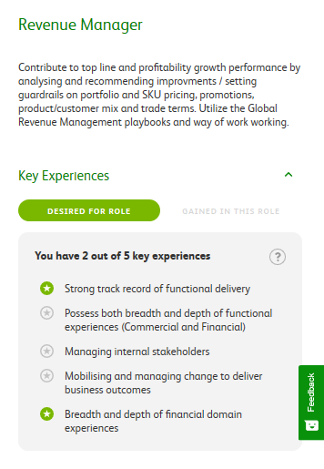
Case Example: Break Down Roles Into Key Experiences
Heineken breaks down each role into key experiences desired for and gained in the role
Collaborate to Define Key Experiences
HR surveys employees and managers to define key experiences in each role, then verifies with function and business unit leadership.
Define Experiences Cross-Functionally
70-90% of key experiences are cross-functional, enabling movement across business units.
Evaluate Roles Based on Employees Experiences
Employee profiles are populated with key experiences gained in past and current roles. Employees can then use this information to match themselves to new roles.
Source: Adapted From Heineken
Notes:
Heineken started by following a design-thinking methodology to break down roles into the experiences gained in them.
To gather information, HR worked across the business units. HR directors conducted surveys of employees and managers across functions and business units. They used focus groups and validated their results with business unit leadership.
The result was role profiles across functions based on key experiences desired for the role and key experiences gained in the role. The used the experiences to create a cross-functional key experiences library.
Lego analogy: You can think of the key experiences as the building blocks from which you can make any job profile in the organization. You can take them apart, put them with other blocks to make a different role.
Once you have roles broken down into key experiences, you can compare them across functions, finding experience connections where you might not have thought to look.
You can also populate employee profiles with skills they have gained in the roles they have had. Employees can use this information to match themselves to new roles.

Slide 9
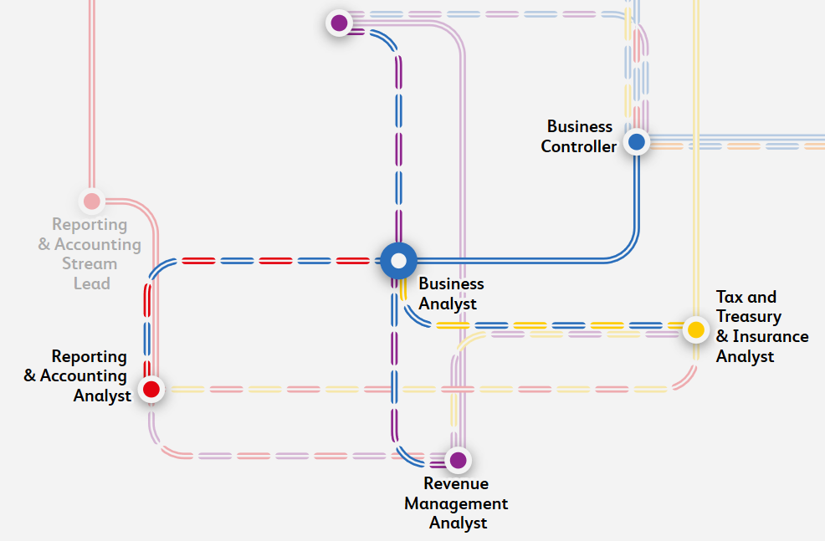
Case Example: Create Experience-Driven Career Guidance
Heineken’s Career Subway Map
Hop On and Explore Your Next Stop
Present Interactive Experience Based Careers
Employees can explore career options based on experience matches and gaps through an interactive “subway map.”
As employees add career journeys to their profile, new data-driven experience connections will appear.
Employees can see predefined routes and routes taken by colleagues.
Source: Adapted From Heineken
Notes:
To visualize these potential matches, Heineken created a career subway map.
Unlike typical career maps, the subway map allows for two-way movement, and shows “transfer stations” to other functions.
The map allows employees to highlight the experience connections they have with any role on the map, and to explore what additional desired experiences they might need for the role.
As the employee continues their journey and adds roles to their profile, new connections appear. Employees can explore predefined routes—created by HR on the basis of key experiences—as well as the routes colleagues have taken.
When a role changes, disappears or is created, the map can be easily updated.
Heineken uses the map during regular career conversations between employees and managers, as well as a way to keep employees engaged in visualizing their future at the company.

Slide 10
Table of Contents
Career Enablers Framework
Career & Growth Path Examples
Career Path Framework

Slide 11
Gartner Recommends 4 Primary Growth Paths to Encourage Connected Learning and Versatile Movement Across the IT Organization
Growth Path 1: Employee grows in skills and experience in a single job, moving up in level and responsibility.
Growth Path 2: Employee acquires new skills and moves to new domains within the same family.
Growth Path 3: Employee acquires new skills by moving to a new job family.
Growth Path 4: Employee acquires new skills by moving to a new job family in a more junior role.
Growth paths are meant to illustrate ways for individuals to grow and develop. To maintain focus on development, while there may be an impact to compensation, those changes are not implied or built into this framework.

Slide 12
If you are currently an engineer…
Notes:
The following slides illustrate sample career paths that an Engineer could potentially pursue using the 4 recommended growth paths.
Career paths are laid out based on the first possible move that an employee may take dependent on their current job, career level and career interests.
Additional moves are illustrated to show future career path options for an employee based on the first move taken.
There are countless permutations of career paths that can be developed using this framework and should be designed specifically with versatility development in mind.

Slide 13
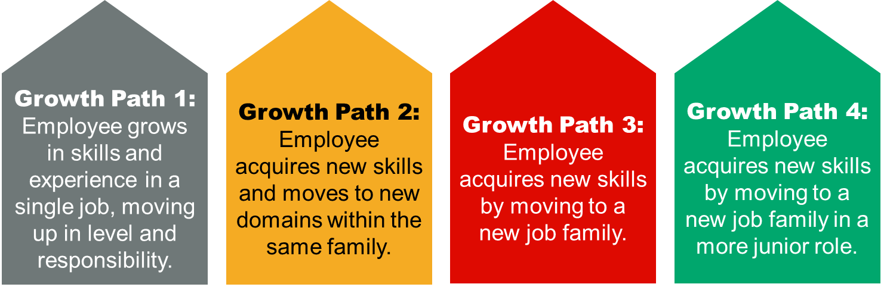
Sample Growth Paths — Do you like data and insights?
Engineering Family
Data Engineer IV
4
Data Engineer III
3
Data Engineer II
1
2
Software Engineer I
Data Engineer I
1. Move to Data Engineer
2. Grow to Data Engineer II
3. Grow to Data Engineer III
4. Grow to Data Engineer IV
Roles to upskill/reskill: Data Steward; Quality Assistant; Requirements Lead; Developer
Roles to expand breadth and depth: Scrum Master; Test Lead
Roles to expand breadth and depth: CoP Leader; Scrum Master; Product Owner
Leverage Job Family Guide and Career Enablers Framework to identify stretch responsibilities and experiences

Slide 14
Sample Growth Paths — Do you like data and insights?
Engineering Family
Analysis Family
Architecture Family
Analytics Analysts III
4
Information Architect I
1B
3
Analytics Analyst II
Software Engineer I
1A
Data Engineer I
2
1A. Move to Data Engineer I
2. Move to Analytics Analyst II
3. Grow to Analytics Analyst III
4. Move to Information Architect I
Roles to upskill/reskill: Data Steward; Quality Assistant; Requirements Lead; Developer
Roles to upskill/reskill: Market Researcher; Requirements Lead; Demand Manager
Leverage Job Family Guide to identify stretch responsibilities
Roles to upskill/reskill: CoP Leader; Product Owner; Solution Architect; Demand Manager
1B. Move to Analytics Analyst II
Roles to upskill/reskill: Data Steward; Market Researcher; Requirements Lead; Demand Manager

Slide 15
Sample Growth Paths — Do you like interfacing with the business?
Engineering Family
Analysis Family
Product Mgt. Family
Sr. Product Manager
Business Analyst III
3
4
Product Manager
1A
2A
Infrastructure
Engineer I
Business Analyst II
1B
2B
Business Analyst I
Note: Some Engineers may need to move to a more junior Business Analyst job before moving into the Sr. Business Analyst job based on individual skills & experience. Some may not.
1A/2B. Move to Business Analyst II
2A. Grow to Business Analyst III
3. Move to Product Manager
4. Grow to Sr. Product Manager
Roles to upskill/reskill: Business Analyst; Requirements Lead; Project Admin
Leverage Job Family Guide to identify stretch responsibilities
Roles to upskill/reskill: Relationship Manager; Demand Manager; CoP Leader (within Analysis family); Portfolio Manager
Leverage Job Family Guide and Career Enablers Framework to identify stretch responsibilities and experiences
1B. Move to Business Analyst I
Roles to upskill/reskill: Business Analyst; Requirements Lead; Project Admin

Slide 16
Sample Growth Paths — Do you like managing/executing projects?
Engineering Family
Analysis Family
Delivery Family
Sr. Resource Manager
4
5
Business Analyst III
3
Scrum Master
Resource
Manager
2
Software/Infra./Data Engineer I
1
Business Analyst II
1. Move to Business Analyst II
2. Grow to Business Analyst III
3. Move to Scrum Master
4. Move to Resource Manager
Roles to upskill/reskill: Business Analyst; Requirements Lead; Project Admin
Leverage Job Family Guide to identify stretch responsibilities
Roles to upskill/reskill: Resource Manager; Demand Manager; Relationship Manager; Solution Architect; Integration Specialist
Roles to upskill/reskill: CoP Leader; Coach; Learning Lead; Project Leader; Staffing Coordinator
5. Grow to Sr. Resource Manager
Leverage Job Family Guide and Career Enablers Framework to identify stretch responsibilities and experiences

Slide 17
Sample Growth Paths — Do you like managing/executing projects?
Engineering Family
Delivery Family
Product Mgt. Family
Sr. Product Manager
4
Sr. Scrum Master
3
Product Manager
2A
Software Engineer II or III
1
Scrum Master
2B
Note: With the right development, Software Engineers are often good candidates for Scrum Masters especially after working in Agile teams.
1. Move to Scrum Master
2A. Grow to Sr. Scrum Master
3. Move to Product Manager
4. Grow to Sr. Product Manager
Roles to upskill/reskill: Business Analyst; Project Manager; Scrum Master; Demand Manager
Leverage Job Family Guide to identify stretch responsibilities
Roles to upskill/reskill: Vendor Manager; Portfolio Manager; Demand Manager; Relationship Manager; CoP Leader
Leverage Job Family Guide and Career Enablers Framework to identify stretch responsibilities
2B. Move to Product Manager
Roles to upskill/reskill: Vendor Manager; Portfolio Manager; Demand Manager; Relationship Manager; CoP Leader

Slide 18
Sample Growth Paths — Do you like designing and architecting?
Engineering Family
Architecture Family
Solution Architect II & III
3
Infra. Engineer II
2
Solution Architect I
1
Infra. Engineer I
Note: This path can be replicated with different types of Engineers and Architects, connecting common subject matter expertise and skills.
1. Grow to Infrastructure Engineer II
2. Move to Solution Architect I
3. Grow to Solution Architect II&III
Leverage Job Family Guide to identify stretch responsibilities
Roles to upskill/reskill: Solution Architect; Project Leader; Technical Lead
Leverage Job Family Guide to identify stretch responsibilities

Slide 19
Table of Contents
Career Enablers Framework
Career & Growth Path Examples
Career Path Framework

Slide 20

The Roles Framework and Career Enablers Focus on Cultivating High-Value Skills and Providing Development Opportunities
Current Development Paradigm
Target Development Paradigm
Roles
Project Manager
Vendor Manager
CoP Leader
Roles Framework
Analyst
1
Analyst
2
Analyst
3
Analyst
2
Vertical Growth
Versatile Growth
Incremental Skills Development
Isolated Concentration of Managerial and Business Skills
Career Enablers
Broad Cultivation of Managerial and Business Skills
Project Managers
Business Analysts
Relationship Management
Required Experiences
Team Leadership
Business-Unit Exposure
Potential next step for leadership development
Ad Hoc Experience Exposure
Coaching
Systematic Experience Management
Budgeting
Stretch Roles
Notes:
The roles framework is used by any employee to gain experiences, skill sets and knowledge and further prepare them for a career move to a new job level, job series or job family. This roles framework supports building of versatile employees.
The career enablers framework provides the expected proficiency for leadership skills that may be leveraged by senior level jobs within each job family.
For example, a senior or principal engineer may be interested in managerial opportunities as part of their future career trajectory within the organization. The employee may leverage both the roles framework to continue to gain experience in the engineering job family, as well as the career enablers framework to develop leadership skills such as team leadership that will better prepare them for success in a managerial role in the same or different job family.

Slide 21
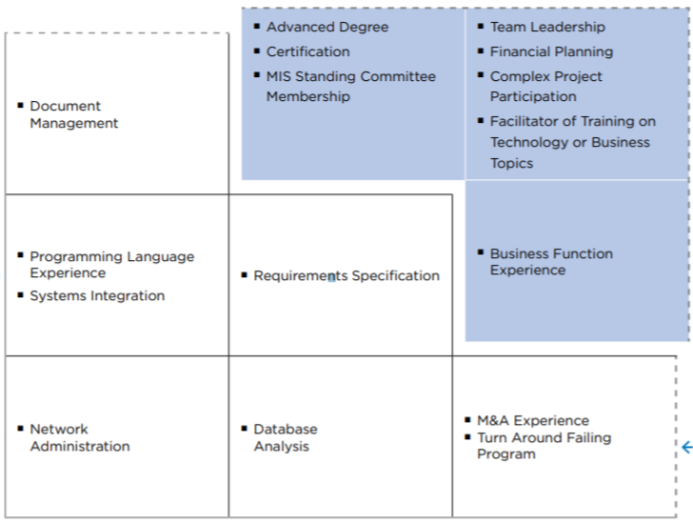
Career Enablers Should Be Widely Available Experiences That Develop High-Value Skills
Kimberly Clark Example
Career Enablers
Broadly available categories of experiences that engender development of high-value employee skills
Access to Experience Across IT
High
Medium
Low
Episodic leadership opportunities
Low
Medium
High
Value of Experience to the Organization
Source: ‘Experience-Based’ Skills Accentuators (Kimberly Clark)
Notes:
Kimberly Clark identifies a set of critical experiences, or accentuators, that develop high-value employee skills (critical business and management skills) through stretch responsibilities. To ensure that employees access these key experiences and access them in the right sequence, the "accentuators" are embedded into development plans and career paths. As a result, the IT organization becomes more flexible as employees with comparable business and leadership skills are able to more easily shift roles and responsibilities.
COMPONENTS
1. Cross-Comparable Skills Ladder: Reorganize the titling structure around levels of employee skill proficiency rather than activities.
2. Experience Value Mapping: Isolate a finite set of work experiences that were historically found to contribute toward high-value skill sets.
3. Value-Added Skills Assessment: Systemize and track the relation between high-value experiences and career progression throughout an employee’s career.
4. Synchronized Staff Planning: Balance the need to provide important development experiences with organizational requirements for project execution.
By developing high-value skills internally, Kimberly Clark reduces reliance on expensive consultants while improving operational efficiency and gaining accolades and increased credibility from customers.
“Our business partners regularly commend us for the quality of our staff, especially our managers. The career development ladders often lead to positions within the business. The business now looks to IT as a talent pool.”
- Dennis Haltinner, Director of MIS Global Services Center Kimberly-Clark Corporation

Slide 22
There Are 7 Career Enablers to Consider When Working to Develop High-Value Leadership Skills
The 7 Career Enablers
Team Leadership & Coaching
Knowledge Base Contribution
Relationship Management
Business-Unit Exposure
Career Enabling experiences are supported by the roles framework, and help prepare employees for leadership
Cross-Service/Cross-Platform Exposure
Multidisciplinary
Strategic Planning/Roadmap Creation

Slide 23
Career Enablers Framework
Illustrative
The career enablers framework is leveraged by individual employees in the senior progression levels of each job family to begin building leadership skills in support of career development into managerial jobs.
Enabler | Manager | Sr. Manager | Director | Sr. Director / VP | Sample Supporting Roles
Team Leadership and Coaching |  |  |  |  | Coach; CoP Leader; Scrum Master; Learning Lead
Knowledge Base Contribution |  |  |  |  | CoP Leader; Data Steward; Coach; Learning Lead
Relationship Management |  |  |  |  | Relationship Manager; Demand Manager; Contract Manager; Vendor Manager
Business-Unit Exposure |  |  |  |  | Relationship Manager; Scrum Master; Portfolio Manager; Demand Manager
Cross Service/Cross Platform Exposure |  |  |  |  | All Roles Apply
Multidisciplinary |  |  |  |  | All Roles Apply
Strategic Planning/Roadmaps |  |  |  |  | Relationship Manager; Vendor Manager; Portfolio Manager; Solution Architect
Valued
Recommended
Critical

Slide 24
Case Example: Logic-Based Careers Accommodate Change
Schlumberger’s Career Logic
Focused Career Logic:
Roles focused on gaining experience within a function.
Example careers:
Expert and technical careers within functions
Functional Management
1
Transverse Career Logic:
Roles focused on gaining experiences across functions.
Example careers:
General management (oversight across functions)
Expertise
Future Roles
Future Roles
Current Role
2
Exposure
Source: Adapted From Schlumberger
Notes:
Instead of following a path, employees at Schlumberger follow a direction or “career logic”.
At regular intervals, employees and managers discuss the employee’s progress. The employee moves in a “focused” logic deeper into a function or a “transverse” one across functions.
A focused logic means developing expertise to become a technical expert or manager within the function.
A transverse career logic mean experience across functions for a career in general management.

Slide 25

Case Example: Employees Grow in a Changing Context
Schlumberger Career Logic
End State: Expertise or Control Within Function
End State: Oversight Across Multiple Functions
1
2
Future Roles
Iterative Career Paths
Future roles depend on changing organizational context and employee preferences.
Next Role
Based on Logic and Preference
Current Role
Function 1
Function 2
Function 4
Function 3
Function 5
Source: Adapted From Schlumberger
Notes:
As they move, employees grow in the context of changing skills needs, organizational structure, and role responsibilities.
At each stage in their careers, they have the option of changing direction—going deeper into a function or moving to another function. The employee regularly assesses and adapts their strategy with their manager.
Crucially, the process is iterative. Employees and managers reassess and, if necessary, adjust their career directions through regular career conversations and performance check-ins.

Slide 26
Case Example: “IT’s Yours to Build” Growth Experience
Case Study: “It’s Yours to Build” Growth Experiences (EY)
Notes:
Instead of providing employees organization-defined professional development opportunities, EY use a two-way process for employees to identify and consume their desired personal and professional growth experiences.
EY’s “It’s Yours to Build” experiences are a part of a broader value proposition to provide the scale, technology, teams and learning employees need to empower them to curate their career journey at EY.
The EY organization is in the process of building its model, and some of the programmatic elements have yet to be launched, but the model includes key components of an employee’s growth and development.

Slide 27
Case Example: An Experience Journey
Case Study: “It’s Yours to Build” Growth Experiences (EY)
Notes:
To create “It’s Yours to Build” growth experiences, EY’s HR team enables employees to access opportunities and develop skills outside of their assigned job. EY’s in-progress tools show experiences available to employees that are populated by employees within the organization, not just the organization. Two of the tools employees use to enable personal growth include their “Talent Marketplace” platform and their “EY Ripples” program. Talent Marketplace focuses on internal opportunities, similar to other learning platforms, while EY Ripples focuses on external volunteering or community opportunities.
Employees determine which opportunities are a good fit for them based on their capacity, the prospect’s alignment to their personal interests and their ability to commit to the specified time frame. Some experiences might be out of scope, so EY’s HR leaders set expectations for what is in and outside of the scope of employees’ opportunities early on.
After a pool of personal growth experience options is created, EY’s HR team gives employees choice over which experiences they invest in based on the factors most important to their needs and interests. EY realized employees feel more valued when they can choose their own experiences, which in turn increases their use of organization-sponsored development opportunities. Employees have the opportunity to personally reflect on and share their preference for:
The type of experience they want (e.g., formal learning, skills building)
The frequency they must work to develop their experience (e.g., weekly, monthly)
Who they work with to develop that experience (e.g., mentor, manager, expert)
What outcome they hope for through this experience (e.g., degree, new skill, expanded network, etc.)
EY implements nudges, such as social media communications, goal setting and awards, to encourage employees to contribute, share and participate in personal and professional growth opportunities.

