Slide 1
Leadership Vision for 2022 Enterprise Architecture August 2021

Slide 2
A Guide for Leading the EA Practice
Create a vision for the EA practice
Redefine EA and how it adds business value
Engage and educate executives and stakeholders
Shift your leadership style to coaching and mentoring
Provide clarity and direction to the team
Encourage learning, flexibility, and personal and team growth
Redefine EA
Change the way you lead
Build the EA team
Deliver business value
Leading the EA Practice
Focus on delivering business value and driving business outcomes
Deliver value early, often and in an “agile” way
Support innovation, transformation and the use of new technologies
Create a flexible, adaptive team
Broaden the skills and competencies of the team
Develop individuals and the whole team
Notes:
In our 2021 Leadership Vision, we identify four priorities for enterprise architecture (EA) leaders:
Redefine EA — Here enterprise architecture leaders redefine, for their organizations, what EA is and how it adds business value. This also involves changing the narrative around EA in the organization, and helping all stakeholders to develop a shared understanding of EA.
Change the way you lead — As the pace of change increases and teams become more devolved, enterprise architecture leaders need a different style of leadership that emphasizes building a team that knows what to do. This shifts the focus of leadership to coaching and mentoring.
Build the EA team — As the value add and types of service that the EA team offer change, new skills and competencies will be needed by the team. This ranges from data science and product design, through to new working practices such as design thinking.
Deliver business value — With the stage set, the enterprise architecture leader must focus the team and its efforts on delivering business value.
In this research we will go through the background to this model, and then close with more specific guidance for each element.

Slide 3
Key Issues
What are the top challenges, priorities or issues affecting enterprise architecture leaders?
What are the major trends affecting enterprise architecture leaders?
What actions should the enterprise architecture leader take now to be successful?
Notes:
There are three categories of issues that this presentation will help enterprise architecture leaders address. We will discuss the three pressing challenges that enterprise architecture leaders are facing, four major trends that are impacting the function, and four actions that enterprise architecture leaders can take to move the practice forward.

Slide 4
Key Issues
What are the top challenges, priorities or issues affecting enterprise architecture leaders?
What are the major trends affecting enterprise architecture leaders?
What actions should the enterprise architecture leader take now to be successful?
Notes:
Let’s start with the top challenges facing enterprise architecture leaders of today.

Slide 5
Challenge No. 1: Businesses Want to Accelerate Digital
39%
Transform
Business
Model
48%
Increase
Investment
50%
Cost
Optimization
60%
Operational
Excellence
69%
Acceleration
n = 260, all respondents, excluding “don't know,” multiple responses allowed
Q. What kind of impact do disruptions caused by COVID-19 have on your organization’s digital business initiatives? Source: Gartner View from the Board of Directors 2021
Notes:
Our first challenge is the acceleration of pace of digital initiatives. For many organizations, the main response to the pandemic was to accelerate the shift to digital — from enabling more home working for staff, through to innovating with new products and services for customers. Almost every part of the organization has been the focus of a digital strategy effort. As our survey shows 69% of boards of directors want to accelerate their digital initiatives.
This has proved challenging for several reasons. The first, and most obviously, was that organizations and their teams were adjusting to the new realities of remote working caused by the pandemic. This quite naturally created a bottleneck for digital initiatives.
There was also the need to develop a new partnership and new ways of working with the business, for example by shifting from project- to product-based approaches. The challenge here is that it often takes several cycles to build the relationship and get new ways of working efficiently.
Similarly for enterprise architecture teams, many were over-stretched simply from the response to the pandemic and adjusting to the short-term priorities of the organization. Shifting gear to support the new digital initiatives has proven a strain. Like other parts of the IT organization, EA teams have taken time to adapt and evolve into the new working arrangements.
Evidence and Related Research
2021 Gartner View From the Board of Directors Survey was conducted was conducted online from May through June 2020 among 265 respondents from the U.S., EMEA and Asia/Pacific.
Survey Analysis: Executive Leaders Should Align to Board Priorities for 2021 — G00735239
2021 CIO Agenda: Global Perspectives on ‘Seize This Opportunity for Digital Business Acceleration’ — G00734305
2021 CEO Survey Research Collection: Introduction and Overview — G00747199

Slide 6
Challenge No. 2: “Democratization” of Digital Capabilities Strains Traditional IT Organizations
6%
Business Unit IT Staff ª
4%
IT Staff reporting to CIO ^{b}
Gartner’s Definition of Business Technologists:
Employees who report outside of IT departments and create technology or analytics capabilities for work.
49%
Technology “End Users”
41%
Business Technologists
n = 11,848 employees across the entire workforce
ª Business unit (BU) IT staff reporting into divisional or BU “CIOs” (see clarification below).
^{b} By CIO, we mean the senior most IT executive, but actual titles may vary. Source: 2021 Gartner Reimagining Technology Work Survey combined with the 2020 Gartner Digital Friction Survey;
Notes:
Our second challenge is the “democratization” of digital capabilities. As Gartner research has shown, there has been a steady, and growing, shift in the delivery of digital capabilities — moving out of the IT organization into the business. This is coupled with an increase in strategic IT investment, also being driven by the business. This ranges from the simple — where a business group funds and runs a digital capability — through to product management approaches being driven from the business and by the business. This is often referred to as the democratization of digital capabilities.
Along with this shift into the business, there has also been a significant shift of digital capabilities to outside service providers. Outsourcing, “as-a-service” and the shift to cloud have all moved digital services outside the IT organization.
This is a challenge for traditional approaches to enterprise architecture, which assume a simple business-IT relationship, and a unified IT organization. Enterprise architecture must now reshape itself to function in this democratized world, and moreover to facilitate this democratized world.
Evidence and Related Research
The 2021 Gartner Reimagining Technology Work Survey was conducted via an online panel in March among over 6,000 employees across functions, levels, industries and geographies. The survey examined the extent to which employees outside IT were involved in customizing and building analytics or technology solutions, the types of activities they performed, the teams and structures they worked in and the types of support they received. Twenty-nine percent of the total sample were employees of midsize enterprises.
The 2020 Gartner Digital Friction Survey was conducted among almost 5,000 employees — across functions, levels, industries and geographies — to assess the analytics and technology activities in their jobs and the reasons for performing those activities.
Presentation: Democratized Technology Delivery: The CIO’s New Opportunity to Boost the Value of IT — G00754237
Design and Build the New Digital Foundations — G00733391
Placeholder for text (substitute your own text; delete when not used)

Slide 7
Challenge No 3: Architecting for resilience and adaptability
Percentage of Respondents Who Somewhat to Strongly Agree With Statement
n varies by segment; all respondents, excluding “not applicable"
Q. Please indicate your level of agreement on each of the following statements Source: Gartner Research Circle 2022 CIO Survey Test
Notes:
One of the realizations of the global pandemic for many organizations was the importance of resilience and adaptability. At a simple level, adaptability is being able to respond quickly and efficiently to change, and resilience is being able to do this over and over again. Adaptability and resilience rely on a number basic principles:
A modular, service-oriented technical foundation — such as a mesh app and service architecture (MASA): The technical base is made up from modules that are service-oriented, connected via APIs and often organized into platforms.
A set of working practices that can use the technical foundations: Iterative, experimental approaches are needed to make use of the technical foundations — for example using design thinking and agile in combination or product management approaches.
A modular business architecture — The business needs to be able to change quickly too, so will benefit from a modular business architecture that capitalizes on business capabilities, business processes and other reusable elements.
This represents quite a challenge for enterprise architecture, as it must function at each of these different levels and keep them in alignment — often working with different, and distributed, teams.
Evidence and Related Research
Gartner Research Circle 2022 CIO Survey Test was conducted online from 19 through 26 March 2021 with 84 participants from CIO Gartner Research Circle — a Gartner-managed panel.
Tool: How Enterprise Architects Plan Their Journey to Mesh, App and Service Architecture — G00745177
Architect for Adaptability to Build a Resilient Enterprise — G00745176
How to Design Enterprise Applications That Are Composable by Default — G00738874

Slide 8
Key Issues
What are the top challenges, priorities or issues affecting enterprise architecture leaders?
What are the major trends affecting the enterprise architecture leader?
What actions should the enterprise architecture leader take now to be successful?
Notes:
Moving forward, there are several major, cross-industry trends that will continue to have a meaningful impact on EA functions.

Slide 9
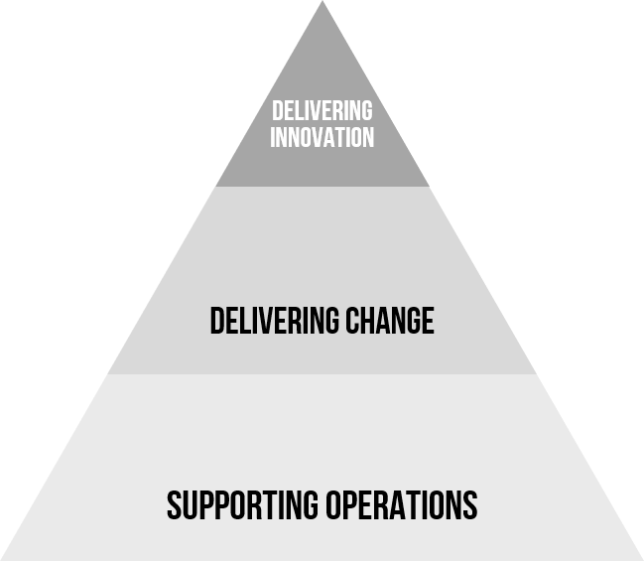
Trend No. 1: The Design and Delivery of Digital and IT Services Is Democratizing
Architecture is needed to bridge the design and delivery
Digital innovation and investment is being driven by the business
Product teams, led by the business, become increasingly common
Outsourcing, “as-a-service” and the shift to cloud move IT delivery outside the organization
The “Democratized” IT Organization
Notes:
The fragmentation of the IT organization is a long-standing trend that is continuing. If we imagine the IT organization as three key capabilities — supporting the operations of the organization, delivering change, and delivering innovation — we can see this trend play out. As our research shows, a lot of digital innovation, and strategic IT investment, is now driven out of the business. A recent example of this is the increasing importance of product management approaches. At the other end, a lot of the foundational operational functions of the IT organizations are moving outside of it — through outsourcing, but also moving to “as-a-service” models and into the cloud.
The challenge for EA teams is that they must support these moves, and use the architecture to bridge across them. This means reinventing EA so that it is relevant, and useful to a business audience. Enterprise architecture leaders must provide a bridge from the business into the IT organization, and the technical foundations to connect multiple technology services, wherever they come from.
Evidence and Related Research
Better Digital Business by Design With the Business Architecture Landscape — G00739500
Use Value Streams to Drive Customer Centricity, Design Services and Operating Models, and Technology Platforms — G00729804
EA’s Role in Supporting Fusion Teams — G00714411

Slide 10
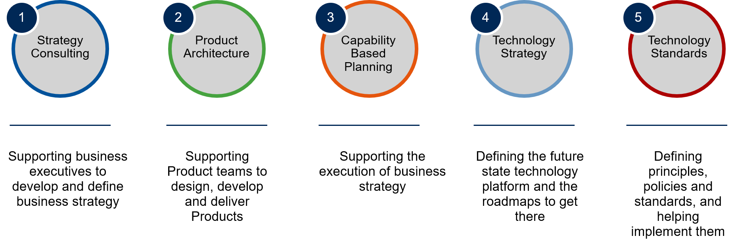

Trend No. 2: Leading Teams Deliver EA as Internal Management Consultancies (IMCs)
EA as IMC
BODEA*
Traditional EA
IMCs define a portfolio of ‘”services”…
…aligned to the needs of the customer
*BODEA = business-outcome-driven enterprise architecture
Notes:
In many organizations, enterprise architecture has focused on the execution end of the strategy cycle. The key focuses are supporting projects and initiatives, and defining the principles, policies and standards that help manage complexity. Over the past five years, there has been a shift toward business-outcome-driven enterprise architecture (BODEA), which has extended the reach of the EA practice into the strategy end of the cycle. Enterprise architecture leaders must identify business outcomes, the supporting business capabilities, change requirements and roadmaps. This activity provides real value and helps organizations execute on their strategies.
But what happens before the business outcomes are defined? This is the vague, “sense-making” part of the strategy cycle, where there are no real answers, but a whole lot of questions — including:
What are our competitors doing?
How can we use artificial intelligence (AI)?
What do our customers really want?
Should we acquire another company?
The list goes on. It’s into this part of the strategy cycle that EA can bring a set of internal management consulting services that provide insight and clarity to the executives and stakeholders involved.
Given the uncertain nature of the coming years, the ability to support business executives to shape strategy, and do so in a quick, iterative way will make the EA practice invaluable.
Evidence and Related Research
Evolve Enterprise Architecture Into an Internal Management Consultancy — G00752867
3 Steps to Creating Enterprise Architecture Services — G00716506

Slide 11





Trend No. 3: Product Management Becomes Widely Used to Support Digital Business
Opportunities for Architects to Support Product Lines
1
Shape business and operating model design and guide transformative change.
2
Inform business strategy, new investment opportunities and funding allocation.
4
Provide autonomy to product owners to make product- level (“emergent”) architecture decisions.
Product Management
3
Set guardrails for shared, enterprise-level (“intentional”) architecture.
Product Roadmaps
5
Coordinate plans and roadmaps across product lines.
6
Fusion Delivery Teams
7
Provide tools, reusable technology, information and coaching/training to business-led fusion teams.
Offer guidance to fusion teams of varying levels of technical maturity.
8
Support shared enterprise services and digital technology foundations.
Digital Foundations
Shared Data and Technology Layer
Notes:
As digital innovation moves into the business, an increasingly popular approach is product management. Initially this came about as a result of the business’s frustration with the stop-start nature of projects, and the desire to innovate continuously. Product teams are often led by the business, bringing together a highly collaborative, cross-functional team — that is, a ‘”fusion” team. Many of these fusion teams also have their own captive IT resources.
While the product management approach is powerful, architecture is needed to make it work. This ranges from defining the business architecture that sets the goals and boundaries for products, through to defining the product architecture. This is a new “service” that EA teams can offer, and one where they have an important role to play.
Evidence and Related Research
Enterprise Architecture Adapted for Product Lines (The Hanover) — G00710849
Product Management Foundations — G00750540

Slide 12
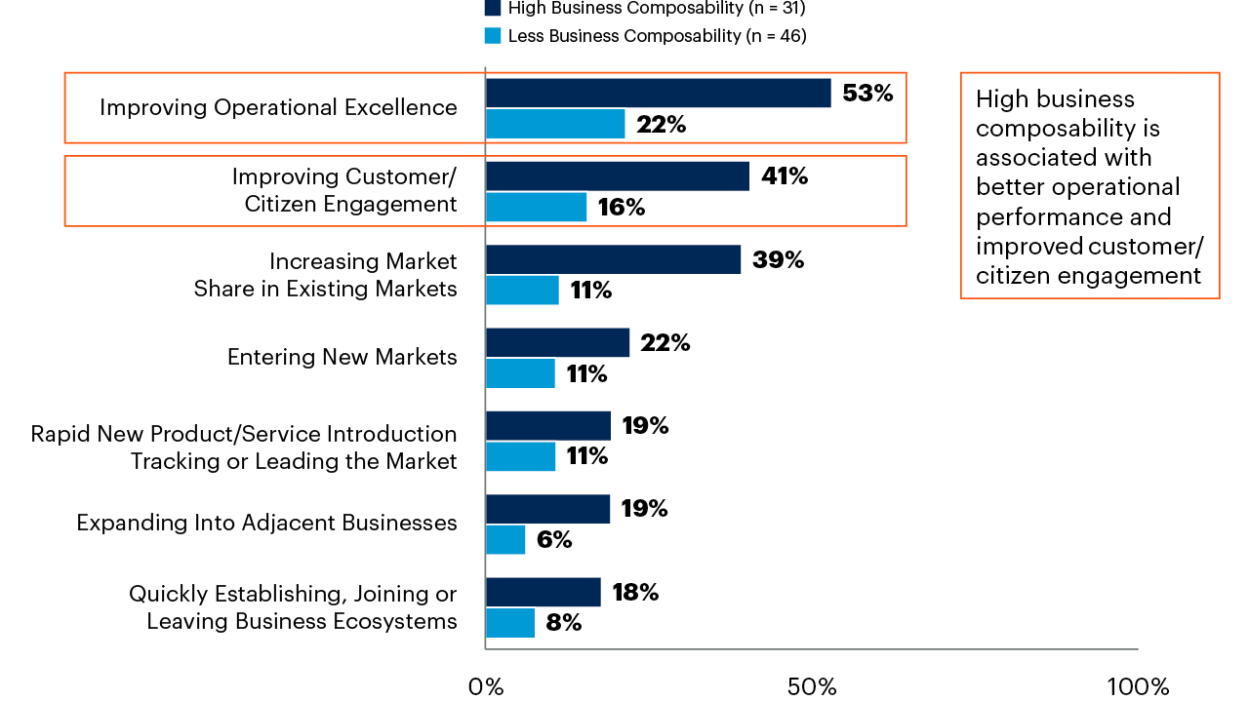
Trend No. 4: The Need to Architect the Organization for Composability
Assessments of Enterprise Effectiveness
Percentage of Respondents Indicating High Effectiveness (6 or 7 on a 7-Point Scale)
68%
…of high composability organizations surpassed their business goals
n varies by segment; all respondents, excluding “not applicable"
Q: In 2020 and 2021 to date, how effective is your enterprise at the following, relative to your peers or competitors?
Note: Some activities (for example, “Entering new markets,” “Expanding into adjacent business,” and “Increasing market share”) were not shown to government industry Source: 2022 Gartner CIO Agenda Pilot Survey
Notes:
As many organizations have found out, adaptability — the ability to change, and change quickly — is a valuable capability. Many of the trends shaping organizations are setting the stage for the adaptable, or “composable” enterprise:
Creating an adaptive technology base — Let’s begin at the technology level. Modularity, platforms, open architectures and associated technologies (like APIs and cloud), allow the rapid configuration and evolution of the technology base. With these in place, it’s also easy to incorporate other elements — such as SaaS and outsourcing capabilities — to further increase adaptability.
Use iterative working practices — Having a flexible technology base isn’t enough. We need the working practices to take advantage of it. The shift to product management is key, as are iterative design approaches (such as design thinking and agile) and the ability to innovate and experiment.
Business design — All of this needs to be driven by a business design approach that allows the business to change quickly, and in a way that is easy to execute.
We see enterprise architecture leaders playing a role in helping shift their organizations to become more adaptable at each of these levels.
Evidence and Related Research
The 2022 Gartner CIO Agenda Pilot Survey was conducted online from 19 March through 26 March 2021, with 84 participants from the CIO Gartner Research Circle, a Gartner-managed panel.
Better Digital Business by Design With the Business Architecture Landscape — G00739500
Adopt a Mesh App and Service Architecture to Power Your Digital Business — G00392875
Architect for Adaptability to Build a Resilient Enterprise — G00745176

Slide 13
Key Issues
What are the top challenges, priorities or issues affecting enterprise architecture leaders?
What are the major trends affecting enterprise architecture leaders?
What actions should the enterprise architecture leader take now to be successful?
Notes:
What can enterprise architecture leaders do to overcome these challenges and address these trends? We have four key next steps that enterprise architecture leaders should take to mature their practices.

Slide 14






Redefine EA Practice as an Internal Management Consultancy
Redefine EA
Leading the EA Practice
Make “Intelligence” Central to the EA Practice
Determine What the EA Practice Will Offer
Construct a Portofolio of Services
Build EA Team Competencies and Skill Sets
Develop the Innovation Management Process
Create a Service Delivery Model Around “Iterative” and “Agile”
Notes:
Shifting toward internal management consulting will mean reframing and rebranding the EA practice. Our aim is to provide a clear definition of what EA is, how it works and how it adds value. Essentially “internal management consulting” is a way of thinking about EA. Most people will be familiar with management consulting and the big-brand consultants, and we can use that familiarity to pick out key elements that describe EA — such as specialist skills and independent advice.
Clarify your vision for EA — how it will add value, and what type of internal consultancy you will be? For example, will you be a strategic consultancy like McKinsey or Bain, or have more of a technical specialty like Accenture or IBM? Ask yourself:
Why does EA exist?
What value will we add for our “customers”?
What types of problem will we help our customers solve?
How do we want our stakeholders to talk about EA?
Develop your brand identity and brand values. Create a storyline for the EA practice.
Test these out with some of your more open stakeholders, and consider renaming the EA practice to align with your brand — for example, digital transformation, business design or business modeling. This tactic is increasingly popular.
Evidence and Related Research
Evolve Enterprise Architecture Into an Internal Management Consultancy — G00752867
5 Steps to Construct a Winning Value Proposition That Positions EA as an Internal Management Consultancy — G00718251

Slide 15






Shift Your Leadership Style to Innovator
Change the way you lead
Leading the EA Practice
Creative
Takes the Initiative
Team Player
63%
Futurist
Adapts to Change
Collaborator
…of high performing EA practices indicate that they need better proficiency in storytelling
Source: Evolving Roles and Responsibilities of Enterprise Architecture Groups (2019), Gartner; n=186 senior architecture leaders
Notes:
Your leadership style can be adjusted to fit the situation and context. The leader that can nurture a high-performing team will need to take advantage of each of these styles given the appropriate situation. Situational leadership approaches also recognize the receptiveness of each individual. Are they committed to the goal, or have they achieved competence at what they do? A new team member who does not understand the objectives of the group and who has not been sufficiently trained in core technical competencies should be communicated to with a different style (coaching) than a team member who understands the goal, is committed and has shown competence (this may be in the form of democratic influence or may even involve full-on delegation of responsibility).
As organizations democratize digital delivery, the enterprise architecture leader will need to lead through influence — and by inspiring those on the EA team, along with its stakeholders.
Evidence and Related Research
This data comes from Gartner’s Evolving Role and Responsibilities of Enterprise Architecture Groups Survey and from 2019 Gartner analysis involving interviews with several dozen enterprise architecture and technology innovation leaders about their evolving role and responsibilities.
The Art of Building High Performance Teams — G00369649
Marquet, L. D. (2013). “Turn the ship around!: A true story of turning followers into leaders.” Penguin.
Goleman, D. (2019). “The emotionally intelligent leader.” Harvard Business Press.

Slide 16
Build a Dynamic EA Team That Delivers EA as Internal Management Consultancy
Build the EA team
Leading the EA Practice
Build capabilities to support fusion teams
Build Trust and Stakeholder Relationships
Build New Skills and Competencies
Expand Architecture Competency
Encourage Flexibility and Learning
Be an example — model good behavior and take a coaching approach
Focus on team dynamics, and address problems and dysfunction quickly
Create a team charter — identify the values, norms and behaviors to drive success
Use team meetings and continuous improvement to build the team
Don’t become a bottleneck for decision making
Coach and mentor your team — encourage them to take decisions and responsibility
Identify training and development opportunities for individuals
Make senior members of the team coach more junior members
Put responsibility for a decision in the hands of the person closest to it
Be clear about what types of decisions can be made locally, and which need to be passed back
Review decisions, and look for opportunities for improvements
Reduce the cycle time for decision making
Encourage team members to have a broader skill set
Provide wider exposure to individuals and coaching to help them develop
Make risk taking and trying out new ideas a valued and accepted practice
Notes:
One of the key insights from our research on digital is that successful innovation and transformation depend on highly collaborative cross-functional teams. Successful transformation requires a collective effort that brings together individuals and teams representing different perspectives and responsibilities. This diversity of ideas and people, coupled with a culture of collaboration and innovation, allows people across the organization to spot new ideas and collectively evolve to realize them.
To do this, the EA team must cultivate its organizational network and reach out to individuals and teams from key areas (for example, business analysts, business strategists, business relationship managers and the project management office [PMO]). The EA team can use more “adaptive governance” approaches, such as a “center of excellence,” which brings people together. Ideally, this network is driven by the senior executive team that is leading the transformation, but it often requires the EA team to make the effort. Diverse and collaborative networks are the foundation of organizational resilience.
Evidence and Related Research
EA’s Role in Supporting Fusion Teams — G00714411
10 Ways to Avoid Mistakes in Thinking About the Future — G00746124

Slide 17
Focus on Delivering Business Value
Deliver business value
Leading the EA Practice
Understand Your Customer Work with your customer to understand the outcomes and their needs.
Understand Your Customer
Debrief and Set the Stage
Define the Business Outcome
Debrief and Set the Stage Ensure customers value and understand what’s been delivered. Set the stage for the next set of services.
Define the Business Outcome Be clear about what the outcome is, and what success looks like.
Business Value
Learn, Pivot, Refine
Develop Metrics
Learn, Pivot, Refine Use a continuous improvement approach to refine your delivery.
Develop Metrics Develop key performance indicators and metrics to drive delivery and demonstrate value-add.
Track Your Progress
Align Your Team
Track Your Progress Carefully oversee your delivery. Ensure that customer expectations and business value are aligned.
Align Your Team Align the team to the delivery. Ensure they are clear about the outcome and their contribution.
Deliver Value Early and Often
Deliver Value Early and Often Create an agile delivery mechanism.
Notes:
A key task for enterprise architecture leaders is keeping the team focused on delivering business value. It begins with being customer-centric — knowing the outcomes that they are looking for and what their real needs are. Then, they must shape the business outcome, along with the metrics that will guide the team’s delivery. They must tell the story of the value added.
Next, enterprise architecture leaders must align the team to the customer and the outcomes. Make sure that each member of the team really knows what their role will be and what is expected of them. Deliver early, and often, and make sure that your customer knows what you’re working on as you go. Use techniques such as Kanban to help your delivery.
Track your progress and make adjustments if needed. Learn as you go and use a continuous improvement approach to refine your delivery. Lastly, debrief the client. Make sure they are really clear on what you have done for them, and the value-add that they are receiving. Get feedback and ideas for improvement that you and your team can incorporate next time.
Evidence and Related Research
Calibrate Digital KPIs to Accelerate and Build Digital Business Momentum — G00745075
Ignition Guide to Creating a Functional Health Dashboard for the Head of EA — G00366685

Slide 18
Recommended Actions
Shift EA toward an internal management consultancy by clearly defining what EA is, how it works, and how it adds value to the organization.
Adopt a new style of leadership by focusing on developing organizational influence rather than spans of control.
Build a dynamic EA team by building individual competencies that support a fusion team operating model.
Deliver business value to enterprise stakeholders by carefully constructing the experience that consumers of EA will have with the practice, and staying focused on the outcomes that they need from the engagement.

Slide 19
Recommended Gartner Research
Evolve Enterprise Architecture Into an Internal Management Consultancy
8 Steps to Start or Restart a High-Impact, Business-Outcome-Driven EA Program
Predicts 2021: Enterprise Architecture Designs the Composable Organization
Better Digital Business by Design With the Business Architecture Landscape
2021 CIO Agenda: Global Perspectives on ‘Seize This Opportunity for Digital Business Acceleration’
2021 CEO Survey Research Collection: Introduction and Overview
5 Steps to Construct a Winning Value Proposition That Positions EA as an Internal Management Consultancy
For information, please contact your Gartner representative.
Notes:
This slide contains a selection of resources that enterprise architecture leaders can use to start taking action and addressing the challenges and trends impacting their organizations.

