Slide 1
Fundamentals of Integration for Software Engineering Leaders
Massimo Pezzini

Slide 2
What Is Integration All About?
Integration is about making independently designed systems to work together
Why is it difficult?
Systems are independently designed:
No upfront agreed design
Diverse data models
Different underlying technology
Developed years/decades apart
Custom vs. packaged
Internal and external to your organization:
SaaS applications
Fine grained cloud services
Marketplaces/commodity cloud services
Public APIs
Business partner services
There are lots of them — and counting!
Integration is often an afterthought
CRM
Cloud Office
ERP
Systems:
Applications, data structures, APIs, devices, cloud services, processes, organizations

Slide 3
Key Issues
What is integration and what are the challenges associated to it?
What are the key integration use cases and how can software engineering leaders tackle them?
How will software engineering leaders support the pervasive integration challenges stemming from digital initiatives?

Slide 4
Key Issues
What is integration and what are the challenges associated to it?
What are the key integration use cases and how can software engineering leaders tackle them?
How will software engineering leaders support the pervasive integration challenges stemming from digital initiatives?

Slide 5
Technically, We Must Develop “Integration Logic” to Sort Out Four Basic Issues
Protocol Conversion/Bridging
Data Validation, Mapping, Transformation, Enrichment
SOAP
OData
XML
JSON
?
?
Message/Data Routing
Process Orchestration
?
Integration platforms help you develop, deploy and manage the integration logic

Slide 6
Systems Can Interoperate in Four Basic Ways
Data Sharing (e.g., Data Virtualization)
Batch Data Movement (e.g., File Transfer, ETL)
Request/Reply APIs (e.g., REST, SOAP)
Asynchronous Events (e.g., CDC, Pub/Sub)
API
Integration platforms support the four interoperability models

Slide 7
The Three Fundamental Integration Use Cases
Data Consistency
Multistep Process
Composite Services
ERP
ERP
WMS
API
CRM
SFA
Billing
SCM
ERP
CRM
Different Databases/Applications Come to “Agree on the Fact”
Independent Applications Collaborate to Automate a Business Process
Applications Consume APIs Built by Composing Other Applications
Integration platforms enable these three use cases

Slide 8
Four Models of Integration Platform Delivery
Coded/Scripted (Community Open Source)
Integration Platform Software
Integration Platform as a Service
Integration Brokerage (Managed Services)
Client Provided
Developers
Client Provided
Developers
Client Provided
Developers
Vendor Provided
Developers
Client Provided
Operations
Client Provided
Operations
Vendor Provided
Operations
Vendor Provided
Operations
Client Provided
Integration Platform
Vendor Provided
Integration Platform
Vendor Provided
Integration Platform
Vendor Provided
Integration Platform
You Are in Charge
Vendor Is in Charge
Watch Out! Integration Technology May Come to You Also “Embedded”

Slide 9
Even in the World of APIs We Do Need to Do Integration Work
«Get Customer Data»
Integration Logic
API
CRM
Integration Logic
Validation, Mapping, Transformation
ERP
API
Client App
«Update Customer Data»
Integration Logic
Billing

Slide 10
Key Issues
What is integration and what are the challenges associated to it?
What are the key integration use cases and how can software engineering leaders tackle them?
How will software engineering leaders support the pervasive integration challenges stemming from digital initiatives?

Slide 11









Mainstream Integration Scenarios That Every Organization Must Support
Application Integration
Data Integration
B2B/Ecosystem Integration
API Publishing
API
Business Partners
Business Partners
API
The Enterprise

Slide 12


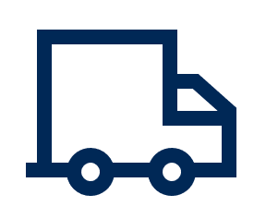




















Integration Platforms to Support the Mainstream Use Cases
Open Source Integration Tools/Frameworks
Classic, Integration Platform Software
Data Integration Tool
ESB
B2B Gateway
Integration PaaS
API Management Platforms
Application Service
iPaaS
APIM Platform
Data Service
Composite Service

Slide 13
Containerization and Microservices Are Breathing New Life Into Classic Integration Platform Software
Data Management and Analytics
On-Premises
Microservices Application
On-Premises
Monolithic Application
SaaS Service
Partner API
Distributed Integration Platform
Integration
Container
Common Services:
Monitoring
CI/CD and Life Cycle Management
On-Premises
Kubernetes Cluster
Log File Collation
Integration Container
Integration Container
Integration Container
Examples:
MuleSoft (Anypoint Platform)
Red Hat Fuse
RoboMQ
Software AG webMethods Microservices Runtime
TIBCO BusinessWorks Container Edition
WSO2 Enterprise Integration & Choreo
Microservices Application in Container
Miniservices Application in Container
Miniservices Application in Container
Virtual Machine
Google Kubernetes
Engine
COTS System
On-Premises
Kubernetes Cluster

Slide 14








Integration Platform as a Service Defined
What is it?
Application, data, process, B2B, API, events integration:
Transformation, routing, orchestration,
Prepackaged integration (flows, adapters, APIs)
Provider-managed cloud service (PaaS)
Low-code/No-code development tools
iPaaS
Use when:
Short time to integration/value
Cloud/mobile center of gravity
Intercloud/Intracloud-to-ground (-to-ground)
Multiple use cases must be supported
Empowering a range of integration personas (specialists, developers, SaaS administrators, data scientists, business technologists, technology users)
Mobile Apps
Mostly iPaaS complements (but can also replace) integration platform software

Slide 15
API Management: Enabling Governance for Your Integration Initiatives
What is it?
Capabilities that support APIs’ life cycle:
Planning and initial design
Implementation and testing
Deploy and run
Versioning and retirement
Cloud, on-premises and hybrid deployments
Minimal integration functionalities
Application Service
API
API
API
Data Service
API Mgmt.
API
Secure access to public/private APIs
Enable communities of API developers and consumers
Tracking adoption and API usage patterns
Use when:
API
API
Composite Service
API management helps you facilitate and control access to application/data services

Slide 16
The Integration Platform Technology Market Is Fast-Evolving, Fragmented and Crowded
Integration Software Providers*:
Actian
Adeptia
Axway
Denodo
Fiorano
Fujitsu
IBM
Informatica
Infor
InterSystems
Lobster
Magic Software
Microsoft
OpenLegacy
Oracle
Precisely
Integration PaaS Providers*:
Actian
Adaptris
Axway
Boomi
Celigo
Celonis
Cleo
ConnectPlaza
DBSync
elastic.io
Flowgear
FRENDS
Huawaei
IBM
IConduct
ICore
Informatica
Infor
API Management Providers*:
Axway
Amazon Web Services
Boomi
Broadcom
F5 (NGINX)
Google (Apigee)
Gravitee
IBM
Kong
Oracle
Perforce (Akana)
Postman
Red Hat
SAP
Salesforce-MuleSoft
SEEBURGER
PROplus Technology
Qlik
Red Hat
SAP
SAS
Talend
TIBCO Software
Saison
Salesforce-MuleSoft
SEEBURGER
Software AG
WSO2
Jitterbit
Magic Software
Microsoft
Oracle
Red Hat
RoboMQ
Saison
Salesforce-MuleSoft
SAP
SEEBURGER
SnapLogic
Software AG
Talend
TIBCO Software
Tray.io
Youredi
Workato
WSO2
Sensedia
Software AG
TIBCO Software
Tyk
WSO2
*Representative vendors only. Not a comprehensive list

Slide 17

Emerging Integration Use Cases That Many Organizations Will Have to Support Over the Next Three Years
Event Stream Ingestion and Delivery
Digital Integration Hub
Stream Analytics
Event Sources
Event Brokering
Edge/IoT Integration
Robotic Process Automation
CRM
ERP
SCM
Scripts

Slide 18
Additional Technology Platforms to Support the Emerging Use Cases …
& Representative Vendors
Event Brokering
Stream Analytics
Publishers
(Event Sources)
Subscribers
(Event Sinks)
“Individual” Events
“Complex” Events
Pub/Sub
Context
Examples: Amazon Web Services, Confluent, Google, IBM; Lightstreamer, Microsoft, Push Technology, Software AG, Solace, TIBCO Software, Vantiq.
Examples: Amazon Web Services, Confluent, Google, IBM, Informatica, Microsoft, Oracle, SAS, Software AG, TIBCO Software
Data Management
Robotic Process Automation Software
DBMS
Alibaba Group
Amazon Web Services
Cloudera
Google
IBM
Huawei
Microsoft
Oracle
SAP
Teradata
Snowflake
In-Memory Store
Aerospike
Hazelcast
GridGain Systems
GigaSpaces
Oracle
SAP
Singlestore
Software AG
VMware Tanzu
VoltDB
Examples: Automation Anywhere, Blue Prism. E2open, Kofax, Kryon, Microsoft, NICE, NTT, RELEX, SAP, UiPath

Slide 19
Key Issues
What is integration and what are the challenges associated to it?
What are the key integration use cases and how can software engineering leaders tackle them?
How will software engineering leaders support the pervasive integration challenges stemming from digital initiatives?

Slide 20
The Future of Application Entails a Pervasive, Multifaceted Integration Challenge …
Democratized Access
Expanding Integration Scenarios
Integration Specialists
“Ad Hoc” Integrators
Application
Data
APIs
Citizen Integrators
Digital Integrators
Ecosystems/B2B
Process/RPA
Events
Proliferating Fragmented Endpoints
Hybrid Deployment and Operating Models
On-Premises
Cloud
(Multi)Cloud
Embedded
Mobile
Things
On-Premises
Hybrid
Outsourced

Slide 21
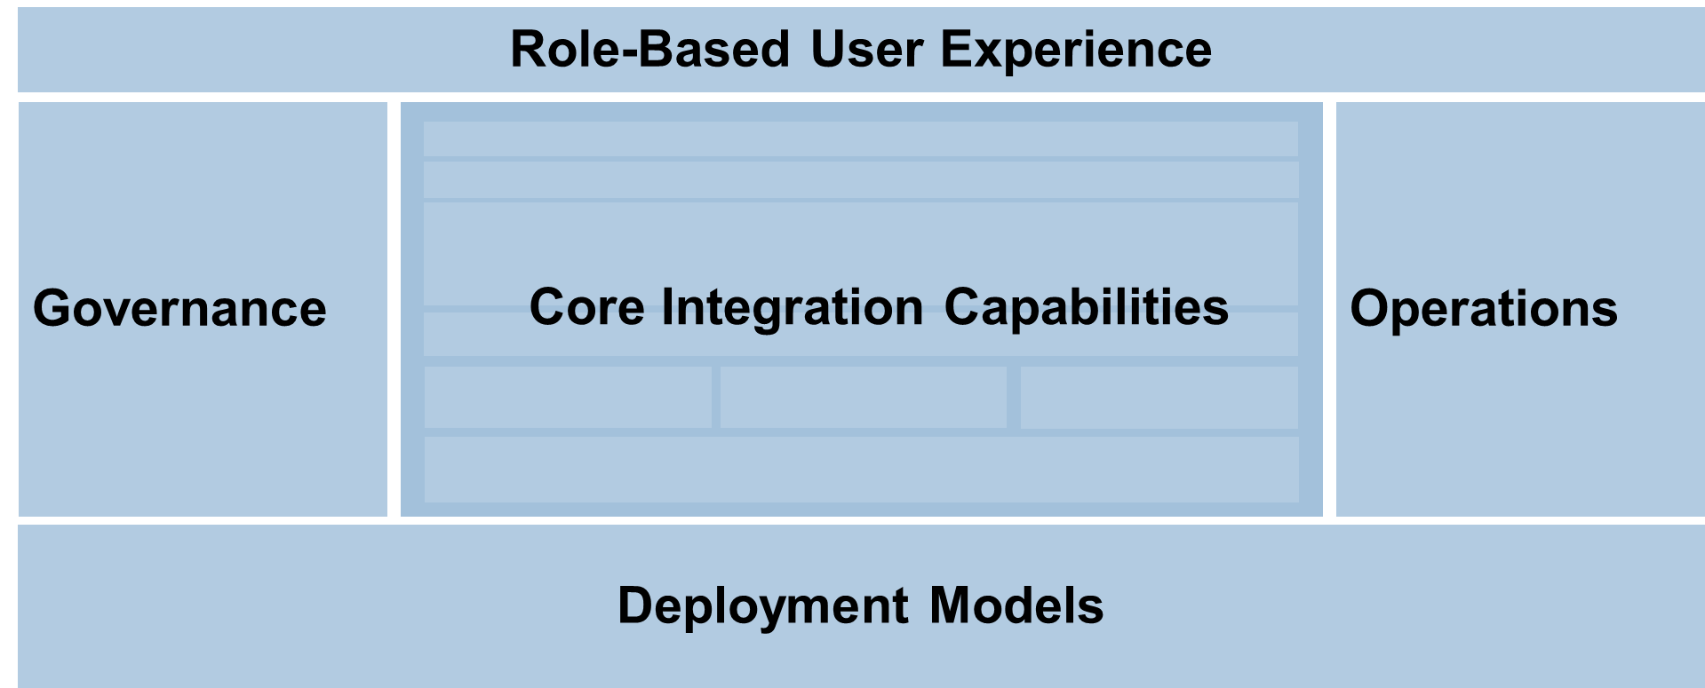
… Which Requires a Combination of Technologies and a Governance Model
… Which Requires a Combination of Technologies
Hybrid Integration Platform
Integration Strategy Empowerment Team
Role-Based User Experience
Governance
Operations
Core Integration Capabilities
Deployment Models
What is it?
What Does It Do?
Integration and governance technologies combo
Wide range of use cases
Multiple integration personas
As a service across organizational units
Self-service
Designs and evolves the integration strategy
Designs, implements and delivers the “core” HIP
Overall governance
Performs integration work
Provides training, support, consulting, help desk services to personas

Slide 22
Action Plan for Software Engineering Leaders Responsible for Integration
Monday Morning:
Assign a team of architects to the integration topic
Next 90 Days:
Task the integration architecture team to identify the top two or three integration use cases
Select the integration platform(s) needed to support these use cases and the personas you wish to empower
Identify the platform delivery model(s) that best fit with your business goals and available skills
Next 12 Months:
Build up trust and credibility by successfully implementing a few selected integration projects that help meet business needs
Incrementally extend the number of use cases and, if needed, enrich the technology portfolio.
Consolidate best practices and derive from them lightweight governance principles/processes

