Slide 1

Adaptive AI Systems
By 2026 enterprises that have adopted AI engineering practices to build and manage adaptive AI systems will outperform their peers in the number of operationalized AI models by at least 25%.
Erick Brethenoux, Soyeb Barot and Ted Friedman
1 © 2022 Gartner, Inc. and/or its affiliates. All rights reserved. Gartner is a registered trademark of Gartner, Inc. and its affiliates.
Notes:
Analysis: Erick Brethenoux Soyeb Barot Ted Friedman

Slide 2
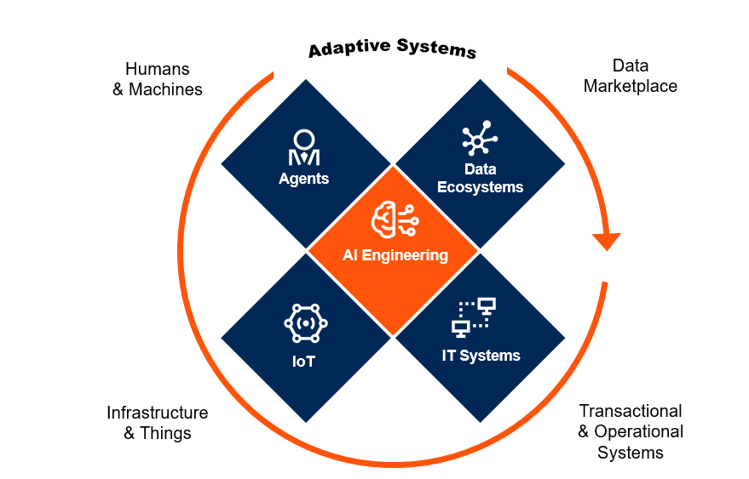
Exploit
Augment
Institutionalize
AI as the Enabler of Adaptive Systems

Slide 3
Exploit
Augment
Institutionalize
Adaptive Systems: The AI Engineering Evolution Horizon
Adaptive Systems
AI Engineering
(Autonomy/Change Management Decision Engineering/Risk)
Generative AI
Technology Complexity
Composite
AI
(Infrastructure/ Operationalization)
ModelOps
Operational Complexity
Notes:
ModelOps - AI Engineering is a discipline focused primarily on the governance and life cycle management of a wide range of operationalized AI and decision models; AI Engineering methods also enables the governance and procedures aimed at providing an uninterrupted flow between the development, operationalization and full maintenance of AI models.
Composite AI - AI Engineering also deals with the combination of AI techniques (or Composite AI). Organizations are combining different AI techniques to improve the efficiency of learning, to broaden the level of knowledge representations and, ultimately, to solve a wider range of business problems in a more efficient manner.
Generative AI - As AI techniques do not just solve problems but are starting, creatively, to generate solutions, Generative AI techniques are also coming under the purview of the AI Engineering discipline.

Slide 4
Recommended Reading
Top Strategic Technology Trends for 2022: AI Engineering
Adaptive Decision Process (Schneider Electric)
The Future of Data and Analytics: Reengineering the Decision, 2025
Decision Intelligence Is the Near Future of Decision Making
Demystifying XOps: DataOps, MLOps, ModelOps, AIOps and Platform Ops for AI
Case Study: Monitoring the Business Value of AI Models in Production (Georgia Pacific)
Case Study: Driving Speed to Value With AI/ML (Kaiser Permanente)

