Slide 1
Leadership Vision for 2022 Technology Innovation August 2021

Slide 2


CIOs Expect Accelerated and Significant Focus on Digital Channels in 2022
83% of CIOs expect an increase in digital channels to reach customers and citizens
69% of CIOs expect an increase in delivering new products and services across digital channels
Source: Gartner’s 2021 CIO Survey
Notes:
Gartner’s 2021 CIO Survey uncovered specific areas where digitalization of customers will occur. The survey asked about five aspects of digital engagement, and, in general, all will increase. The use of digital channels to reach customers and citizens increased in 2020 and will increase more in 2021 — and so will the rate of introduction of new digital products and services. Note that top performing organizations are even more aggressive in both areas than is typical. Nine-out-of-10 of the top performers are pursuing new digital channels, and almost three-quarters are introducing digital products faster. Organizations that have increased their use of digital channels to reach customers or citizens are 3.5 times more likely to be a top performer than to be a trailing performer.¹ Top performers have gone all in on digital business — developing the capabilities to allow them to do it.
Evidence and Related Research
The 2021 Gartner CIO Survey was conducted online from 14 July through 14 August 2020 among Gartner Executive Programs members and other CIOs. Qualified respondents are each the most senior IT leader (CIO) for their overall organization or a part of their organization (for example, a business unit or region). The total sample is 1,877, with representation from all geographies and industry sectors (public and private).
The survey was developed collaboratively by a team of Gartner analysts, and was reviewed, tested and administered by Gartner’s Research Data and Analytics team. Results do not represent “global” findings or the market as a whole, but reflect sentiment of the respondents and companies surveyed.
For more information, see The 2021 CIO Agenda: Seize This Opportunity for Digital Business Acceleration — G00734780
¹ Results of the driver analysis were arrived at by using logistic regression. Results are interpreted as “odds of success” — as in, the probability of achieving success in terms of an “odds ratio” because of the impact of predictor variables. The odds ratio represents the impact of predictors’ on effectiveness rating of “failure” versus “success.” For the purpose of this analysis, the dependent variable was the “top-typical-trailing” classification, and it was transformed into a two-level variable, with top as the success criteria. All predictor variables shown have a significant impact at a 95% confidence interval and were also transformed into a two-level variable.
Disclaimer: The results for any predictor variable should not be read individually, but rather as being included in a group of actions/initiatives that result in success. Other variables, which have not been explored in the survey, may also have an impact.

Slide 3
Key Issues
What are the major trends affecting technology innovation leaders?
What are the top priorities for technology innovation leaders?
What actions should the technology innovation leader take now to be successful?

Slide 4
Key Issues
What are the major trends affecting technology innovation leaders?
What are the top priorities for technology innovation leaders?
What actions should the technology innovation leader take now to be successful?

Slide 5
Trend No. 1: Digital Is the New Normal — CEOs to Increasingly Focus on Scaling
CEOs’ Most Important Initiatives for the Overall Success of Organization
Digital scaling is required to gain access to new markets and customers.
n = 280 respondents
Q: Which initiatives would you say are the most important overall to the success of your organization?
Source: Gartner’s Third Annual Tech CEO Survey 2021
Notes:
Evidence and Related Research
Gartner’s Third Annual Tech CEO Survey, 2021 — Results presented are based on Gartner’s annual survey to stay current on Tech CEOs’ mission-critical priorities to prioritize and steer research for the Tech CEO research agenda.
The primary research was conducted online between November and December 2020 among 280 respondents in North America (U.S., Canada), Western Europe (Italy, France, Germany, Spain, U.K.) and Asia/Pacific (Australia, India, New Zealand, Singapore) and Latin America (Brazil).
Eligible organizations operate in the high-tech industry (i.e., applications/software, cloud, business and technology services, communications services, hardware, IT services and semiconductors), with anticipated annual revenue for FY 2020 of up to $250 million USD or equivalent, including companies in the pre-revenue stage. All organizations focus on businesses and government/non-profits as their primary customers (including, B2B, B2B2C, B2B2B, government/non-profit, etc.).
Qualified respondents from these organizations have the title of CEO/Managing Director, Owner or COO/C-level Executive of operations or equivalent.
The survey was developed collaboratively by a team of Gartner analysts who follow these markets and was reviewed, tested and administered by Gartner’s Research Data Analytics team.
Disclaimer: Results of this study do not represent “Global” findings or the market as a whole, but are a simple average of results for the targeted countries, industries and company size segments covered in this survey.
For more information, see Gartner Annual Tech CEO Survey, 2021: Transitioning From the Pandemic — G00742324

Slide 6
Trend No. 2: Funding of Digital Innovation Will Increase
Digital Innovation Portfolio
Radical
Transform
Disrupt
56% of CIOs state that funding of digital innovation will increase.
Incremental
Optimize
Extend
Existing
New
Source: The 2021 Gartner CIO Survey
Notes:
Most organizations will have multiple innovation projects at various stages — from ideation, through proof of concept and development, to delivery and operationalizing the innovation.
Technology Innovation leaders can then filter ideas into quadrants (with each representing a different set of goals, risk thresholds and evaluation metrics):
Optimize — Making incremental changes to existing business elements is the least risky approach. Existing activities and skills are minimally disrupted and more easily changed. The impact on customers that comes with making a change to a product or service is likewise minimal. These initiatives are typically focused on driving improvements in efficiency or marginal improvements in customer and employee satisfaction. These initiatives are generally part of normal day-to-day operations. Organizations should target a 0% failure rate.
Extend — Incremental additions to business activities with new business elements have minimal-to-modest risk. This does not typically change existing business activity, but adds value or drives greater efficiency. A classic example is product and service extensions to existing offerings. These initiatives may have some failures or require adjustments as the innovation is delivered.
Transform — Radical changes to business elements often have moderate-to-high risk. Transformation often has organizational implications for staffing, management and training requirements. These initiatives may have some failures or require adjustments as the innovation is delivered to market.
Disrupt — Radical change to the business model with new business elements is the most risky approach. One of the big challenges is that there is less historical data to consider when evaluating business outcomes. Executives should expect some failures and must determine an acceptable rate. The organization should ensure any initiatives in this category go through a “fast failure” process during the development stage, and a postmortem review process to ensure that the company learns from any failures.
Evidence and Related Research
The 2021 Gartner CIO Survey was conducted online from 14 July through 14 August 2020 among Gartner Executive Programs members and other CIOs.

Slide 7
Trend No. 3: Technology Work is Democratizing Rapidly
Where do technologists work?
6% Business Unit IT Staffª
4% IT Staff Reporting to CIO
49% Technology “End Users”
41% Business Technologists^{b}
n = 11,848 employees across the entire workforce
Source: 2021 Gartner Reimagining Technology Work Survey combined with the 2020 Gartner Digital Friction Survey
ª Business unit IT staff reporting into divisional or business unit (BU) CIOs.
^{b} Gartner defines business technologists as employees who report outside of IT departments and create technology or analytics capabilities for work.
Note: By CIO we mean the senior most IT executive, but actual titles may vary.
Notes:
Our third trend is the “democratization” of digital capabilities. As Gartner research has shown, there has been a steady, and growing, shift in the delivery of digital capabilities — moving out of the IT organization into the business. This is coupled with an increase in strategic IT investment, also being driven by the business. This ranges from the simple — where a business group funds and runs a digital capability — through to product management approaches being driven from the business and by the business. This is often referred to as the democratization of digital capabilities.
Along with this shift into the business, there has also been a significant shift of digital capabilities to outside service providers. Outsourcing, “as-a-service” and the shift to cloud have all moved digital services outside the IT organization.
This is a challenge for traditional approaches to enterprise architecture, which assume a simple business-IT relationship, and a unified IT organization. Enterprise architecture must now reshape itself to function in this democratized world, and moreover to facilitate this democratized world.
Evidence and Related Research
Presentation: Democratized Technology Delivery: The CIO’s New Opportunity to Boost the Value of IT — G00754237
Design and Build the New Digital Foundations — G00733391
The 2020 Gartner Digital Friction Survey was conducted via an online survey platform from January through March 2020, with a total of approximately 4,500 employees who used technology in their daily work.
The 2021 Gartner Reimagining Technology Work Survey — Gartner surveyed almost 11,848 employees — across functions, levels, industries and geographies — to assess the analytic and technology activities in their jobs and the reasons for performing those activities. This helped us assess the prevalence of what we call business technologists: Employees who report outside of IT and create technology or analytics capabilities for internal or external business use.
Disclaimer: Results of this study do not represent global findings or the market as a whole, but reflect sentiment of the respondents and companies surveyed.

Slide 8
Key Issues
What are the major trends affecting technology innovation leaders?
What are the top priorities for technology innovation leaders?
What actions should the technology innovation leader take now to be successful?

Slide 9



Priority No. 1: Meet the Increased Demand for Digital Products and Services
Examples of Digital Products and Services
Technology
End-to-End Services
Capabilities
Specialized Applications
API Platforms
Data and Analytics
Artificial Intelligence Applications
Customer Portals
Supplier Portals
Operating Technology
Enterprisewide
Integration Services
Workplace Services
Hosting Services
Cybersecurity
Aligned to Capabilities
Front Office (Pricing, Management, CRM and Supply Chain)
Back Office (Talent, Management, and Financial Planning and Analysis)
Customer Engagement
Supply Chain
Digital Channels
Source: Gartner
Notes:
Three types of internal products seem the most prevalent:
Technology — Specialized applications, technologies and digital platforms.
End-to-End Services — IT services offered enterprisewide and IT services aligned to specific capabilities.
Capabilities — Business-led digital product management (DPM) to deliver strategic capabilities.
Evidence and Related Research
The CIO’s Essential Guide: Digital Product Management — G00390832

Slide 10
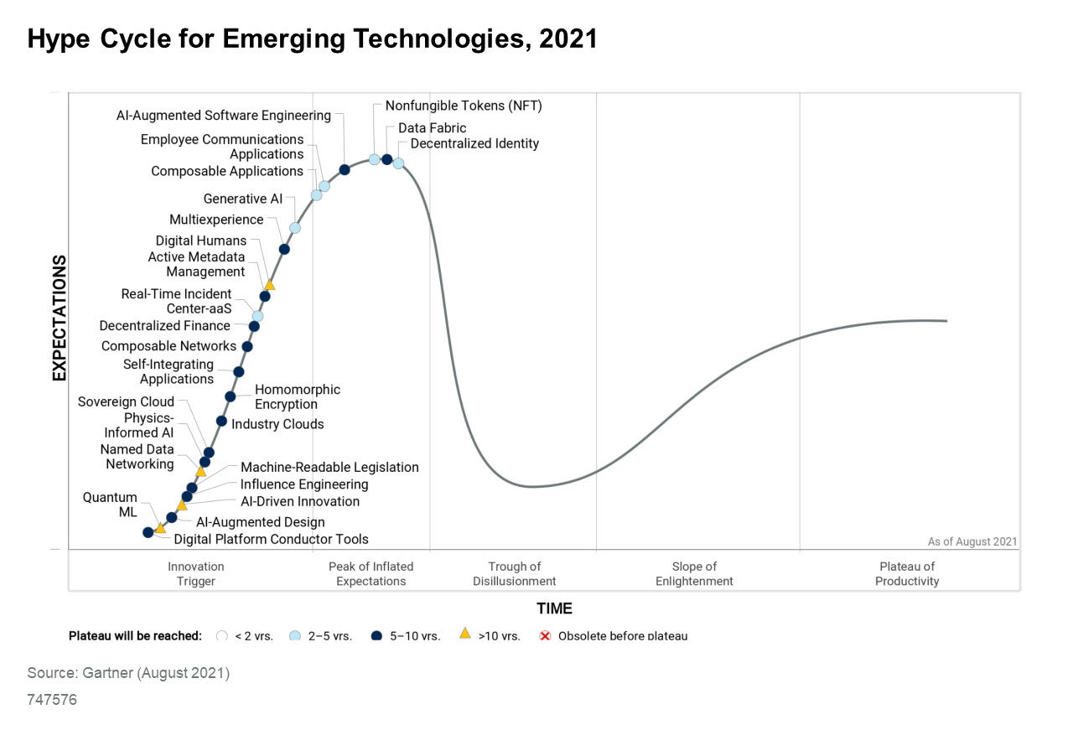
Priority No. 2: Assess Digital Scaling Potential of “Game-Changing” Technologies
2021 Hype Cycle for Emerging Technologies
Emerging (Exploratory and High Uncertainty)
Growth (Evolving and Medium Uncertainty)
Mainstream (Established and Low Uncertainty)
Market Penetration
Strategic Technology Trends
Time
Source: Gartner
Notes:
As a technology innovation leader, CTO or CIO, you must stay up to date with emerging technologies to determine their impact on your industry and the opportunities they present for your organization. Technology innovation leaders can use the Hype Cycle for Emerging Technologies as a starting point to:
Understand the technologies to watch during the five- to 10-year planning horizon.
Explore potential opportunities.
Plan to exploit these technologies as they become commercially viable.
Gartner’s research on top strategic technology trends aims to identify trends that have a high potential for impact on people, businesses, industries and IT markets. These trends create potential business threats and disruptions, but also offer the opportunity to disrupt competitors and drive competitive advantage.

Slide 11
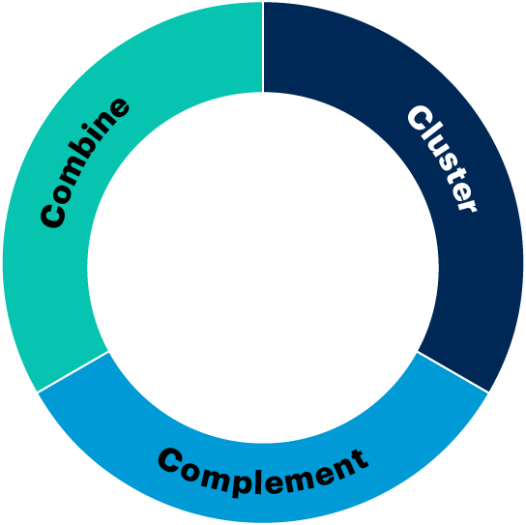
Priority No. 3: Assess Digital Scaling Potential of “Game Changing” Technologies
Combinatorial Innovation
Innovation Partnership
Use Case 1
Use Case 2
Combinatorial Innovation
Method
Tech A
Tech B
Tech A
Tech C
Tech B
Success is increased by breaking silos and partnering with busines technologists, using fusion teams for enterprise-level use cases.
Source: Gartner
Notes:
There are three components to combinatorial innovation that technology innovation leaders, including CTOs should incorporate into their process for evaluating emerging technology trends:
Combine — Focus business innovation projects and proof of concept efforts by looking at different emerging technologies and trends that can be combined for maximum value. Do this rather than looking at each effort as an experiment to test one emerging technology within a given business process or context.
Cluster — Invest in technology research that identifies how clusters of emerging technology components provide unique or higher business value that cannot be achieved when they are used by themselves.
Complement — To uncover new business opportunities, encourage initiatives that identify secondary areas and technologies that will be impacted by specific emerging technologies.
Combinatorial innovation explores and exploits how multiple technologies and nontechnology events interact to create disruptions, drive trends or enable innovative opportunities to generate business value. These technologies are not only digital (for example, CRISPR, nanotechnologies and material science), and the trends are not only technological (including political, economic and social trends — see A Tapestry [TPESTRE] of Trends for Strategic Planning — G00742004).

Slide 12
Key Issues
What are the major trends affecting technology innovation leaders?
What are the top priorities for technology innovation leaders?
What actions should the technology innovation leader take now to be successful?

Slide 13







Action No. 1: Reach Beyond Technology to Actively Sense and Respond to Trends and Disruptions
A Tapestry (TPESTRE) of Trends for Strategic Planning
Technological
Political
Economic
Social/Cultural
Trust/Ethics
Regulatory/Legal
Environmental
Impact
Maturity
Dynamics
Readiness
Strategy
Innovation Plan
Roadmap
Source: Gartner
Notes:
Organizations must strive to become future-fit. Future-fit organizations actively prepare for and respond to disruptions, and anticipate change. Technology innovation leaders should promote the use of technological, political, economic, social/cultural, trust/ethics, regulatory/legal, and environmental (TPESTRE) factors and analysis to identify relevant accelerators and inhibitors (Gartner refers to this as a “tapestry”).
A recent Gartner survey on trendspotting found that only 38% of organizations performing trendspotting have a defined, or formal, process. Most use an ad hoc approach. This leads to a disjointed effort that risks not taking full advantage of the positive impact that a formal trendspotting approach will have on overall strategic planning.
CTOs and technical innovation leaders need to identify which technology trends they should follow by creating a trendspotting initiative to determine which trends will significantly affect their organization. This research provides a method to help organizations build a list of technology trends that they should track. It is based on three criteria:
The potential impact of a trend.
The degree of maturity of a particular trend.
The market dynamics surrounding each trend.
Organizations can then assess organizational readiness and whether the relevant trends present an opportunity to innovate or a competitive threat to mitigate.
Evidence and Related Research
A Tapestry (TPESTRE) of Trends for Strategic Planning — G00742004
Getting Started With Trendspotting — G00745136
Use a Trendspotting Method to Identify the Technology Trends You Need to Track — G00372734
Inventing the Future With Continuous Foresight — G00466739
Gartner’s 2021 Trendspotting Survey was conducted online from 8 February through 24 February with 154 members of the Gartner Research Circle — a Gartner-managed panel of IT and business leaders. The purpose of this study was to understand how organizations are operating and measuring the success of trendspotting. Respondents were screened to be aware of trends being tracked in their organizations and doing some level of trendspotting.
The survey was developed collaboratively by a team of Gartner analysts, and was reviewed, tested and administered by Gartner’s Research Data and Analytics team.
The results of this study are representative of the respondent base and not necessarily the market as a whole.

Slide 14




Action No. 2: Unleash Digital Channels by Adopting a Digital Product Management Approach
Digital Product Management Approach
Product Management Leadership
1
Design and Development
Product Vision, Strategy and Planning
2
Adoption and Optimization
1
3
Maintenance and Utilization
4
Life Cycle Management
2
4
Retirement and Replacement
3
Source: Gartner
Notes:
DPM is a management approach — a different way of working. Once product management is established (product managers and teams), the team develops the vision, strategy and planning for their products over the defined life cycle. Then they execute actions to manage the products in four distinct phases of effort.
Evidence and Related Research
The CIO’s Essential Guide: Digital Product Management — G00390832

Slide 15
Action No. 3: Redirect Resources by Utilizing Jobs-to-be-Done
The Jobs-to-be-Done Process
Identify the business outcome that the job-to-be-done will positively impact, to influence stakeholders outside the target customer
Identify the “job-to-be-done” and the customer
Identify the tools, processes and capabilities required to execute
Pinpoint your use case
Recognize solution fit
Identify strategy to fill gaps
Communication: market and “sell” your solution
Optimize existing
Solution
Identify the job and the people involved
Analyze “job” execution
Uncover opportunity
Create new
Combinatorial innovation
Solution
Test solution and continually iterate
Source: Gartner
Notes:
There are a variety of ways to move through the innovation process. Organizations that have not had a heavy focus on innovation often have loose and informal processes, but more formal and structured methodologies gain traction as organizations increase their interest in and focus on innovation.
There is no single approach that is ideal for all organizations in all situations. Organizations need to consider their innovation goals and innovation maturity as outlined in the Gartner innovation framework (see Jump-Start Your Innovation Journey With a Customizable Innovation Framework — G00369323) and consider the right path based on the nature and scope of the innovation goal.
Jobs to be done (JTBD) is an approach that was popularized by Clayton Christensen and has been built into formalized methodologies and tools by a variety of vendors. It is a highly prescriptive approach that starts with an understanding of the job that the customer is trying to get done and the metrics that the customer uses to evaluate products that deliver a solution to this job. By focusing on what customers want to accomplish and knowing how customers measure value, organizations can focus R&D, product development, and marketing efforts to systematically deliver this customer value.
Currently, JTBD is mostly used in marketing and product development groups within the business to explore customer needs. However, it can be applied to a wide variety of innovation needs and is being considered by IT-led innovation teams as a goal-oriented methodology to drive internally focused innovation projects.
Evidence and Related Research
Hype Cycle for Innovation Management Techniques, 2021 — G00748297
Executing on Innovation: Design the Process From Idea to Value — G00367587
General Manager Insight: Expand Your Concept of Use Cases to Be Truly Customer-Centric — G00721535
Quick Answer: How Can Jobs-to-Be-Done Methods Improve EA Business Value? — G00750956
Know Your Customers’ “Jobs to Be Done,” HBR, available at: https://hbr.org/2016/09/know-your-customers-jobs-to-be-done

Slide 16
Key Opportunities for Technology Innovation Leaders in 2022
Enable Organizational Adaptability and Resilience
Redirect
Unleash
Reach Beyond
Redirect resources by utilizing jobs-to-be-done and accelerating combinatorial innovation.
Unleash digital channels by adopting a disciplined digital product management approach.
Reach beyond technology by actively sensing and responding to trends and disruptions.
Source: Gartner
Notes:
To sum up the key opportunities for technology innovation leaders:
Redirect resources by utilizing jobs-to-be-done.
Unleash digital channels by adopting a disciplined digital product management approach.
Reach beyond technology to actively sense and respond to disruptions and anticipate change.

Slide 17

Recommended Actions
Harness the expertise and ingenuity of all employees by democratizing technology delivery.
Apply combinatorial innovation to identify new opportunities.
Partner with business technologists, using fusion teams for enterprise-level use cases.
Redirect resources by utilizing jobs-to-be-done.
Unleash digital channels by adopting a disciplined digital product management approach.
Reach beyond technology to actively sense and respond to disruptions and anticipate change.

Slide 18
Recommended Gartner Research
Seize the Technology Advantage With Combinatorial Digital Innovation
A Tapestry (TPESTRE) of Trends for Strategic Planning
Quick Answer: How Can Jobs-to-Be-Done Methods Improve EA Business Value?
Leveraging Digital Product Management for Digital Business Transformation and Optimization
Getting Started With Trendspotting
Presentation: Democratized Technology Delivery: The CIO’s New Opportunity to Boost the Value of IT
IT Score for CTO
Quick Answer: How to Use Combinatorial Innovation to Identify Opportunities From Trends and Emerging Technologies
For information, please contact your Gartner representative.

