Slide 1
Build an Elevator Pitch for Your Evolved PMO
Notes:
Presenter's Name
Presenter's Name

Slide 2

INSTRUCTIONS
Purpose
Using this tool, facilitate a discussion with your team and/or stakeholders to:
Create a compelling and concise description of the value of your function or group that can be covered in the time it takes to ride an elevator.
Audience
This tool is intended for use by PMO and EPMO leaders for structuring discussions around the changing mandate and value proposition of the PMO in the digital era.
Please note: PMO in this tool is an umbrella term for a project, program and/or portfolio management group such as PMO, EPMO, SRO, VRO, DTO, etc. Leaders from all these groups can customize this deck to define and sell the overall value of their functions to different stakeholder groups.
Leadership Title Acronyms:
PMO: Project / Program / Portfolio Management Office
EPMO: Enterprise Program and Portfolio Management Office
DTO: Digital Transformation Office
VRO: Value Realization Office
SRO: Strategy Realization Office
Directions
Use the next two slides to lay out the context and essential components of an elevator pitch. [slides 3-4]
Work through Parts 1 - 3 as an individual or group exercise to arrive at an initial draft of your elevator pitch. [slides 5-8]
View common analogies on how other PMO leaders describe their value proposition to draw inspiration for improving your pitch. [slide 9]
Conclude the exercise with an updated elevator pitch for key target audiences. [slide 10]
Notes:
You will find additional directions and scripting advice in this section throughout the document. Please be sure to remove this text as you build your exercise materials.

Slide 3
SETTING THE CONTEXT FOR A PMO ELEVATOR PITCH
Definition of an Elevator Pitch
Sample Structure
A clear, simple message that communicates the value of your function in a memorable way.
Our PMO focuses on [x activities] for
[y target group] to deliver [z value] to the organization.
Key Success Factors
Simple and Straightforward: Keep it clear, concise, and easy to understand; avoid jargon and niche industry terms.
Audience-Oriented: Focus on what your target audience cares about; reflect their priorities, not yours.
Memorable: Be creative; analogies can be a memorable way to communicate your value.
Strategic: Connect to key enterprise priorities; avoid anchoring on tactical words like tools or methodology.
Clearly Positioned: Define your current activities, capabilities or services with a clear message about the overall posture or identity (e.g., talent enabler, strategic portfolio advisor or orchestrator)
Brief: The recommended time period for an elevator pitch is 30 seconds or less.
Notes:
This is just one possible structure of an elevator pitch on the page. Elevator pitches come in a variety of formats – it’s important to adapt the structure to the specific situation. Review the key success factors, and make sure your elevator pitch has a selling/influencing tone.

Slide 4
EXAMPLES OF A PMO ELEVATOR PITCH
How PMO Leaders Describe the Value Proposition of their Function
“Our PMO recently shifted focus to provide more upfront support to set the project up for success. The PMO’s role is like a flu shot. We inoculate projects to prevent problems from happening later on.”
“Our EPMO is the 'referee or official on the field,' responsible for 'throwing the flag' early enough. We need to give early warnings of risk or liability to guide our business partners to success."
“We tried to launch SAFe and it failed, because the business was not educated on it. The DTO is the grease that oils the wheels for digital initiatives -- such as the shift to agile or product lines -- through coaching and oversight.”
“Our DTO is the bridge that connects strategy with delivery. We enable a digital mindset by educating stakeholders on ‘what, why, how and when’ of digital initiatives.”
“While our PMO forms the execution layer, EPMO is the strategic layer that provides enterprise-view of all the strategic initiatives within portfolios. We are the trusted thought partners for all verticals.”
“Our VRO is like a fitness tracker. We don't execute the steps for you, but we make it easy for squads and teams to take the right steps in realizing the strategic goals.”
Notes:
Use these real-life examples from PMO leaders above to gather inspiration for your own elevator pitch, noting how they use analogies to convey the value they provide to the enterprise.

Slide 5
PART 1: PREPARE FOR YOUR ELEVATOR PITCH
Instructions: In this exercise, you will be creating an elevator pitch for your PMO’s new mandate in response to digitalization across the organization. As a first step:
Reflect on the questions below
Write down bullet points to focus your ideas
Who is the target audience for your elevator pitch? Why did you choose this particular audience?
______________________________________________________________________________________________________________
______________________________________________________________________________________________________________
How will the PMO provide value to the organization in the digital era?**
____________________________________________________________________________________________________________
____________________________________________________________________________________________________________
What do we want our PMO to be known for?
___________________________________________________________________________________________________________
____________________________________________________________________________________________________________
Notes:
Spend some time reflecting and brainstorming some of the ideas for your elevator pitch. Take about 10 minutes to reflect on the questions on this page. Think about the new roles your PMO needs to play and the activities you’d like to take on, reflecting on recent conversations you’ve had with your team and other PMO leaders on how your organization is shifting to provide value.
**View the appendix at the very end of this deck [slides 12 – 15] to help think about the complete spectrum of activities that the PMO provides to the organization. Use this set of activities to consider the value that the PMO contributes beyond delivery, which will help shape your answer to question 2 above.

Slide 6
PART 2: CREATE A DRAFT ELEVATOR PITCH
Instructions: Write a draft of your elevator pitch using the bullets from the previous page. Don’t worry about making it perfect or fitting it into the sample structure — just focus on the key words and phrases you think will help energize others about your PMO’s new value proposition.
Use the next slide to create an elevator pitch for a different audience, as need be.
Target Audience 1
__________________________________________
Draft Elevator Pitch
____________________________________________________________________________________________________________
____________________________________________________________________________________________________________
____________________________________________________________________________________________________________
____________________________________________________________________________________________________________
____________________________________________________________________________________________________________
____________________________________________________________________________________________________________
© 2014–2018 Gartner, Inc. and/or its affiliates. All rights reserved. PMO181907
Notes:
Spend time (10-15 minutes) drafting your elevator pitch. It shouldn’t be more than 2-3 sentences. If you’re struggling to write full sentences, just jot down some key words or phrases you might use to establish a foundation and the intended stakeholder audience for your pitch.
You can also leverage a storytelling structure to help make your pitch more compelling and engaging. We suggest using the simple structure of ‘three acts’ that storytellers often use. Details of the storytelling structure in the appendix [Slide 16]

Slide 7
PART 2: CREATE A DRAFT ELEVATOR PITCH (CONTINUED)
Instructions: Select a different target audience than what you used on the previous page and think through how you would adapt or customize your elevator pitch for that new target audience.
Again, don’t worry about making it perfect or fitting it into the sample structure — just focus on the key words and phrases you think will help energize others about your PMO’s new value proposition.
Instructions: Select a different target audience than what you used on the previous page and think through how you would adapt or customize your elevator pitch for that new target audience.
Again, don’t worry about making it perfect or fitting it into the sample structure — just focus on the key words and phrases you think will help energize others about our PMO’s new value proposition.
Target Audience 2
__________________________________________
Draft Elevator Pitch
____________________________________________________________________________________________________________
____________________________________________________________________________________________________________
____________________________________________________________________________________________________________
____________________________________________________________________________________________________________
____________________________________________________________________________________________________________
____________________________________________________________________________________________________________
© 2014–2018 Gartner, Inc. and/or its affiliates. All rights reserved. PMO181907
Notes:
Again, spend a bit of time (10-15 minutes) drafting another elevator pitch for a different target audience. It shouldn’t be more than 2-3 sentences. If you’re struggling to write full sentences, just jot down some key words or phrases you might use to establish a foundation and the intended stakeholder audience for your pitch.

Slide 8
PART 3: DISCUSS YOUR ELEVATOR PITCH
In your group(s), share your elevator pitch and discuss strategies to make them more effective in articulating the new value proposition of your PMO.
Take turns sharing your elevator pitches and providing feedback on what’s working as well as what’s not working for each of the elevator pitches.
Reflect on what you just heard:
What terms stand out as particularly memorable?
Does it avoid jargon or consultant speak?
What are some critical elements to include?
Are there any terms or ideas you want to avoid for your target audience?
How would you update your pitch based on peer feedback?
Is the pitch duration longer than recommended?
On the upcoming slide, update your elevator pitches based on your conversation.
Notes:
Practice your elevator pitch with your team in groups of 2-3 people. Practice it three times and describe how you see yourself using it.
For the first practice pitch, limit yourself to 2 minutes. Repeat your practice pitch a second time, but limit yourself to 1 minute. Practice your pitch a third time, and limit yourself to 30 seconds. When making an elevator pitch, we need to be flexible, because we might not have the speaking time that we anticipated during our practice sessions. By rehearsing under multiple time restrictions, we can learn to adapt to the situational context.
This tactic will help you focus on the concision of your pitch. Listen carefully to what you hear from your peers – revise your pitch based on feedback or inspiration you get from your group discussion. Go over the reflection questions to prompt your discussion.

Slide 9
HOW YOUR PEERS DESCRIBE THEIR PMOs
Common Analogies PMO Leaders Use to Articulate the Value Proposition of their Office
Our PMO is a…
Value Accelerator
Gladiator
Flu Shot
Catalyst
Arbitrator
Steward
Changemaker
Orchestra Conductor
Roadblock Remover
Strategy Executor
Air Traffic Controller
Roadblock Remover
Negotiator
Negotiator
Negotiator
Coach
Bridge Builder
Talent Agent
Curator
Facilitator
Honest Broker
Fortune Teller
Compass
Spark Plug
Trusted Thought
Partner
Diplomat
Talent Matchmaker
Ambassador
Incubator
Mediator
Glue
Notes:
Review these PMO analogies for inspiration on a memorable comparison that you feel describes your PMOs’ mandate well to your target audience.

Slide 10
FINAL STEP: UPDATE YOUR ELEVATOR PITCH
IMPLEMENTATION TOOL
Instructions: Update your elevator pitch in the space below.
Target Audience
Target Audience
Example: Project Manager Community
Example: C-suite
Updated Elevator Pitch
Updated Elevator Pitch
Our PMO creates PMs who can step into any scenario, team, or industry and figure out what success looks like. We do this by developing entrepreneurial and collaborative skills via experiences, not just in classroom. This helps them build relevant, long-lasting careers, and prepares them for future leadership roles.
Our EPMO is the trusted thought partner of business leaders. We continuously work with teams to align their work portfolios to enterprise strategy. This includes defining and mapping business value, (re)prioritizing work to changing business priorities and enabling cultural change.
.
Target Audience
________________________________________________________________
Updated Elevator Pitch
_________________________________________________________________________________________________________________________________________
_________________________________________________________________________________________________________________________________________
_________________________________________________________________________________________________________________________________________
_________________________________________________________________________________________________________________________________________
Notes:
Take a few minutes to reflect on this slide.
Reflect on how significantly you updated your elevator pitches. Share it with your peers (other PMO leaders, members of your team). Finish the exercise by considering who your target audience was, where you would use this elevator pitch, and how you would change the pitch if you were talking to finance/your CEO/business partner/your team.

Slide 11
Appendix

Slide 12
PMO CHARTER ON A PAGE
An Effective PMO Charter Template to Showcase PMO Role, Mandate and Value
Mission: “Improve organizational capabilities to manage and execute portfolios of initiatives, projects and programs to enhance organizational responsiveness.”
Vision: “Make project and portfolio management capability a competitive advantage for the organization.”
Mission: “Improve organizational capabilities to manage and execute portfolios of initiatives, projects and programs to enhance organizational responsiveness.”
Vision: “Make project and portfolio management capability a competitive advantage for the organization.”
Guiding Principles
Objectives | Metrics
Manage the Integrated Portfolio | Portfolio Health; Business Case Approval Rate; Portfolio Change Load; Resource Bottleneck Visibility; High-Risk “Driver” Projects
Manage Frameworks and Standards | Methodology Flexibility; Compliance with Methodology Standards
Deliver Projects/Initiatives | On-Time, On-Budget, and On-Scope; Initial Estimate vs. Actual Time and Budget
Partner with Stakeholders | Sponsor Satisfaction; Projects with Dedicated Sponsor, Sponsor Engagement
Enable Project/Product Management and Delivery Roles | Prevalence of Entrepreneurial Teams; Team Stability; Resource Utilization
Manage the PMO Function | Total Cost of Portfolio Management; Estimated vs. Actual PMO spend
Business Value
Judgment
Enterprise Perspective
Risk Management
Shared Accountability
Stakeholder Partnership
Proactivity
Time Management
Cost-Efficiency
Reuse
Key Stakeholders
Key PMO Staff
PMO Executive Sponsor
PMO Steering Committee
Governance Partners (Risk, Audit, etc.)
Functional Partners (Human Resource, Finance, etc.)
Project/Program Sponsors
Full-Time Project/Program Managers
Project Delivery Resources
Product Owner
Product Line Manager
Other PMOs
PMO Head
Methodology Director
Resource Manager
Service Manager
PM L&D Director
Project Manager
Program Manager
Portfolio Manager
Project Recovery Consultant
Key PMO Activities
Define a Stakeholder Management Approach
Engage Project Sponsors
Prepare Business Partners to Manage Projects
Manage the Portfolio Prioritization Process
Select and Report Portfolio Metrics
Manage Change
Define Project/Product Methodology
Improve Project/Product Methodology
Manage Process Adherence
Collect Proposals and Business Cases
Define Programs
Design a Risk Management Approach
Source:Gartner
Notes:
Visit Gartner.com to download the full “PMO Charter Template” tool.

Slide 13
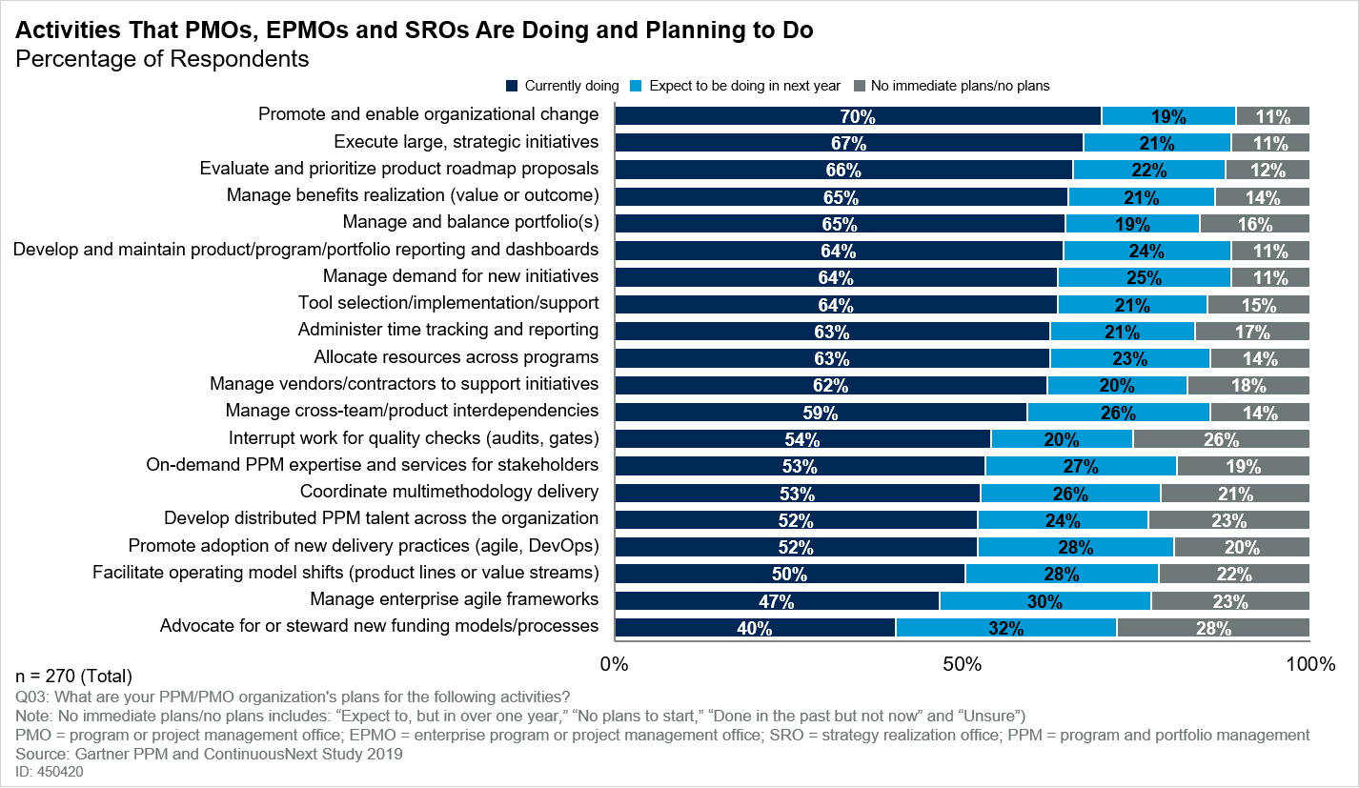
PM LEADERS MUST ENABLE CONSTANT CHANGE
Activities that PMOs, EPMOs and SROs are doing or planning to do at Digitally Mature Organizations
Source: PPM and ContinuousNext Study 2019

Slide 14
RESHAPING THE PMO FOR THE DIGITAL ERA
Activities of Increasing Significance for PMO Leaders in a Digital Context
Increasing Emphasis
Ensure Investment
Investment
Develop and Enable
Orchestrate Delivery
Govern and
Alignment
Steward
Digital Talent
Team Workflows
Deliver Projects
Facilitate operating model shifts (e.g., to product lines).
Develop PM staff digital skills.
Coordinate multi- methodology delivery.
Execute projects.
Define methodology and enforce compliance.
Coordinate solution delivery team workflows and dependencies.
Foster true product ownership.
Steward enterprise- level capital allocation.
Promote adoption of new delivery practices (e.g., Agile, DevOps).
Support business- managed projects.
Enable project-level prioritization and funding decisions.
Align product roadmaps with strategic goals.
Promoter
Adapt project management career paths.
Manage cross- team/product interdependencies.
Advocate for and support enterprise change.
Plan and allocate project resources.
Continuously improve product line performance.
Build extended project management community.
Track project health and benefits realization.
Enable effortless governance partner coordination.
Facilitate cross-portfolio prioritization.
Broker third-party relationships.
PMOs must increasingly focus on these activities to enable their organizations’ digital ambitions.
Source: CEB analysis.

Slide 15
PMOs MUST FLEX ACROSS MULTIPLE ROLES
PMO Roles for the Digital Enterprise
Enablement
Investment Steward
Update investment allocation processes for a digital context.
Orchestrator
Talent Enabler
Coordinate solution delivery team workflows and dependencies.
Develop talent and enable new roles in solutions delivery communities.
Promoter
Advocate for and support enterprise change.
Service Provider
Program Driver
Support stakeholders with on-demand expertise and services.
Execute large, strategic
and cross-enterprise initiatives.
Execution
Source: Gartner

Slide 16
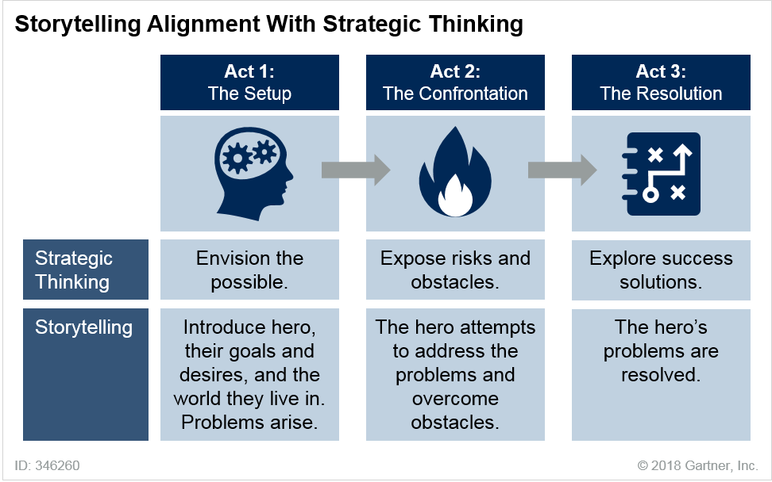
CRAFT A BETTER PITCH WITH STORYTELLING
Use the simple ‘Three Acts’ Storytelling Structure for a more Compelling Elevator Pitch
In Act 1, the Setup, the hero of the story and the hero’s mission (i.e., goal, desire or objective) are introduced.
In Act 2, the Confrontation, the stakes for the hero are raised through a series of obstacles that prevent the hero from completing the mission.
In Act 3, the Resolution, the hero either finds a way to succeed at the mission or fails.
Source: Gartner
Read the full research on Gartner.com
Notes:
To read more about this storytelling structure, visit Gartner.com and search with the title “Selling Digital Transformation: A CIO’s Guide to Crafting Better Stories”.

