Slide 1
Top Trends in Privacy-Enhancing Computation 2022
Bart Willemsen
As of October 2021

Slide 2
Strategic Planning Assumption
By 2025, 60% of large organizations will adopt PEC for processing data in untrusted environments and (multiparty) data analytics use cases.

Slide 3
Top Investment Priority
40%
of SRM survey respondents indicate that PEC is their top investment priority.
n = 210, Privacy Management Domain, Excluding “Don’t Know”
Q: Which are the top 3 capabilities your organization intends to pursue over the next 12 months? Source: 2021 Gartner Global Security and Risk Management Survey

Slide 4
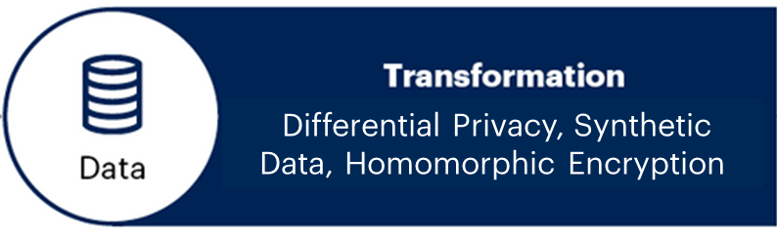
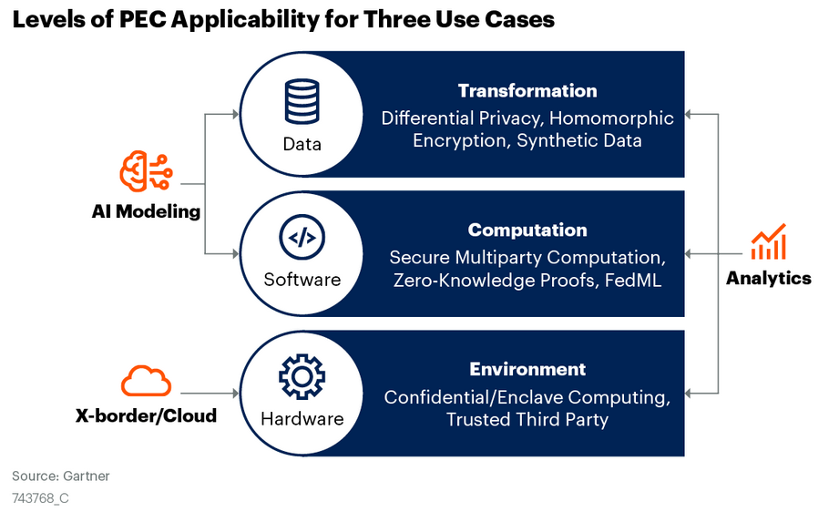
Privacy-Enhancing Computation (PEC) Techniques

Slide 5
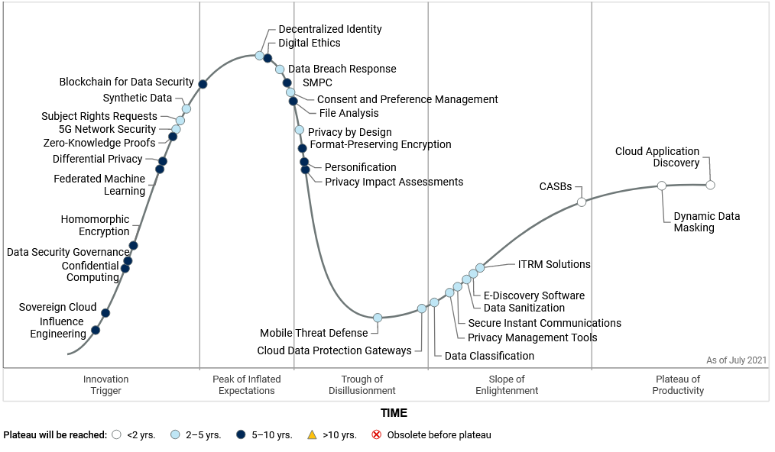

PEC on the Hype Cycle for Privacy, 2021
From Hype Cycle for Privacy, 2021, 13 July 2021 (G00743765)

Slide 6
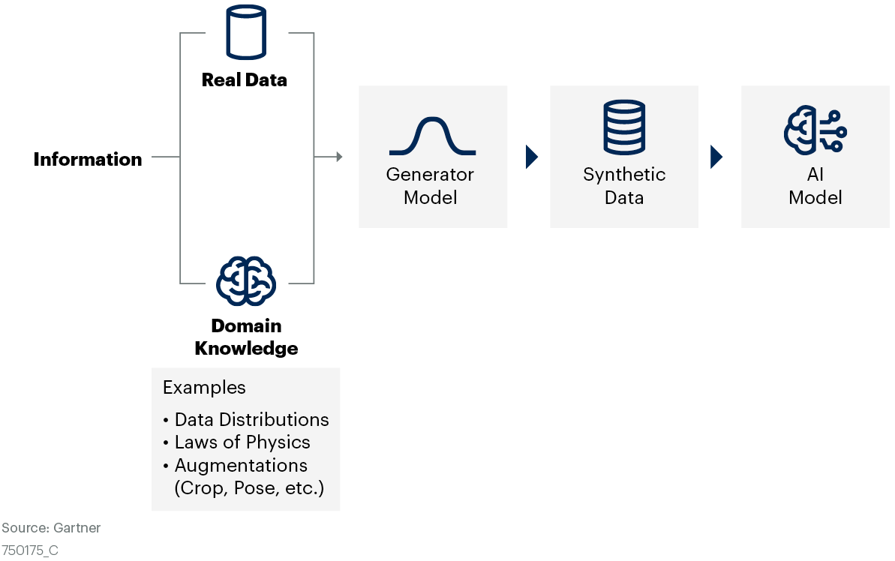
Example: Synthetic Data

Slide 7

Example: Differential Privacy
Q
Authorized Access
A
Laplace noise
Operational Production Processes
Q
External Queries
A
Differential Privacy Barrier
Organization’s Data Lake
(Central Repository)
Q
A

Slide 8
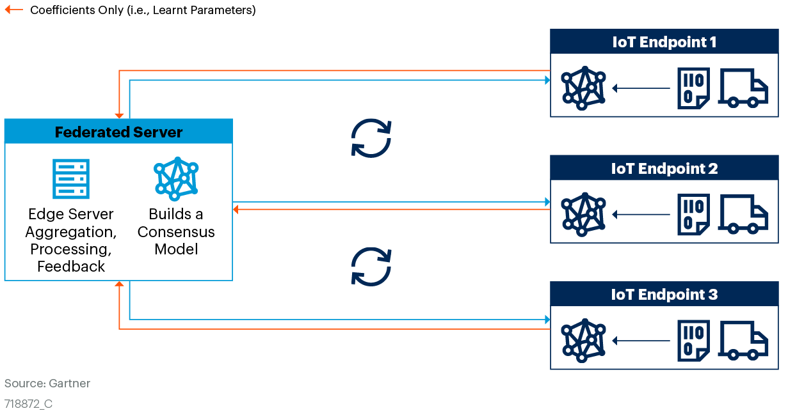
Example: Federated Learning

Slide 9
Recommendations
Expand your impact assessments to include PEC techniques in your considerations.
Identify: What problem are you trying to solve?
Investigate: Is PEC a possible solution to your data sharing, analyzing and (cloud) processing-related privacy concerns?
Experiment: Set up a working group to test these technologies and see how they can aid privacy protection.
Operationalize: Purchase or build, monitor and maintain.
Evaluate: Is the protection adequate, as well as over time?

Slide 10
Gartner Recommended Research
Hype Cycle for Privacy, 2021 Bart Willemsen (G00743765)
Three Critical Use Cases for Privacy-Enhancing Computation Techniques Bart Willemsen, David Mahdi and Mark Horvath (G00743768)
Executive Leaders Perspective: Top Strategic Technology Trends for 2021 Brian Burke (G00741328)
Predicts 2021: Balance Privacy Opportunity and Risk Bart Willemsen, Penny Gillespie and Others (G00728464)

