Slide 1
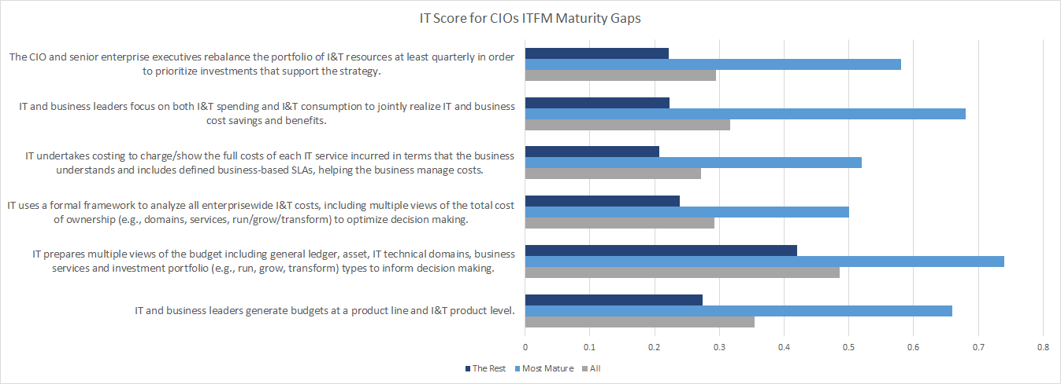
ITFM Pain Points Evidence Graph

Slide 2
Orgs. Successful in Enabling Digital Business Are More Likely to Say They Have Made Significant Changes to Their Financial Governance Processes
Financial governance processes
Significant change
Differences are statistically significant
n varies, excluding don’t know
Q13b: Thinking about your organization's financial governance processes, to what extent has your organization changed each of these to support digital change?
Source: Gartner 2021 Trends in IT Financial Management
ID:
Notes:
Differences by region, size,

